Slide 1
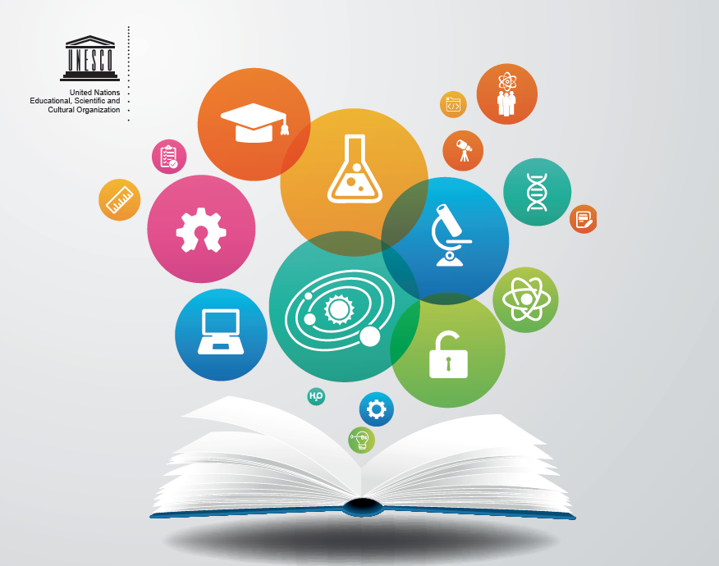
Towards a UNESCO Recommendation
on Open Science
Building a Global Consensus on Open Science

Slide 2
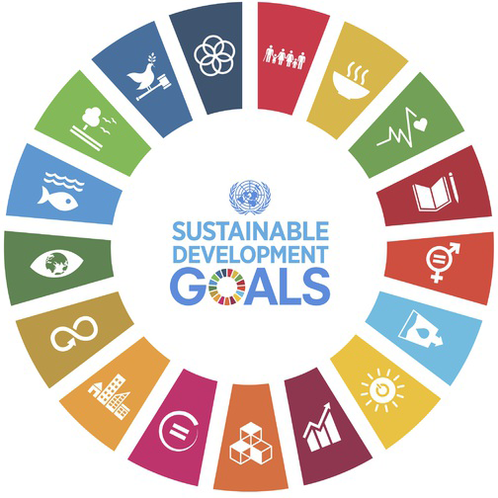
The Need for Science, Technology and Innovation
Importance of timely and free access to scientific data, publications, information
Importance of scientific collaborations and sharing of information at all levels
Importance of science-policy-society dialogue
Need for Open Science

Slide 3
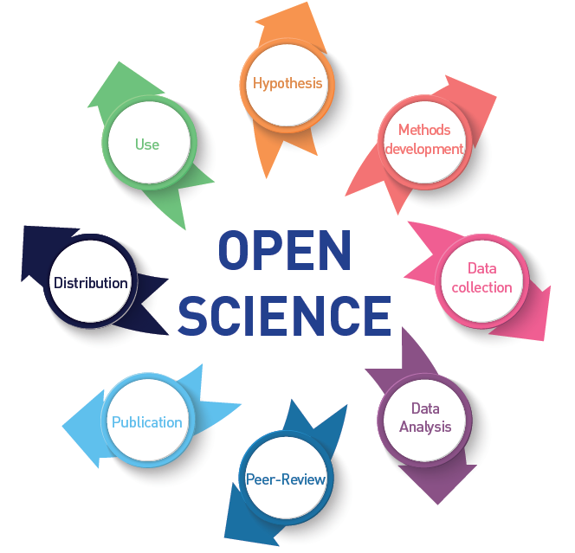
Democratize Science
Open Science embodies the movement to transform and democratize the entire scientific process to ensure that science truly drives and enables the achievement of the United Nations Sustainable Development Goals for the benefits of all.

Slide 4
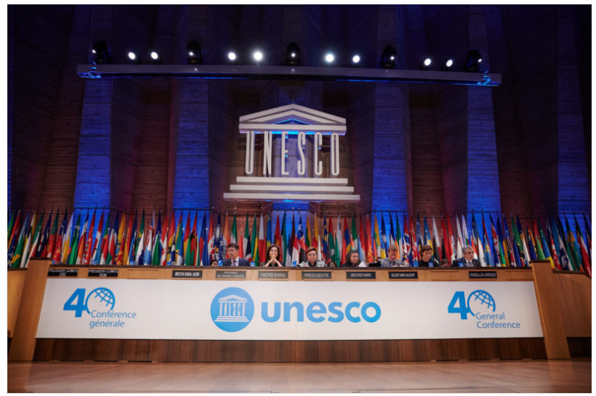
A global understanding is needed
The question is no longer whether Open Science is happening, but rather how everyone can contribute and benefit from the transition.
At the UNESCO 40th General Conference, 193 Members States tasked UNESCO with the development of an international standard-setting instrument on Open Science in the form of a UNESCO Recommendation on Open Science.
UNESCO 40th Session of the General Conference

Slide 5
UNESCO Open Science Recommendation
Drafting process
The first draft was developed by the Open Science Advisory Committee based on the inputs received:
from the Advisory Committee Members;
from the UNESCO Open Science Partnership;
through the UNESCO Global Consultation, held online from February to July 2020
through the thematic and regional consultations on Open Science held since December last
The first draft was shared with the UNESCO Member in September 2020
https://unesdoc.unesco.org/ark:/48223/pf0000374409.locale=en.page=10
UNESCO invites feedback on the draft text @ openscience@unesco.org by 31 December

Slide 6
Current draft of the UNESCO Open Science Recommendation
Definition of Open Science
Open Science refers to an umbrella concept that combines various movements and practices aiming to:
make scientific knowledge, methods, data and evidence freely available and accessible for everyone,
increase scientific collaborations and sharing of information for the benefits of science and society, and
open the process of scientific knowledge creation and circulation to societal actors beyond the institutionalized scientific community.
1
2
3
4
Scientific outputs should be as open as possible, and only as closed as necessary, mindful of the issues relating to security, privacy and respect for subjects of study
5

Slide 7
Current draft of the UNESCO Open Science Recommendation
Definition of Open Science
Open Science is a complex of elements, including:
1
Open Engagement of Societal Actors
Open Data
Open Access
Open Source/Software and Open Hardware
Openness to Indigenous Knowledge Systems
2
Open Science
Openness to Diversity of Knowledge
3
Open Evaluation
Openness to all Scholarly Knowledge and Inquiry
4
Open Science Infrastructures
Open Educational Resources
5

Slide 8
Current draft of the UNESCO Open Science Recommendation
Open Science Core Values
Quality and Integrity
Collective Benefit
1
Inclusiveness
Diversity
Equity and Fairness
2
Guiding Principles
3
Transparency, scrutiny, critique and verifiability
Collaboration, participation and inclusion
4
Equal opportunities and access
Respect, responsibility and accountability
5
Flexibility
Sustainability

Slide 9
Current draft of the UNESCO Open Science Recommendation
4
Areas of Action
Promoting a common understanding of OS
Developing an enabling policy environment for OS
Investing in OS infrastructures and services
Investing in capacity building for OS
Transforming scientific culture and aligning incentives for OS
Promoting innovative approaches for OS at different stages of the scientific process
Promoting international cooperation on OS

Slide 10
Investing in Open Science infrastructures
Community-led, interoperable, inclusive, interconnected and sustainable digital infrastructures and computing facilities to ensure long-term preservation, stewardship, and community control of research products.
Community agreements should define community practices for data sharing, data formats, metadata standards, ontologies and terminologies, tools and infrastructure.
Technical requirements for every digital object of significance for science, whether a datum, a dataset, metadata, code, a publication should also be addressed.
Certain core specifications, such as for example the FAIR and CARE principles for data stewardship.

Slide 11
Investing in Open Science infrastructures
Joint strategies for shared, multinational, regional Open Science platforms to provide coordinated support for interoperability from the perspective of policy, practices and technical specifications.
Platforms for exchanges and co-creation of knowledge between scientists and society
Monitoring and information systems to complement national, regional and global data and information systems.

