Slide 1
ISC CODATA Decadal Programme: Making Data Work for Cross-Domain Challenges
Simon Hodson
Executive Director
CODATA
www.codata.org
USNC Meeting
2 November 2020

Slide 2
Making Data Work for Cross-Domain Challenges: the Premise
The major, pressing global scientific and human issues of the 21st century can ONLY be addressed through research that works across disciplines to understand complex systems, and which uses a transdisciplinary approach to turn data into knowledge and then into action.
The digital and data revolution presents us with huge opportunities and significant challenges.
Major challenges for many scientific domains – requires work on data specifications, semantics, infrastructures, etc.
80% of effort used on data wrangling; conservative estimate of 10.2 Bn Euro opportunity cost from sub-optimal data stewardship.
Open Science and FAIR data provide solutions.
Considerable global interest in data platforms (EOSC etc).

Slide 3
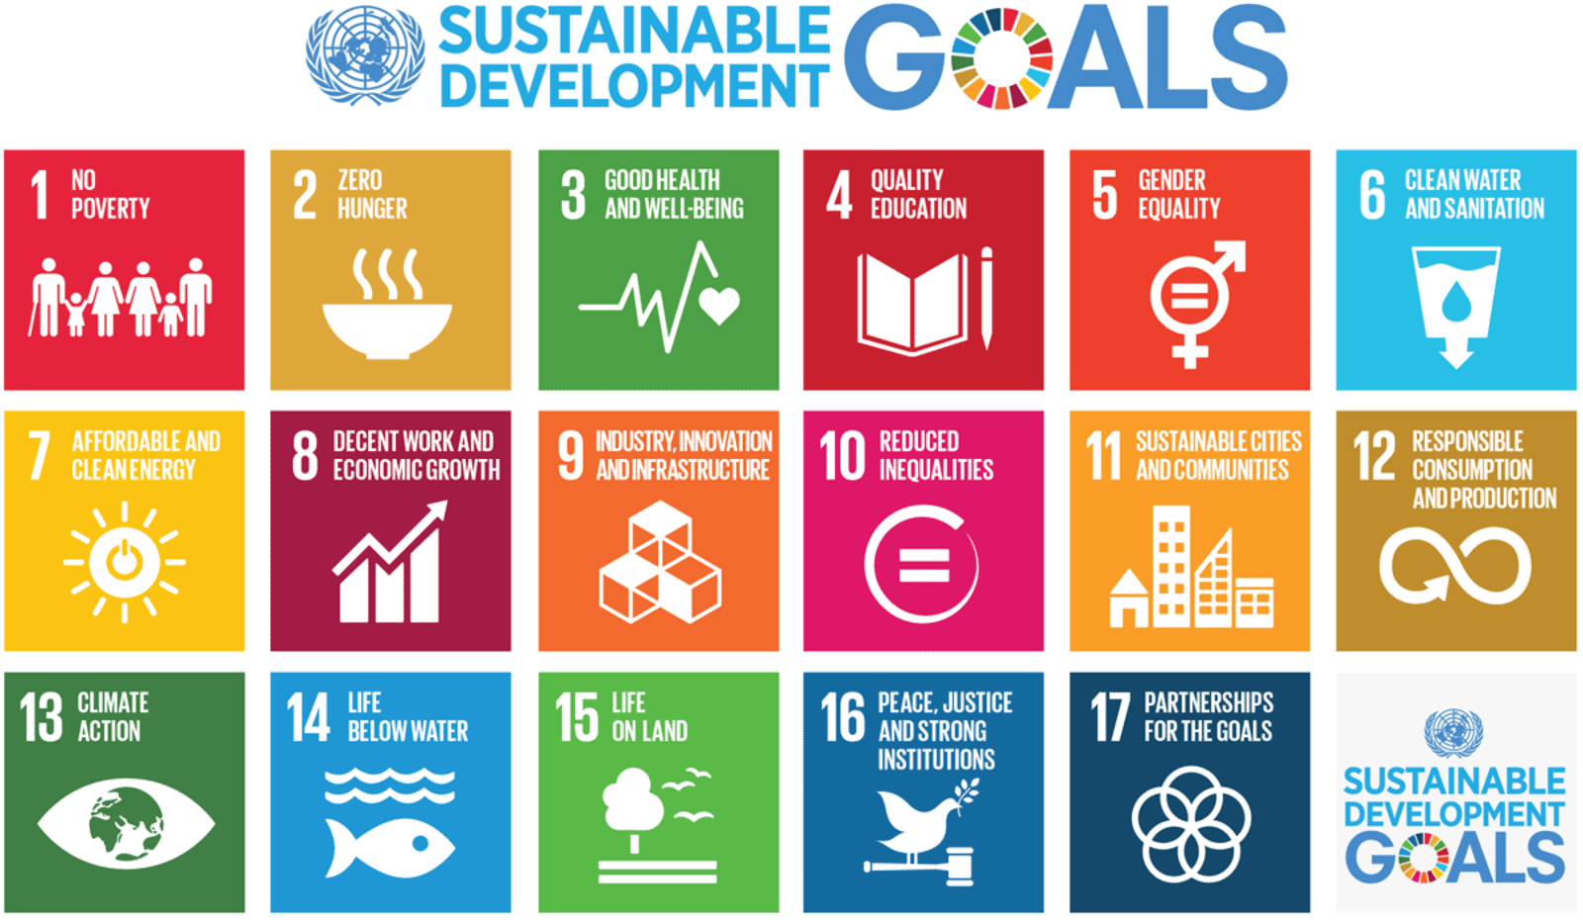
Data for Global Grand Challenges
Addressing global grand challenges requires cross-domain collaboration.
Needs the ability to gather data from many sources, to combine them and extract information from complex and heterogeneous data.
Combining data for SDG indicators is challenging.
Combining data for the scientific contribution to understanding of SDGs is very challenging!
ISC and ISC members (particularly Unions and Associations), and ISC programmes have a role to play.
Addressing how to access and combine data (issues of data interoperability) need input from domain experts and definitions agreed by communities.
Major challenge of fundamental importance to science – the work of a global decadal programme.

Slide 4
Making Data Work: programme design
Programme comprises three work areas.
Consensus and technical solutions for data interoperability (terminologies, ontologies, metadata, machine learning);
Mobilising domains and breaking down silos (working with Unions, Associations and other domain organisations);
Advancing solutions through cross-domain case studies.
Current case studies in: resilient cities, disaster risk reduction and infectious diseases. More planned and invited!
Working with domain and cross-domain areas, semantic solutions and machine learning.
1: Making Data Work
Programme of technical and consensus building activities for interoperability
2: Mobilising Domains and Breaking Down Silos
3: Advancing Interoperability through Cross Domain Case Studies

Slide 5
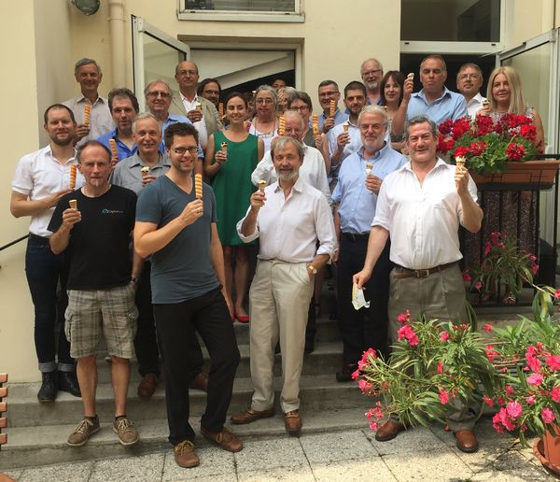
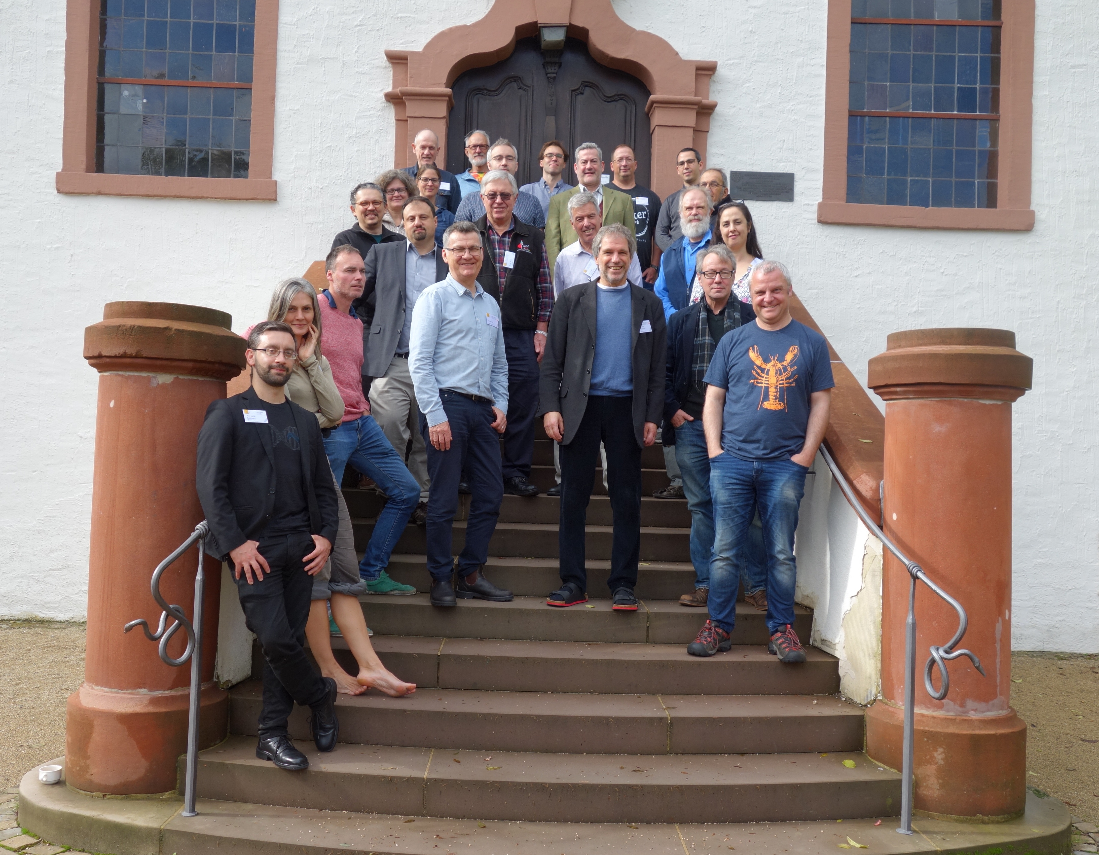
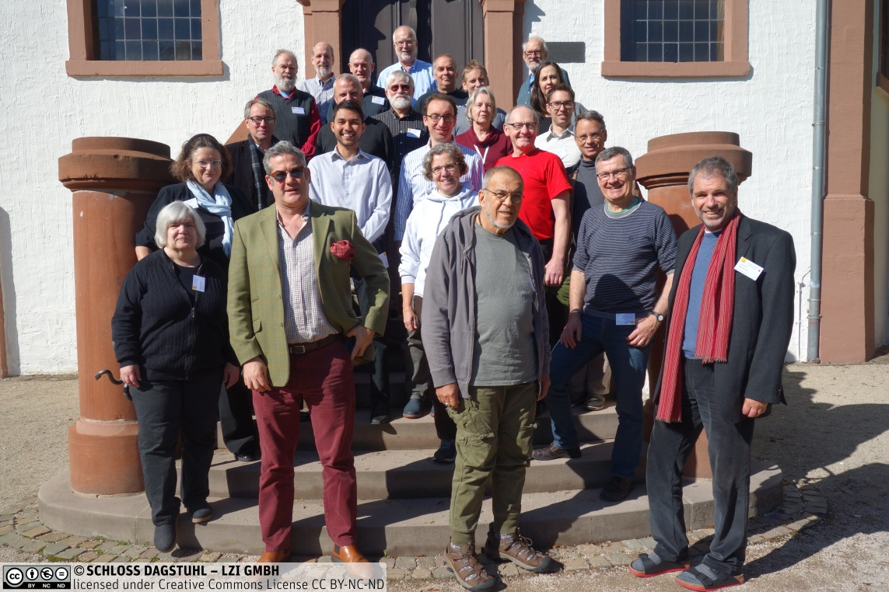
Initial Pilot Activities
Initial Working Groups / Activities
Digital Representation of Units of Measure (TG is a key contribution to the decadal programme)
Semantic Interoperability and Conceptual Framework (good practice for semantic resources)
Supporting further refinement of the DDI-Cross Domain Integration specification
Policy Monitoring Indicators (SDGs, Sendai etc)
Infectious Diseases: projects looking at data integration in HIV and COVID, including collaboration with RDA.
Resilient and Healthy Cities: large group with a number of cities and projects, identifying shared themes.
Global Open Science Cloud: CAS-funded project as the first project under the Decadal Programme.
GO FAIR: FAIR DOs, FAIR Implementation Profiles (FIPs)

Slide 6
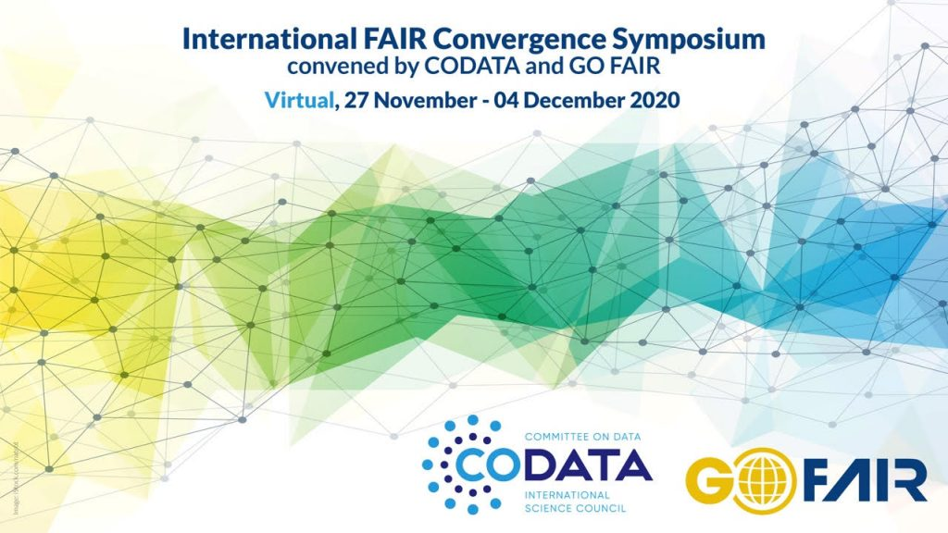
FAIR Convergence Symposium
Entirely virtual, 27 Nov, 30 Nov-4 Dec.
Keynotes, panels, interactive sessions, posters.
Programme Grid: http://bit.ly/FAIRSymposium_ProgrammeDraft
Detailed Programme (plenary session information to appear shortly): https://conference.codata.org/FAIRconvergence2020/programme/
Register: https://conference.codata.org/conference/FAIRconvergence2020/registration/

Slide 7
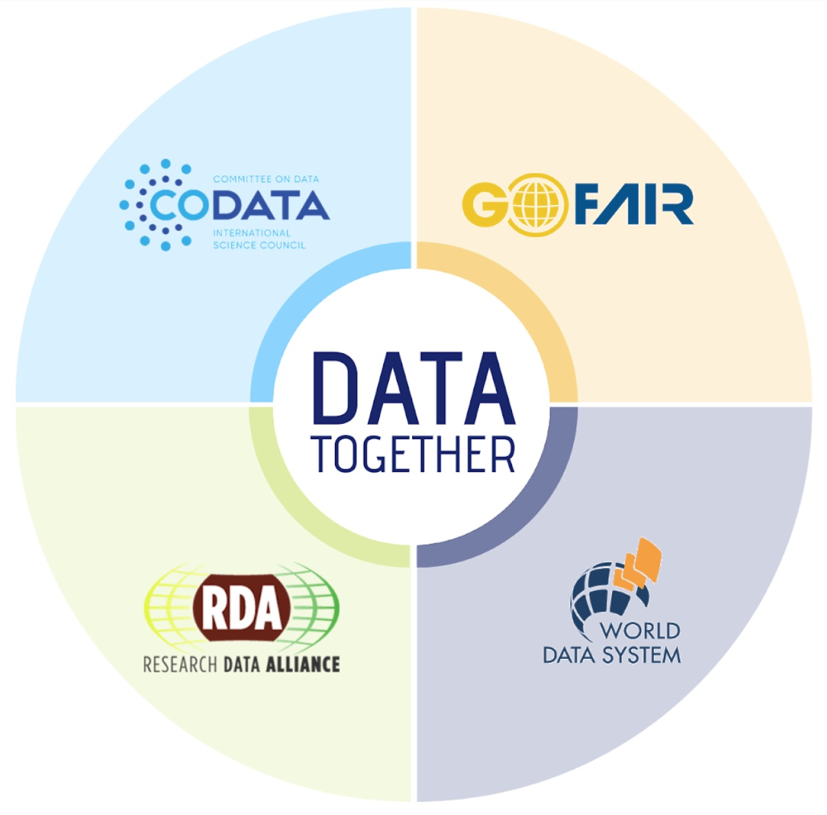
Decadal Programme: Delivery Agents / Activities
Delivery Agents
Coordinating Programme Office / Secretariat
Cohort of Metadata and Ontology Experts
Distributed programme offices / nodes
Partner projects and working groups
Preparing call for Management Committee and for Programme Offices and Partners.
Delivery Activities / outputs
Consensus workshops
Regular intensive sprint workshops (Dagstuhl model)
Identification and description of issues in domains / across domains
Alignment and harmonisation of metadata specifications, refinement of ontologies and taxonomic systems, development of cross-walks between vocabularies, and the application of automation and machine learning to assist data linking and integration.

Slide 8
Making Data Work for Cross-Domain Challenges
Aim to launch the Decadal Programme at the ISC GA and associated events ‘Global Knowledge Forum’ in Oman, 10-14 October 2021: https://council.science/about-us/governance/general-assembly/muscatassembly

Slide 9
Initiating the GOSC Project
Workshops at CODATA 2019 Beijing, led to the CAS Funded Project – see this as a key part of the Decadal Programme.
Beijing Declaration: https://doi.org/10.5281/zenodo.3552330
Working Draft of the areas for cooperation, alignment and interoperability: input to this workshop.
Working Group preparing DRAFT Project Plan, in collaboration with CNIC and will then be shared with stakeholders for input.
EGI Conference Workshop and Sessions at International FAIR Convergence Symposium: https://conference.codata.org/FAIRconvergence2020/
Call for Papers for a Special Collection in the Data Science Journal on Open Science in response to the UNESCO Draft Recommendation: http://bit.ly/DSJ-OpenScience

Slide 10
Priority Tasks for GOSC (Areas for Cooperation and Alignment)
FAIR object ecosystem (FAIR Digital Objects, PIDs/GUPRIs, Types)
Core Community Resources: units, semantic resources, metadata schema
Core Community Resources: repositories/data resources, data stewardship services, analytical tools
Community data sharing agreements (scientific responsibility, as open as possible, proportionate protections, embargoes)
Open Science and FAIR Policies (institutions, funders)
Infrastructure (network, compute, storage)
Skills and Training: data science
Skills and Training: data stewardship
Business Models and Sustainability
Governance and Rules of Engagement
Add and vote: https://app.sli.do/ Code 5​9288

Slide 11
Follow CODATA!
CODATA Website: http://www.codata.org/
CODATA Blog: http://codata.org/blog/
CODATA International News and Discussion List: http://bit.ly/CODATA-International-List
CODATA Data Science and Data Stewardship Careers List: http://bit.ly/CODATA_Careers_List
CODATA on Twitter: @CODATANews and @simonhodson99
Facebook: https://www.facebook.com/codata.org/
Insta: https://www.instagram.com/codatainternational/

Slide 12
Thank you for your attention Simon Hodson, CODATA www.codata.org simon@codata.org @simonhodson99 ; @CODATAnews

