Slide 1
Open Science in a global context
Natalia Manola
OpenAIRE Managing Director
European Open Science Cloud Executive Board Member
Athena Research & Innovation Center

Slide 2
Open Science: why?
Access, reproducibility and accountability (fact checking), collaboration, innovation → better research
From Open Access to Open Science
It is not about knowledge, but about actionable and sustainable knowledge
Open Science is here to stay! It is becoming the new norm.
Question is how to make it work for us. For all in an equitable, transparent and trusted way

Slide 3
Towards a Global Science Common
Time to act at different levels: local-national-regional-global
Interlinking policies, platforms, technologies and social infrastructures
Decentralized, common values, no-lock in, shared benefits
A Global Science Commons is the only way to accelerate the implementation of SDGs.
A Global Science Commons cannot exist without open science
https://www.openaire.eu/open-science-for-un2030-agenda
https://research.un.org/ld.php?content_id=51390330

Slide 4
OpenAIRE
approach for Global Open Research Commons
through scholarly communication

Slide 5
3 main pillars of action
Building synergies via regional networks
Metadata exchange
Best practices
Producing tools for the global community
Co-producing global resources

Slide 6
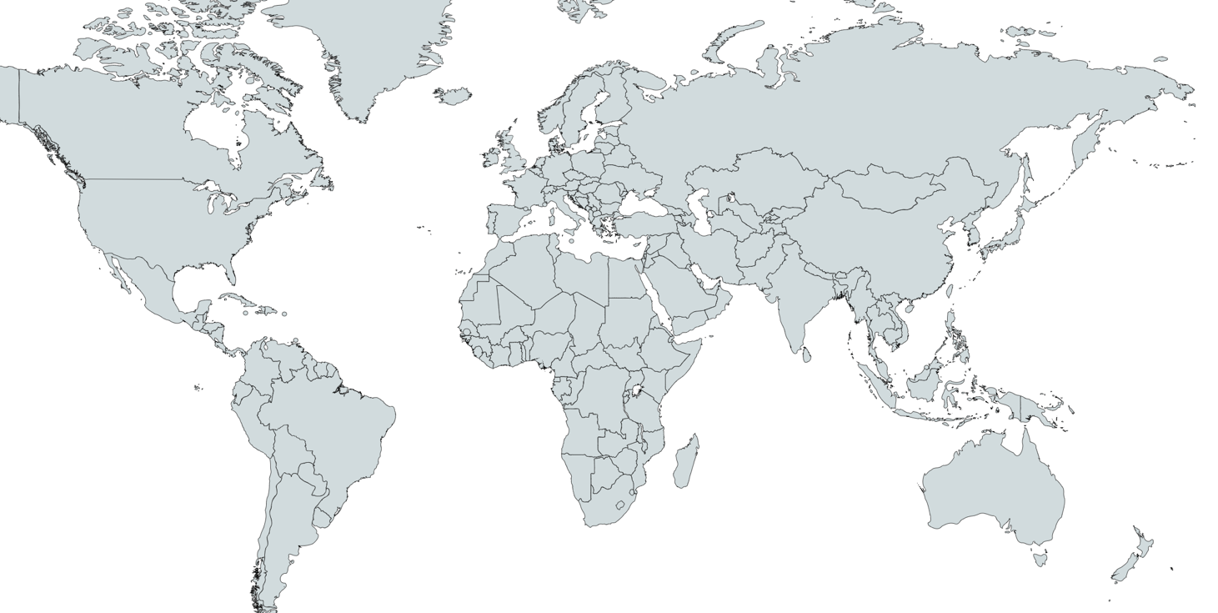
Building synergies via regional networks
Linked to infras around the world

Slide 7
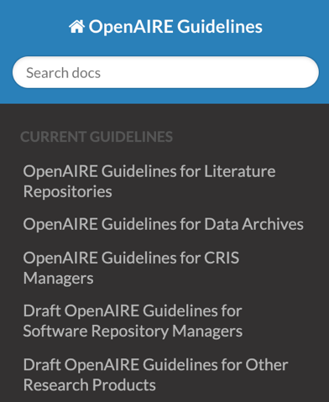
Starting from the basics: How to exchange metadata
OpenAIRE Guidelines
for LITERATURE Repositories v4.0
OpenAIRE Guidelines
for DATA Repositories
OpenAIRE Guidelines
for SOFTWARE Repositories
OpenAIRE Guidelines
for OTHER research products
OpenAIRE Guidelines
for CRIS
OpenAIRE Guidelines
for USAGE statistics
guidelines.openaire.eu
FAIR principles

Slide 8
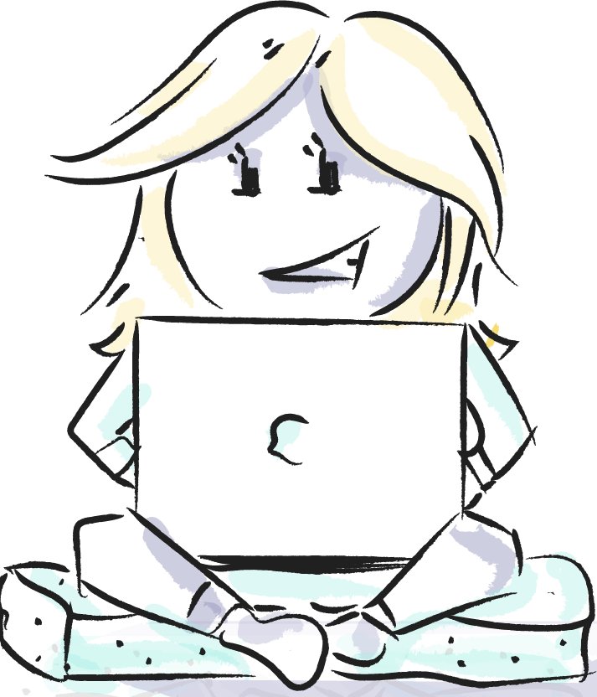
Producing tools for the global community

Slide 9
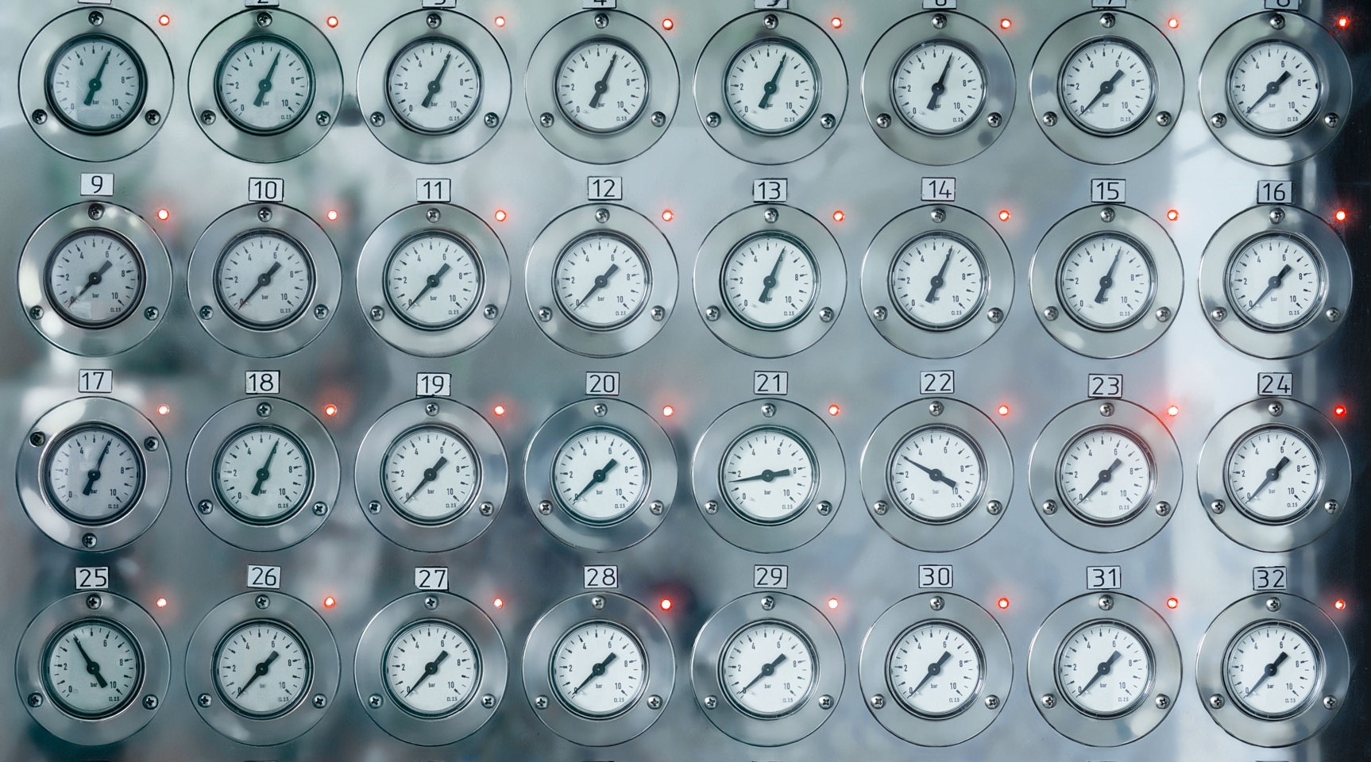
Not just for researchers…
Research is an interconnected endeavor
Services for ALL stakeholders involved
Closing the loop from discovery – publishing - monitoring
Different levels (providers / users)
Providers: connecting via standards, APIs
End users: researchers, content & service providers, policy makers

Slide 10
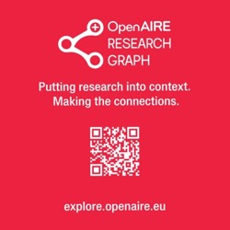
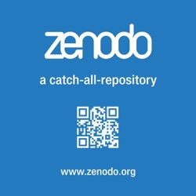
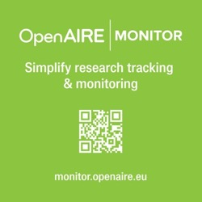
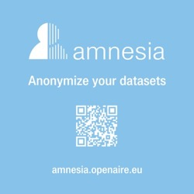
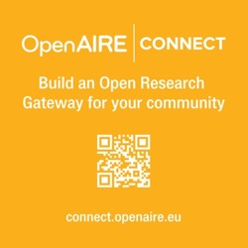
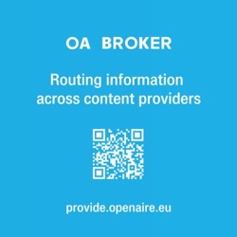
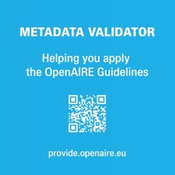
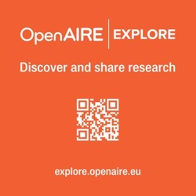
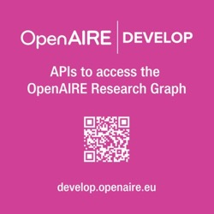
Services for the global community
Services for all
providers / users

Slide 11
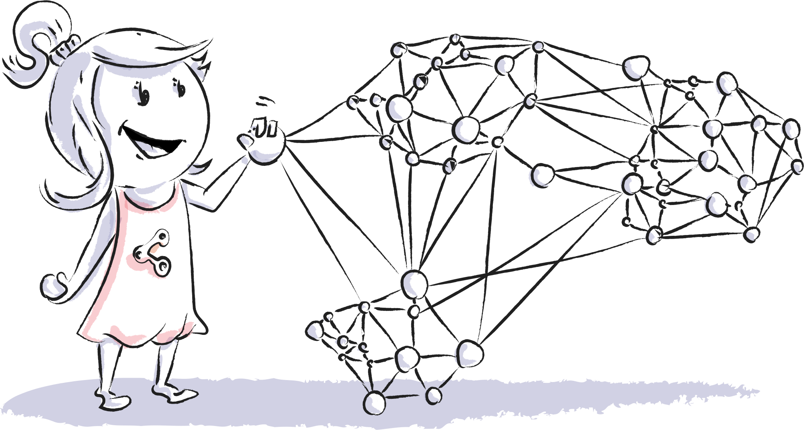
Co-producing global assets

Slide 12
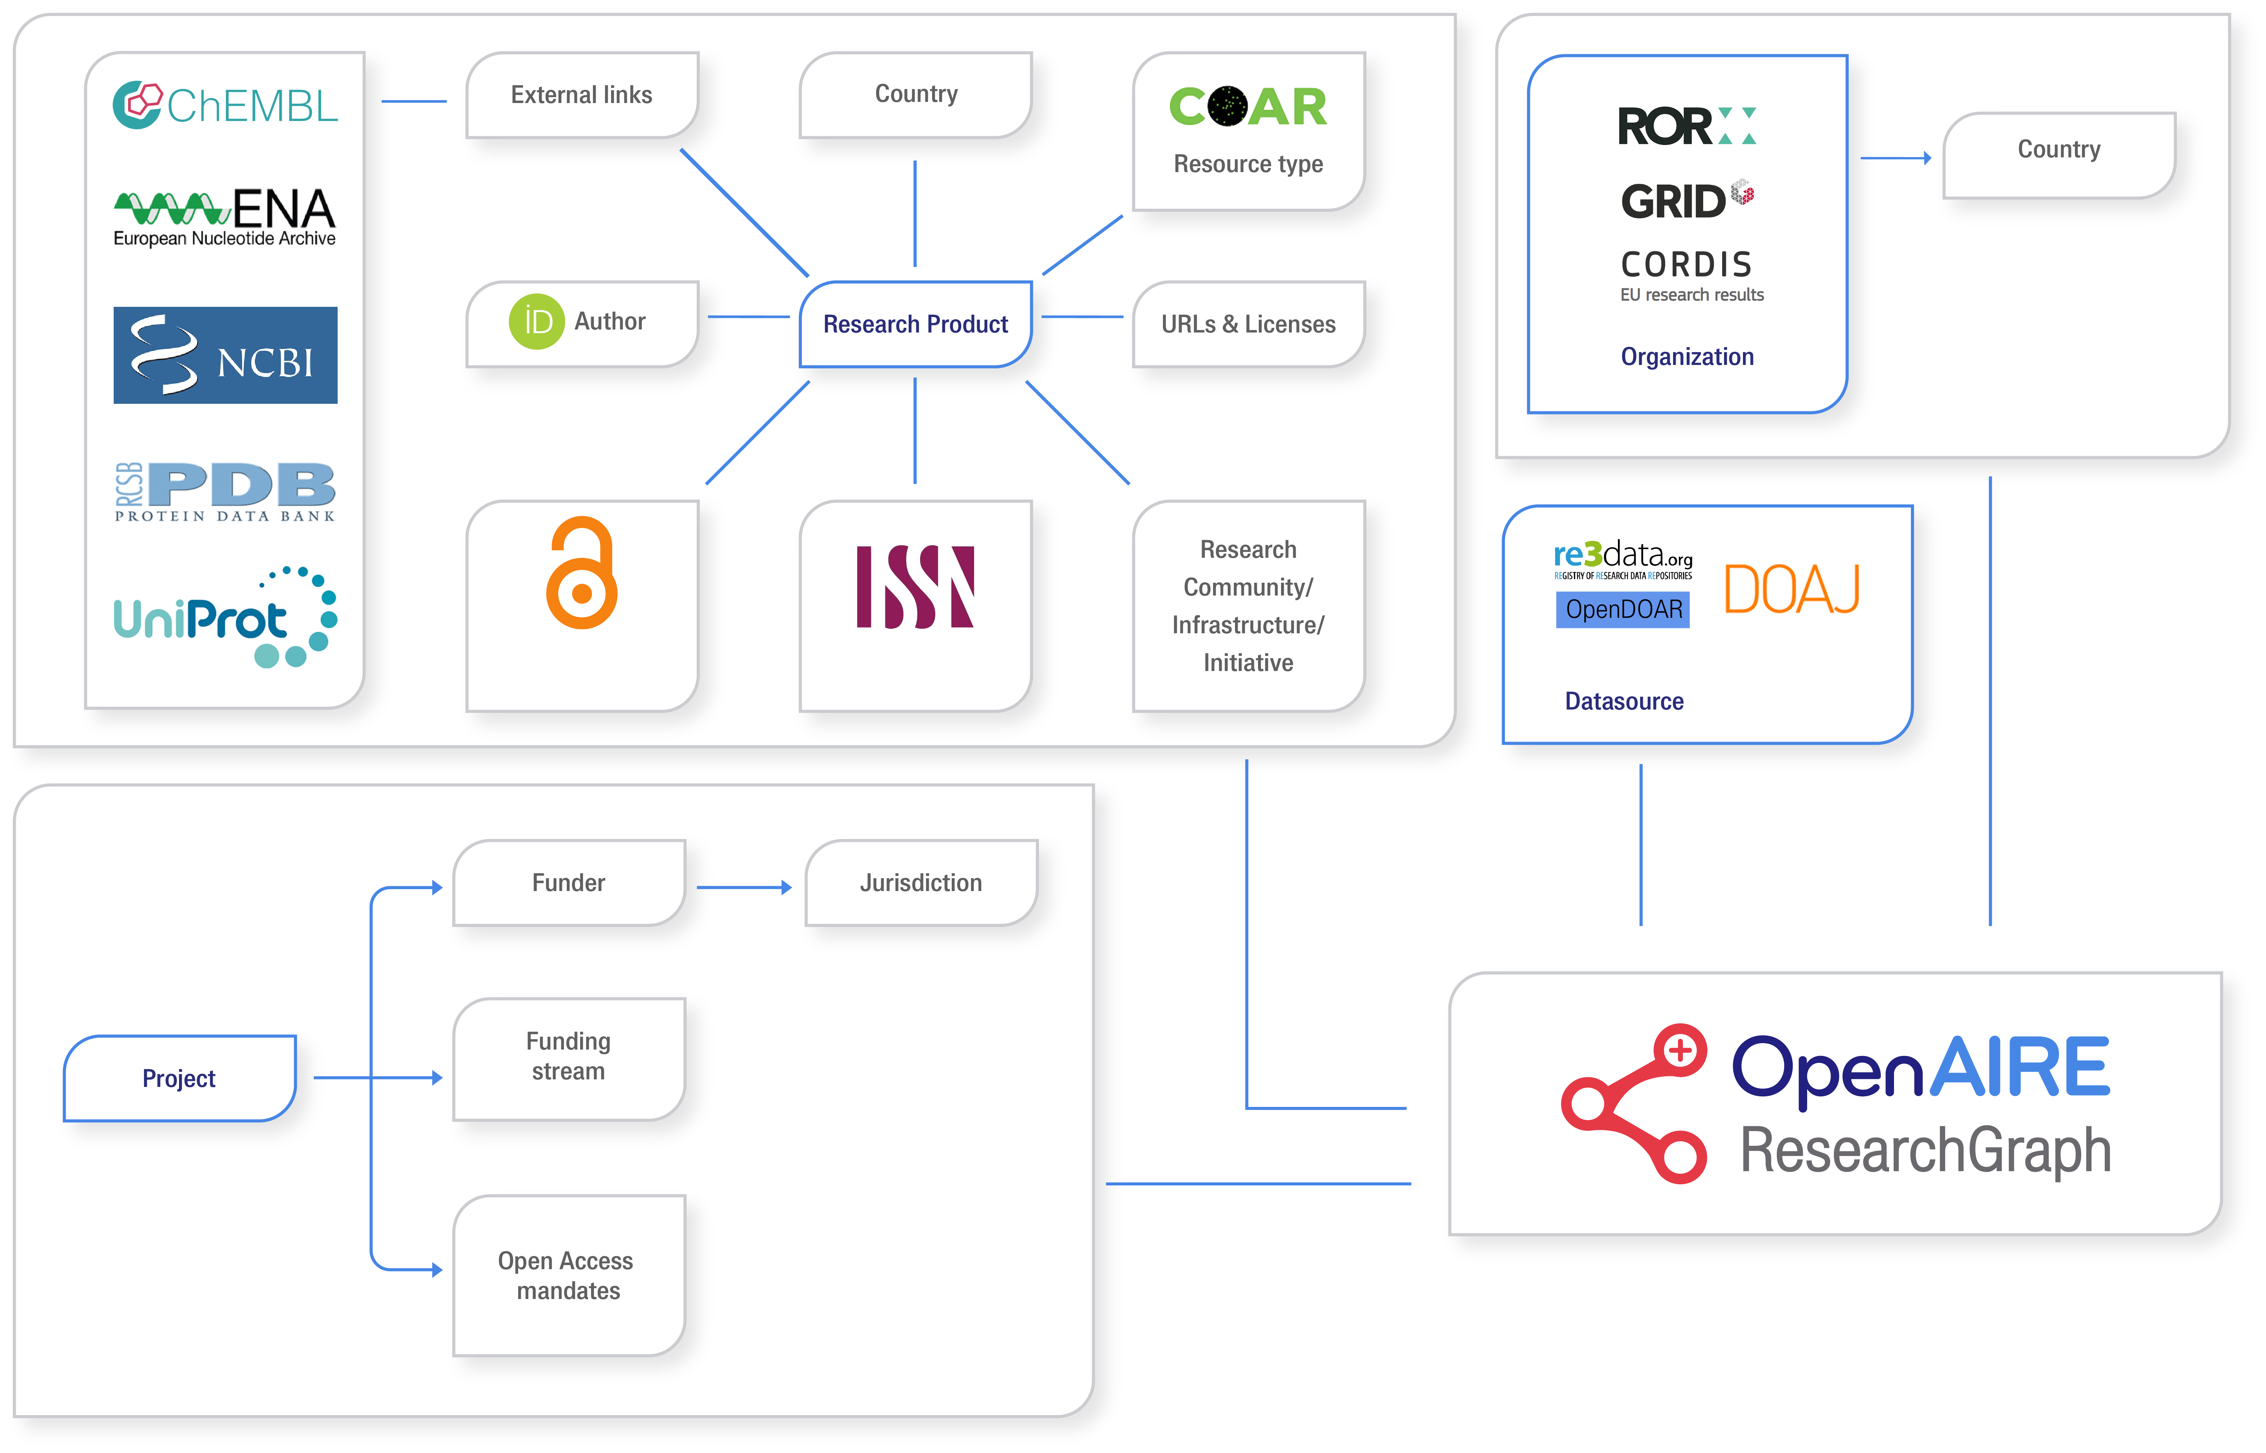
OpenAIRE Research Graph
From Open And Authoritative Sources Around The Globe

Slide 13
Natalia Manola
nataliam@openaire.eu

