Slide 1
EGI Support to International Scientific Collaborations
Success stories and challenges
Tiziana Ferrari, EGI Foundation
GOSC Workshop, 04/11/2020

Slide 2
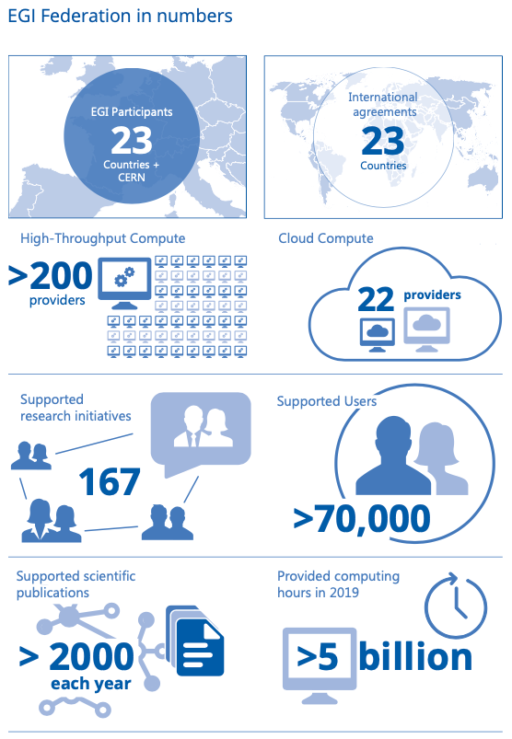
Vision and Mission
Vision
All researchers have seamless access to services, resources and expertise to collaborate and conduct world-class research and innovation
Mission of the EGI Federation
Deliver open solutions for advanced computing and data analytics

Slide 3
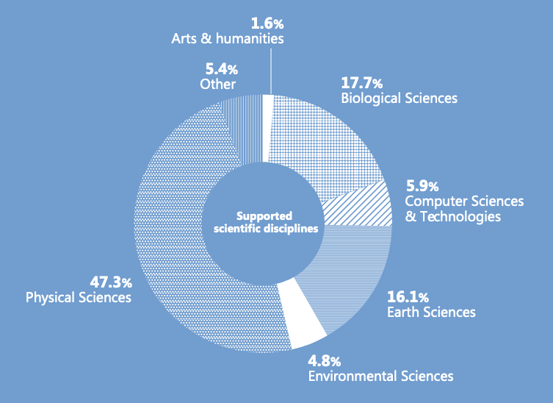
User communities of the EGI Federation
> 71,000 users
45.5% Medical and Health Sciences
17% Higher Energy Physics
10.4% Environmental Sciences

Slide 4
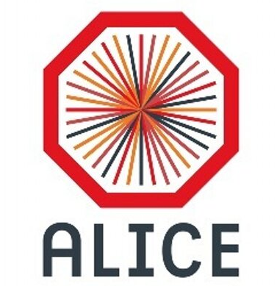
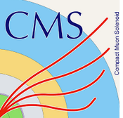
Support to structured international scientific collaborations
Hundreds of Institutes
Tens of countries across all continents
Thousands of researchers
Notes:
ATLAS comprises about 3000 scientific authors from 181 institutions around the world, representing 38 countries from all the world’s populated continents.
CMS: 229 institutes, 51 countries

Slide 5
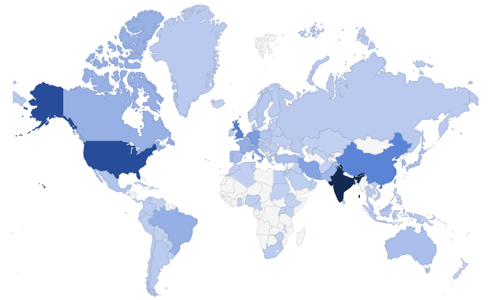
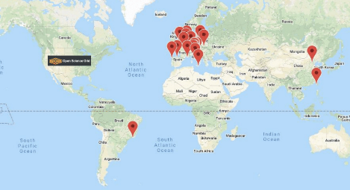
Support to international communities of practice: HADDOCK and WeNMR
122 Countries
20,000 users
EU users:
25%
Bilateral agreements between Europe, Asia Pacific and USA

Slide 6
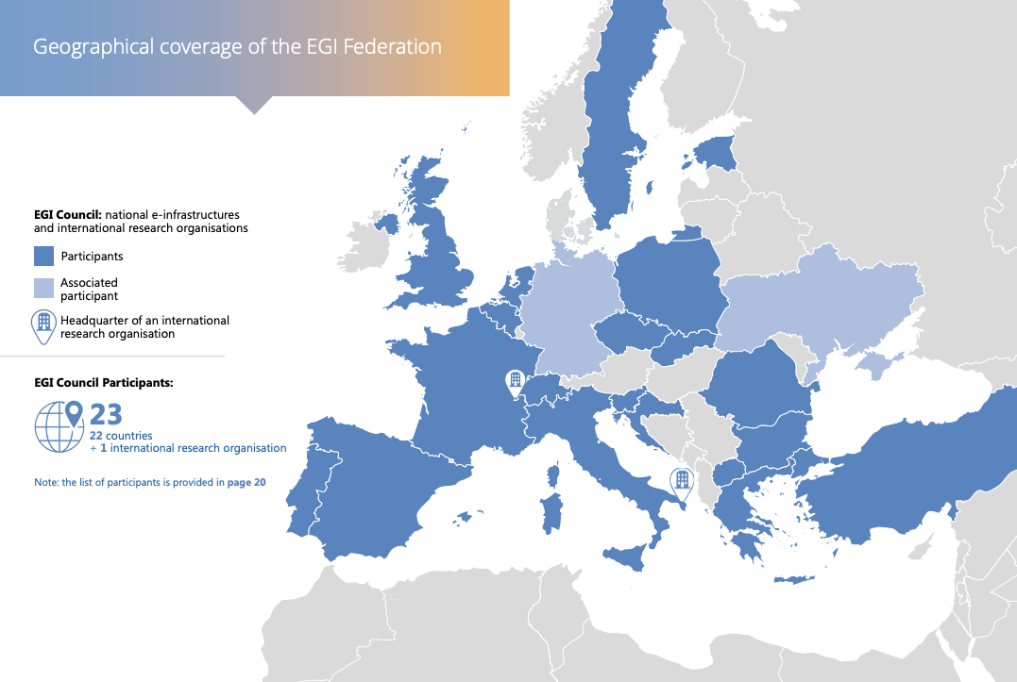
26 from 2021

Slide 7
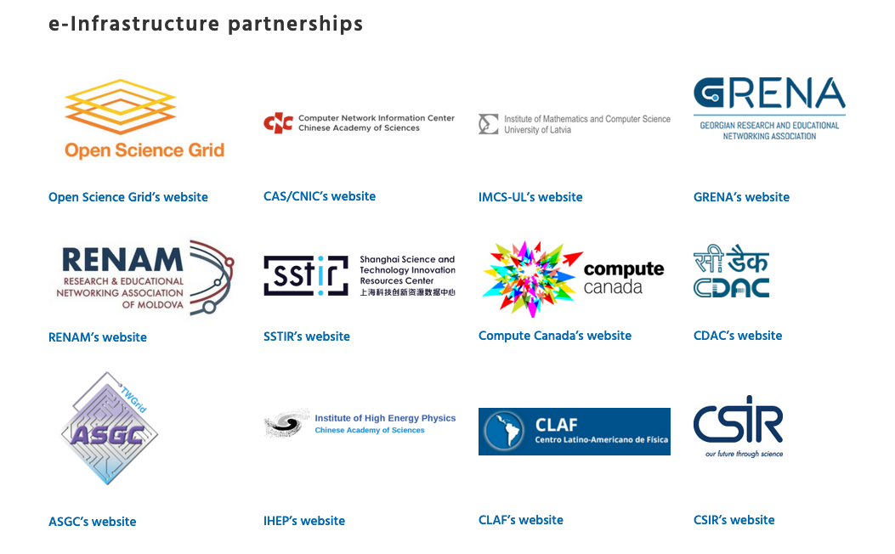
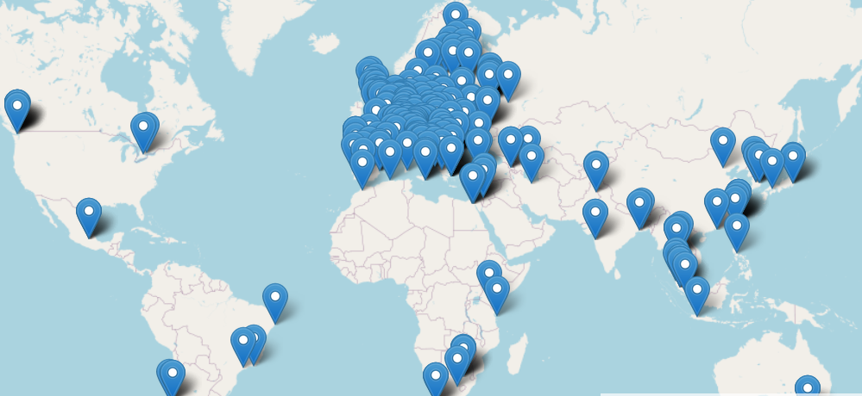
e-Infrastructure International Cooperation Agreements

Slide 8
Requirements for international e-Infrastructures
Need for a community-level governance: agreed access policy to data and services and related business model (e.g. sponsored access, opportunistic access, pay for use etc.)
National infrastructures are not open by default as they are generally funded to support national research only
National infrastructure have different incompatible access processes ➔ Silos
The same access policy needs to be supported by all federation members:
Community agreements on share of pledged capacity
Service Level Agreements between the community and the service providers…
Technical “interoperation” (as opposed to interoperability) is mandatory (e.g. AAI, compute and storage facilities, platforms and scientific applications)
Coordinated service management across the federation is necessary (e.g. accounting, security incident response, user support) ➔ MoUs
Interoperable trust and identity framework to enable authentication and authorization across different domains, security operations coordination across federation members

Slide 9
Three major gaps to be addressed
Governance. Lightweight international-level federated e-Infrastructures (both at European level and worldwide level)
Success stories are currently based on ad-hoc agreements and bilateral agreements
Long lead time from requirement to production
The current approach is not scalable and is only proven to work for well organized research collaborations
Organization. Coordinated human networks for user support at international level (end user and expert user)
Access policies. Open infrastructure policies
For coordinated cross-border capacity allocation

