Slide 1
A European Discovery Platform for the SSH
EGI Check-in for TRIPLE and its innovative services
Name | Organisation | DAY | PLACE
Luca De Santis (et al.) | TRIPLE | Nov. 4th 2020 | EGI Conference 2020

Slide 2
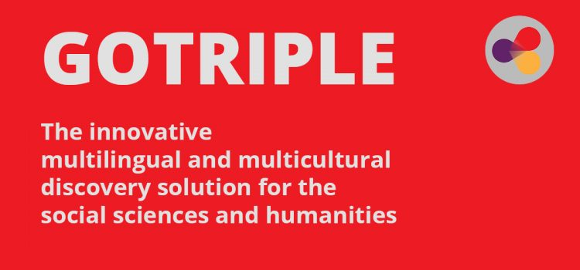
Introducing TRIPLE
The Project
The Platform
Transforming Research Through Innovative
Practices for Linked Interdisciplinary Exploration
An Horizon 2020 project, started on Oct. 2019 with a duration of 42 months
19 partners from 13 European countries
Coordinated from France by Huma-Num, a unit of the French National Centre for Scientific Research (CNRS)
An innovative multilingual and multicultural discovery solution for the social sciences and humanities (SSH);
Born from the experience of the Isidore search engine, developed by Huma-Num since 2010
First version to be released as a prototype in autumn 2021
Notes:
The project
launched on 1 October 2019
duration of 42 months (2019–2023)
financed under the Horizon 2020 framework with approx. 5.6 million Euros
consortium of 19 partners from 13 European countries
Coordinated from France by Huma-Num, a unit of the French National Centre for Scientific Research (CNRS)
currently 87 staff members working for one or more of the 8 work packages
operation planned for 2023
final goal is to integrate the discovery solution into the EOSC marketplace
The platform
first version to be released as a prototype in autumn 2021;
is an innovative multilingual and multicultural discovery solution for the social sciences and humanities (SSH);
will provide a single access point that allows you to explore, find, access and reuse materials such as literature, data, projects and researcher profiles at European scale;
is based on the Isidore search engine developed by Huma-Num (unit of CNRS)
will be one of the dedicated services of OPERAS, the research infrastructure supporting open scholarly communication in the social sciences and humanities in the European Research Area.

Slide 3
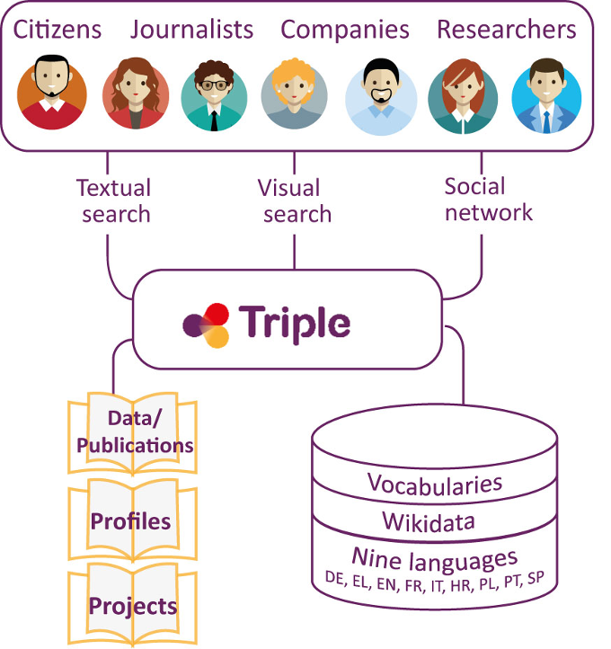
GOTRIPLE: Platform (contents, processes, services)
GO
Notes:
The platform will focus on 3 main kinds of resources: publications and data, profiles of researchers and research projects of.
TRIPLE focuses on subject-specific and multilingual diversity on the one hand, and on the other hand enables researchers to identify not only data, but also other scientists and projects in the European research area across subject and language boundaries, and to reuse the data generated in these project contexts.
It will organize data from different providers, findable through a search engine and workable through annotations and visualizations tools. It also offers ways to connect with other scientists through services of recommendation and based on trust.

Slide 4
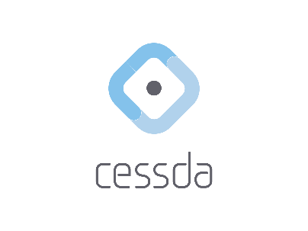
TRIPLE and related projects
A SERVICE OF
INFRASTRUCTURES
WILL FEATURE
IN
PARTNERS
WILL FEATURE IN
PART OF
COORDINATES
CONTRIBUTES TO
Notes:
TRIPLE will feature in the SSHOC Marketplace and in EOSC Catalogue of Services

Slide 5
TRIPLE is a service of OPERAS
A distributed Research Infrastructure supporting open scholarly communication of European SSH researchers, by:
coordinating and federating resources (services, practices, technology) across the main SSH actors
efficiently addressing the scholarly communication needs.
Notes:
to coordinate and federate resources (services, practices, technology) across main actors in the SSH scholarly communication in Europe
to efficiently address the scholarly communication needs of European researchers in the field of SSH.

Slide 6
OPERAS uses extensively EGI Check-In
 | Integrated (dev)
 | Integration acted but work not finished
 | Later stage
OPERAS Publication Service Portal
GO
OPERAS Discovery Service
OPERAS Certification Service
OPERAS Metrics Service
OPERAS Research for Society

Slide 7
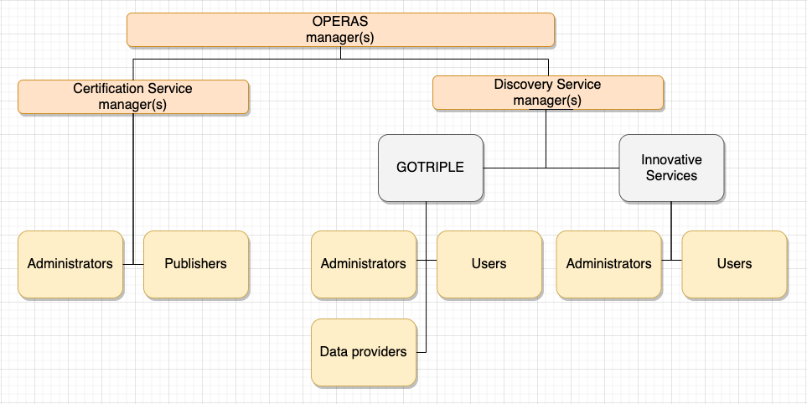
OPERAS Virtual Organisation
Check-in
Management

Slide 8
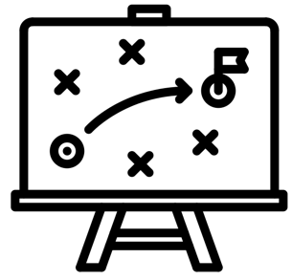
Why Check-In in TRIPLE
Technical Reasons
Strategic reasons
Providing the widest and easiest way to access services to potential users
Open to researchers (Institutional credentials) and common citizens & professionals alike (Social Network credentials)
EGI has a central role in EOSC
EGI is part of the TRIPLE and OPERAS partnerships
Tight integration with OPERAS through EGI’s Virtual Organization
Notes:
Technical reasons
Providing the widest and easiest way to access services to potential users
Researchers (Institutional credentials) and Common Citizens & Professionals alike (Social Network credentials)
Strategic reasons
EGI has a central role in EOSC
EGI coordinates the EOSC-Hub project
EGI is part of the TRIPLE and OPERAS partnerships
Tight integration with OPERAS through V.O.

Slide 9
EGI integration in TRIPLE: an overview
EGI SERVICE PROVIDERS
T5.3
TBS
T5.5
Open Annotation
Tool
T5.1
3rd Party Applications
GO
Federated Services
PROJECT

Slide 10
Need and challenges of the integration
TRIPLE need: to simplify the user experience
Users have to do a double registration, to EGI Check-In and to the Service Provider
Too much information requested to users in the EGI “standard” registration form
EGI Check-In team to the rescue!
… with the New User’s enrollment module
Leaner and simpler registration process
Friendlier User Interface

Slide 11
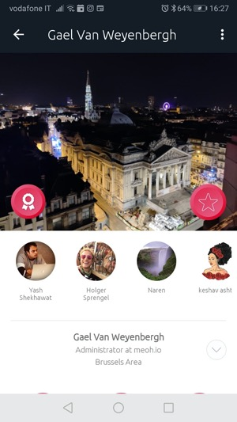
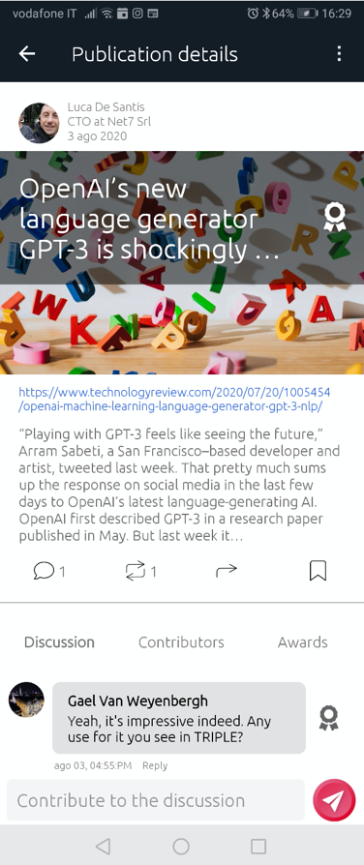
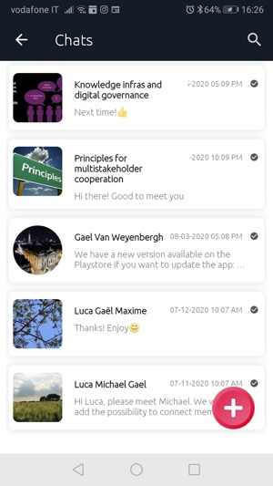
Integration in TRIPLE: TBS
The Trust Building System (TBS) is a collaborative platform aimed at facilitating transdisciplinary cooperation between a variety of stakeholders such as scientists, policy makers, public services, business networks, and civil society.
It is designed by Meoh (BE) and implemented by Nuromedia (DE) as an innovative service of TRIPLE.

Slide 12
Integration in TRIPLE: TBS
EGI Check-In will help the TBS to meet two important needs:
End-to-end trust
Social trust: TBS architecture which is human-sized, human-curated, and invite-only
Technical trust: EGI “light” check-in which is secure yet user-friendly
Multistakeholder cooperation
EGI can provide a single point of integration as it offers sign-ins both for popular social networks and for big research infrastructures

Slide 13
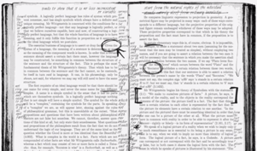
Integration in TRIPLE: Pundit
Pundit is a web annotation system, powered by Semantic Technologies - https://thepund.it
Annotation…
“Attaching data to some other piece of data”
Think of “marginalia” in books
Semantic Annotation…
Annotations not limited to “comments” & “highlighting” but consist of fully expressed and web-linked concepts
More expressive. Better search & reuse
Annotation Data formally defined and compliant to standards (W3C Web Annotation Data Model)

Slide 14
Integration in TRIPLE: Pundit & Check-In

Slide 15
Luca De Santis (presenter) - Net7
Yin Chen, Valeria Ardizzone - EGI.eu
Gael Van Weyenbergh, Maxime Bouillard - MEOH
Yoann Moranville - OPERAS/DARIAH
Stefanie Pohle - Max Weber Stiftung
Emilie Blotiere, Suzanne Dumouchel, Laurent Cappelli - Huma-Num
Michael Köberlein - Nuromedia
Giulio Andreini, Massimiliano Pardini - Net7
Image credits:
slide 8 “technical by Nithinan Tatah” and “strategy by lastspark” from the Noun Project - CC BY 3.0

