Slide 1
Experience with cloud vouchers in OCRE
EGI Conference
04 November 2020
Marion Devouassoux marion.devouassoux@cern.ch

Slide 2
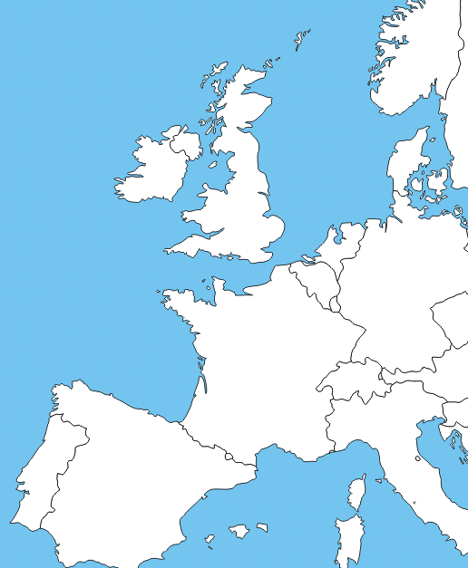
1. Past Experience with Cloud Vouchers
Pre-Commercial Procurement
Piloted hybrid cloud platforms involving competitively selected providers
Procurement budget: €5.3M
8% as Cloud Vouchers
Cloud voucher: cloud computing resources in the form of credit (free at the point of the user)

Slide 3
1. Past Experience with Cloud Vouchers
Advantages of Cloud Vouchers:
Facilitate distribution to end-users
Particularly suitable for small-scale projects
Allow testing before procuring at scale

Slide 4
2. Cloud Vouchers in OCRE
OCRE: Open Clouds for Research Environments
Procurement of commodity cloud based services for the EOSC (2019 – 2021)
Led by GÉANT
Procurement Budget: €9.5 million
Aim: accelerate cloud adoption in the European research community
Cloud vouchers for the Long-Tail-of-Science

Slide 5
2. Cloud Vouchers in OCRE
Call off ran in Q2 2019 under GEANT IaaS framework
Total Amount procured: €500 000
Voucher face value: €500 to €2000
3 cloud providers:
3 distribution channels:

Slide 6
3. Cloud Vouchers Distribution
Applications collection (Q3 2019)
Requirements gathering study (Q2 2019)
Distribution (Q4 2019 –ongoing)
Feedback gathering (ongoing)
# vouchers distributed: 65
# researchers: 57
Results requirements gathering study (>70 answers) :

Slide 7
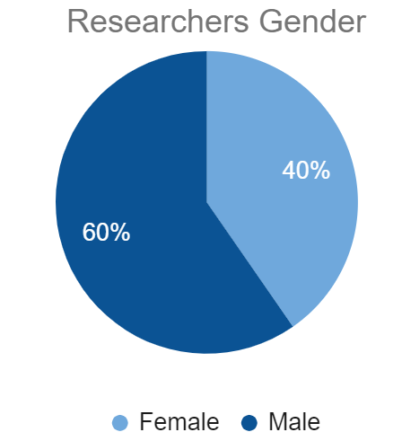
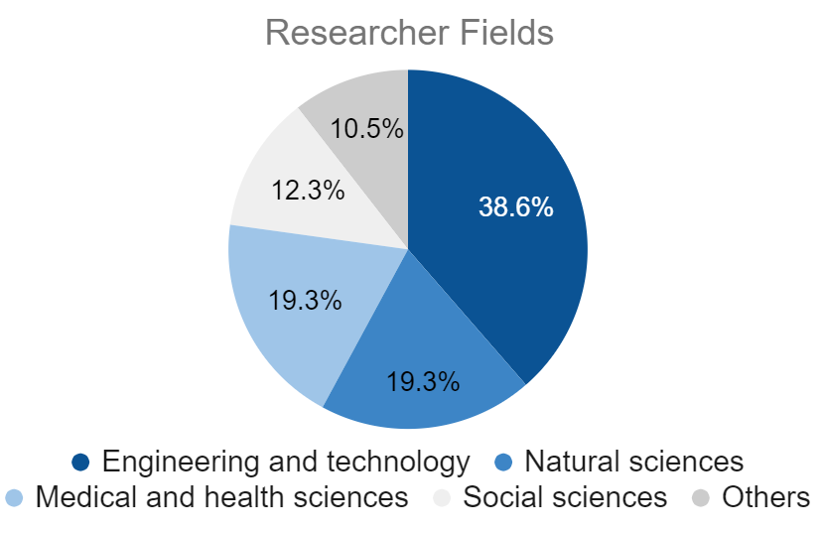
3. Cloud Vouchers Distribution
CloudSigma: 35
Exoscale*:24
TI-Sparkle: 4
Micromail: 2
Contractors available via GÉANT IaaS Framework
*Exoscale is not a contractor via the GÉANT IaaS. Vouchers were (exceptionally) funded and distributed by CERN, in compensation for the frustration of Micromail and TI-Sparkle contracts due to VAT issues. Open Call via CERN openlab

Slide 8
4. Feedback and Lessons Learned
18 researchers’ feedback collected:
Didn't meet my expectations at all
Fully met my expectations

Slide 9
4. Feedback and Lessons Learned
Small scale, time limited calls
= easier to manage
Vouchers face value of several thousands of Euros
= necessary to ensure results
Exit strategies & re-allocation
= crucial to ensure uptake
Training materials and support
= key to increase uptake
Voucher usage tracking & re-allocation of unused vouchers
= essential to avoid wasted resources
Next steps
Increase distribution
Automate tracking & distribution process

