Slide 1
ARCHIVER – Design Phase Archiving and Preservation for Research Environments Jakub Urban (CERN) Technical Coordinator
2nd of November 2020

Slide 2
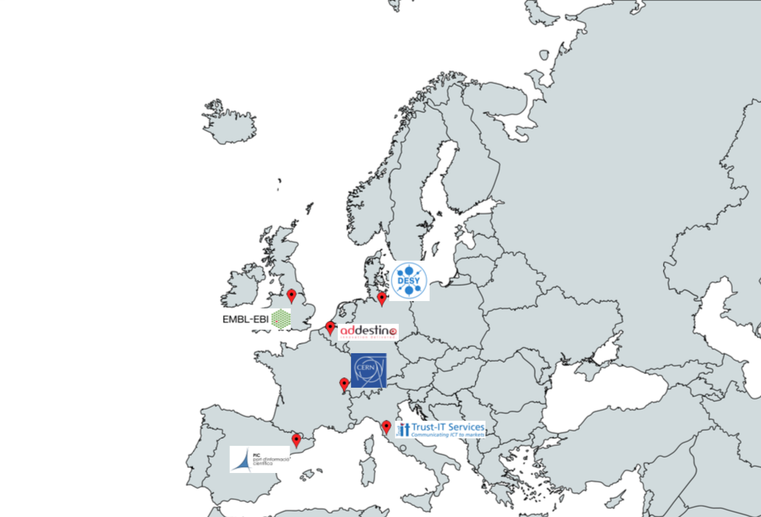
Project
Focus: Archiving and Data Preservation Services using commercial cloud services to be available via the European Open Science Cloud (EOSC)
Procurement R&D budget: 3.4M euro; Total Budget: 4.8M
Starting Date: 1st of January 2019
Duration: 41 Months
Coordinator: CERN (Lead Procurer)

Slide 3
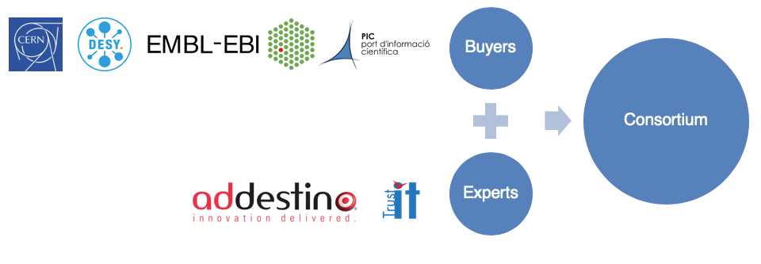
Consortium
Includes Buyers and Experts in the preparation, execution and promotion of the
procurement of R&D services
The “Buyers Group”: Public organisations committing funds to contribute to a joint-R&D-procurement, research data use cases and R&D testing effort
Buyers
Buyers
Experts – Partner organisations bringing expertise in requirement assessment and promotion activities, not part of the Buyers Group
Consortium
Consortium
Experts
Experts

Slide 4
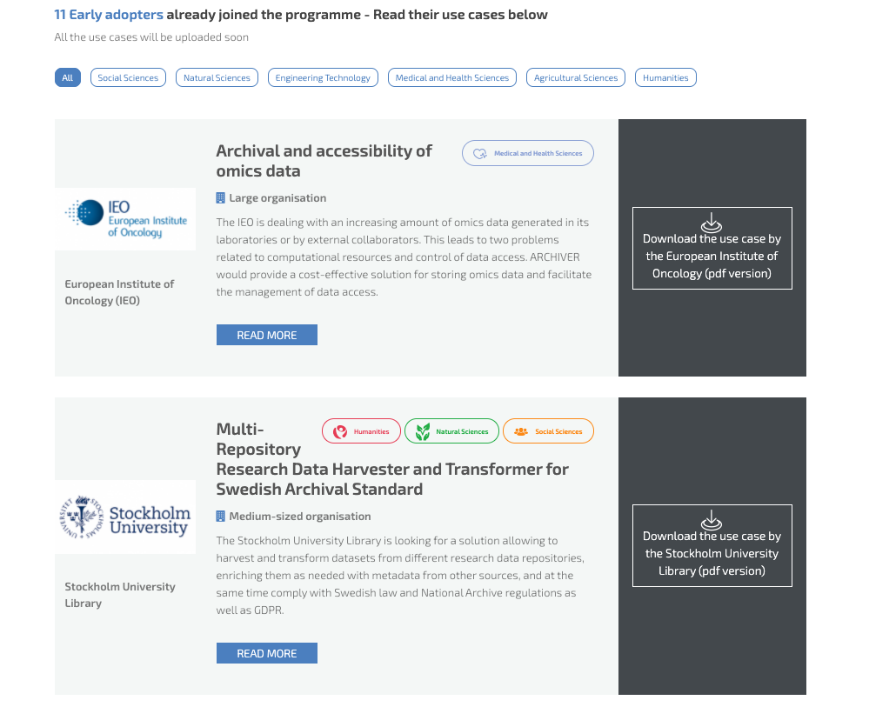
Early Adopters
https://archiver-project.eu/early-adopters-use-cases
Participants:
Demand side public sector organisations
Key advantages
Access and assess if resulting services address archiving and preservation meet their needs
Contribute and shape the R&D carried out in the project, contribute with use cases and
Have the option to purchase pilot-scale services by the end of the project
Confirmed 11 organisations, more are in the process:
High level of interest from the community

Slide 5
Move from current state of the art
Current Scientific Data Repositories
PB scale demonstration of scientific data repositories
Profit from considerable experience of European SMEs preservation experts
Promote FOSS, open standards & concretely test exit strategies
Best practices: FAIR, TRUST, DPC(RAM)
Pan-European: resulting services available in the EOSC
Cost model adapted to public research
Growing data volumes
Basic bit preservation capabilities
Concerns: technology lock-in (tape), Disaster Recovery/Business Continuity plans needed (COVID-19)
Most of research data not published
Fragmentation across scientific disciplines & countries
Cost underestimation at the planning phase
ARCHIVER “current state of the art” report: https://doi.org/10.5281/zenodo.3618215

Slide 6
R&D Scope
Demand Side Requirements
Layer 4
Advanced services
High level services: visual representation of data (domain specific), reproducibility of scientific analyses, etc.
Layer 3
Baseline user services
User services: search, discover, share, indexing, data removal, etc. Access under Federated IAM
EMBL 2 – Cloud Caching
PIC 3 – Data Distribution
CERN 2 – CERN Open Data
CERN 3 – CERN Digital Memory
CERN 1 – The BaBar Experiment
DESY 1 – Individual Scientist
DESY 2 – Petra III Experiment
DESY 3 – EUXFEL Experiment
Layer 2
Preservation
OAIS conformant services: data readability formats, normalization, obsolesce monitoring, files fixity, authenticity checks, etc. ISO 14721/16363, 26324 and related standards
PIC 1 – Large File Storage
EMBL 1 – FIRE
PIC 2 – Mix File Storage
Layer 1
Storage/Basic Archiving/Secure backup
Data integrity/security; cloud/hybrid deployment
Data volume in the PB range; high, sustained ingest data rates. ISO certification: 27000, 27040, 19086 and related standards. Archives connected to the GEANT network
Scientific use cases deployments documented at: https://www.archiver-project.eu/deployment-scenarios

Slide 7
Project Timeline
Preparation
Phase
R&D Bids Submission,
Evaluation & Selection
R&D Competitive Execution
We are here

Slide 8
Selected Consortia for the Design Phase

Slide 9
R&D proposal of ARKIVUM
SaaS stack deployed on Google Cloud
Scientific Data oriented
OAIS Archive workflow
FAIR Data support
Open standards & specifications
Trusted Digital Repository techniques
Cost-effective archiving and preservation
https://www.archiver-project.eu/design-phase-award/consortium-1
Notes:
SCIENTIFIC DATA ORIENTED - The Arkivum solution and workflows are all about enabling content, which in the case of ARCHIVER includes scientific data from a range of sources, to be captured, ingested, preserved and made accessible to those who need to use that content in the future.
OAIS ARCHIVE WORKFLOW - This includes the ability to ingest, validate, organize and manage content as it comes into an archive. The content will then go through appropriate preservation and safeguarding processes, including generating OAIS archiving packages to ensure it is properly protected and remains usable.
FAIR DATA SUPPORT - ensure that the data is searchable, discoverable and accessible for users both today and in the future so people can find and use the content in the archive that they need, when they need it.
SaaS stack deployed on Google Cloud Platform (GCP) - Google Cloud enables the team to manage data on the immense scale required by ARCHIVER
Open standards, open specifications, open source and open APIs to ensure portability, interoperability, exit strategies and removal of vendor and solution lock-in
Trusted Digital Repository techniques and ensuring data is Findable, Accessible, Interoperable and Reusable (i.e. adhering to the FAIR principles).
The emphasis of the development is on cost-effective archiving and preservation that can meet the very large data volumes and high ingest rates from organisations such as CERN, DESY, EMBL-EBI and PIC.

Slide 10
R&D proposal of GMV
Piql Connect and Piql UI
Piql software on top of Archivematica
Fed. Identity & Access Management
AI functionalities
Container-based workflows
Operations over huge data scale
https://www.archiver-project.eu/design-phase-award/consortium-2
Notes:
Piql Connect and Piql UI will simplify the user interaction with the whole system. Access and permission management against repositories and various collections will be also supported by the Federated Identity and Access Management schemes, as a strategy to promote open data access in the research community.
the solution will provide features for the retention and integrity of data over a decade ensuring its tamper-proof behaviour whilst allowing easy access and basic re-usability with a collection of artificial intelligence functionalities
Reproducibility of experiments will be based on container-based workflows exposed to the user taking advantage of modern cloud computing paradigms that provide scale on-demand, necessary to run large scientific experiments
GMV Soluciones Globales Internet, Piql AS, Amazon Web Services and Safespring to develop a solution that will provide features for multi-cloud deployment (over private, public, hybrid, community and special purpose Clouds)
The preservation layer will enhance Piql software on top of Archivematica
The solution will operate with volumes of hundreds of TBs providing preservation user services
The solution will allow the operation with volumes of hundreds of TBs with support of indexing, elastic search, deduplication, single point access, crawling, cross-checking, vulnerability scanning, and plugins configuration filtering potential datasets rapidly, to access dataset metadata and decide on its relevance.
Automated metadata indexing for several tens of PB content will be supported, including also support for dataset filtering and information tagging, aiming at maximum interoperability and easy and broader searches for the research community

Slide 11
R&D proposal of LIBNOVA
Established preservation platform
Life-cycle OAIS compliant
Scalability
Containers
Cost Efficiency
Dynamic insights
Budget Assistant
https://www.archiver-project.eu/design-phase-award/consortium-3
Notes:
The solution we are proposing is built on pre-existing digital preservation platforms already in use by many leading organizations across the world. It proposes a solution for the whole organization and for the whole data life-cycle, completely aligned with OAIS, ISO16363, FAIR and TRUST principles, with powerful and really innovative capabilities in all functionality layers
Scalability (sustained high throughput in the 100s of PBs range)
Digital Preservation Best Practices (OAIS, ISO 16363, PSC-Preservation Storage Criteria, Best Practices recommendations and implementations – OAIS Information Model including Representation Information and Preservation Description Information components, problem detection such as duplicates, hidden encryption - , format migration/evolution, exit strategy)
Metadata management (import/creation and preservation), following OAIS
Data integrity management (integrity chain, integrity at rest)
FAIR principles (F: containers, customized metadata, structured hierarchy, … A: multiprotocol access, public sharing, discovery solutions, … I: Data policies, research data Representation Information, … R: Integrated active integrity control, Representation Information and Provenance Information)
Cost efficiency (flexibility on deployment, several computation/storage options)
Containers – keep content accessible with several protocols, organized and protected. These containers keep metadata, data and code together to ensure usability (OAIS-aligned).
Dynamic Insights – help users when dealing with personal information, digital preservation and emissions reduction, with the following components: Data Policies Assistant, GDPR Assistant, Emissions Optimizer, Digital Preservation.
Budget assistant – helps users to plan and follow expenditures
Content gateway – connects the platform with repositories for discovery solutions, such as Invenio or Dataverse
Digital Preservation, OAIS and FAIR conformance – as support for the OAIS Information Model and for the Mandatory Responsibilities, and the results will fully support repositories in OAIS conformance. The focus on usability is also critical for the “Interoperability” and “Reusability” required by the FAIR principles.

Slide 12
R&D proposal of RHEA
Secure Service Portal
Federated access service (SAML 2.0)
Open Source applications
Archivematica and AtoM tools
Stewardship lifecycle
Readiness XaaS services
https://www.archiver-project.eu/design-phase-award/consortium-4
Notes:
The infrastructure for Data and Information long term preservation is based on the open source Archivematica and AtoM tools also proposed in the ARCHIVER project.
R&D activities for designing, implementation and deploying of a complete and secure service model to fully cover the stewardship lifecycle of multiple and heterogeneous research data exceeding the occurring lacks in these concepts, involving organisation, processes and technologies
open source applications and a dedicated hybrid cloud in order to grant the whole integrated and fully protected data stewardship and curation lifecycle
Federated access service will be implemented incrementally following the Buyers Group needs (e.g. machine-to-machine approach or specific protocols for FIM), providing “in-house” solutions reusing and adapting already available components and taking advantage of internal know-how
Secure Service Portal (Identity Access Management, Access Layer Interface, Validation and Pre-ingestion services), implemented by RHEA;
Existing and mature Open Source platforms for data archiving, preservation, reporting and access/discovery (Archivematica/AToM/JasperSoft), integrated and configured by DEDAGROUP;
Readiness XaaS services, provided by all partners;
Cloud connect product for integration with proposed robust and scalable managed Hybrid Cloud, provided by GTT
authentication services based on SAML 2.0

Slide 13
R&D proposal of T-SYSTEMS
Petabyte-scale storage options, compliance with OAIS, PREMIS, METS and BagIT standards and new innovate functions for distributed data and workflow management, search and discovery, data representation and scientific analysis.
https://www.archiver-project.eu/design-phase-award/consortium-5
Notes:
The R&D will focus on new innovative functionality for baseline and advanced data preservation services, including Petabyte-scale storage options, compliance with OAIS, PREMIS, METS and BagIT standards and new innovate functions for distributed data and workflow management, search and discovery, data representation and scientific analysis.
The objective is an integrated service offer for end-users, integrators and cloud providers for deployments on local and public cloud infrastructures. T-Systems will operate the services as part of its Open Telekom Cloud portfolio, a leading European public cloud service based on OpenStack.

Slide 14
Design Phase conclusions
The objectives of the design phase were successfully met.
Most of the deliverables provided by the companies were of sufficient quality.
Good indication that the main R&D purpose and the use cases requirements were globally understood.
CERN, EMBL-EBI, DESY and PIC allocated significant effort assessing and testing the demo platforms showcasing current capabilities and state-of-the-art.
Feedback was systematic. Companies congratulated the project team for the excellent interaction, generating good progress when compared to other project formats, including project dissemination actions.

Slide 15
The next steps of ARCHIVER project
Selection process for the Prototype Phase
Kick Off event - 9th December 2020 (TBC)
https://www.archiver-project.eu/
https://twitter.com/ArchiverProject
https://www.linkedin.com/company/archiver-project/
https://www.youtube.com/channel/UCCBIyLpUt-hWmQatqdIhIzw

