Slide 1
Hubdrive: Enhancing HUBzero© for Offline Data Sharing Sandra Gesing, James B. Graves and Michael Zentner Sandra.gesing@nd.edu 3 November, 2020 EGI Conference 2020

Slide 2
What is HUBzero?
HUBzero is an open source software platform for building powerful science gateways that host analytical tools, publish data, share resources, collaborate and build communities in a single web-based ecosystem.
A hub is a place for your community to:
Connect with new audiences
Measure their impact
Sustain their research
Notes:
We are an open source platform for building powerful gateways,
or what we call Hubs, that host analytical tools, publish data,
share resources, collaborate and build communities in a single web-based ecosystem.
We developed the HUBzero software,
and we have been supporting Hubs since 2008
with better than ninety-nine percent uptime.
When you create a Hub you are creating a place for your Research Community to
Generate a Wider Audience
Where they can measure their impact
And provide sustainability for their research project

Slide 3
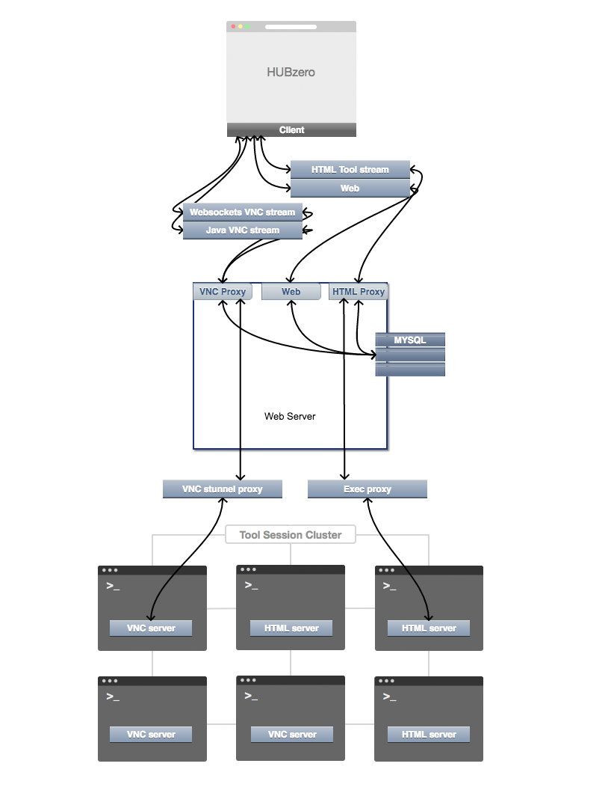
HUBzero Architecture
HUBzero Platform
Front End
Linux, Apache, MySQL, PHP
Middleware libraries
Deploy tools
& Access to HPC resources
Contained inside your
web browser
Notes:
Looking at more modern infrastructure options for the platform’s architecture; for example we’re planning to upgrade to CentOS8 soon.
As you’ll see from this flow chart the front end of a Hub is a fairly standard LAMP stack with PHP based application integrated with MySQL.
Our middle library allows the PHP application to launch and manage private execution environments. The middleware library is composed of many parts that are shown here to handle the traffic from the beginning of the tool session invocation to tool session termination.
Inside those isolated, private, and secure execution environments, we can deploy a variety of different types of tools and setup access to HPC resources.
We’ve had different cases of integrating with various computing cluster resources and the middleware can be adjusted as needed to function seamlessly with those resources.
Access point for all this functionality is contained inside your web browser.
Hubs are containerized in our infrastructure (on-prem, AWS) or for open source the package can even be launched from someone’s individual workstation.

Slide 4
Web Feature Interactions
Collaboration features - Forums, Collections, Content Pages, Login
Web code (PHP, Apache, HTML, JS)
Database Tables and Records
External Authenticator Services
Uploading Files - In Resources, Publications, Courses, Forums
Database Tables and Records
Hard Disk Usage (watch for large files)
User Quotas for Home Directory Filesystem

Slide 5
Expanded Horizons
Docker
Ogre → Ansible
BOINC
Notes:
Working towards moving toward more modern technologies and methodologies to make Hubzero more turn key solution
Docker - discontinued use of OpenVZ and moved to more modern technology of Docker for hosted hubs (except for AWS). Using Docker images and files for tools and being able to run those individually on a hub. Will be providing Docker option for open source hubs later this year (2020).
Docker is a set of platform as a service products that uses OS-level virtualization to deliver software in packages called containers. Containers are isolated from one another and bundle their own software, libraries and configuration files.
Ogre was custom built configuration manager and we’ve now adopted more of an industry standard in Ansible and are fine tuning and optimizing this new tool. Ansible provides more security as well. Config managers mangage configuation of system, with Ansible can create a system from scratch (security, permissions, packages for infrastructure)
Ansible is an open source IT Configuration Management, Deployment & Orchestration tool. It aims to provide large productivity gains to a wide variety of automation challenges. This tool is very simple to use yet powerful enough to automate complex multi-tier IT application environments.
We’re not sharing Ansible scripts with others now.

Slide 6
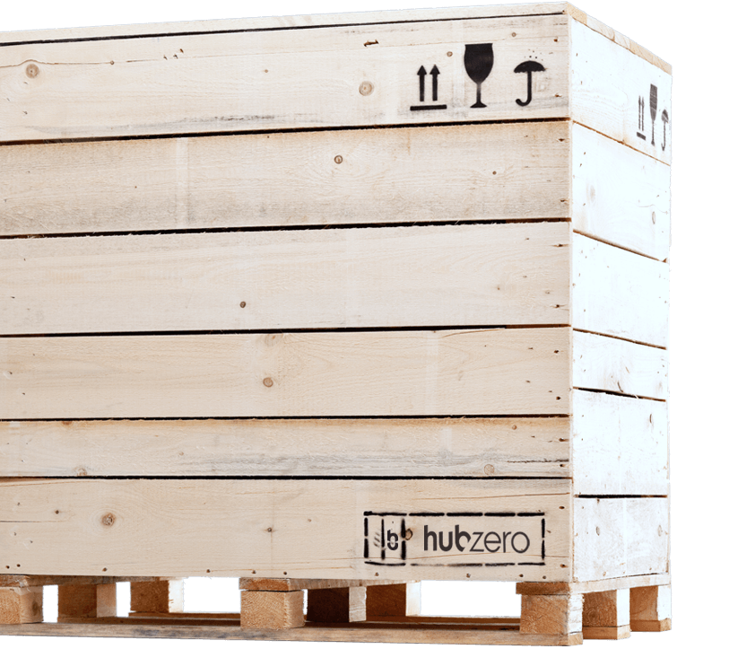
HUBzero Features
HUBzero provides a variety of components ready to be deployed on your hub in a matter of seconds.
Applications
Communities
Publications
Notes:
Now we will look at the features of a Hub.
We provide a variety of components ready to be deployed on your Hub.
We will go over the main feature sets of Communities, Publications,
and Applications.
Hubs can choose components that matter most to them and as their communities grow they can expand their features and use of them as they see fit.
Some hubs have additional features we’ve helped them develop or that they’ve developed on their own.

Slide 7
Running Applications
Every instance of HUBzero has the ability for online applications, otherwise known as Tools, to be hosted on your hub.
Linux
Jupyter Notebooks
RStudio
R Shiny Apps
Standalone Web Apps
Use-case
Notes:
Every Hub has the ability to run online applications, also known as Tools hosted on the hub and accessible through a simple web interface. These Tools can be:
Linux
Jupyter Notebooks
RStudio
R Shiny Apps
Standalone Web Apps - SocialMediaMacroscope
HUBzero is somewhat unique in that in that it can serve more research oriented needs and submit jobs to HPC resources to run more intense simulations as well as serving more educational/instructional needs where a student working in a lab can submit and get results immediately during their class.
The process starts with a member filling out a web form to register their intent to submit a tool.
The member then uploads code into a source code repository (subversion) and develops the code within a workspace.
The member can work alone or with their team to build the tool and design a graphical user interface.
With a little help from the manager's of the hub, tools can be installed and published for either a limited group of colleagues or for the entire community.

Slide 8
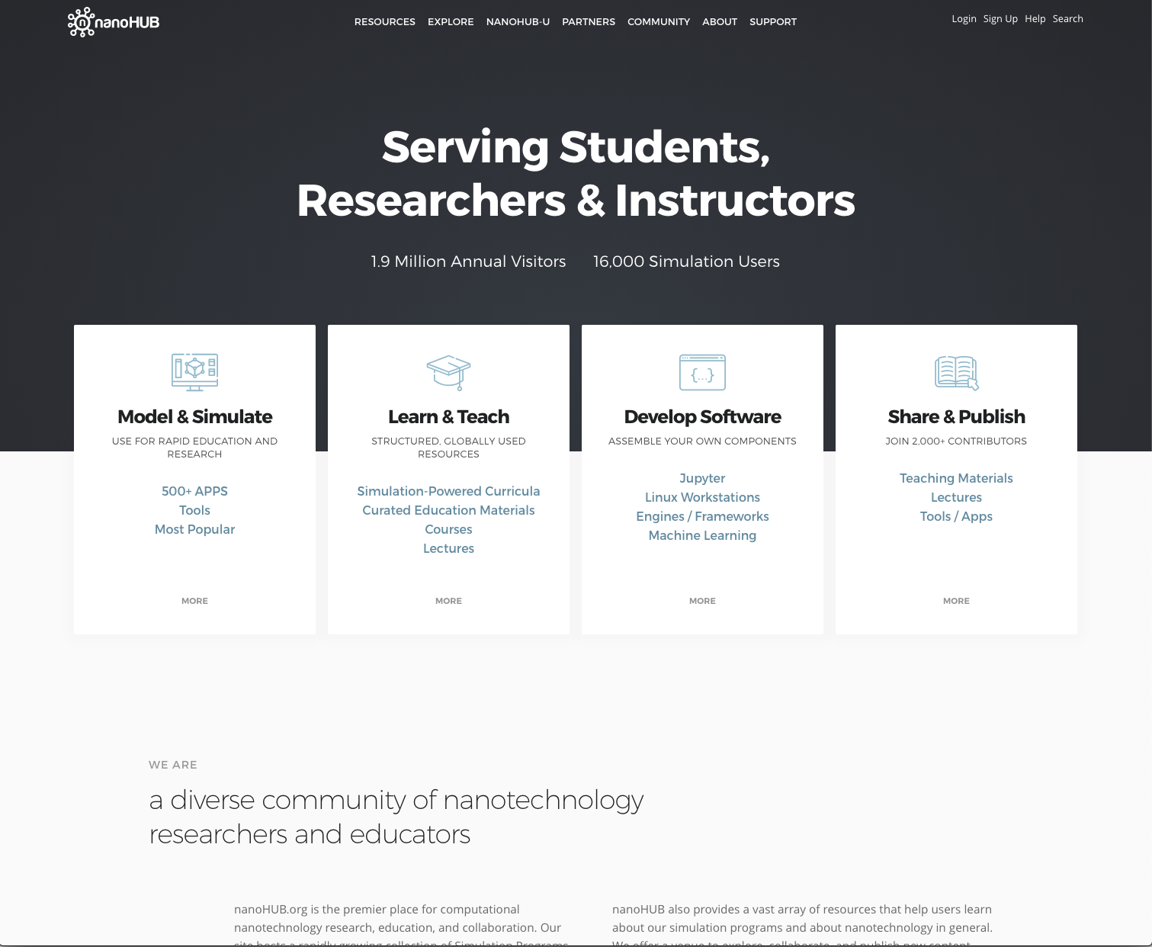
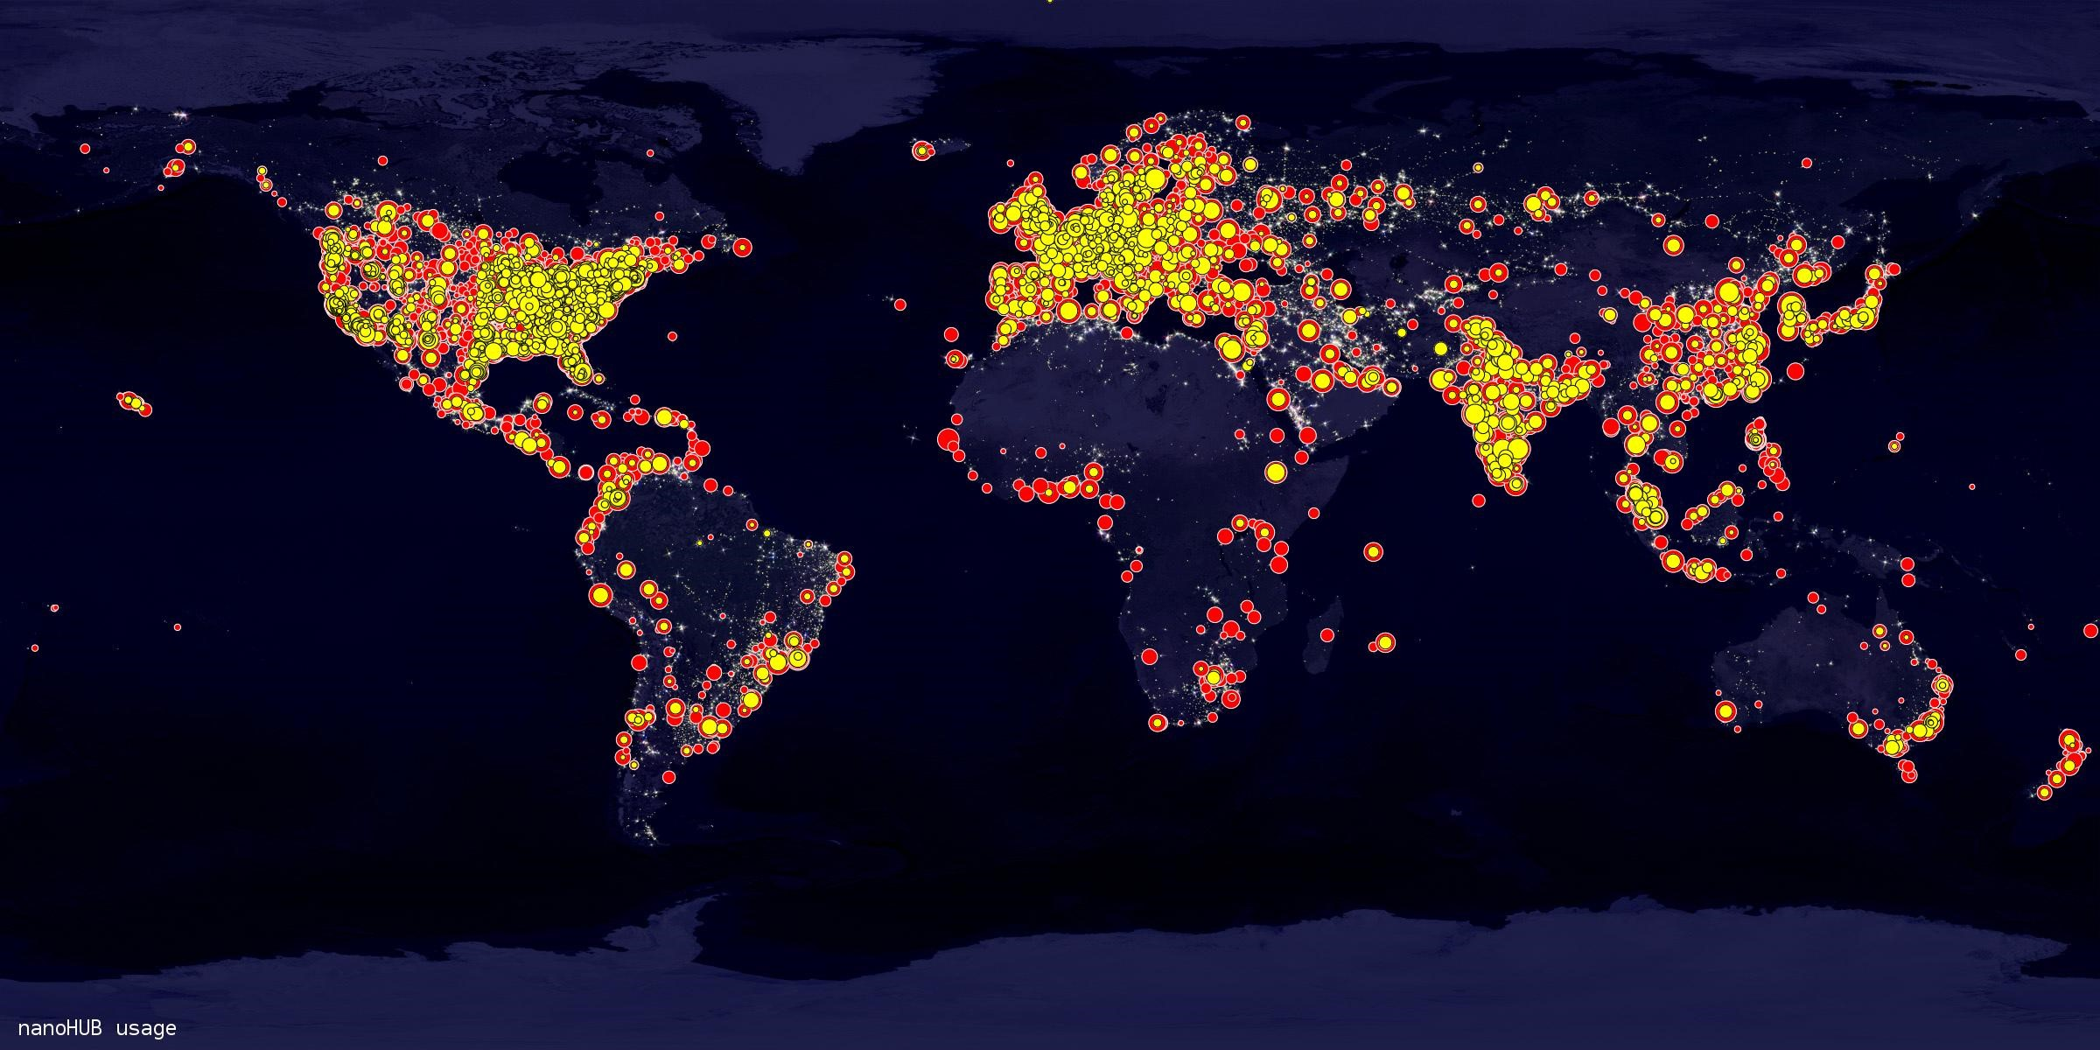
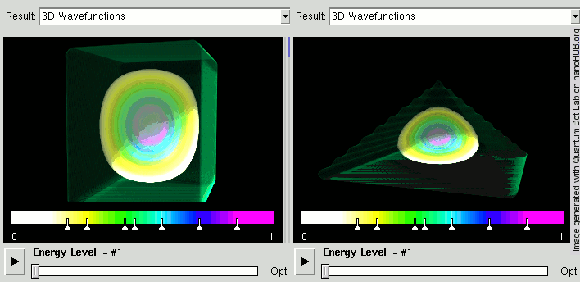
nanoHUB
https://nanohub.org/about/presskit
Notes:
nanoHUB is the granddaddy of HUBzero and started back in 2002 with the formation of the Network for Computational Nanotechnology (NCN) charged with the mission of create, deploy, and operate a national resource for theory, modeling, and simulation in nanotechnology.
nanoHUB is a place where researchers and educators meet to get real work done. 1.6M annual unique visitors and about 200K registered users. 5,000 lecture and tutorials, 110 online courses => MOOC
Most importantly, nanoHUB connects users to the simulation tools they need for research and education.
Users can access more than 600 interactive, graphical tools, and not only launch jobs, but also visualize and analyze the results within a web browser. The middleware hides much of the complexity of Grid computing, handling authentication, authorization, file transfer, and visualization, and letting the researcher focus on their work.
Sustainability - driving increase # of users: know who users are, what they’re doing, and where they are. Classify users into groups: self-study, research, students. Unify geolocation databases, analyze computing hours, improved algorithm for counting classes. By IDing these things more ways to add champions and engage these users. Research group is 1-2% of user base - primary users are for education and seeking content that is ready to use
increase products/offerings -
decrease costs/inefficiency -
Led work with BOINC( Berkeley Open Infrastructure for Network Computing) an open-source middleware system, supports volunteer and grid computing. BOINC enables researchers to tap into enormous processing resources of multiple personal computers around the world. nanoHUB partnering with this resource to run thousands of simulation jobs each month.

Slide 9
Collaborate with your Community
Communities provide space for your research teams and collaborators to discuss data concepts, track progress and share files by using the services your already know, such as Google Drive, GitHub or Dropbox.
Groups
Projects
Wiki
Collections
Use-case
Notes:
The community you will build on your Hub will provide space for your teams and collaborators
to discuss data concepts, track progress and share files by integrating with existing services such as Google Drive, GitHub, or Dropbox.
These collaboration spaces include:
Groups - have content and conversation, either privately or with the world. Each group comes with the ability to create group-specific content pages, invite and manage group membership, send announcements, publish a blog, add events through a calendar, share ideas through collections, discuss methods through forums, work on tasks through projects, share information through wikis, manage files, and much more.
Projects - Whether working on a new funding proposal, research paper or developing an application, projects are a great way to manage your data, workflow, and communication. Each project space comes with a wiki area, to-do list management, the ability to connect to Google Drive, Dropbox and other file management systems, and publishing data straight from a project space.
Wiki - Wiki pages where any contributor or a group of contributors can create new articles, and there can be multiple articles on the same wiki, each written by a different author.
Collections - A quick and easy way to share and organize information on a hub. Start with an image, link, or file you would like to share with your community. Share the collected content in a post by uploading the materials or collecting the materials from around the hub. Fellow community members can collect and follow your collections and individual posts, which allows for any updates to appear in their collection feed.
Forums
Blogs
Share info about events and announcements
Ability to customize branding for groups

Slide 10
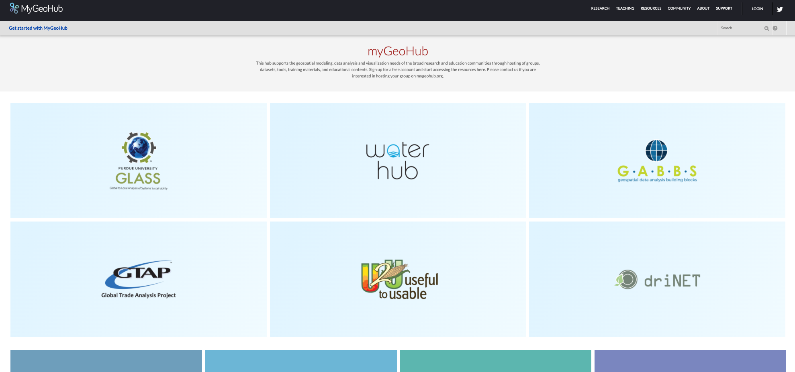
MyGeoHub
https://mygeohub.org/
Notes:
MyGeoHub is a geospatial science gateway that supports the geospatial modeling, data analysis and visualization needs of the broad research and education communities through hosting of groups, datasets, tools, training materials, and educational contents
MyGeoHub team further supports the sustainability of research, education and broader engagement projects by hosting "supergroups". These contain some former “hubs” that may have seen the end to their funding come to sustain all of their hard work. Each group is able to have its own custom branding, collaboration space, membership management, and access to backend computing resources.
MyGeoHub has a great team of experts which provides technical support and training to these groups hosted on their gateway. The team has also developed a lot of tools in the geospatial and earth sciences space.

Slide 11
Components
Collaborate
Groups
Knowledge Base
Newsletter
Collections
Blog
Forum
Events
Wiki
Projects
Courses
Citations
Tools
Resources
Publications
Data Viewer
Application
Publish

Slide 12
Integrations & Collaborations
Notes:
Here is a reference list of some of our other collaborations and integrations.

Slide 13
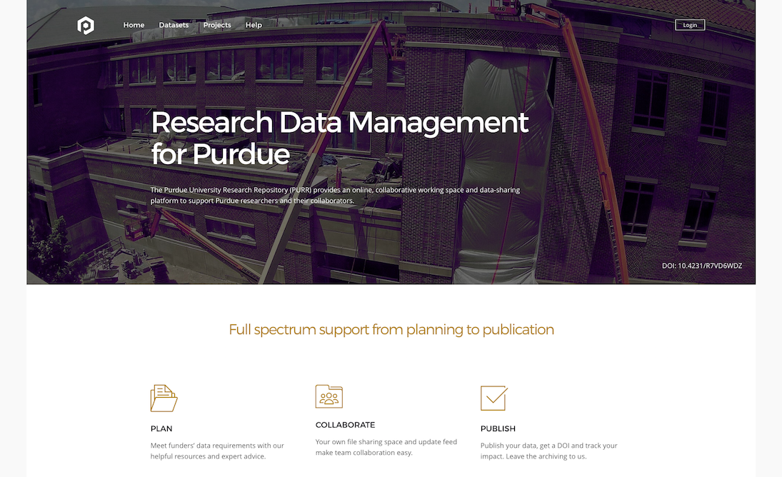
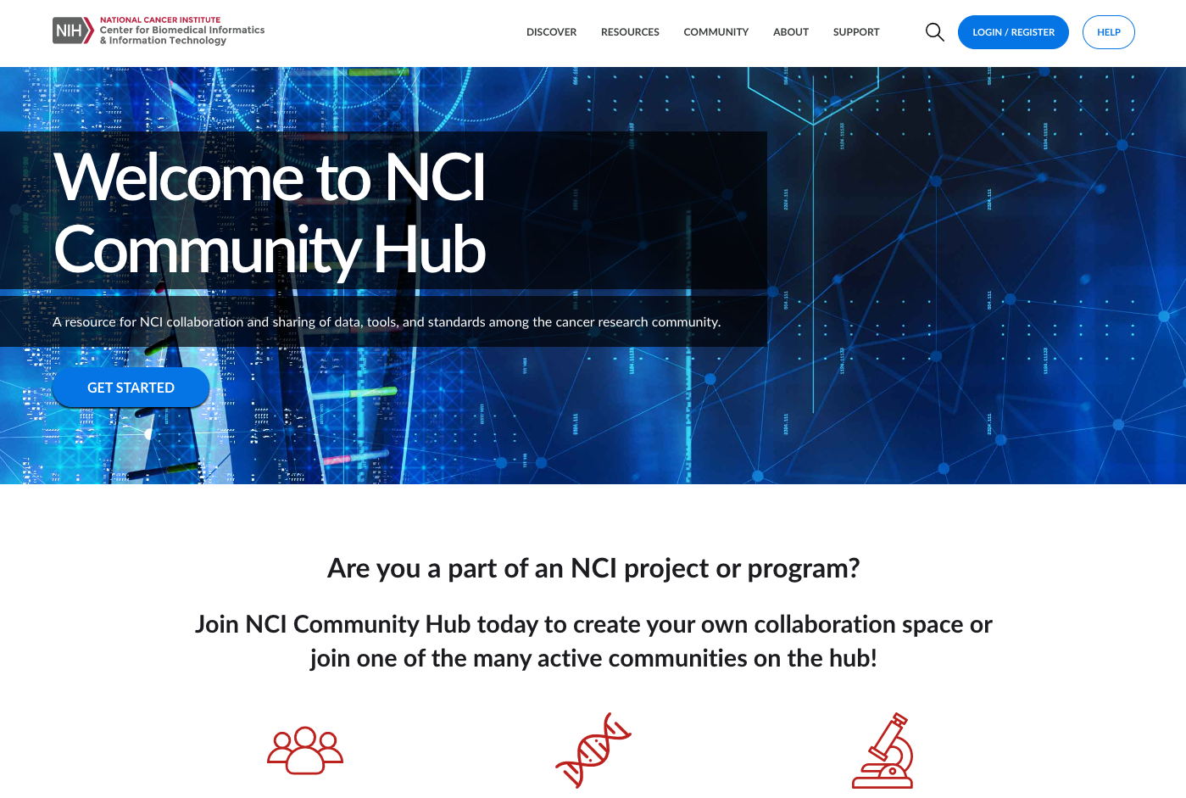
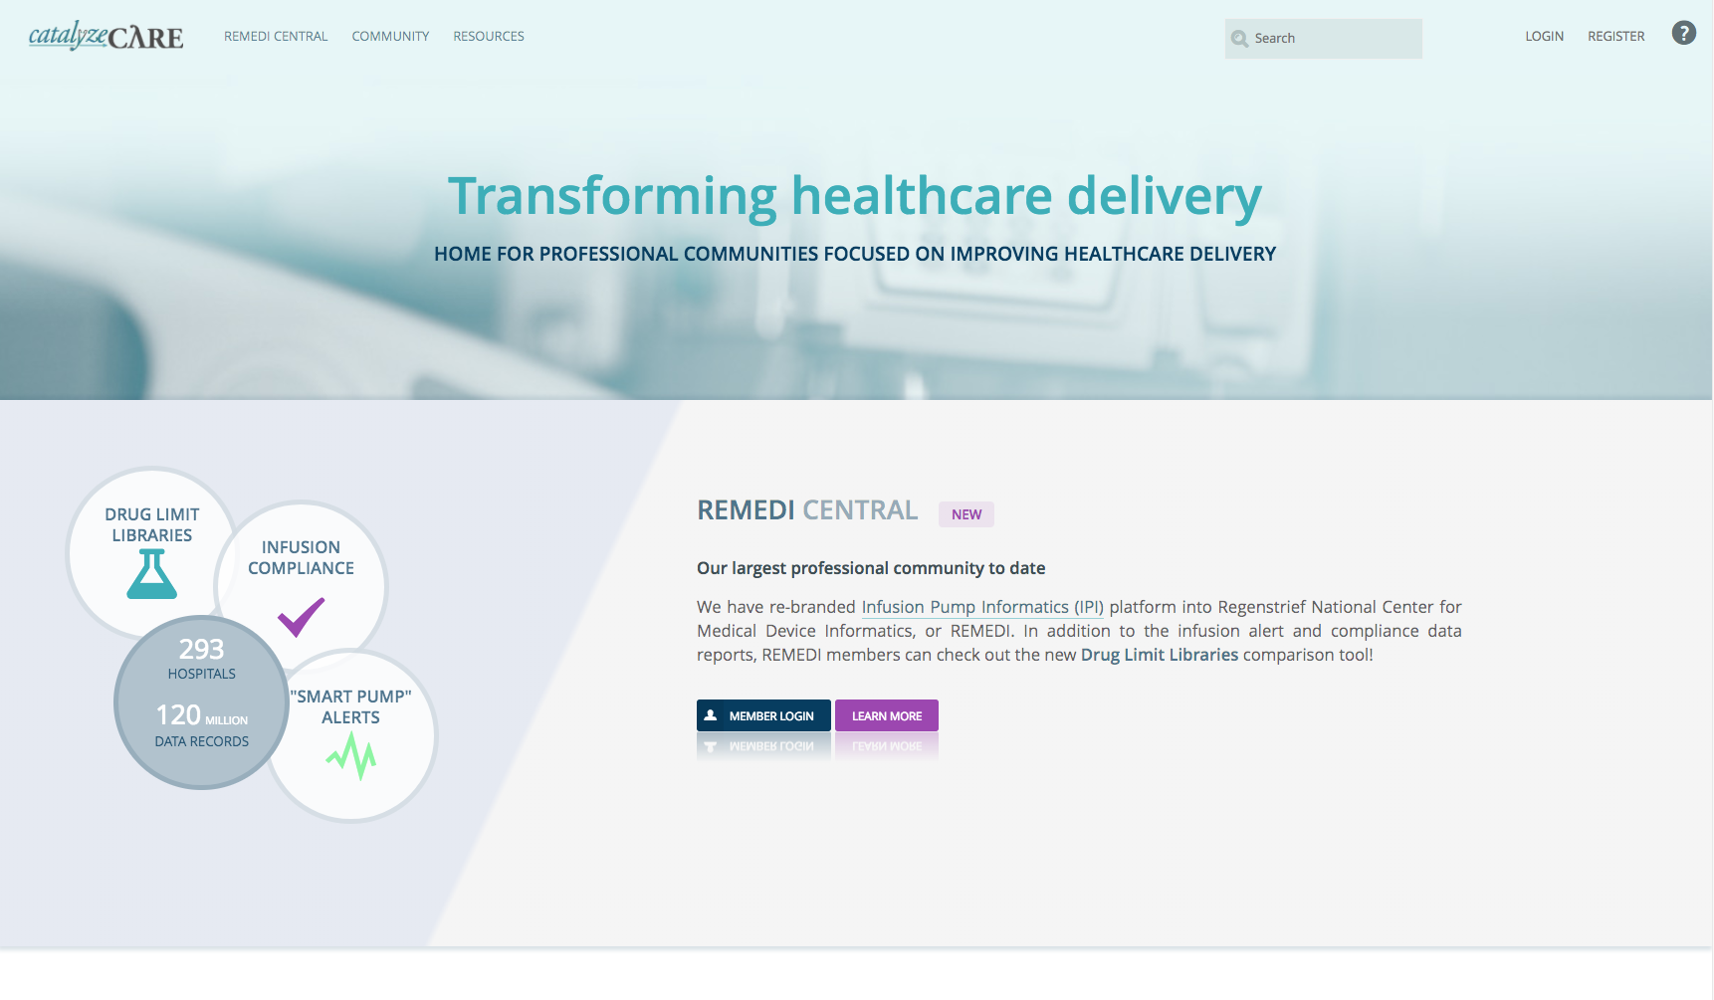
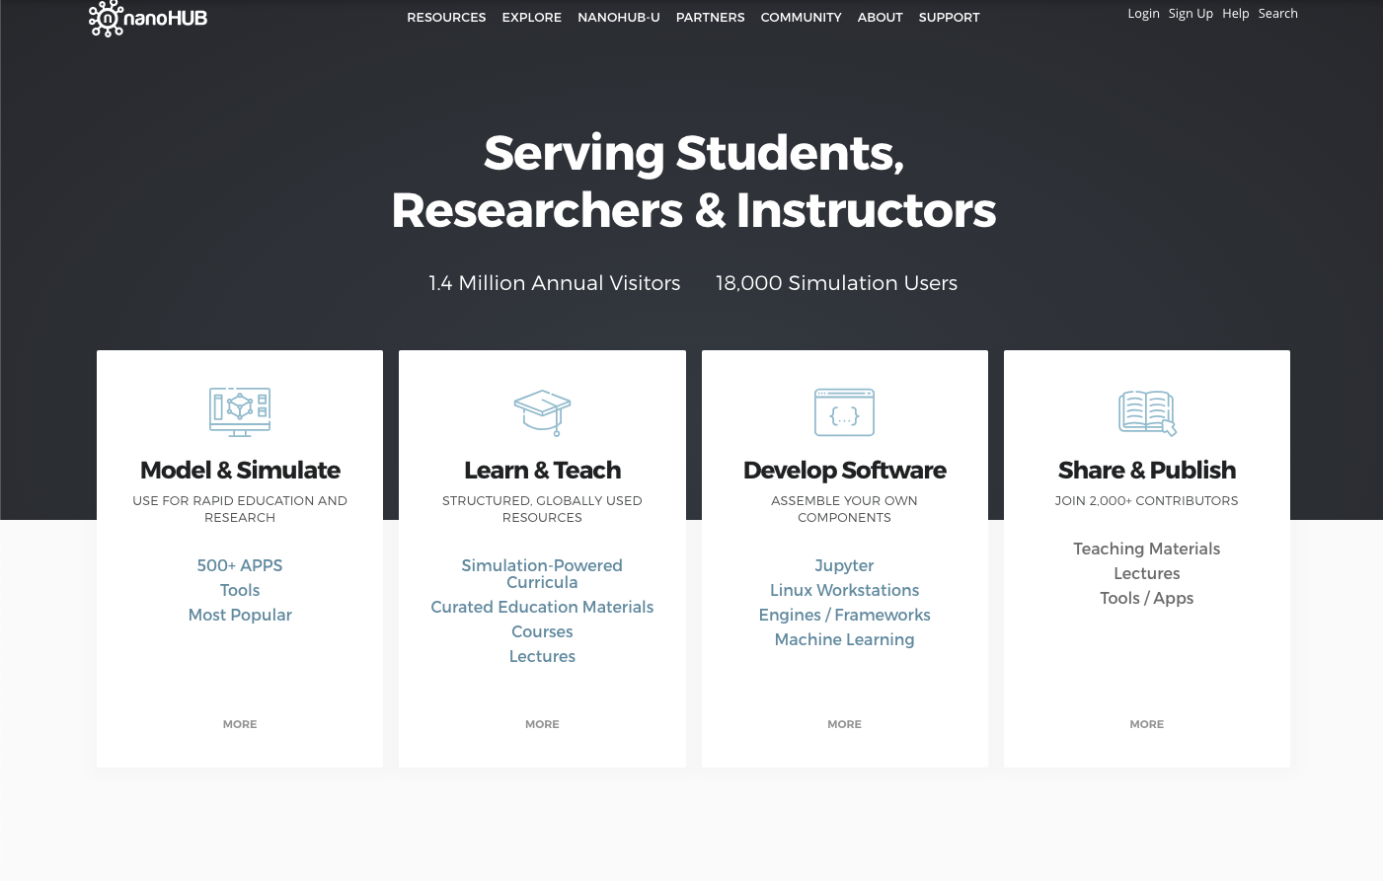
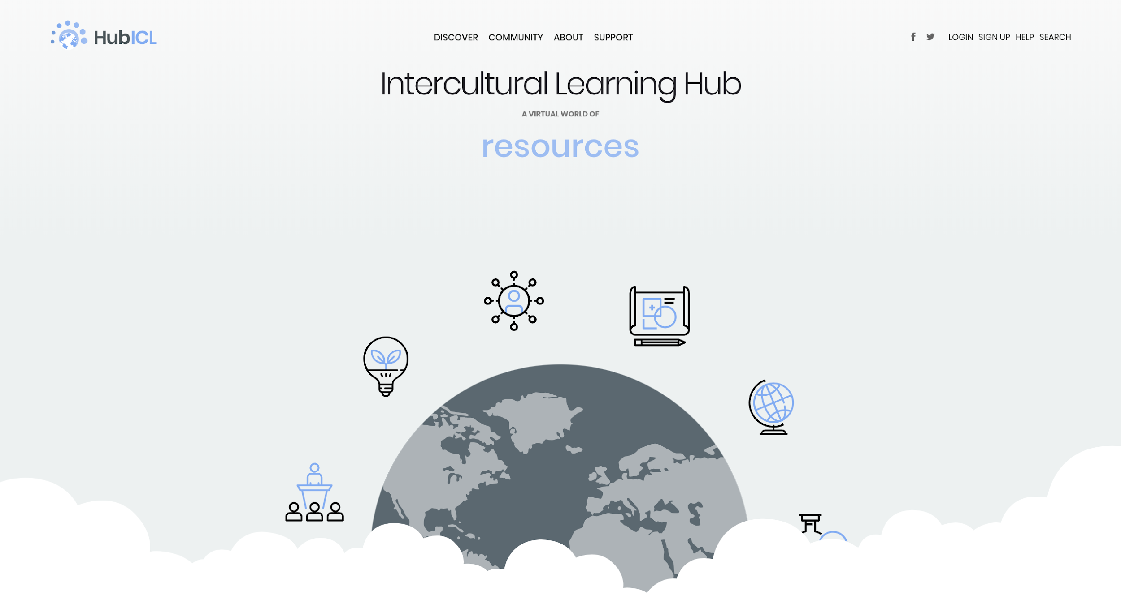
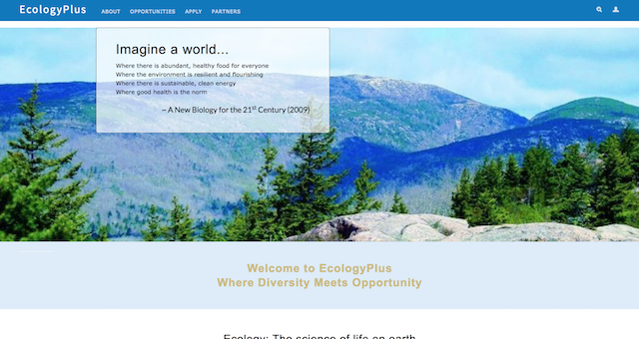
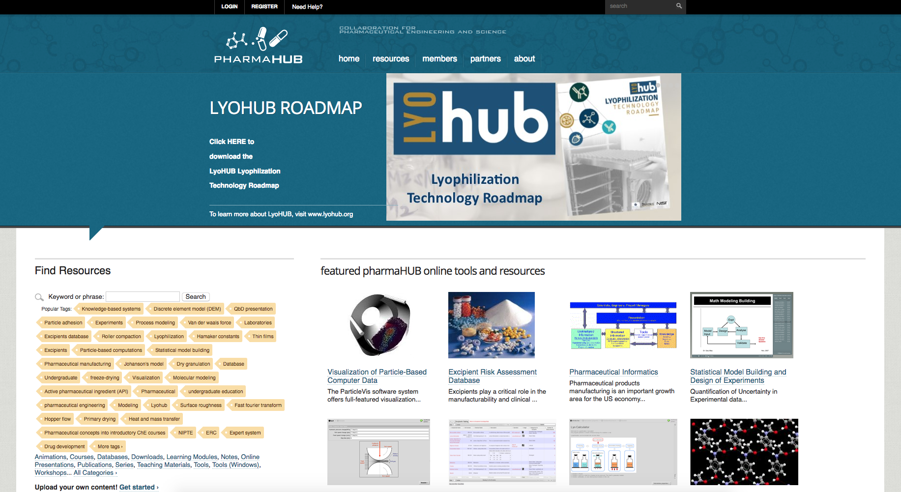
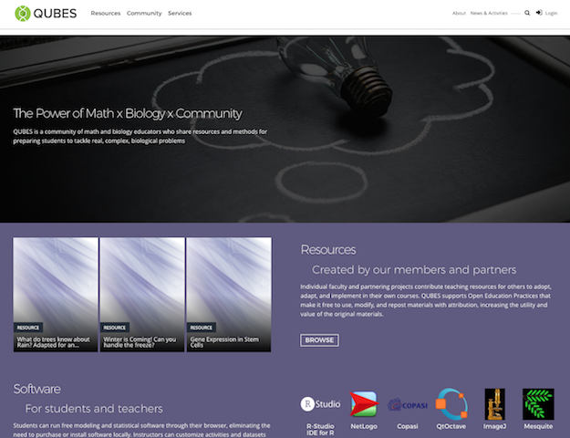
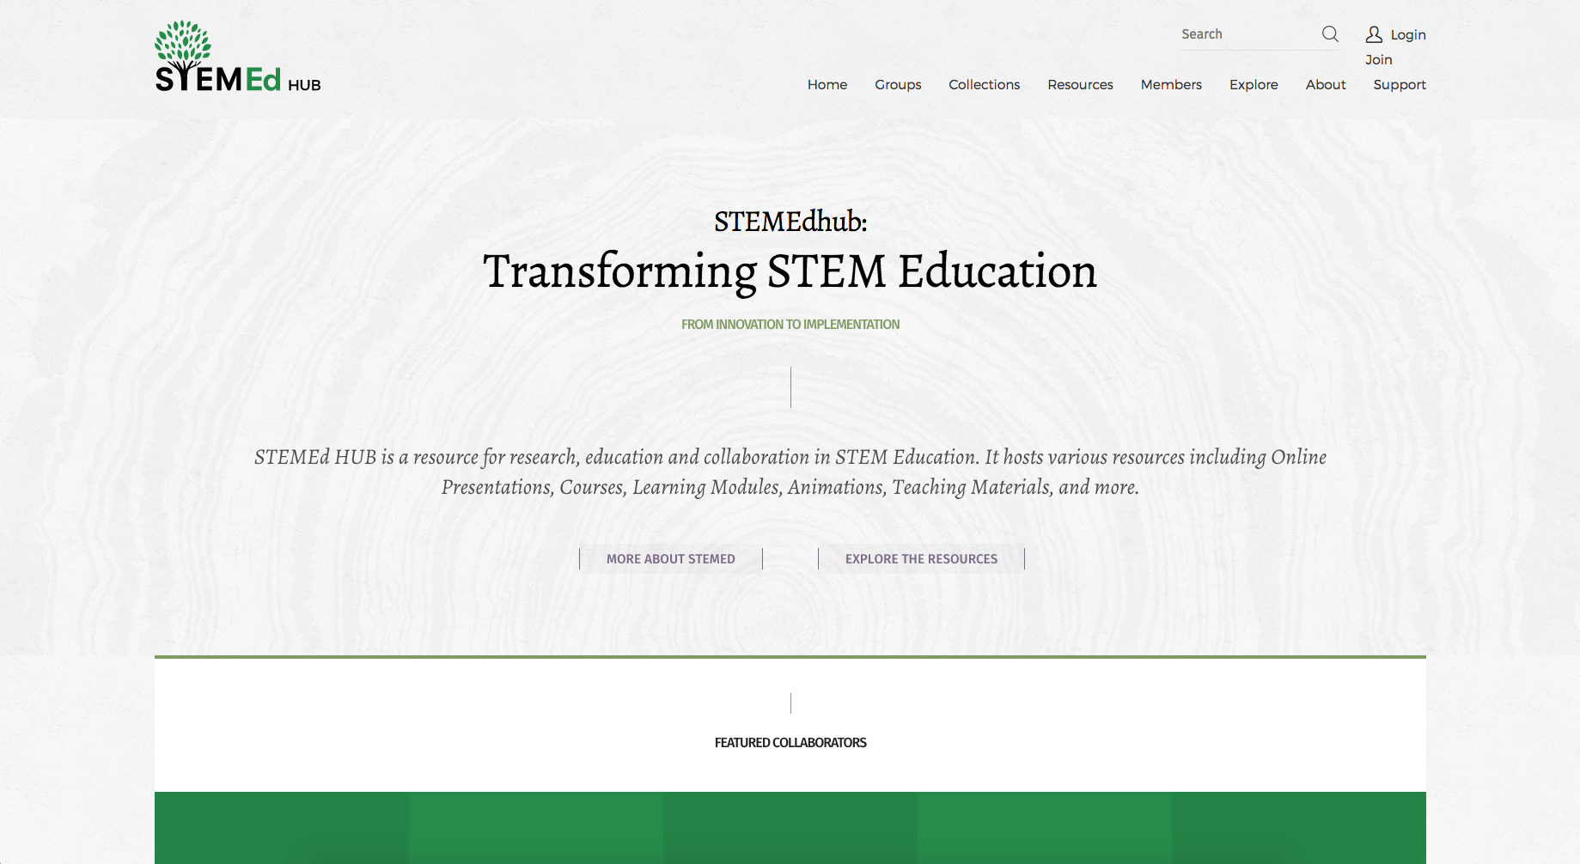
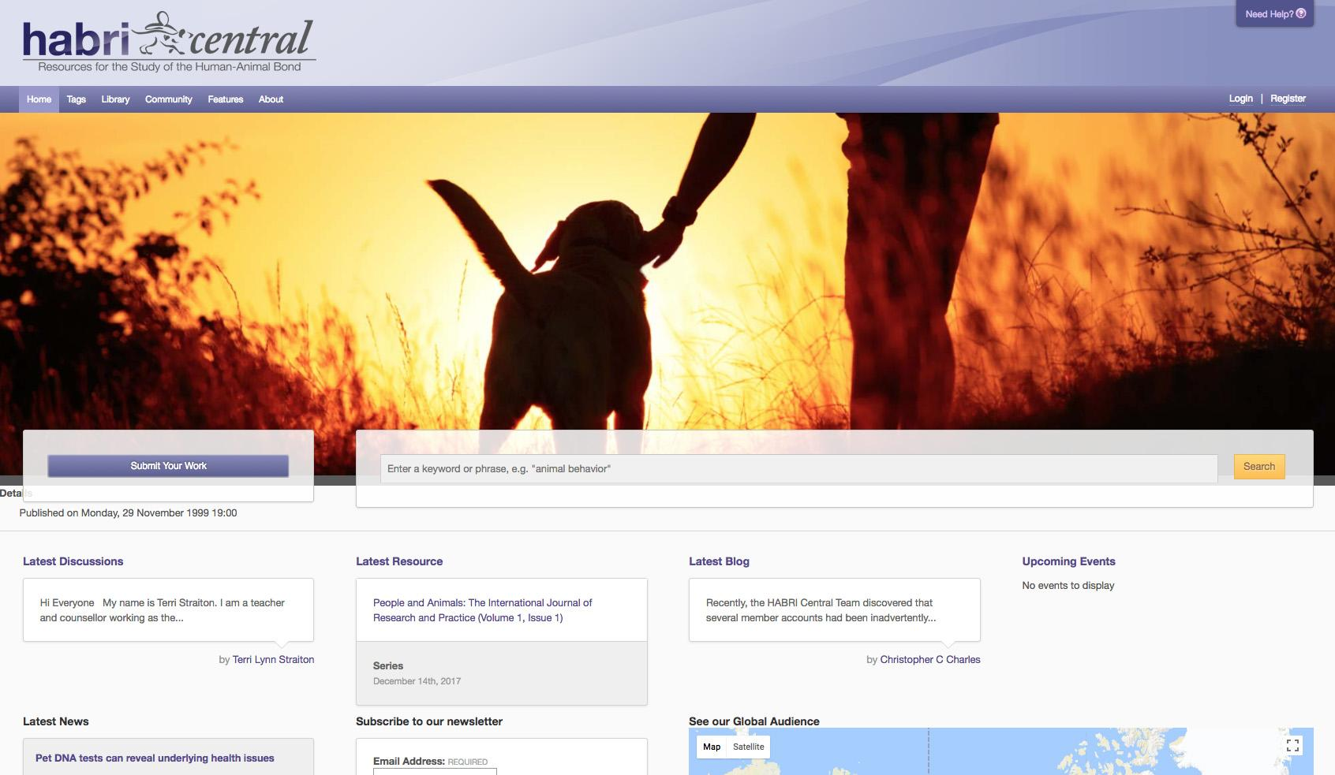
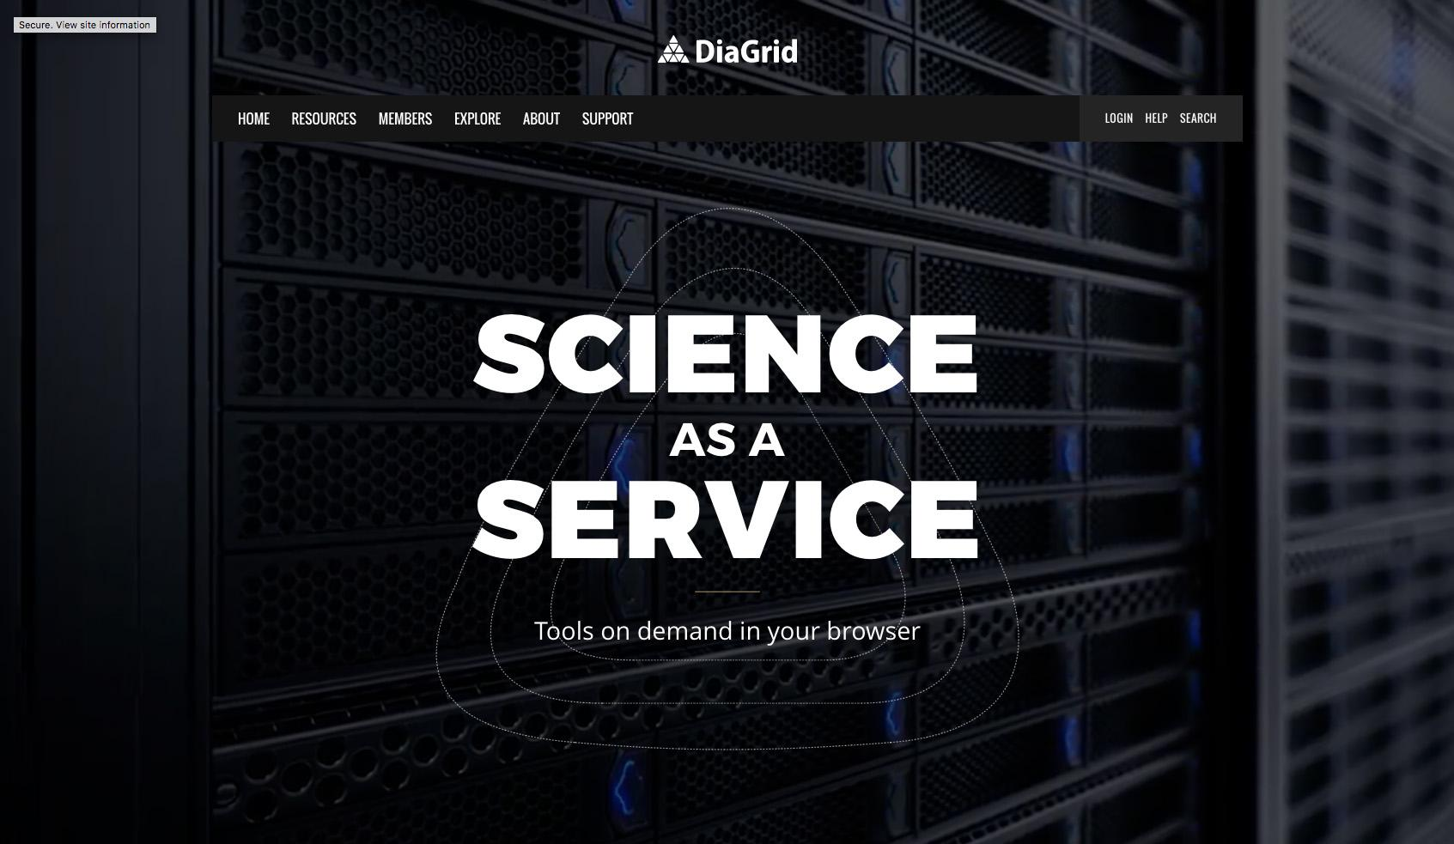
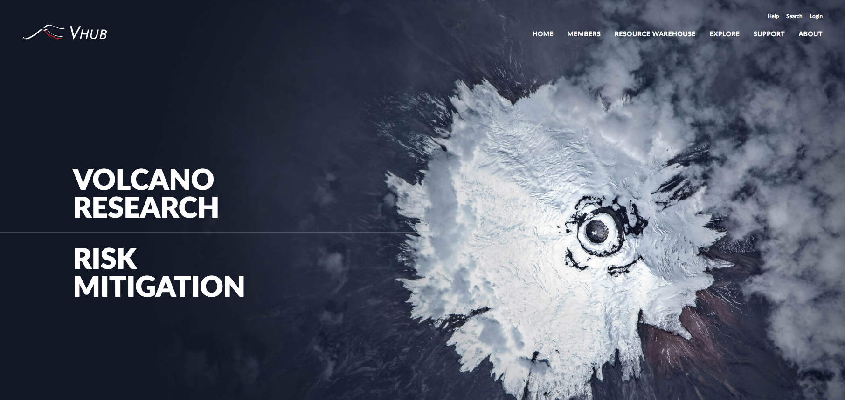
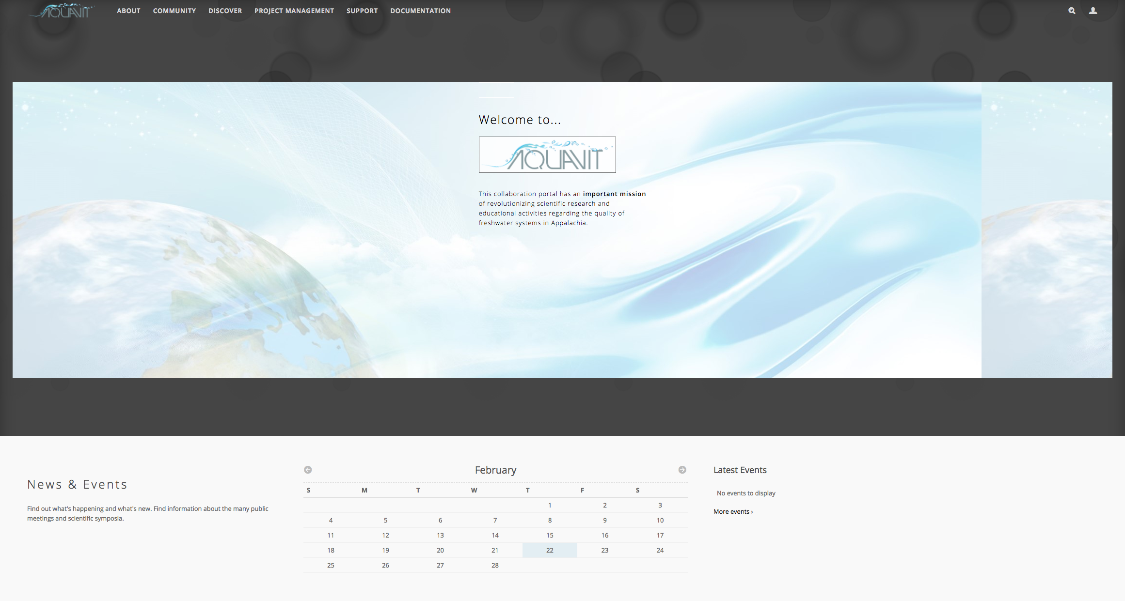
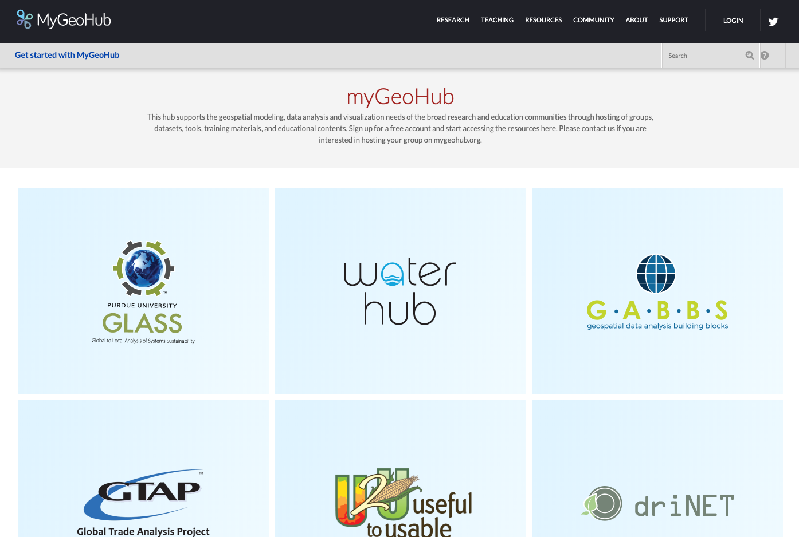
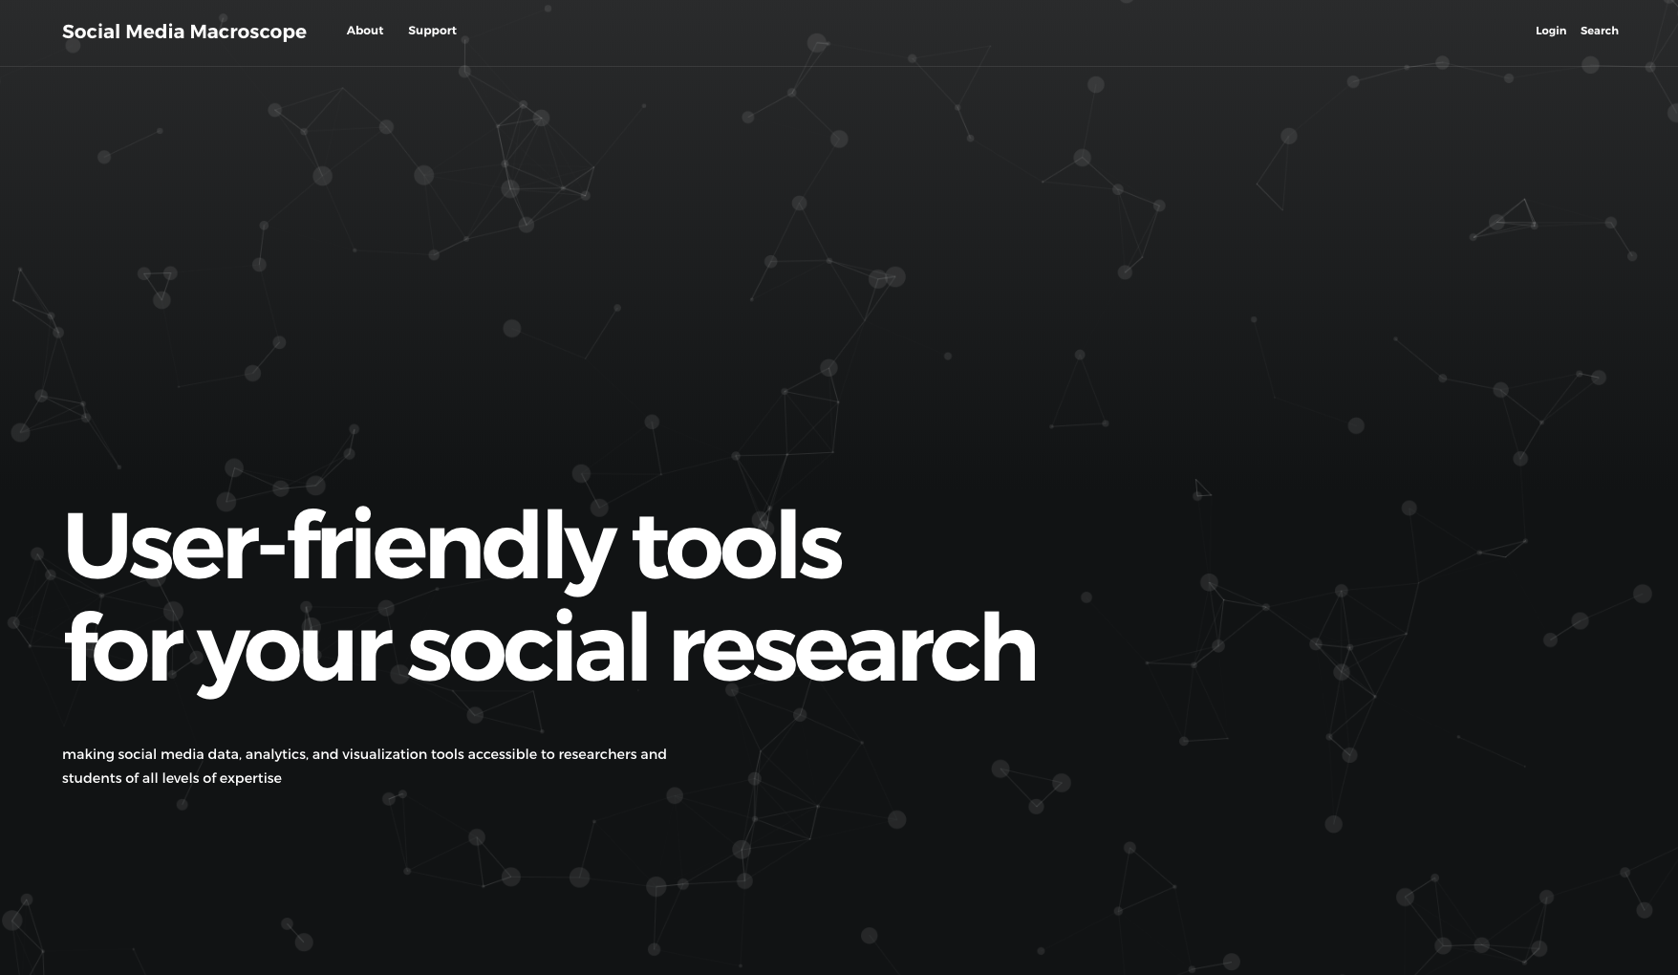
Over 60 Hubs

Slide 14
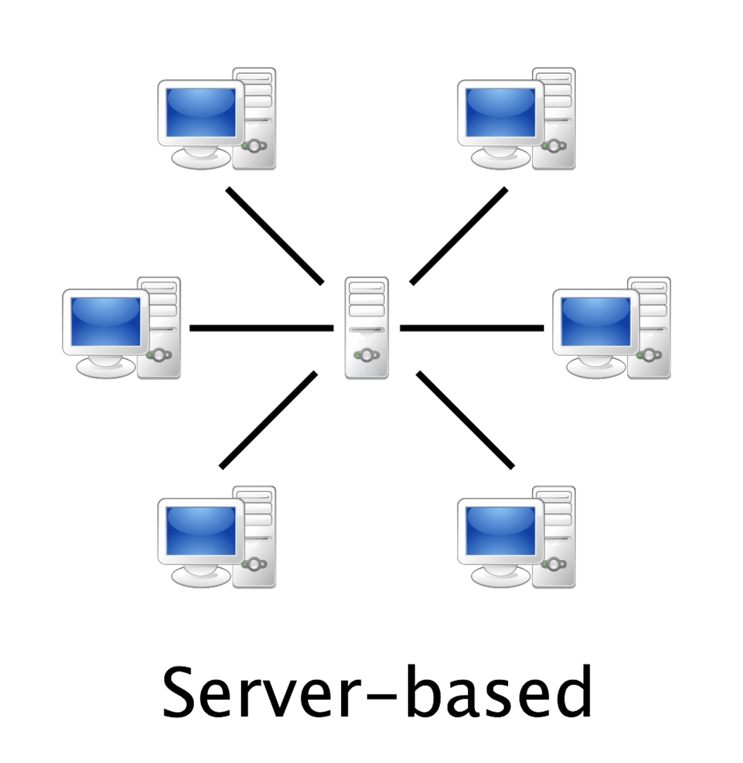
HUBzero – A Client-Server Architecture
Advantages
No installation on users’ side
Well-defined environments
Central security
Disadvantages
Dependency on server and Internet
Working on data often requires manual download/upload

Slide 15
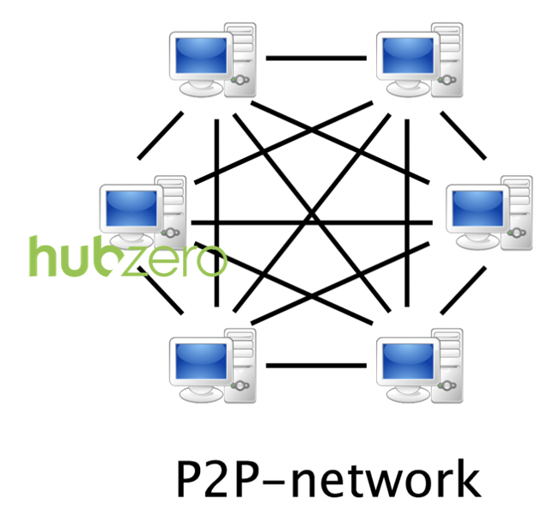
HUBzero – Hubdrive extension
Advantages
Automatic replication of data
Working on data offline
No size limit for data
Disadvantages
Desktop client installation
Security relies on clients

Slide 16
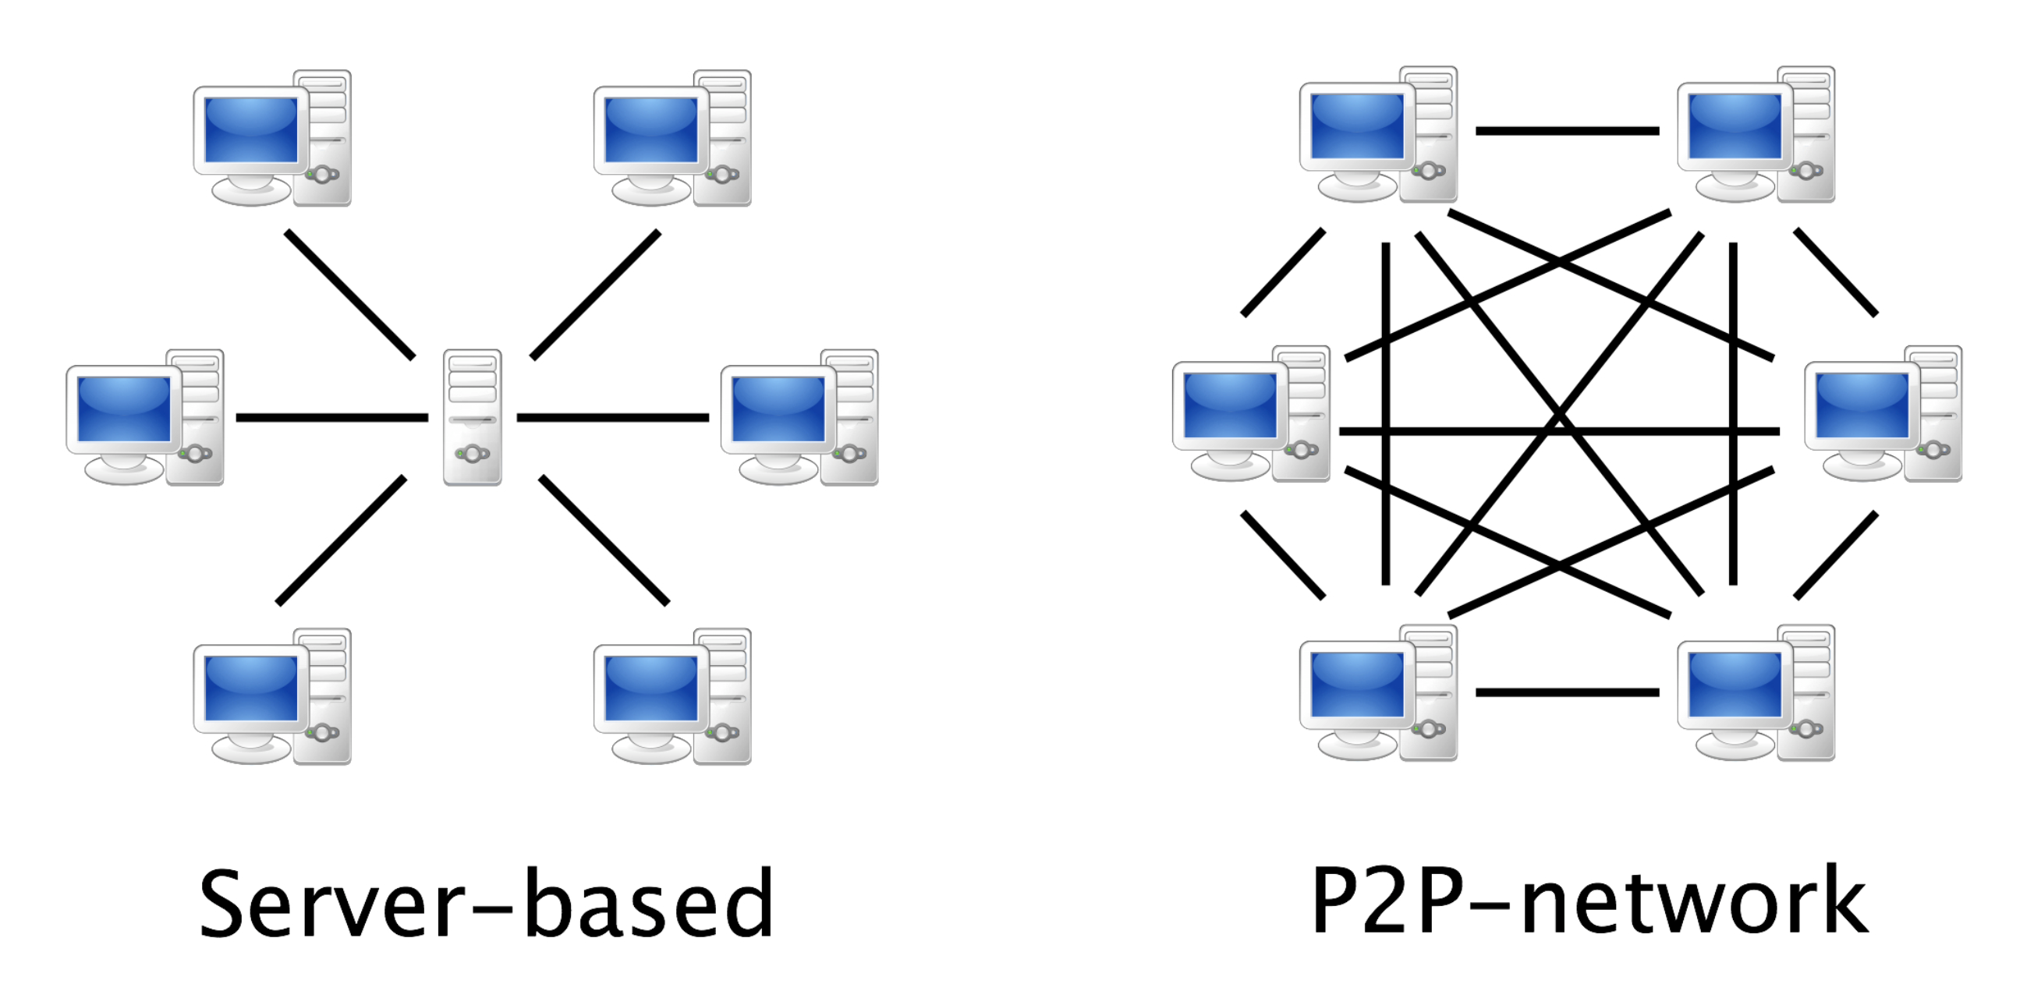
HUBzero – Hubdrive extension
Well-defined environments
Automatic replication of data
Working on data offline
No size limit for data

Slide 17
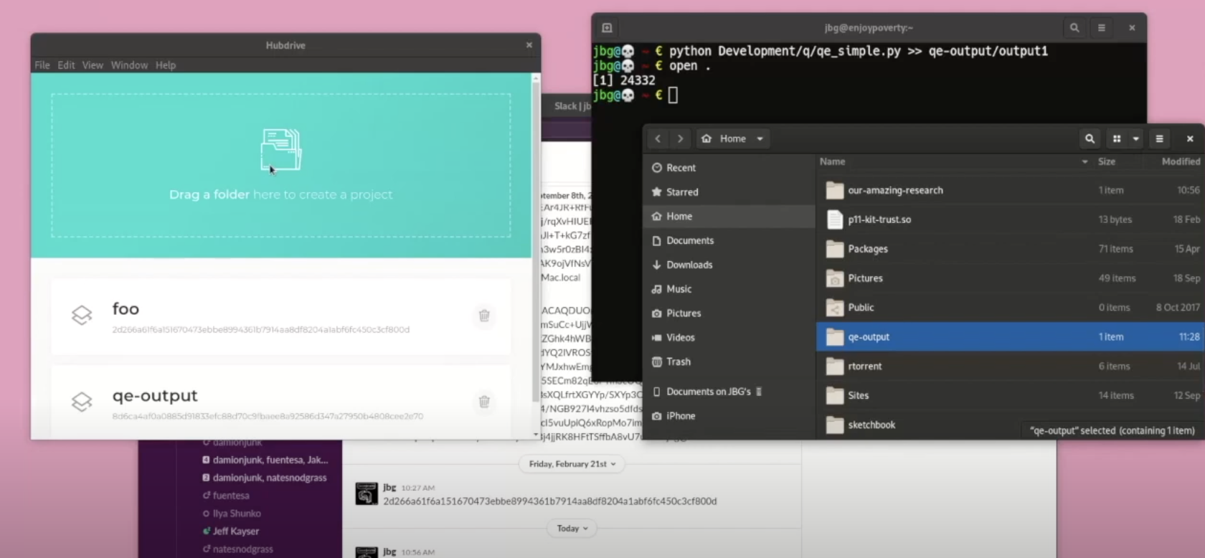
HUBzero – Hubdrive extension

Slide 18
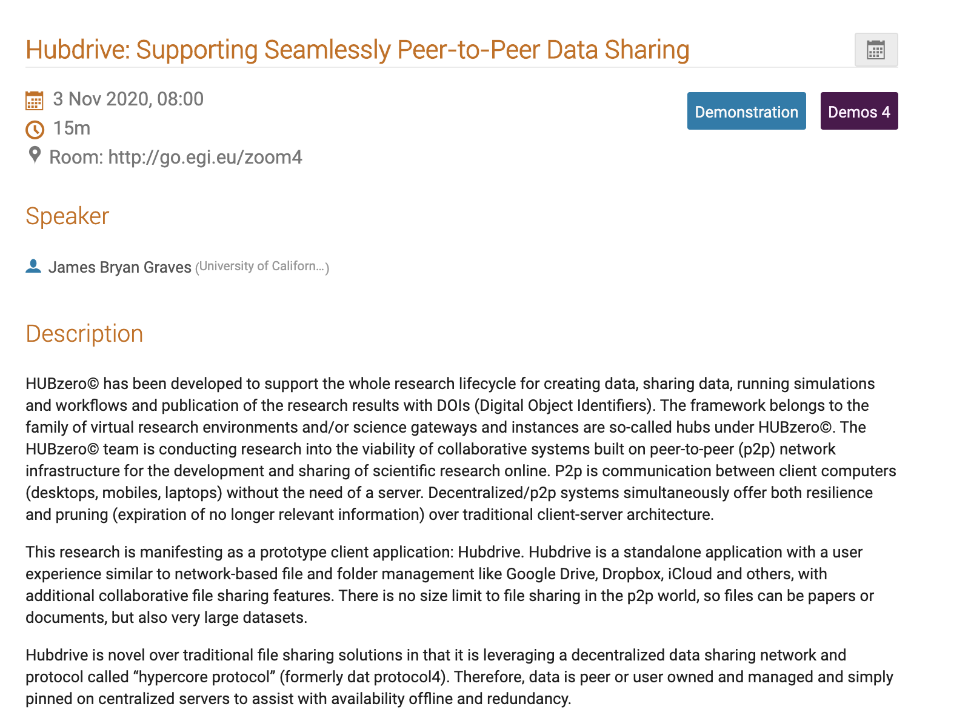
Hubdrive Demo
Thank you
Sandra.gesing@nd.edu
https://hubzero.org/

