Slide 1
Image © STFC Alan Ford
Notes:
To edit the background image, select ‘Format’ from the PowerPoint menu and ‘Slide Background’ from the drop-down menu. Within the new list of options that appears on the right of the screen, select the ‘File’ button under ‘Insert picture from’ and select your image from your file browser. Remember to delete the image credit if using your own image.

Slide 2
IRIS IAM
Federated Identity Management for IRIS
Thomas Dack
Will Furnell
Notes:
The abstract pattern can be removed or repositioned if required. Be careful to ‘Send to Back’ so that it does not obscure any important information.

Slide 3
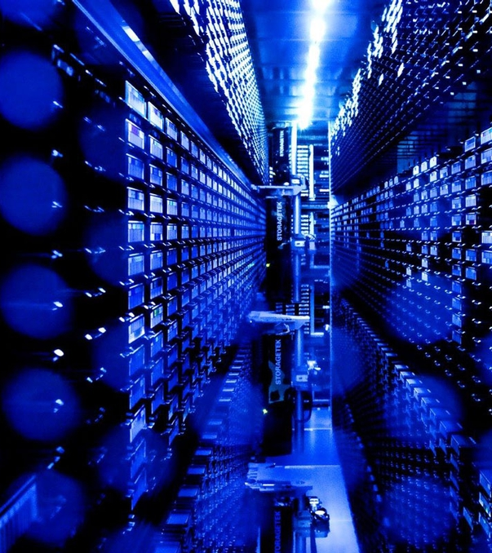
Agenda
1 Introduction to IRIS and the IRIS IAM
2 Progress and Challenges
3 Command Line Integration
4 Next Steps
Image © STFC Alan Ford
Notes:
To replace photo with one of your own. 1) Send the geometric shape overlay to the back – Right-Click > Send to Back > Send to Back. 2) Replace image – use the guides provided to correctly position it. 3) Send your image to the back so that the geometric overlay re-appears over the image. Remember to delete the image credit if using your own image.

Slide 4
But what is IRIS?
eInfrastructure for Research and Innovation for STFC
Collaboration between Science Activites and Provider Entities
Driven by the physics communities supported by UKRI STFC
A coordinating body for the provision of STFC eInfrastructure
IRIS does not run infrastructure directly
Commissions deployment of resources available to all science activities
IRIS 4x4 is a capital project coordinated by IRIS
£4 million per year for 4 years
No money for operations
Can issue grants for equipment and grants to make things
Such as the IRIS IAM
Identity management is required for IRIS resources to function as a coherent infrastructure
Notes:
STFC supports a diverse set of science activites, and many of these require substantial eInfrastructure to support them – both physical infrastructure and software.
The infrastructure is provided by several provider entities, including STFC’s own computing departments and partners such as GridPP.
But what about IRIS?
First and foremost Iris is a self-formed coordination body, bringing together these science activities and provider entities, which together are referred to as the IRIS partners.
IRIS was not mandated from above – rather formed from the bottom up by the partners as it was felt to be the sensible decision to make.
Things IRIS can do:
Coordinate approaches to physical infrastructure
Coordinate approaches to software where it makes sense to do so
Engender sharing of existing resources and expertise between members on a best efforts basis
Compile and aggregate the eInfrastructure requirements of its partners and relay this information to STFC.
IRIS also provides physical resource, through its capital funding. IRIS cannot run eInfrastructure directly, however its partners can commission the deployment of resources to be made available to all science activities. But not that IRIS is *only* able to commission the resource – IRIS has no staff effort funded and there fore no capability to provide software infrastructure – the software needed to exploit the resources IRIS can provide is the responsibility of the end user.
IRIS does have some allowance for the creation of digital assets – pieces of software built with the intention of enabling users of the National facilities to exploit data mote quickly and efficiently.

Slide 5
IRIS Partner Examples
IRIS Provider Entity examples:
STFC Scientific Computing Department
The Hartree Centre
The Ada Lovelace Centre (SLC)
DiRAC [HPC]
GridPP [HTC]
The DLS Computing Department
CCFE computing
IRIS Science Activity examples:
ALMA
ATLAS
CCFE
CLF
CMS
CTA
DLS
DUNE
eMERLIN
EUCLID
GAIA
ISIS
LHCb
LIGO
LSST
Lux-Zepelin
SKA

Slide 6
IRIS Background
Need some common elements to support these communities working together:
Policy and Trust Framework
Identity Management
Resource Accounting
Monitoring
Identity management is required for IRIS resources to function as a coherent infrastructure
Notes:
STFC supports a diverse set of science activites, and many of these require substantial eInfrastructure to support them – both physical infrastructure and software.
The infrastructure is provided by several provider entities, including STFC’s own computing departments and partners such as GridPP.
But what about IRIS?
First and foremost Iris is a self-formed coordination body, bringing together these science activities and provider entities, which together are referred to as the IRIS partners.
IRIS was not mandated from above – rather formed from the bottom up by the partners as it was felt to be the sensible decision to make.
Things IRIS can do:
Coordinate approaches to physical infrastructure
Coordinate approaches to software where it makes sense to do so
Engender sharing of existing resources and expertise between members on a best efforts basis
Compile and aggregate the eInfrastructure requirements of its partners and relay this information to STFC.
IRIS also provides physical resource, through its capital funding. IRIS cannot run eInfrastructure directly, however its partners can commission the deployment of resources to be made available to all science activities. But not that IRIS is *only* able to commission the resource – IRIS has no staff effort funded and there fore no capability to provide software infrastructure – the software needed to exploit the resources IRIS can provide is the responsibility of the end user.
IRIS does have some allowance for the creation of digital assets – pieces of software built with the intention of enabling users of the National facilities to exploit data mote quickly and efficiently.

Slide 7
The IRIS IAM
INDIGO IAM selected for use due to existing capabilities and support
Originally developed as part of the INDIGO Datacloud Horizon2020 project
For more info, see Andrea Ceccanti’s talk on Monday: https://indico.egi.eu/event/5000/contributions/14488/
Aims of the IRIS IAM:
Provide users with a consistent authentication experience across IRIS services
Provide science communities with central authorization through group management capability
Observer in AEGIS, active participant in FIM4R

Slide 8
Current Status of the IAM
Production standard service based on AARC blueprint
Primary authentication a number of IRIS services, including Accounting Portal, MISP Security Portal and OpenStack Clouds
Primary means of authorization for IRIS Users within the SCD Cloud
Small team supporting the service development and operations
Currently looking to expand effort in order to better serve community
Close liaison with IRIS Policy and Trust Framework
Ensure that the IAM follows collaboration polices and policies reflect what is possible
For more information see yesterday’s talk here
Testing IdP-of-last-resort usage with select science communities

Slide 9
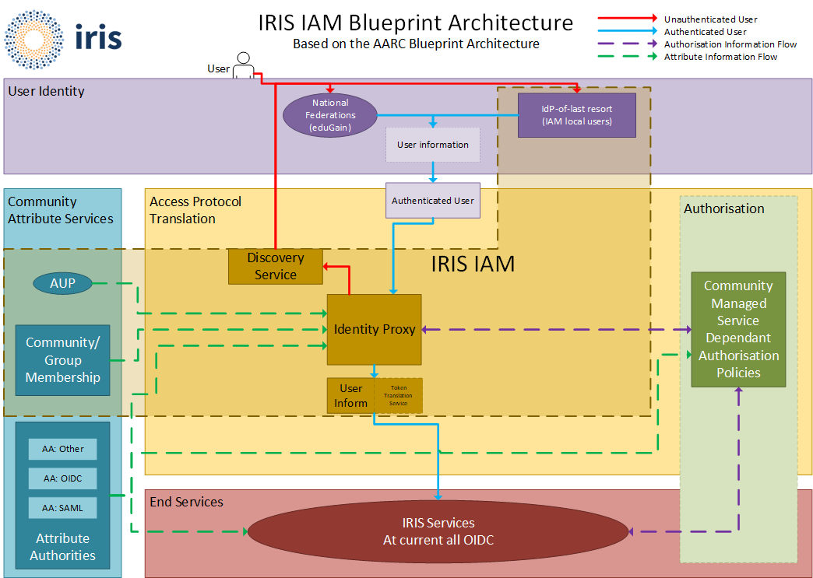
IRIS IAM: AARC Blueprint based
Federated Identities via eduGAIN
SIRTFI compliant with REFEDS status asserted
GÉANT COC compliant

Slide 10
Challenges
How to provide access to services which operate only over command line
Will will discuss next
Assurance for users who do not have an eduGAIN IdP
Using the IRIS IAM as an IdP-of-last-resort
How best to ensure registration approvals follow security policies
Community and Client Buy In
The service is in production and serves some IRIS communities
Slow uptake from others – the service is fully in operation, but challenge in getting adoption from people with existing solutions
Full delegated group management is not currently implemented
This is due to be improved in IAM 2.0

Slide 11
SSH Access
Via IRIS IAM
Will Furnell
Notes:
The abstract pattern can be removed or repositioned if required. Be careful to ‘Send to Back’ so that it does not obscure any important information.

Slide 12
SSH access via IAM
PAM Module
https://github.com/stfc/pam_oauth2_device
Fork of https://github.com/ICS-MU/pam_oauth2_device
No client side software needed
Integrates well with IRIS IAM & Openstack
No special/custom SSH server required
Not just SSH!
Notes:
STFC supports a diverse set of science activites, and many of these require substantial eInfrastructure to support them – both physical infrastructure and software.
The infrastructure is provided by several provider entities, including STFC’s own computing departments and partners such as GridPP.
But what about IRIS?
First and foremost Iris is a self-formed coordination body, bringing together these science activities and provider entities, which together are referred to as the IRIS partners.
IRIS was not mandated from above – rather formed from the bottom up by the partners as it was felt to be the sensible decision to make.
Things IRIS can do:
Coordinate approaches to physical infrastructure
Coordinate approaches to software where it makes sense to do so
Engender sharing of existing resources and expertise between members on a best efforts basis
Compile and aggregate the eInfrastructure requirements of its partners and relay this information to STFC.
IRIS also provides physical resource, through its capital funding. IRIS cannot run eInfrastructure directly, however its partners can commission the deployment of resources to be made available to all science activities. But not that IRIS is *only* able to commission the resource – IRIS has no staff effort funded and there fore no capability to provide software infrastructure – the software needed to exploit the resources IRIS can provide is the responsibility of the end user.
IRIS does have some allowance for the creation of digital assets – pieces of software built with the intention of enabling users of the National facilities to exploit data mote quickly and efficiently.

Slide 13
SSH access via IAM
Demo video

Slide 14
SSH access via IAM
Other options considered, but…
Moonshot
Needs client software, which is no longer supported on Windows
All institutions need to deploy a RADIUS server with Moonshot support
Vault
Needs client software (which does work on Windows)
More management involved (just IAM UI is better for us)

Slide 15
Next Steps
Integration of more IRIS services and communities
Including particular focus on Command Line services
This includes services such as RUCIO, Dynafed, and DiRAC [HPC]
Adoption of FITSM
Service is operating fine, but adoption of FITSM would help with sustainability
Adoption and Migration of INDIGO IAM 2.0 when available
Improved multi-tenancy support
Notes:
STFC supports a diverse set of science activites, and many of these require substantial eInfrastructure to support them – both physical infrastructure and software.
The infrastructure is provided by several provider entities, including STFC’s own computing departments and partners such as GridPP.
But what about IRIS?
First and foremost Iris is a self-formed coordination body, bringing together these science activities and provider entities, which together are referred to as the IRIS partners.
IRIS was not mandated from above – rather formed from the bottom up by the partners as it was felt to be the sensible decision to make.
Things IRIS can do:
Coordinate approaches to physical infrastructure
Coordinate approaches to software where it makes sense to do so
Engender sharing of existing resources and expertise between members on a best efforts basis
Compile and aggregate the eInfrastructure requirements of its partners and relay this information to STFC.
IRIS also provides physical resource, through its capital funding. IRIS cannot run eInfrastructure directly, however its partners can commission the deployment of resources to be made available to all science activities. But not that IRIS is *only* able to commission the resource – IRIS has no staff effort funded and there fore no capability to provide software infrastructure – the software needed to exploit the resources IRIS can provide is the responsibility of the end user.
IRIS does have some allowance for the creation of digital assets – pieces of software built with the intention of enabling users of the National facilities to exploit data mote quickly and efficiently.

Slide 16
INDIGO IAM Users Workshop
https://indico.cern.ch/event/970568
January 27th - 28th 2021 with provisional times of 14:00 - 17:00 (UTC) each day (depending on number of talks, and scheduling)
The aim of this workshop is to facilitate user led discussion around best practice, administration and deployment experience between the different communities who utilise the INDIGO IAM Authentication and Authorization service.

Slide 17
Notes:
The abstract pattern can be removed or repositioned if required. Be careful to ‘Send to Back’ so that it does not obscure any important information.

Slide 18
Science and Technology Facilities Council
@STFC_matters
Science and Technology Facilities Council
Notes:
The abstract pattern can be removed or repositioned if required. Be careful to ‘Send to Back’ so that it does not obscure any important information.

