Slide 1
Cell as a Service (CaaS):
Seamlessly scale Jupyter experiments
Spiros Koulouzis, Yuandou Wang, Andrea Manzi, Daniel Kissling, Zhiming Zhao
LifeWatch ERIC: vLab&Innovation Center
University of Amsterdam: Multiscale Networked Systems, Biogeography & Macroecology (BIOMAC) lab
EGI
EGI Conference 2020
2-5 November 2020

Slide 2
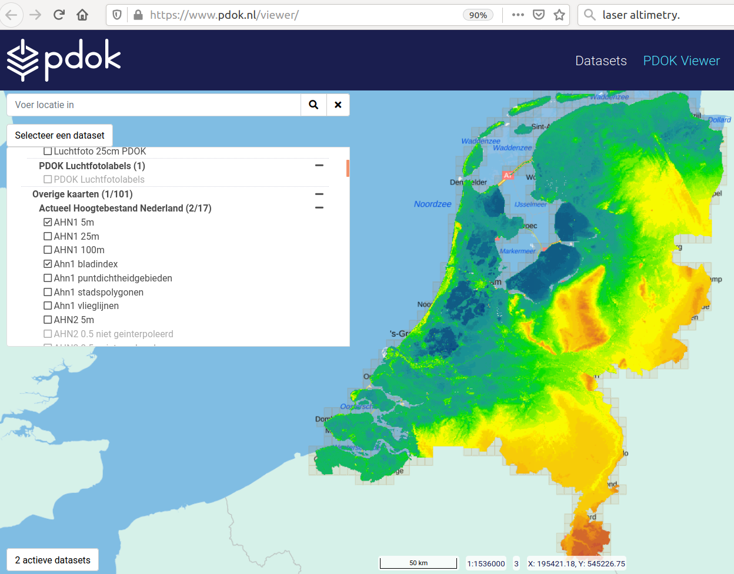
laser altimetry

Slide 3
Environmental Science Research Context
To investigate why animal populations decline, and how they respond to habitat fragmentation and land use change, the Biogeography & Macroecology (BIOMAC) lab (UvA research group) need to apply species distribution models
An important task in this research is to be able to identify habitat types e.g. forests or marshlands
This is achieved by using high-resolution Light Detection and Ranging (LiDAR) datasets and machine learning algorithms to perform object classification
PDOK (government platform for geodata) has collected large LiDAR datasets that will be analyzed
laser altimetry

Slide 4
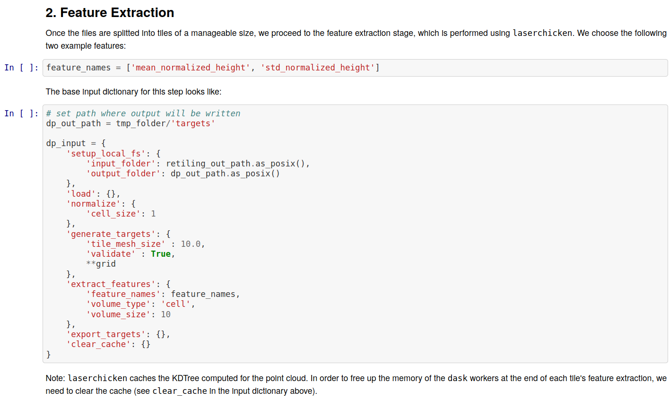
Scientific Code Prototyping
As many researchers, BIOMAC uses Jupyter notebooks to prototype classifiers using a Python library called Laserchicken
To scale experiments with large data volumes on Cloud infrastructures Jupyter cells need to be encapsulated as services

Slide 5
From Jupiter Cells to Web Services
We need to bridge the gap between prototyping and deployment of sceitifc code
Thus improving the code’s findability, accessibility, interoperability, and reusability (FAIR)

Slide 6
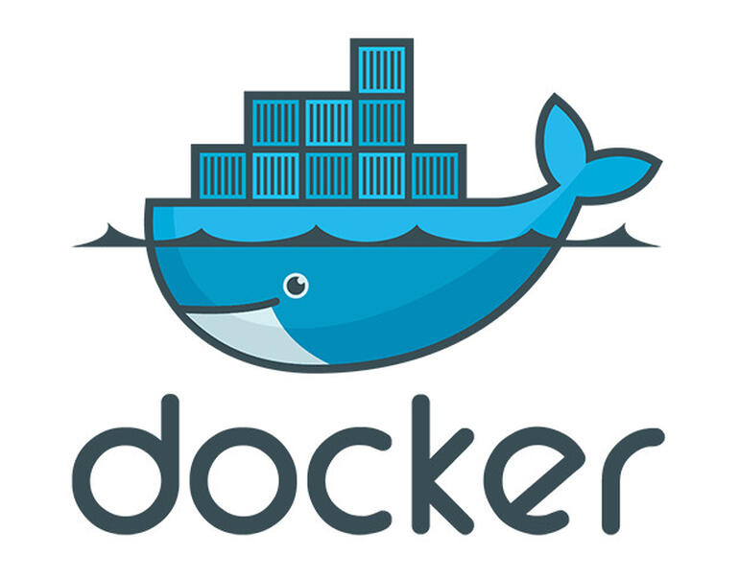
From Jupiter Cells to Web services
FAIR-Cells is a Jupyter Notebook extension that allows users to interactively encapsulate a Jupyter cell as RESTful service wrapped as a Dockerfile
FAIRCells
1

Slide 7
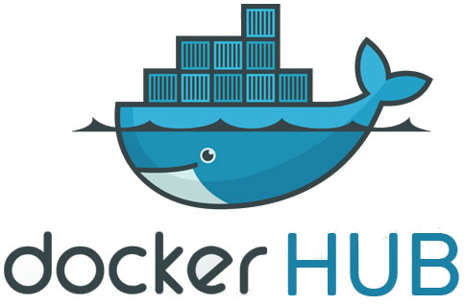
From Jupiter Cells to Web Services
FAIR-Cells can push the docker image to a public or private docker repository
FAIRCells
2

Slide 8
Deploying Cells on the Cloud as Web services
Cloud-Cells is a complementary extension that allows the deployment of docker images on the Cloud
FAIRCells
CloudCells

Slide 9
Deploying Cells on the Cloud as Web services
Cloud-Cells generates a TOSCA description
Topology and Orchestration Specification for Cloud Applications (TOSCA), is a standard to describe a topology of cloud based services, their components, relationships, and the processes that manage them.
FAIRCells
CloudCells
4

Slide 10
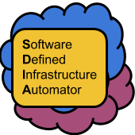
Deploying Cells on the Cloud as Web services
Cloud-Cells uses SDIA to deploy the Jupyter cells on the Cloud
The Software Defined Infrastructure Automator (SDIA) is a framework for planning, provisioning and deployment of applications on multi-cloud environments
FAIRCells
CloudCells
5

Slide 11
Deploying Cells on the Cloud as Web services
SDIA will analyze the application and plan for the size and type of the virtual infrastructure
SDIA contacts the cloud provider to provision the necessary virtual infrastructure that will host the docker orchestration (Kubernetes)
FAIRCells
CloudCells
6

Slide 12
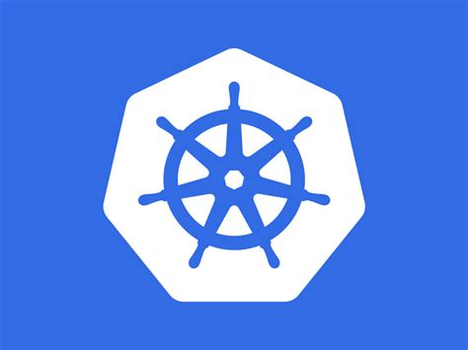
Deploying Cells on the Cloud as Web services
As a next step SDIA will deploy kubernetes
On top of kubernetes SDIA will deploy the Jupyter cells that have been encapsulated as web services
FAIRCells
CloudCells
7

Slide 13
Deploying Cells on the Cloud as Web services
The new web service can be optimally placed near the data that needs to consume
FAIR-Cells, Cloud-Cells and SDIA can seamlessly scale Jupyter experiments providing a Cell as a Service (CaaS)
FAIRCells
CloudCells
8

Slide 14
Software Links & Acknowledgment
Live Demo: https://51.68.85.143
Token:
FAIR-Cells:
https://github.com/QCDIS/FAIRCells
https://pypi.org/project/FAIR-Cells/
https://hub.docker.com/r/qcdis/fair-cells
Cloud-Cells:
https://github.com/QCDIS/Cloud-Cells
https://pypi.org/project/Cloud-Cells/
https://hub.docker.com/r/qcdis/cloud-cells
SDIA:
https://github.com/qcdis-sdia/
Acknowledgments:
EGI
Articonf
ENVRI FAIR
LifeWatch
EOSC-Early Adopter Program
BlueCloud
CLARIFY

