Slide 1
Using the EGI infrastructure for REPROLANG2020
Reproducibility in the context of Natural Language Processing
Dieter Van Uytvanck, André Moreira, Willem Elbers
EGI Conference, 2 November 2020
Virtual Meeting

Slide 2
CLARIN in eight bullets
CLARIN is the Common Language Resources and Technology Infrastructure
ESFRI ERIC status since 2012, Landmark since 2016
that provides easy and sustainable access for scholars in the humanities and social sciences and beyond
to digital language data (in written, spoken, video or multimodal form)
and advanced tools to discover, explore, exploit, annotate, analyse or combine them, wherever they are located
through a single sign-on environment
that serves as an ecosystem for knowledge sharing
and: ready for integration in EOSC (European Open Science Cloud; link)

Slide 3
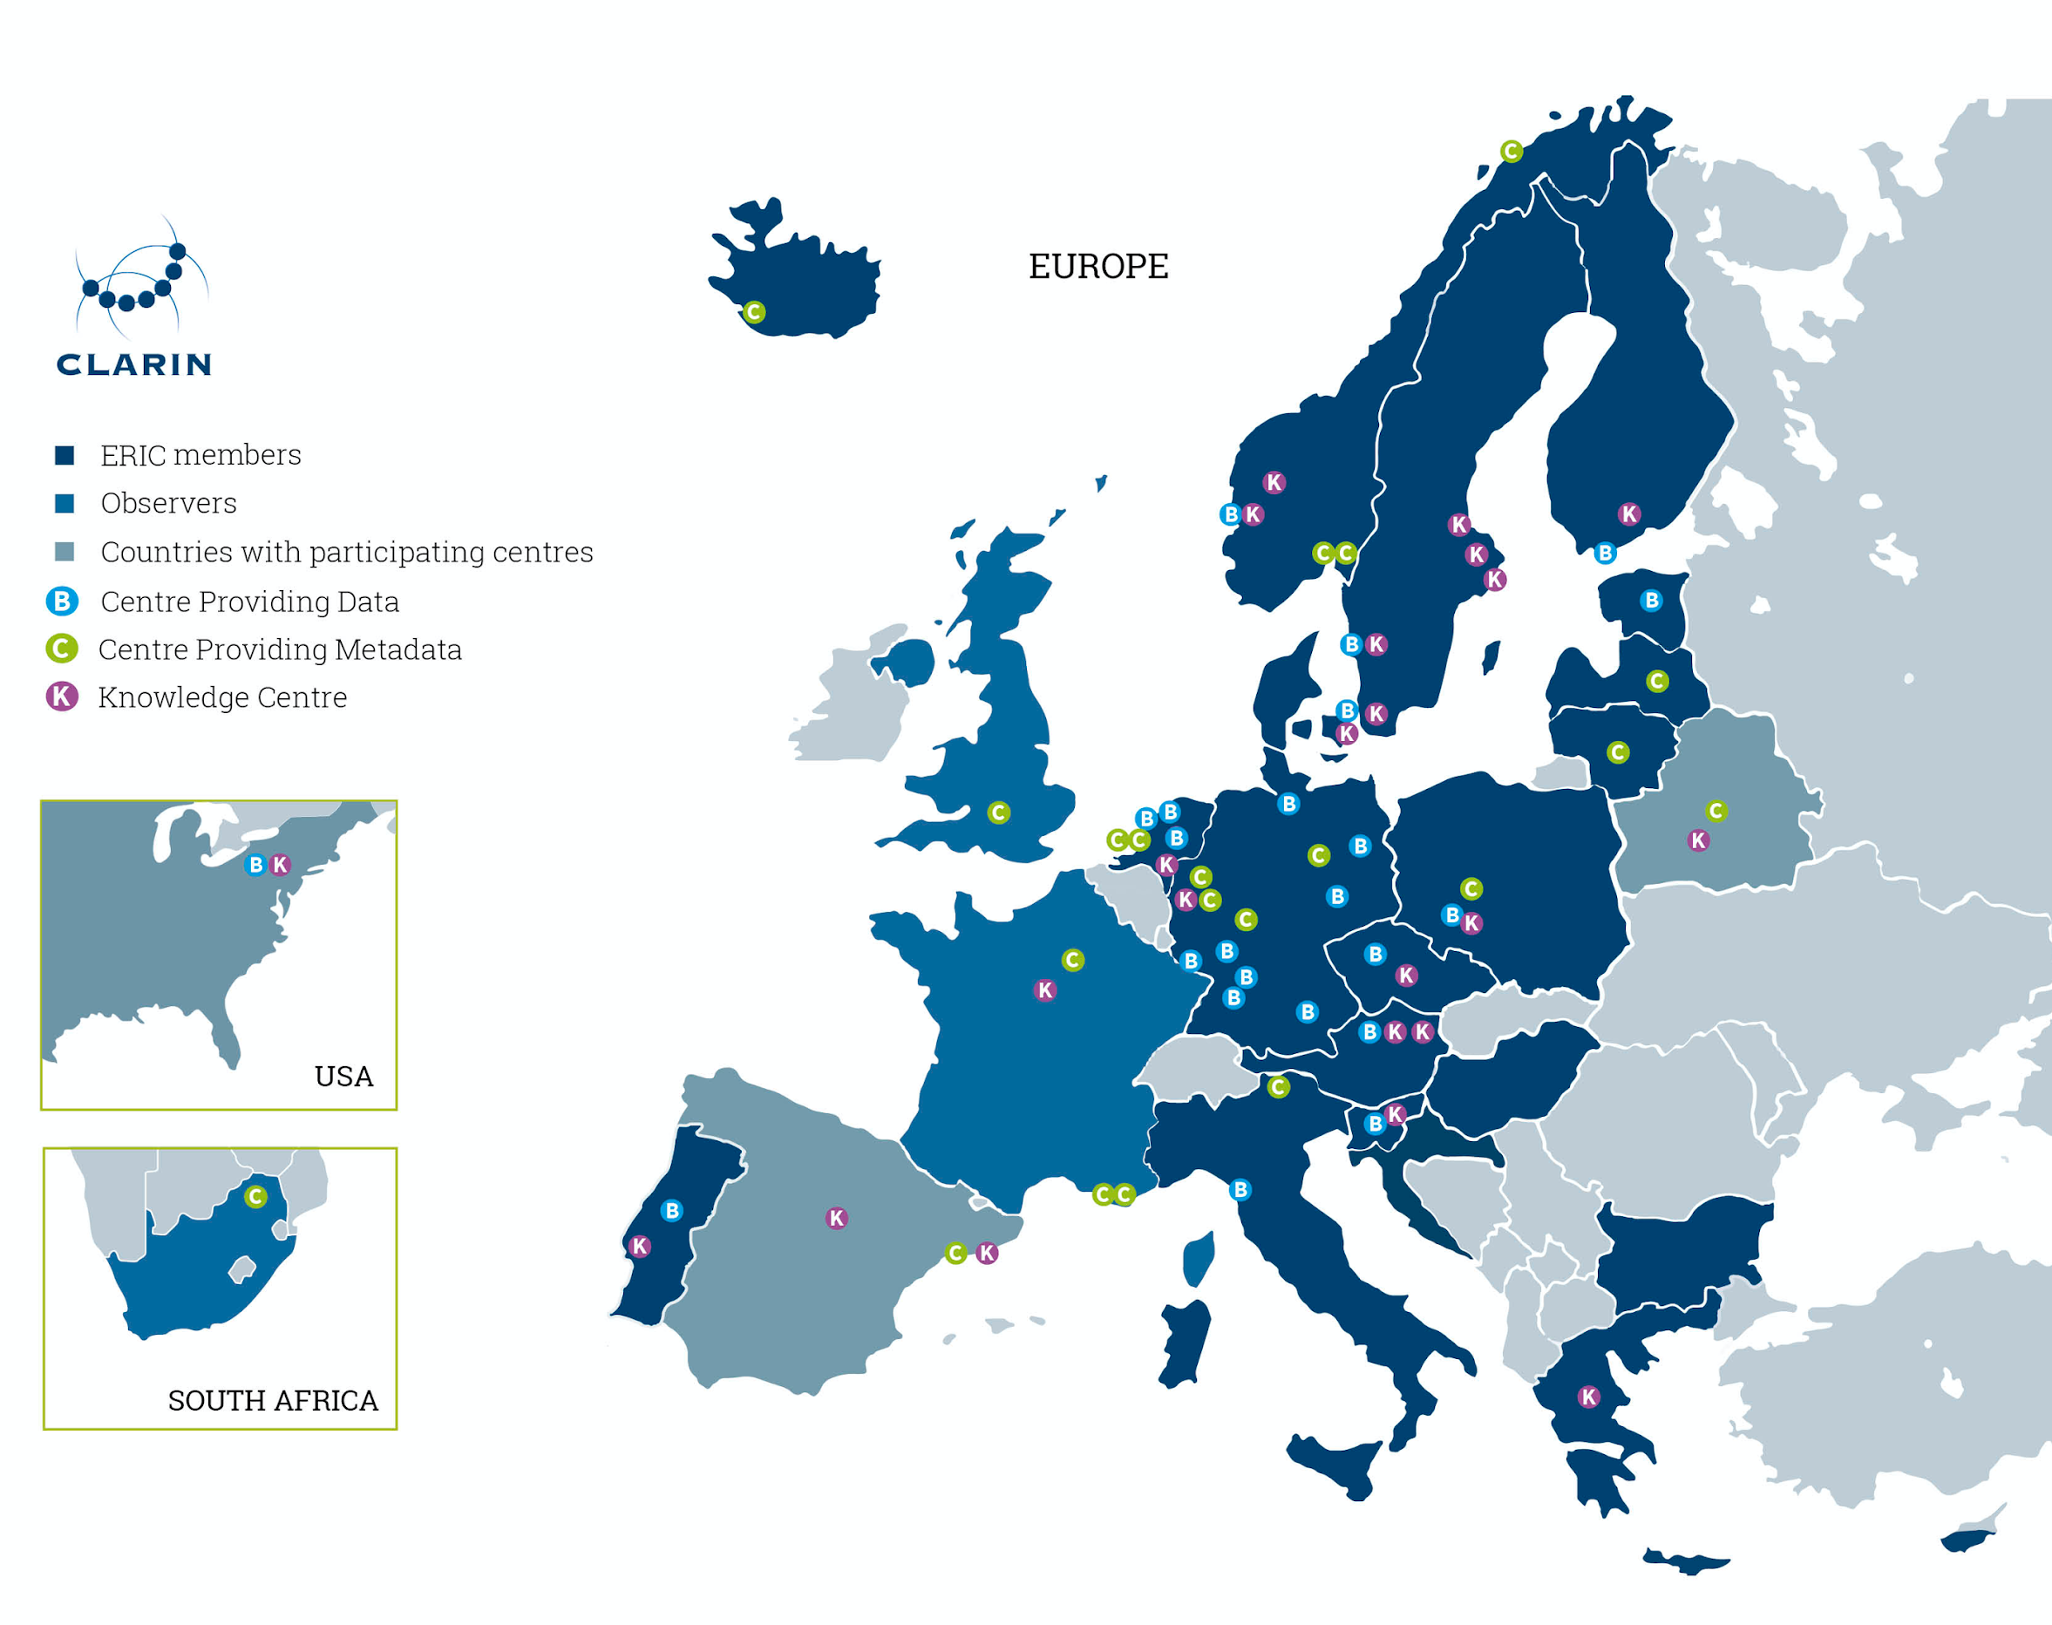
CLARIN ERIC in members and centres
A consortium of:
21 members: AT, BG, CY, CZ, DE,
DK, EE, FI, GR, HR, HU,IS, IT,
LT, LV, NL, NO, PL, PT, SE, SI
3 observers: FR, UK, ZA
>50 centres

Slide 4
Background
This workshop build on the previous pioneer LREC workshops on reproducibility 4REAL 2016[1] and 4REAL 2018[2].
Scientific knowledge is grounded on falsifiable predictions and thus its credibility and raison d’être relies on the possibility of repeating experiments and getting similar results as originally obtained and reported. In many young scientific areas, including ours, acknowledgement and promotion of the reproduction of research results need very much to be increased.
[1] 4REAL2016: http://4real.di.fc.ul.pt/
[2] 4REAL2018: http://4real2018.di.fc.ul.pt/
Notes:
REPROLANG 2020, the Shared Task on the Reproduction of Research Results in Science and Technology of Language, main goals are:

Slide 5
Goals of the workshop
Repeating of existing experiments with the expectation to obtain similar results as originally reported reinforcing the level of reliability on its results by means of their eventually convergent outcomes.
New type of task:
similar to the usual competitive shared tasks in the sense that all participants share a common goal
partly different to previous shared tasks in the sense that its primary focus is on seeking support and confirmation of previous results, rather than on overcoming those previous results with superior ones
Notes:
REPROLANG 2020, the Shared Task on the Reproduction of Research Results in Science and Technology of Language, main goals are:

Slide 6
Procedure
Select from a predefined list of experiments, categorized as follows by the task selection committee:
Lexical processing, Sentence processing, Text processing, Language resources or Applications
Work on repeating the experiment, following the technical framework
Submit the reproduction following the submission guidelines
Review submissions → reject if guidelines not followed
Provision infrastructure
Run experiments
Collect results
Review results reported by participant vs. results from us
Notes:
Bullets in bold were responsibility of CLARIN ERIC as technical committee

Slide 7
Technical Framework
Using a container approach to encapsulate the algorithms together with the environment required to run the experiment
Use version pinning
Include everything to run the experiment in the image, except the input dataset (no host mounts)
Don’t install packages at runtime
Mount input dataset and output location from the host
Include an entrypoint that runs the experiment and utilises the input and output directories
All images build via a GitLab CI pipeline triggered on tag creation

Slide 8
Technical Framework
Submission
Host
Experiment
(container)
GitLab.com
Pull image
Dataset
(input)
Results (output)
Data repo
Prepare Host
- Download dataset
- Verify checksum

Slide 9
Running the experiments
We used EGI cloud infrastructure to run the experiments at 3 different providers:
19 vCPU, 180GB RAM, 8GB GPU RAM
Intel Xeon Processor (Skylake, IBRS) @ 2000Mhz
RTX 2080 8GB
16 vCPU, 64GB RAM
Intel Xeon Processor (Skylake, IBRS) @ 2300MHz
12 vCPU, 24GB RAM
QEMU Virtual CPU version 1.5.3 @ 2300MHz
Commercial instance:
AWS GPU instance V100

Slide 10
Reviewing of submissions
Score | Description
5 | Reproduction of the results reported by the respective authors completed without any problem. The paper provided enough information.
4 | Reproduction completed but some technical difficulties were found and/or the paper did not provide sufficiently detailed information.
3 | Reproduction completed but running it was cumbersome for various reasons and/or documentation was not clear.
2 | The means to reproduce were provided by the respective authors but reproduction was not completed or reported results were not generated.
1 | It was impossible to run or start the reproduction process given the provided materials and/or information.
Notes:
The technical committee scored the submission based on reproduction success:

Slide 11
Reviewing and results
Submission were further scored by the review committee on reproduction, meaningful reflection and replication extra-mile
We received 18 submissions, of which 11 were retained. 7 cases failed to follow submission guidelines.
Description | # Experiments | Score
Completed successfully | 4 | 5 or 4
Partly completed, partly failed | 1 | 3 or 2
Failed to complete (in time) | 1 | 2
Impossible to run | 5 | 1

Slide 12
Challenges
Quality of submissions varies a lot
Some container images simply did not run
Not following guidelines requiring interaction to get the experiments to run
Limitations of gitlab.com on artifact size
Experiments requiring more resources, e.g. more GPU ram
Provisioned GPU resources on commercial infrastructure
Support response times
EGI support mainly via assigned individual contact
AWS support very slow over Christmas period
Notes:
8GB vs 12GB Gpu RAM required

Slide 13
Challenges
Experiments requiring specific cpu instructions
Run experiment at different provider
Available CPU instructions not easily visible up front
No information was supplied with the submission on the requirement for the instructions
Due to the runtime of the experiments it was not possible to complete the experiment within the reserved time
Due to the runtime of the experiments there was not enough time to run all experiments twice
Once to produce the replication result based on the input data set
Once to produce a validation result based on a ablated input data set

Slide 14
Summary
The workshop was considered a success since:
A substantial number of participants, 12 in total resulting in 19 experiments
The majority of experiments was successfully reproduced
It provides valuable experience in defining a structured approach for reproducibility of research
Nonetheless it is a labor intensive initiative
Areas to improve:
Announce runtime limits and available CPU, RAM and GPU resources beforehand
Offer more variety with respect to available GPU resources
Investigate ways to add more automation in order to reduce the required labour

Slide 15
Thank you for your attention!
Workshop page:
https://lrec2020.lrec-conf.org/en/reprolang2020/
Paper reporting on results:
https://www.aclweb.org/anthology/2020.lrec-1.680
Technical framework:
https://gitlab.com/CLARIN-ERIC/reprolang

Slide 16
Acknowledgements
We are very grateful to the authors that offered their papers,or accepted our invitation to do so, to be the target of the reproduction tasks. They are listed in Branco et al. (2020).
The results reported here were partially supported by POR-TULAN CLARIN—Research Infrastructure for the Science and Technology of Language, funded by Lisboa 2020,Alentejo 2020 and FCT—Fundação para a Ciência e Tecnologia under the grant PINFRA/22117/2016.
The computing environment for the replications by the technical committee has been kindly provided by EGI and the EOSC-hub H2020 project (grant agreement 777536) with the dedicated support of the CESGA, CESNET-MCC and RECAS-BARI providers.

