Slide 1
GENERAL HOUSEKEEPING
Please make sure your microphone and video are deactivated unless the (co)host gives permission.
Use the function to ask to speak, you find the option in the “participants” list
All presentations will be available on
Indico (see session via Timetable).
If you do not see all the Zoom buttons
at the bottom of the Zoom window, move your mouse on that window and buttons will appear.
Share your impressions and experiences on Twitter using #EGI2020 and mention @EGI_eInfra.

Slide 2
Joining the EGI Federation
Sergio Andreozzi
Head of Strategy, Innovation and Communications EGI Foundation

Slide 3
Outline
Key terms:
EGI Foundation
EGI Participant
EGI Federation
EGI Community
Joining the EGI Federation
Value
Eligibility
Options
Fees
http://go.egi.eu/join

Slide 4
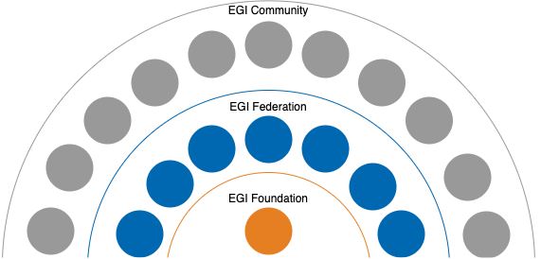
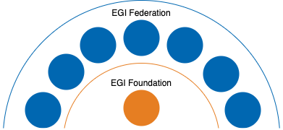
EGI - Key terms
EGI community The EGI Federation plus the served research communities, the technology providers or any other organisation linked via an agreement with the EGI Foundation and contributing to the mission of the EGI Federation
EGI Federation EGI Foundation, EGI Foundation Participants and Associated Participants, their linked organisations (e.g. service and resource providers) represented within EGI Foundation that contribute to the
objectives of the foundation EGI Participant NGIs, EIROs, ERICs and such other legal entities, in their own capacity or as representative of a consortium, that contribute to the objective of the foundation
EGI Foundation (or EGI.eu or Stichting EGI) The legal entity whose objective is to coordinate and develop, in
collaboration with its Participants, the EGI infrastructure that provides long-term distributed compute and storage resources for performing research and innovation activities.
Definitions from the EGI Foundation Statutes http://go.egi.eu/statutes

Slide 5
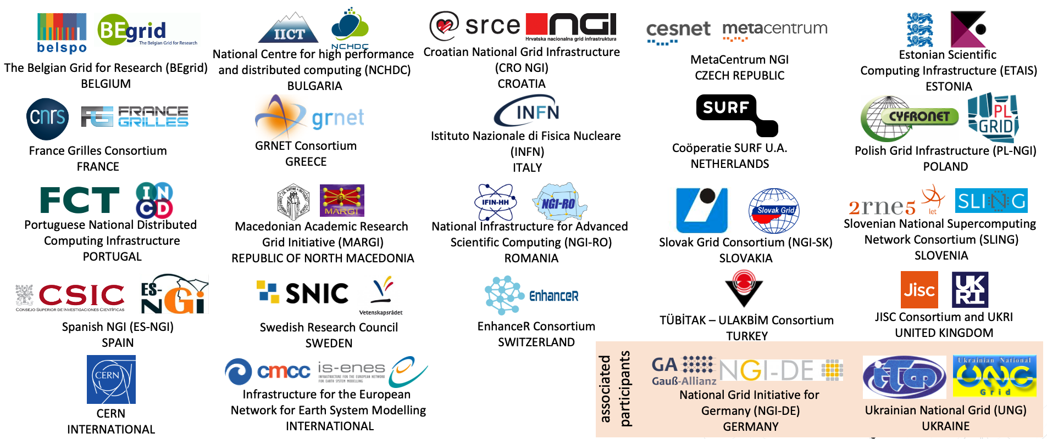
EGI Federation (Nov 2020)
Participants of the EGI Council and Represented Entities

Slide 6
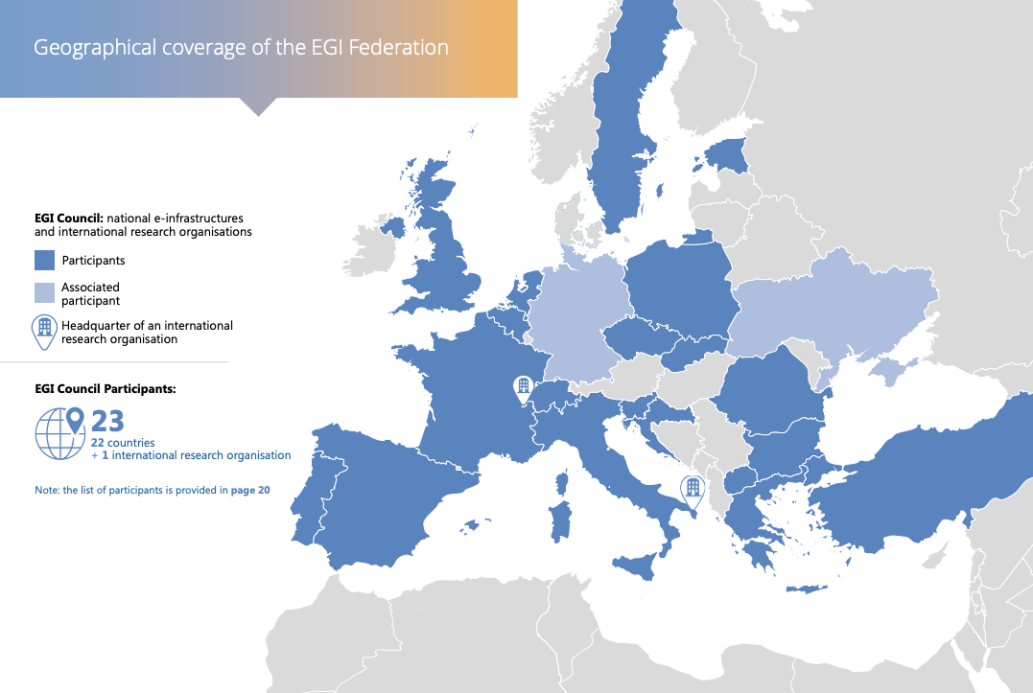
4 membership applications received in 2020
Germany will become full participant in 2021
26 from 2021

Slide 7
Services
delivered
by the
EGI Federation

Slide 8
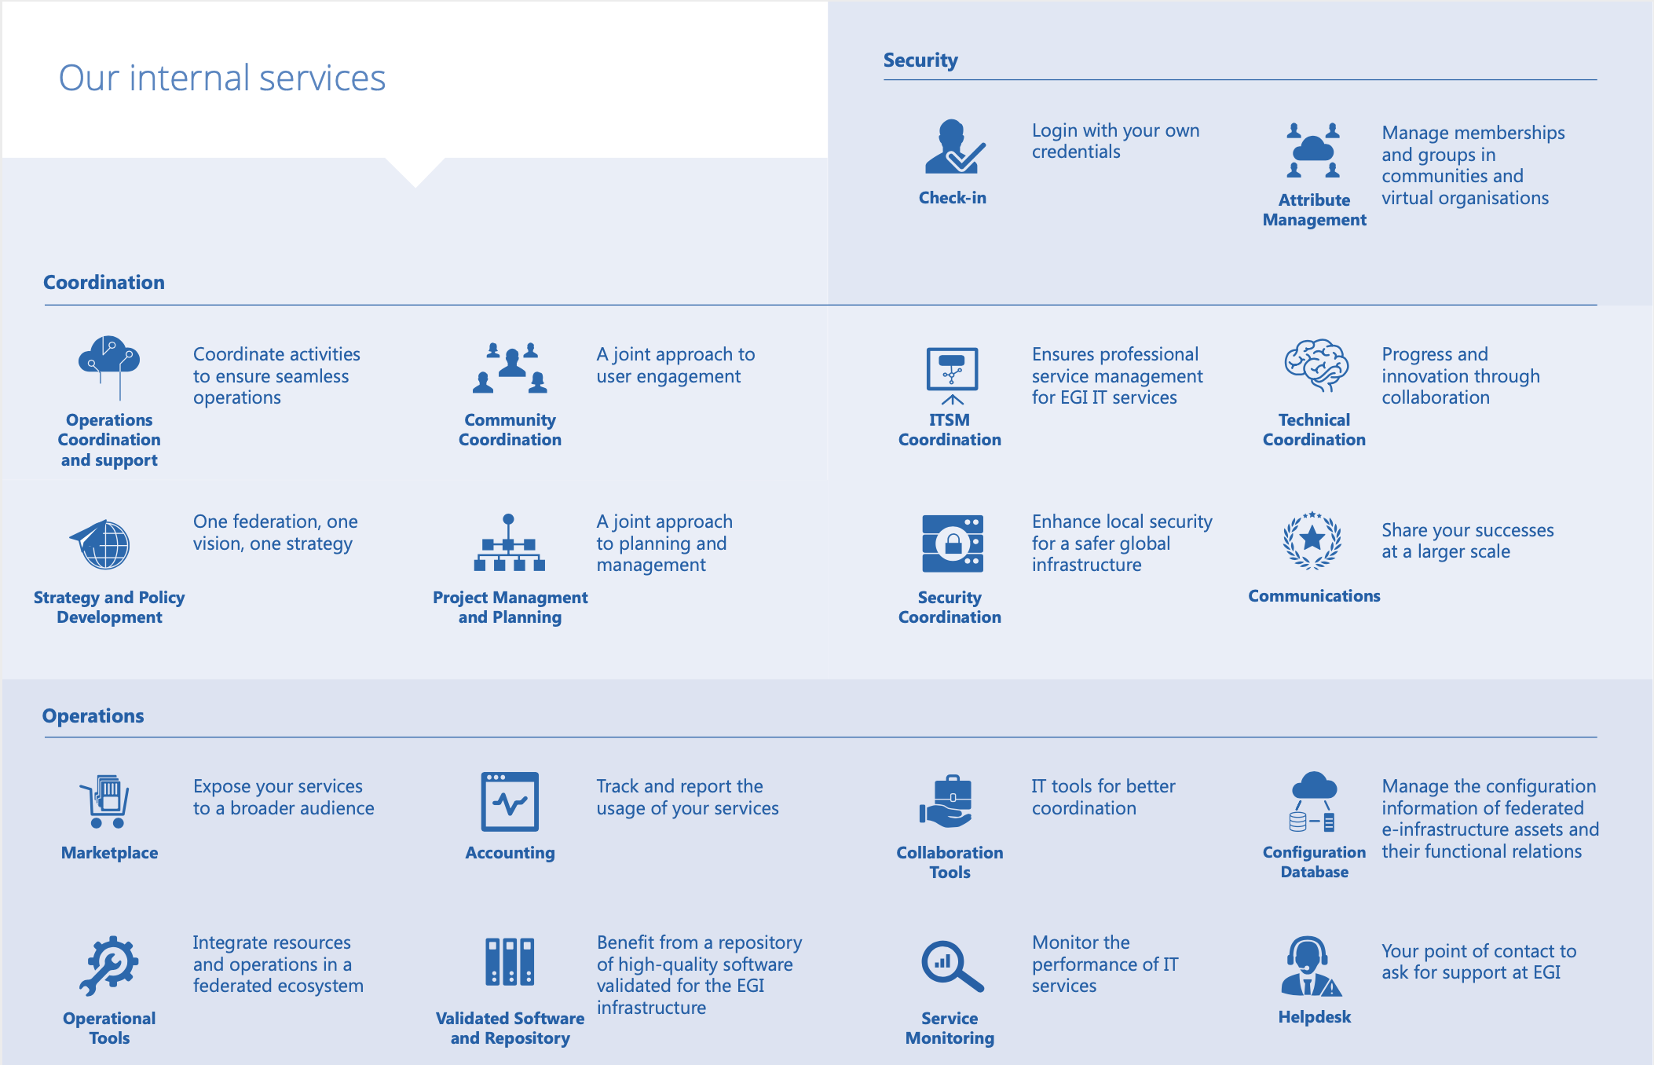
Services
delivered
by the
EGI Foundation
in collaboration with some EGI Participants

Slide 9
Values of becoming an EGI Participant
Access services and tools for federating infrastructures
Access services and support for advanced computing
Promote your services internationally
- Benefit from a suite of technical tools, internal services and management processes that support federated operations - Take an active role in the provision of services enabling federations
Benefit from federated AAI, federated data access and management, federated compute access and management
- Get support in promoting your services in the EGI or EOSC marketplaces - Co-develop new products/services and exchange expertise - Simplify international collaboration and support transnational access to services
1
2
3

Slide 10
Values of becoming an EGI Participant
Engage expert communities
Boost knowledge sharing
Improve access to funding
Shape strategy and policy
- Access strong connections with international research communities and infrastructures - Improve your understanding of requirements from emerging research infrastructures and communities
Priority access to community knowledge, expertise and trainings Share your knowledge within the EGI Federation and related user communities, and contribute to a stronger European Research Area
Join flagship projects led by the EGI Foundation or access invitations directed to the EGI Federation Participate as a service provider in (pay for use) or virtual access programme
- Influence the EGI Federation strategy and align your direction with other countries - Influence European-level policy on digital services for research with a unique and coherent voice
4
5
6
7

Slide 11
EGI Participant
Eligibility
Who can join the EGI Federation
Organisations representing national e-infrastructures with a mission to provide distributed data & computing services to researchers
Organisations representing international communities of researchers with a strong interest in distributed data & computing services
Any legal entity, in their own capacity or as representative of a consortium that can contribute to the objective of the EGI Federation
Note: If the country is represented in the EGI Federation and new organisations have a national scope, then first they should try joining the current EGI Participant

Slide 12
Participant Option and Related Benefits
Benefit | Participant | Assoc. Part.
Advertised on EGI website, according to type of membership | ✔ | ✔
Attend Council meetings | ✔ | ✔
Participate to working groups | ✔ | ✔
Access the internal services | ✔ | ✔
Bidding for internal services | ✔
Vote on any decision submitted to the Council | ✔
Be part of the 'linked third party' mechanism to join proposals (e.g. EC projects) | ✔
Prominence in promotional material | ✔
Access Strategy and Policy Decision Support briefing and document reports | ✔
Benefit from the EC regulation about public procurement | ✔

Slide 13
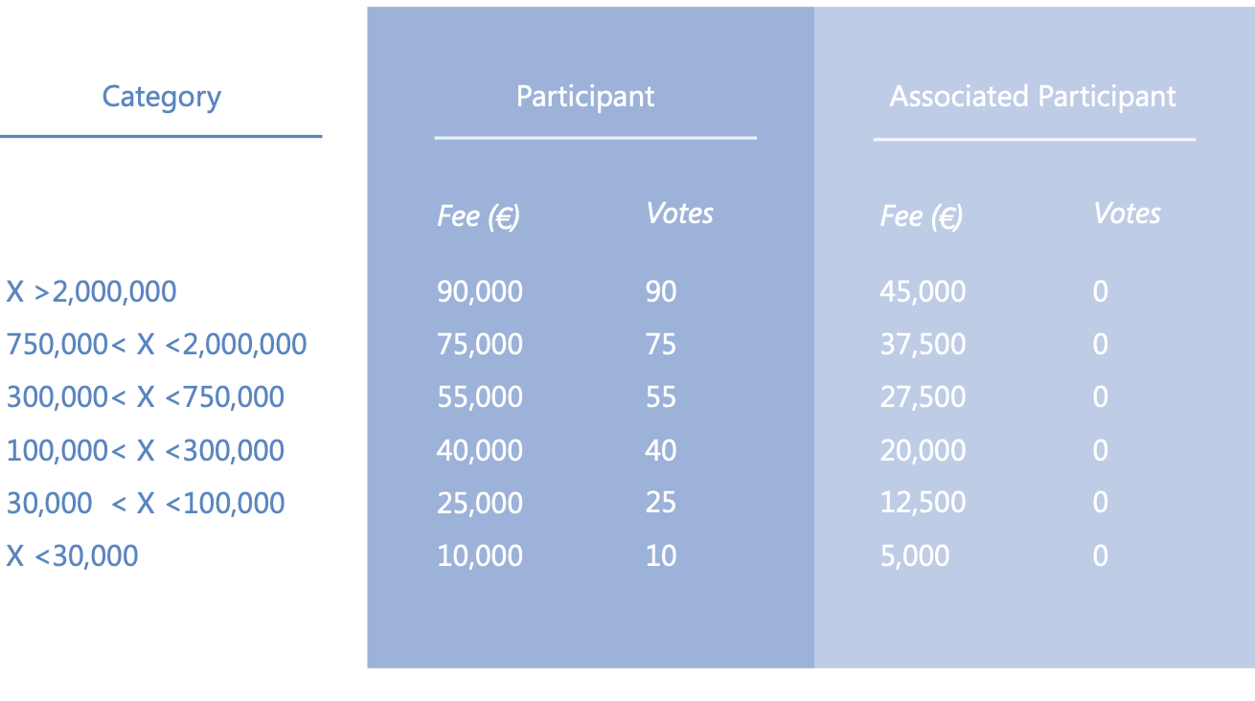
Participant annual fee
For organisation representing a country:
X is the national GDP (in million US$)
For organisation representing an international research community or a consortium, or in their own capacity
X is the annual budget of the headquarters legal entity (in thousand €)

Slide 14
Are you interested in joining
the EGI Federation? Send your expression of interest to: director@egi.eu http://go.egi.eu/join
Thank you :) Contacts: sergio.andreozzi@egi.eu @digitalities

