Slide 1
Partnering with the EGI Federation
Giuseppe La Rocca
Customer Support Team Lead
Matthew Viljoen
Service Delivery & Information Security Lead

Slide 2
EGI Participant (from previous)
Eligibility
Who can join the EGI Federation
Organisations representing international communities of researchers with a strong interest in distributed data & computing services
Organisations representing national e-infrastructures with a mission to provide distributed data & computing services to researchers
Any legal entity, in their own capacity or as representative of a consortium, that can contribute to the objective of the EGI Federation
Note: If your country is represented in the EGI Federation, then you can join indirectly by establishing an agreement with the related EGI participant

Slide 3
Join the Community Partnership
Prototyping
Production use
EGI Federation Participant
Type of Agreement:
MoU
Project-based
Examples:
OPERAS
OpenRiskNet
IDIA
...
Type of Agreement:
Corporate SLA or dedicated SLA
Examples:
WeNMR
LSGC
...
Type of Agreement:
Join a consortium represented in the EGI Federation
Application to become EGI Federation member
See http://go.egi.eu/join
Examples:

Slide 4
Example: OpenRiskNet
Research Community Partnerships
Signed on June 2020 (EGI-ACE)
Document: https://documents.egi.eu/document/3613
Partner: OpenRiskNet/NanoCommons community
Areas of interest:
JA1: Coordinate delivery of e-Infrastructure services
JA2: Jointly support research communities
JA3: Disseminate success stories based on the joint work
The parties will:
seek for aligned operational policies and procedures,
harmonised service delivery and infrastructure oversight
The parties will:
identify research groups and communities that can be potential users of the EGI– OpenRiskNet joint e-infrastructure, and
coordinate outreach, support, training and service delivery for these communities.
The parties will:
share success stories,
prepare joint articles, publications, presentations and demonstrations, and
present/distribute these at high impact events

Slide 5
Example: IDIA
Research Community Partnerships
Signed on June 2020 (EGI-ACE)
Document: https://documents.egi.eu/document/3618
Partner: Inter-University Institute for Data Intensive Astronomy, University of Cape Town
Areas of interest:
JA1: Federate cloud resources
JA2: Application deployment and shared datasets
JA3: Impact assessment and dissemination
EGI will support IDIA in federating its Ilifu (cloud) resources within the EGI Federation
IDIA aims to use the EGI federation to enhance collaboration with scientific partners in Europe
IDIA has developed the toolset required to analyse the data being produced by the MeerKAT
telescope.
The aim of the partnership with EGI is to make the tool available and deployable on EGI cloud resources.
The parties will:
share success stories,
deliver presentations/demos based on these at high impact events,
promote the activities in the EGI and IDIA dissemination channels.

Slide 6
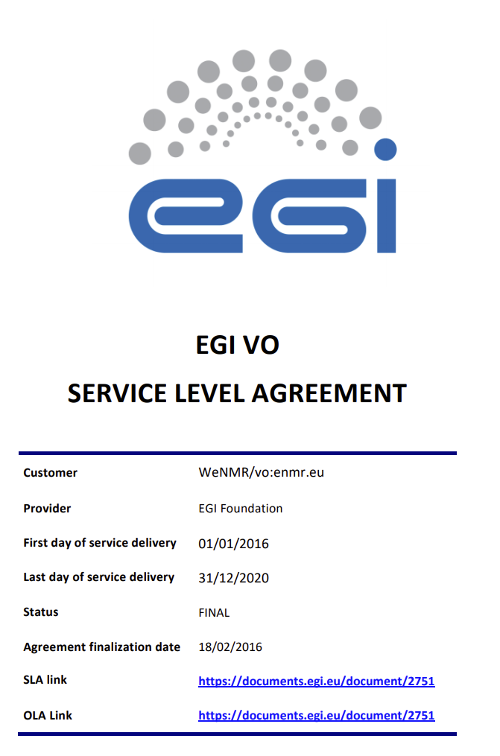
Example: WeNMR SLA
Research Community Partnerships
Signed on Feb. 2016
Document: https://documents.egi.eu/document/2751
Partner: the Faculty of Science – Chemistry, Utrecht University
HTC Resources:
HEPSPEC: 60M, 26GB of RAM and >59TB of storage
Cloud Resources:
vCPU cores: 540, up to 1.3TB of RAM and >8TB of storage

Slide 7
Example: renewal of WLCG MoU
Peer e-Infrastructure Partnership
Existing MoU since 2012
Renewal to align with new 2021 project plans (EGI-ACE, EOSC-Future)
Areas of collaboration:
Communication and dissemination
User support
Services and activities of mutual benefit:
Infrastructure and operation services
Middleware distribution
Software support
Security services and activities
Participation in forums (EGI, WLCG)
Service evolution related activities (development, deprecation)
EOSC and HPC
Limiting Environmental Impact and Carbon Footprint
Notes:
(Matt: I can go on for around 5 mins - if necessary - here, going into details that will be covered by the new WLCG MoU as examples of activities of a peer e-infra)

Slide 8
Thank you!

