Slide 1
EGI Data Transfer WG workshop
Intro
Andrea Manzi (EGI Foundation)

Slide 2
GENERAL HOUSEKEEPING
Please make sure your microphone and video are deactivated unless the (co)host gives permission.
Use the function to ask to speak, you find the option in the “participants” list
All presentations will be available on
Indico (see session via Timetable).
If you do not see all the Zoom buttons
at the bottom of the Zoom window, move your mouse on that window and buttons will appear.
Share your impressions and experiences on Twitter using #EGI2020 and mention @EGI_eInfra.

Slide 3
The EGI Data Transfer WG
The Working Group (WG) is part of the EGI Technology Coordination Board (TCB) which provides the forum for EGI to coordinate the requirements, assessment, delivery and verification of software technology as it moves into the production infrastructure
Mandate: Drive the technical evolution of the EGI Federation in the area of Data Transfer.
To support this goal, the following activities will be carried out:
Perform a technology scouting to identify available technical solutions in the area of data transfer
Deal with user communities to gather requirements and recurrent use cases;
Identify gaps of the current solutions with a focus on those from the technology providers participating in the WG;
Discuss and plan enhancements for technical providers

Slide 4
Participants
EGI is engaging different types of stakeholders to accomplish the objectives of this WG:
User communities: which will have a forum to present their requirements and use cases; to test and validate transfer services
Technology providers: which can benefit of direct contacts with large communities to drive the evolution of their services
EGI infrastructure providers: which are hosting or planning to host the services/technologies part of the WG

Slide 5
Current participants
Technology providers:
Services already used by the EGI communities, e.g. FTS, Onedata
New services going to be part of the EGI portfolio, e.g. Rucio
EGI possible collaborations, e.g. Globus
Communities with data transfer use cases
WLCG, PaNOSC, EMBL-EBI, HIFIS, AARNET, INFN
Infrastructure providers
CERN, STFC

Slide 6
Working Group Terms of Reference
ToR
https://documents.egi.eu/public/ShowDocument?docid=3659
Communication Channels
Mailing list : tcb-datatransfer-wg@mailman.egi.eu
Wiki page : https://wiki.egi.eu/wiki/TCB:Data_Transfer_WG
Meetings & Minutes : https://indico.egi.eu/category/200/

Slide 7
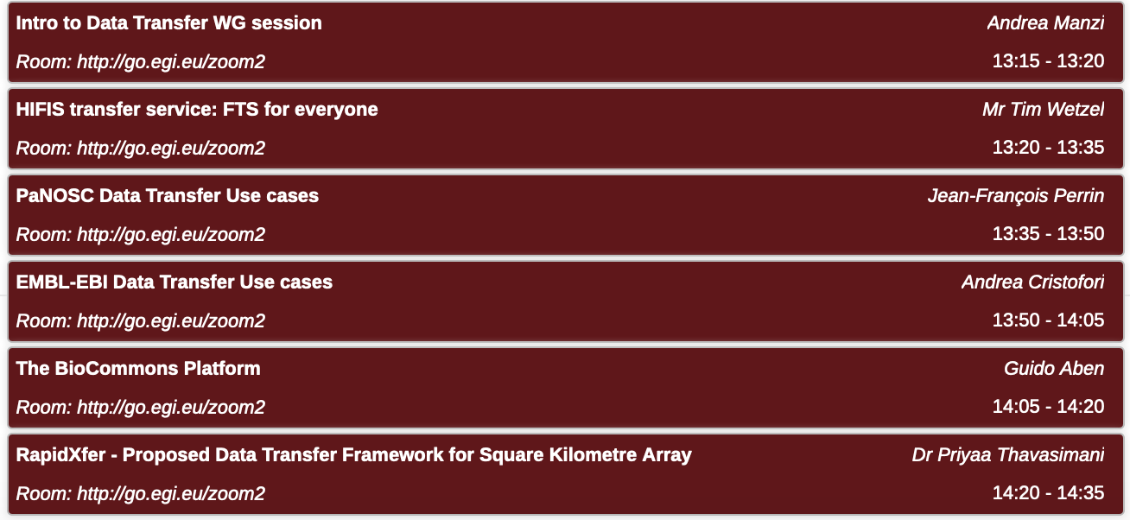
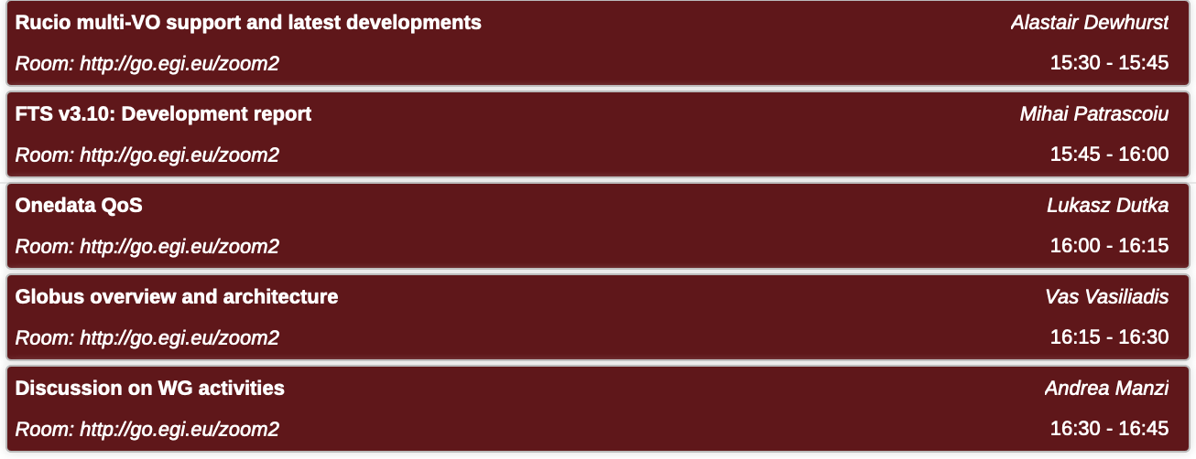
Agenda
2 Sessions today - Zoom: http://go.egi.eu/zoom2
User communities - 13:15 - 14:35 CET | Technology providers - 15:30 - 16:45 CET

