Slide 1
HIFIS backbone transfer service: FTS for everyone
Tim Wetzel¹, Paul Millar¹, Uwe Jandt¹, Patrick Fuhrmann¹, Stefan Helmert², Tobias Huste², Guido Juckeland²
¹ Deutsches Elektronen-Synchrotron DESY,
² Helmholtz-Zentrum Dresden-Rossendorf HZDR
EGI conference, Nov 03, 2020

Slide 2
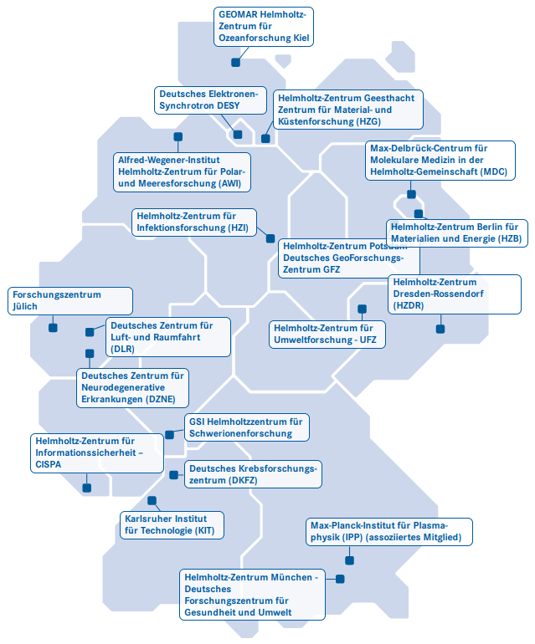
Helmholtz Association (HGF)
Founded in 1995 to formalise relationships between research centres
Members: 19 autonomous research centres in Germany
Mission: Contributions to grand challenges facing society, science and industry
Fields: energy, earth & environment, health, aeronautics, space & transport, matter and key technologies
1

Slide 3
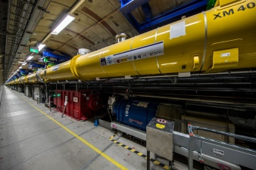
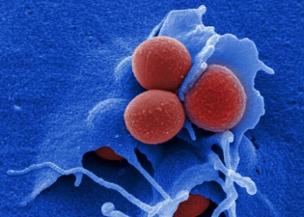
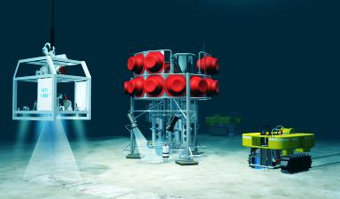
Motivation
New challenges
Top position of Helmholtz research relies increasingly on cross-centre collaboration and international cooperation
Growing importance of cloud access to common data treasure and -services
Rapidly growing data exchange from research instruments requires excellent data networking
Growing connections between HGF, EOSC and FAIR
1

Slide 4
Helmholtz Incubator
Helmholtz aims for joint research & information environment for all Research Fields
& Schools
Helmholtz Information & Data Science Incubator
1

Slide 5
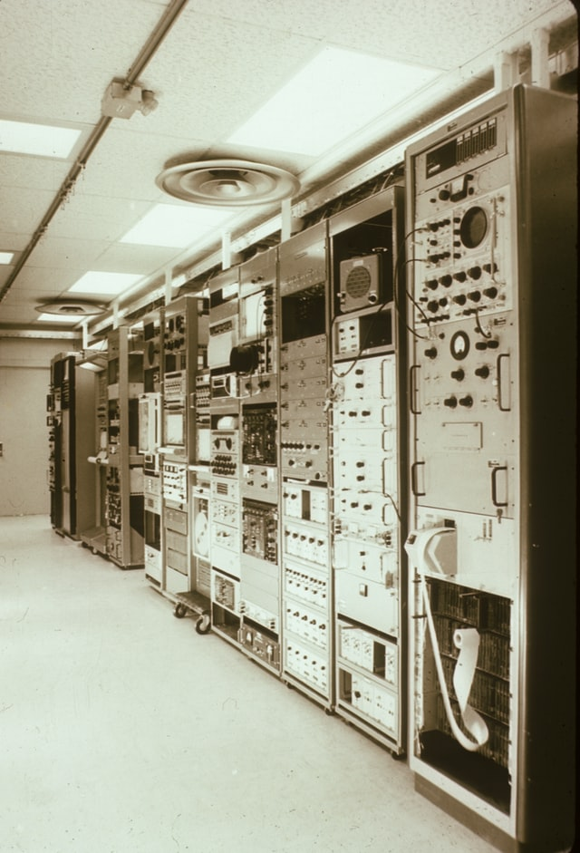
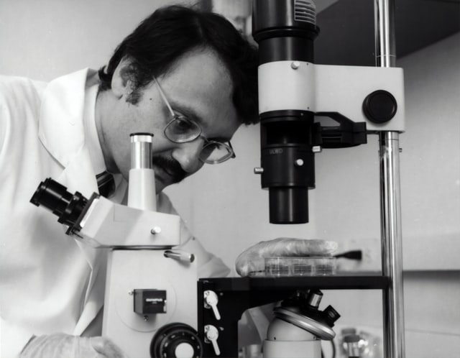
HIFIS
Helmholtz aims for joint research & information environment for all Research Fields
Helmholtz Federated IT Services HIFIS
connects all HGF centres
….and their world-wide collaboration partners!
Portfolio of federated IT services
Common marketplace
Access via HelmholtzAAI with home credentials
Easy and comfortable federation for collaborative web services
Photos by Markus Winkler, NOAA, National Cancer Institute on Unsplash
1

Slide 6
HIFIS
Helmholtz aims for joint research & information environment for all Research Fields
High performance + collaborative services
Shall connect all centres
….and their world-wide collaboration partners!
Secure, simple access and easy-to-use
Widely establish best-practices for development+use of research software:
high level of quality, visibility and sustainability
This year‘s pandemic was a powerful reminder of how important collaborative and scalable IT services are today!
Photos by Markus Winkler, NOAA, National Cancer Institute on Unsplash
1

Slide 7
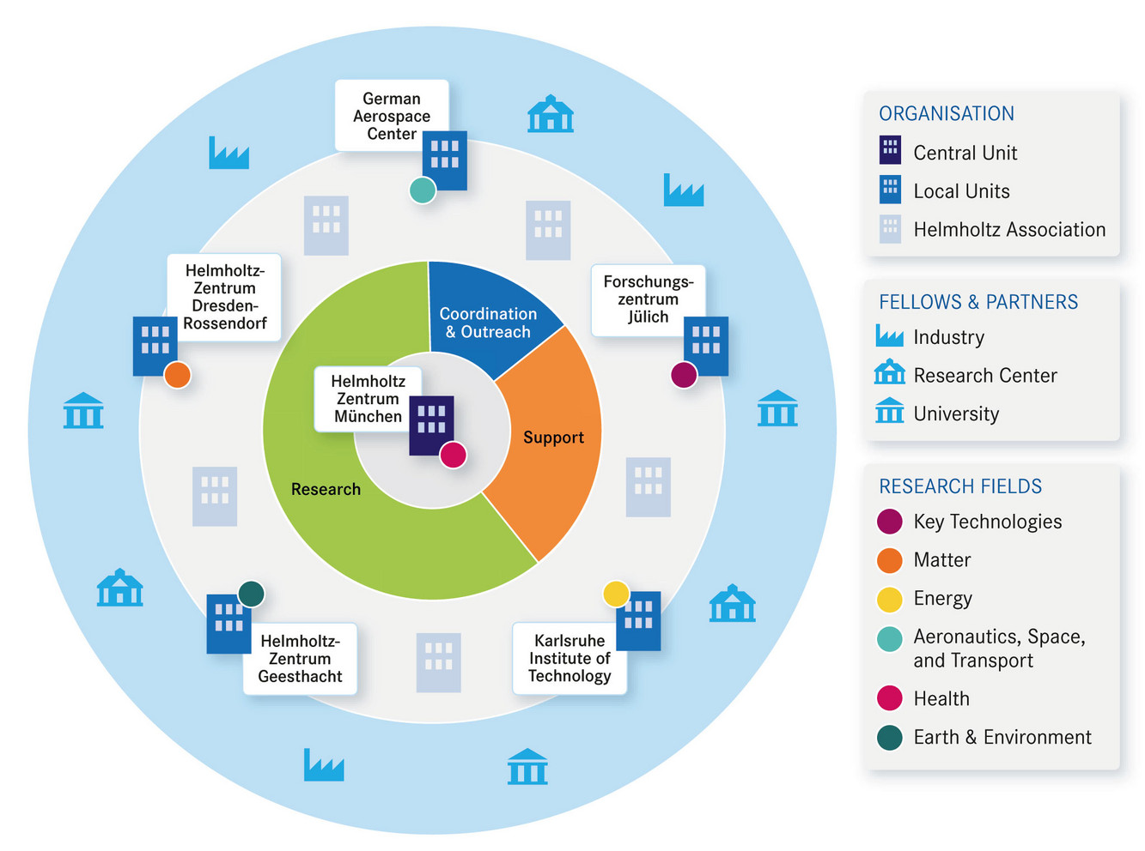
Why data transfers?
Helmholtz centres distributed all over Germany
Large data sets in collaborative research projects
Policy-driven data transfers required
Data analysis often sensitive to latency
Data locality is important!
Part of HIFIS backbone contract
Reliable, comfortable and robust transfer methods needed
Helmholtz centres in Germany
helmholtz.ai structure

Slide 8
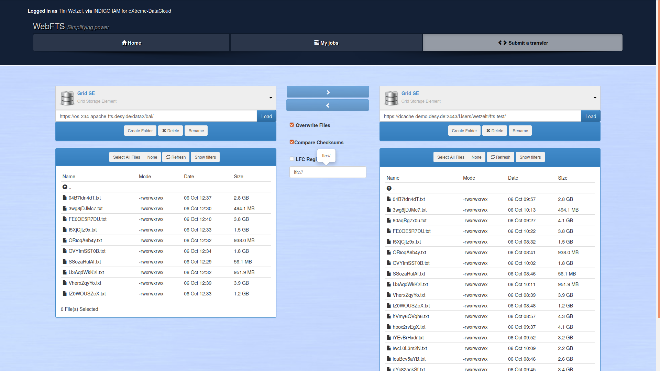
Transfer services
As HIFIS backbone core service
CERN‘s FTS3 as backend
webFTS as comfortable WebUI
FTS3-REST-API as CLI for automated transfers
Later: Rucio for policy driven transfers
Client applications for all needs and purposes

Slide 9
HTTP Third-Party Copy (TPC)
WLCG development for data transfers
Extension of the HTTP protocol
Third party can commission transfers between source and destination
Data is transferred directly between endpoints w/o third party
One endpoint needs to understand TPC-COPY extension (active party, WLCG)
The other endpoint needs to enable PUT or GET requests for files (passive party)
Asynchronous data transfers possible
Not implemented in standard Apache httpd
dCache needed as active party

Slide 10
WLCG storage Endpoints
storage solutions in WLCG:
dCache
EOS
DPM
StoRM
Developed for constant high load and huge data volumes
Enclosed view on data
More open endpoint solution needed for HIFIS

Slide 11
Endpoint components
Apache httpd webserver modules used:
mod_ssl (SSL/TLS capabilities)
mod_dav (webDAV capabilities)
mod_auth_openidc (OpenIDConnect/OAuth2)
modified mpm_itk (Multiprocessing module, user mapping)
self-written mod_want_digest (instance digests following RFC 3230)
Compatible with FTS3 and accessible via OAuth2 secured webDAV
Transfers are possible between GRID storage and Apache
Direct transfers between two Apaches are WIP

Slide 12
Transfer tests
Endpoints:
DCache @ DESY as active party
Apache @ HZDR Dresden (OAuth2-secured webDAV EP) & @ DESY (+ local user mapping and instance digests) as passive parties
Throughput of 20 to 100 MB/s, depending on available bandwidth
1 TB of data could be transferred in roughly 3 - 15 h

Slide 13
Summary
Enabling data transfers between HGF centres with existing open-source software
New software configuration for HTTP-TPC that is easy to deploy
Together with FTS3 and WebFTS provides base for a transfer service
Transfer tests between Apache endpoints and dCache instance successful
Valuable addition to transfer services after module optimizations
Currently limited to transfers involving grid storage endpoint (e.g., dCache), but future work will make Apache httpd itself capable of HTTP-TPC
Practical solution for data transfers between Helmholtz centres

Slide 14
tim.wetzel@desy.de
www.hifis.net
Grateful acknowledgements:
Andrea Manzi, EGI
Mihai Patrascoiu, CERN
Jan Erik Sundermann, KIT
1

Slide 15
backup slides

Slide 16
Endpoint components
mod_want_digest (github.com/wetzel-desy/mod_want_digest):
Developed by Tim Wetzel and Paul Millar, fragments taken from httpd‘s mod_negotiation
Implements instance digests in accordance with RFC 3230 (HTTP headers „Want-Digest“ and „Digest“)
Supports ADLER32, MD5 and SHA digests
Alpha version until now
No digest caching mechanism or on-the-fly calculation
Has to read file from disk for digest calculation
Good first version but needs to be optimized (WIP)

