Slide 1
Data Movement in the
AUSTRALIAN BIOCOMMONS
Guido Aben, AARNet (Biocommons slide content courtesy Jeff Christiansen @Biocommons)

Slide 2
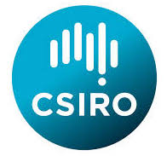
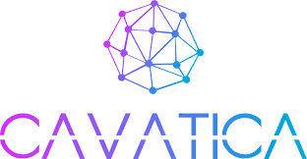
The Australian BioCommons
facilitating interactions between life science communities, established computational providers and international exemplars to build a more fit-for-purpose, flexible and cohesive data analysis ecosystem
genome annotation
genome assembly
proteomics
metabolomics
metagenomics
cancer genomics

Slide 3
Current BioCommons Investment Partners
$20M investment for Australian BioCommons
(Q3 2019 - Q2 2023)
$2.2M investment through Platforms Program
$10M in-kind contributions from multiple partner organisations

Slide 4
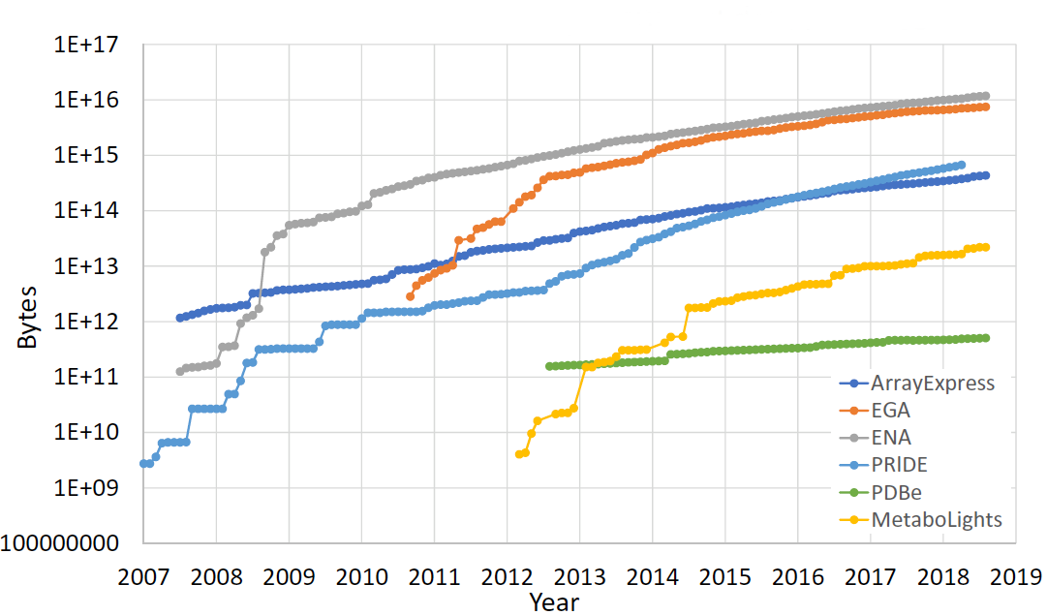
Rapid advances in sensing technologies
have made the life-sciences data-intensive
Data growth by EMBL-EBI data resource. Fig 2B. Cook et al, Nucleic Acids Research, 2019, Vol. 47, Database issue D15–D22 doi: 10.1093/nar/gky1124

Slide 5
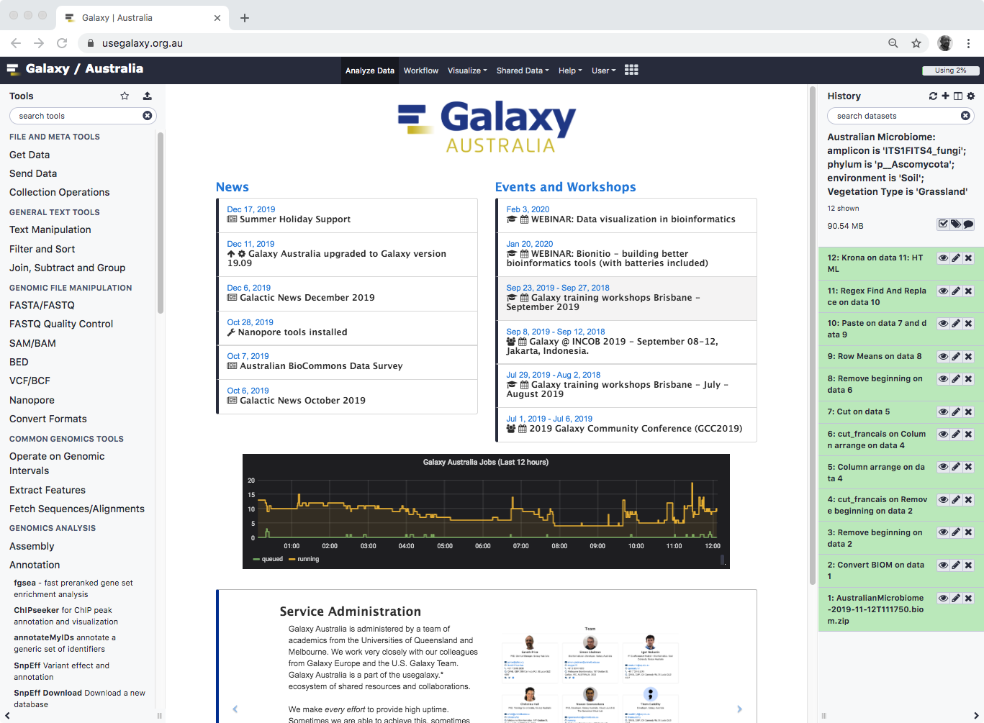
The Australian BioCommons
when relevant, we are working with infrastructure providers to establish and provision managed platforms e.g. Galaxy Australia
researchers

Slide 6
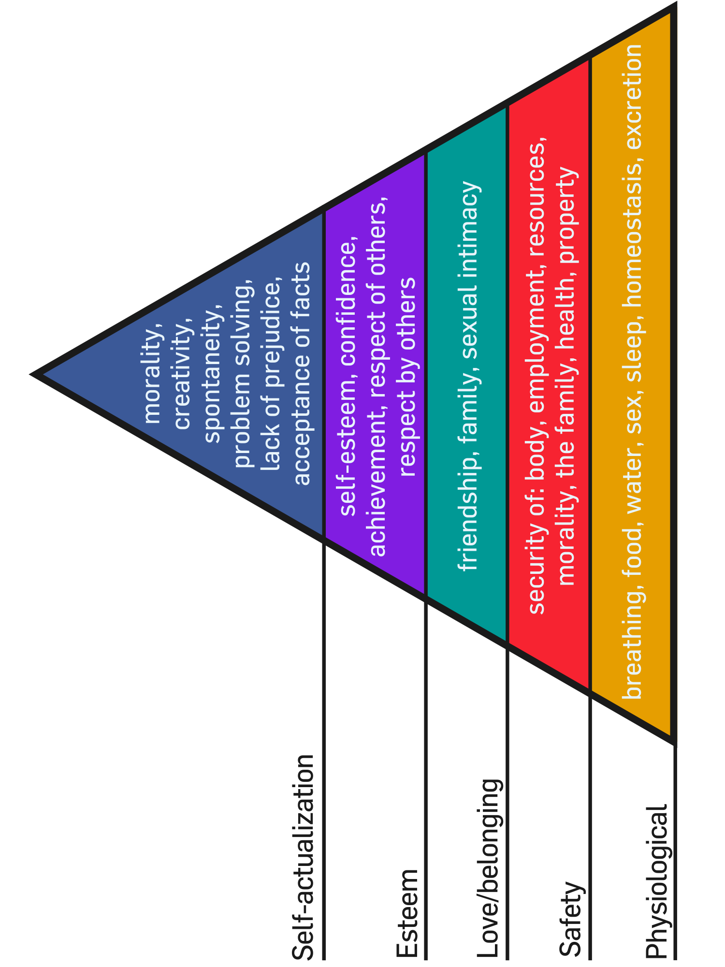
Data movement Maslow levels
We, and the science counterparts we deal with, think (or pretend) all users are here (perfect understanding of sizes and tools, good data hygiene, identified collaborators, a global namespace, metadata etc)
------>
But inevitably, some (often the majority!) are here (ad hoc data bottlenecks, ad-hoc collaborations, low training levels, need a quick fix).
If we win them over and help them look after themselves, they may begin to ascend the pyramid
------>

Slide 7
Maslow levels, made concrete
Globus. And perhaps in due time Rucio/xroot/webdav
------>
Synch-based, EFSS-managed data ingress/egress,
with connectors to useful compute/workflow platforms
------>
Filesender: a quick-fix, no-install, web-based terabyte-capable directory movement platform that uses recipient email address as destination identifier
------>

Slide 8
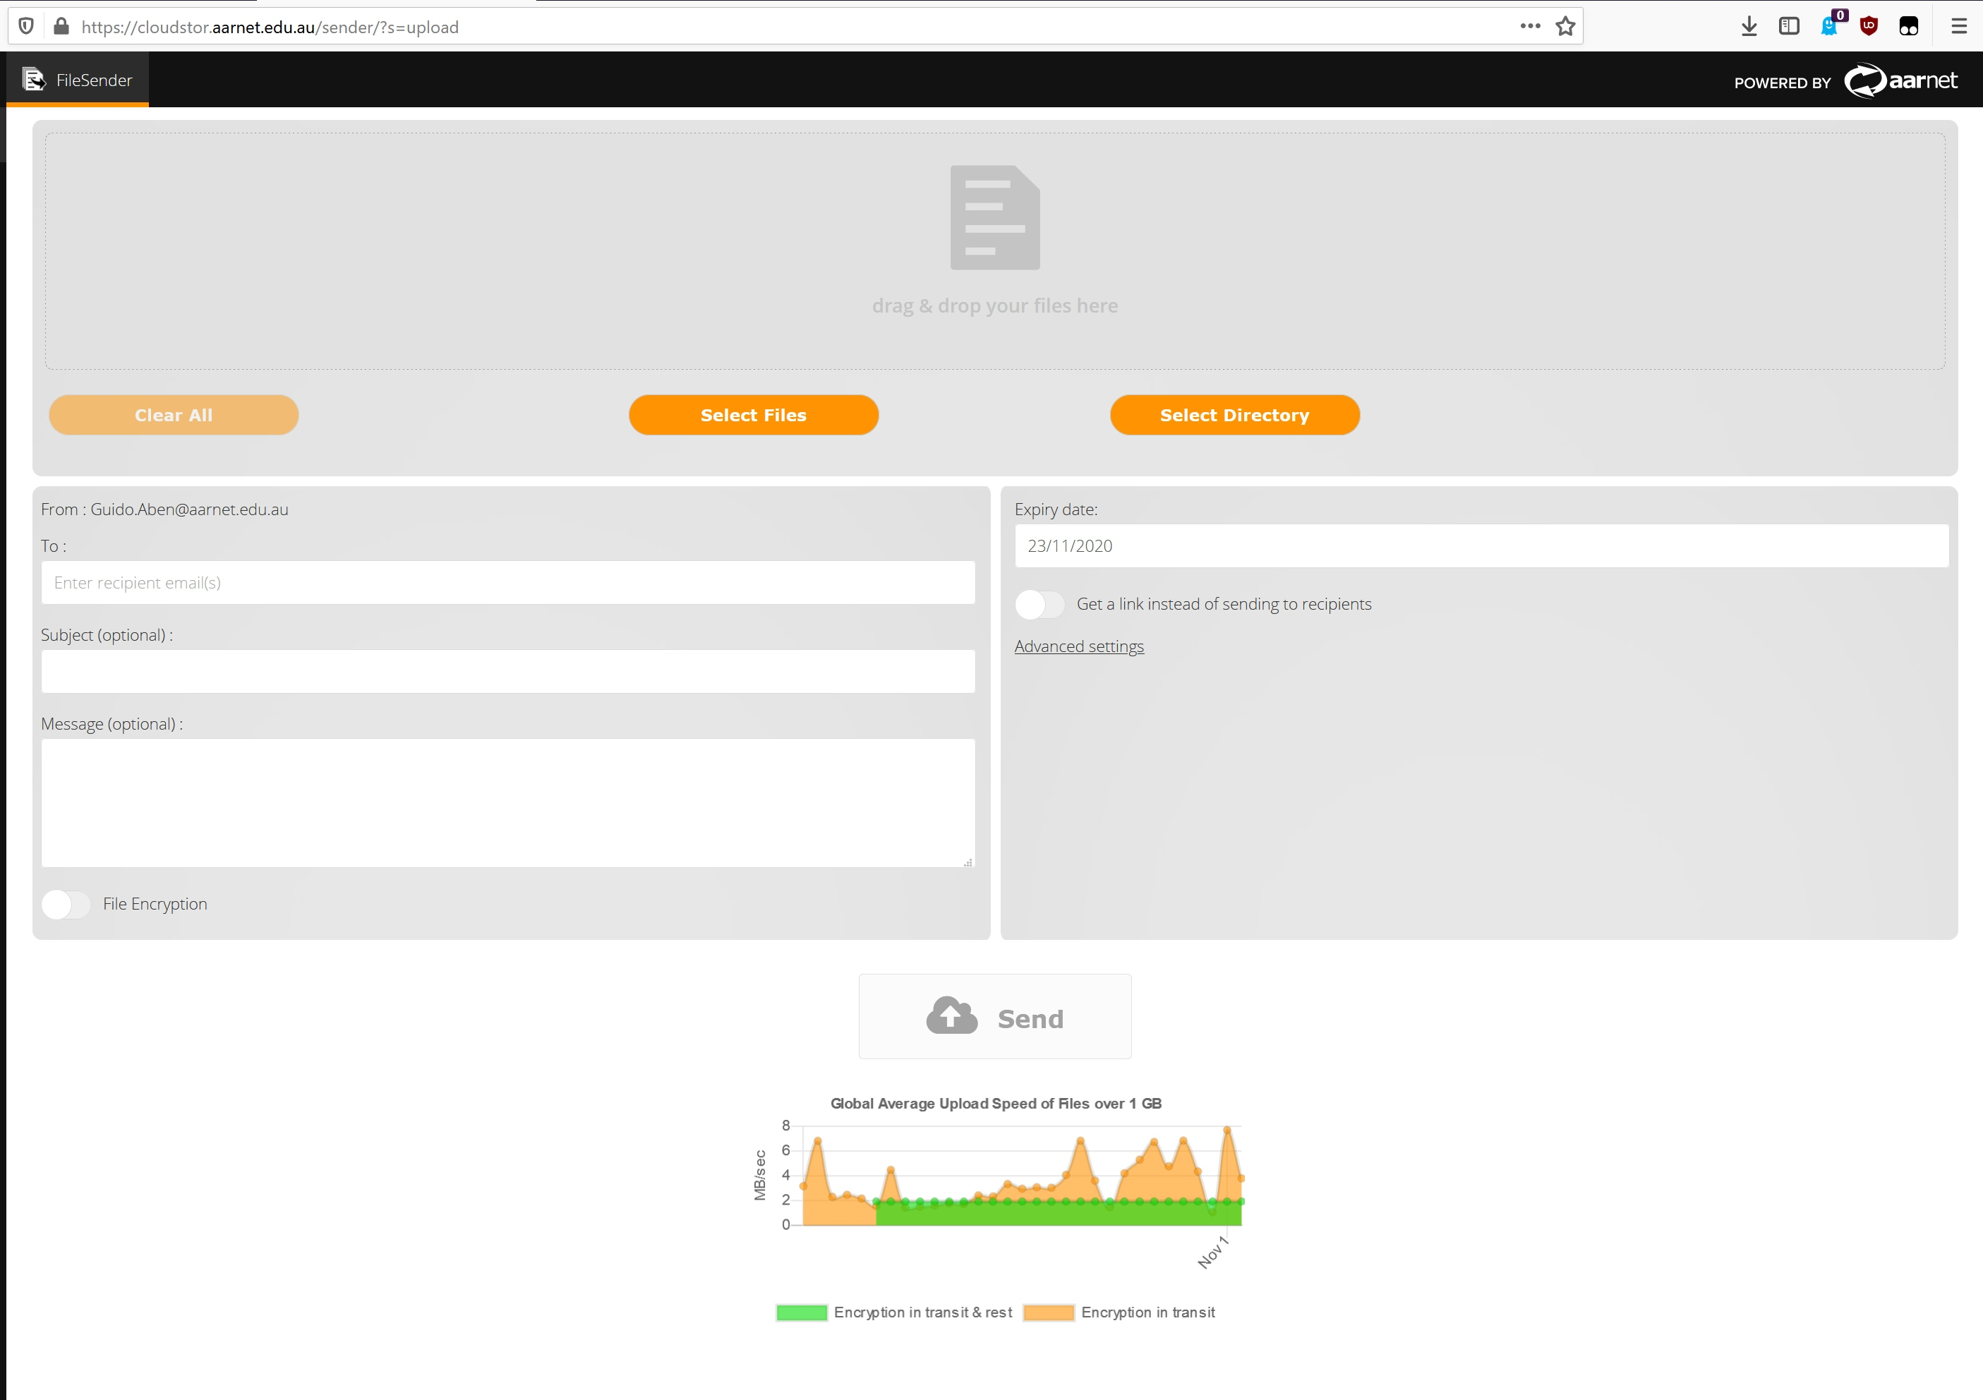
Level 1 FileSender
Both through the AARNet-hosted service, as well as brought up at genomics facilities needing to move lots of sample results to lots of people in lots of places (Garvan, Ramacciotti)

Slide 9
“The tool is performing really well and we notice the effect of lower latency provides an improvement on upload speeds with the platform we installed in-house vs the AARNet hosted one. So, 10 points there. I can’t speak for all users but I think the API has been a great resource. 10 extra points. But again, we love it. More and more people are using it and we are very happy with it.” (Estevan Mayolas, Head of IT, Garvan Institute)

Slide 10
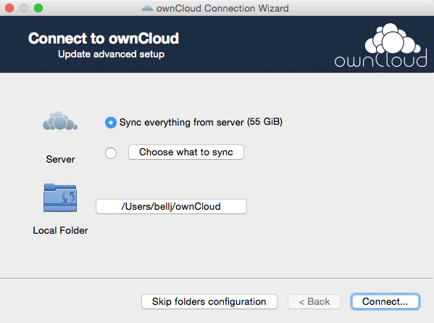
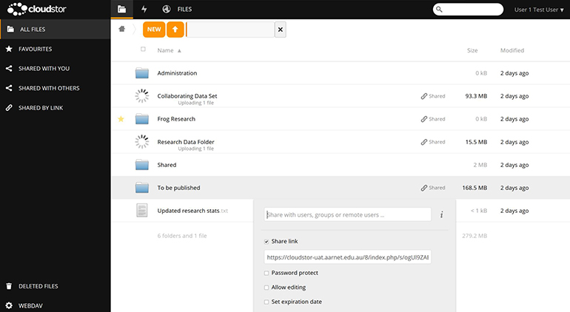
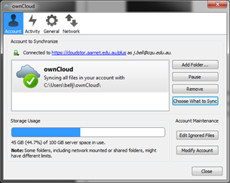
Level 2
“CloudStor” –
Owncloud based synched data with inter-connectors
…such as to the Galaxy platform, a bioinformatics go-to portal in worldwide use
The crux is: data gets get synched from slow instruments and desktop platforms into our well-connected well-tuned cloud platforms. Then when bulk data movement needs to happen, it happens from the cloud platform
→

Slide 11
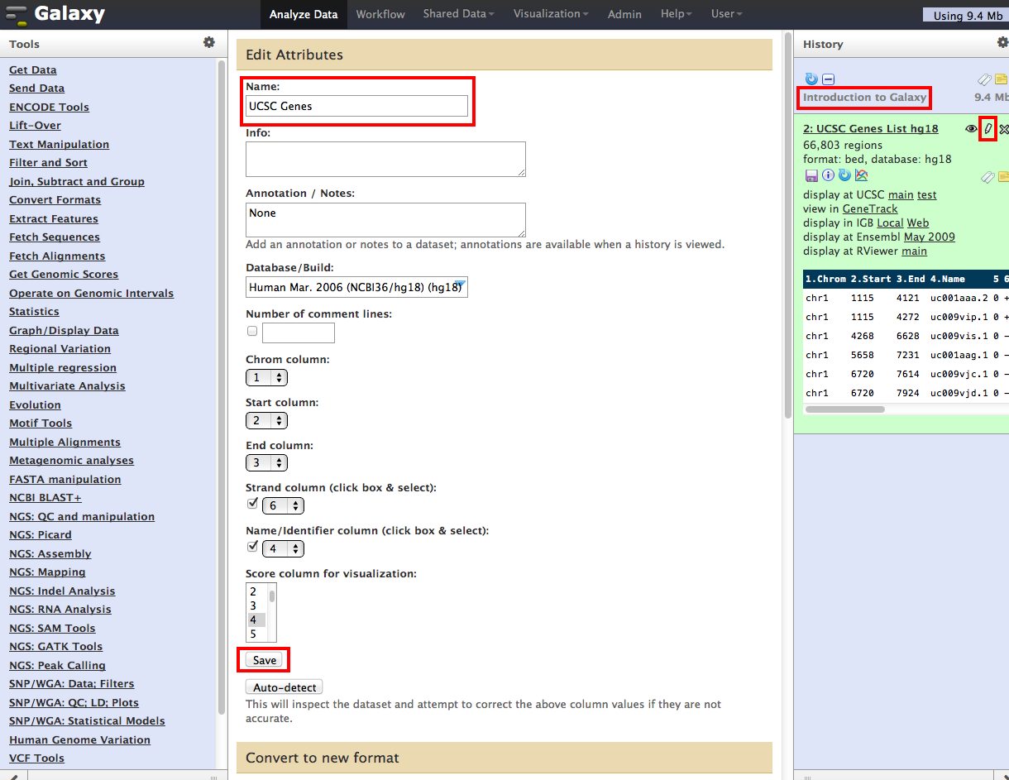
Generic Galaxy screenshot
--
just to get a sense of what sort of GUI researchers have to navigate and why smooth interop is beneficial

Slide 13
Introduction Galaxy Australia, the life science platform that allows reproducible, transparent analyses through a web interface and Cloudstor, AARNet’s cloud research data storage platform, have brought users of these platforms together by enabling easy and secure data transfer options between these national platforms. Methods The “Import from Cloudstor” tool allows users of Galaxy Australia, after a simple configuration of their Cloudstor storage allocation, to navigate through their folders to import files, directories or multi-directories of files into their Galaxy History. Once their data has been analysed the ”Send data to Cloudstor” tool allows the user to securely transfer any files back to their Cloudstor allocation. Results Running on the latest version of Galaxy (20.05), researchers analysing data can now rely on seamless interaction and movement of their data to / from their AARNet provided Cloudstor personal account. Conclusion The development of functionality to connect a long standing national platform (AARNet) with the rapidly growing user base of Galaxy Australia demonstrates the advantages of national platforms working to service integration, for the benefit of all Australian researchers.

Slide 14
And finally, Globus (and perhaps Rucio) meant to formalise and automate existing fast-data workflows between well-established facilities (HPC centres, big-rig genomics sequencers and a handful of sundry other sites). This needs maturity coaching (about identity harmonisation, about namespace agreements, about scheduling and orchestration in the science workflow) perhaps more than tech support (rolling out and operating globus) And this of course is where we’d really benefit from international coordination – make Metcalfe’s law work for the platforms we settle on (Globus, Rucio, others?)

Slide 15
Questions? Guido.Aben@aarnet.edu.au

