Slide 1
Data Services in EGI: overview and use cases

Slide 2
GENERAL HOUSEKEEPING
Please make sure your microphone and video are deactivated unless the (co)host gives permission.
Use the function to ask to speak, you find the option in the “participants” list
All presentations will be available on
Indico (see session via Timetable).
If you do not see all the Zoom buttons
at the bottom of the Zoom window, move your mouse on that window and buttons will appear.
Share your impressions and experiences on Twitter using #EGI2020 and mention @EGI_eInfra.

Slide 3
Agenda
EGI Data Services Overview
Andrea Manzi (EGI Foundation) - 30’
The ECRIN MetaData Repository (MDR) for clinical study objects
Sergei Gorianin (ECRIN) - 15’
Data Management in the Belle-II experiment
Cedric Serfon (BNL) - 15’
Q&A - 15’

Slide 4
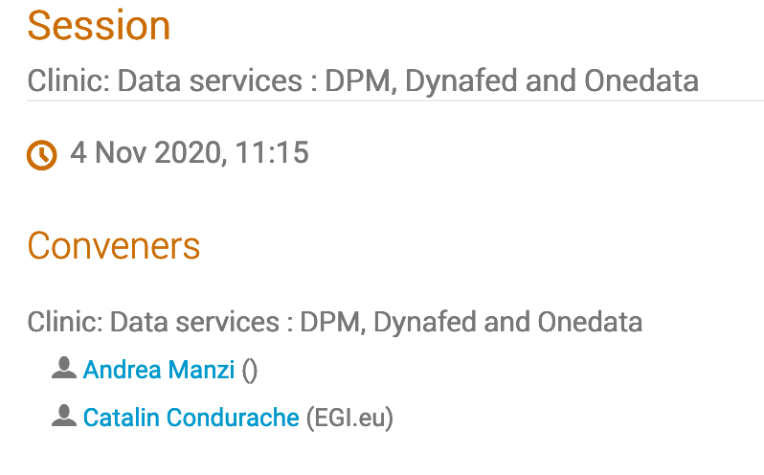
Clinic: Data Services

Slide 5
EGI Data services Overview
Andrea Manzi
EGI Foundation

Slide 6
Overview
EGI Data Services
EGI DataHub
EGI Online Storage
EGI Data Transfer
Enhancing the EGI Data Offer
Rucio
Globus
Service Design Workshop

Slide 7
EGI DataHub
https://datahub.egi.eu

Slide 8
EGI DataHub Overview
Service based on Onedata technology
It allows transparent data access under a common namespace regardless of the location
open access
access restricted to members of a Virtual Organization (VO)
Data can be accessed via a GUI or APIs
Allows replication of data from data providers for resiliency and availability purposes. Replication may take place either on­ demand or automatically.
Easy integration with other EGI components and with user communities existing infrastructures thanks to integration with EGI Checkin service, the EGI Authentication and Authorization Infrastructure (AAI)

Slide 9
Architecture
DS.3
FUSE Client
Oneclient
EGI Checkin
Service
Data Space 1
HTTP GUI
REST / CDMI
FUSE Client
Oneclient
Onezone
FUSE Client
Oneclient
Data Space 2
HTTP GUI
REST / CDMI
FUSE Client
Oneclient
Credits : Bartosz Kryza

Slide 10
Service Options
Access to a PLAYGROUND public space is open to anyone for testing and evaluation
N.B. Limited and shared storage
Users are able to create private empty spaces and provide/ask for storage support via Oneprovider
installing Oneproviders on their infrastructure to store or expose existing datasets
contacting EGI support to request storage support from EGI Federation providers
According to SLA to be agreed with the providers
Communities may decide to have a customized and dedicated DataHub installation for their use cases
e.g. PaNOSC https://onezone-panosc.egi.eu/
contacting EGI to discuss the support and installation

Slide 11
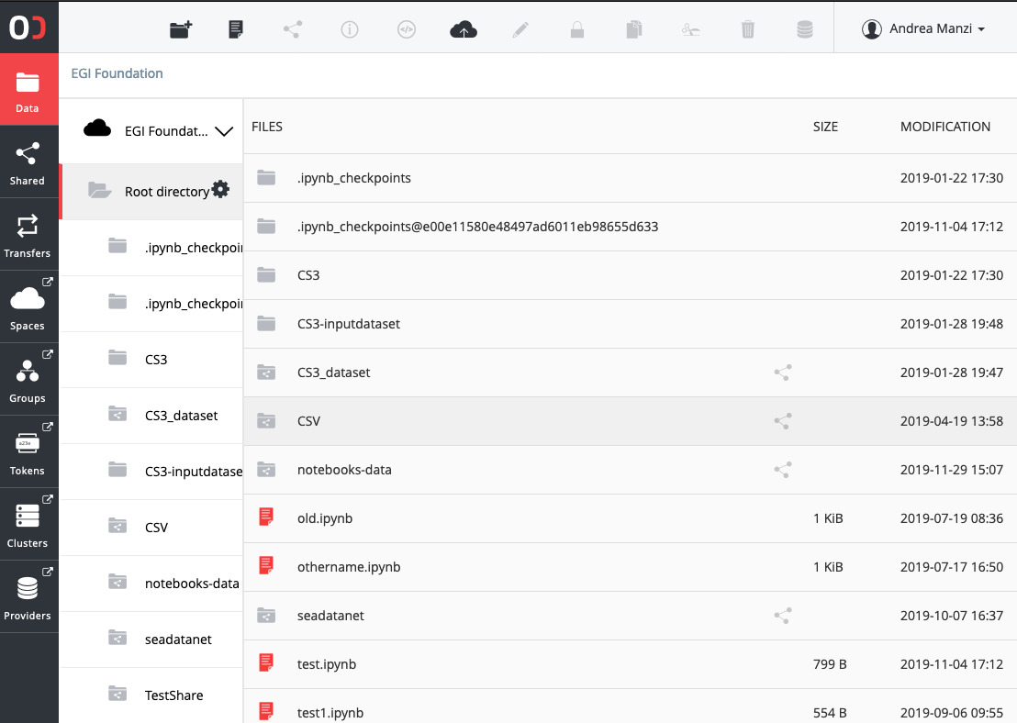
File / Share management
For each space, users can manage files stored at the OneProviders
Usual file operations supported
Directory can be publicly shared
https://datahub.egi.eu/share/8a7d0e1de074f8ab12cfdd8f2428f4b8ch6b7b
Shares can eventually be published via Handle services and have a PID assigned
http://hdl.handle.net/21.T15999/QBFl7Pw

Slide 12
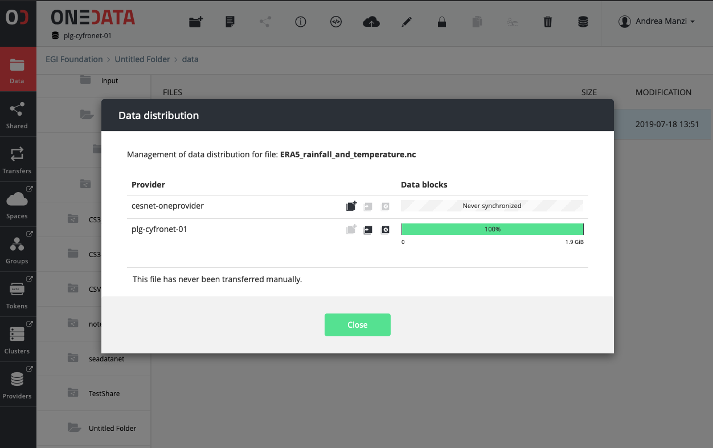
Replica / Transfer management
For spaces supported by multiple OneProviders, the data distribution can be adjusted
Data migration
Data balancing
Transfers can be scheduled, monitored and cancelled from the Web interface and REST API
Support for QoS
OneData QoS talk by Lucasz Dutka (Cyfronet) at EGI Data Transfer WG workshop

Slide 13
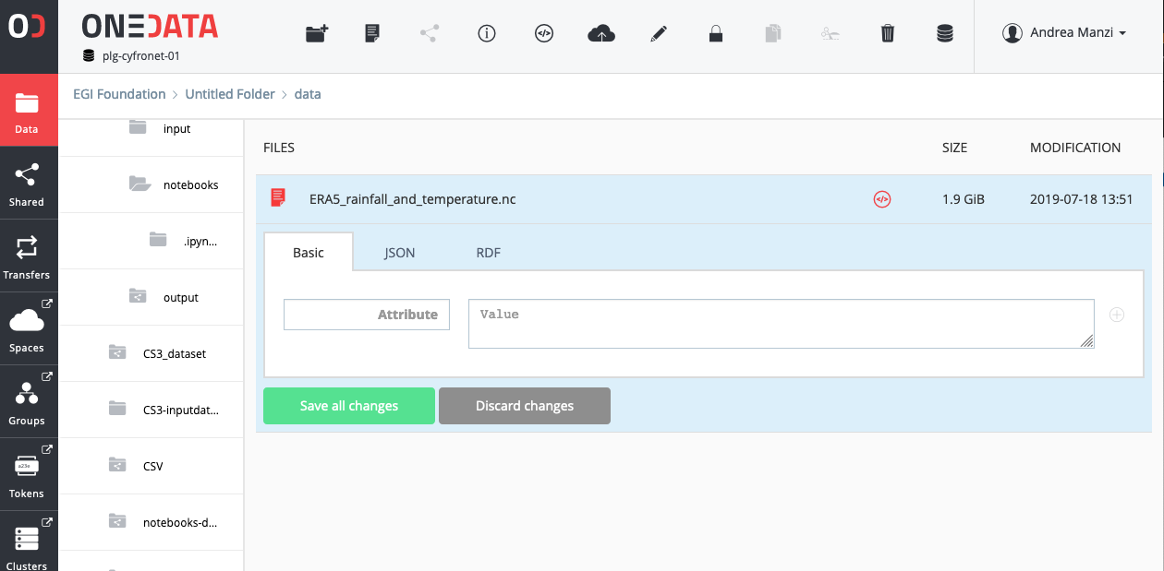
Metadata management
Metadata associated to files
Key/value pairs
Json
RDF
Possibility to create indexes via REST API
Metadata harvesting via OAI-PMH interface
http://datahub.egi.eu/oai_pmh?verb=ListRecords&metadataPrefix=oai_dc

Slide 14
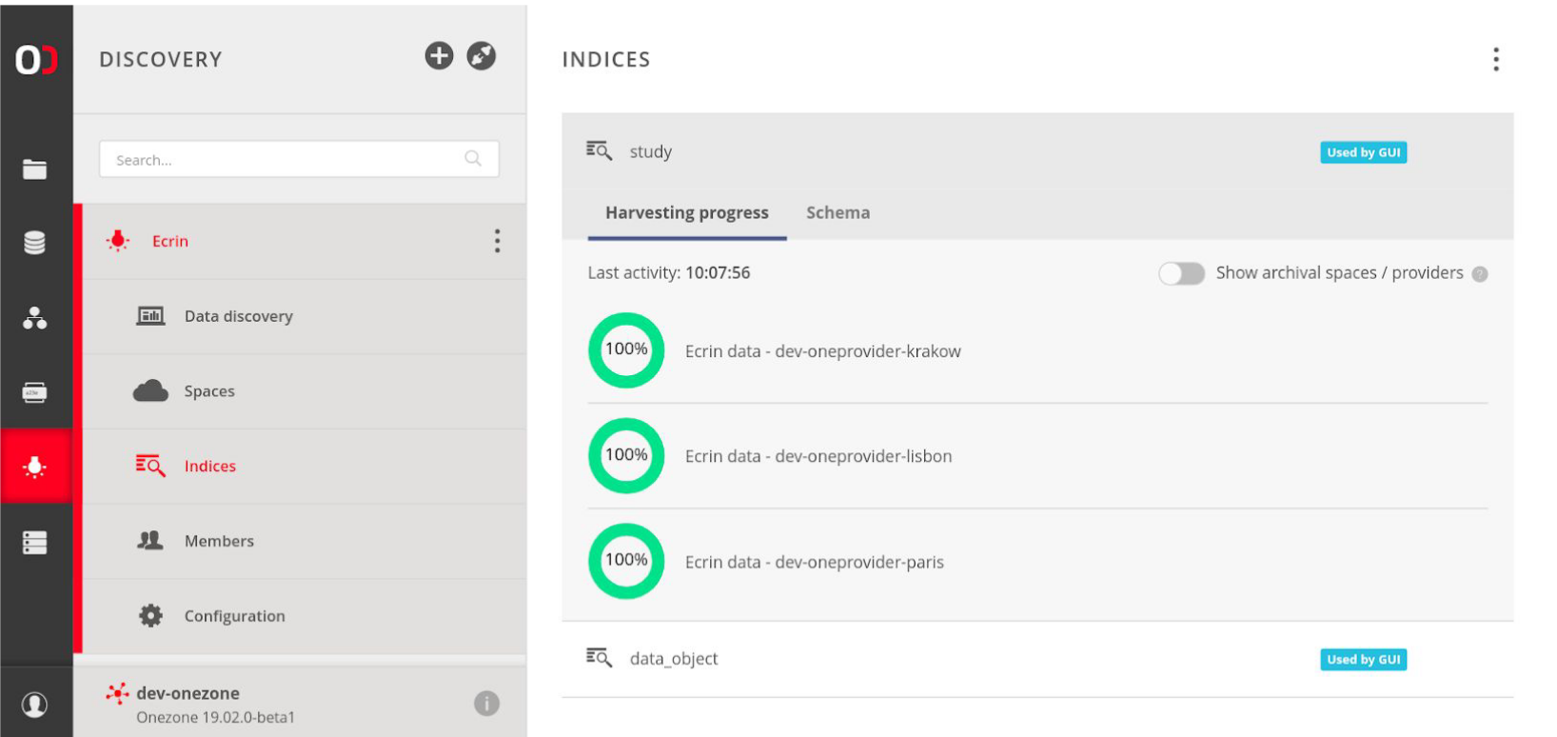
Harvester management
Possibility to automatic extract metadata from files published to a space
Metadata updates are pushed to external indexes ( e.g. Elastic Search) and automatically synchronized
Search interface as GUI plugin
MDR use case implemented by ECRIN

Slide 15
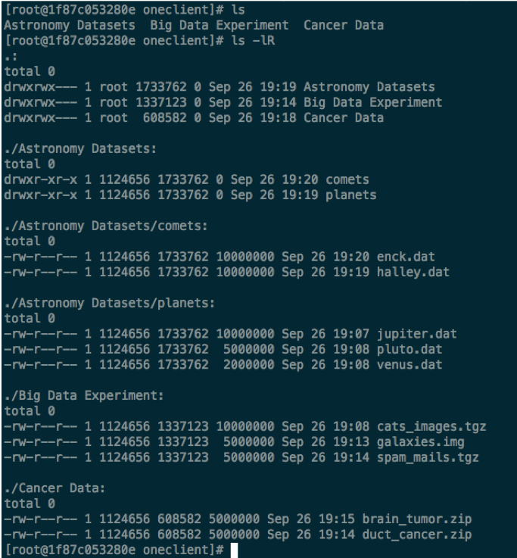
Posix Access via Oneclient
Files not available on the mounted Oneprovider, when accessed, are transparently transferred from other Oneproviders supporting the same space

Slide 16
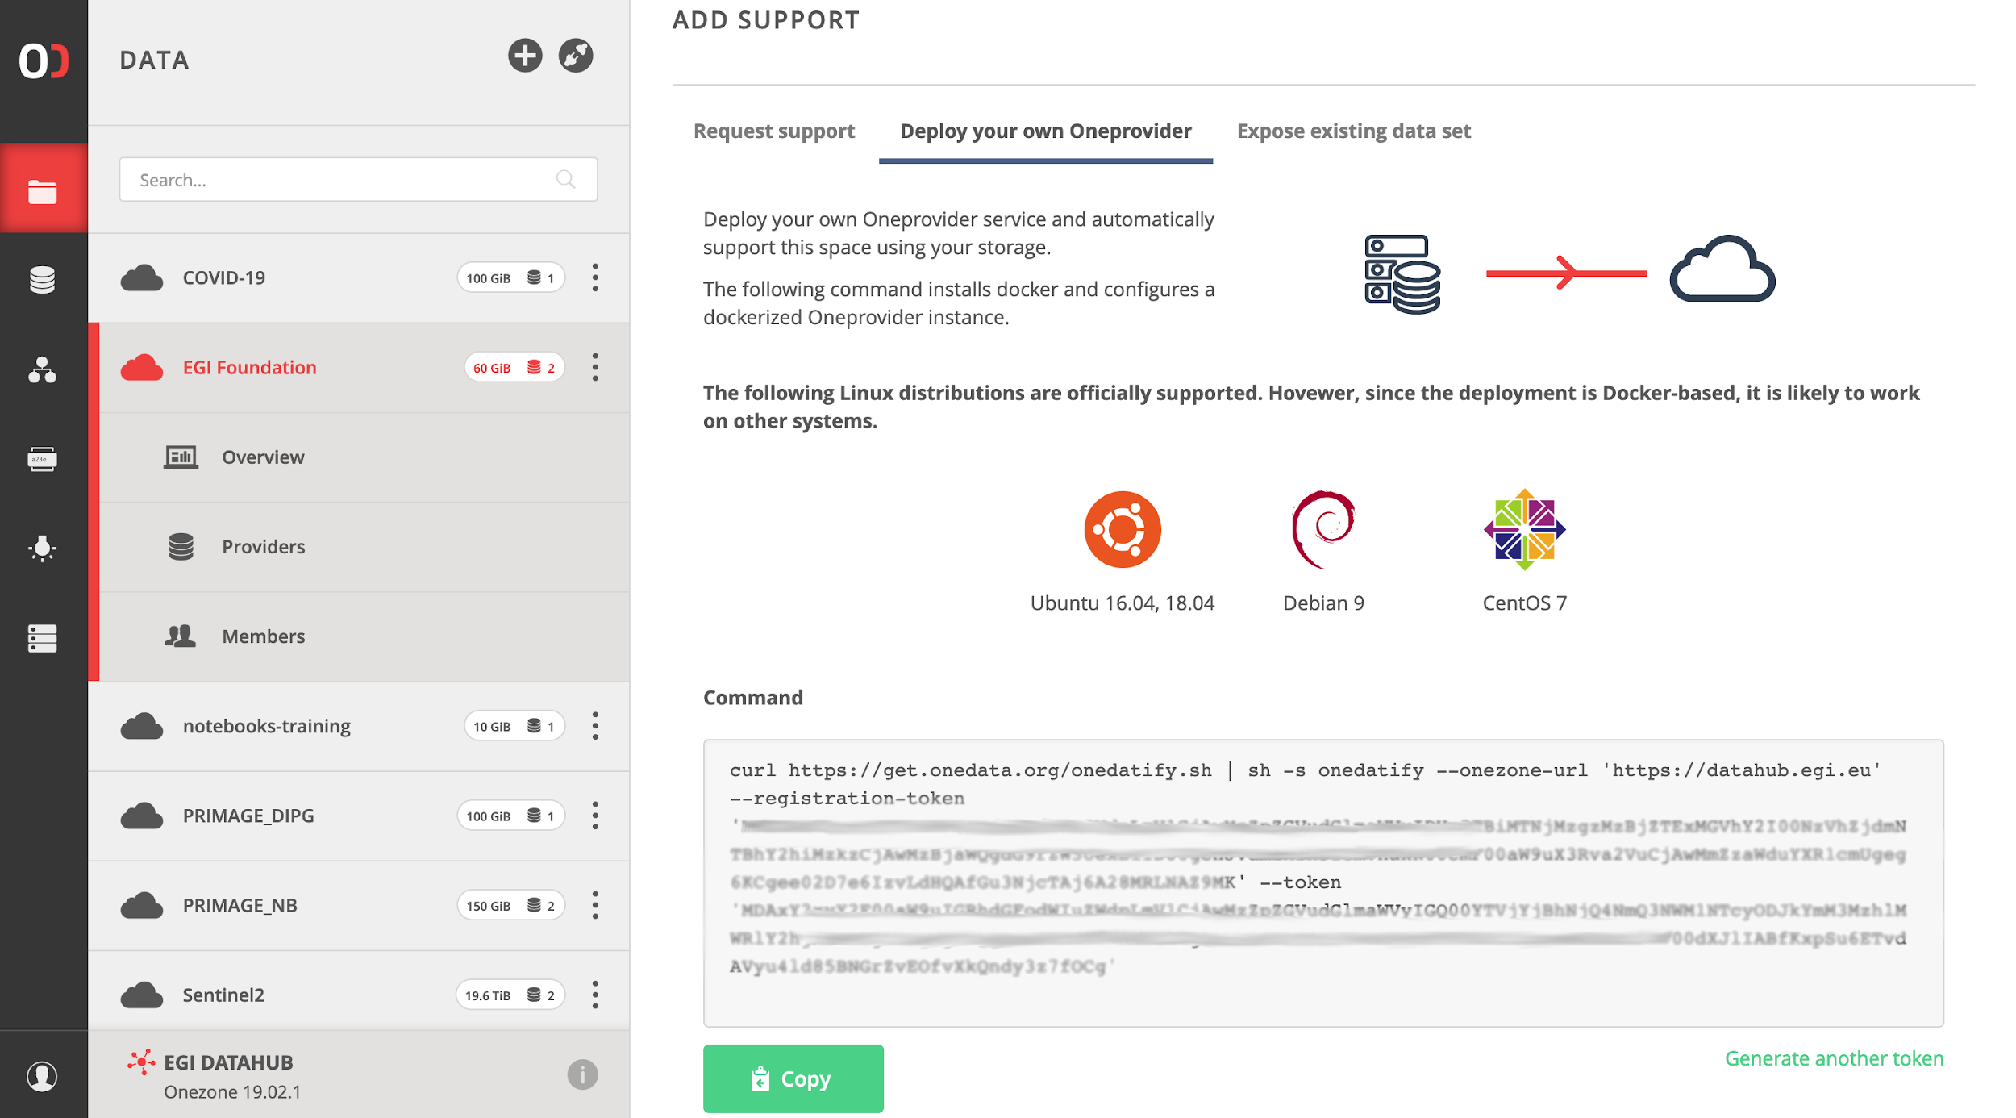
OneProvider installation to support spaces
Automatic SSL certificate installation via Let’s Encrypt
Supported backend
Posix
S3
Swift
CEPH
GlusterFS

Slide 17
Documentation/Links
https://docs.egi.eu/users/datahub/
https://docs.egi.eu/providers/datahub/
https://onedata.org/

Slide 18
EGI Online Storage

Slide 19
EGI Online Storage
Access data through different protocols and replicate data across different data centres to increase fault-tolerance
Access highly-scalable storage from anywhere
Control the data sharing
Organise data using a flexible hierarchical structure
Extends storage resources for compute instances
Assign global identifiers to files

Slide 20
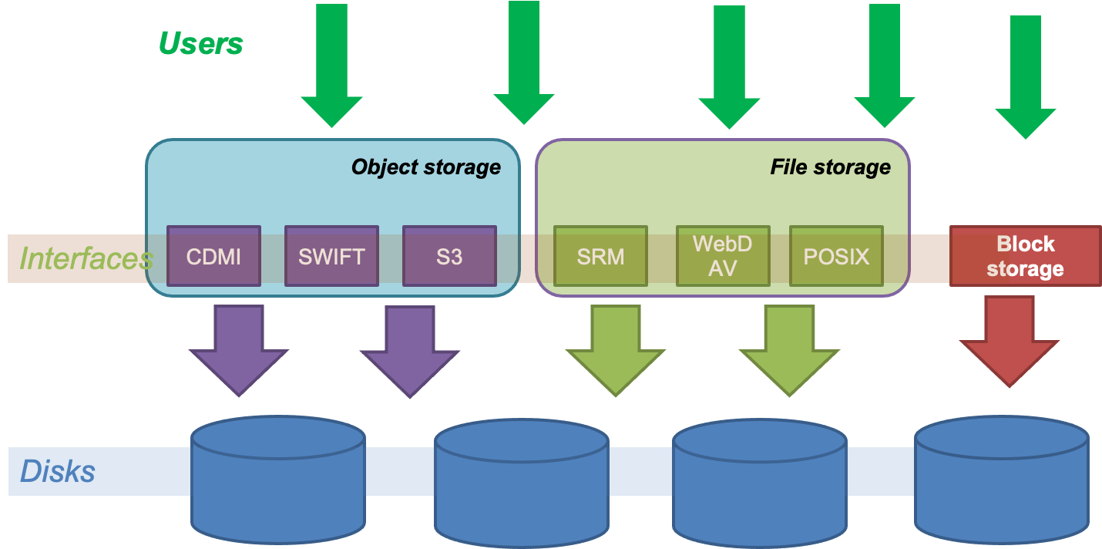
Service options

Slide 21
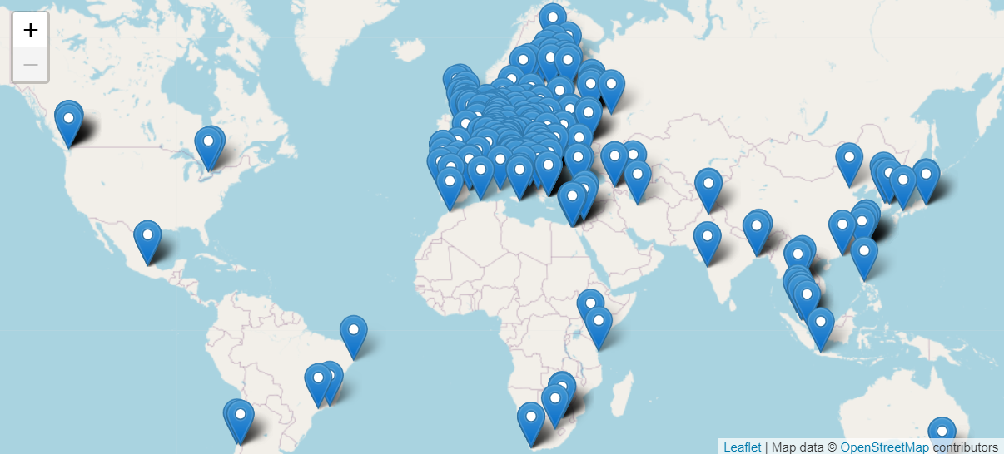
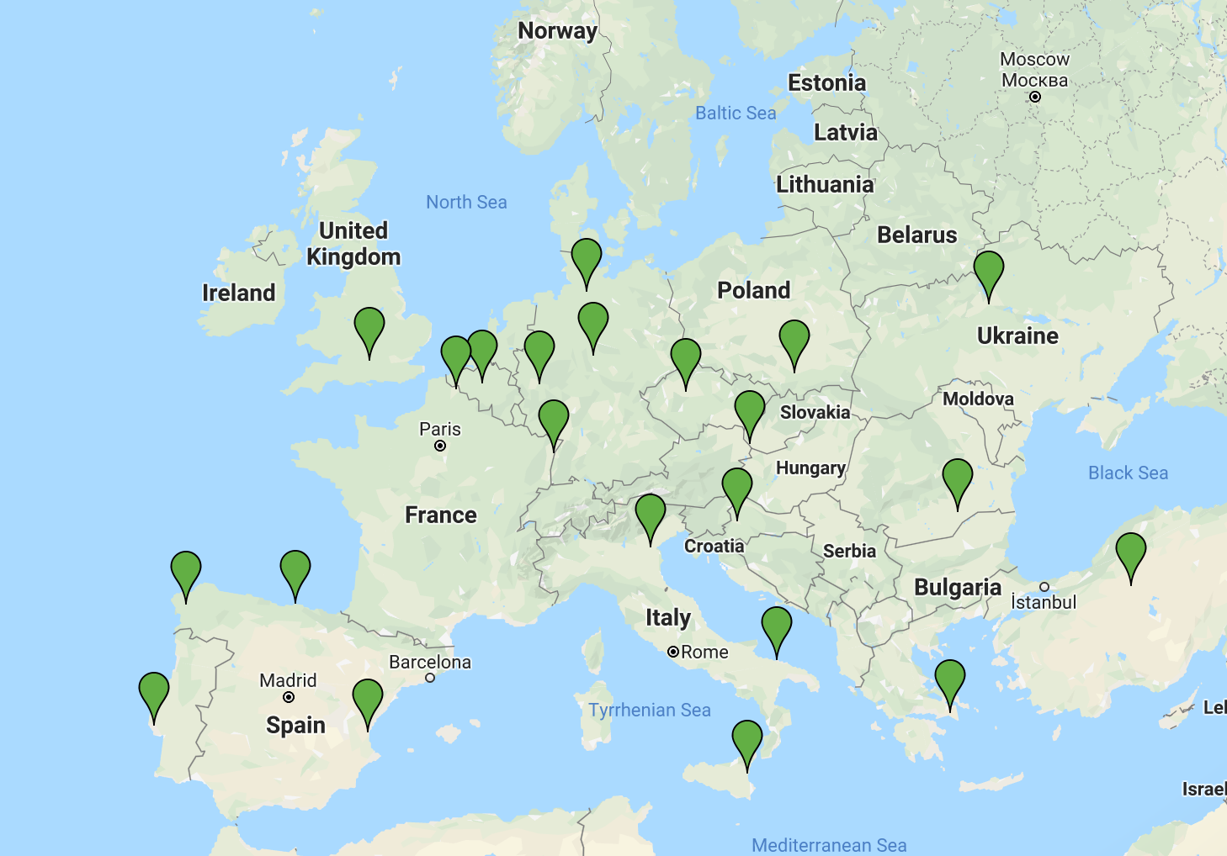
EGI HTC Federation & Cloud federation
Cloud providers: Block & Object storage
HTC providers: File storage

Slide 22
Service options - File Storage
File storage can be used for storing and accessing files on the infrastructure as input/output to EGI HTC computations
The EGI Workflow Management systems (DIRAC) is able to access files stored in File Storage instances via different protocols, and schedule the computations in order to be executed close to where the input files are stored
It implements also the File cataloguing
Technology: DPM, dCache, StoRM
Interfaces: SRM, HTTP/WebDAV, XRootD, gsiftp, CDMI

Slide 23
Service options - Block Storage
Block-level storage solution that allows to expand the storage capacity of instances in the EGI Federated Cloud, offering the lowest possible latency for applications
Increase storage without increasing the size or capacity of the instance or by provisioning new ones; delete servers, keeping data intact
Enhancing Technology: Openstack Cinder
Interfaces: POSIX for access, OCCI and Openstack CLI/GUI for management

Slide 24
Service options - Object Storage
Manages data as objects. Each object includes the data itself, a variable amount of metadata, and a globally unique identifier.
Cloud object storage allows relatively inexpensive, scalable and self-healing retention of massive amounts of unstructured data
The main uses cases are:
Backups and Data Archive, AI and ML , Cloud Native applications
Technology : OpenStack Swift, CEPH
Interfaces: S3, Swift, CDMI

Slide 25
Services Access
File Storage
The services expose standard interface for data access that can be contacted via many CLI tools and libraries
For grid based protocols ( SRM, gsiftp, XrootD) the gfal2 library and CLI is the recommended choice
For HTTP/Webdav access via standard clients like curl
Auth/Authz is based on X509, transition to JWT tokens has been pushed and coordinated by WLCG
Access via EGI Checkin available at some testing endpoints

Slide 26
Services Access
Block Storage
Storage is mounted directly on the VMs
Object Storage
Openstack Swift implementations: the OpenStack CLI can be used to access objects and containers.
any CDMI and S3 command line client/library can be used for Object storage instances exposing S3/CDMI protocols
Dynafed - Enables object storage access via X509 and OAUTH2
See Data Clinic

Slide 27
Documentation/Links
https://docs.egi.eu/users/online-storage/
https://www.egi.eu/services/online-storage/
https://marketplace.egi.eu/34-online-storage

Slide 28
EGI Data Transfer

Slide 29
EGI Data Transfer
Simplicity
Easy users interaction for submitting transfers.
WebFTS portal for end-users, Real Time monitoring and Web Admin
Reliability
&
Integrity
Checksums and retries are provided per transfer.
Multiprotocol support
Different clients to access the service (RESTFul APIs, python bindings).
Transfers from/to different storages
Flexibility
&
Scalability
Intelligence
Parallel transfers scheduling and optimization to get the most from network without burning the storages.
Priorities/Activities support for transfers classification.

Slide 30
Transfer Scheduler
For each link transfers are prioritized according to:
Transfer Priority
provided by the users
Activities shares
Weights associated to transfers activities ( labels assigned to transfers )
VO shares
Link weights associated to VOs

Slide 31
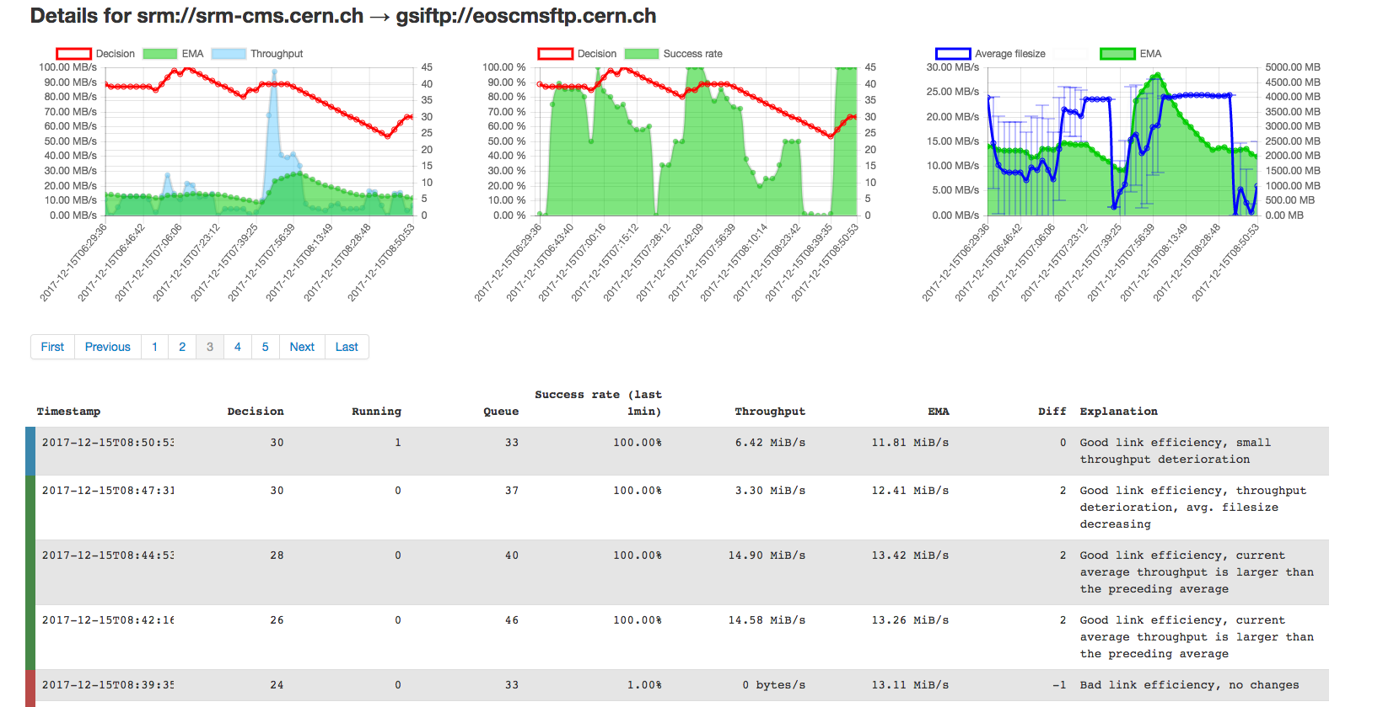
Transfer Optimizer
Number of Streams per transfer are also optimized
based on the file size and the transfer queue (if enough transfers on a link -> 1 stream per file)

Slide 32
User Tools and APIs
RESTFul APIs
https://fts3-docs.web.cern.ch/fts3-docs/fts-rest/docs/api.html
Python “easy” bindings and CLI
https://fts3-docs.web.cern.ch/fts3-docs/fts-rest/docs/easy/index.html
https://fts3-docs.web.cern.ch/fts3-docs/fts-rest/docs/cli.html
C++ CLI
http://fts3-docs.web.cern.ch/fts3-docs/docs/cli/cli.html
Data Management frameworks integrated
Rucio, Phedex, DIRAC, Dynamo, etc.

Slide 33
Other Main Features
Tape Archives integration
FTS can request to ”bring-online” files to disk from storages supporting Tapes
Multi-hop transfers support
Transfers from A->C, but also A->B->C
Bulk File deletions
Clients can send a list of files to delete and FTS optimizes the interactions with the storages
Messaging integration
Messages produced for job/transfer state change and optimizer decisions

Slide 34
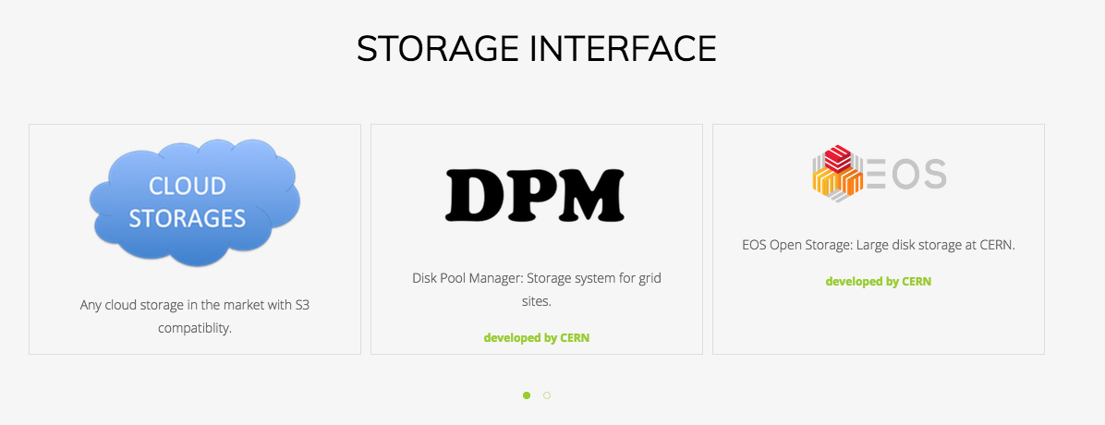
Multiprotocol support: gfal2
FTP/gsiftp, HTTP,XRootD, SRM, S3, Gcloud, ..
TPC (3rdParty) copy or protocol translation (streaming)

Slide 35
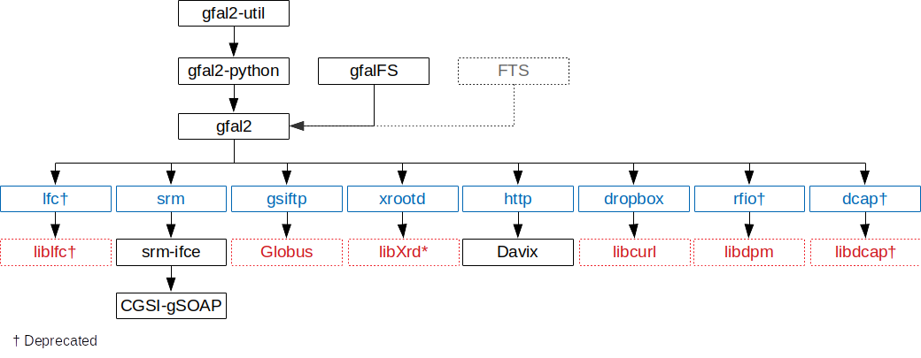
gfal2 components diagram

Slide 36
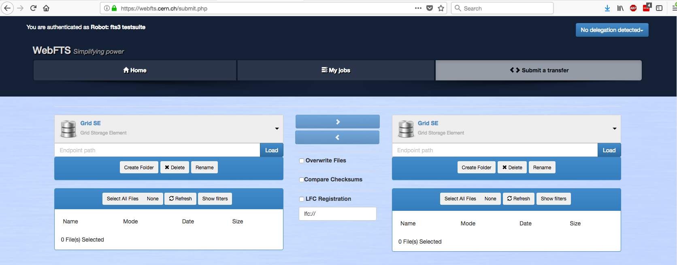
WebFTS – Transfer management from your browser

Slide 37
EGI FTS instances
2 Production instances available for EGI VOs since February 2019
CERN ( server + WebFTS)
STFC-RAL
Soon available new functionalities
OIDC supports, QoS, Archive monitoring
FTS 3.10 talk by Mihai Patrascoiu (CERN) at EGI Data Transfer WG workshop

Slide 38
Documentation/Links
https://docs.egi.eu/users/data-transfer/
https://www.egi.eu/services/data-transfer/
https://marketplace.egi.eu/36-data-transfer

Slide 39
Enhancing the EGI Data offer

Slide 40
Enhancing EGI Data services offer - Rucio
Rucio is the software developed at CERN for the management of ATLAS LHC experiment data
Under integration by many communities also outside HEP
Extremely scalable, policy-driven data management system
Included in the next EGI flagship EU-project (EGI-ACE) to be operated by STFC-RAL
Catch-all instance ( Multi-VO)
Possibly interfaced with DIRAC
Rucio talk by Alastair Dewhurst ( STFC-RAL) at EGI Data Transfer WG workshop

Slide 41
Enhancing EGI Data services offer - Globus
Globus is well known and widely used service for Data transfer and sharing, with easy to use GUI and client installation
The data transfer feature is available for free, sharing
and advanced features are available under subscriptions
Discussions ongoing for a possible Globus EU instance operated by EGI federated with the US instance. Need to understand the EU communities interest and possible funding
https://ec.europa.eu/eusurvey/runner/globus-eu
Globus Talk by Vas Vasiliadis (U. Chicago) at EGI Data Transfer WG workshop

Slide 42
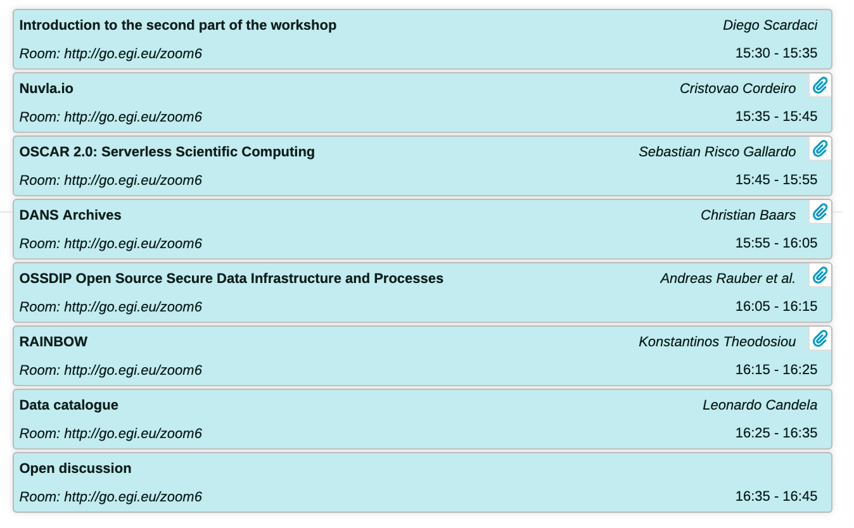
Enhancing EGI Data services offer: WG
Service Design WS: New services - proposals for EGI
today 15:30 - 16:45 CET
Proposals for Data Services presented
Open Source Secure Data Infrastructure
and Processes (OSSDIP) by Tu Wien
D4Science data catalogue by ISTI-CNR
Preservation Storage by DANS

Slide 43
Thank you!

