Slide 1
MetaData Repository (MDR) for clinical study objects
Sergei Gorianin
04.11.2020
Notes:
This is the cover page slide. Insert headings and titles as appropriate.

Slide 2
Background
Clinical research studies and data objects belonging to it are it often scattered around (e.g. website, publication, repository, registry).
Mechanisms for gaining access vary between different places and different data objects.
No agreed discovery metadata schemas implemented and used for discovery.
Findability of clinical studies and related data objects is a difficult, time-consuming process.

Slide 3
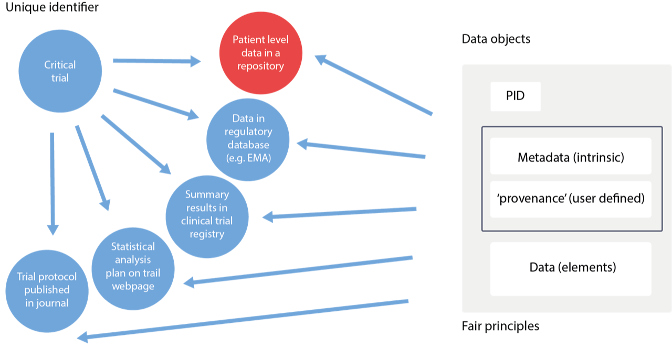
A study is any clinical research study with humans as study participants, and which is therefore subject to ethical approval, whether or not the study is interventional (a 'clinical trial'), or observational (including disease registry data), or a case study.
A data object is any information available in electronic form (a 'data stream') and may be a document (e.g. a pdf), a dataset in one of a variety of formats (spreadsheet, csv files, database file, XML etc.), a media (audio, video) file, an image (e.g. a conference poster) or simply a web page with useful text.
Fig. 1 – Structure of clinical trial (study, data object)

Slide 4
MDR… Why?
To maximize the discoverability of all these studies and related data objects, it is necessary to collect the metadata about them, including object provenance, location and access details, into a single system.
To that end ECRIN is currently developing an MDR (MetaData Repository) to standardize, assemble and display the metadata about clinical studies and the data objects generated by them, and provide access to them through a single system, accessed via a web portal.

Slide 5
MDR… Implementation
The web portal is developed in collaboration with ONEDATA (Cyfronet, Poland); functionality for discoverability of studies and related data objects is provided by INFN (Italy)*. So far metadata from ~18 data sources have been collected using different modalities (e.g. XMLs processing, APIs, scraping of web pages) and stored as JSON objects/relational DB form on the test bed server at INFN. Data will be then ingested, uploaded and made available for the users.
The ONEDATA solution will implement the metadata collection and transport from multiple OneProvider to the central OneZone service; it will also deal with the ACLs management to implement the data protection.
* Within H2020 XDC project

Slide 6
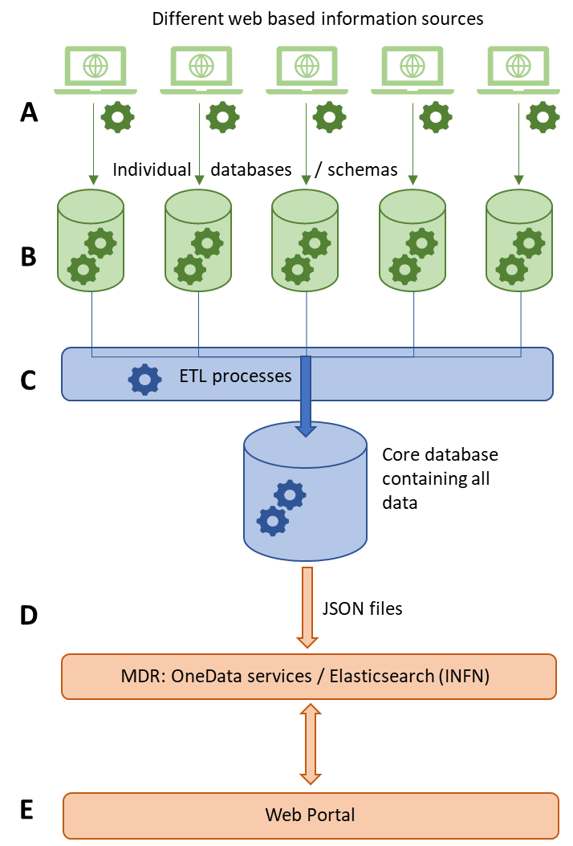

Slide 7
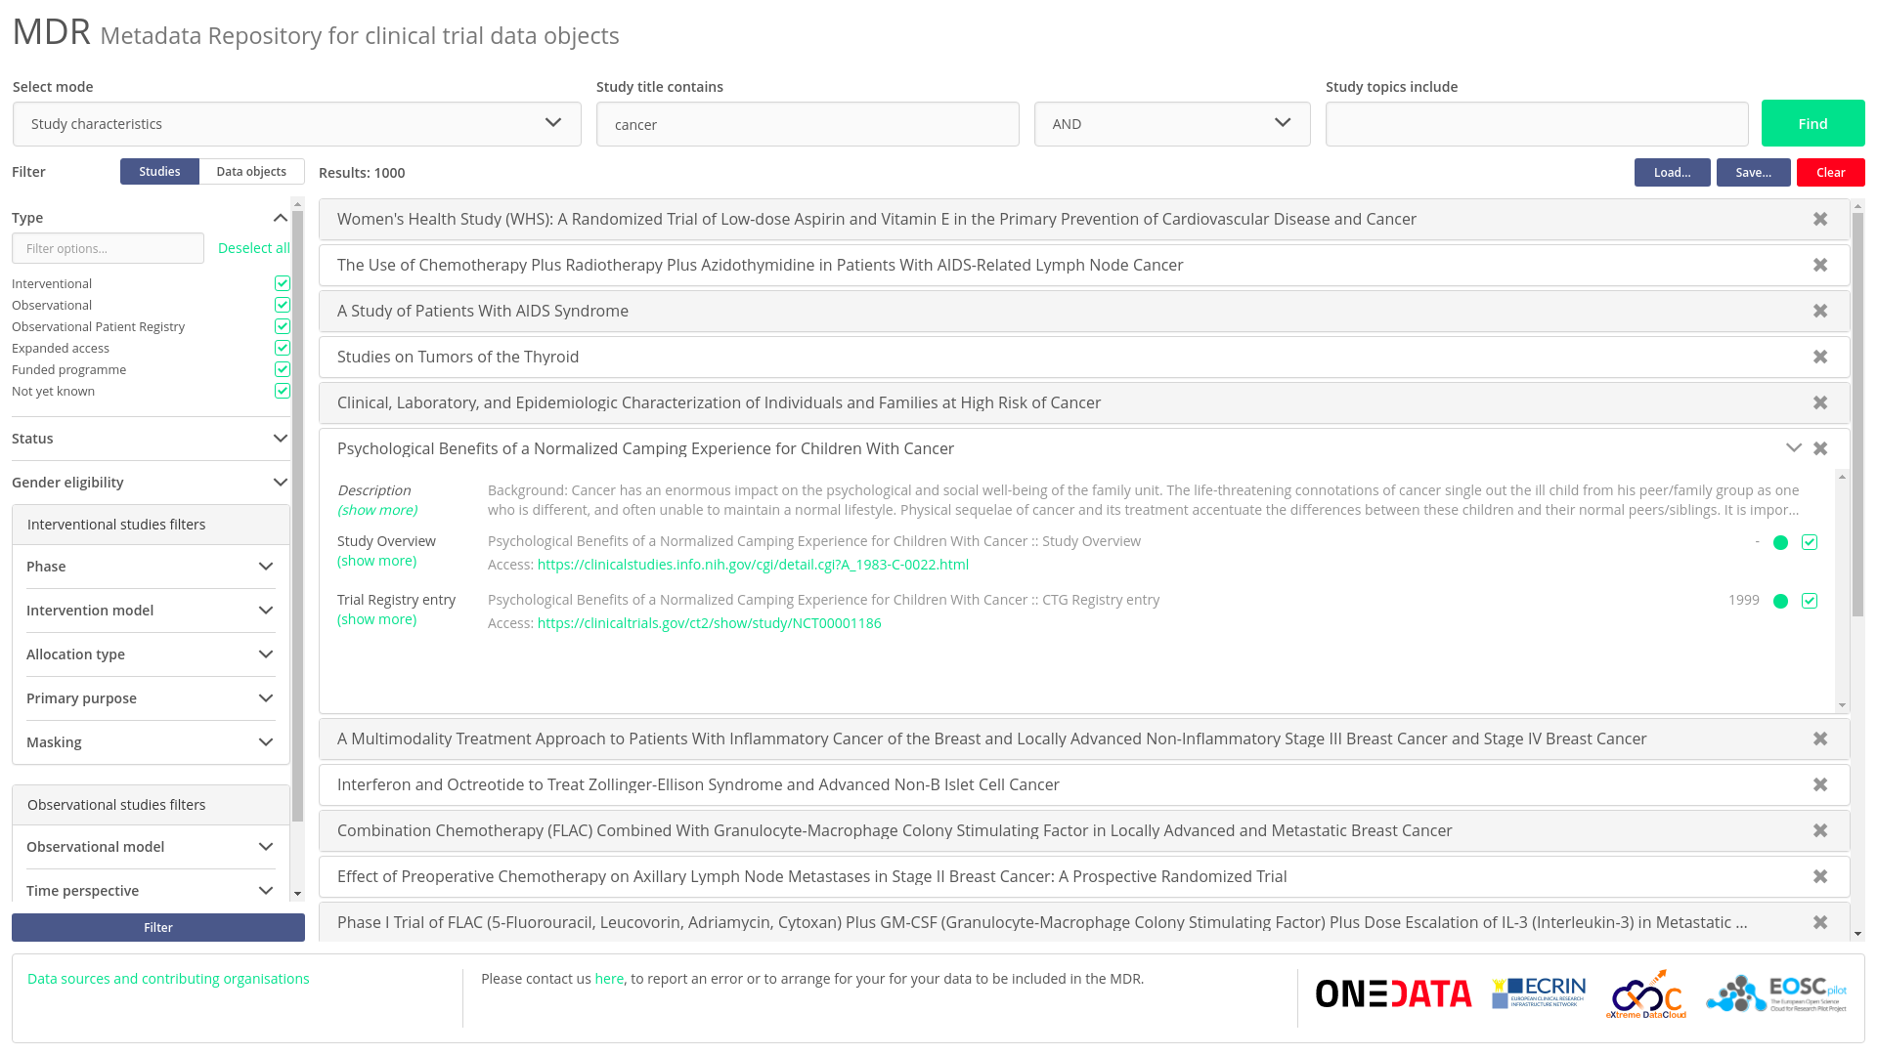
User interface for Web portal (developed by ONEDATA)

Slide 8
Current progress
~ 18 data sources (including PubMed, CT.gov, BioLINCC, Yoda, WHO ICTRP, etc) are connected
Single and universal metadata schema was developed*
~ 2 millions of studies and data objects uploaded (including COVID-19 related clinical trials)
JSON Schema - http://ecrin-mdr.online/index.php/JSON_Schemas
ECRIN Clinical Research Metadata Schema https://zenodo.org/record/3562911

Slide 9
User feedback
From technical point of view most features and functionality are implemented.
From UI point of view the web-portal is designed well.
From UX point of view the web-portal has to be revised, but, in general, users found it quite clear and easy to use.
In general, users’ feedback is positive. Users found MDR very useful.

Slide 10
Next steps EOSC-Hub
Revise web-portal
Investigate different mechanisms for accessing ECRIN metadata stores
Continue to developing ElasticSearch-based APIs
Extend the MDR demonstrator to run in production in the EOSC environment
Make MDR demonstrator part of the EOSC catalogue
Collect data on user actions
Collect user feedback

Slide 11
More details?
Our wiki:
http://ecrin-mdr.online/index.php/Project_Overview

Slide 12
DEMO

Slide 13
Thank you!
Any questions?

