Slide 1
EU-Open Science Policy Platform from Recommendations to Practical implementation
Rebecca Lawrence, Managing director, f1000 research ltd; editor of the OSPP final report

Slide 2
The EU Open Science Policy Platform (OSPP)
First mandate: May 2016 to April 2018
High-level Expert Groups analysed and addressed issues related to most of the eight challenges, leading to a series of reports and recommendations
Led to publication of the OSPP-REC
Second mandate: May 2018 to April 2020
Shift from ‘Recommendation Mode’ to ‘Implementation Mode’, through PCIs: Practical Commitments for Implementation at stakeholder level
Particular focus on Next-generation Metrics, Rewards and Incentives
Core stakeholder communities
Universities
Research Organizations
Academies & Learned Societies
Funding organizations
Citizen Science Organizations,
Publishers
Open Science Platforms & Intermediaries
Libraries

Slide 3
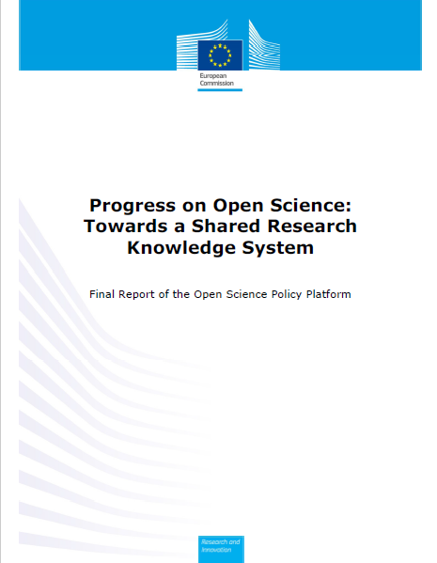
Aims of the final report
Review progress against the OSPP-REC: the combined recommendations of the Open Science Policy Platform (OSPP) in 2018, focussing on the EC’s eight pillars of Open Science – highlight exemplars and identify blockers
Provide a Vision for moving beyond Open Science to a Shared Research Knowledge System by 2030

Slide 4
1. Reviewing progress against the OSPP-REC

Slide 5
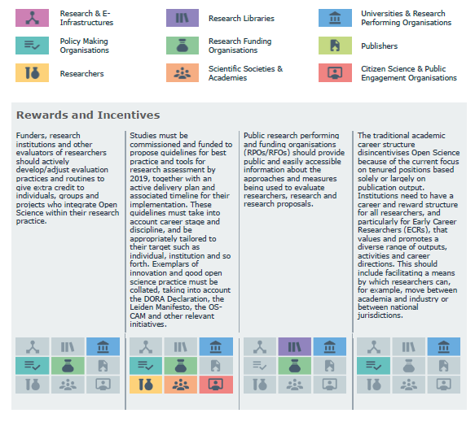
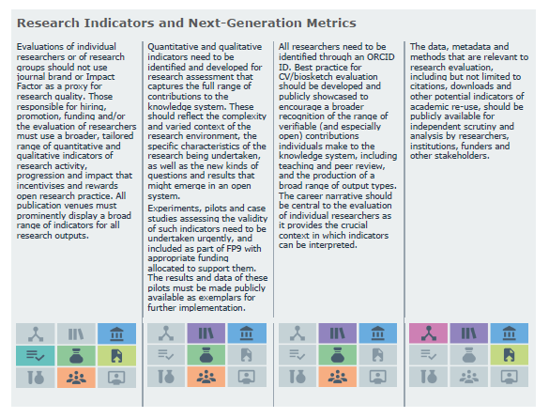
OSPP-REC
Published May 2018
2-4 recommendations for each of the EC’s 8 pillars of Open Science
Rewards and Incentives
Research Indicators and Next-Generation Metrics
Future of Scholarly Communication
European Open Science Cloud
FAIR Data
Research Integrity
Skills and Education
Citizen Science

Slide 6
Progress since OSPP-REC: Three main outcomes
OSPP registry of pilots and implementations of responsible metrics
Appointment of Open Science Coordinators and task forces for the implementation of Open Science
Collated series of Practical Commitments for Implementation (PCIs)

Slide 7
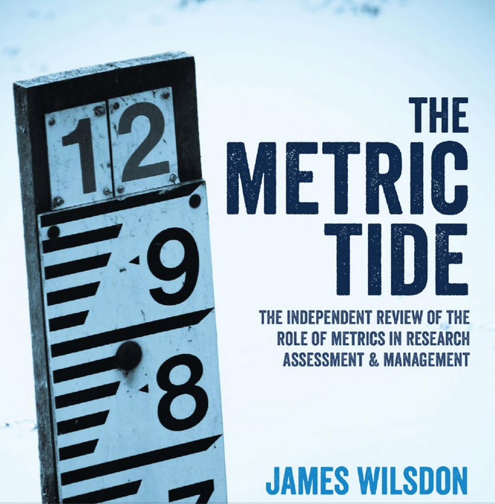
Using research-related metrics responsibly
Several key reports and frameworks proposed
Manage and plan for unintended consequences and/or ‘steering’ effect of indicators
Don’t create incentives for only tokenistic / superficial change in behaviours
Tailor suite of indicators to field, project, type of entity measuring etc

Slide 8
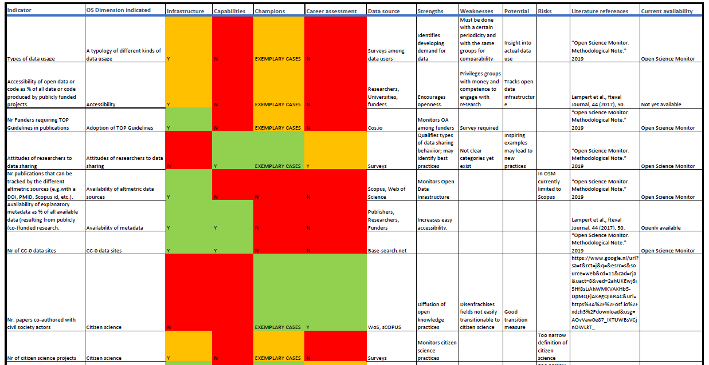
Large number of indicators available

Slide 9
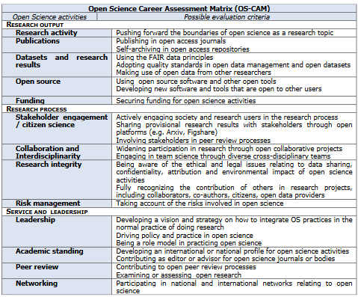
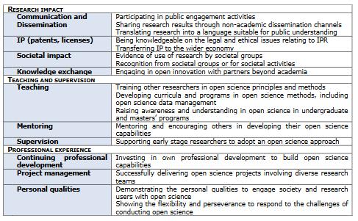
https://ec.europa.eu/research/openscience/index.cfm?pg=rewards_wg

Slide 10
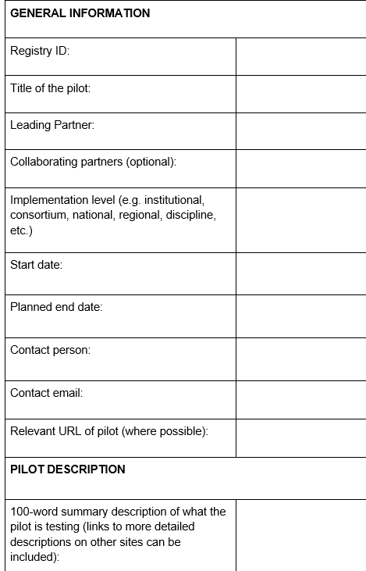
OSPP registry of pilots and implementations of responsible metrics
Uptake hampered by lack of exemplars and lack of evidence base on what works and what doesn’t
Registry aims to drive broader uptake by calling for new pilots or policy implementations and then openly sharing learnings
Coordinated by RDA (working with DORA), creating a structured, searchable Registry
Register pilot, then come back after 1-2 years and report on outcomes (positive and negative) + analysis of what can be learned
Ensure open evaluation of pilots and dissemination of results
Use successes to support uptake and broader adoption by others

Slide 11
Open Science Coordinators and task forces
OSPP-REC called for the appointment of national coordinators and task forces for the implementation of Open Science
Since 2018, many National Coordinators appointed and many Member States (MS) have developed National Open Science Plans, e.g. Finland, Ireland and France
In October 2019, 21 MS representatives came together as part of the Finnish EU Presidency to create the Council for National Open Science Coordination (CoNOSC)
Aim is to:
fill gaps in national Open Science coordination across the European Research Area
provide insight into activities through dialogue with other international partners.

Slide 12
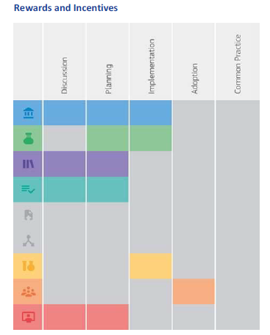
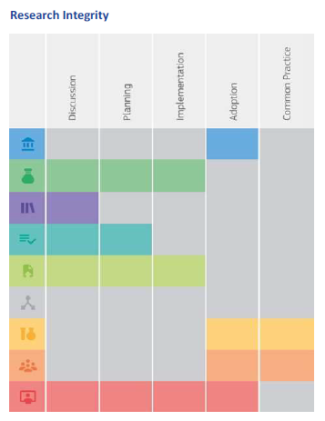
Practical Commitments for Implementation (PCIs)
Reviewed OSPP-RECs, captured example PCIs, asked each actor to categorise progress, and identified blockers
Areas of consensus:
Rewards and Incentives – some initiatives moving to implementation
Research Indicators and Next-Generation Metrics - some initiatives moving to implementation or even adoption
Future of Scholarly Communication – moving to implementation and even adoption
European Open Science Cloud – moving to implementation in 2021
FAIR Data – moving to adoption and even becoming common practice
Areas of disparity:
Research Integrity – research performing orgs, researchers & societies view progress as adoption; funders, libraries, policy-making organisations & publishers view that we are only at discussion / planning / implementation
Skills and Education – research performing organisations & libraries view progress as adoption; the other actors view we are only at discussion / planning / implementation
Citizen Science – citizen science organisations view progress as adoption; the other actors view we are only at discussion / planning / implementation

Slide 13
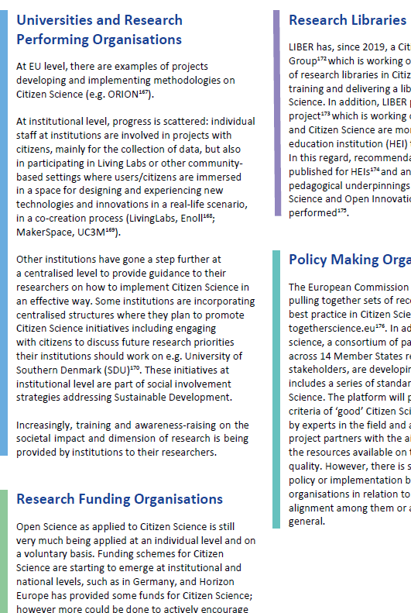
Practical Commitments for Implementation (PCIs) – key points
For real progress, stakeholders need to have constructive dialogue to understand each others’ perspective; disparity in views on progress risks polarization
Urgent need for debate and discussion between academia and industry concerning the Open Science challenges in public-private partnerships
Need to develop a framework to ensure that the open diffusion of knowledge does not disadvantage players that are already underprivileged.
A full list of PCIs and blockers, by actor, is detailed in the report.

Slide 14
2. Vision for moving beyond Open Science to a Shared Research Knowledge System by 2030

Slide 15
Vision - Background
Open Science progress slower than anticipated and obstacles remain:
disparity in progress and motivation across disciplines, institutions, actors, and researchers at different career stages
Lack of policy alignment across local, regional, national and international jurisdictions
Insufficient cost/benefit analysis of Open Science requirements
Open Science not an end in itself
The power of opening up science, sharing knowledge and collaboration has been demonstrated by the significant acceleration of progress on new insights into the spread and mitigation of COVID-19
Now leverage these collective benefits, and the lessons learned, to make more structural changes to the research system to ensure that all of science can advance more rapidly and effectively, for the good of science and society
Call on European MS and other relevant actors to co-create, develop and maintain a ‘Research System based on shared knowledge’ by 2030

Slide 16
shared research knowledge system – five attributes
An academic career structure that fosters outputs, practices and behaviours to maximise contributions to a shared research knowledge system
A research system that is reliable, transparent and trustworthy
A research system that enables innovation
A research culture that facilitates diversity and equity of opportunity
A research system that is built on evidence-based policy and practice

Slide 17
1. An academic career structure that fosters outputs, practices and behaviours to maximise contributions to a shared research knowledge system
Researchers need to be empowered by a reward system that encourages them to collaborate and share their work openly, to be creative, honest and transparent and to take responsible risks
All actors should explore and openly report on new ways to motivate and evaluate researchers, institutions, and their contributions to this knowledge system
No one size will fit all - any change needs to be sensitive to different contexts and jurisdictions, and decision makers at different levels must undertake the necessary steps to be aligned

Slide 18
2. A research system that is reliable, transparent and trustworthy
Reliability and trustworthiness of research outputs is essential (and crucial to speed up research) but not commonly used in research or researcher evaluation
Where codes of conduct do exist (e.g. The European Code of Conduct for Research Integrity), limited data on whether they improve research practice, or are adhered to or enforced
Lack of publication of null / negative / inconclusive results creates publication bias. Good research practice should require the sharing of such findings
Member States (MS) should coordinate a series of workshops to develop, test and share a minimum set of community-based standards of research integrity
MS should ensure training, support, monitoring and enforcement of research integrity standards at publicly funded institutions, in the practice and communication of outputs of publicly funded research

Slide 19
3. A research system that enables innovation
Need clear policies to increase the availability and reuse of research knowledge and technology in a global competitive context
A global interoperable infrastructure of tools, services, hardware and software
Clear regulatory frameworks to manage each stakeholder’s interests for the collective good
A transparent competitive market
A shared research system based on reciprocity

Slide 20
4. A research culture that facilitates diversity and equity of opportunity
A shared research knowledge system should be open and equitable for all, to enable both access / reuse of knowledge but also to contribute to it
This needs to transcend individual disciplines, organisations, culture and politics
All actors need to collaborate on a set of values for a research knowledge system and create a legal and social framework within which these values can be implemented.

Slide 21
5. A research system that is built on evidence-based policy and practice
How we fund and support researchers, publish and review research findings, and incentivise the research system is crucial in the production of research insights and output.
Need to better understand when new ways of working are effective and should be changed
Lack of translation of meta-research into policy – makes it hard to deliver consensus on what a new ‘open’ future should look like
Need a coordinated strategy for funding and delivering a programme of ‘research on research’, including identifying priority areas, and involving representatives from key actors across the system

Slide 22
acknowledgements
Authors of the final report: Eva Mendez (Chair, OSPP Mandate 2), Rebecca Lawrence (Editor and Coordinator), Catriona J. MacCallum (Writing Chair), Eva Moar (Rapporteur), together with all the members of the Open Science Policy Platform
EC’s Research & Innovation team, especially Jean-Claude Burgelman, Rene von Schomberg and Kostas Glinos
Access to the report is at: https://ec.europa.eu/research/openscience/pdf/ec_rtd_ospp-final-report.pdf#view=fit&pagemode=none

Slide 23
Thank you
rebecca.lawrence@f1000.com | @rnl_s

