Slide 1
EGI Contribution to Open Science
Sergio Andreozzi
Head of Strategy, Innovation and Communications EGI Foundation

Slide 2
Outline
The EGI journey from Open Infrastructure to Open Science
Practical Commitments for Implementation and Status
Summary

Slide 3
EGI journey towards Open Science
Key policy initiatives
2014
EGICONF14: Session: Open access to EGI research outputs
2015
vision paper http://go.egi.eu/zrpuy
https://zenodo.org/record/1092
http://go.egi.eu/moyyp
EGICONF15 http://go.egi.eu/eewdz
2012
EGI-Engage project http://go.egi.eu/cyvlt
2016
2020
Start of OSPP and EGI Participation http://go.egi.eu/yxekf
Final OSPP report and EGI PCIs http://go.egi.eu/frqkx
2018
Contribution to OSPP-REC http://go.egi.eu/yxekf
www.eosc-hub.eu

Slide 4
8 EC Pillars of Open Science
Rewards and Incentives
Research Indicators and Next-Generation Metrics
Future of Scholarly Communication
European Open Science Cloud
FAIR Data
Research Integrity
Skills and Education
Citizen Science
EGI Focus

Slide 5
Priority: Research Indicators and Next-Generation Metrics
REC #2
“Quantitative and qualitative indicators need to be identified and developed for research assessment that captures the full range of contributions to the knowledge system”
Identify open indicators applicable to the EGI Federation
Monitor and publish them on an annual basis
2020: Complete analysis and selection of indicators, e.g.:
Nr. software deposits under OSI-approved license
Nr. of citations to software
Nr. open collaboration services
2021: Track, publish and reassess effectiveness
PCI
STATUS
https://op.europa.eu/s/onXf

Slide 6
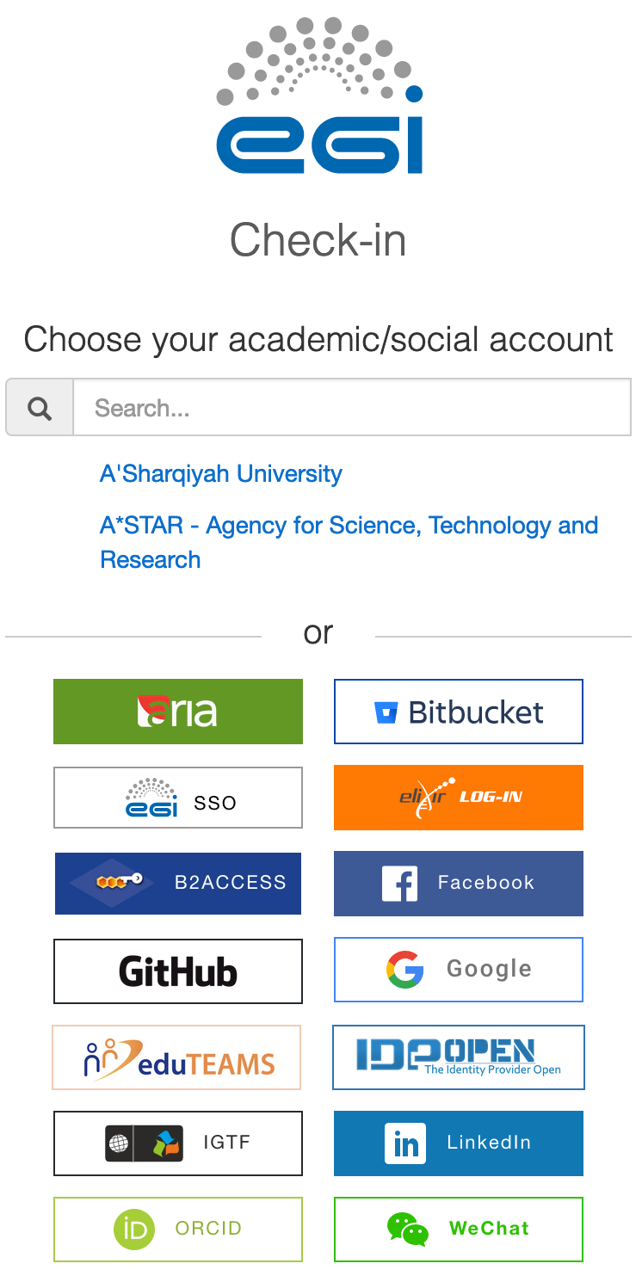
Priority: Research Indicators and Next-Generation Metrics
“All researchers need to be identified through an ORCID ID”
Add ORCID ID support to the EGI Check-In Service
The work is completed and the functionality is avaialble in both:
The production EGI Check-In service
The EOSC Portal AAI
REC #3
PCI
STATUS

Slide 7
Priority: European Open Science Cloud (EOSC)
“... The structure should ... be compatible with other related initiatives including national, European and Global Research infrastructures to ensure interoperability and the free movement of information across all national and international boundaries and between disciplines...”
Commit to the development of EOSC
Co-created the EOSC-hub project, the first implementation of the EOSC Core and initial service catalogue for research with both common and thematic services
Commitment to EOSC is a strategic goal in the new EGI Fed. strategy for 2024
Created the EGI-ACE project for delivering the EOSC Computing Platform (start 2021)
Co-developed the Global Open Science Cloud session at the EGI Conference 2020
http://go.egi.eu/fslhq
REC #1
PCI
STATUS

Slide 8
Priority: European Open Science Cloud (EOSC)
REC #2
“EOSC must have a long-term baseline funding commitment to become trustworthy… EOSC must be free and easy to use for research and education purposes”
Contribute to develop sustainability and business models for the EOSC
Planned and contributed to activities in the EOSC-hub project
Current results fed into the EOSC Sustainability WG
EOSC Business Models Recommendations: https://indico.egi.eu/event/5220/
D12.2 Report on business model analysis for procuring services in the EOSC: https://documents.egi.eu/document/3627
Final report expected in March 2021
PCI
STATUS

Slide 9
Priorities: European Open Science Cloud (EOSC) & Skills and Education
“... all researchers must receive appropriate EOSC training...”
“… work towards the design of appropriate Open Science training … ”
Develop training material to be made available via the EOSC portal
Developed training contents to promote the implementation of the Open Science principles, based on the use of open-source solutions
(e.g.: Jupyter notebooks and Binder technology and Zenodo)
Material available via the EOSC-hub Training Portal https://eosc-hub.eu/training-material
Working on e-Learning platform based on Open edX
EOSC REC #3
S&E REC #1
PCI
STATUS

Slide 10
Priority: FAIR (Findable, Accessible, Interoperable, Reusable) Data
REC #2
“Data resulting from publicly funded research must be made FAIR and citable, and be as open as possible, as closed as necessary”
EGI will make research data more accessible and reusable enabling data-centric computing
EGI mission: “deliver open solutions for advanced computing and data analytics”
Next flagship project EGI-ACE:
Develop the compute platform for EOSC
Focus on data-centric computing and conduct FAIR maturity assessment of services
Develop data spaces according to the EC strategy
PCI
STATUS

Slide 11
Summary
EGI Federation: Open Infrastructure for Open Science
EGI Federation:
Open ecosystem pooling together resources, services and expertise
Based on an open governance with country or community representatives
Enable open science practices, especially in the area of advanced computing and data analytics
Main contributions
Co-creating the EOSC
Adoption of open standards
Bridging communities for knowledge sharing across borders
Focus on simplify access and reuse of data from research communities

Slide 12
Thank you
E-mail: sergio.andreozzi@egi.eu Twitter: @digitalities

