Slide 1
OSPP: 4 years shaping up
Open Science in Europe
Eva Méndez
Universidad Carlos III de Madrid
Chair of the EU-OSPP
@evamen | @euospp

Slide 2
OSPP: 4 years 2 mandates
Who, Why, What?
Principal outcomes:
From Recommendations to Implementatio
No more Bs, more PCIs

Slide 3
OSPP: 25 members / 8 groups
Funding organisations:
Matthias Kleiner. Science Europe
Citizen Science organisations:
Johannes Vogel (ECSA)
Publishers:
Michael Mabe (STM)
Paul Peters (OASPA)
OS platforms and intermediaries:
Rebecca Lawrence (F1000)
John Wood (RDA)
Steve Cotter (GÉANT)
Sergio Andreozzi (EGI)
Natalia Manola (OpenAIRE)
Jennifer Edmond (DARIAH),
Jan van den Biesen. Business EU
Libraries:
Kristiina Hormia Poutanen (LIBER)
Universities:
Norbert Lossau (EUA)
Kurt Deketelaere (LERU)
Karel Luyben (CEASAR)
Eva Méndez (YERUN)
Manuela Epure (ACEU)
Research organizations:
Ernst Kristiansen (EARTO)
Michela Bertero (EU-LIFE)
Michele Garfinkel (EMBO)
Tuija Hirvikoski (ENoLL)
Academies/Learned Societies:
Christophe Rossel (EPS),
Wolfram Koch (EUCHEMS),
Michela Vignoli (YEAR),
Sabina Leonelli (GYA)
http://ec.europa.eu/research/openscience/pdf/ospp_nominated_members.pdf#view=fit&pagemode=none

Slide 4
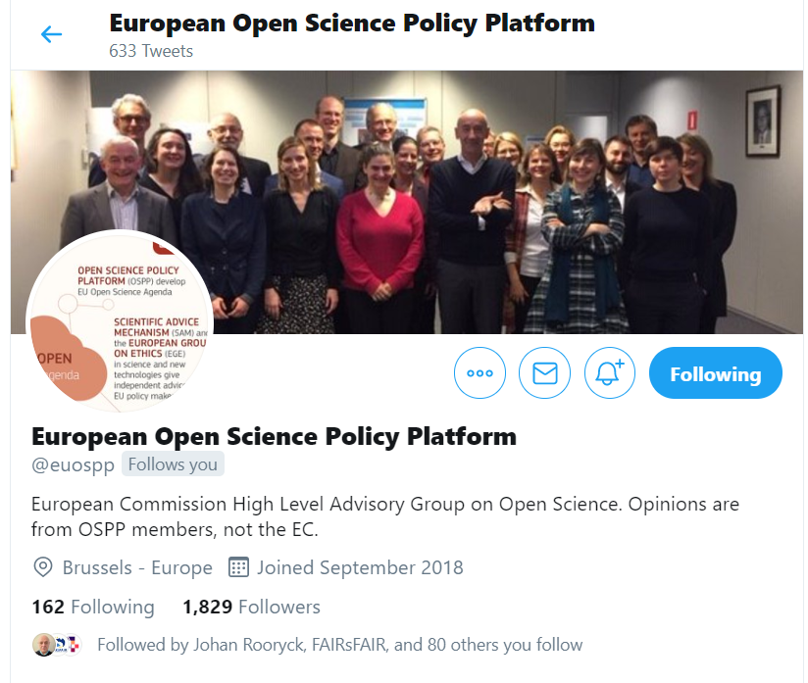
#EUOSPP

Slide 5
OSPP in the EC Open Science state of play (2016)
ERA & framework conditions for actors:
European Charter for researchers
Code of conduct for Research Integrity
Charter for Access to Research Infra
…
European Open Science Agenda:
OA publishing models
FAIR open data
Science Cloud
Alternateive metrics
Rewards & careers
Education & skills
Citizen Science
Research integrity
…
European Commission
Open Science Policy Platform
DSM & framework conditions for data:
Copyright - TDM
Data Protection
Free Flow of Data
…
Wide input from stakeholders:
ad-hoc meetings and workshops
e-platform with wider community
reports and independent experts
advice
opinions
HLEG on EU open science cloud (I and II)
HLEG on altmetrics → Next generation metrics
HLEG on careers & skills
HLEG on rewards
HLEG on Future of Scholarly Communication
HLEG on FAIR open data
HLEG on Indicators
EG on open science cloud
EG on altmetrics
EG on alt. business models for OA publishing
EG on FAIR open data
context

Slide 6
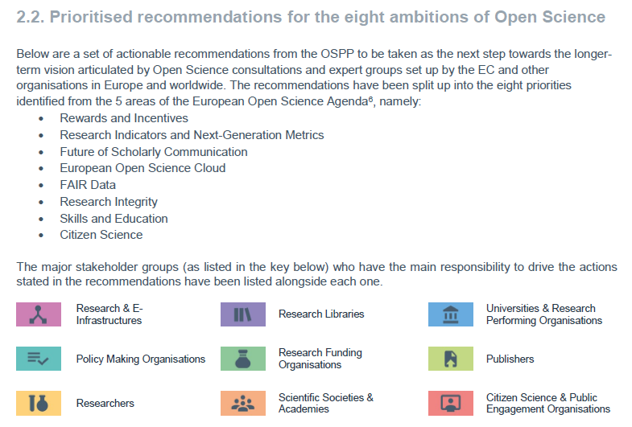
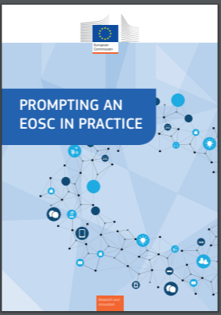
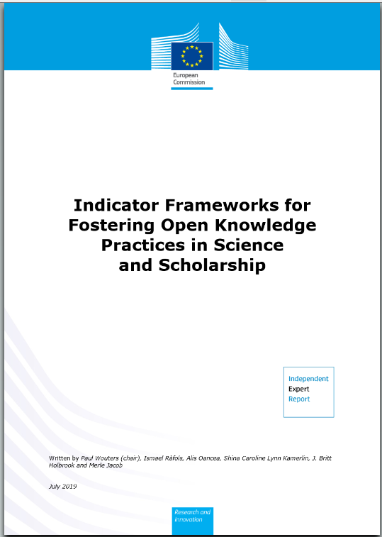
OSPP in 2020
Framework / conditions for actors:
European Charter for researchers
Code of conduct for Research Integrity
Charter for Access to Research Infrastructures
OSPP-REC
FIRST MANDATE
Open Science Policy Platform
Framework / conditions for data:
Copyright - TDM
Free Flow of Data
Data Protection (GDPR)
Review PSI-Data Directive
SECOND MANDATE
Wide input from stakeholders:
Ad-hoc meetings and workshops
Reports & independent experts
HLEG on EOSC (I and II)
HLEG on Altmetrics → Next Generation Metrics
HLEG on Careers & skills
HLEG on rewards and incentives
HLEG on Future of Scholarly Communication
HLEG on FAIR (Open) data
HLEG on Indicators

Slide 7
PRINCIPAL OUTCOMES
Competitiveness Council May 2018
OSPP-REC

Slide 8
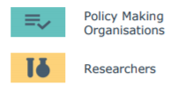
Rewards and Incentives
FAIR DATA
EOSC
FSP (Future of Scholarly Communication)
Next Generation metrics (new indicators)
Rewards and Incentives
Research Integrity
Education and Skills
Citizen science
Stakeholders / Actors of Open Science
Open Science challenges / pillars in EUROPE

Slide 9
EU-OSPP (M2)
Communication and engagement (We need to talk!)
Statkeholders meetings
@euospp
Change from Declaration mode to the Implementation mode (PCIs)
from REP&REC to PCIs
From #YAD to #NPCI
Map-interconnect - the projects working in Open Science (eInfras, SWAFS, etc.)
Align MS policies→ Align OSPP-MS objectives
[Meeting with MS October 2019 with Member States →Council for National Open Science coordination: https://conosc.org/ ]

Slide 10
What are PCIs for Open Science
Commitments regarding any aspect (challenge) of Open Science
Actual, realistic and affordable… in a level where the proponent has “jurisdiction”
Effect → real implementation
They answer to the question: What CAN I do to make Open Science happen?
Open science at “action level” (practical)

Slide 11
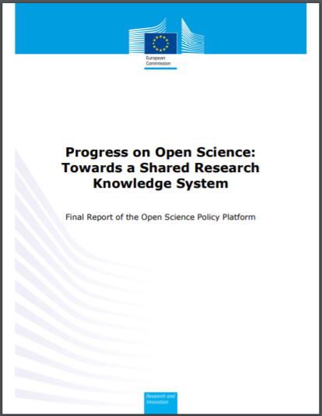
Final report
https://ec.europa.eu/research/openscience/pdf/ec_rtd_ospp-final-report.pdf#view=fit&pagemode=none

Slide 12
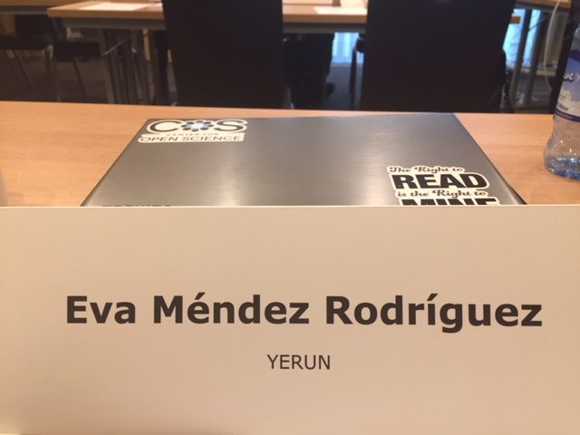
Thank you!!!
@euospp #EUOSPP
@evamen
emendez@bib.uc3m.es

