Slide 1
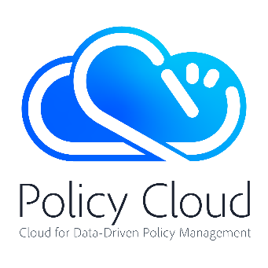
Policy Management on Cloud Environments.
An introduction to PolicyCLOUD
Ricard Munné, ATOS - PolicyCLOUD Coordinator
EGI Conference 2020

Slide 2



Policy Cloud
The European Cloud for data-driven policy management will provide integrated reusable models and analytical tools, turning raw data into valuable and actionable knowledge towards efficient policy making.
Notes:
Over a three-year period until December 2022, the Policy Cloud project will improve policy making for public administrations across Europe, by harnessing the potential of digitisation, big data and cloud technologies to support transparent, democratic, and evidence-based decision making, around the creation and implementation of social and economic policy.

Slide 3
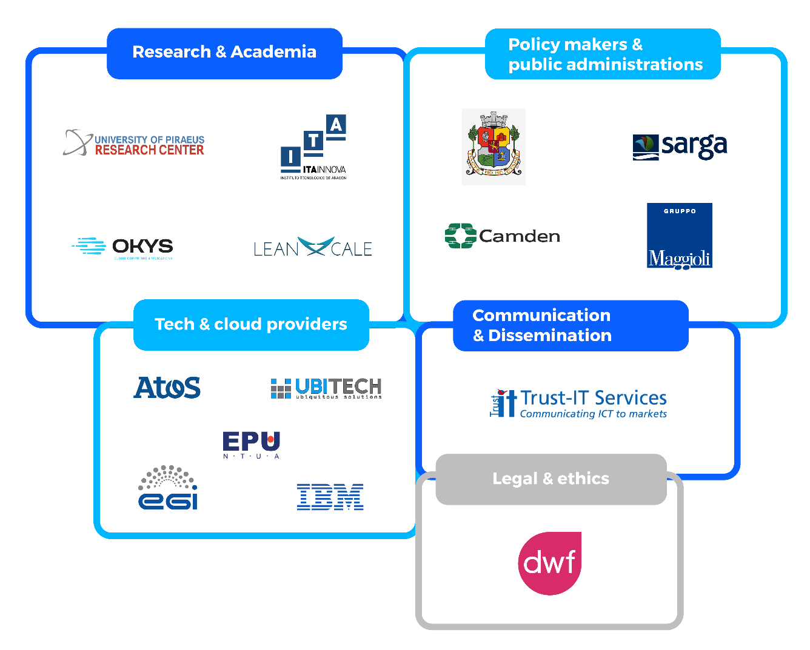
Policy Cloud Consortium
Notes:
The consortium is composed by fifteen partners with complementary skills and expertise:
Four partners from Research and Academia:
ICCS/NTUA (Institute of Communication and Computers System)
OKYS
University of Piraeus Research Center
Itainnova (Aragon Technological Institute / Instituto Tecnológico de Aragón)
Five partners as tech and cloud providers
Atos Spain
IBM Israel
EGI
Leanxcale
UBITECH
Four partners form Policy Making and Public Administrations
Maggioli, Italy UC (main Italian corporate organisation providing solutions and services to Local Public Administrations)
Sarga, Spain UC (Aragonese Society for Environmental Management / Sociedad Aragonesa de Gestión Medioambiental)
Municipality of Sofia, Bulgaria UC
London Borough of Camden, UK UC
One partner in the area of Communication and Dissemination
TRUST-IT Services
One partner providing legal and ethics support
DWF

Slide 4
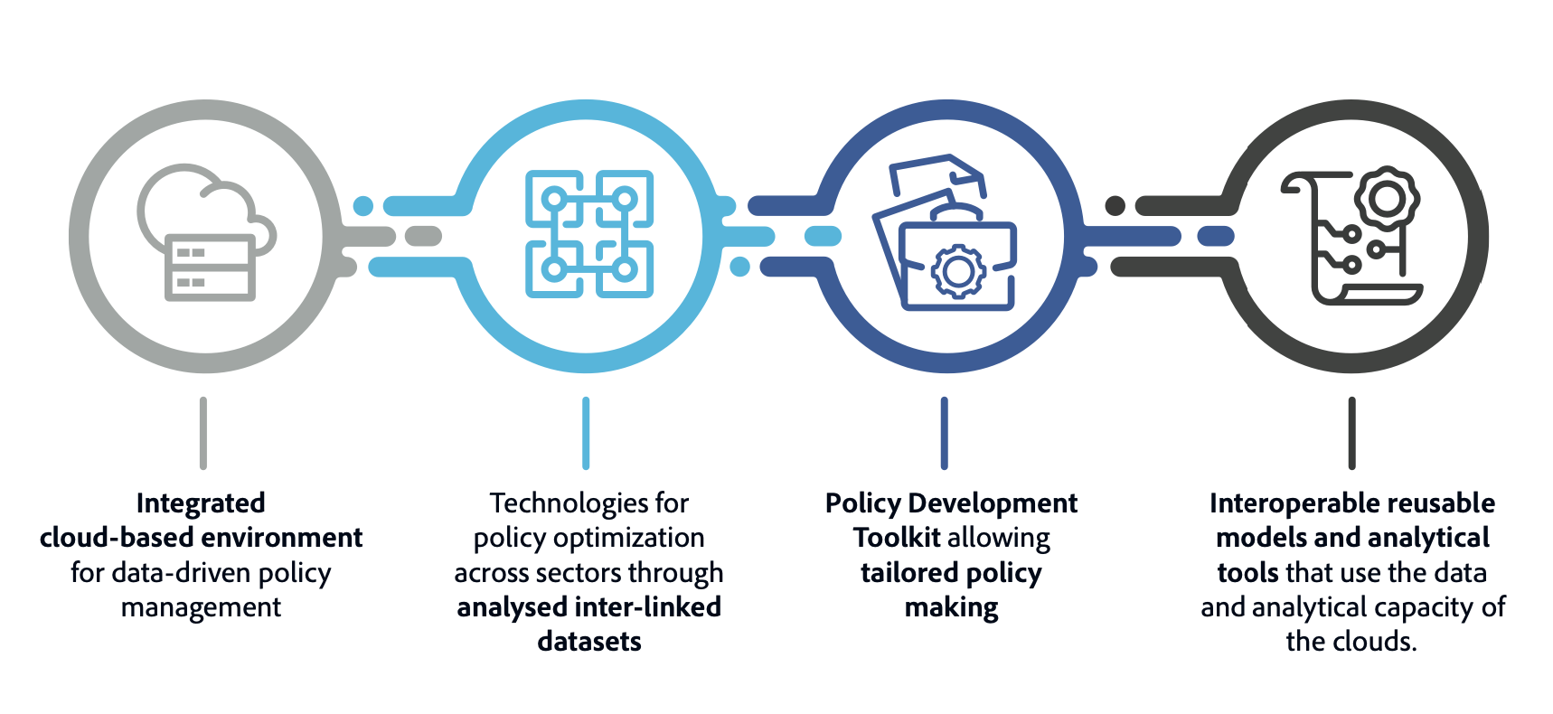
PolicyCloud will deliver:
Notes:
Specifically, the project will deliver a unique, integrated environment of curated datasets and data management, manipulation, and analysis tools addressing the full lifecycle of policy management in four thematically distinct pilot use cases.
An integrated cloud-based environment, for data-driven policy management
Technologies for policy optimization across sectors through analysed inter-linked datasets
Policy Development Toolkit allowing tailored policy making
Interoperable reusable models and analytical tools that use the data and analytical capacity of the clouds
These datasets and tools will eventually become accessible to the public from the European Open Science Cloud (EOSC).

Slide 5
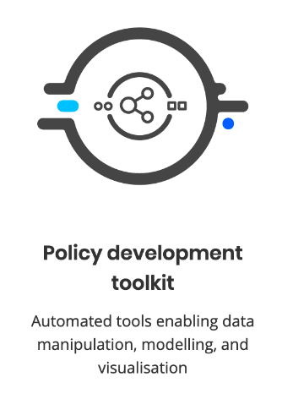
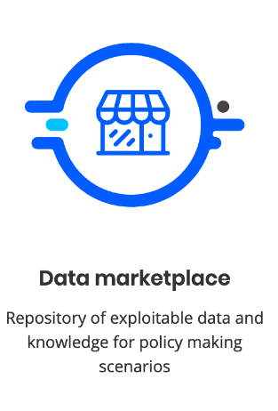
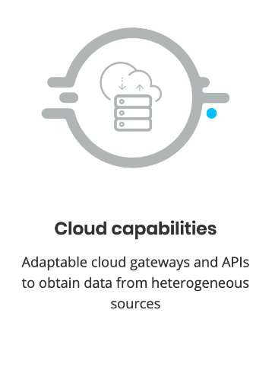
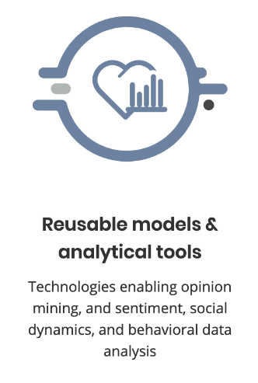
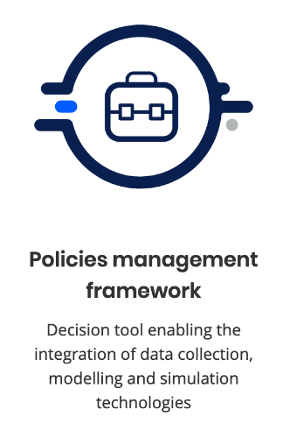
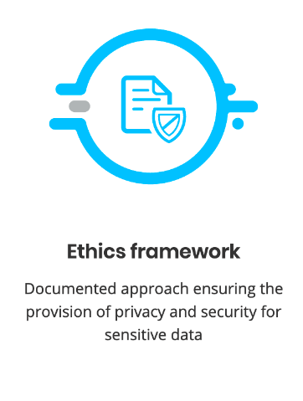
Policy Cloud Services
6 SERVICES –
AN INTEGRATED CLOUD-BASED SERVICE ENVIRONMENT
FOR DATA-DRIVEN POLICY MANAGEMENT.
Notes:
The datasets and tools developed during the Policy Cloud project will be offered to public administrations and businesses as a suite of six services enabling the creation of data-driven policies using data management and manipulation technologies which turn raw data into valuable and actionable knowledge to be exploited in conformance with legal, security and ethical norms.
They are:
Policy Development Toolkit: To provide automated tools for data manipulation, modelling and visualisation
Data Marketplace: A repository of exploitable data and knowledge for policy making scenarios
Cloud capabilities: Adaptable cloud gateways and APIs to obtain data from heterogeneous sources
Reusable models & Analytical tools: Enabling opinion mining, sentiment analysis, social dynamics and behavioural data
Policies Management Framework: Enabling the integration of data collection, modelling and simulation technologies
Ethics Framework: Ensuring the provision of privacy and security for sensitive data

Slide 6
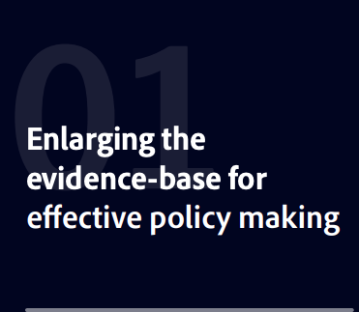
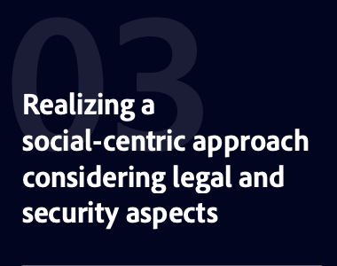
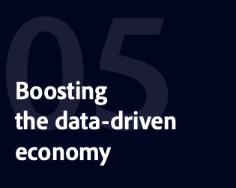
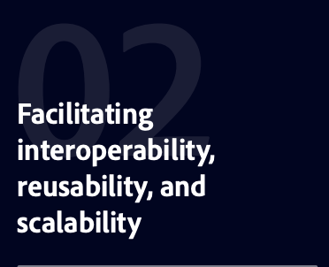
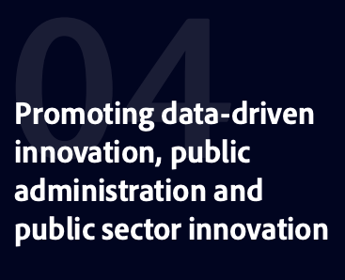
Expected impacts
Notes:
There are five expected impacts in the area of data-driven policy making:

Slide 7
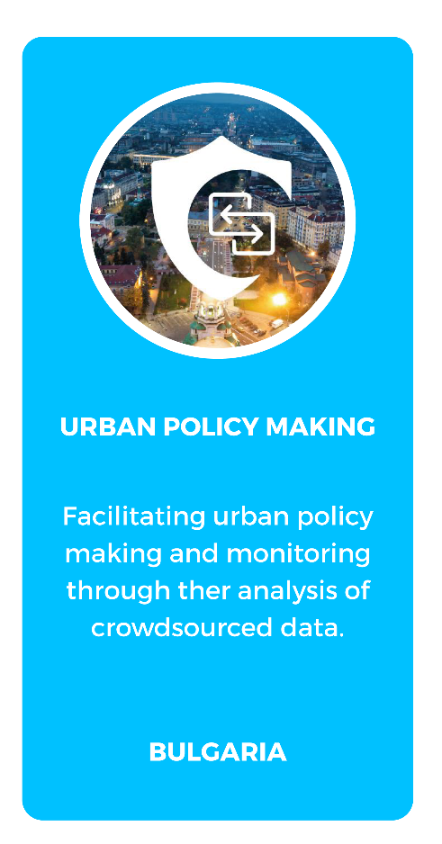

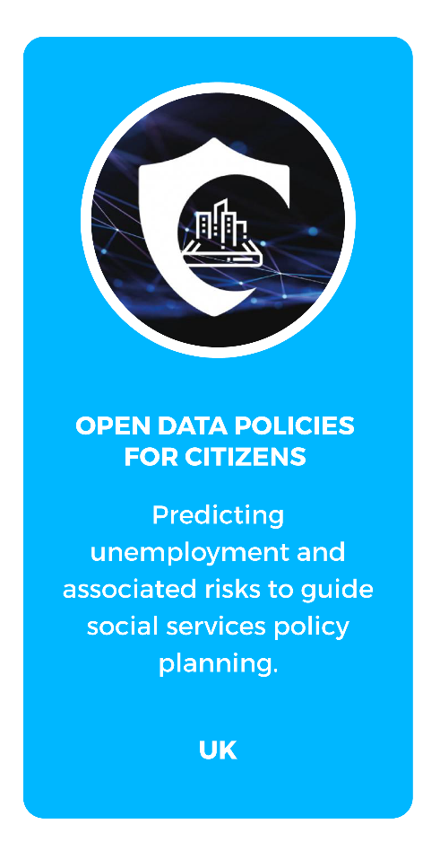
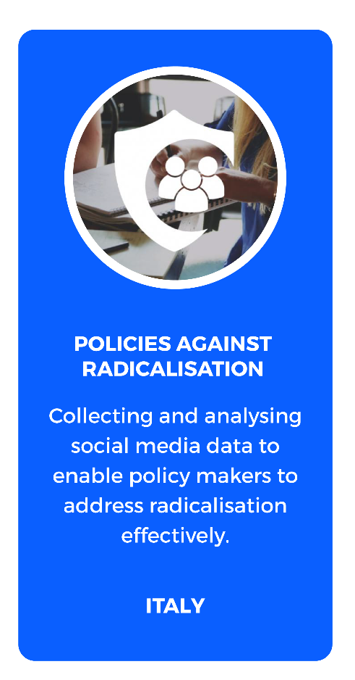
Pilot Cases covering different societal challenges
Notes:
The datasets and tools developed during the Policy Cloud project will be tested, refined, and showcased first in four thematically distinct pilot use cases situated in different parts of Europe:

Slide 8



Citizens’ benefits
Opportunities to participate in policy creation
Continuous improvement through iterative design
Policies designed for targeted segments of population
Notes:
Citizens’ benefits on using PolicyCLOUD
Opportunities to participate in policy creation through the iterative design and implementation methodology adopted
Continuous improvement in policies through an iterative design approach which leverages newly available data on an ongoing basis and optimises policies simultaneously across multiple sectors
Increasingly relevant and useful policies designed around homogeneous segments rather than entire populations

Slide 9
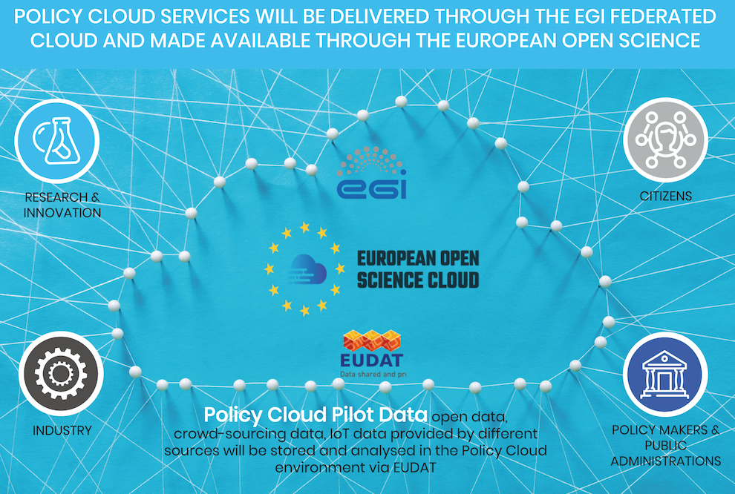
Policy Cloud Value proposition for
European Open Science Cloud
Notes:
Policy Cloud services will be delivered through the EGI federated cloud, and made available through the European Open Science Cloud to reach the targeted stakeholders.

Slide 10



GET IN TOUCH
www.policycloud.eu
@PolicyCloudEU
PolicyCloud has received funding from the European Union’s Horizon 2020 research and innovation programme under grant agreement No 870675.
PolicyCloud EU

