Slide 1

openEO platform
Christian Briese [EODC] & openEO platform team

Slide 2


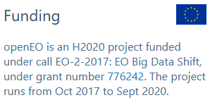
OpenEO Platform
ESA ITT “open Earth Engine”
calls for the realisation of a federated open infrastructure (open source software, data, compute platform)
Extremely ambitious goal, only possible by
  reusing modern and relevant existing components and by
  full support from a consortium that is not just skilful and dedicated but also experienced in running operational services
Proposed solution: openEO Platform
  Builds upon the EO cloud processing platforms managed by VITO, Sinergise, EODC and EURAC and the experience
  In management of the platforms
  Software development experience of these partners
  Based on the openEO API, a community project that started with H2020 funding

Slide 3
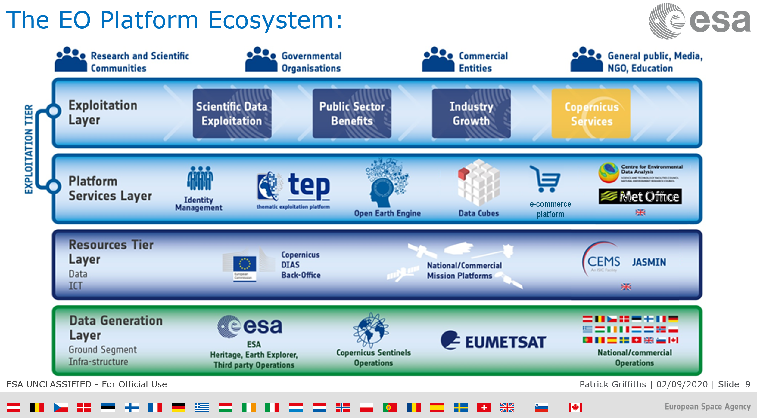

Wide ESA EO Platform Ecosystem

Slide 4
openEO vision
Aim: serve the user with a large scale continental scale Earth observation data analytics solution that allows:
Run a script locally, in a browser, notebook, or Rstudio
Have it connect to cloud platforms to carry out computations remotely:
  Discover which image collections are available
  Discover processes, compose processes, execute
Show the results, responsive (low res), or download (batch/high res)
Using an interface that doesn’t mind what the cloud platform runs, so that we can
  Compare the costs
  Compare and validate the results
Insert custom Python / R / … scripts for e.g. time series modelling, to be executed close to the data (user-defined functions)
To make this easy, an API is needed. We made this, and named it openEO.

Slide 5
The next step: openEO platform
The openEO API’s original goal (https://openeo.org/)
  fostering the current heterogeneity in interfaces of cloud-based EO processing back-ends
matches the ESA requirement of
  realizing a federated infrastructure and matches the current situation that no single processing back-end serves (or will any time soon serve) all datasets of interest.

Slide 6
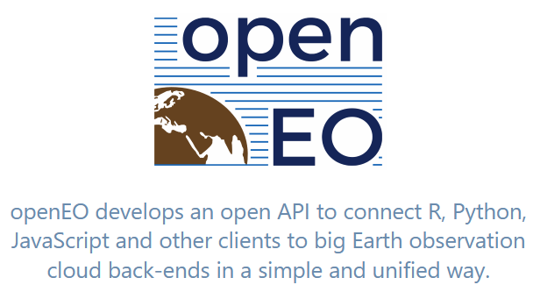
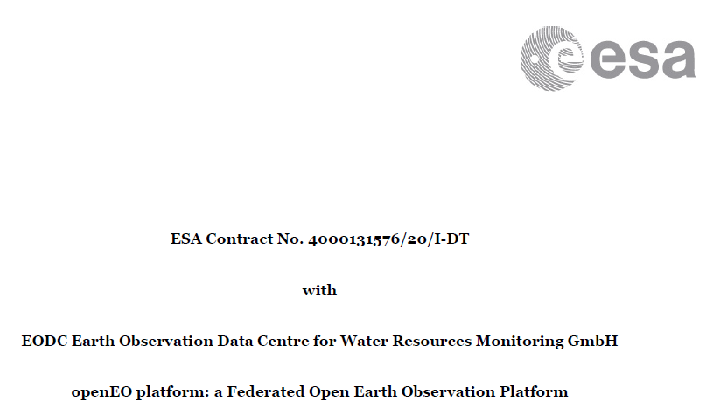
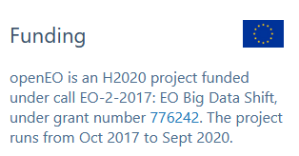
openEO Platform

Slide 7
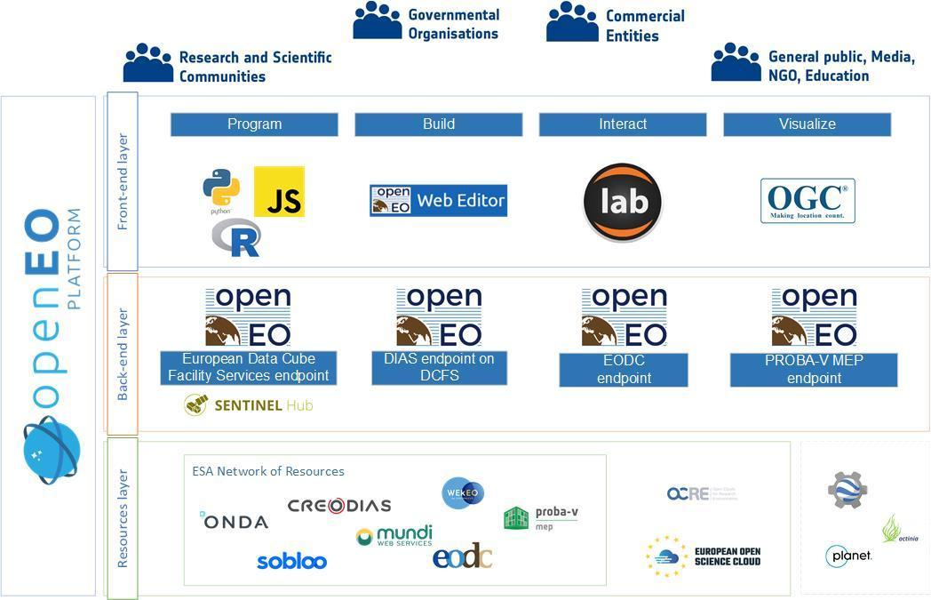
High level overview
First Service Readiness Review and initial public service offering end February 2021 !

Slide 8
Different users Different interfaces
EO Researcher
Data analyst
Data producer
Application developer
Notebooks, Editor
Marketplace, Maps
Editor
Web API's

Slide 9
Web Editor

Slide 10
Python client: Phenology

Slide 11



















9 use cases in 24 months
UC2:
Vessel
Detection
UC3:
Crop
Type
UC9:
Dynamic
LC EU
UC 15:
Crop
Conditions
UC1:
ARD
KO
SRR-1
SRR-2
SRR-3
SRR-4
UC8:
Canopy
Cover
UC 11:
Flood
Risk
UC6:
NRT
Forest
NO₂
UC4:
NO₂

Slide 12
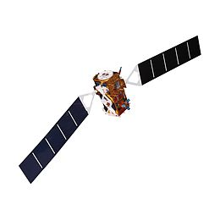


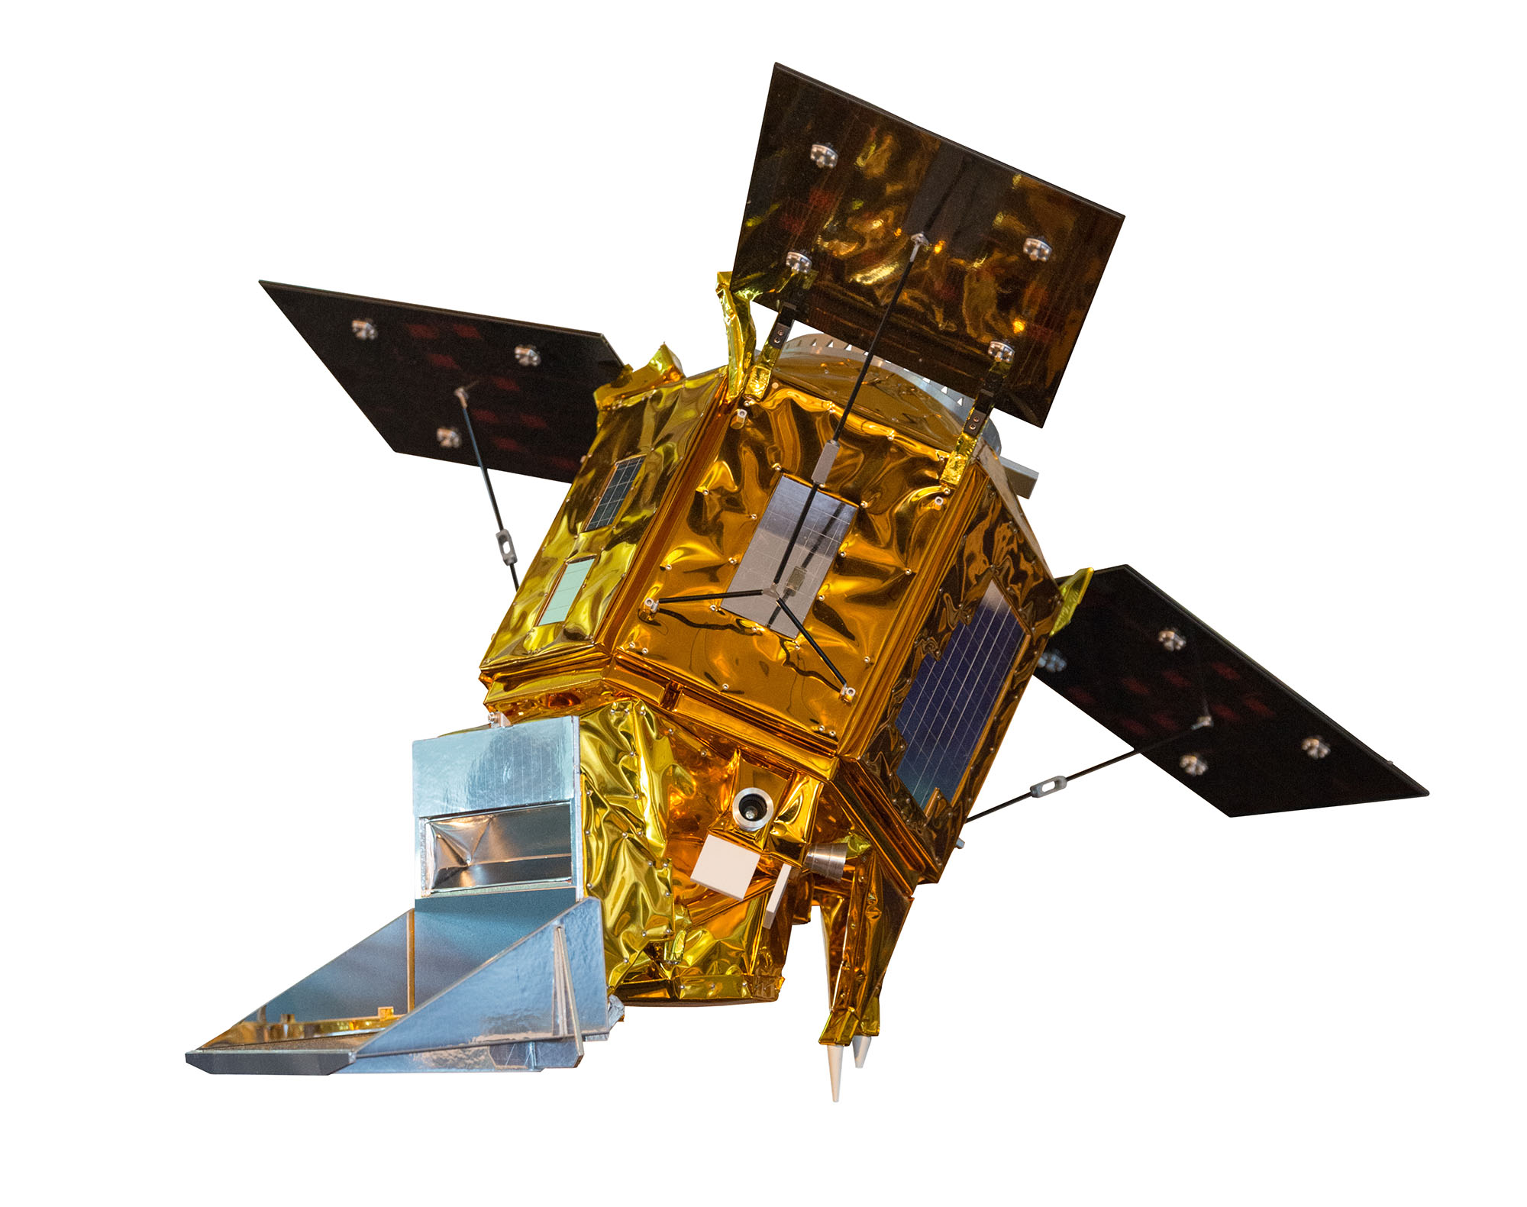

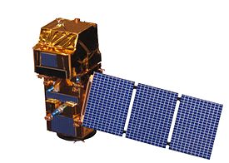


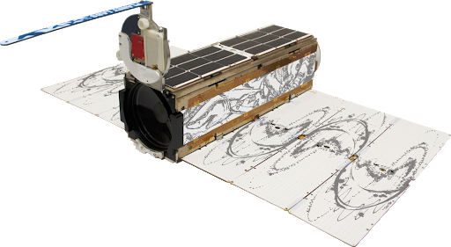
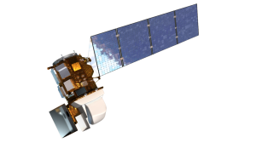

Use Case 1: Analysis Ready Data
UC1:
ARD
Sentinel-1
WP-2
Sentinel-5p
Sentinel-2
UC1:
ARD
Planet Lab
Landsat-8

Slide 13
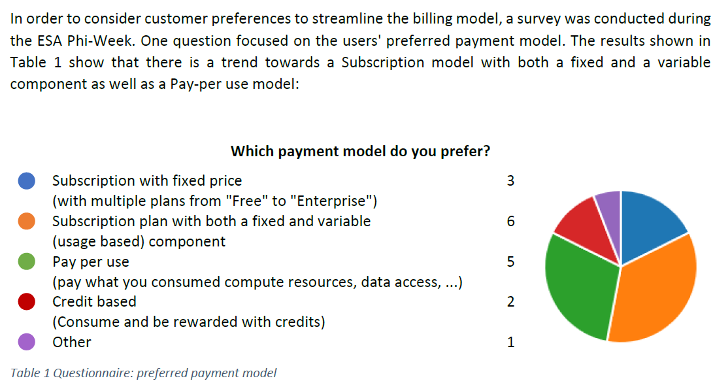
openEO platform business model
Consider user demands from the beginnig
Setup a transparent billing system
Iterate and evaluate the model together with the users

Slide 14





A Federated Open Earth Observation Platform
Stay in touch:
Subscribe to our mailing list: https://eodc.eu/register-openeoplatform
Follow us on twitter: #OpenEOplatform, @open_EO

