Slide 1
C-SCALE project
Copernicus - eoSC AnaLytics Engine
INFRAEOSC-07-2020 A6
Diego Scardaci
EGI Foundation – Technical Solutions Team Lead

Slide 2
The C-SCALE Project
Copernicus - eoSC AnaLytics Engine
Federate European EO (DIASes, CollGS nodes, etc) and e-Infrastructure services to support Copernicus research and operations
Call: INFRAEOSC-07
Sub-topic: A6
Coordinator: EODC (Austria)
Start date: 1 January 2021
Duration: 30 months
Budget: 2 M€ (500K€ for VA)
The C-SCALE consortium brings together expertise from:
EO sector: EODC, Deltares, VITO, CloudFerro, TUW, CESNET, GRNET
e-Infrastructure: EGI, CESNET, INFN, SURFsara, GRNET, INCD
C-SCALE will enrich EOSC and its Portal with scalable Big Copernicus Data Analytics federated services

Slide 3
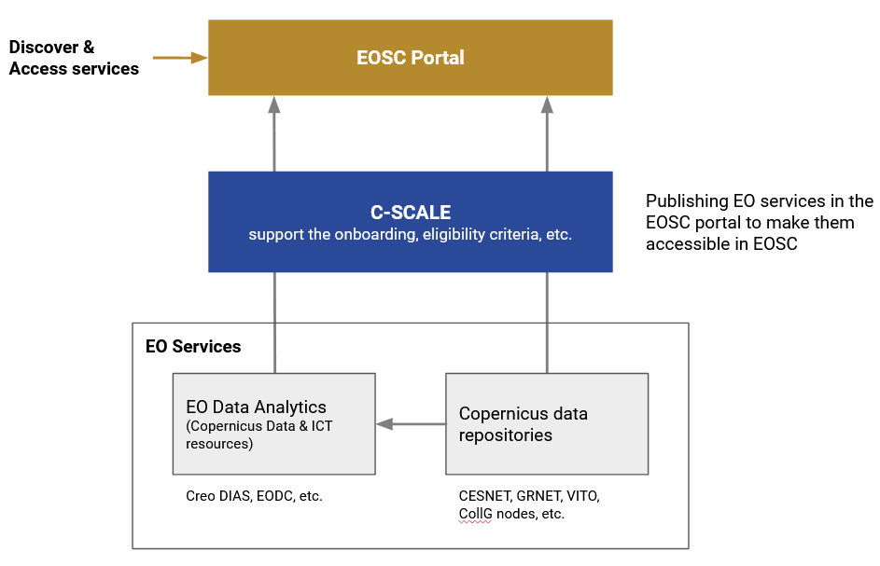
C-SCALE Objectives – O1
O1: Scale-up the EOSC Portal integrating computing and data resources for Copernicus
CREODIAS platform
WEkEO DIAS
EODC global Sentinel archive and processing infrastructure
ESA SENTINEL Collaborative Ground Segment: CESNET, GRNET, VITO

Slide 4
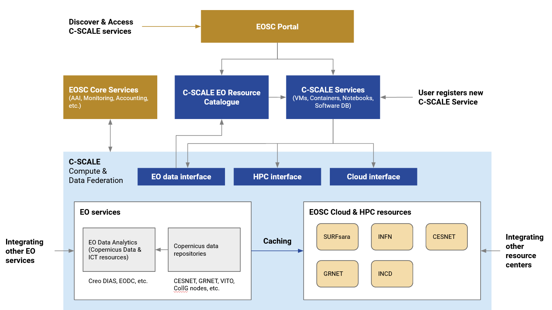
C-SCALE Objectives – O2
O2: Federated Copernicus resources with EOSC computing and storage providers to deliver a wide infrastructure optimised for very large FAIR Copernicus data handling
Federation principles:
Services accessible through homogeneous and standard interfaces
EO data FAIR across the providers
Burden to join the federation limited
Adhere to EOSC policies and operational and technical requirements
Basic and ops features (AAI, accounting, etc.) available through EOSC core services
Maximise interoperability with other EOSC services

Slide 5
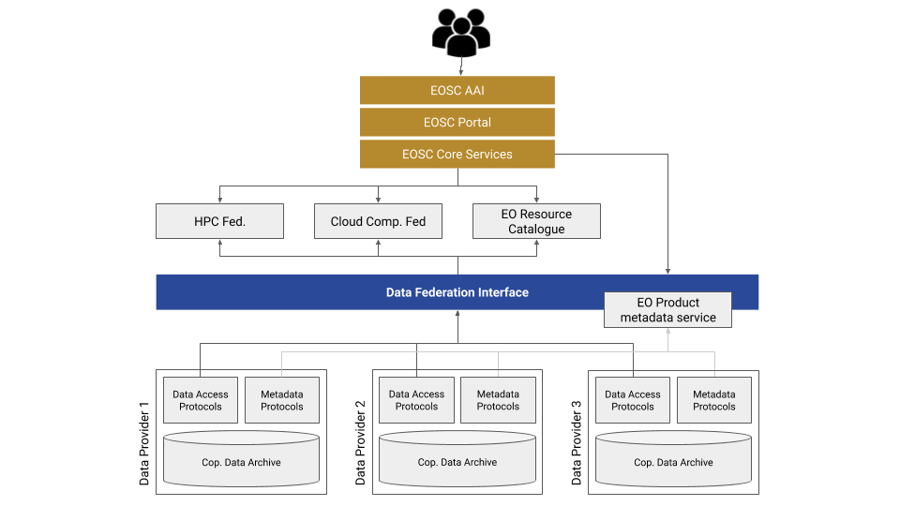
C-SCALE Data Federation

Slide 6
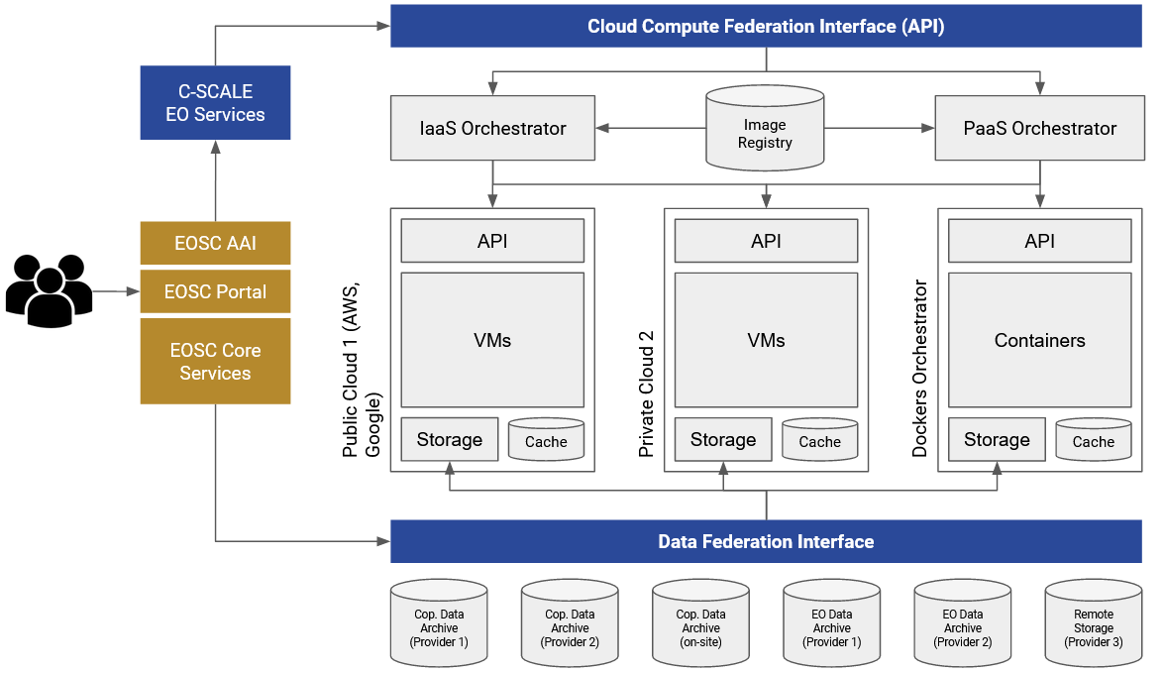
C-SCALE – Cloud Federation

Slide 7
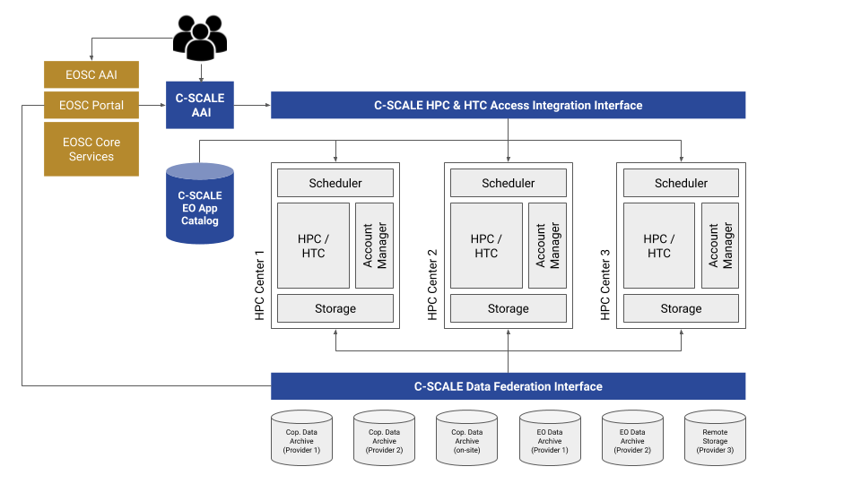
C-SCALE – HPC/HTC Federation

Slide 8
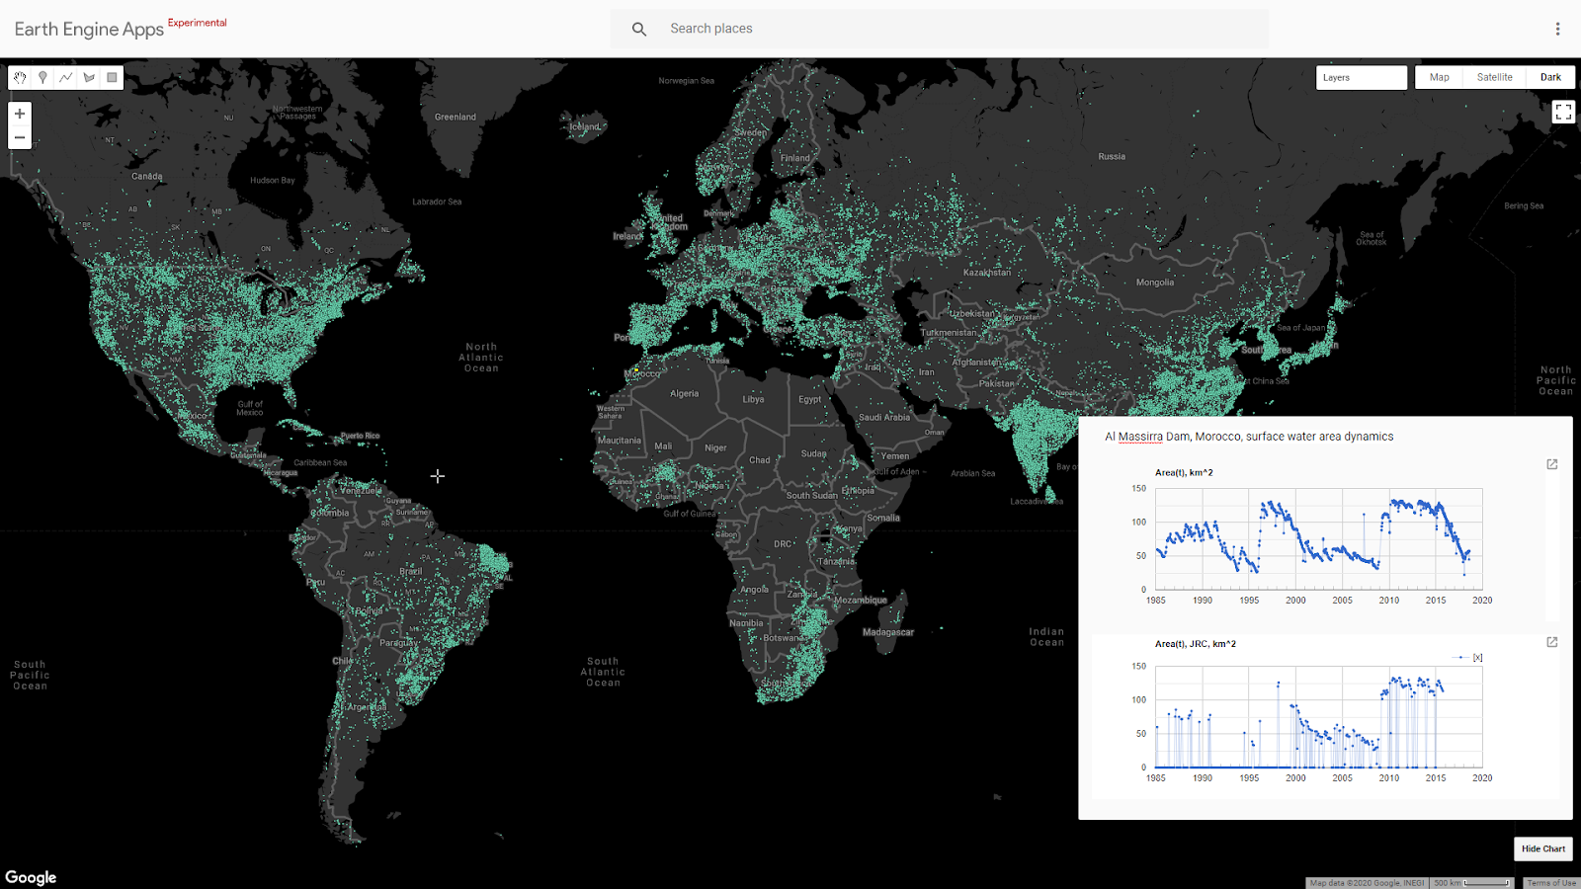
C-SCALE Objectives – O3
O3: Piloting the provision of a distributed online Sentinel long-term archive in EOSC
No plans for Europe to maintain a full on-line archive of Copernicus data
Cold storage not adequate for processing of long time series in arbitrary geographical area
EOSC may fill this gap offering a Copernicus historical distributed data archive
C-SCALE will develop a technical strategy to offer this archive in EOSC
Example of surface water area dynamics time series during nearly 40 years for one of 80 000 reservoirs quantified globally.

Slide 9
C-SCALE Objectives – O4
O4: Co-design of the federation with relevant scientific community across Europe
Use case | Description | EO Data
Aqua monitor | how the Earth's surface water has changed in the last 30 years | Landsat 4,5,7,8 Sentinel 2
Water watch | reanalysis of surface water changes in reservoir | Sentinel 1 Sentinel 2
HiSea | provide high resolution data of water quality at sea | Sentinel-3 ERA5
Land Surface Analysis | map with seasonal forecasts of drought indicators | Sentinel-1 ASCAT PROBA-V
RETURN | monitoring tropical forest recovery capacity | Sentinel 1 Sentinel 2 Landsat 5,7,8
Virtual European Sentinel Data Cubes | virtual Sentinel data cubes covering European countries and the whole of Europe | Sentinel 1 Sentinel 2
6 use cases
Early Adopter programme to attract more use cases
User forum to collect requirements for the co-design
Automation to offer a seamless user experience
Increased exploitation of Copernicus through the EOSC Portal

Slide 10
C-SCALE services in EOSC
How EOSC users will access C-SCALE services
Suite of three services
C-SCALE EO Data Archive
provide access to a large C-SCALE EO data archive
C-SCALE Compute services
compute services integrated with the C-SCALE EO Data archive
C-SCALE EO Analytics platforms
set of analytics platforms that can be deployed on top of the C-SCALE EO data archive and compute services
C-SCALE federation services will be available in the EOSC Portal around mid 2022

Slide 11
C-SCALE Virtual Access resources
Installations (short name) | Service Category | Unit of access | Units
EODC EO Storage | Storage Service | TB year | 150
EODC EO Cloud | Cloud Service | CPU year | 620
EODC HPC | HPC/HTC Service | CPU Hour | 600,000
CESNET MetaCentrumCloud - CPU | Cloud Service | CPU Month | 2,850
INFN Bari Storage | Storage Service | TB Month | 1,500
INFN Bari CPU | Cloud Service | CPU Month | 3,840
SURFsara dCache Front end Storage | Storage Service | TB Year | 154
SURFsara Spider (HTDP) storage | Storage Service | TB Year | 160
SURFsara Data Processing Compute | HPC/HTC Service | CPU Hour | 1,500,000
SURFsara MS4 Storage | Storage Service | TB Year | 10
SURFsara MS4 SSD Storage | Storage Service | TB Year | 96
SURFsara MS4 Compute | HPC/HTC Service | CPU Hour | 147,600
VITO CVB (Storage) | Storage Service | TB Month | 1,200
VITO CVB (Compute) | Cloud Service | CPU Hour | 876,000
GRNET KNS-Storage Cloud | Storage Service | TB Hour | 250,000
GRNET KNC Cloud | Cloud Service | CPU Hour | 1,650,000
GRNET ARIS-Storage HPC | Storage Service | TB Hour | 219,000
GRNET ARIS-Compute HPC | HPC/HTC Service | CPU Hour | 1,000,000
CREODIAS – Storage | Storage Service | TB Month | 2,762
CREODIAS - Compute | Cloud Service | vCore hour | 1,500,000
CREODIAS – GPU | GPU service | GPU hour | 6,000
INCD Lisbon (NCG) (Storage) | Storage Service | TB Month | 450
INCD Lisbon (NCG) (Compute) | Cloud Service | CPU Day | 4500
Total capacity of resources offered through VA:
cloud: 1648 CPU core/year
HTC/HPC: 370 CPU core/year
storage: 1104 TB/Year;

Slide 12
Conclusion
C-SCALE puts together EO and the e-infrastructure partners to:
Facilitate the exploitation of Copernicus data leveraging on large resources and advanced technologies from e-infras and EOSC
Make Copernicus resources easily accessible to new research areas and EOSC in general
C-SCALE will deliver a federation of EO and e-infrastructure services and resources
Create a very large distributed repository of EO data close to compute resources
EO data will be FAIR through the federation
Federation services accessible through the EOSC Portal
C-SCALE federation will be co-designed with researchers
Large amount of resources available through the Virtual Access mechanism

Slide 13
Questions?

