Slide 1
Roadmap towards expanding capacity, services and user base
Isabel Campos - CSIC
Jorge Gomes - LIP & INCD
CSIC - Spanish National Research Council
LIP – Laboratório de Instrumentação e Partículas
INCD – Infraestrutura Nacional de Computação Distribuída

Slide 2
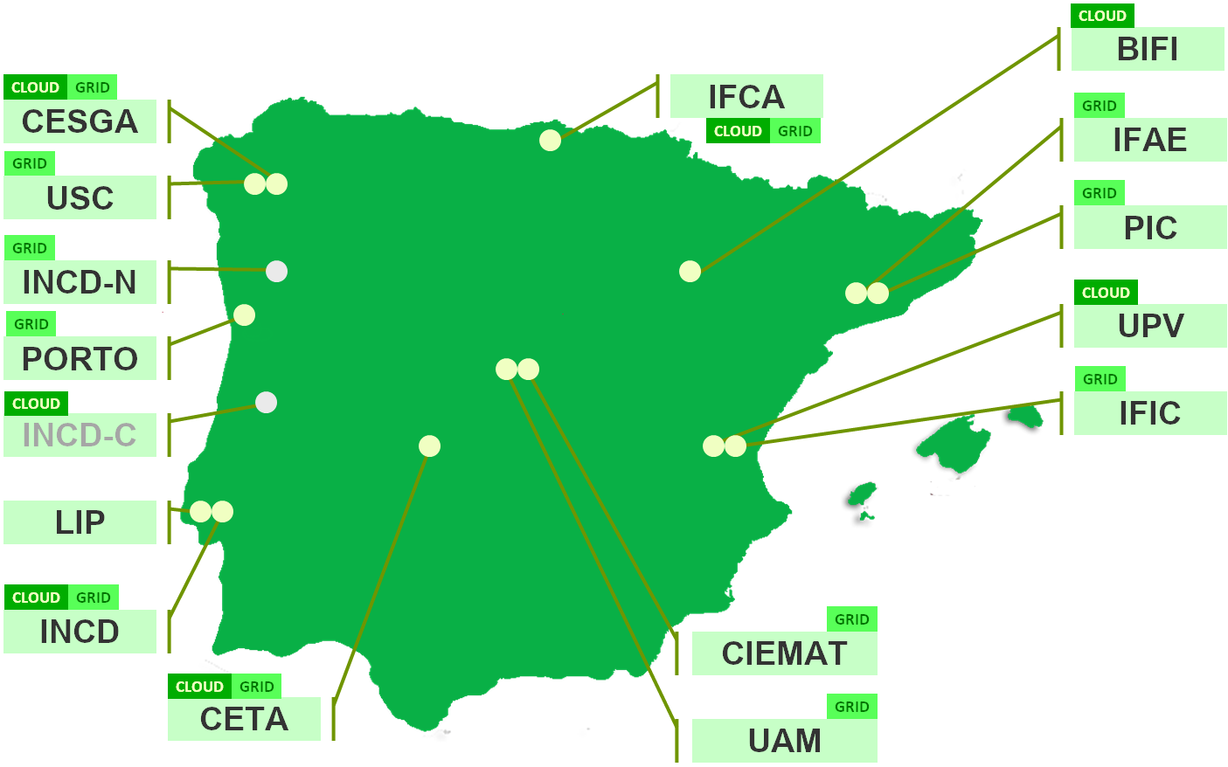
Distributed computing infrastructure
Federation of Spanish and Portuguese computing and data facilities
Reinforced in the context of the Iberian MoU of Valladolid in 2018
Technical coordination

Slide 3
Distributed computing infrastructure
Federates infrastructures from Iberian research and academic organizations (PT + ES) mainly focused:
Cloud Computing
Grid Computing
Data Processing
Enables a joint participation in the European Grid Initiative (EGI) and other initiatives (EOSC, ESFRIs, WLCG, etc);
Provides the regional operations coordination for the computing and data processing activities of several user communities;
Forum for common activities and sharing of knowledge.
Participation in EU and cross-border projects including both R&D and infrastructure oriented projects
Conferences and events (IBERGRID conference series)

Slide 4
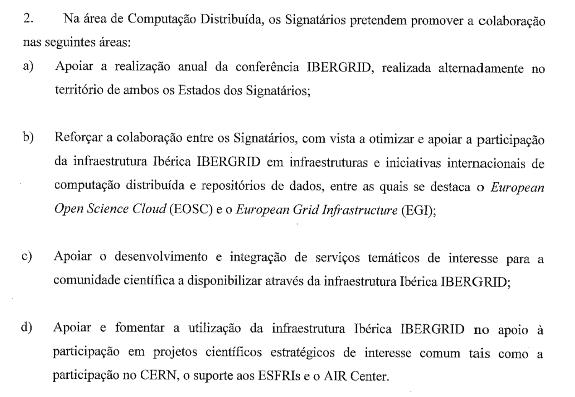
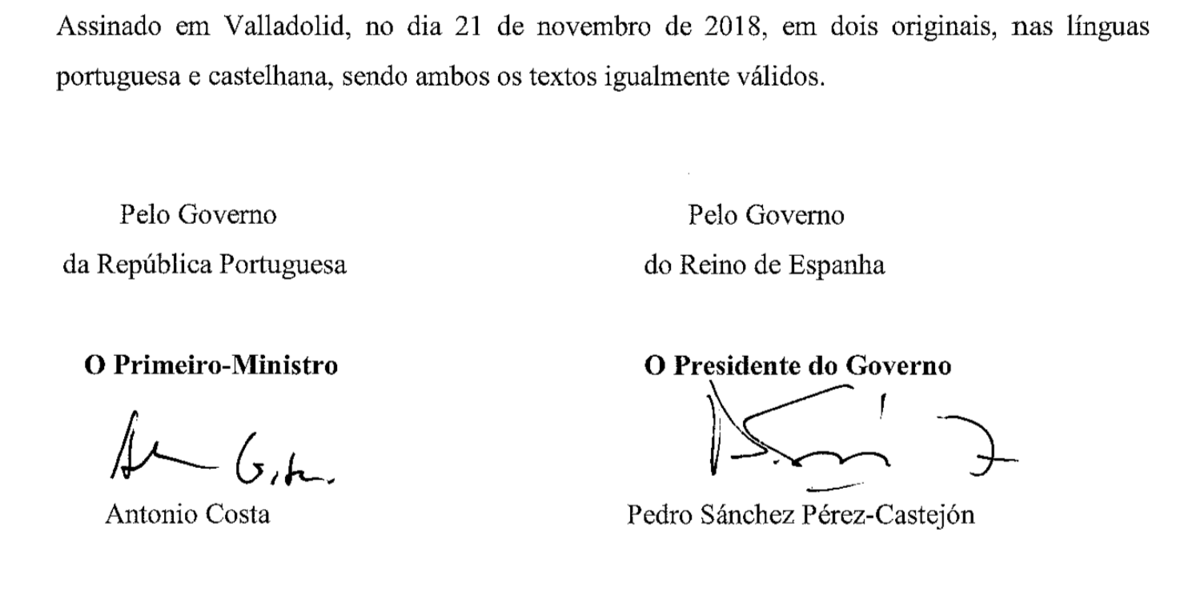
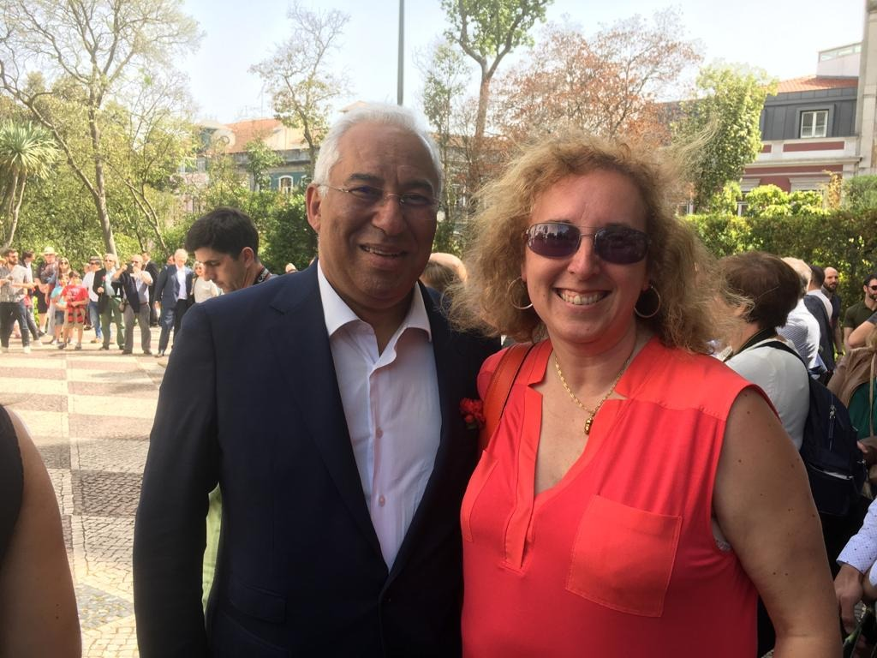
MoU between Governments (2018-2024)
Valladolid, 21st November 2018
Lisboa, 25th April 2018

Slide 5
EOSC-synergy: key implementation project
Led by IBERGRID funded in infraeosc-5b: www.eosc-synergy.eu
22 partners in 10 countries (ES, PT, FR, UK, DE, NL, CZ, SK, PL and BR)
Skills development
Environment for tutorials with a dedicated MOOC platform, courses methodology and a Hackaton as a service platform.
Promoting EOSC High Quality Services
Software quality as a service, FAIRness evaluation and quality certification badges
Capacity Expansion at the
Infrastructure level
Integration of services and resources from the RIs of the consortium partners.
Thematic Services Integration
10 thematic services addressing 4 scientific areas (Earth Observation, Environment, Biomedicine and Astrophysics)
Alignment at the Policy Level
Collaboration with regional projects on landscaping activities, gap analysis and contribution to EOSC policies.

Slide 6
Infrastructure Deployment plans

Slide 7
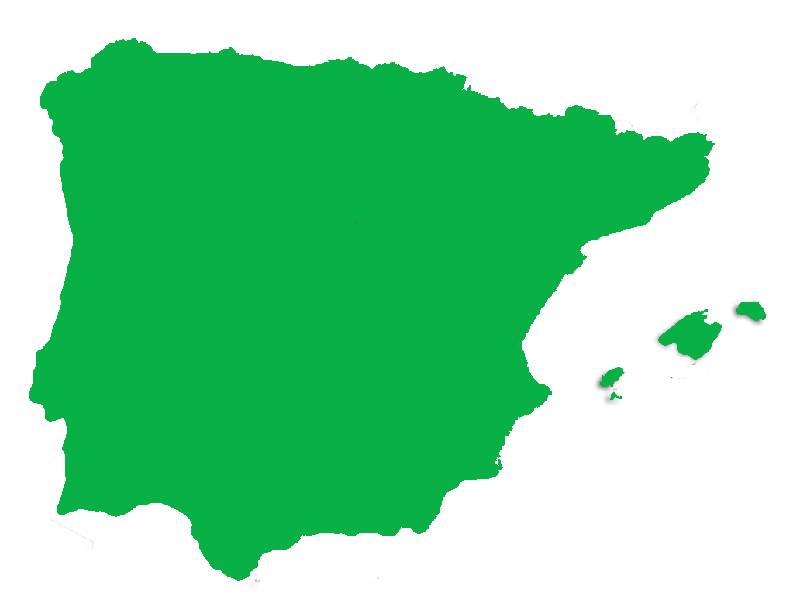
Joins PT + ES cloud and grid:
CLOUD
BIFI
CLOUD
GRID/HPC
IFCA-CSIC
GRID
CESGA
CLOUD
GRID
IFAE
GRID
USC
~ 10,000 Cloud CPU cores
> 25,000 Grid CPU cores
~ 25 PB storage
GRID
PIC
CLOUD
GRID/HPC
INCD-B
CLOUD
GRID
UPV
PORTO
GRID
STORAGE
IFIC
INCD-C
STORAGE
LIP
CLOUD
GRID
INCD-A
CLOUD
GRID
15 computing sites
2 Portugal
11 Spain
CIEMAT
CLOUD
CETA
IAA-CSIC
GRID
UAM
CLOUD

Slide 8
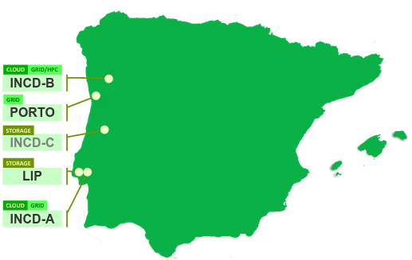
Portugal - upgrades
INCD-A: Lisbon
Hardware to expand cloud and HPC/HTC
1400 TB online Lustre
720 TB online Ceph
768 CPU cores with GPUs + 480 CPU cores with GPUs
INCD-B: Minho
Working on deployment of grid for the existing HPC/HTC cluster
Hardware to deploy 2nd cloud site and expand cluster
480 TB online Lustre
1400 TB online Ceph
2200 CPU cores some with GPUs mainly for cloud
INCD-C: Coimbra
Reactivate site for offline storage of scientific data
~ 10 PetaBytes Tape Library

Slide 9
Spain - upgrades
CSIC
Upgrade of Cloud facilities (+2500 cores)
CPUs
CPUs + GPU
Upgrade of CEPH Storage
400TB
CESGA
Upgrade of Cloud Facilities (+3000 cores)
CPUs (TBD)
Cloud Storage: + 1,5PB
BIFI
Upgrade of Cloud facilities (+1800 cores)
Upgrade CEPH Storage
+ 1PB
CLOUD
IFCA-CSIC
CESGA
GRID
CLOUD
CLOUD
BIFI
PIC/IFAE
GRID
CLOUD
CLOUD
CETA-CIEMAT
UPVLC
IFIC
GRID
GRID
CLOUD
CIEMAT
IAA-CSIC

Slide 10
Cloud Resources usage trends

Slide 11
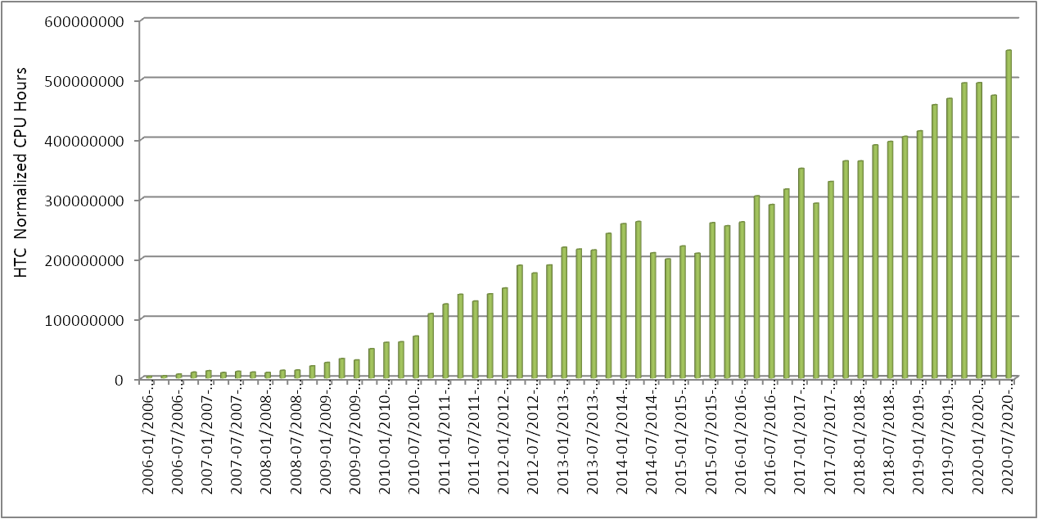
266 million jobs executed since 2006 1,447 million wall clock processing hours
EGI accounting portal powered by

Slide 12
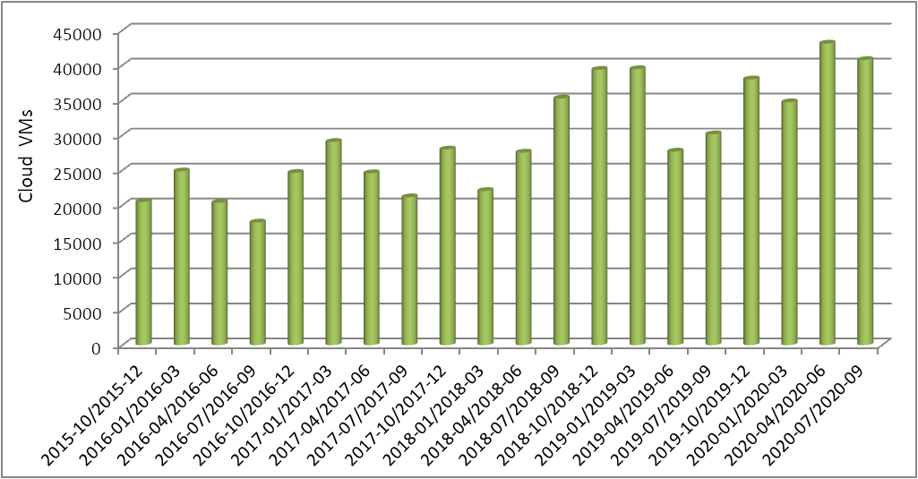
Instantiation of cloud VMs 588 thousand from Oct 2015 to Sep 2020
EGI accounting portal powered by

Slide 13
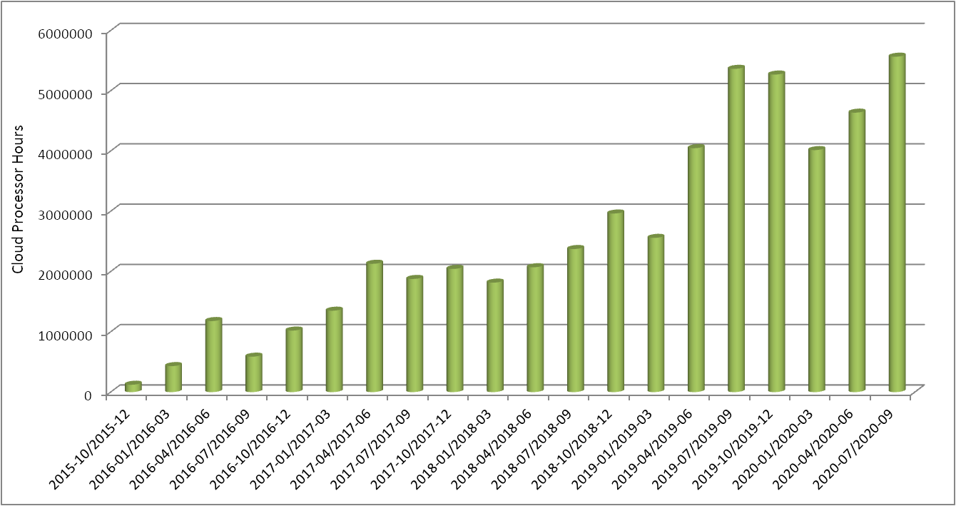
Processors * hours of cloud VMs 51 million from Oct 2015 to Sep 2020
EGI accounting portal powered by

Slide 14
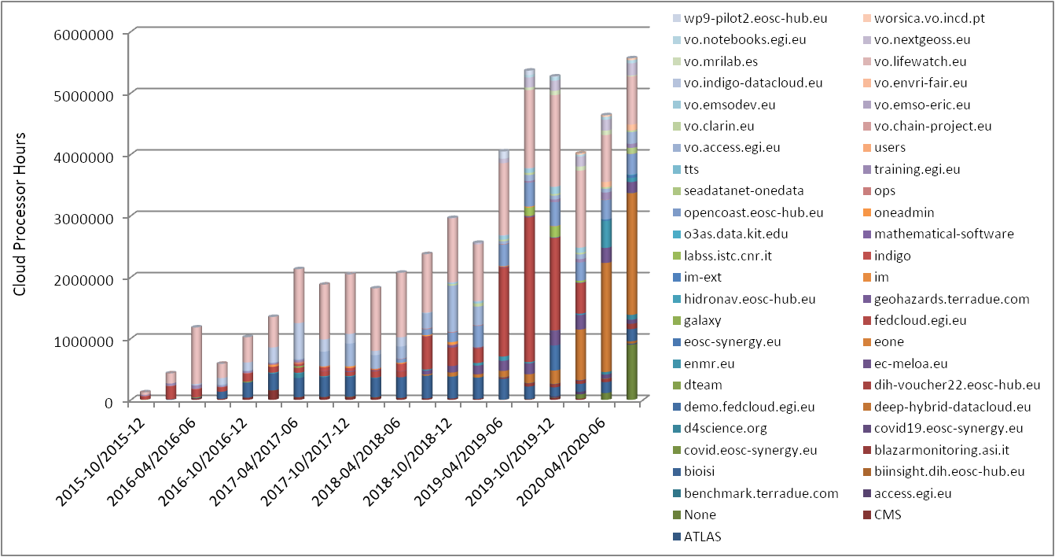
Processors * hours of cloud VMs per VO 49 VOs supported from Oct 2015 to Sep 2020
EGI accounting portal powered by

Slide 15
Processors * hours of cloud VMs per VO 49 VOs supported from Oct 2015 to Sep 2020
EGI accounting portal powered by

Slide 16
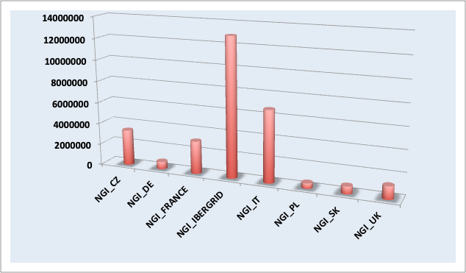
IBERGRID support to FedCloud VO
CPU hours (2015-2020)
Over the past 5 years
IBERGRID delivered
about 45% of the capacity
used for the generic fedcloud VO

Slide 17
Support to ESFRIs
HL-LHC
Lifewatch ERIC
INSTRUCT ERIC
EMSO ERIC
EuroBioImaging

Slide 18
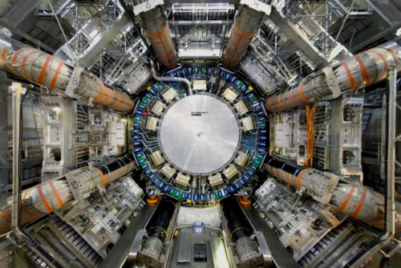
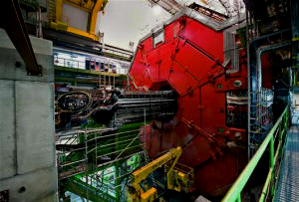
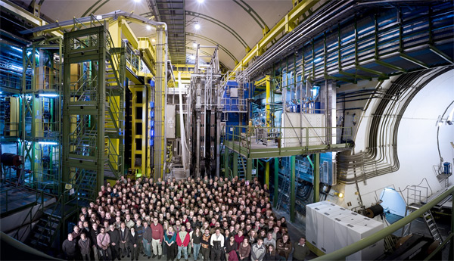
CERN LHC simulation and data analysis
ATLAS
594,245,304 hours
CMS
617,362,629 hours
HTC GRID PROCESSING
LHCb
158,721,729 hours
ALICE
4,208,953 hours

Slide 19
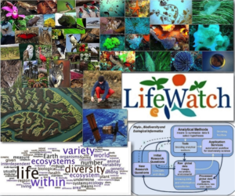
LifeWatch ERIC
LifeWatch ERIC, is a distributed Research e-Infrastructure to advance biodiversity research and to address the big environmental challenges and support knowledge-based strategic solutions to environmental preservation.
The services currently available for the biodiversity community are also available for wider re-use by other scientific communities.
In the Iberian area the activity of Lifewatch ERIC is articulated via IberLife, which in turn relies on the support of Ibergrid for the deployment and operation of core services.
16,732,290 hours in IBERGRID since Oct 2015

Slide 20
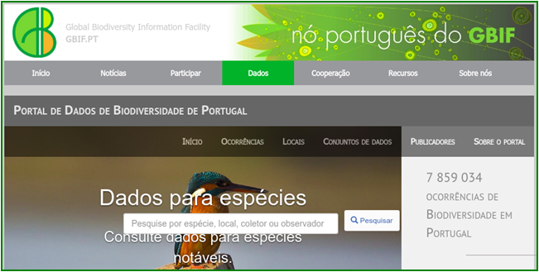
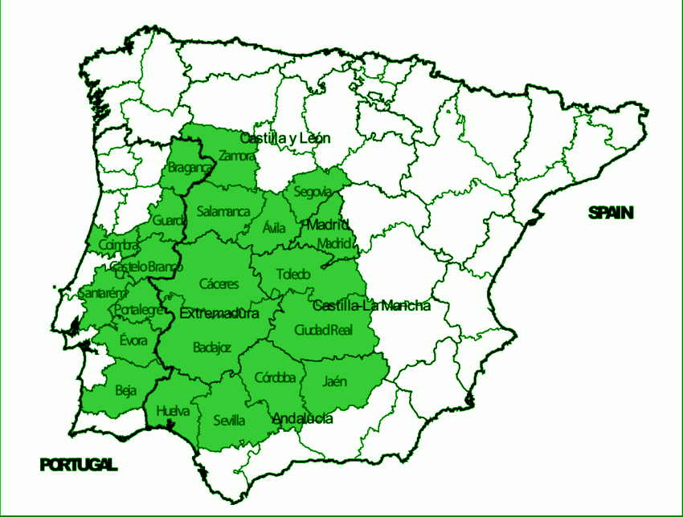
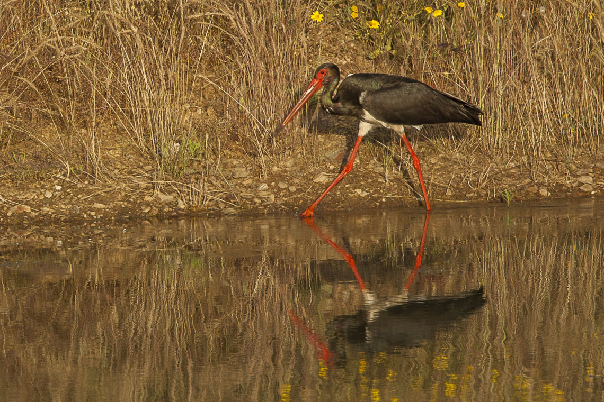
Global Biodiversity Information Facility: GBIF.org
GBIF Nodes in Portugal and Spain are key components of the LifeWatch ERIC.
These activities are supported by IBERGRID
Housing facilities, technologies and integration: https://dados.gbif.pt & https://datos.gbif.es
GBIF Data Space for the Iberian Peninsula is co-funded by EGI-ACE, as a pilot for integration of biodiversity and environment data in territories with shared characteristics
Distribution of Black Storks in the Iberian Peninsula
IBERGRID-aware Black Stork crossing smoothly Extremadura,
direction Alentejo

Slide 21
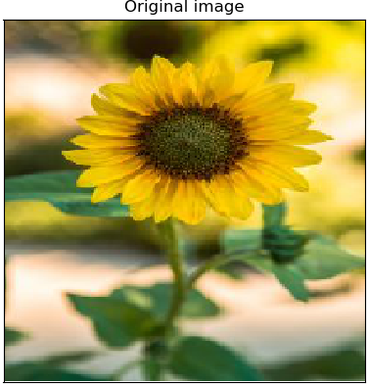
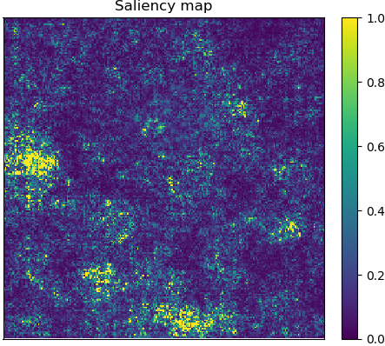
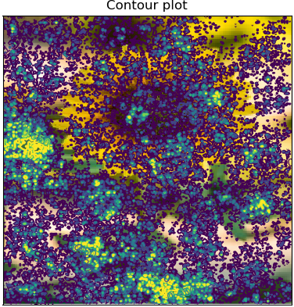
Classifying plants
Deep learning convolutional neural network applied to plant recognition
Used 240,000 images from PlantNet + ResNet model for classification
Used the Lifewatch VO in the EGI FedCloud to execute on IBERGRID cloud resources with GPGPUs
ResNet outperforms most public plant classification algorithms
Collaboration on-going in the DEEP-Hybrid-DataCloud project
http://deep.ifca.es/#plants
5,178,562 hours in IBERGRID since Oct 2019
Helianthus annuus

Slide 22
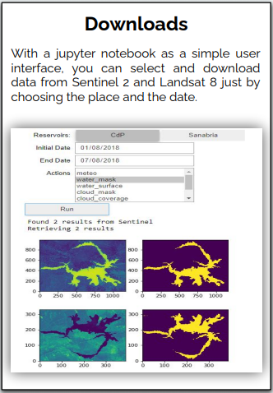
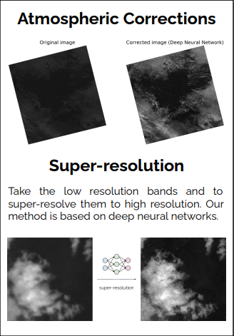
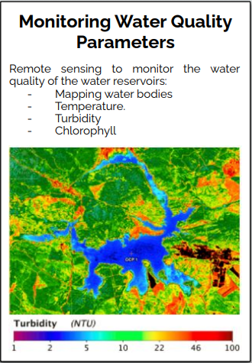
Remote Sensing & Water Quality
Virtual Research Environment (VRE) based on JupyterHub & distributed storage.
Access to Remote Sensing Data (Copernicus, Landsat), Open Data sources (AEMET) and in-situ monitoring.
Lifewatch thematic service at EOSChub.
Linked to Machine learning and modelling methods. eXtreme-DataCloud & DEEP-Hybrid-DataCloud project.
https://remote-sensing.ifca.es/

Slide 23
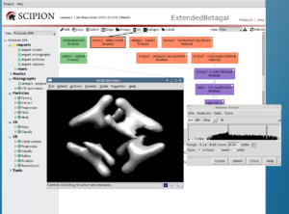
INSTRUCT ERIC
Scipion is an image processing framework used to obtain 3D maps of macromolecular complexes using cryo Electron Microscopy.
Developed by the researchers of CNB-CSIC: community self-developed solution that can be integrated for support in generic Clouds (public and private).
Scipion is the solution offered by the Instruct Image Processing Center (I2PC) to European scientists accessing the European Research Infrastructure for Structural Biology (Instruct).
Supported on-demand in the IBERGRID Cloud via EGI AppDB

Slide 24
New ESFRI arrivals

Slide 25
EMSO
EMSO is a large-scale research infrastructure of seafloor & water-column observatories, set up to monitor long-term environmental processes and their interactions.
Collecting and analyzing ocean data on a day-to-day basis is crucial to monitor environmental processes.
EMSODEV developed the DMP platform on top of the EGI Federated Cloud. The DMP is now being deployed and tested.
New community starting in the IBERGRID Cloud
IBERGRID, Italian NGI, INGV, IPMA, CESGA, CSIC

Slide 26
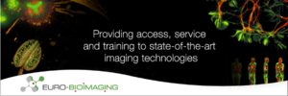
EuroBioImaging
The Euro-BioImaging (EuBI ERIC) provides open physical user access to a broad range of state-of-the-art technologies in biological and biomedical imaging for life scientists.
The EuBI consists of a set of 29 geographically distributed Node Candidates (specialised imaging facilities) that can grant access to scientists from all European countries and beyond.
Supports collaboration between I3M at Universidad Politécnica de Valencia and Portuguese Brain Imaging Network (BIN) at INESC Porto.
New user community in IBERGRID

Slide 27
Support to International Research Communities
Oceanography
Astroparticle Physics
Computational Chemistry
Genetics,...

Slide 28
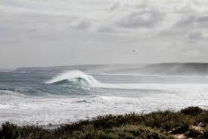
OPENCoastS
OPENCoastS – On-demand Operational Coastal Circulation Forecast Services, is an innovative service providing on-demand circulation forecast systems as-a-service for the European Atlantic coasts.
OPENCoastS builds on-demand circulation forecast systems for user-selected sections of the North Atlantic coast.
OPENCoastS generates forecasts of water levels, 2D velocities and wave parameters over the spatial region of interest for periods of 72 hours, based on numerical simulations of all relevant physical processes.
EOSC thematic service supported by IBERGRID 2,762,426 since 2019
Collaboration LIP, LNEC, INCD, UNICAN, CNRS, CSIC

Slide 29
WeNMR and MoBrain
WeNMR provides an e-Infrastructure platform and Science Gateway for structural biology. WeNMR serves all relevant INSTRUCT communities in line with the ESFRI roadmap.
WeNMR is part of West-Life virtual research environment for structural biology.
The current challenges in the post-genomic era call for virtual research platforms that provide the worldwide research community with both user-friendly tools, platforms for data analysis and exchange, and an underlying e-infrastructure.
735,902 hours in IBERGRID since 2012
Cooperation on tools and packaging

Slide 30
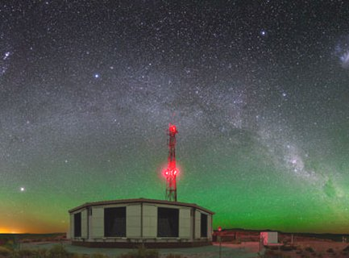
AUGER
On the vast Pampa Amarilla in western Argentina, the Pierre Auger Observatory is studying the highest-energy particles in the Universe, so-called cosmic rays.
Cosmic rays with low to moderate energies are well understood, while those with extremely high energies remain highly mysterious. By detecting and studying these rare particles, the Pierre Auger Observatory is tackling the enigmas of their origin and existence.
12,714,524 hours in IBERGRID since 2009

Slide 31
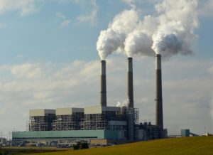
Computational Chemistry
Pioneering a way to produce high-quality, carbon-neutral methane gas using industrial waste carbon dioxide. Study recycling a pollutant to produce a high-quality methane in a carbon neutral circular economy scheme.
Chemical reactions are at the core of everything that happens in the Universe. Compute accurately the efficiency of molecular processes in which molecules collide to react, dissociate, exchange energy and deform.
4,145,510 hours in IBERGRID since 2009

Slide 32
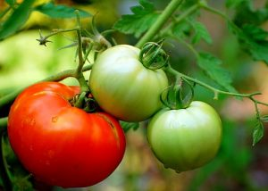
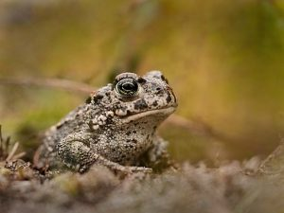
Genetics
Self-fertilization can improve resilience to extinction of plant species. If the species survives, the surviving individuals will have less deleterious mutations and the end result is a more robust and resilient population.
Industrial landscapes often leave a trail of ecological catastrophe on their wake, but a new study on genetic diversity shows that old spoil heaps from coal mining can be paradise for natterjack toads.
20,056,601 hours in IBERGRID used by BIOMED since 2006

Slide 33
EOSC integration model

Slide 34
Users of Generic Platforms
and client tools
OSCAR
Platforms
Research Platforms
Operators
Orchestration
Federation Services
Research
Community users
Accounting, Monitoring,…
IaaS
Providers
Federated AAI across all layers: EGI-CheckIn, supporting as well INDIGO-IAM (Deep Learning) and Eduteams

Slide 35
Development of tools to support advanced computing paradigms
Repository | User base
github.com/indigo-dc/udocker | “user-level tool” widely expanded in BioInformatics, HEP, Fusion...
github.com/grycap/im | Application architect and application manager Cloud orchestration tool to deploy virtual infrastructures as code, integrated in the EGI Dashboard of the Federated Cloud.
github.com/grycap/ec3 | User-level tool for deploying self-managed batch and Kubernetes clusters, used in different scientific disciplines.
github.com/grycap/oscar | Application developer tool for building applications based on functions activated through triggers.
Container support for HTC and HPC
Easining access to IaaS Clouds
Deploy Virtual Elastic Clusters
OsCAR: Open Source Serverless Platform
“A Quality based approach to software an services”
https://indico.egi.eu/event/5000/sessions/4495/#20201103,
by Mario David, 03/11, 9:45am

Slide 36
Thematic services - I
Info & Entry point | User base
https://deepaas.deep-hybrid-datacloud.eu/ https://marketplace.eosc-portal.eu/services/deepaas-training-facility | Deep learning tools to support training, data processing: environmental and earth observation
https://marketplace.eosc-portal.eu/services/opencoasts-portal Generating on-demand coastal forecasts using EOSC resources: the OPENCoastS service https://indico.egi.eu/event/5000/sessions/4490/#20201102 by M. Joao Rogeiro, 02/11, 15:45 | Coast observation: environment and civil engineering
http://scipion.i2pc.es/ Towards FAIR CryoEM workflows in EOSC https://indico.egi.eu/event/5000/contributions/14322/ by Laura del Cano, 02/11, 13:40 - 13:55 | Structural Biology: 3D electron microcospy

Slide 37
Thematic services - under development
Info / Entry point | User base
Integration of WORSICA’s thematic service in EOSC - challenges and achievements - https://indico.egi.eu/event/5000/sessions/4490/#20201102 by Ricardo Martins, 02/11, 16.30-16.50 | Coast observation: environment and civil engineering.
SAPS: Estimating the Evolution of Forest Masses and Crops using Cloud Resources - DEMO https://indico.egi.eu/event/5000/sessions/4580/#20201103, EGI 2020, 03/11, 14.45-15.00 | Environment, focussed on forest preservation.
LAGO: Latin American Giant cosmic ray Observatory http://lagoproject.net/, https://www.eosc-synergy.eu/thematic-services/lago/ | Astrophysics: A cosmic ray observatory composed of a network of water-Cherenkov detectors (WCD).
“Quality and Capacity expansion of Thematic Services in EOSC-SYNERGY”
https://indico.egi.eu/event/5000/sessions/4495/#20201103,
by Ignacio Blanquer, 03/11, 10.20am

Slide 38
Some considerations on cooperation between
research communities

Slide 39
Cooperation is fundamental (why do we need others?)
The problems that remain to be solved are extremely complex
A high level of specialization is required to tackle them
Expertise that comes only after a number of years of dedicated and focussed work in a particular problem.
Joint development of tools and methodologies
It will help also to solve domain-specific challenges
While technical discussions are possible, sociology remains too complex for
reasons that boil down to the competition for funding.
Interdisciplinary studies: in the data area
Climate and planet impact, biodiversity analysis,…
Data Privacy regulations (medicine but also daily activities)
Science should exploit them for the benefit of the whole society

Slide 40
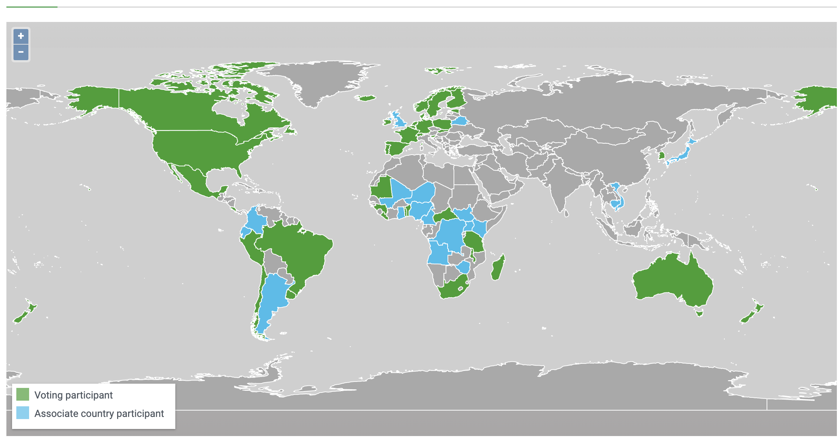
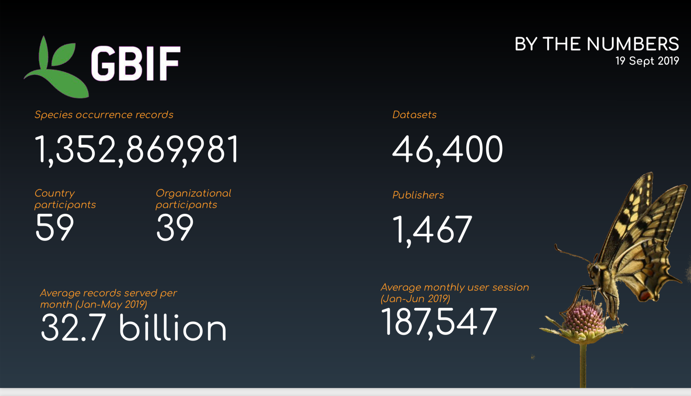
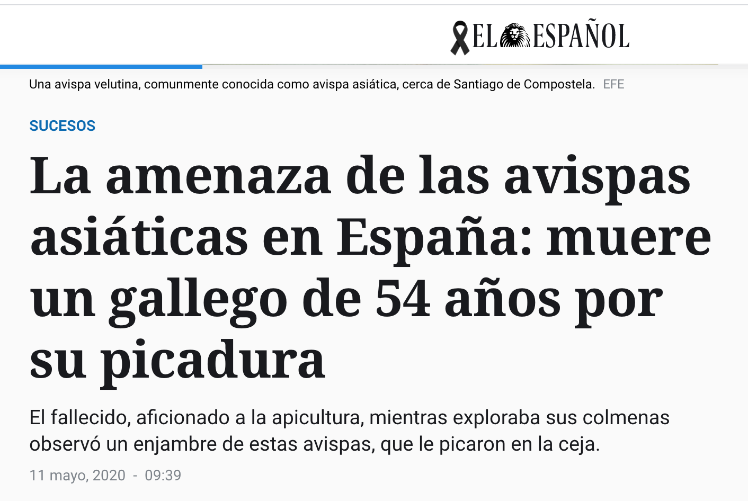
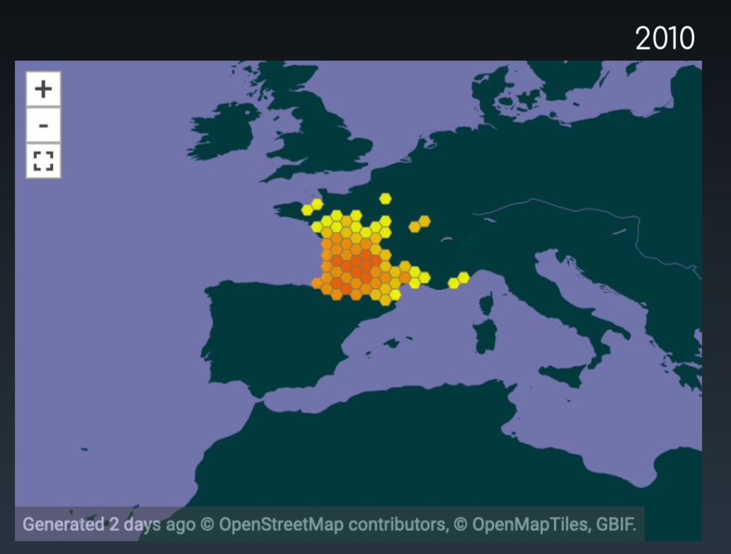
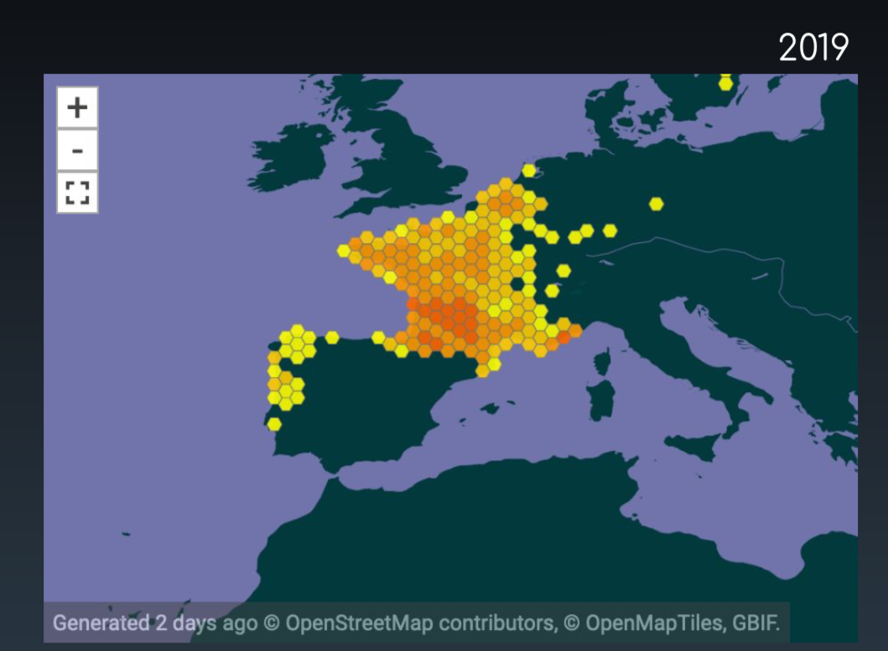
Example in Biodiversity : GBIF
2010
2015
2019
11th May 2020
2005
Slides courtesy of
GBIF_PT and GBIF_ES

Slide 41
There are ideas to learn from:
Slide courtesy of
GBIF_PT and GBIF_ES

Slide 42
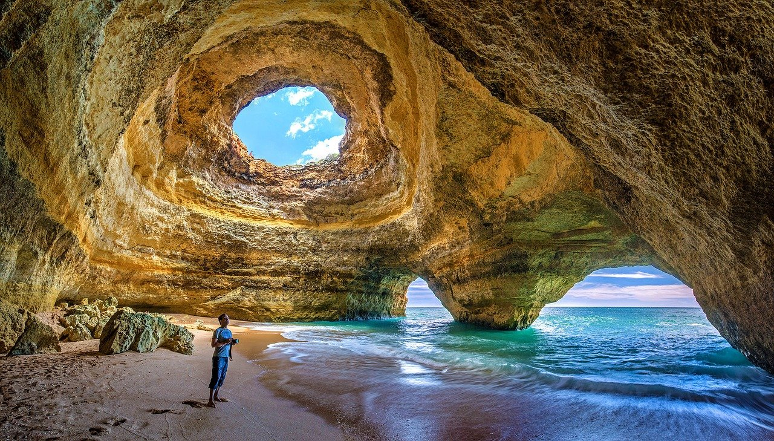
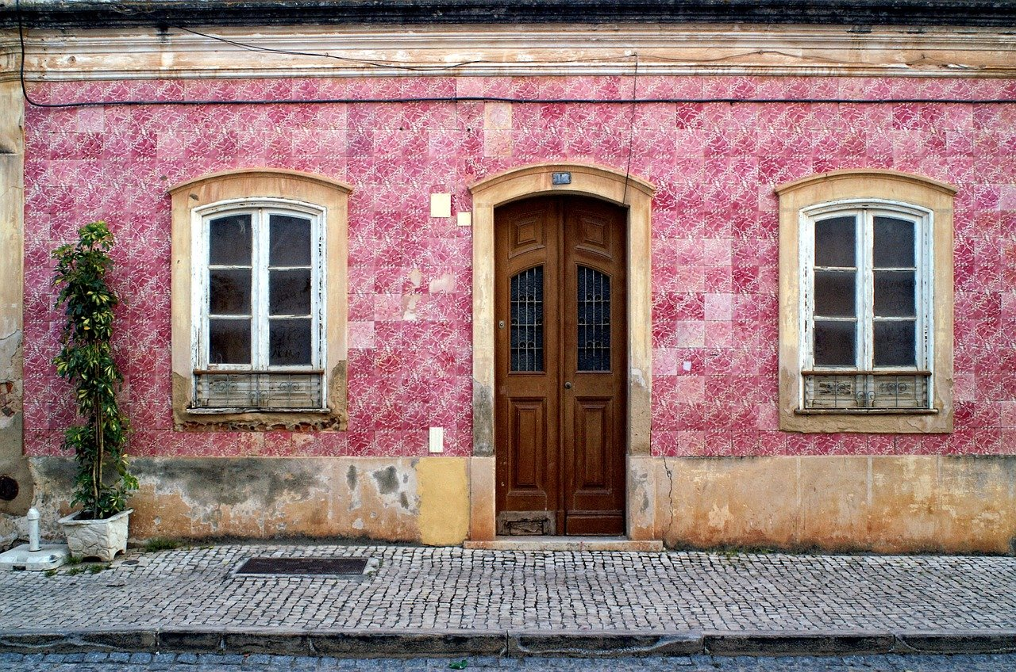
Outlook and Future plans
Expanding Capacity in quantity and quality
Support science cases that require heterogeneous hardware
Co-designing advanced computational services with user communities:
Some key areas:
Biodiversity
Ocean and Coastal observation
BioInformatics,
Genetics,
High Energy Physics and Astrophysics
Date to be decided !

Slide 43
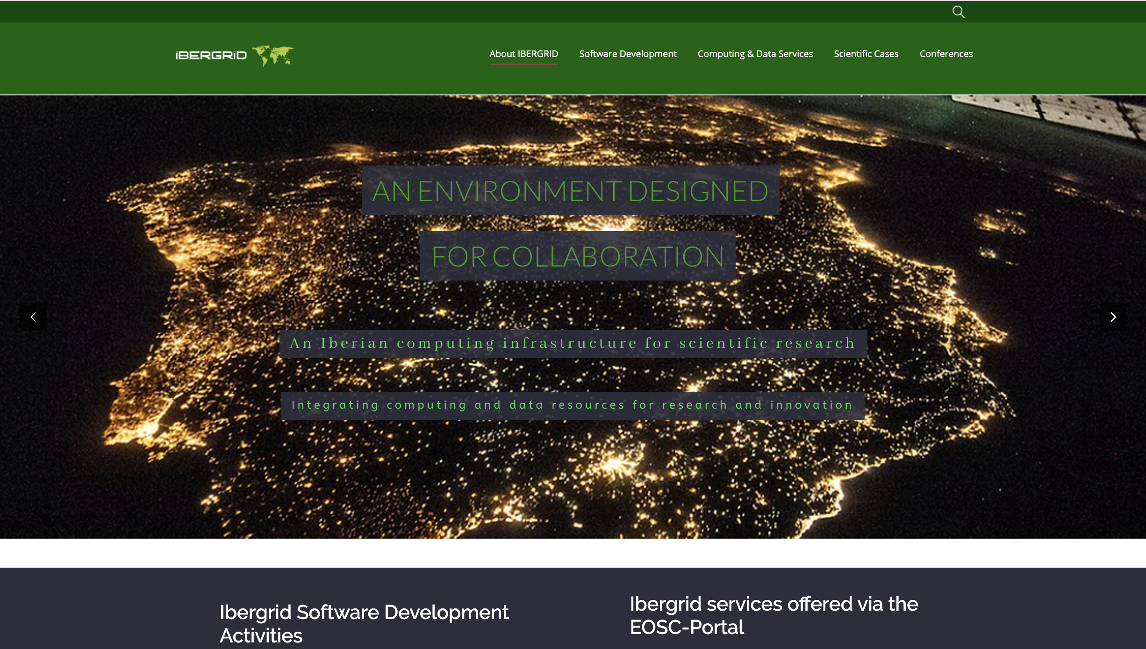
http://www.ibergrid.eu/
Thank You!
We look forward to welcoming the EGI community in Portugal at IBERGRID 20/21

