Slide 1
GENERAL HOUSEKEEPING
Please make sure your microphone and video are deactivated unless the (co)host gives permission.
Use the function to ask to speak, you find the option in the “participants” list
All presentations will be available on
Indico (see session via Timetable).
If you do not see all the Zoom buttons
at the bottom of the Zoom window, move your mouse on that window and buttons will appear.
Share your impressions and experiences on Twitter using #EGI2020 and mention @EGI_eInfra.

Slide 2
How to measure the impact of user engagement?
Gergely Sipos
Head of Services, Solution and Support
Giuseppe La Rocca
Community Support Team Lead.

Slide 3
Outline
Introduction (Gergely Sipos)
How EGI measures its impact? (Giuseppe La Rocca)
Infrastructure impact
Impact of outreach and support activities (EGI CRM)
Number of users across the services (from the EGI Ops Portal; REST API; Check-in)
CPU usage (from the EGI Accounting Portal)
Scientific impact
List of publications (OpenAIRE)
Other impact
Customer interviews (free forms response)
Council interviews (guided questionnaire)
Monitoring scientific outputs with OpenAIRE (Paolo Manghi)
Q&A, Discussion

Slide 4
What do we need?
2,000+
110
Open Access Scientific Publications in 2019
Engaged communities
71,000
58M+ CPUh
Active users
Monitoring the CPU usage of resources
OpenAIRE portal
Communities repositories, and customers interviews
CRM
Customer interviews
EGI Operations Portal
REST APIs
EGI Accounting Portal

Slide 5
Infrastructure impact
Impact of outreach and support activities
Customer relationship management
Number of users across the services
From the EGI Ops Portal
Customer’s REST APIs
EGI AAI Check-In dashboard
CPU usage
from the EGI Accounting Portal

Slide 6
Customer relationship management
Distributed activity based on NGI teams, community-specific support teams and EGI.eu user community support team
Regular (~monthly) teleconferences on priorities, status, experiences, plans
Databases in the EGI IT Service Management System to track
Opportunities (new communities, new providers)
Supported communities (incl. footprint, matching NGIs, requirements, etc.)
KPIs (and other reports) can be generated quite easily

Slide 7
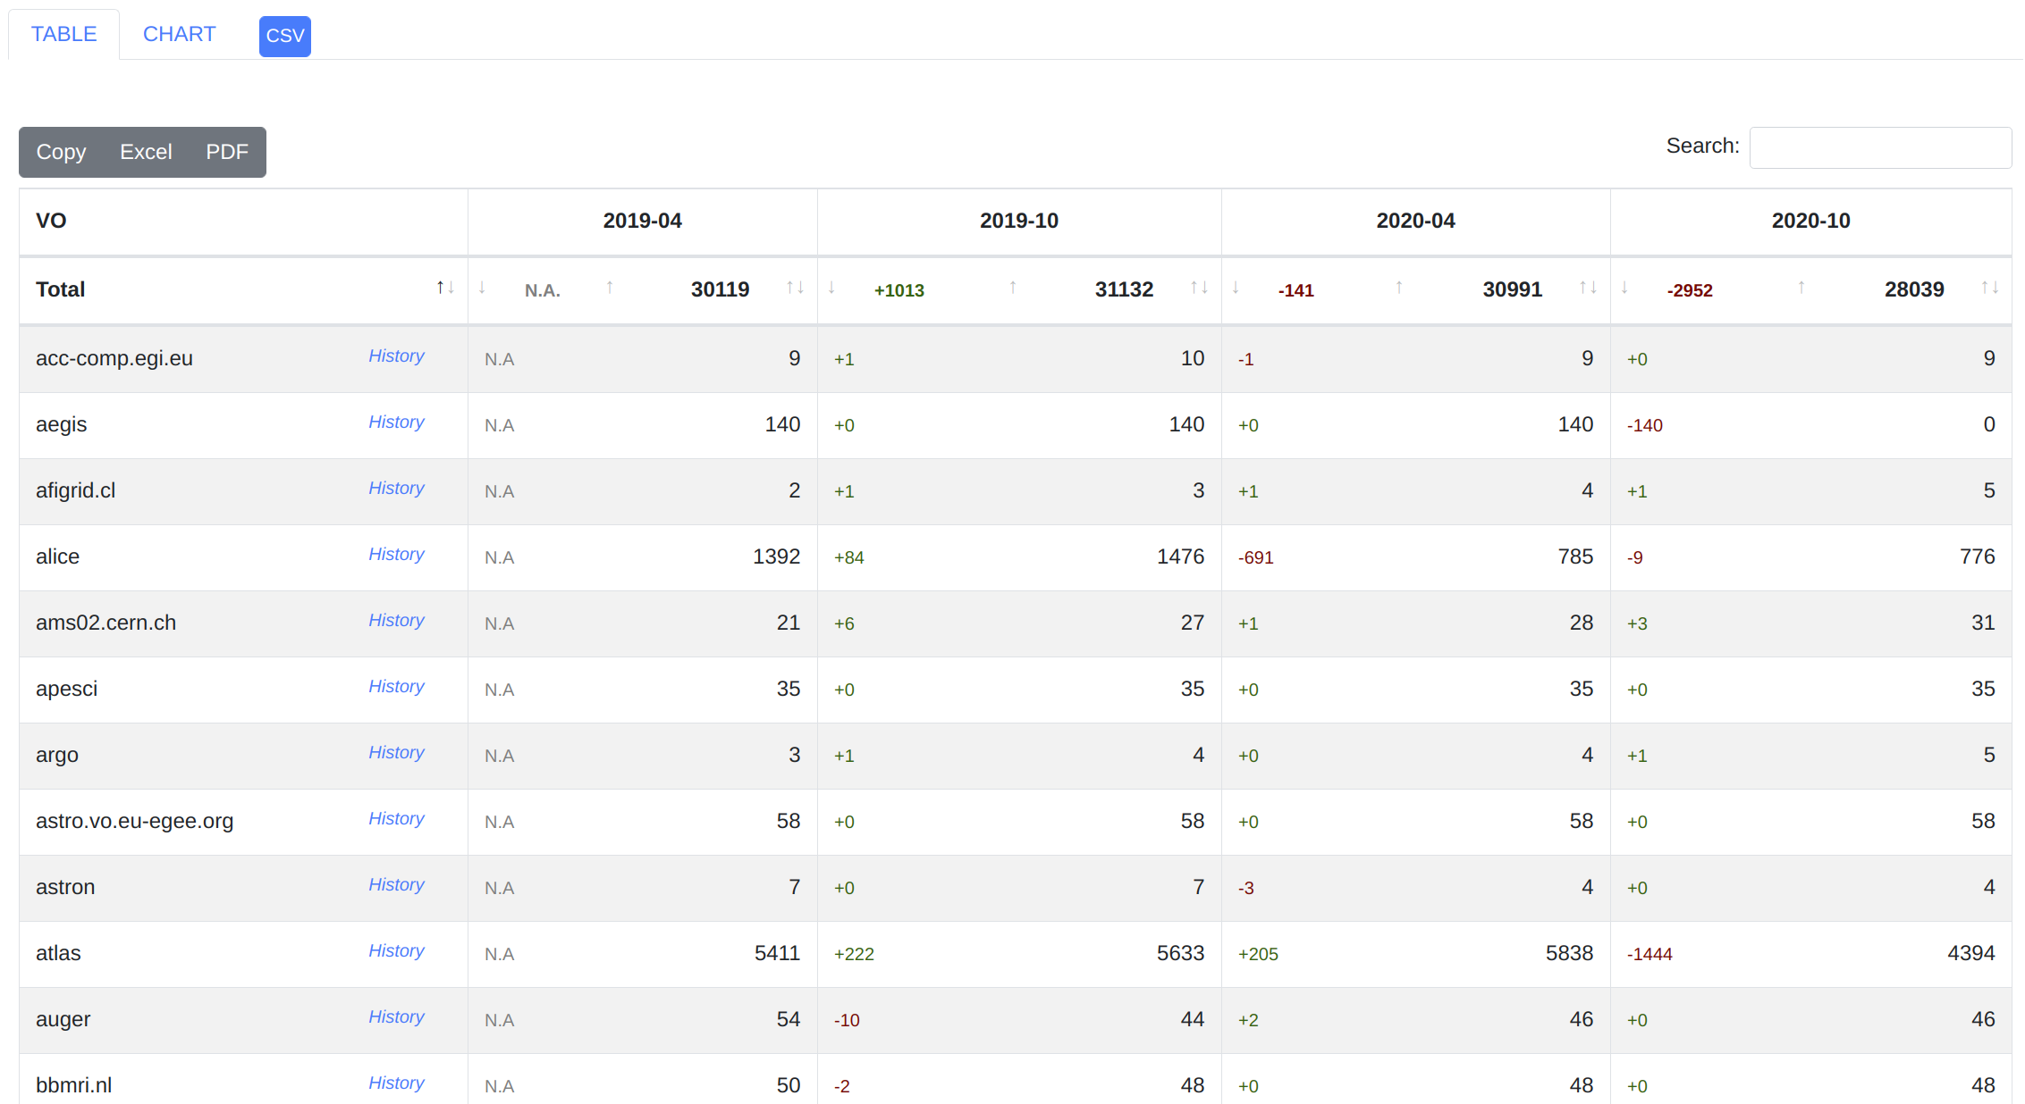
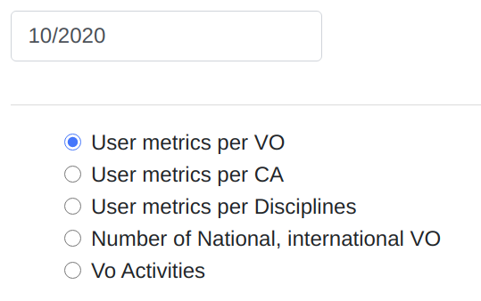
Number of users from the EGI Ops Portal
https://operations-portal.egi.eu/
User Metrics per VO

Slide 8
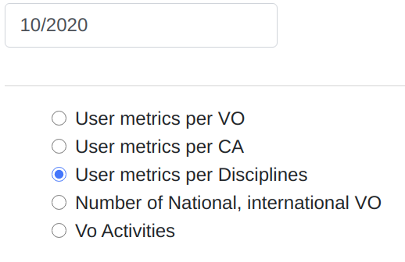
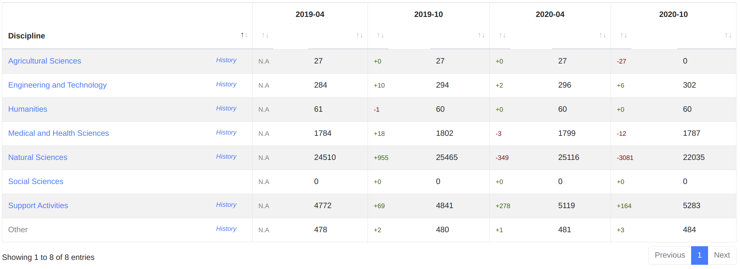
Number of users from the EGI Ops Portal
https://operations-portal.egi.eu/
User Metrics per Disciplines (first/second level)

Slide 9
Customer’s REST APIs
Returns the “total number of users” registered between two specific dates
]$ python pyWeNMR_metrics.py
- 19426 WeNMR total users
- From/To: 03-01-2010 21:37:01 - 01-11-2020 17:11:45
Returns the “num. of users per service” between two specific dates
]$ python pyWeNMR_metrics.py
- Total users: 18689 for the service 'HADDOCK'
- Total users: 2610 for the service 'DISVIS'
- Total users: 2344 for the service 'SPOTON'
...
- From/To: 01-01-2010 - 01-11-2020

Slide 10
Customer’s REST APIs
Returns the “num. of users per institute” (and service) between two specific dates
Returns the “nunm. of users per country (and service) between two specific dates
]$ python pyWeNMR_metrics.py
- Total users: 579 for the service 'HADDOCK'
- Country: NETHERLANDS
- From/To: 01-01-2010 - 01-11-2020
- Num. of users per institutes:
- VU UNIVERSITY AMSTERDAM [3]
- MAASTRICHT UNIVERSITY [4]
- BIJVOET CENTER FOR BIOMOLECULAR RESEARCH [16]
- UTRECHT UNIVERSITY [189]
- WAGENINGEN UNIVERSITY [19]
- ...
- WeNMR: already implemented the REST APIs
- BIOMED: will integrate the new APIs in the next VIP release
- In discussion with other communities (e.g.: NBIS, GEOSS)

Slide 11
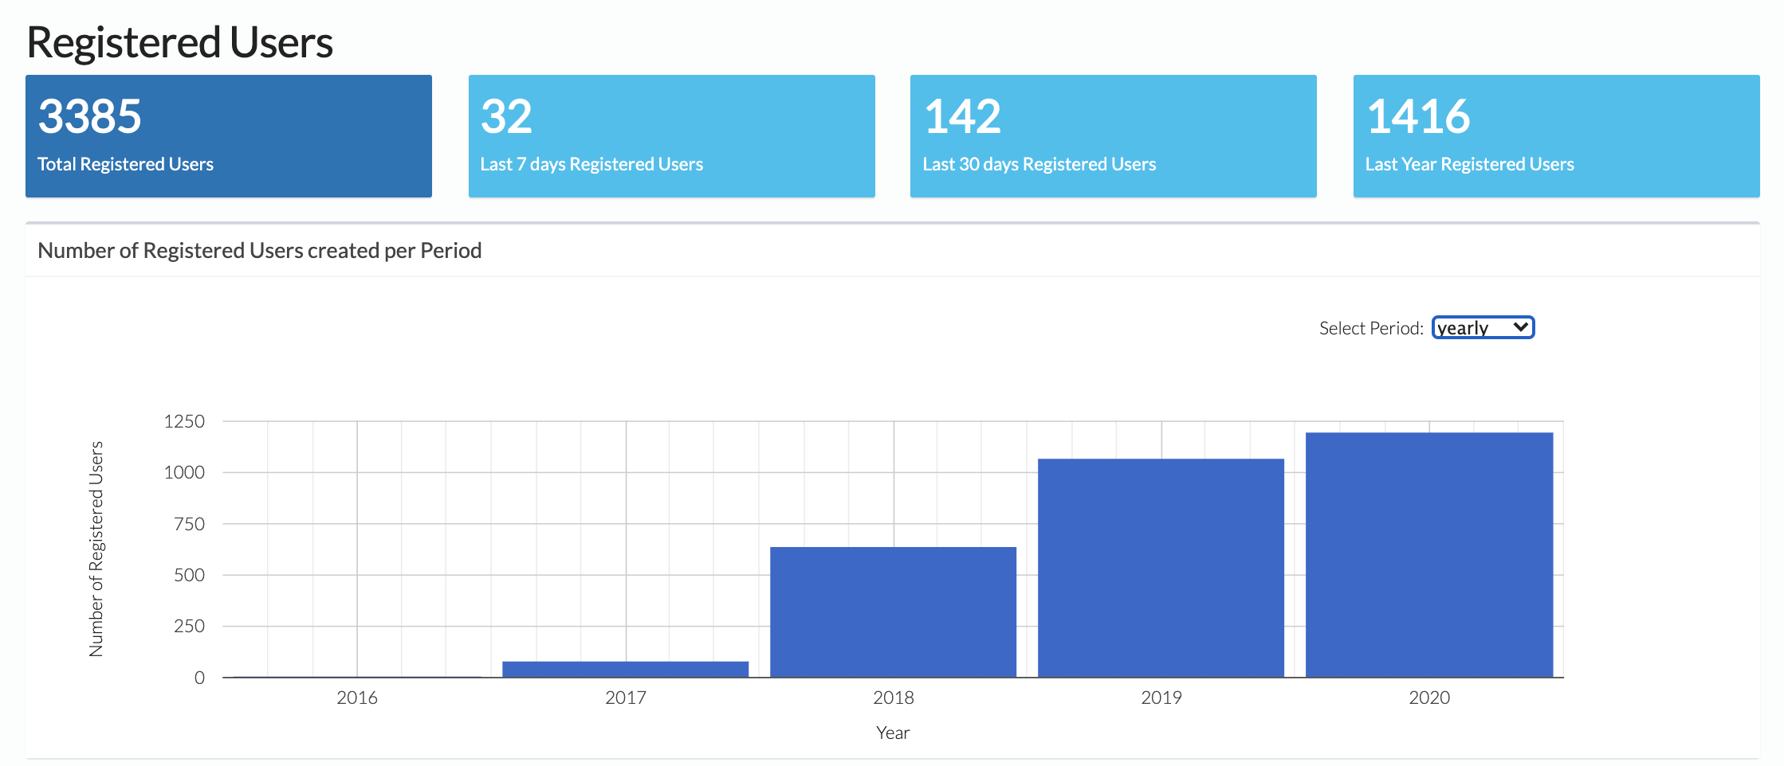
EGI Check-In statistics
https://aai.egi.eu/registry/rciam_stats_viewer/rciam_stats_viewer_services/index/co:2
EGI AAI Check-In Registered Users

Slide 12
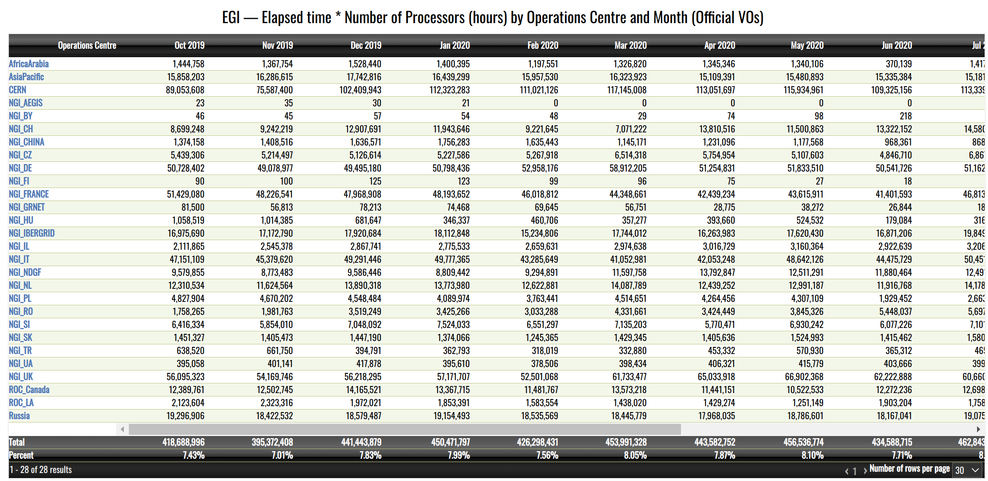
CPU/h used from the EGI Accounting Portal
https://accounting.egi.eu/

Slide 13
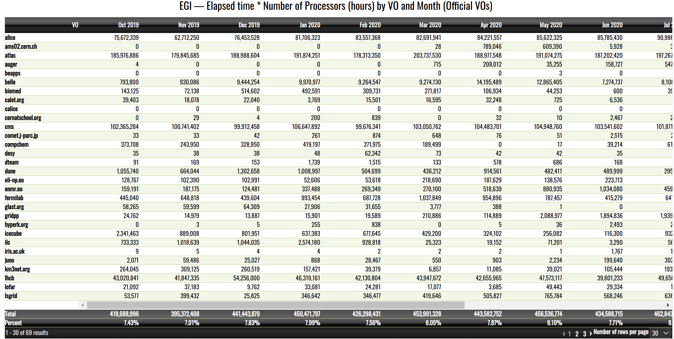
CPU/h used from the EGI Accounting Portal
https://accounting.egi.eu/

Slide 14
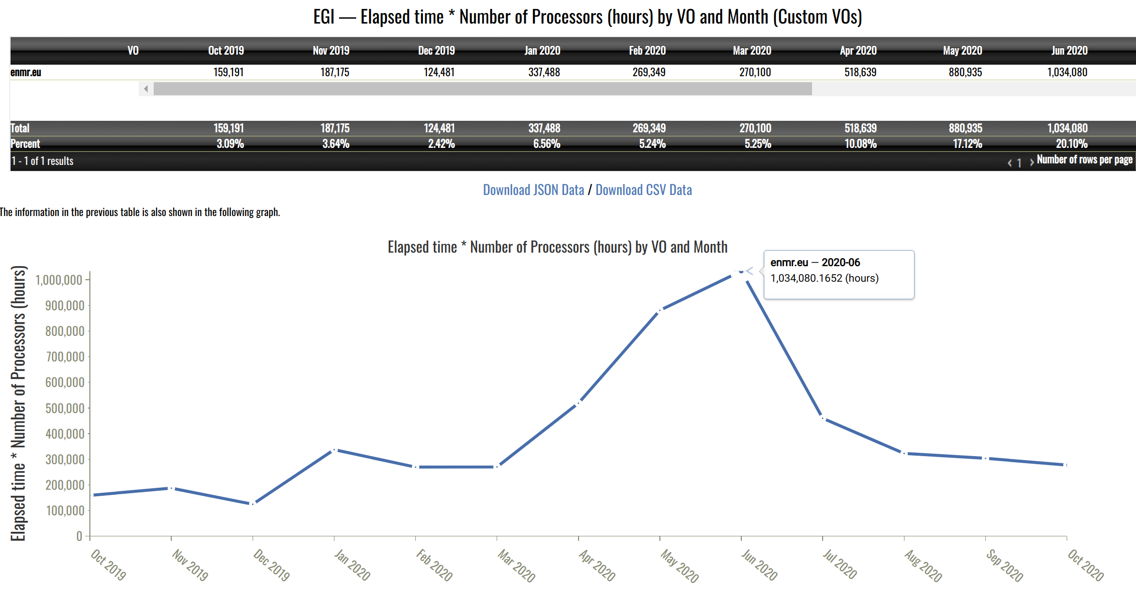
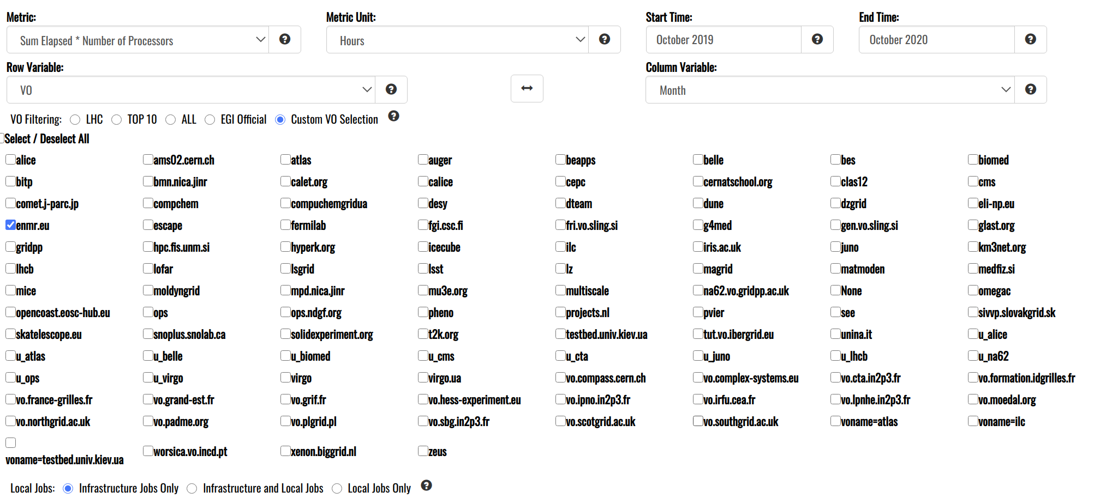
CPU/h used from the EGI Accounting Portal
https://accounting.egi.eu/

Slide 15
Scientific impact
List of publications (OpenAIRE)
Experiment repositories

Slide 16
Monitoring of the publications
OpenAIRE provides a service for national funders to report the outcomes of their work, and to give an overview of scholarly output, enabling visibility to all stakeholders
Several Community Gateways are already available:
.. and many others.
The EGI Community Gateway is available at: https://beta.egi.openaire.eu/

Slide 17
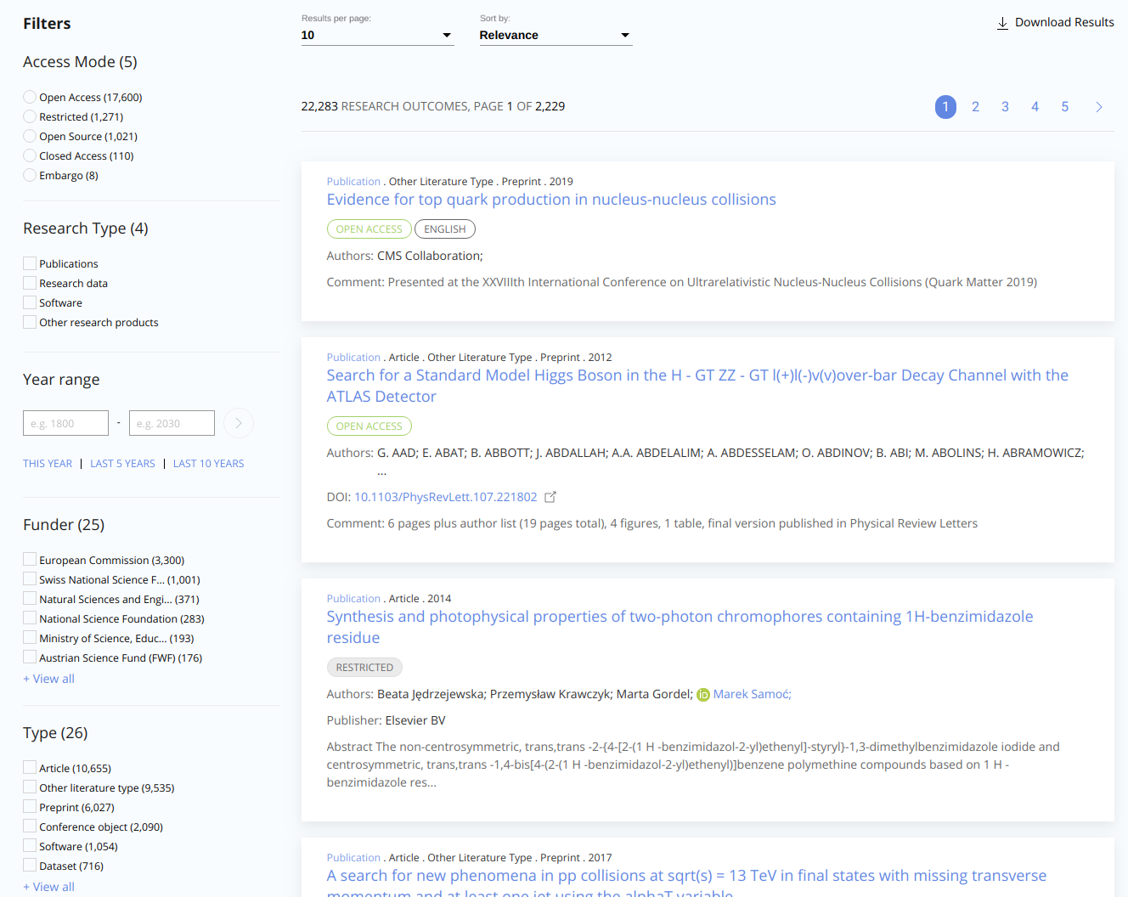
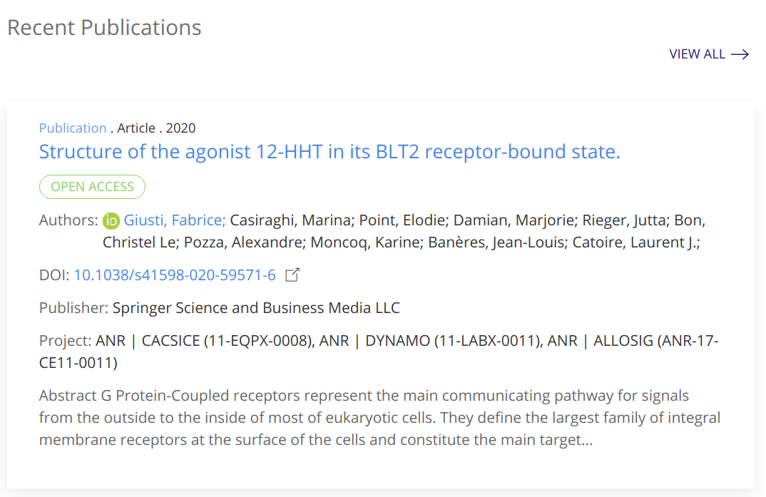
Monitoring of the publications
https://beta.egi.openaire.eu/

Slide 18
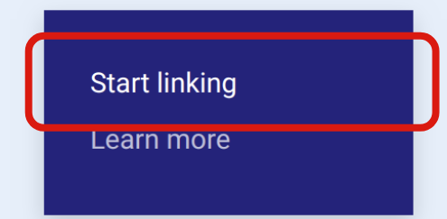
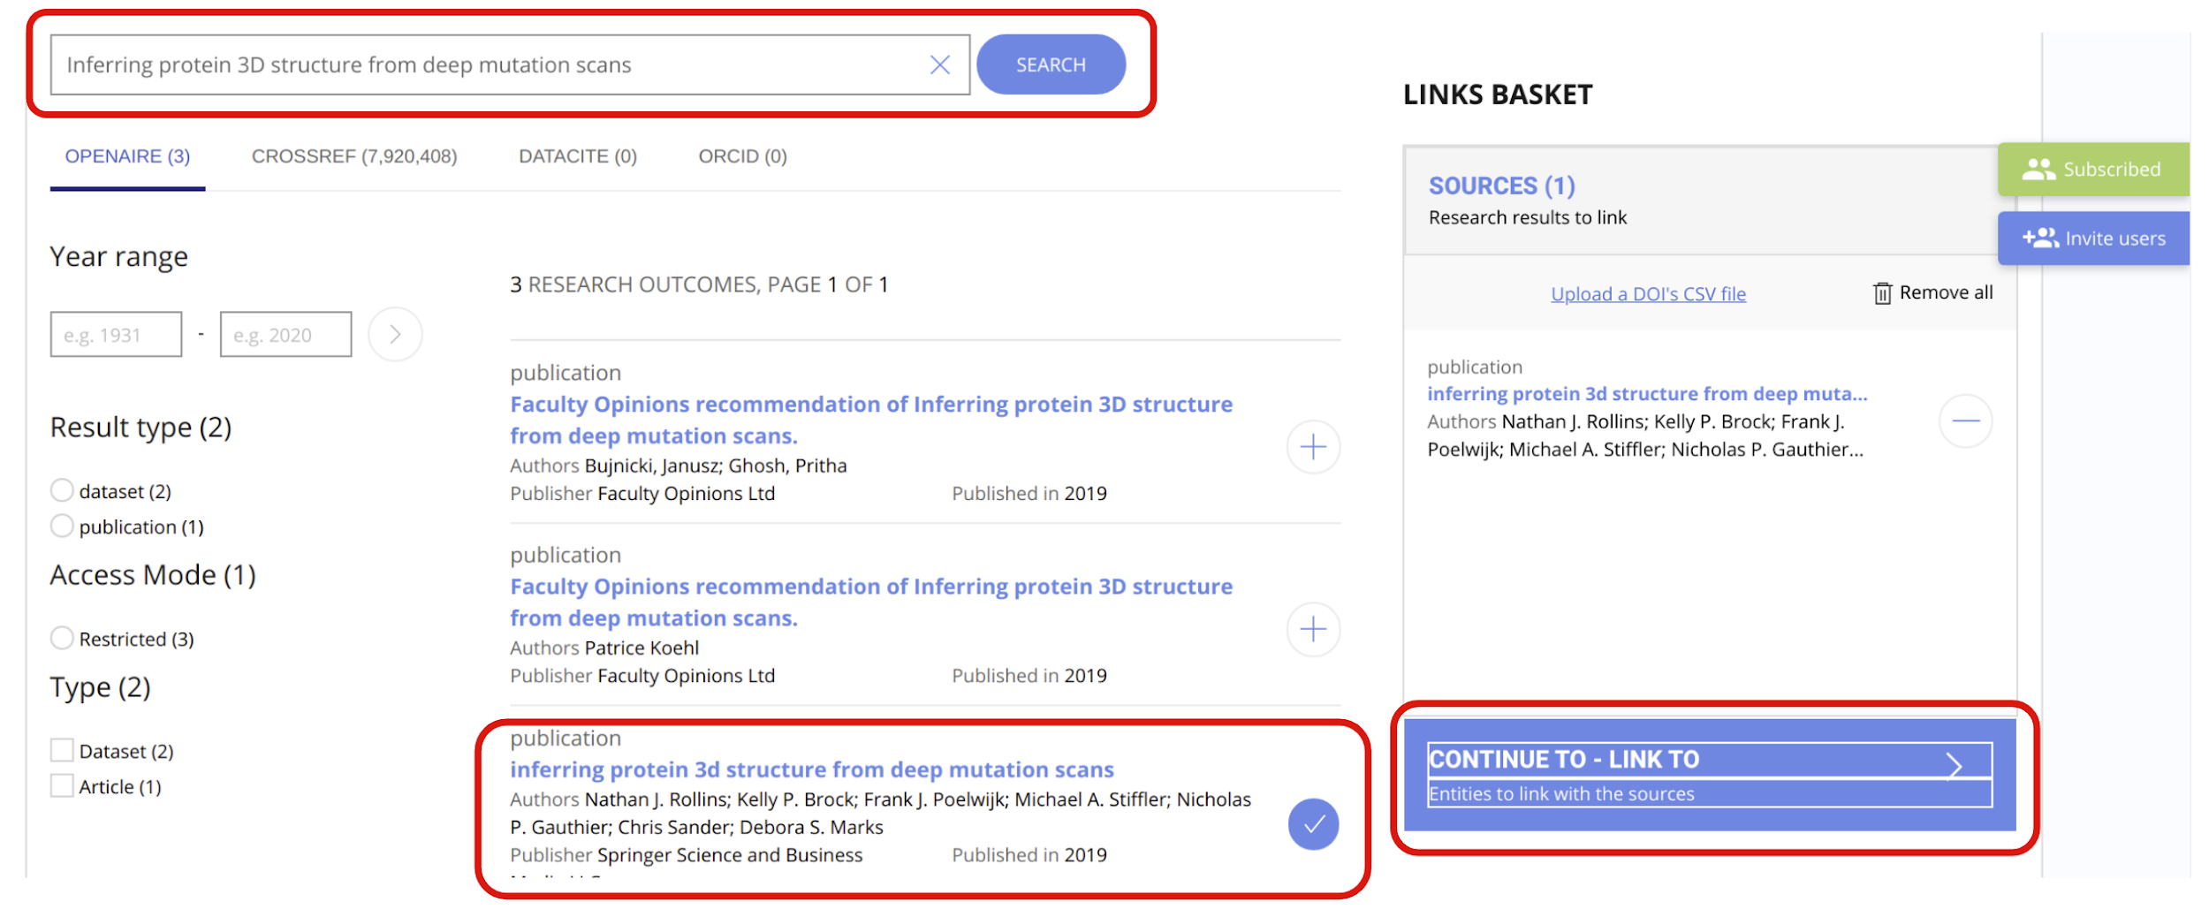
How to claim publications
https://beta.egi.openaire.eu/
Sign in with your account.
Click on the “Starting linking” button (under the Link menu):
Use the text editor to add the publication to be linked and click on the Search button:
Click on the “Continue to Link” button
Select “Communities” as type of Entity to Link your sources
Select “EGI Federation” as community
Click on the “Finish Linking” button

Slide 19
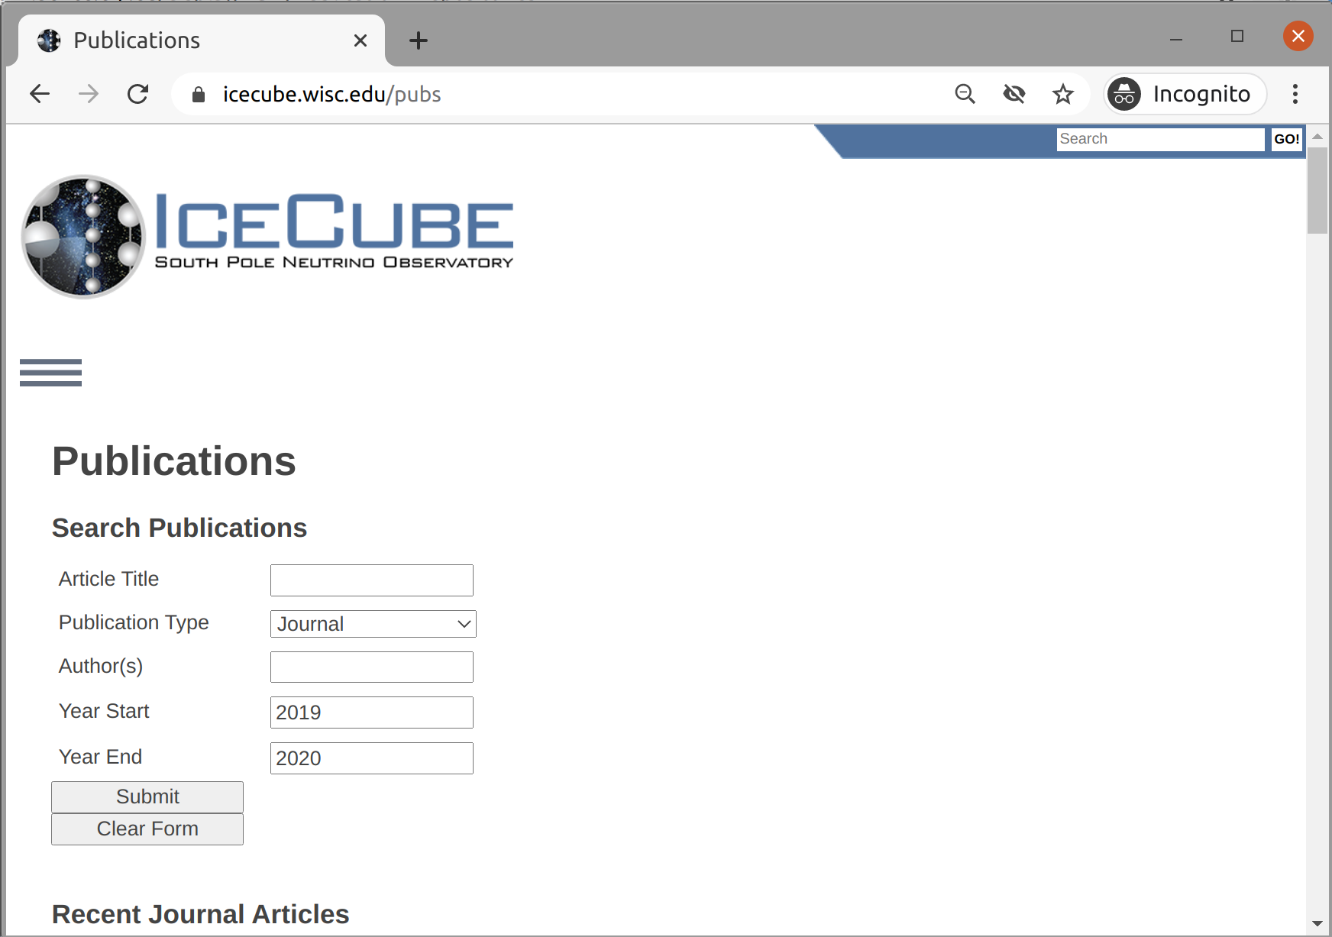
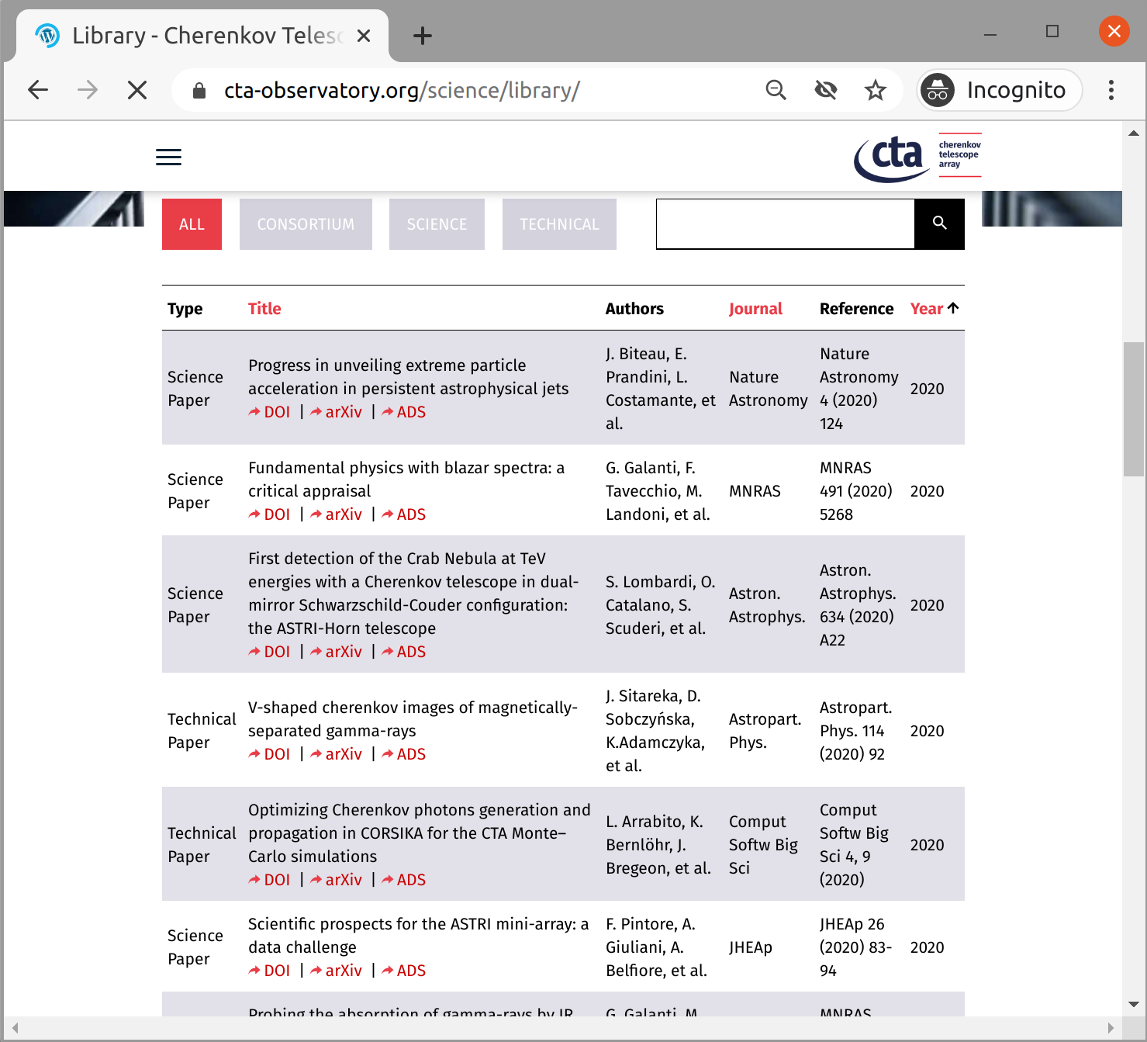
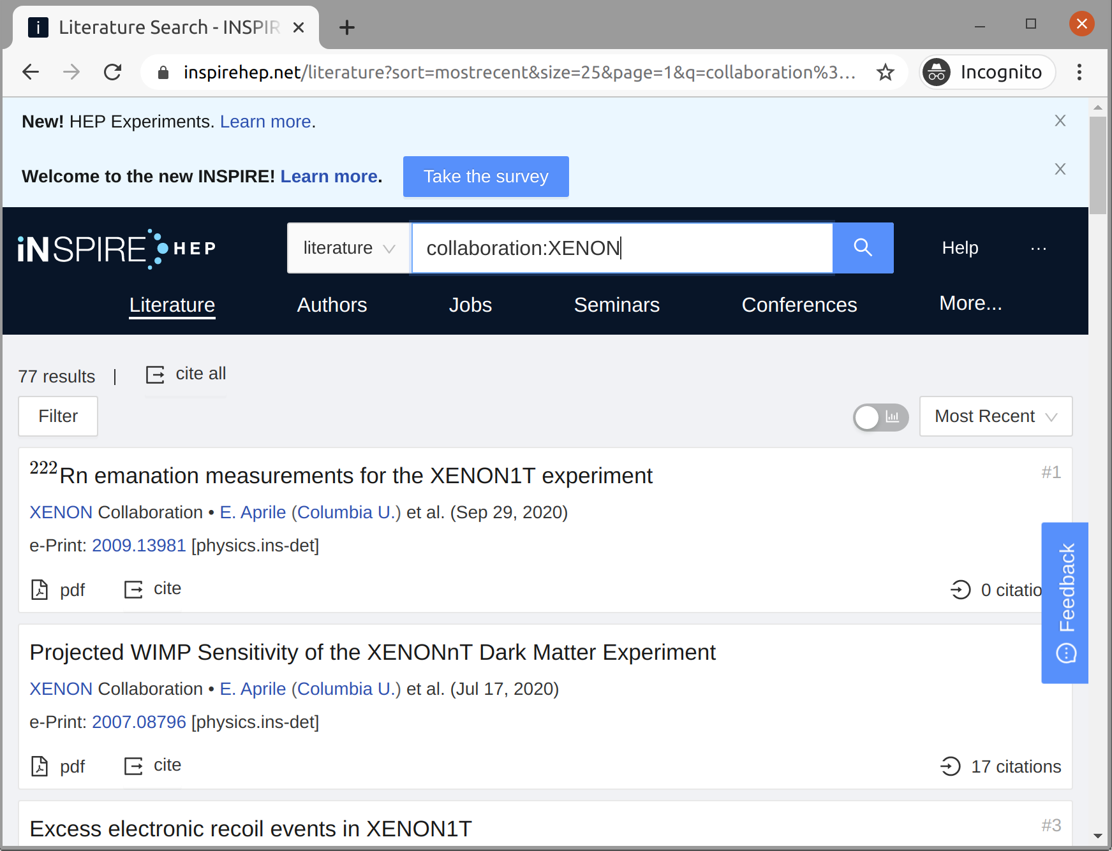
Experiments repositories
Different experiment repositories:
ALICE, LHCb, SeaDataNet, XENON, CTA, …. and many others
Different way to publish scientific publications:
HTML, XML, bibtex, JSON, etc.
Parsing communities’ experiment repositories on regular basis using:
Beautiful Soup (v4.0) libraries, and
the bib2csv module

Slide 20
Other impact
Customer interviews (free forms response)
Council interviews (guided questionnaire)

Slide 21
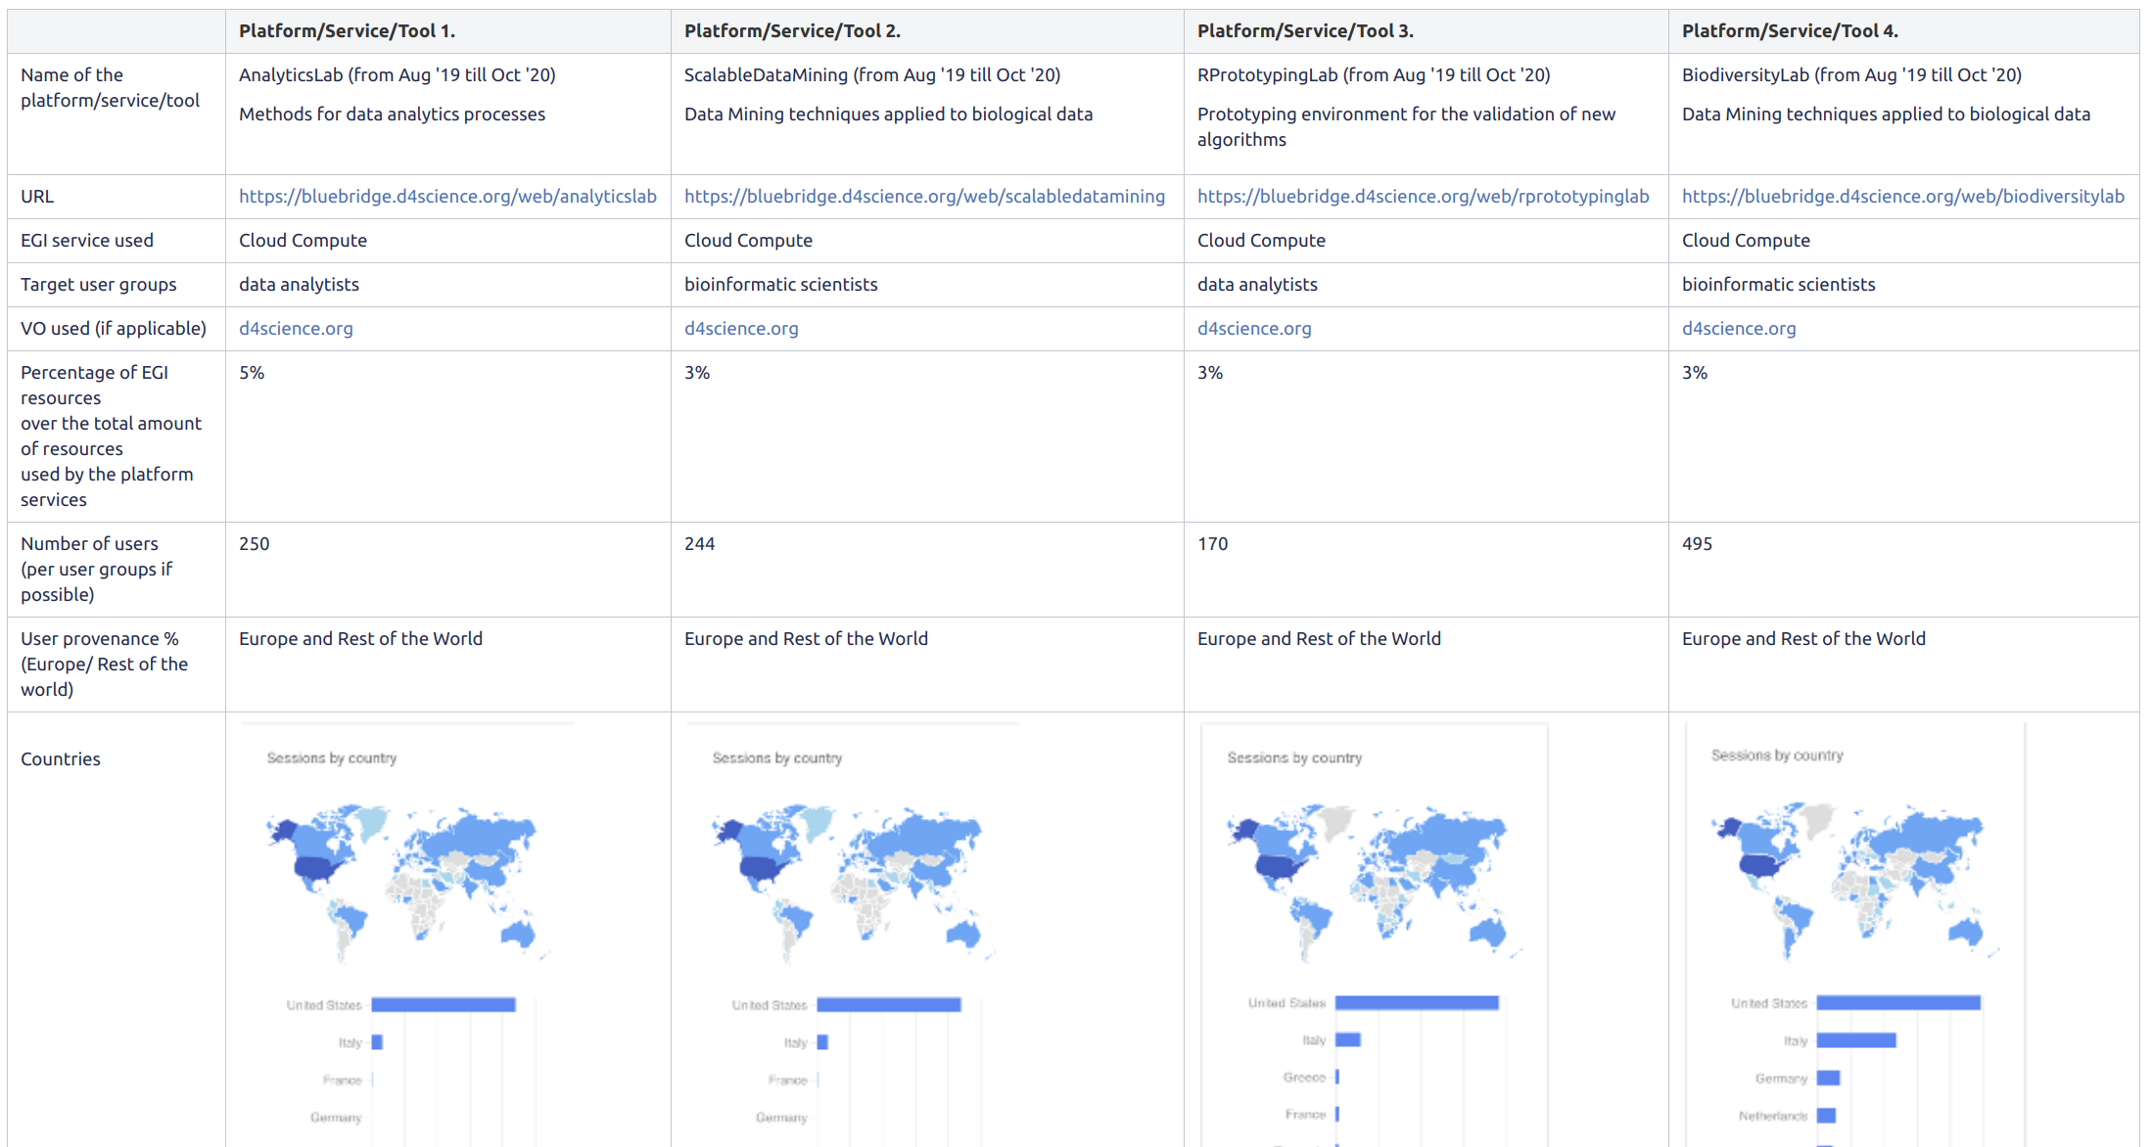
Customer Satisfaction Reviews
As part of EGI IMS is organizing, on a regular basis, meetings with customers to collect:
Feedback from the service delivered via SLA
List of publications benefiting from the use of the services/resources provided by EGI
Numb. of users accessing the services deployed in the EGI Infrastructure

Slide 22
Council interviews
Council = Representatives of EGI Foundation participants
National e-infrastructures (24 NGIs)
Scientific communities (CERN, ENES)
1-on-1 interview with each of them annually
Objectives are to:
Assess legal status of participant
Discuss the EGI value and strategy → What EGI enabled them to achieve
Learn about the participant (e.g. technology roadmaps; capacity plans; …)

Slide 23
Open challenges
Infrastructure impact
Incomplete picture (not every service/community provides complete report)
Scientific impact
Too many false positives/negatives in OpenAIRE
Which repository to use?
Zenodo vs Experiment-specific vs. National vs. Institutional repositories
Integrating and cleaning data from all these
Other impacts
New reporting demands (e.g. ‘how much’ country X used service Y) (Various readers; How detailed?)

Slide 24
Thank you!

