Slide 1
EGI MONITOR
Paolo Manghi (CNR-ISTI)
EGI Conference
November 4th, 2020

Slide 2
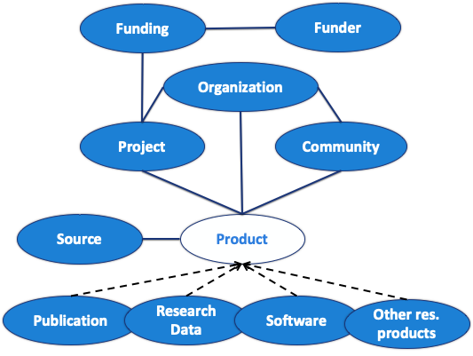
An open metadata research graph of interlinked scientific products, with access rights information, linked to funding information and research communities

Slide 3
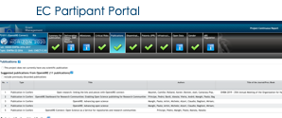
OpenAIRE Research Graph the supply chain
Full-text mining Inference of new properties and links
Stats analysis
Aggregation
Deduplication
Enrichment
indexing
RAW
Different records representing the same entity (results or organization) are merged in one
Data sources
Metadata records corresponding to equivalent objects are merged. Pre-print, post-print, published versions are considered equivalent for stats & monitoring purposes

Slide 4
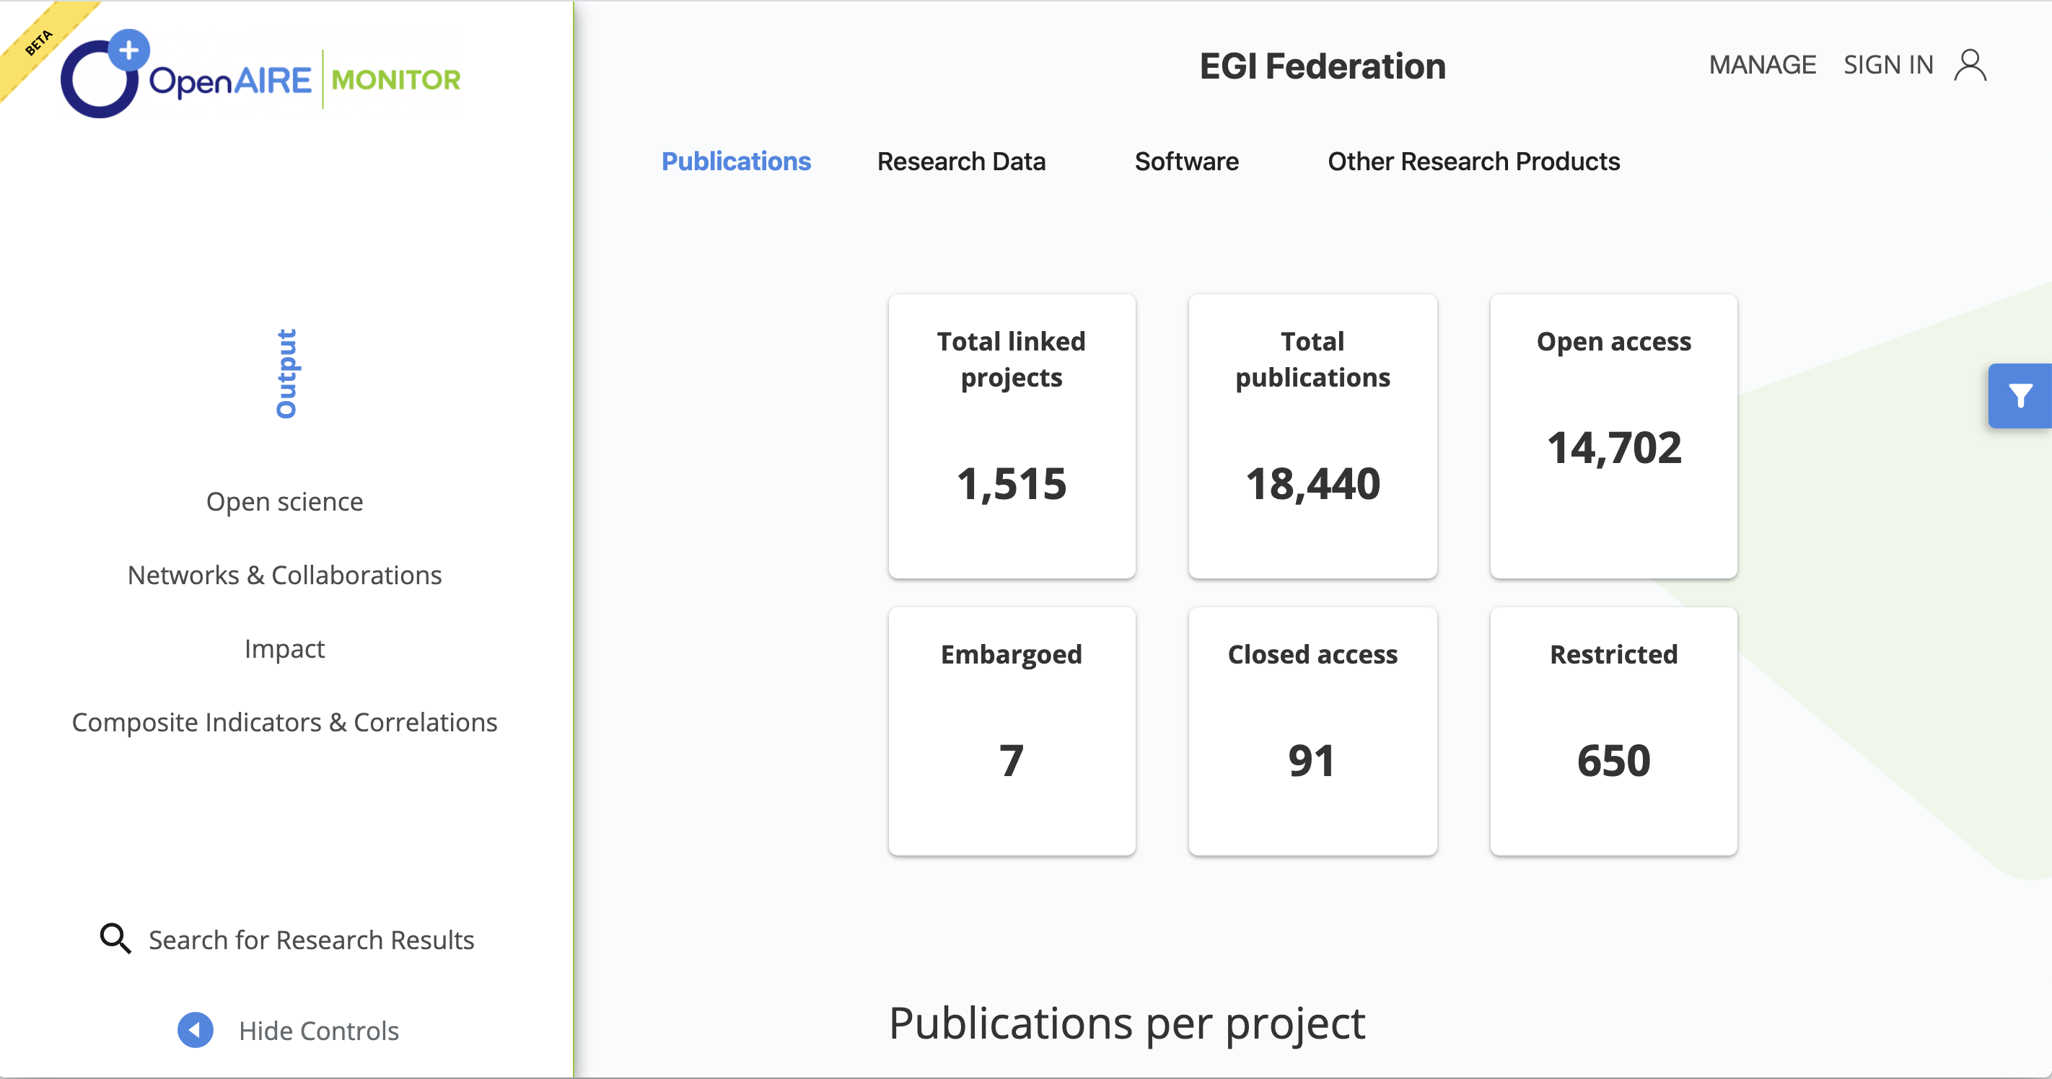

Slide 5
EGI MONITOR: use cases
List all publications
Associated to EGI
Associated to a certain Virtual Organisation (VO)
Associated with a certain EGI scientific discipline
With relationships
Publication "using EGI"
Publication "using NGI:XX"
Publication "supporting EGI"
Publication "related to VO:XYZ"
Publication "related to EGI Scientific Discipline:XYZ"
Notes:
Some of the possible use cases/applications

Slide 6
EGI provided…
Acknowledgement statements typically used by EC projects & EGI VO’s in scientific publications
Organisation Name | Type | Grant ID | Suggested Acknowledgement
WeNMR | EC Project | 261572 | "The WeNMR project (European FP7 e-Infrastructure grant, contract no. 261572, www.wenmr.eu), supported by the European Grid Initiative (EGI) through the national GRID Initiatives of Belgium, France, Italy, Germany, the Netherlands (via the Dutch BiG Grid project), Portugal, Spain, UK, South Africa, Taiwan and the Latin America GRID infrastructure via the Gisela project is acknowledged for the use of web portals, computing and storage facilities." and the following article describing the WeNMR portals should be cited: Wassenaar et al. (2012). WeNMR: Structural Biology on the Grid.J. Grid. Comp., 10:743-767.
EGI-InSPIRE | EC Project | 261323 | The authors acknowledge the use of resources provided by the European Grid Infrastructure. For more information, please reference the EGI-InSPIRE paper (http://go.egi.eu/pdnon).
ALICE | VO | n/a | The ALICE collaboration gratefully acknowledges the resources and support provided by all Grid centres and the Worldwide LHC Computing Grid (WLCG) collaboration.
LHCb | VO | n/a | The Tier1 computing centres are supported by IN2P3 (France), KIT and BMBF (Germany), INFN (Italy), NWO and SURF (The Netherlands), PIC (Spain), GridPP (United Kingdom). We are thankful for the computing resources put at our disposal by Yandex LLC (Russia), as well as to the communities behind the multiple open source software packages that we depend on.
NGI:PT | NGI | n/a | This work makes use of results produced with the support of the Portuguese National Grid Initiative. More information in https://wiki.ncg.ingrid.pt
… | … | … | …
Notes:
used to create rules to mine publications and link them to EGI.

Slide 7
EGI provided…
General search terms to use in generic rules to discover publications potentially linked to EGI
“European Grid Infrastructure” “European Grid Initiative”
“National Grid Infrastructure” “National Grid Initiative”
“WLCG”
“France Grilles”
“Metacentrum”
“Swiss National Grid Association”
“Ibergrid” “NGI-ES”
“BIGGrid” “The Dutch e-Science Grid”
“PL-Grid” “Polish National Grid Initiative”
“TRUBA” “Turkish National Grid Initiative”
“ISRAGRID” “Israel National Infrastructure for Grid and Cloud Computing”
…
Notes:
used to create rules to mine publications and link them to EGI.

Slide 8
Text Mining
Extract full text from publications
If structured, use “funding” & “acknowledgements” fields
Scan text for matches against any of the EGI organization names provided
For each match, search surrounding context for
General terms & suggested acknowledgements (using word pairs) to add a confidence value to the match and eliminate false matches
For EC projects, we search not only for the project acronym (e.g. EGI-InSPIRE) but also for the grant ID (261323)
Notes:
Ioannis & Lefteris:
The full text is cleaned (stop-word removal) and normalized before all further processes
For Virtual Organizations (VOs):
- We search VOs names in the text for matches
For each VO match, we search the surrounding text for (also cleaned and normalized) suggested acknowledgement word pairs.
Each word pair hit increases the confidence value

Slide 9
Mining output → Curation → Tuning
Fine tuning via feedback from EGI experts after each new update of the mining module to eliminate false positives, e.g.:
Disregard publications older than certain date, e.g. <2007 overall, <2011 for Auger VO & Icecube VO, etc.
Restrict search for particular collaborations only in the Author fields, as if the collaboration is a person, for:
High Energy Physics VOs: ATLAS, ALICE, CALICE, LHCb, etc.
Pierre Auger collaboration
IceCube collaboration
MAGIC VO
HESS VO
etc.
Notes:
The reason searching only in the Author field for some VOs was essential is that the algorithm was previously mining full text, including the reference lists, and scored a hit every time an author mentioned, say, the Icecube experiment. EGI preferred we have a STRICT algo that eliminates those false positives, even if recall is also reduced by doing this.

Slide 10
Example: CMS

Slide 11
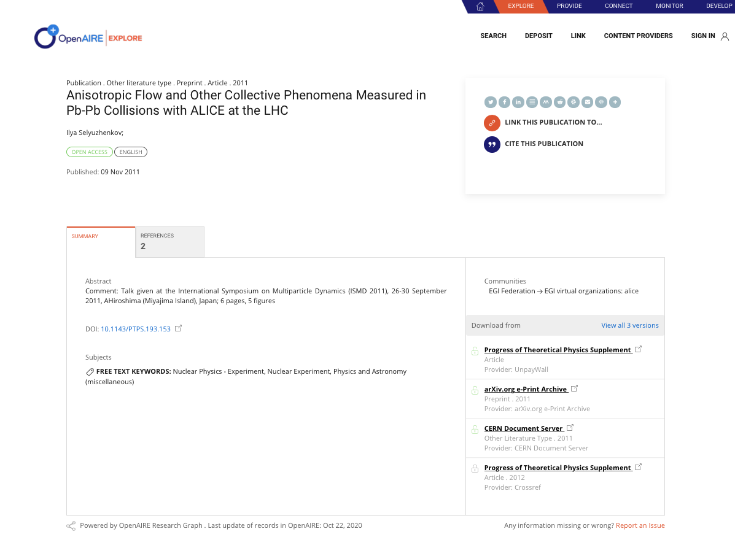
Example: ALICE

Slide 12
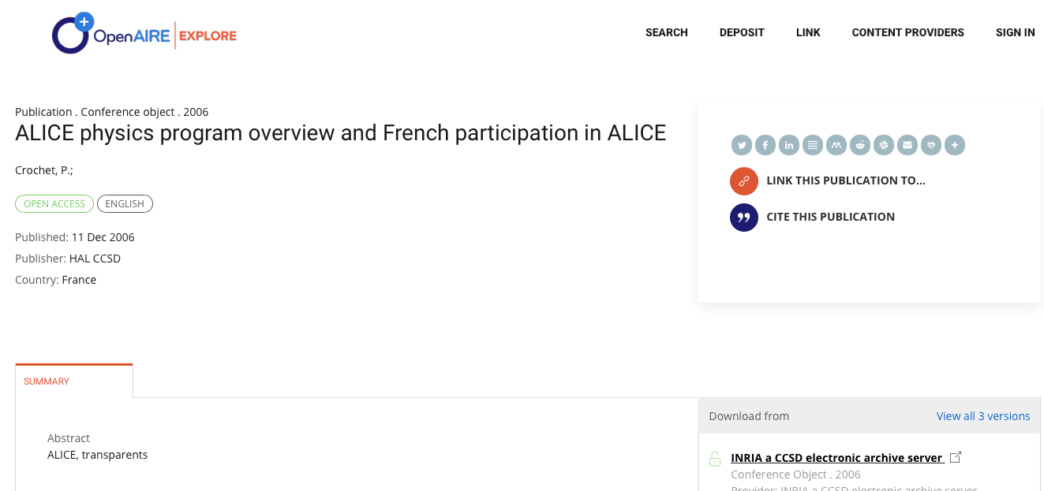
False +ve removed: not “ALICE”collaboration
Notes:
Mentions ALICE many times in the text but not “ALICE Collaboration” in the Title as requested by EGI.

Slide 13
Demo
Connecting….

Slide 14
Best practices for MONITOR Gateway Managers
Ground truth
Context for mining
Clean and normalize
Mining tolerance
Humans in the loop
Collect some representative examples of good matches beforehand
Collect as much information that may help with the mining beforehand. Even information that you may not think that it'll help, it may prove useful in the end.
Character encoding, stop-word removal, character case, special characters, etc.
Design your data mining methods to be very tolerant, e.g. suggested acknowledgements never appeared exactly as given in the input texts
Manual curation of the results to tune your data mining methods.
Notes:
Some lesson learned/best practices that could be re-used for other communities.

Slide 15
Future plans
Rollout to production (Nov 2020)
Open Science indicators
Further reasoning on the interpretation of the numbers, i.e. fine tuning of the impact
(project → product) AND (project → EGI) THEN (EGI → product)
Including usage statistics indicators
Download, views
Process!

Slide 16
Paolo Manghi (CNR-ISTI)
paolo.manghi@isti.cnr.it

