Slide 1
EGI AAI – Check-in
Overview
Valeria Ardizzone
EGI Foundation

Slide 2
Authentication and Authorization Infrastructure

Slide 3
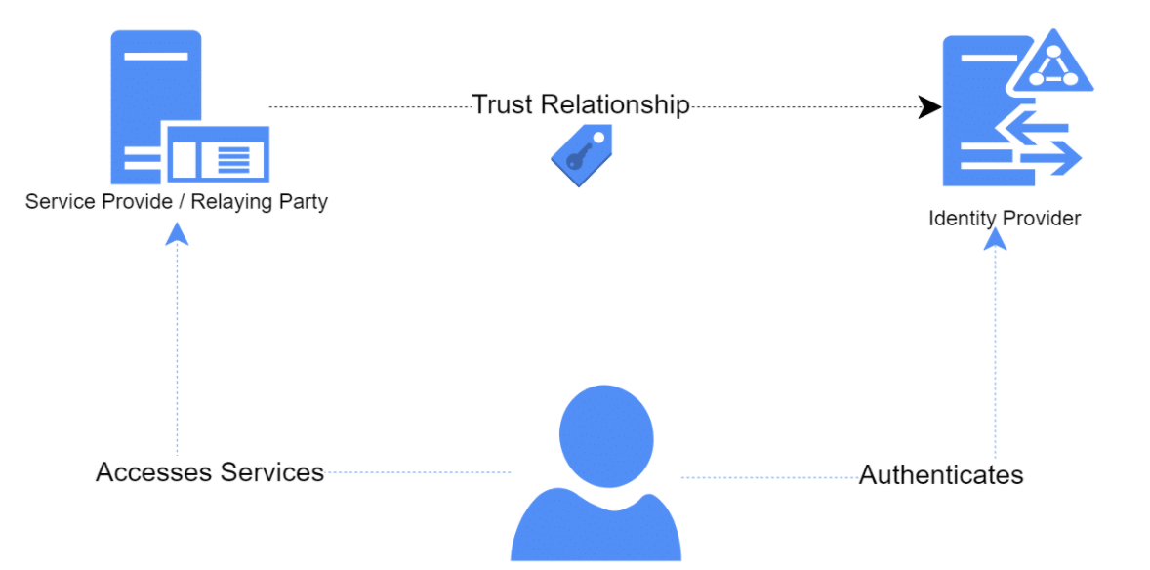
Federated Identity and Federation
Identity Providers (IdPs), Service Providers (SPs), Relaying Party

Slide 4
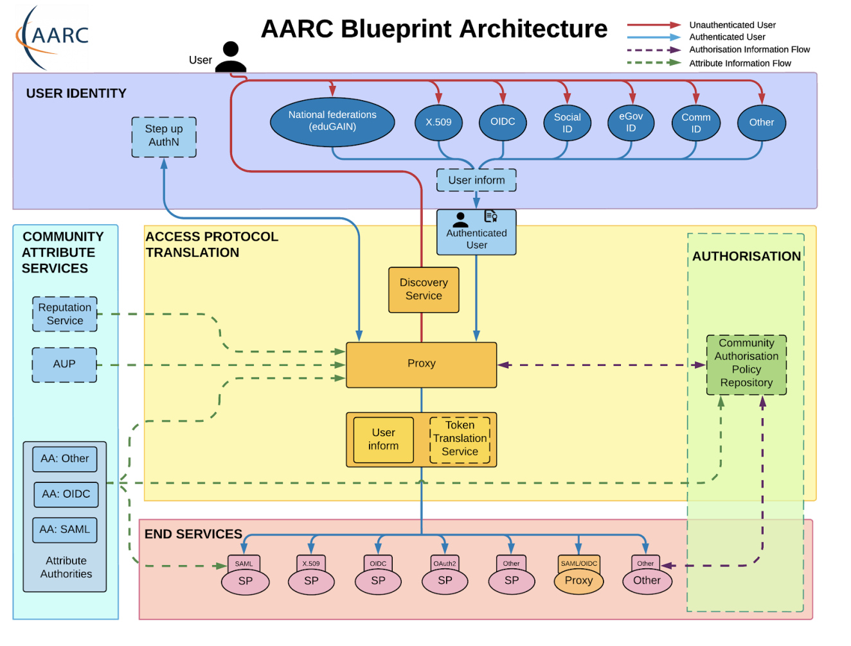
Five component layers:
User Identity
Community Attribute Services
Access Protocol Translation
Authorization
End Services

Slide 5
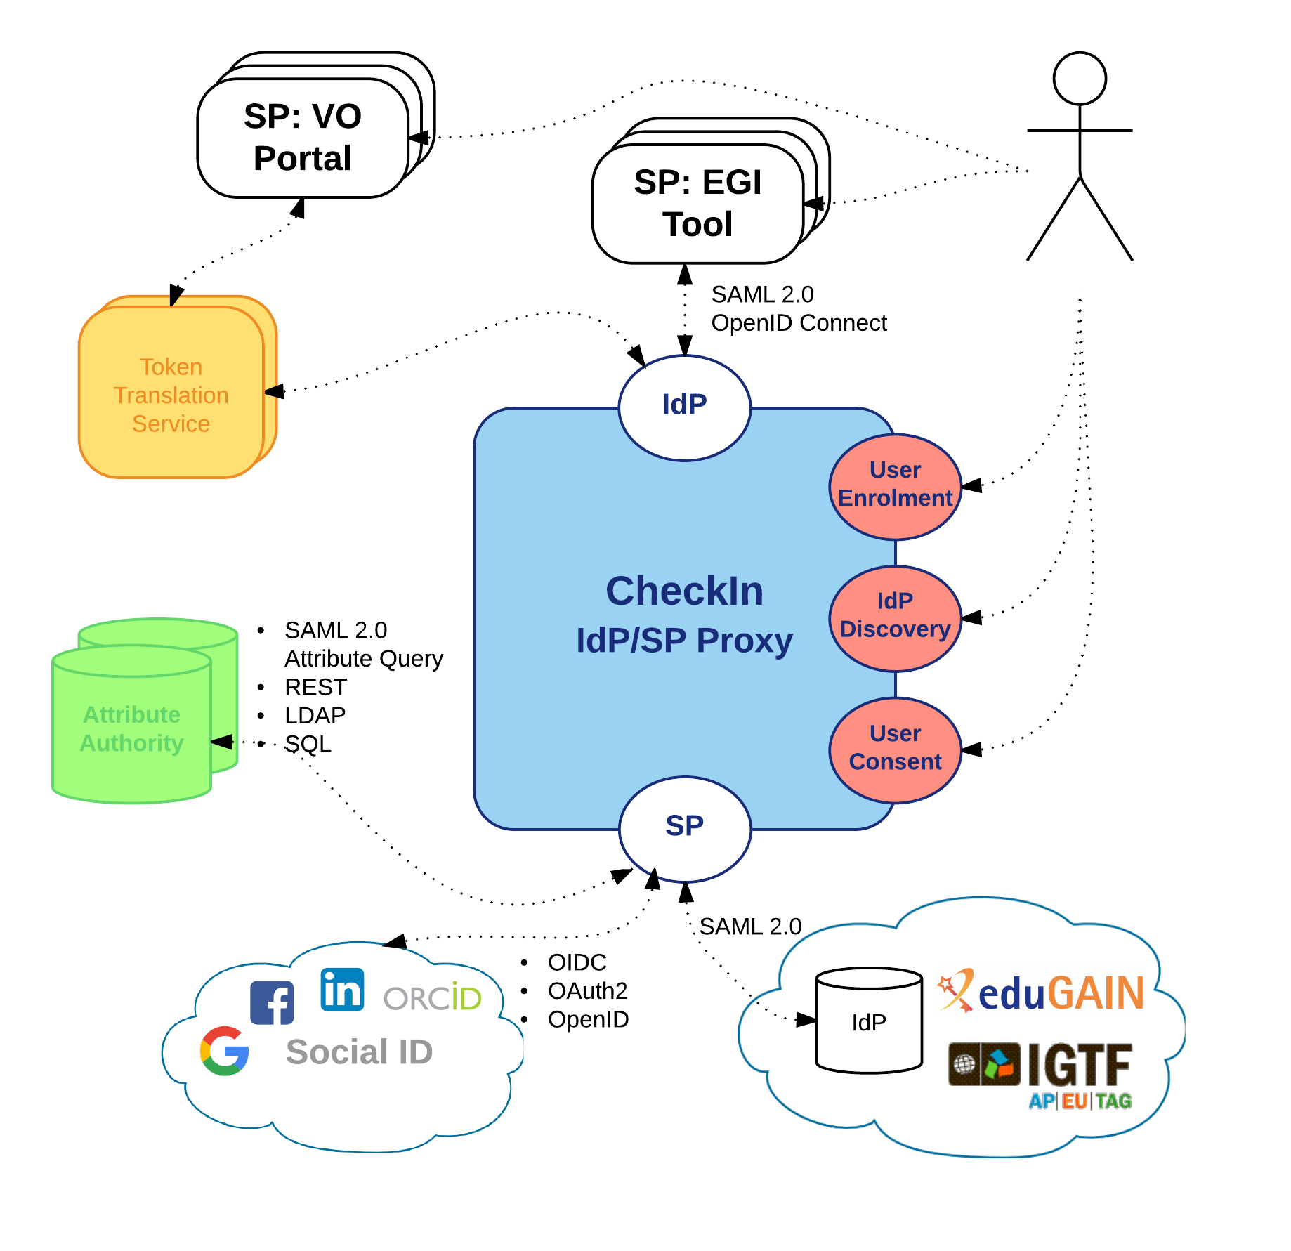
The EGI AAI Platform: Check-in
The IdP/SP Proxy
Identity Providers:
SAML2.0: eduGAIN
OIDC/OAuth2: Google, Facebook, LinkedIn, ORCID, WeChat, BitBucket
X.509: IGTF
Service Providers:
SAML2.0 & OIDC
Attribute Authorities
SAML2.0 Attr. Query, REST, LDAP, SQL
Token Translation Services
SAML2.0-to-X.509: Master Portal to RCauth.eu Online CA
Support for Levels of Assurance
User enrolment & account linking
IdP Discovery
User Consent

Slide 6
Use case: AAI as a Service
CheckIn as an authentication proxy to allow user logins from institutional IdPs in eduGAIN and social media for non EGI services
Minimal overhead for the service development
Prerequisites:
Service provider must accept EGI policies on data protection
Social IDPs
eduGAIN
Institutional IdP
EGI CheckIn
EGI Infrastructure
SERVICE

Slide 7
Use case: AAI Integration
Social IDPs
eduGAIN
Community operating its own AAI connected as an IdP to CheckIn to allow its users to access EGI services & resources
Users can access EGI services without changing their authentication workflow
See the ELIXIR use case
Institutional IdP
AAI Proxy
EGI CheckIn
EGI Infrastructure
Service
Service

Slide 8
Use case: External Attribute Provider
eduGAIN
Community managing authorisation information about the users (VO/group memberships and roles) via their own group management service, which is connected to CheckIn as an external attribute authority
CheckIn will handle the configuration of the IdPs and the aggregation of the attributes for the SPs
The VO is managing independently the information about their users
No need to migrate the group information into an EGI specific attribute authority
LTOS is one example of VO integrated in this way
Institutional IdP
Social IDPs
Virtual Organization
EGI CheckIn
EGI Infrastructure
Service
Service

Slide 9
Use Case Group Management as a Service
eduGAIN
Communities that do not operate their own group management service can leverage the group management capabilities of the CheckIn platform
Avoid overhead of deploying a dedicated group management service
Authorised VO admins will manage the information about their users independently
Can be used with EGI and non-EGI services
Institutional IdP
Social IDPs
EGI CheckIn
Service
Virtual Organization
Service
EGI Infrastructure
Service
Supported technologies:
CΟmanage
Perun

Slide 10
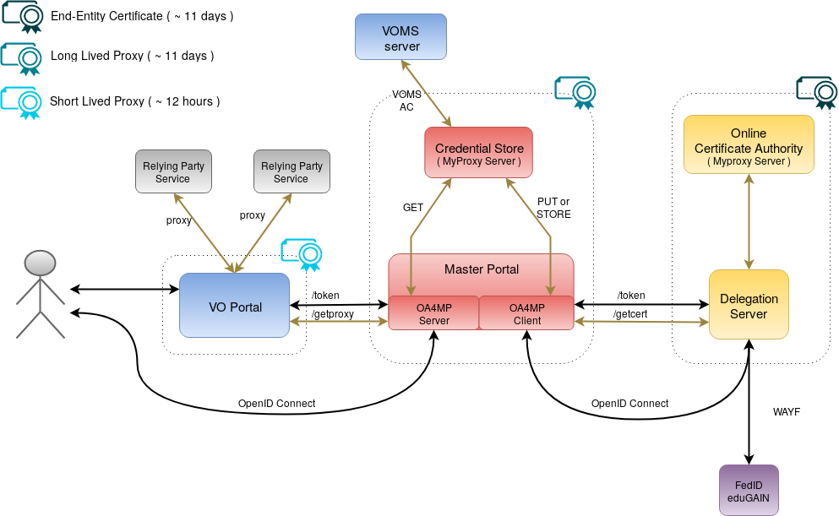
Non-web use cases & delegated access
RCauth.eu Online CA issued certificates
Check-in has been integrated with the production RCAuth.eu Online CA for allowing users to retrieve X.509 proxy certificates using their federated credentials
Master Portal retrieves end-entity certificate from RCauth.eu
Long-lived proxy certificate stored in backend MyProxy server
Short-lived proxies provided via:
Science Gateways via OIDC (so-called VO-portals)
users e.g. via SSH key authentication
EGI Check-in

Slide 11
Authorization model
Supports authorisation decisions based on the combination of different types of information:
identity attributes asserted by the IdP of the user’s home organisation;
VO/group membership and role information aggregated from one or more community-managed attribute authorities;
assurance information associated with the authenticated identity
Provides two types of attributes/claims that can be used by SPs to control access to resources:
Entitlements expressing:
rights/capabilities of the user to access specific services/resources, or
VO/group membership and role information in support of group- and/or role-based access control by SPs
Attributes carrying assurance information can be used by SPs to decide how much to trust the assertions made by Check-in and its attribute sources

Slide 12
Check-in Documentation
Usage guide
Integration guide for service providers
Integration guide for identity providers
Getting Support

