Slide 1
GENERAL HOUSEKEEPING
Please make sure your microphone and video are deactivated unless the (co)host gives permission.
Use the function to ask to speak, you find the option in the “participants” list
All presentations will be available on
Indico (see session via Timetable).
If you do not see all the Zoom buttons
at the bottom of the Zoom window, move your mouse on that window and buttons will appear.
Share your impressions and experiences on Twitter using #EGI2020 and mention @EGI_eInfra.

Slide 2
EGI Notebooks for D4Science
Enol Fernandez, Andrea Manzi
(EGI Foundation)

Slide 3
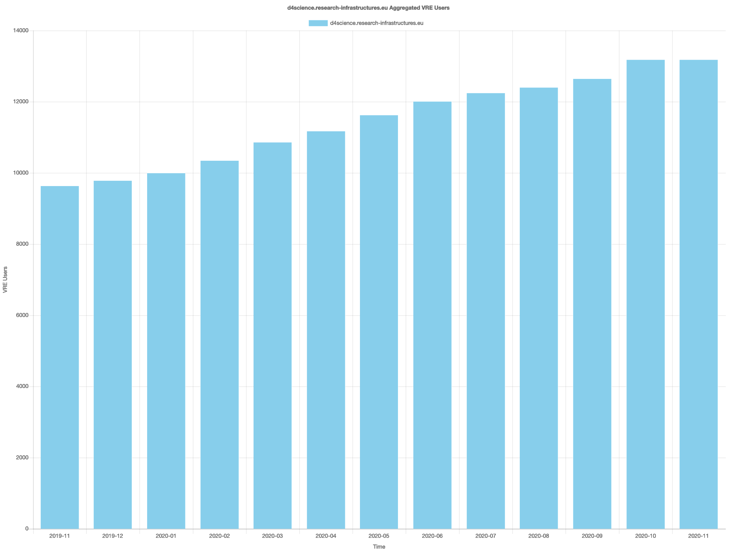
D4Science in brief
https://www.d4science.org/
https://services.d4science.org
An infrastructure enabling Virtual Research Environments
web-based, community-oriented, comprehensive, flexible, and secure working environments conceived to serve the needs of their designated community
dynamically created with “little or no cost” for resource providers
management is a community-led activity promoting co-development
possibly supporting all the phases of a research lifecycle & research process
… currently serving more than 13k users by
19 gateways
more than 150 VREs

Slide 4
EGI Notebooks: D4Science Community deployment
Option of the service to be deployed and customised for a specific community
EGI notebooks hosted in the EGI Cloud:
OLA with EGI cloud providers for the hosting of the resources
SLA recently extended to include the EGI notebooks service
Projects benefiting from the deployments:
AGINFRA+
BlueCloud
SoBigData++ ( where EGI is also a member)

Slide 5
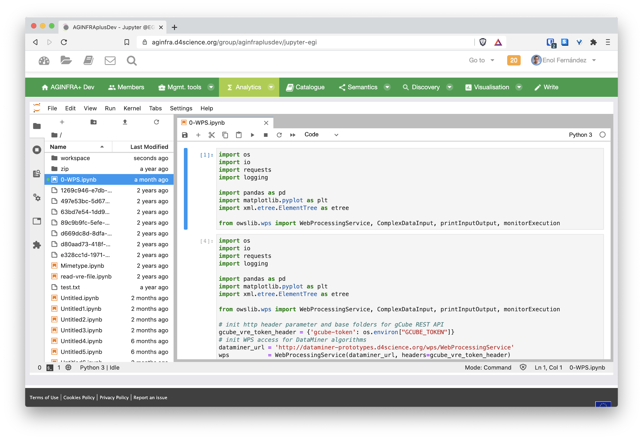
EGI Notebooks for D4Science
D4Science profile API
authentication
proxy
hub
hub volume
redirects
spawns: create pods
and volumes
single user pod
NFS
server
mount
User
workspace
User volume
D4Science Workspace
EGI Cloud Provider

Slide 6
D4Science customisations of Notebooks (1)
Authentication: integration with D4Science Auth/Authz framework
New JupyterHub Authenticator class:
Takes a user personal token from VRE and uses it to get user account details
Relies on https://dev.d4science.org/authorization
Spawner:
customisable size of user notebooks

Slide 7
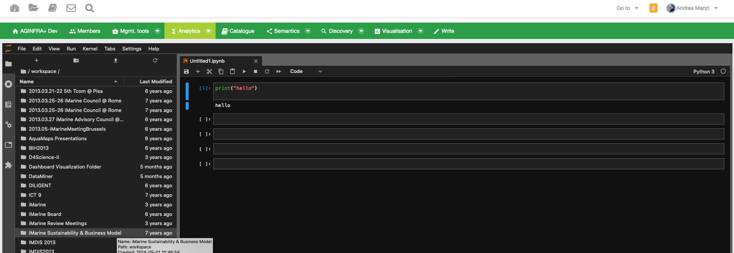
D4Science customisations of Notebooks (2)
Allow Jupyter to be embedded in an iframe in the VRE

Slide 8
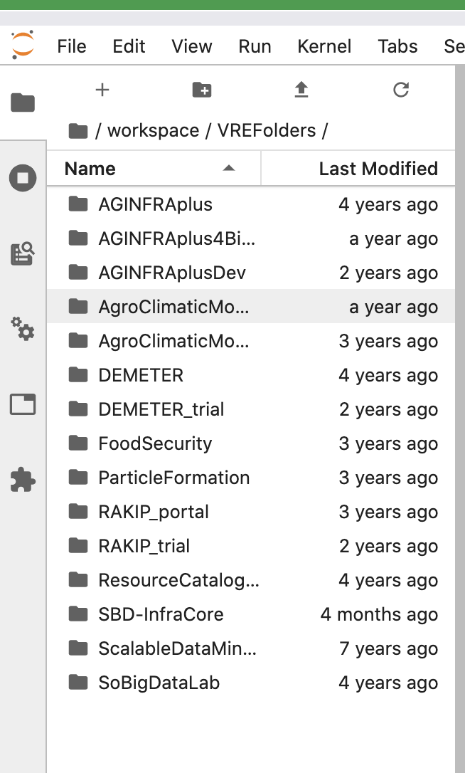
D4Science customisations of Notebooks (3)
Workspace integration
VREs have an associated workspace for users to share files
A fuse-based mounting system relies on the D4Science StorageHub https://gcube.wiki.gcube-system.org/gcube/StorageHub_REST_API
Mounted in a sidecar container of the user’s notebook pod and made available under $HOME/workspace, files

Slide 9
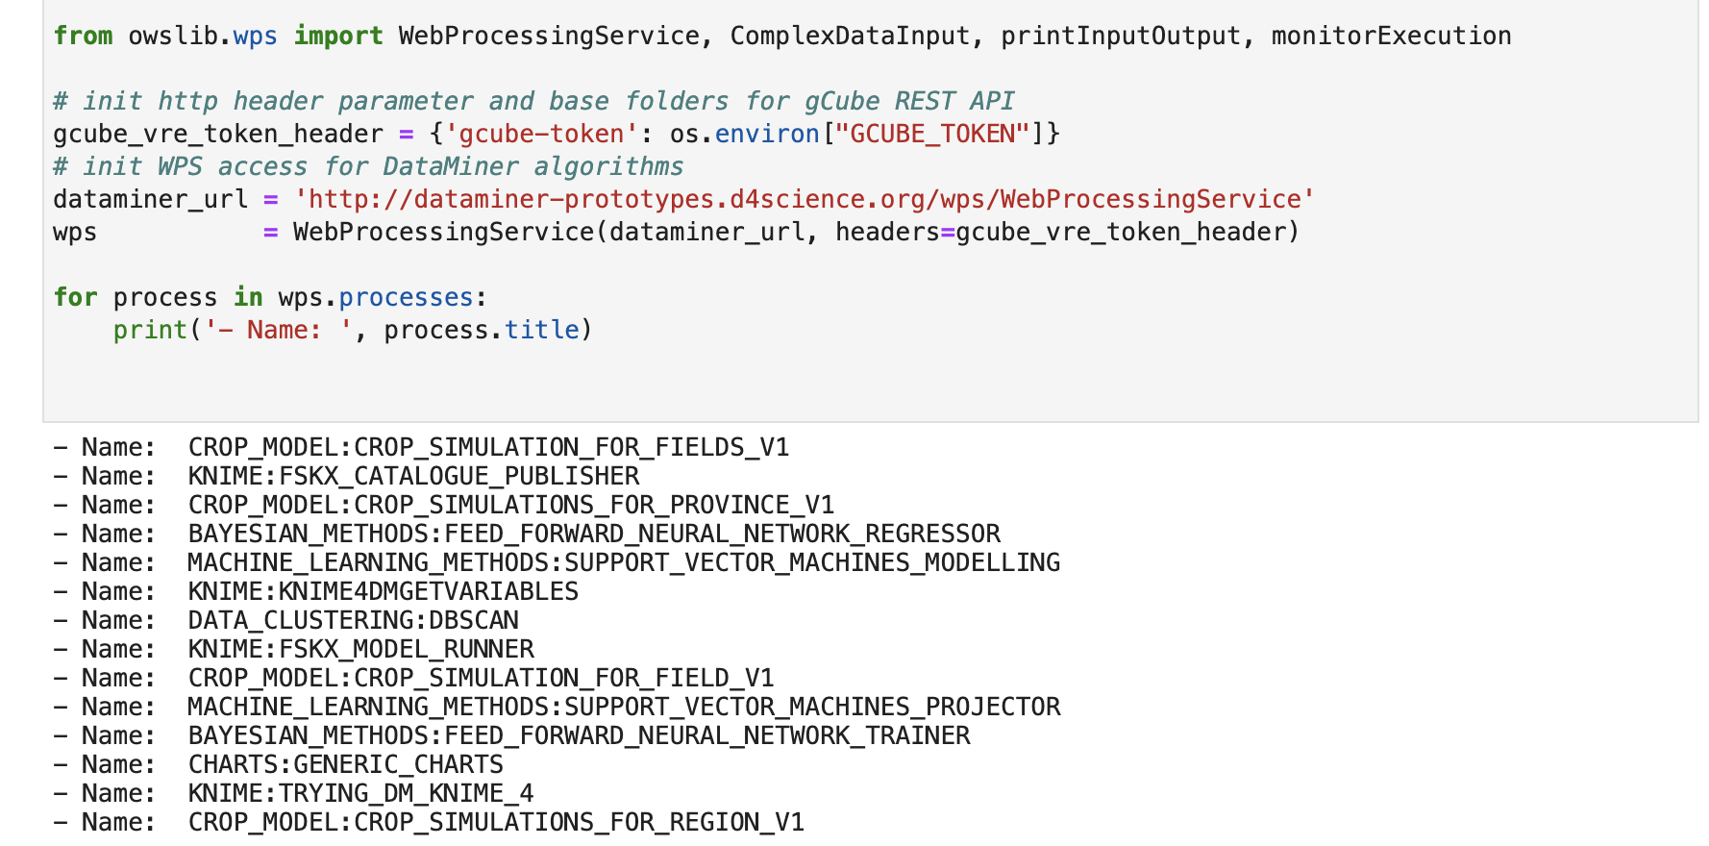
D4Science customisations of Notebooks (4)
Notebooks environment
Specific notebook image created for D4Science, with useful libraries for D4Science users
DataMiner integration via calls to the service using WPS (https://www.ogc.org/standards/wps)

Slide 10
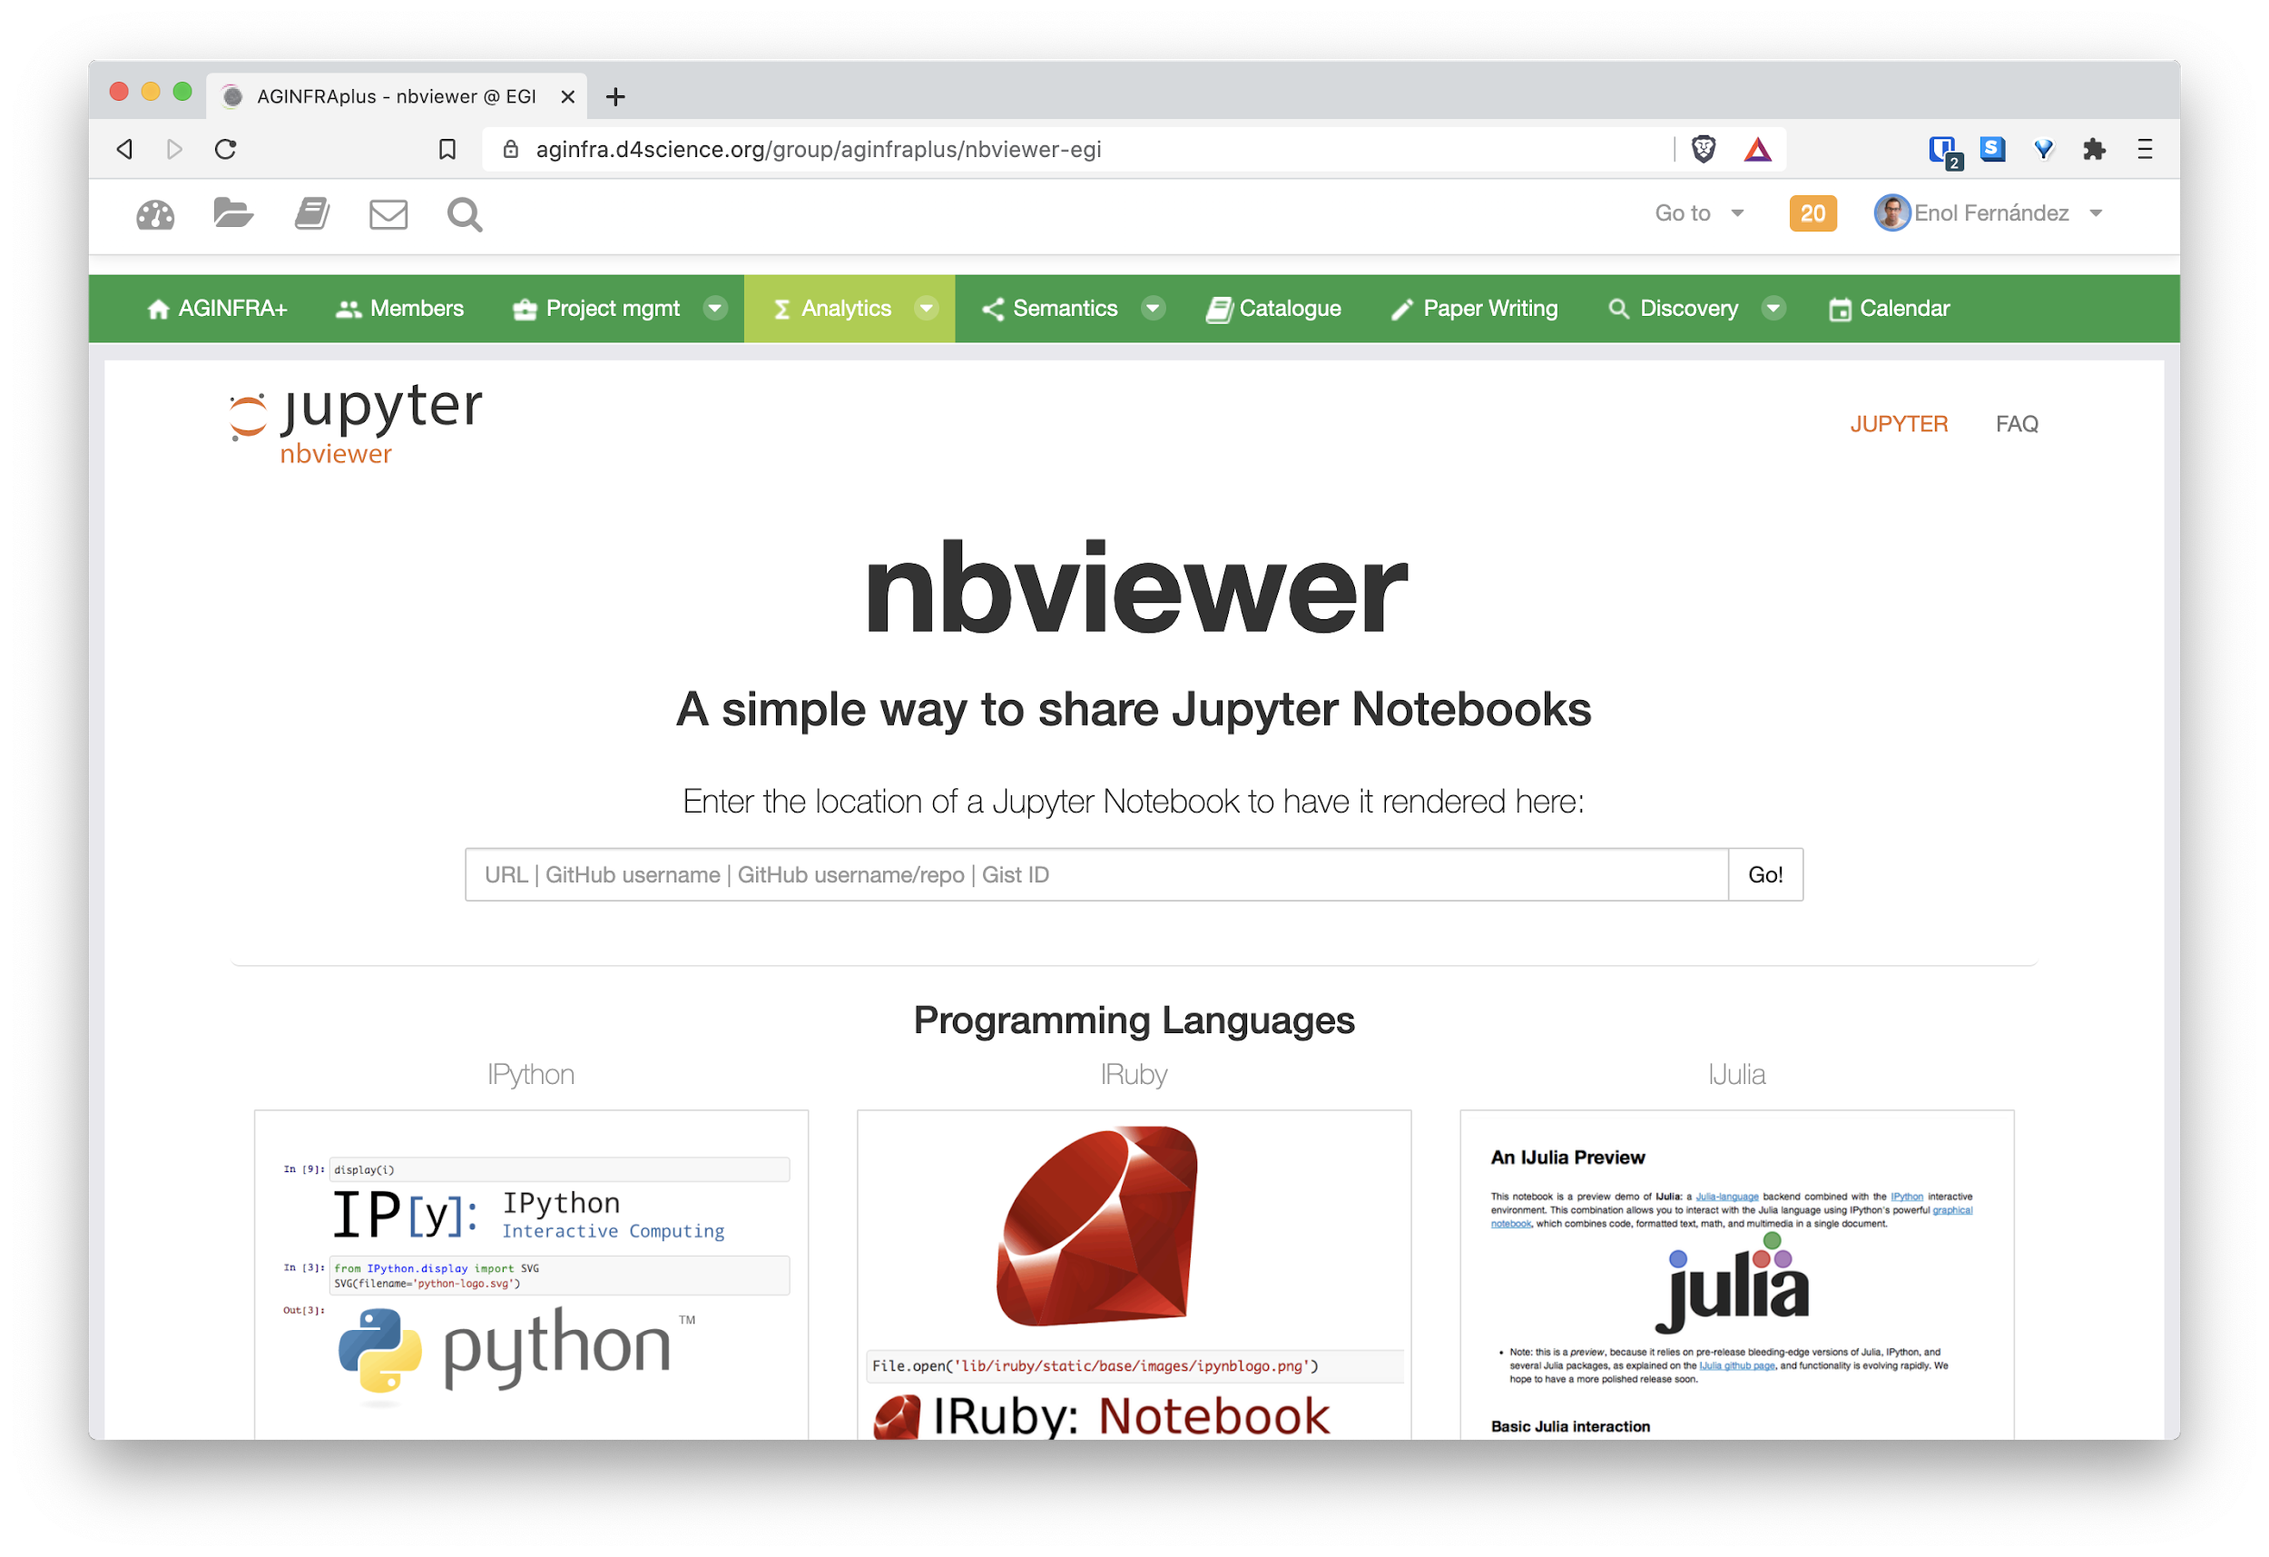
AGINFRA+ deployment
AGINFRA+ is the project where the EGI Notebooks integration in the D4Science environment was piloted
Deployed on resources shared as part of the Notebooks Catchall instance
Currently supporting 59 users from 11 VREs
Supporting D4Science extensions for the Notebooks + nbviewer for notebook rendering

Slide 11
BlueCloud/SoBigData++ deployment
The Instance for BlueCloud/SoBigData++ is not hosted on EGI Cloud resources, but on one of the site part of the D4Science infrastructure (GARR)
Deployment and operations performed by EGI
Capacity
80 concurrent users with 8GB RAM per Notebook
Current users
BlueCloud: 23
SoBigData++: 17

Slide 12
BlueCloud/SoBigData++ deployment
Enhancements on the line: components, user support and operations
Streamline installation of libraries in notebooks
Now user support tickets
Possiblity to use CVMFS to distribute images (under testing) and let users upload their images
Better information at runtime of the notebooks CPU/MEM ( done this week)
Implement NFS backup
Future plans
Publication of the notebooks to the D4science Catalogue

Slide 13
Supported Kernels
Python
Default Python 3 kernel, it includes commonly used data analysis and machine learning libraries. Created from the jupyter/scipy-notebook stack.
Julia
The Julia programming language with the libraries described in jupyter/datascience-notebook.
R
The R programming language with several packages from the R ecosystem as provided by jupyter/r-notebook and some extra libraries.
Octave
The Octave programming language installed on its own conda environment

Slide 14
Thank you!

