Slide 1
Elastic Cloud Compute Cluster (EC3)

Slide 2
What is EC3?
EC3 was created with the idea of providing virtual elastic computer clusters on Cloud platforms.
Facilitate access to computing platforms for non-experienced users
Maintain the traditional work environment, with clusters configured with a well-known middleware.
Automatic management of elasticity, reducing costs (public cloud) and energy expenditure (private cloud).
Automatic configuration of the application execution environment.
Compatible with a wide range of cloud providers (public, federated and on-premises).
Support for hybrid clusters.

Slide 3
EC3 Components
EC3 deploys and configures virtual elastic clusters. It relies on IM to deploy the machines and on CLUES to automatically manage the elasticity.
Offers a set of predefined templates to configure the resources through Ansible:
Kubernetes, Mesos, SLURM, Torque, SGE, HTCondor, Nomad.
IM
CLUES
EC3
Ansible recipes

Slide 4
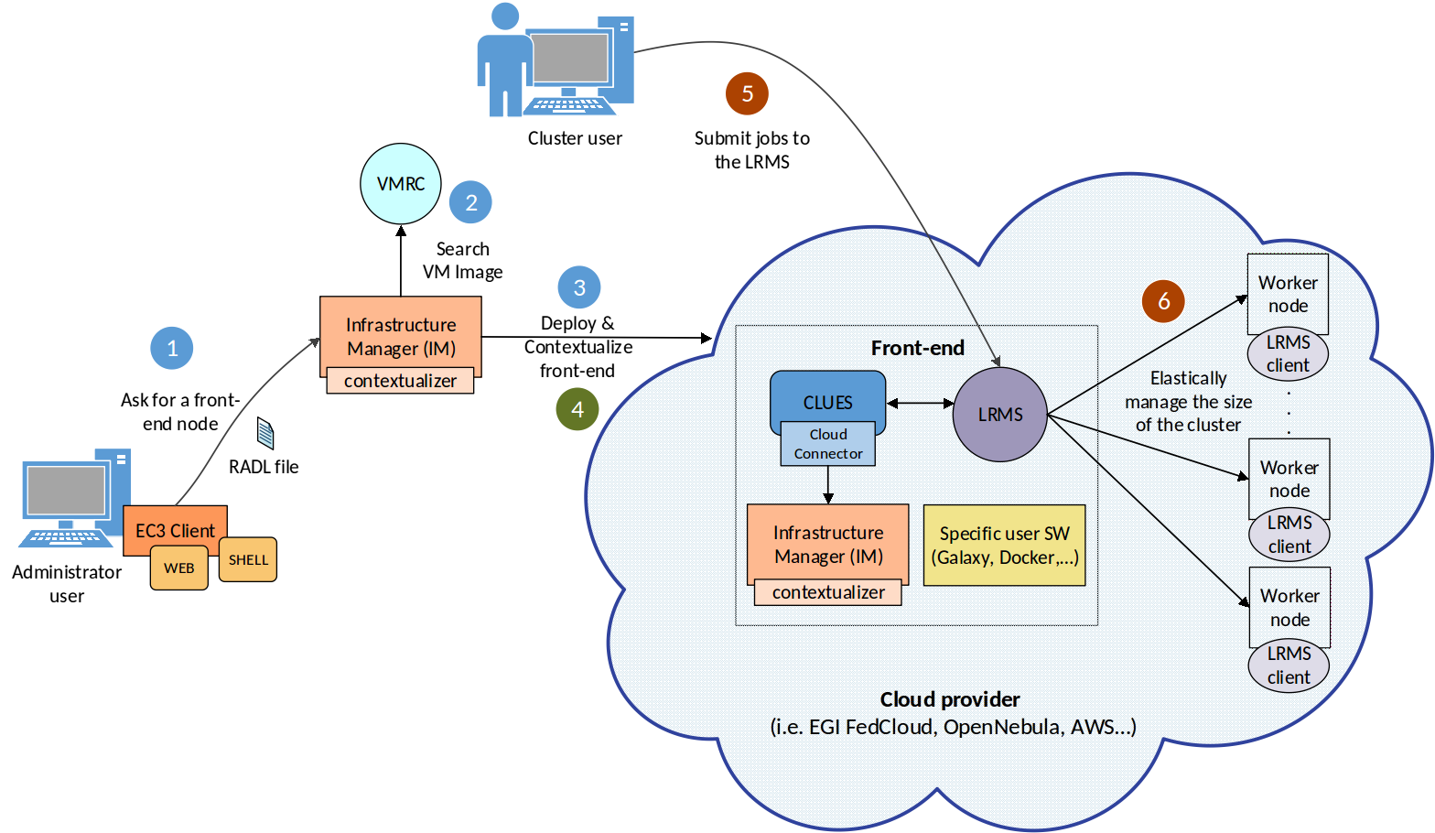
EC3 Architecture
Cluster request
Deploy
Configure
Manage

Slide 5
Automatic Elasticity
Elasticity Management: ability to adapt the size of the cluster to the workload dynamically and automatically:
Horizontal Elasticity: increase / decrease the number of VMs.
Self-management: elasticity rules are evaluated from the main node of the cluster without requiring any external entity in charge of monitoring the cluster to decide when to increase / reduce the size of the cluster.
Transparency: elasticity should not affect the execution of tasks, going unnoticed both for tasks and for the user.

Slide 6
Automatic Elasticity (II)
The elasticity module is responsible for dynamically adding and removing nodes from the cluster by monitoring the LRMS.
Deployment policies (scale out):
On demand: a node is deployed for each job that comes to the queue.
Bursts: deploys a group of VMs for each job in the queue, assuming that if a job arrives at the LRMS, there is an increased chance that new jobs will arrive soon. (i.e HTC applications).
Undeployment policies (scale in):
On demand: ends idle nodes when there are no pending jobs in the LRMS queue.
Delayed power off: inactive nodes turn off after a certain configurable period of time. (i.e public clouds)

Slide 7
EC3 in the EGI Applications on Demand
The EGI AoD allows small laboratories and individual researchers the access to a wide range of computational resources and on-line services to manage and analyse large amount of data.
Inside this service we find the EC3 portal:
The EC3 AoD portal enables to launch virtual elastic clusters on top of EGI FedCloud resources using the EC3 tool.
It only requires the EGI checking account (and vo.access.egi.eu VO) to access to the service.
The user is guided step by step in the deployment process.
Documentation and tutorials are available, i.e. configuring a Galaxy cluster for data intensive research

Slide 8
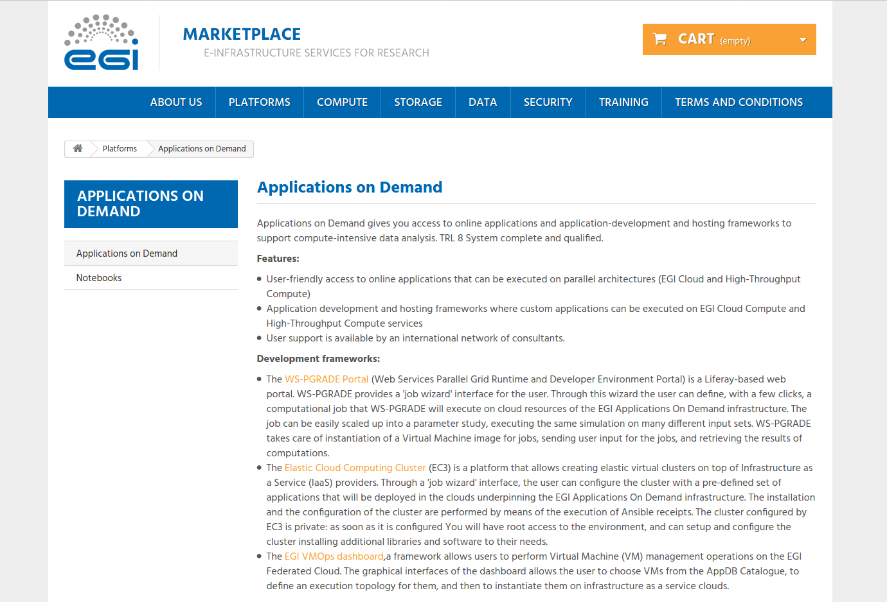
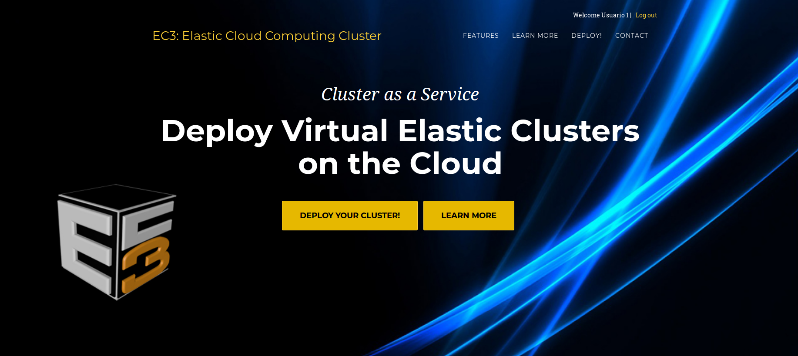
EC3 Portal (EGI AoD)
EC3aaS facilitates the usage of EC3 to non-experienced users:
It presents an user-friendly web interface that allows to easily deploy and configure a virtual elastic cluster on EGI Cloud Compute resources.
Limited actions: create, list and destroy.
Documentation: https://ec3.readthedocs.io/en/latest/ec3aas.html

Slide 9
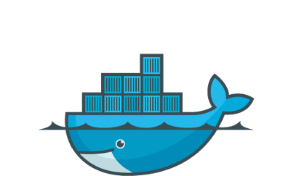
EC3 Client
More powerful client interface than the Web interface:
More control over the cluster (reconfigure, clone, migrate, stop, restart).
Support for hybrid clusters
Support for golden images
The user needs to define an authorization file
Documentation: https://ec3.readthedocs.io/en/latest/ec3.html
EC3 Client Source Code in GitHub: https://github.com/grycap/ec3
EC3 Client image in Docker Hub: https://hub.docker.com/r/grycap/ec3/

Slide 10
EC3 Client (II)
usage: ec3 [-h] [-v] [-l LOG_FILE] [-ll LOG_LEVEL] [-q]
{launch,list,show,templates,ssh,reconfigure,destroy,clone,migrate,stop,restart}
Operation:
launch launch a new cluster
list list launched clusters
show print RADL
templates list available templates
ssh connect to cluster via SSH
reconfigure reconfigure the cluster
destroy destroy a launched cluster
clone clone a launched cluster in another Cloud provider
migrate migrate a launched cluster to another Cloud provider
stop stop a launched cluster
restart restart a previously stopped cluster
...

Slide 11
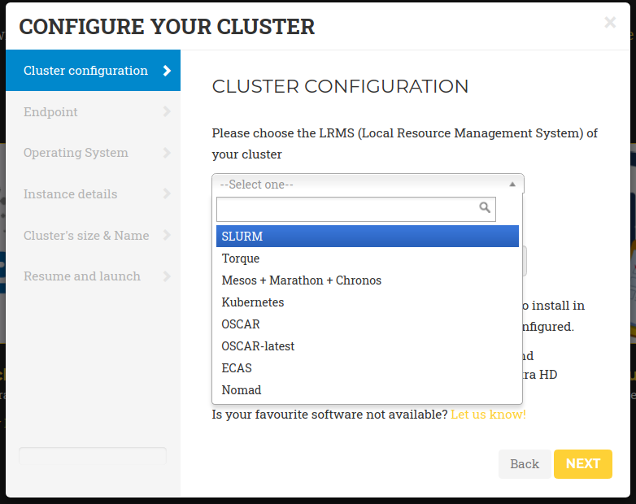
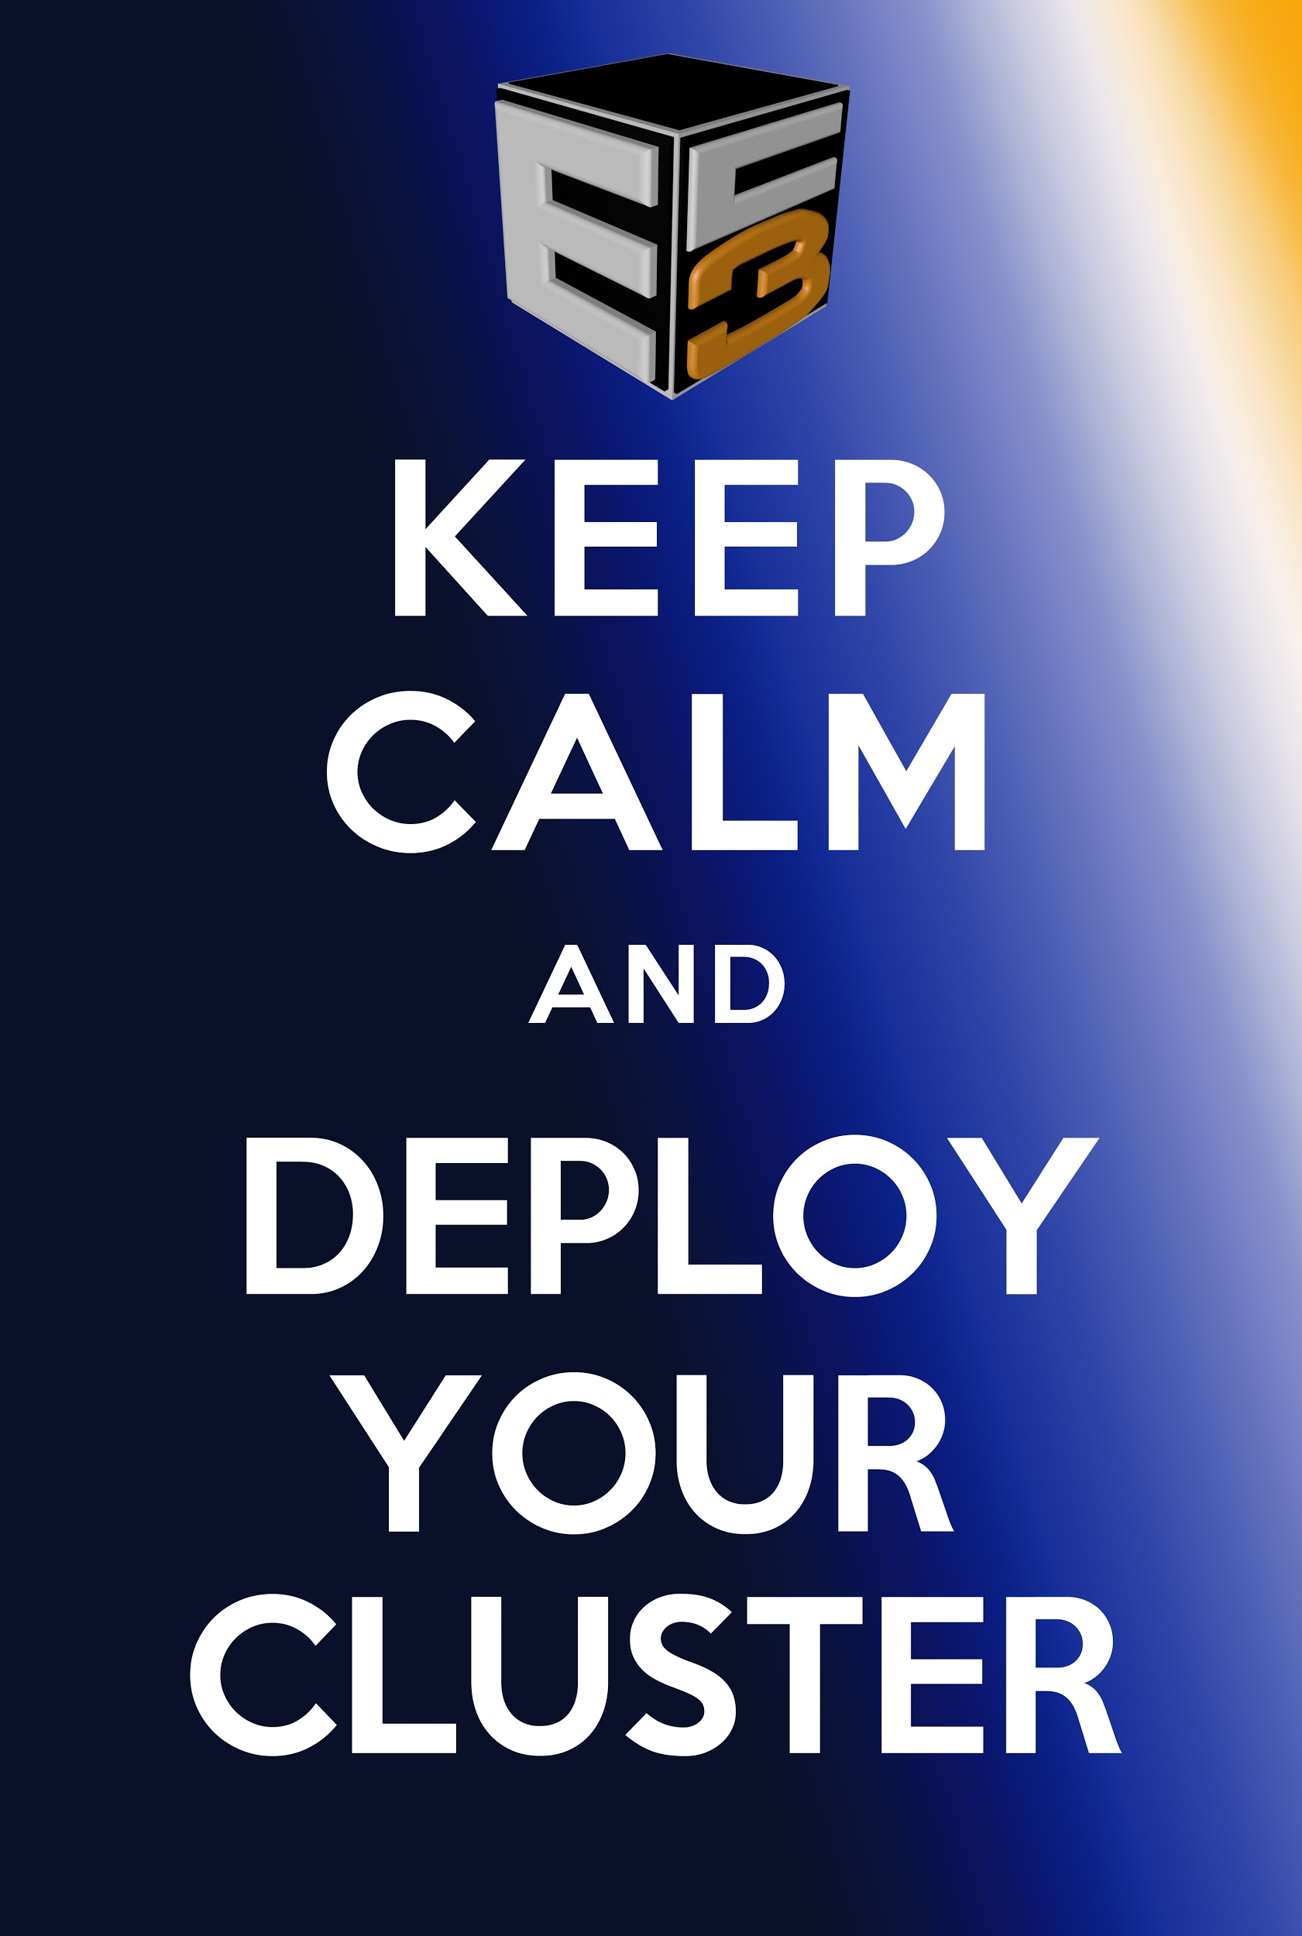
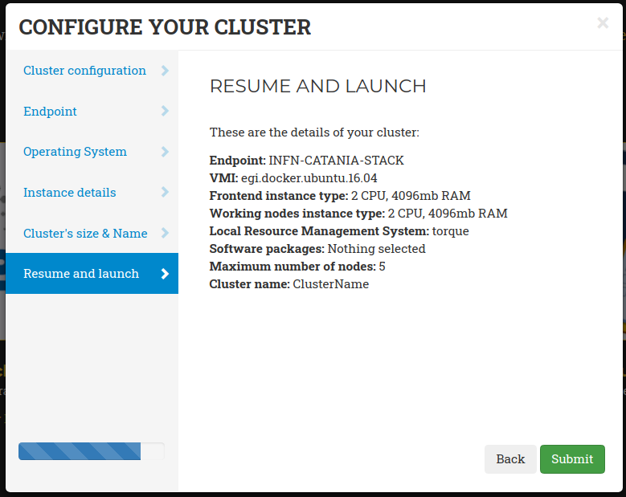
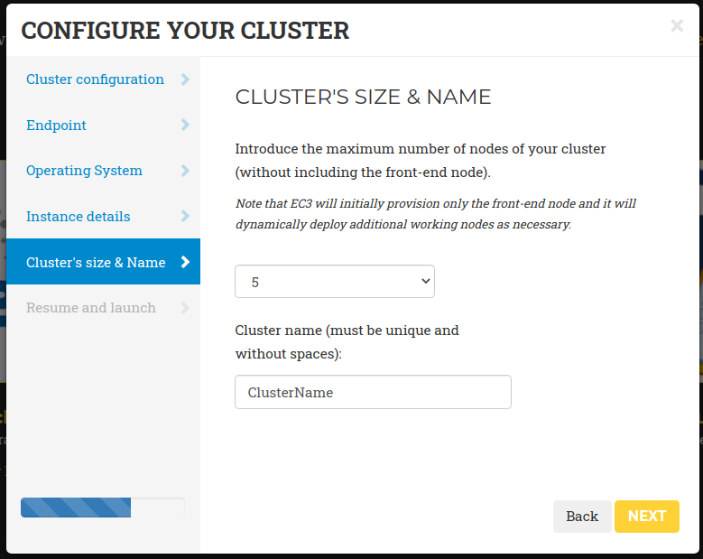
Wizard with 6 simple steps

Slide 12
Usage examples
An elastic Kubernetes cluster to deploy SAPS and estimate evapotranspiration and other environmental data that can be applied on water management and the analysis of the evolution of forest masses and crops.
Demo: https://indico.egi.eu/event/5000/contributions/14300/
EKaaS: The EKaaS (Elastic Kubernetes as a Service) is an on-demand service to deploy Elastic Kubernetes clusters on the EGI Cloud Compute
Demo: https://indico.egi.eu/event/5000/contributions/14287/
OSCAR: is Functions as a Service (FaaS) computing model for file-processing applications. It enables the creation of highly-parallel event-driven file-processing serverless applications that execute on customized Docker containers than run on an elastic Kubernetes cluster.
Session: https://indico.egi.eu/event/5000/contributions/14289/

Slide 13
More Information
Video tutorials and demos in YouTube:
https://www.youtube.com/playlist?list=PLgPH186Qwh_1IOesmaTLjd35Q-QqdWf9k
EC3 AoD portal:
https://servproject.i3m.upv.es/ec3-ltos
EC3 in EOSC Marketplace:
https://marketplace.eosc-portal.eu/services/elastic-cloud-compute-cluster-ec3
EC3 official documentation:
https://ec3.readthedocs.io/en/latest/
EC3 source code:
https://github.com/grycap/ec3

