Slide 1
EGI Notebooks
Clinic: data analytics services
Enol Fernández
enol.fernandez@egi.eu

Slide 2
The Jupyter Notebook is an open-source web application that allows you to create and share documents that contain live code, equations, visualizations and narrative text. Uses include: data cleaning and transformation, numerical simulation, statistical modeling, data visualization, machine learning, and much more.

Slide 3
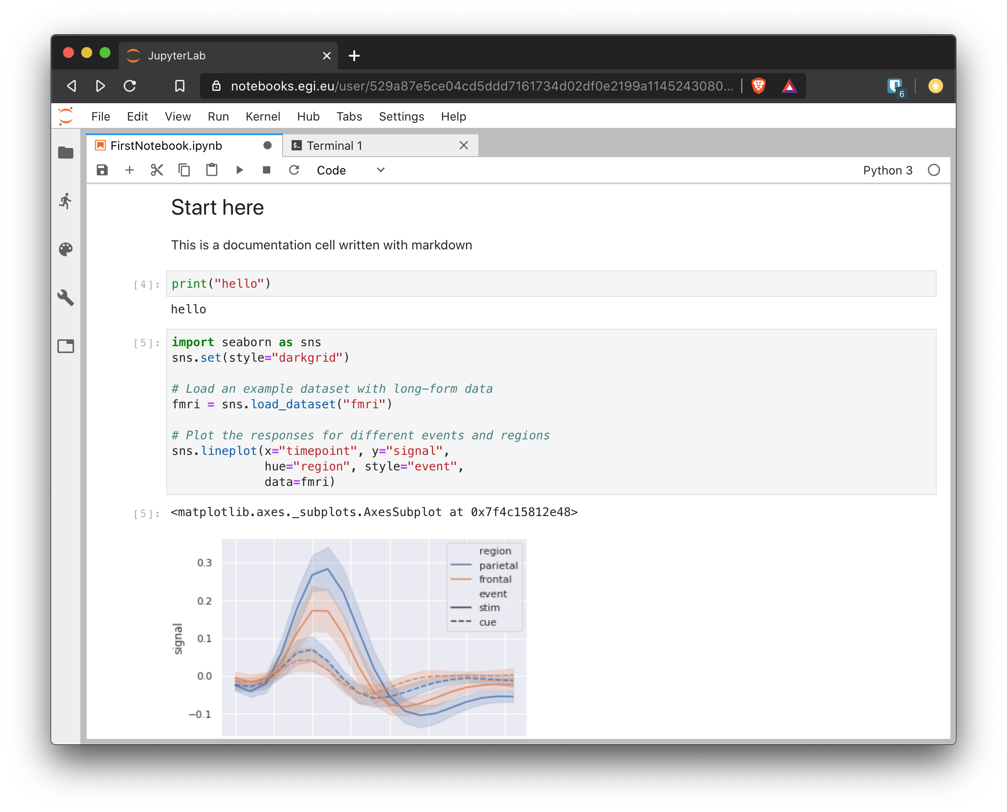
Notebooks
Code
Use your favourite language (50+ supported)
Documentation
Text formatted using Markdown/LaTeX
Output
Results of the code execution(e.g. plots)
Interactive
browser based environment

Slide 4
EGI Notebooks
Managed JupyterHub on EGI cloud

Slide 5
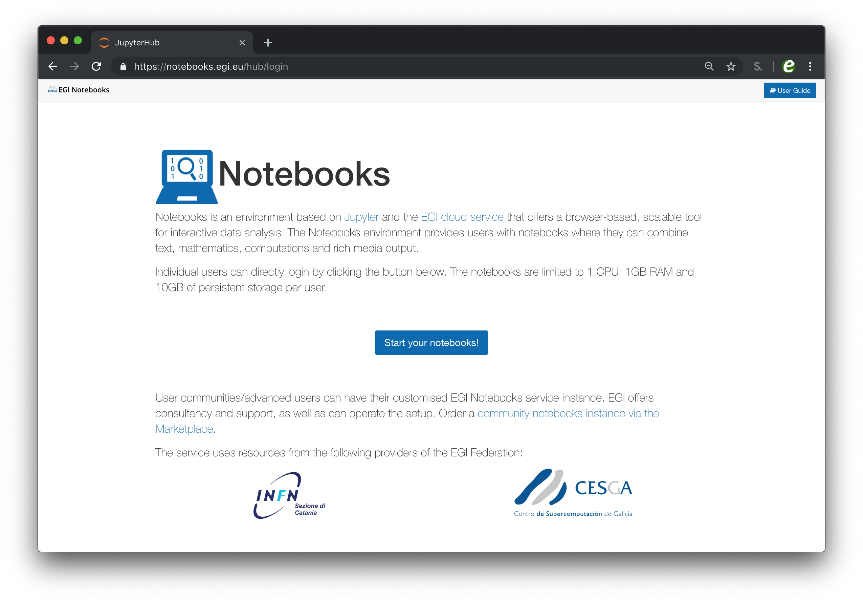
EGI Notebooks
JupyterHub hosted in the EGI Cloud
Offers Jupyter notebooks ‘as Service’
One-click solution: login and start using
Main Features:
Login with the EGI AAI Check-In service
Persistent storage for notebooks
Use EGI computing and storage resources from your notebooks

Slide 6
Service options
Catch-all instance - https://notebooks.egi.eu
Limited resources: 1 CPU, 1GB RAM and 10GB of persistent storage
Sponsored access (free for the users)
Kills notebooks after 1 hour of inactivity (files are permanent, installed libraries no)
Community deployments
Available via the Marketplace
Tailored to specific community with custom computing/storage, e.g.:
access to GPUs, fat nodes
access to Spark, other BigData/ML environments
auto-mount filesystems on notebooks (e.g. specific DataHub space)
…
Deployment for training https://training.notebooks.egi.eu
1 CPU / 1GB RAM and 10GB storage / user
Available for training events and tutorials

Slide 7
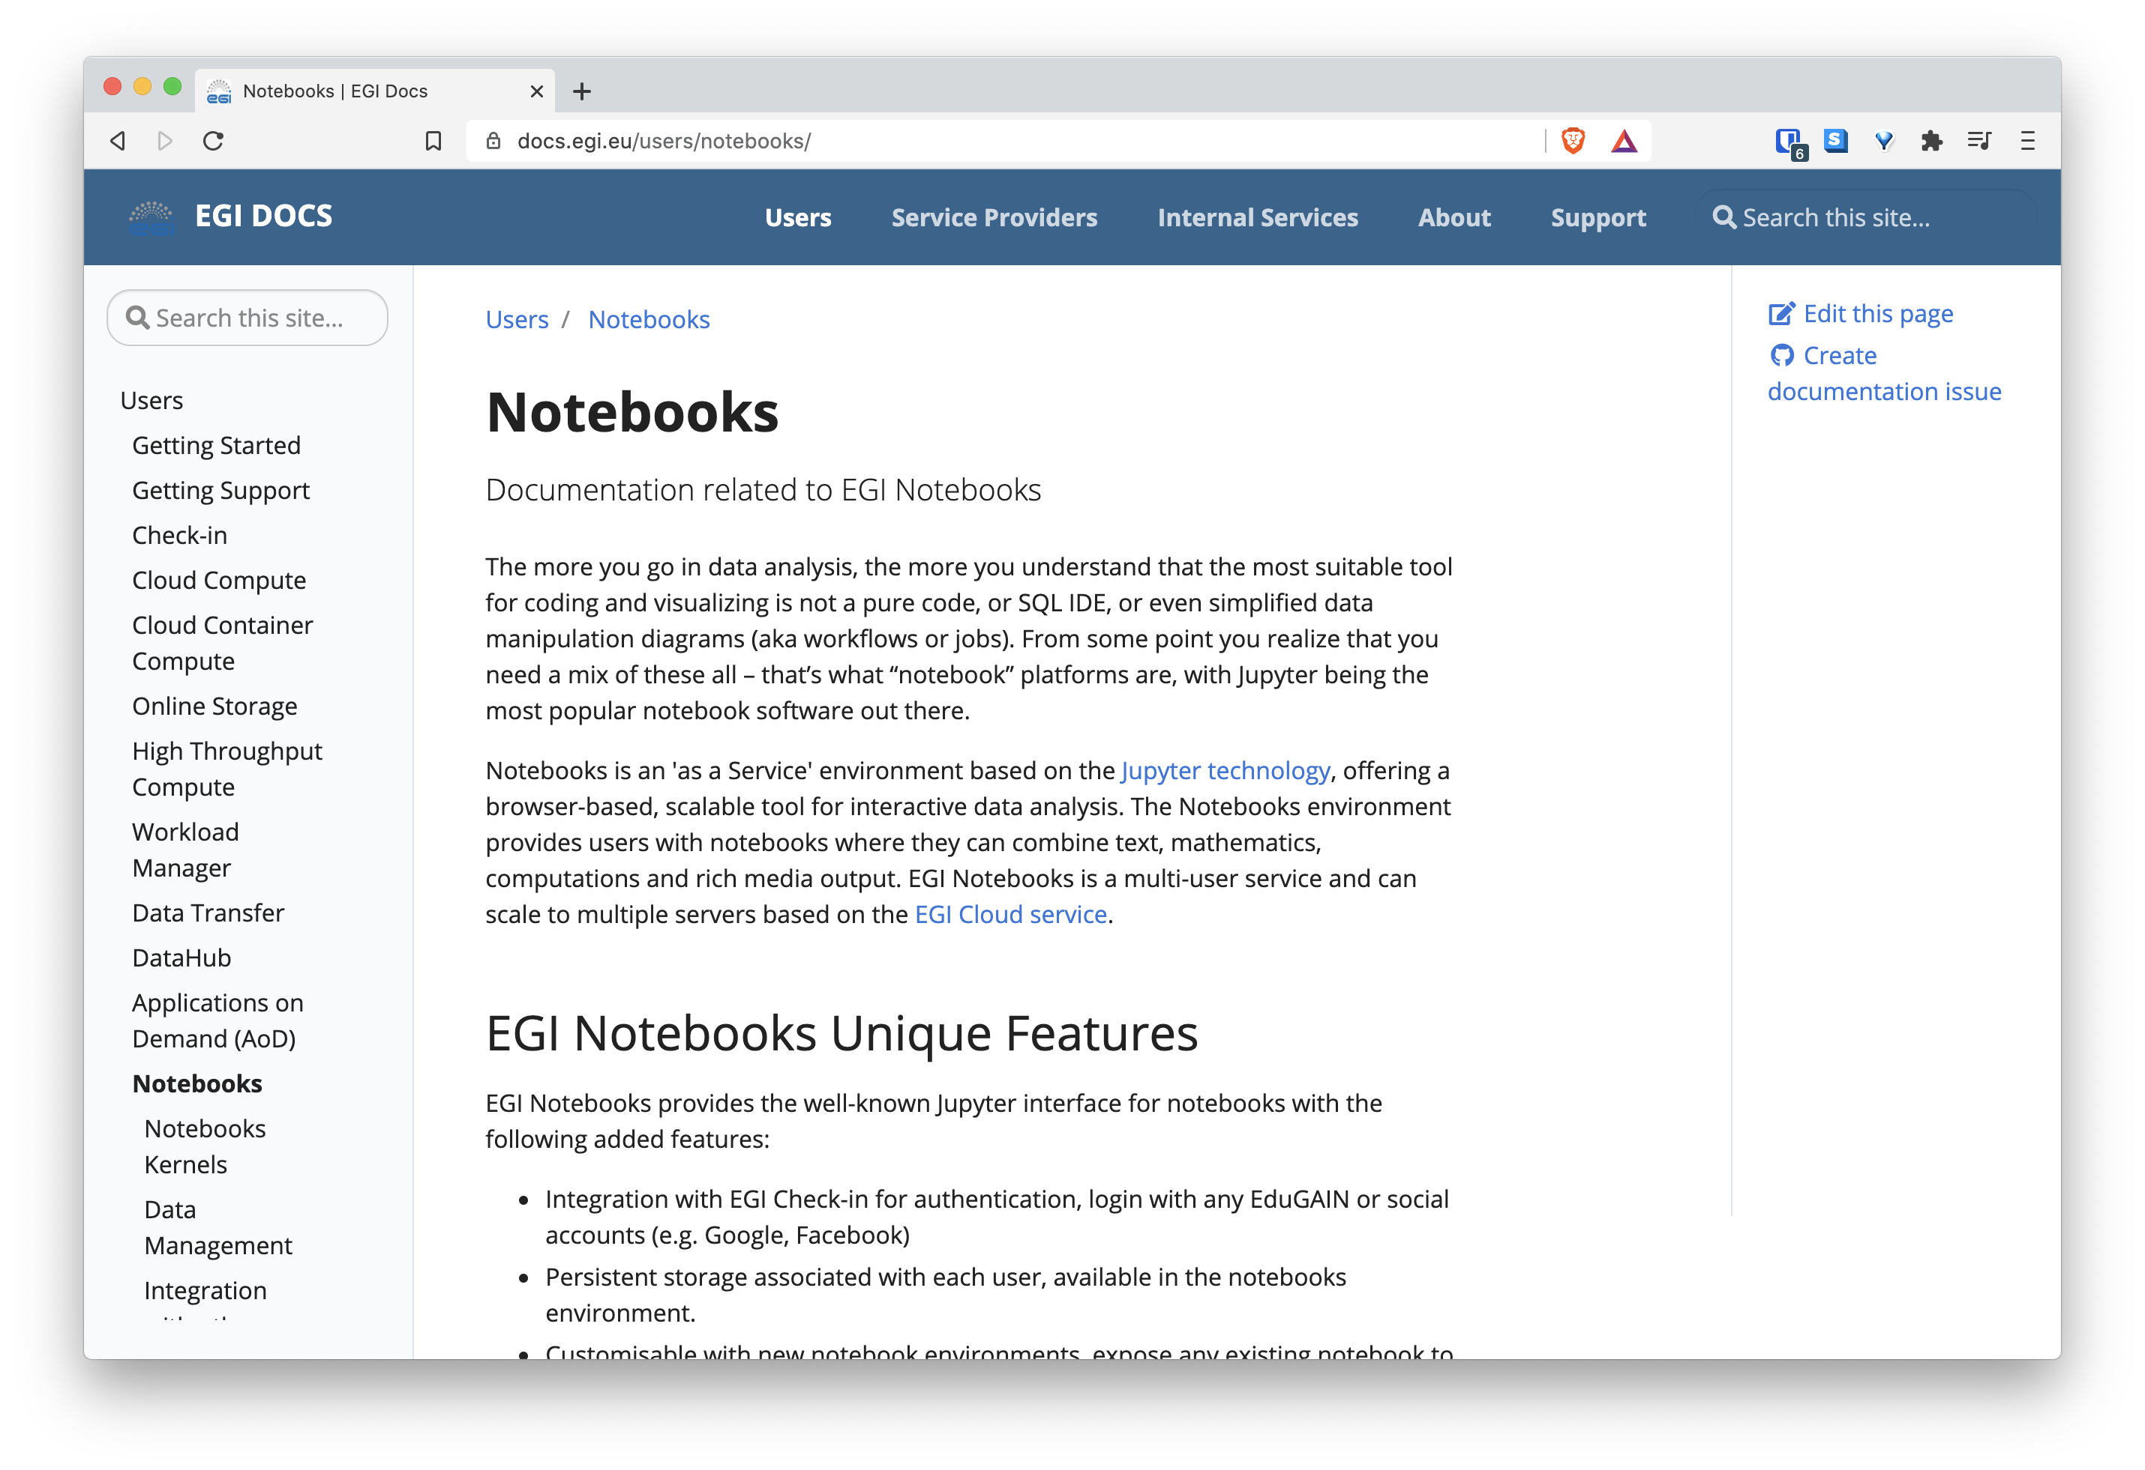
https://docs.egi.eu/users/notebooks
Documentation

Slide 8
Kernels
Python : Default Python 3 kernel, it includes commonly used data analysis and machine learning libraries. Created from the jupyter/scipy-notebook stack.
DIRAC / Python 2: A python 2 kernel that includes a DIRAC installation for interacting with the EGI Workload Manager service.
Julia: The Julia programming language with the libraries described in jupyter/datascience-notebook.
R: The R programming language with several packages from the R ecosystem as provided by jupyter/r-notebook and some extra libraries.
Octave: The Octave programming language installed on its own conda environment (named octave).
Your own kernel: If you want to add a new kernel, just let us know and we will discuss the best way to support your request. We built images from the EGI-Foundation/egi-notebooks-images GitHub repo

Slide 9
Accessing (big) data
EGI Notebooks allows you to access/download remote data
Can work for smaller data
EGI DataHub provides access to big data in a distributed infrastructure
Combining data from different data providers
Moving data to the computing resources as needed
Transparently integrated with the notebooks

Slide 10
EGI Notebooks Architecture
EGI Check-in
authentication
k8s ingress
proxy
hub
hub volume
spawns: create pods
and volumes
redirects
single user pod
External data sources
NFS
server
mount
extra
volumes
User volume
D4Science Workspace
EGI Cloud Provider
Notes:
Kubernetes run on top of one of the EGI providers and is in charge of managing the underlying resources: CPU/RAM coming from a set of nodes and storage volumes supported by an NFS server.
Using k8s hides the complexity and differences between providers so it’s easy to move the deployment from one provider to another.
Proxy/hub are internal JupyterHub components: hub manages authentication and takes care of creating new servers for the users as needed. The servers are created using Kubernetes pods (this is mainly name of container in k8s) and volumes. Once the server is up, the proxy will redirect any requests from the user to that instead of the hub.
The hub is configured to authenticate with EGI Check-in

Slide 11
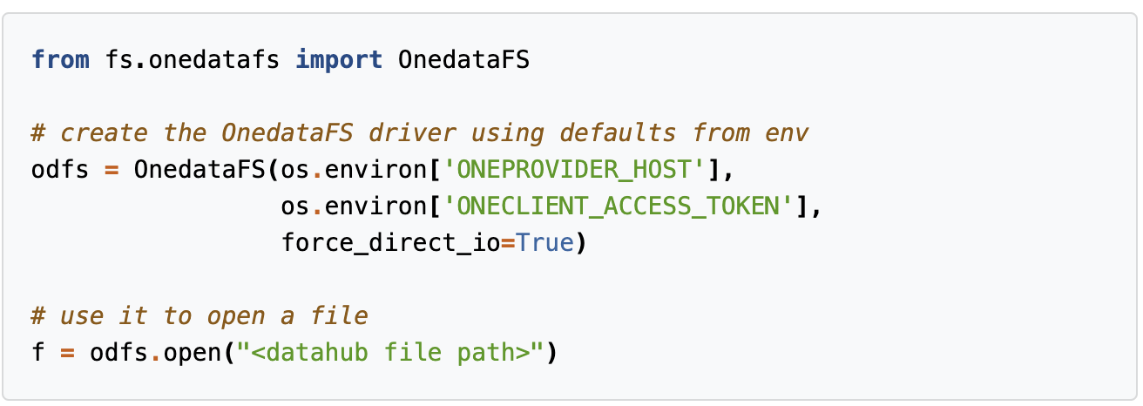
DataHub integration
Check-in
DataHub
Onezone
AuthN/AuthZ + token generation
EGI Notebooks
Manage
Access data
oneprovider A
Transfer data transparently
notebooks
oneprovider
oneprovider B

Slide 12
Other data services integrations
B2DROP
Dropbox-like storage service from EUDAT
WebDAV based access, mounted with fuse
D4Science Workspace
Shared file facility for the D4Science VRE with its own StorageHub API
Mounted with fuse with a sidecar container
Potentially anything that can be exposed as volumes in k8s
NFS
Ceph
Cinder (block volumes)

Slide 13
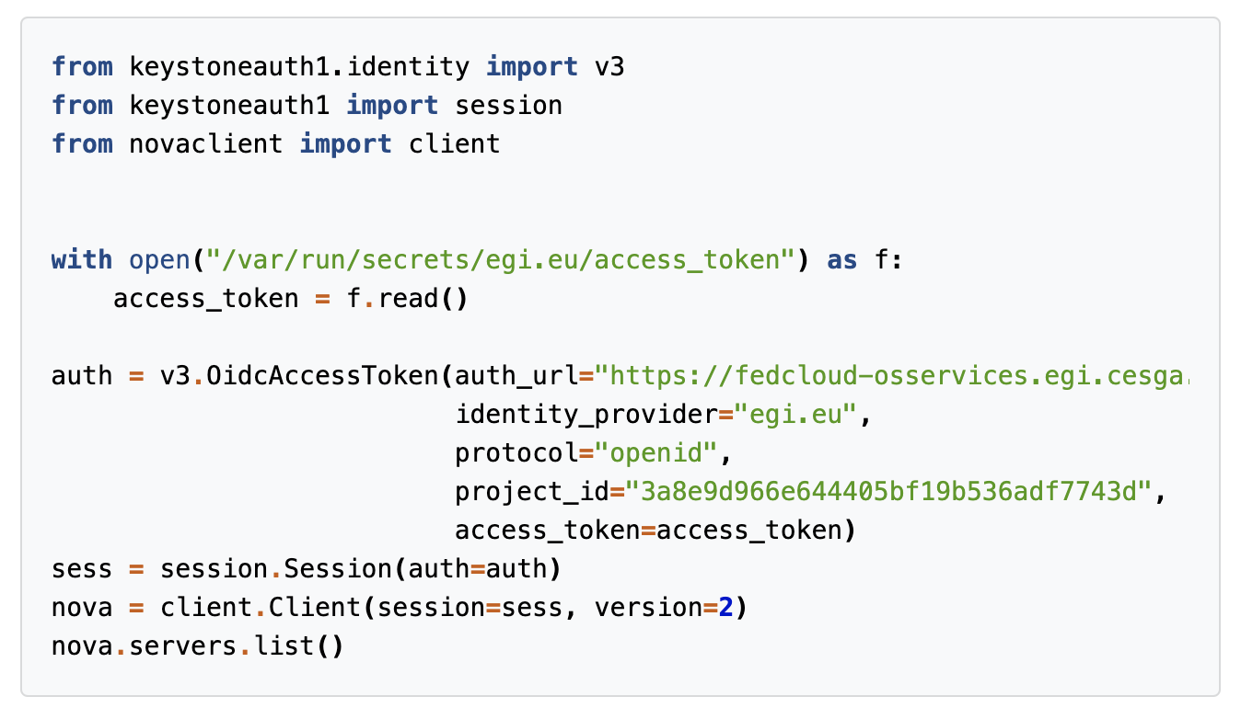
Accessing other EGI services
Notebooks environment has a valid access token that can be used to interact other EGI services
Stored in /var/run/secrets/egi.eu/access_token
Automatically renewed as needed

Slide 14
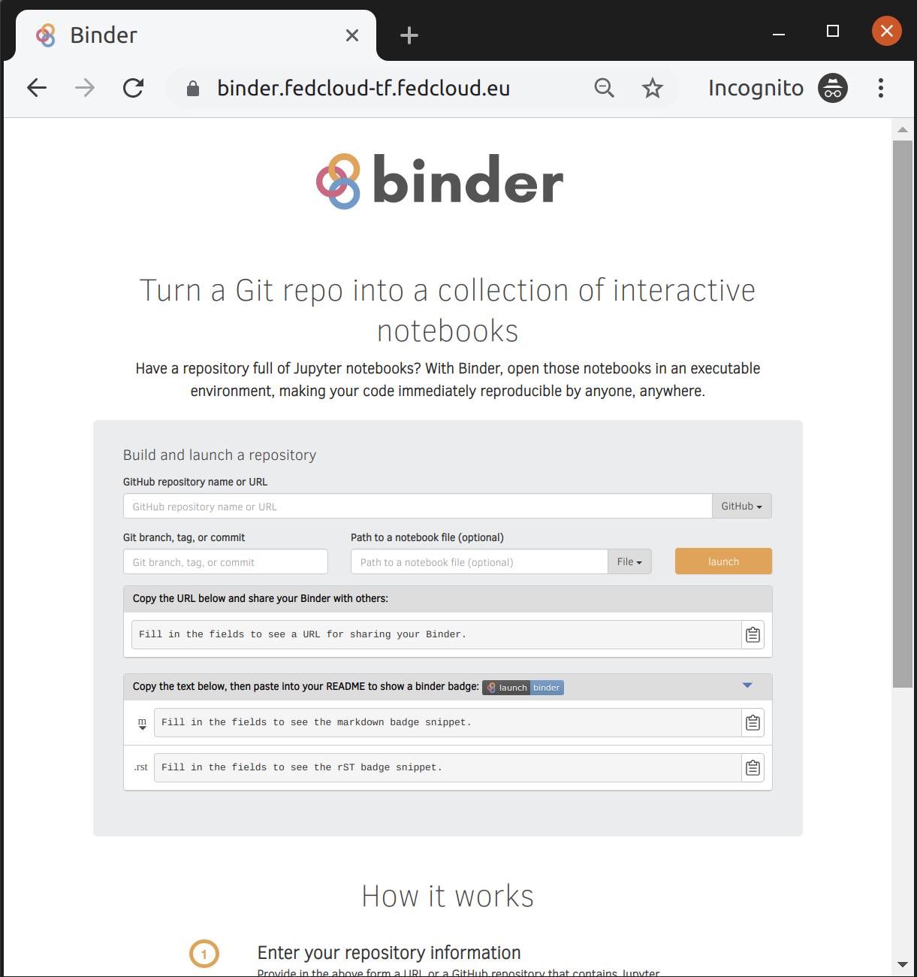
Binder
Provide means to reproduce notebooks
Builds a container image with notebooks + dependencies
Currently working on nicer integration with the notebooks service

