Slide 1
PaN, PaNOSC and ExPaNDS Achieving a Photon and Neutron community federated cloud in the EOSC.
^{2th} Nov, 2020
Presenter: Patrick Fuhrmann
Authors: With contributions from PaNOSC and ExPaNDS folks.

Slide 2
Content
What are Photon and Neutron Facilities?
What can you do with Photon Neutron Beams?
The PaN Data Lifecycle.
Recent example of state of the art Photon Science @ PETRA III.
The projects : PaNOSC and ExPaNDS.
PaN facilities covered by PaNOSC/ExPaNDS.
Linking publications, data and infrastructures: The PaN Portal.
ExPaNDS and PaNOSC contributing to horizontal infrastructure deployment.
Achieving a Photon and Neutron community federated cloud in EOSC

Slide 3
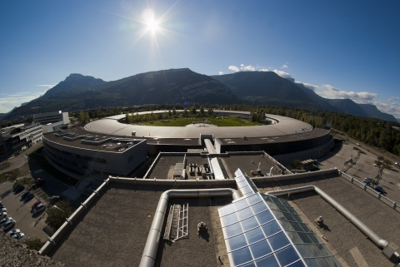
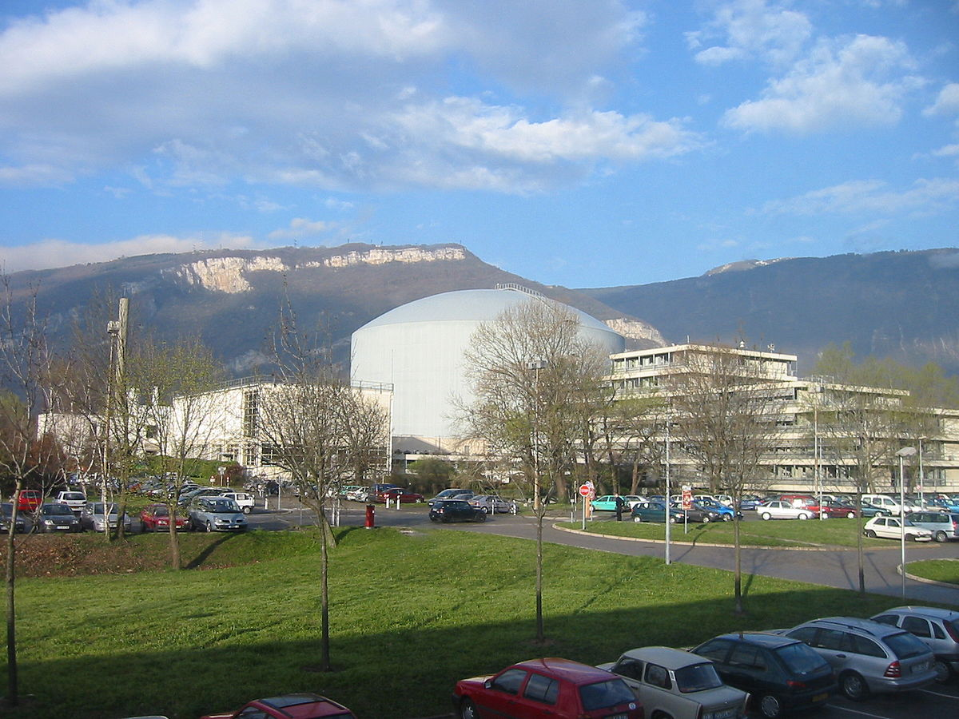
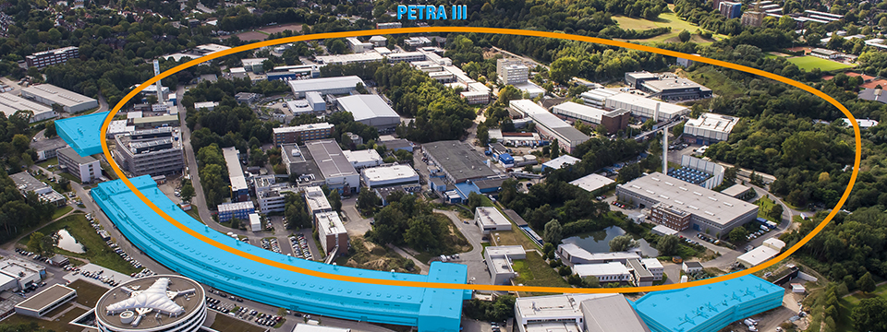
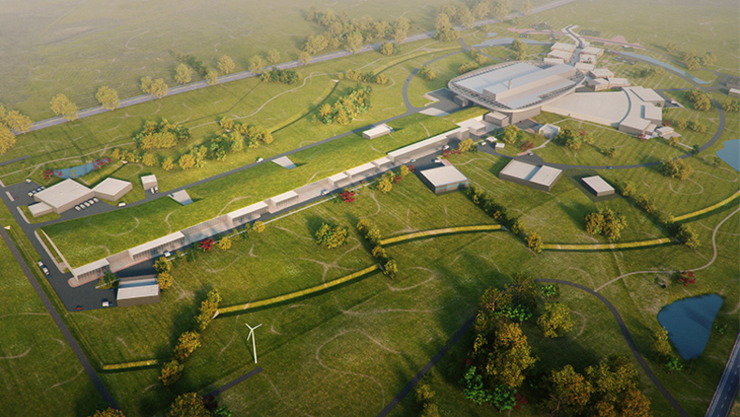
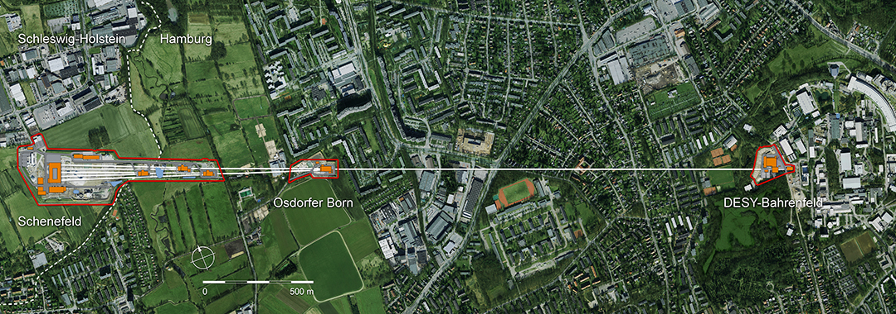
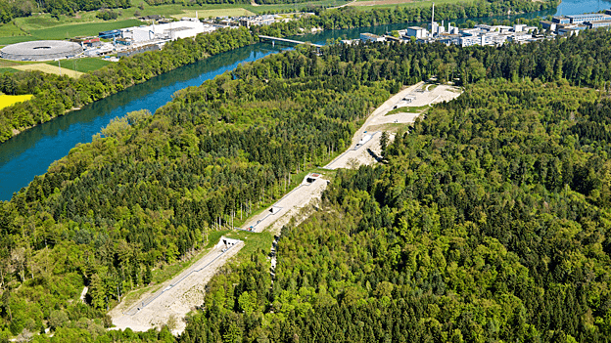
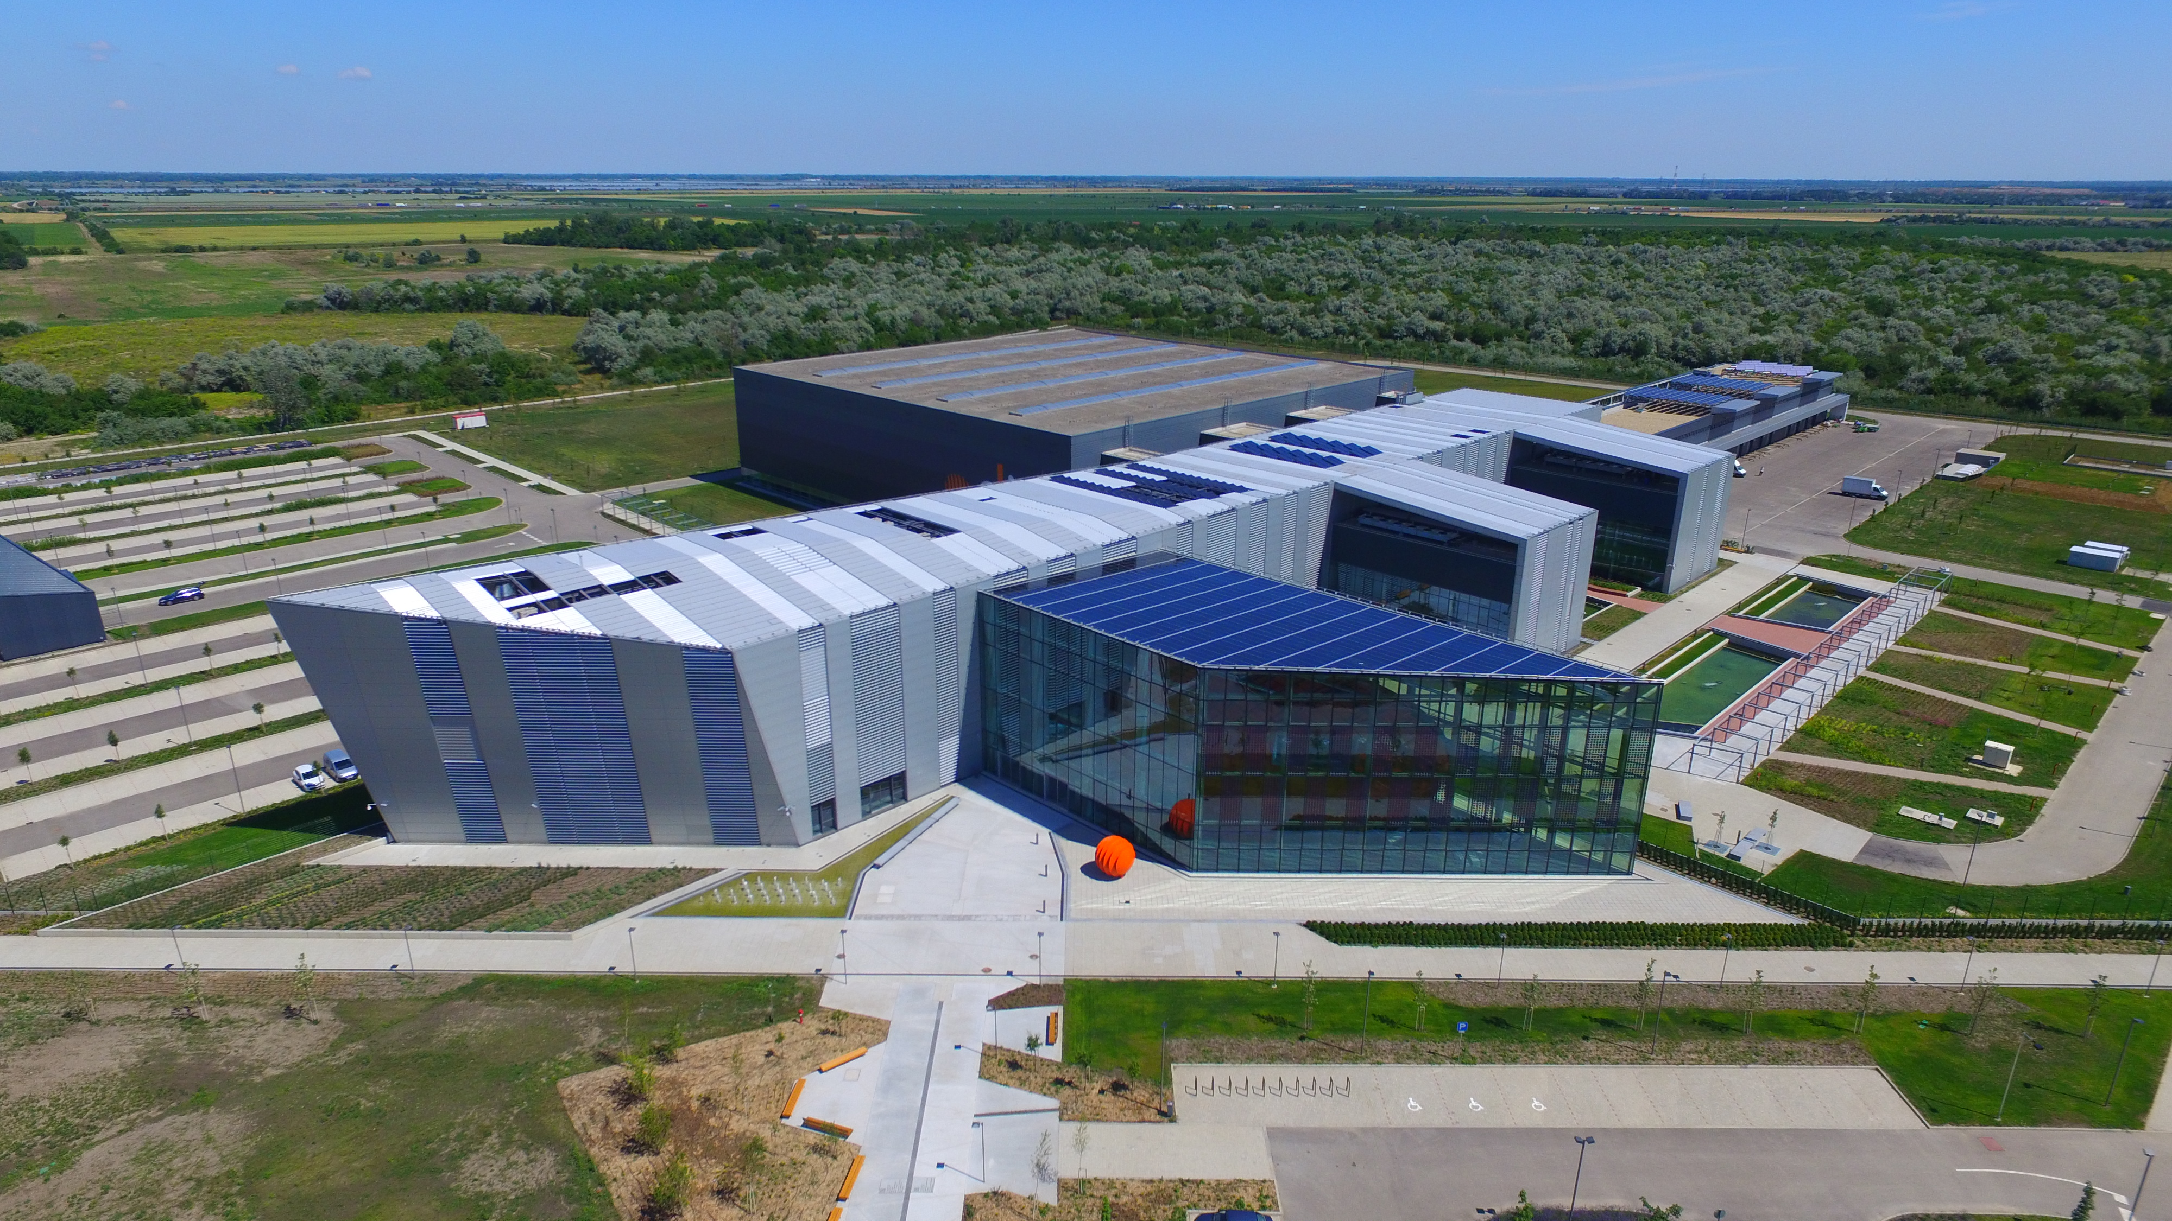
What are Photon and Neutron Facilities?
Neutrons
Photons
Synchrotrons
Neutron Reactor Sources
Spallation Source
Free Electron Lasers
Conventional Lasers
Images borrowed from Facility Webpages @ ESRF, Eu-XFEL, Petra III, SwissFel, ELI, ESS, ILL

Slide 4
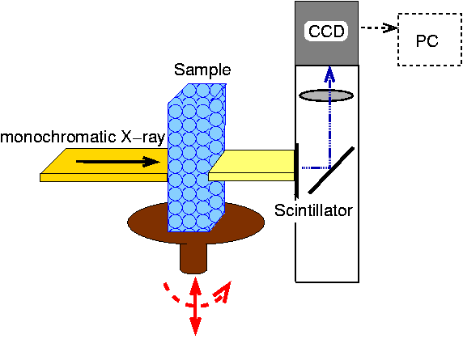
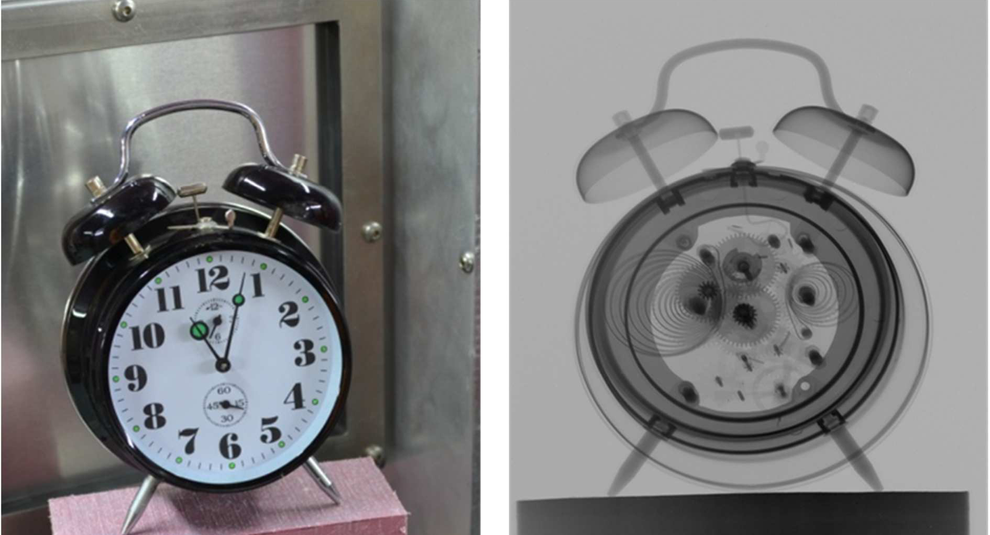
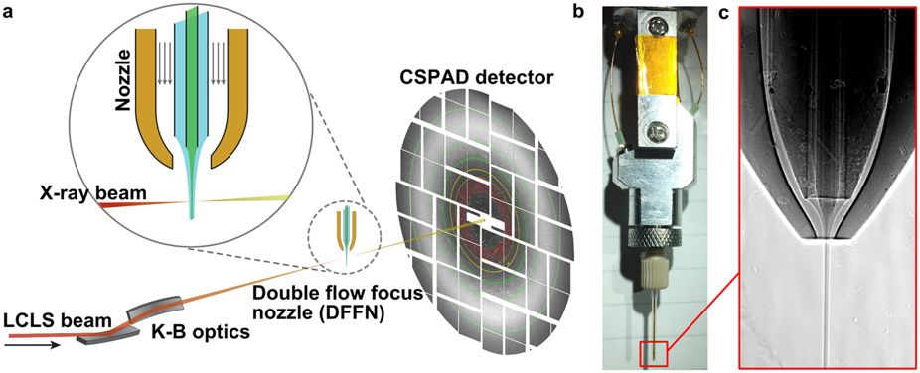
What can you do with Photon Neutron Beams?
Photon Tomography
Conservative Crystallography
Neutron Tomography
Serial Crystallography
A new Neutron Radiography / Tomography / Imaging Station DINGO at OPAL
Plasma Physics, Quantum Physics , ******
See Lightsources.org
Thanks to Frank Schlünzen for a lecture in PaN Physics

Slide 5
PaN Data Lifecycle
Process
Store Data
Validate Data
Visualize Data
Create
Experiment
Measurements
Collect Metadata
Analysis
Integrate Data
Create Output
Publish Results
Plan
Data formats
Storage
Sources
Metadata
Papers
Papers
Papers
Proposal
Save
Curate,
Store and Archive
Metadata &
Data
Reuse
Impact Research
Reviews
Teaching
Access
Share Data
Open Access
Access rules and
control

Slide 6
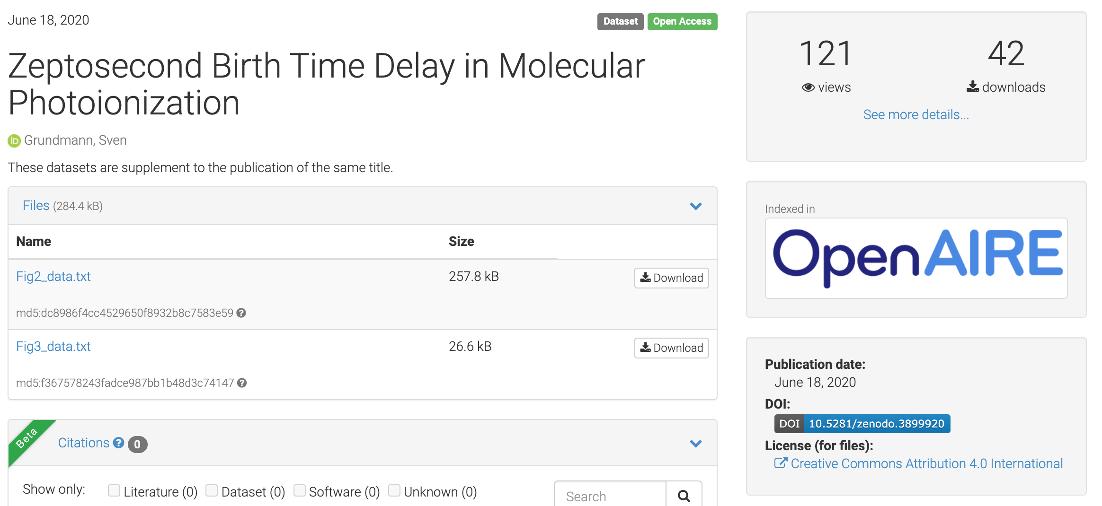
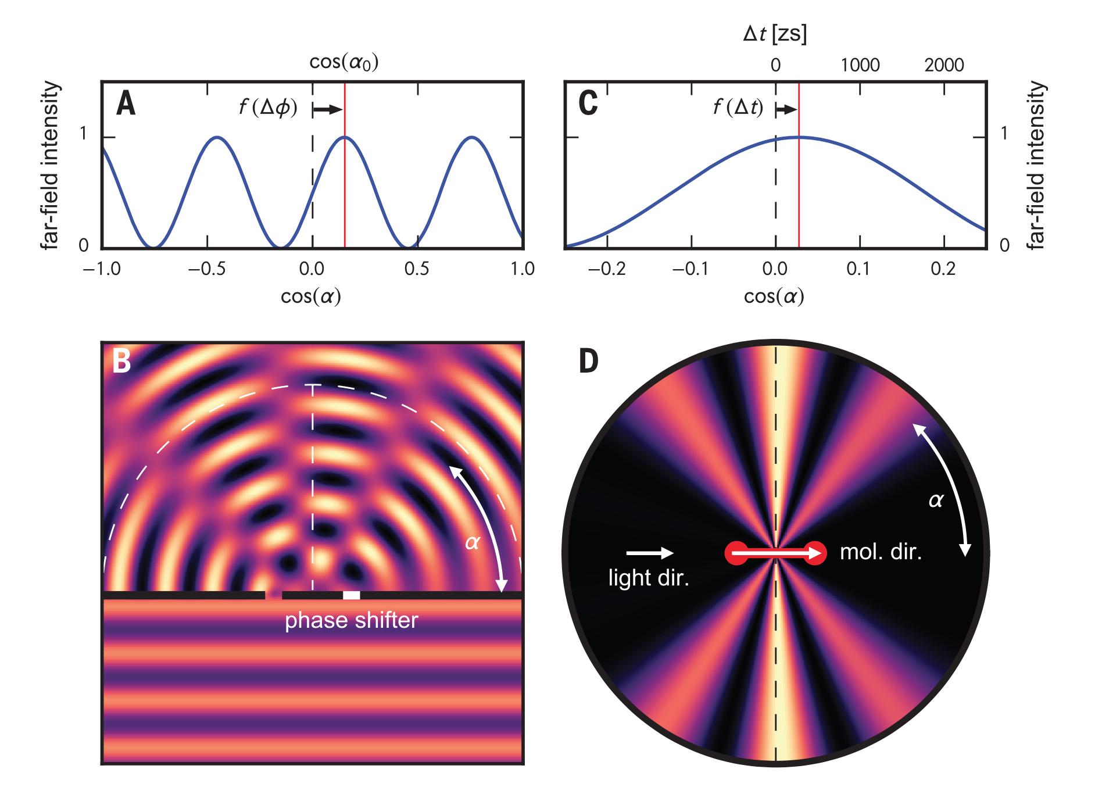
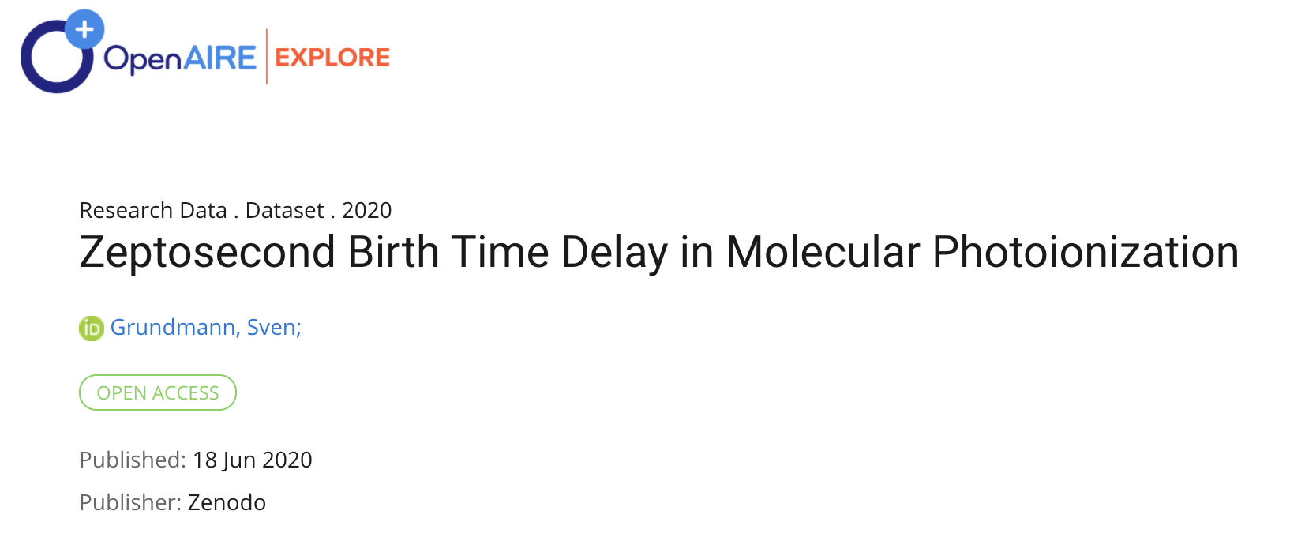
Recent example of state of the art Photon Science @ PETRA III
Zeptosecond birth time delay in molecular photoionization, Sven Grundmann, …., Florian Trinter et al.
Fig. 1. Concept of birth time delay measurement. (A) Intensity distribution on a screen in the far field behind the double slit in (B). (B) A plane wave impinges on a double slit. The phase shift 1⁄2Df in the right slit causes a tilt of the interference pattern. (C and D) Emission of a photoelectron wave from two indistinguishable atoms of a homonuclear diatomic molecule mimics the double-slit setup in (B). Here, the angle a is enclosed by the electron momentum vector and the molecular axis. A time delay (Dt) between the emission from one of the two centers—e.g., originating from the travel time of the photon impinging from the left side in (D)—leads to a shift of the interference fringes in (C). The ratio of slit distance (molecular bond length R, respectively) to wavelength is 1.65 in both cases [(B) and (D)]. In (B) the right-hand part of the wave is delayed by Df 1⁄4 p=2, whereas in (D) a birth time delay of 247 zs causes Df ≈ p=11 for R = 0.74 Å. light dir., light direction; mol. dir., molecular direction.

Slide 7
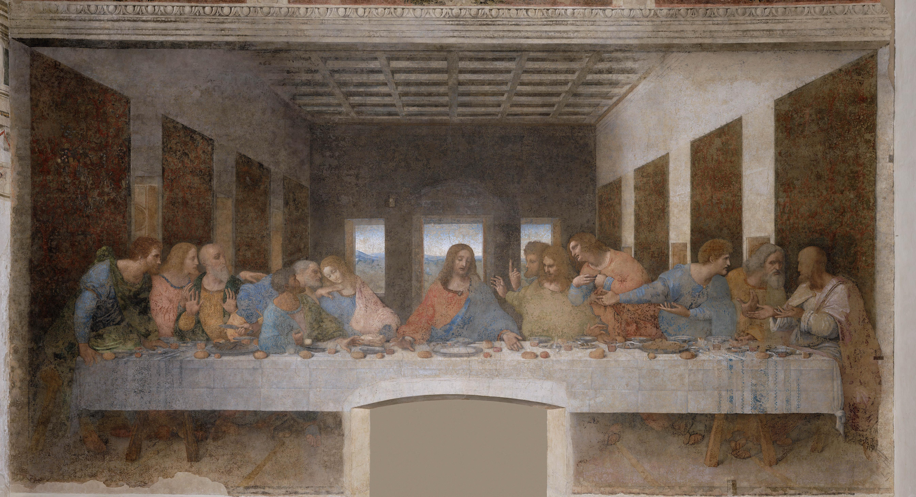
Another example : Support of Cultural Heritage
Institute: ESRF, Scientist: M. Cotte, Conservation of old Paintings, “Last Supper by L. Da Vinco”
Courtesy : Andy Götz, ESFR
Request
Prepare data reduction scripts as Jupyter notebooks for non-expert users
Demonstrates
Jupyter notebooks
Data Portal
HDF5 data format
Software Catalogue
Linked to
Any community in need of standard data reduction scripts in a standard data format.

Slide 8
The projects : PaNOSC and ExPaNDS

Slide 9
PaNOSC and ExPaNDS cheat sheet
Timeline
EOSC Association
2019
2020
2021
2022
PaNOSC
ExPaNDS
EOSC Future
3 years
2018-12-01
2019-09-01
2022-08-31
2023-02-30
2022-11-30
Core data
 | PaNOSC | ExPaNDS
Call | INFRAEOSC 04 | INFRAEOSC 5B
Budget | 12 M Euro | 6 M Euro
Number of Partners/Facilities | 7 / 5 ESFRI | 11 / 10 National
Start | 2018-12-01 | 2019-09-01
End | 2022-11-30 | 2022-08-31 / 2023-02-30
EOSC Future will unlock the potential of European research through a vision of Open Science for Society.

Slide 10
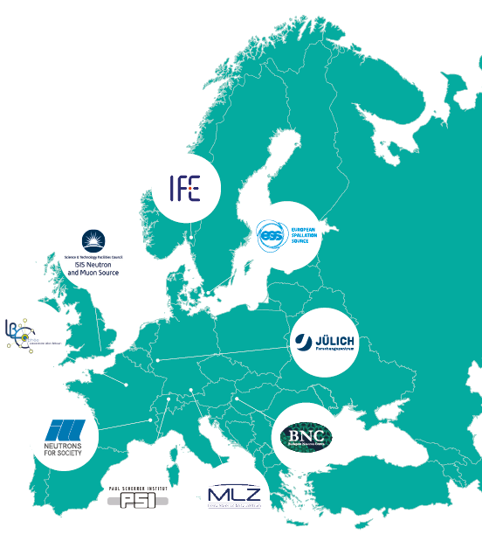
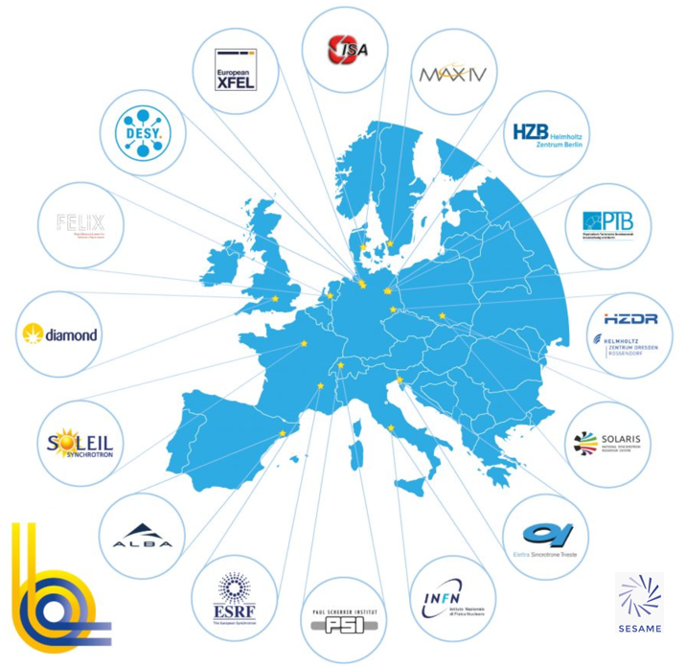
PaN facilities covered by PaNOSC/ExPaNDS
PaNOSC
Photon (LEAPS)
ExPaNDS
Neutron (LENS)
DESY
CESNET
STFC
Stolen from Helmut Dosch

Slide 11
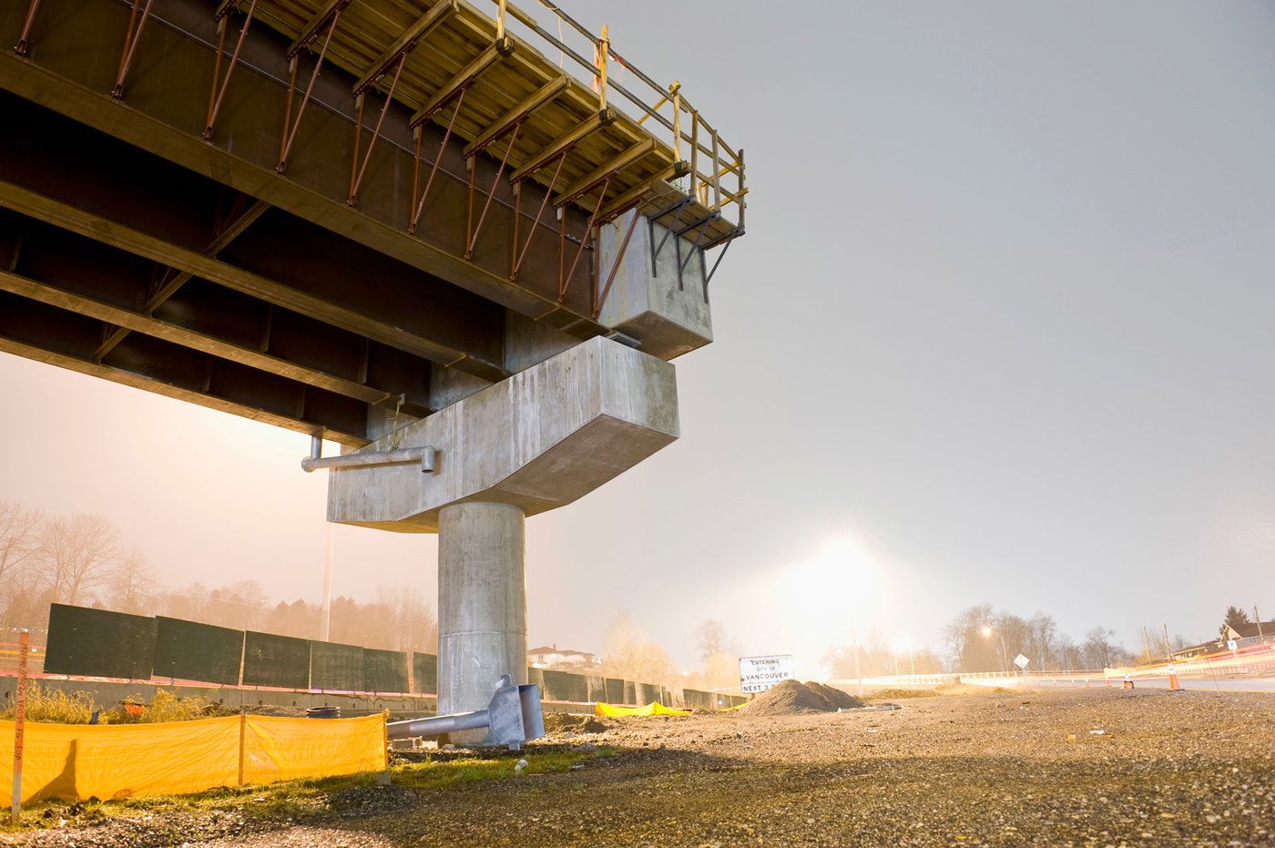
EOSC , EGI and horizontal infrastructures

Slide 12
Linking publications, data and infrastructures: The PaN Portal.
Facility
Cloud Services
Horizontal
Infrastructures
Super Portal
Search for publications
Get corresponding data
Enrich the meta data with your metadata
Get more data matching meta data
Find infrastructure to run publication algorithm on collected datasets.
Mobile
Apps
Remote Desktop
HPC
Portal Engine (backend)
Catalogue Service
Global
Databases
Browser
GUI
ICAT
SciCat
A
P
I
Data Management
CLI
Data
Lakes

Slide 13
ExPaNDS and PaNOSC contributing to horizontal infrastructure deployment
EGI FedCloud
DESY Cloud Infrastructure
Development: ILL , ELI
CD / CI e.g. at DESY
This is what Jean-Francois Abramatic usually is referring to.
“EOSC is a federation of your infrastructures”.
EOSC
EGI FedCloud
DevOps Image: Courtesy : Software Group at US Airforce

Slide 14
And the show for you today is …..
Brian Matthews
Enabling our facilities to produce FAIR data.
Alun Ashton
Federated services accessible through the 'PaN portal’.
Nazaré Guimard / Thomas Holm Rod
Sharing knowledge with the open PaN e-learning platform.
Andy Götz
Remote access to PaN facilities instruments and services, including data transfer.

Slide 15
FIN
Further Reading ….
www.panosc.eu
www.expands.eu

