Slide 1
PaN, PaNOSC and ExPaNDS Sharing knowledge with the open PaN e-learning platform
^{2th} Nov, 2020
Presenter: Thomas Rod (ESS), Nazaré Guimard (SOLEIL)

Slide 2
Content
Objectives
On-going training activities: FAIR workshop
PaN training portal concept
Description of the e-learning platform: history, scope, examples, progress
Added-value of the future PaN training portal

Slide 3
PaNOSC and ExPaNDS Training activities objectives
Provide an e-learning platform and service
Organize a series of training events
Provide training material
Provide an e-learning platform and service to provide training to staff and users
Provide training material
accessible to staff and users from national RIs
using EOSC data websites and e-learning platforms
to use the e-learning platform
to develop courses, and train staff at relevant RIs at specific workshops
to promote the FAIR principles and best practices
to promote services and capabilities of PaN facilities
Organize a series of training events in :
data FAIR principles
data stewardship
data management
data analysis services integrated into the EOSC services
staff training on e-learning platform

Slide 4
First training event: FAIR workshop (01-02/10/2020)
https://expands.eu/2020/09/09/expands-fair-workshops-1st-2nd-october-2020/
Target audience: Instrument scientists and other facility staff
Overview of FAIR – key questions related to the data facilities produce – What is FAIR? What’s the difference between FAIR and Open? What are the benefits of FAIR for the PaN community? How do I start to make data FAIR? Examples connect the concept of FAIR to practice, highlighting the vital role facilities play in supporting FAIR for PaN research.
Exploration of the FAIR experiment – What are the implications of FAIR for data management before, during, and after the experiment? When, where and how during the lifecycle of an experiment do we collect the metadata we need to document data and make them FAIR? What is active data management planning? How does it benefit both facilities and users and how does it help to make data FAIR?

Slide 5
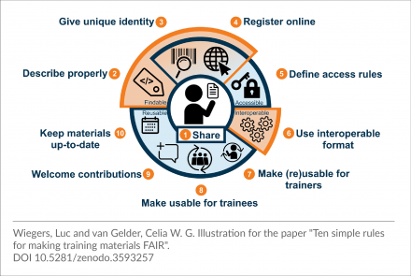
Ten simple rules for making training materials FAIR
Garcia et al. (2020) Ten simple rules for making training materials FAIR. PLoS Comput Biol 16(5): e1007854. https://doi.org/10.1371/journal.pcbi.1007854
Guidelines which apply the FAIR principles to limitation experienced by trainers looking to find, (re)use and adapt learning materials.
Guidelines pertinent across domain and include amongst others:
Plan to share your training materials online
Give your training materials a unique identity
Make your training materials contribution friendly
Improve findability of your training materials by properly describing them

Slide 6
Characteristics of the future PaN training portal
The future PaN training portal:
will be a registry that helps European PaN RIs to promote their latest events and contribute to their catalogue of training material.
will be an aggregator of training resources (material and events)
will include the e-learning platform currently developed by PaNOSC to create and locally store training material
will not be a repository and will not store (major) content (the e-learning platform will do it locally if necessary). it will describe the training material and index links to content provider’s training material (training provider’s website or repositories as Github, Zenodo, Open Aire, etc).
Future work on collecting the material and events, and on metadata definition to index the training content

Slide 7
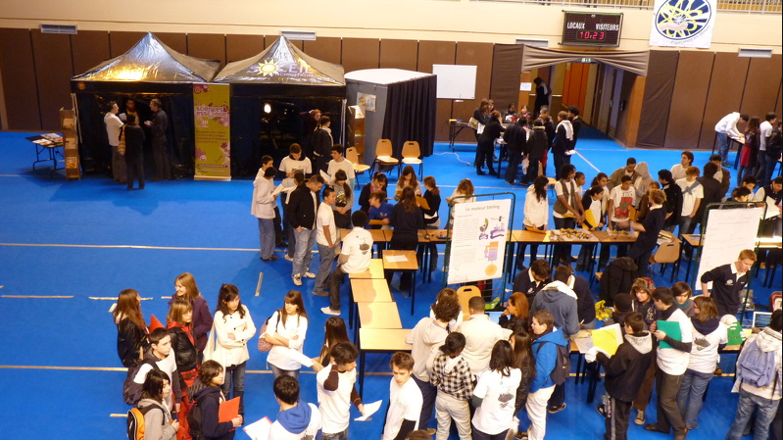
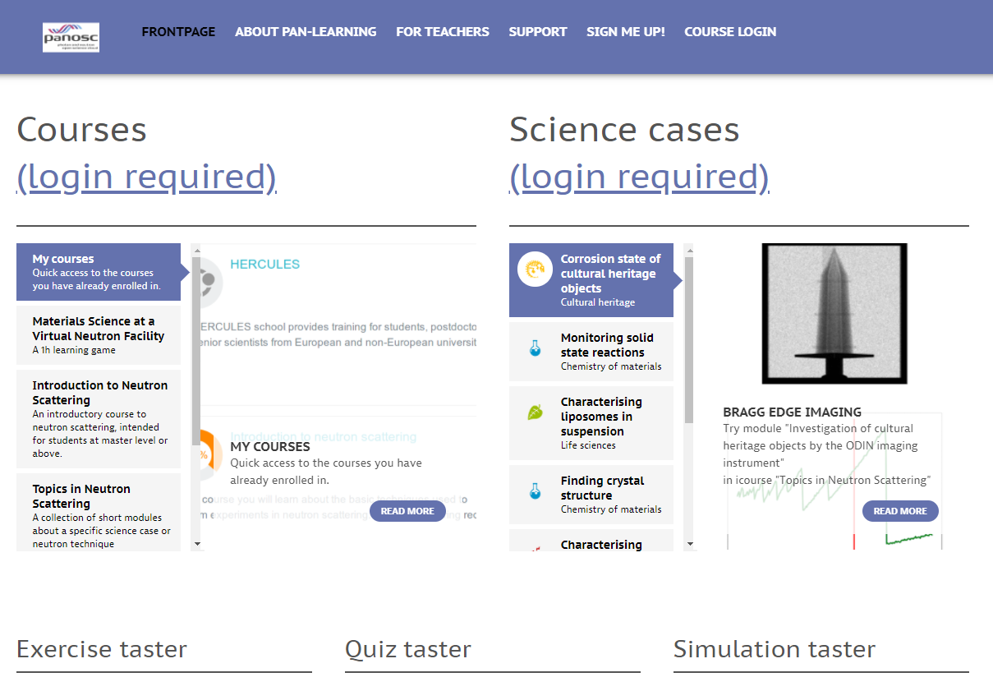
PaN training portal
Vision
Training events
Catalogue of training events of interest for the PaN community (Online and f2f events)
Workshops, MOOCs, summer schools, users’ meetings …
Training material
Catalogue of training materials of interest for the PaN community
External links to content provider’s website or repositories as Github, Zenodo, Open Aire, etc
E-learning platform
Tool available to create and store training material
Moodle
Simulation tools
MediaWiki

Slide 8
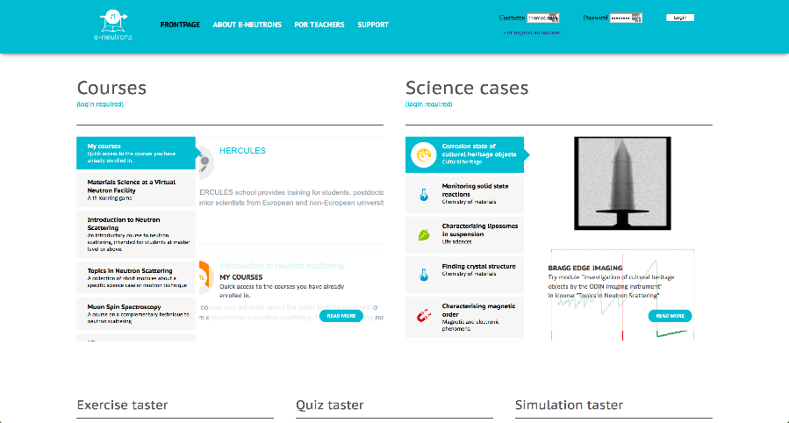
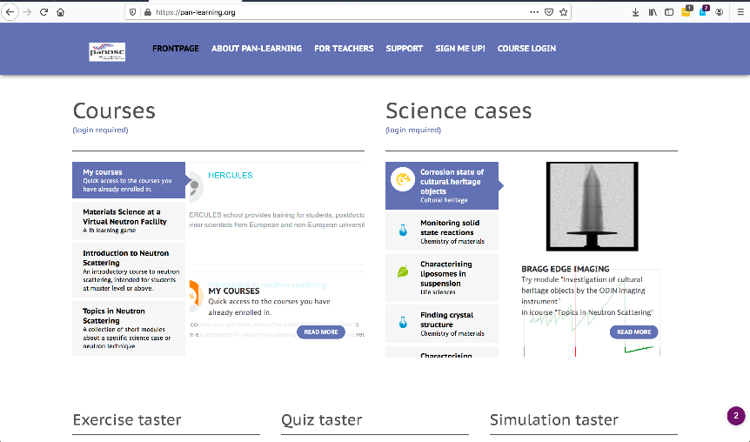
Scope & history of the e-learning platform
https://e-neutrons.org
e-neutrons.org invented and developed primarily by Linda Udby (UCPH) & Peter Willendrup (DTU) in NMI3 and SINE2020
https://www.youtube.com/watch?v=LvRVnPoAkNs&feature=youtu.be
https://pan-learning.org
e-neutrons.org / pan-learning.org used used at multiple places, e.g.:
University of Copenhagen
Technical University of Delft
Berlin school on neutron scattering
SwednESS Summer schools.

Slide 9
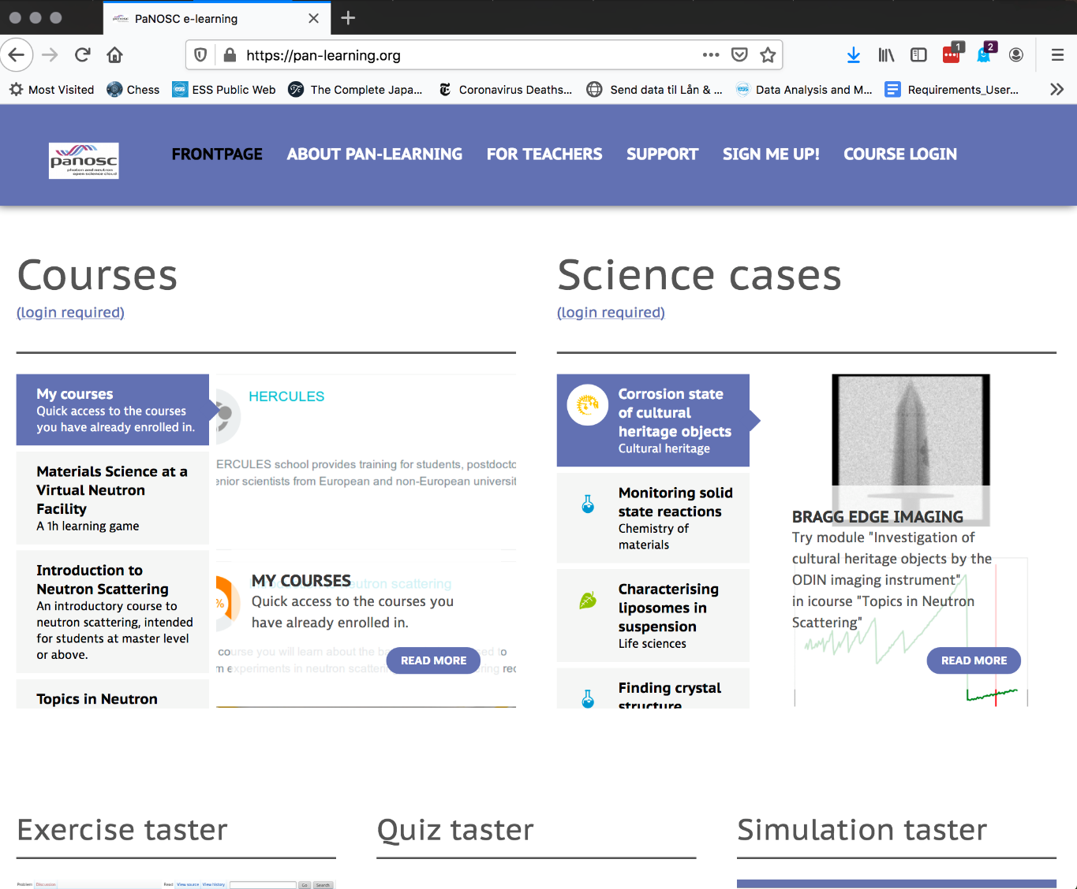
Components enable a rich e-learning environment
Components
Work in progress:
+ other simulation software

Slide 10
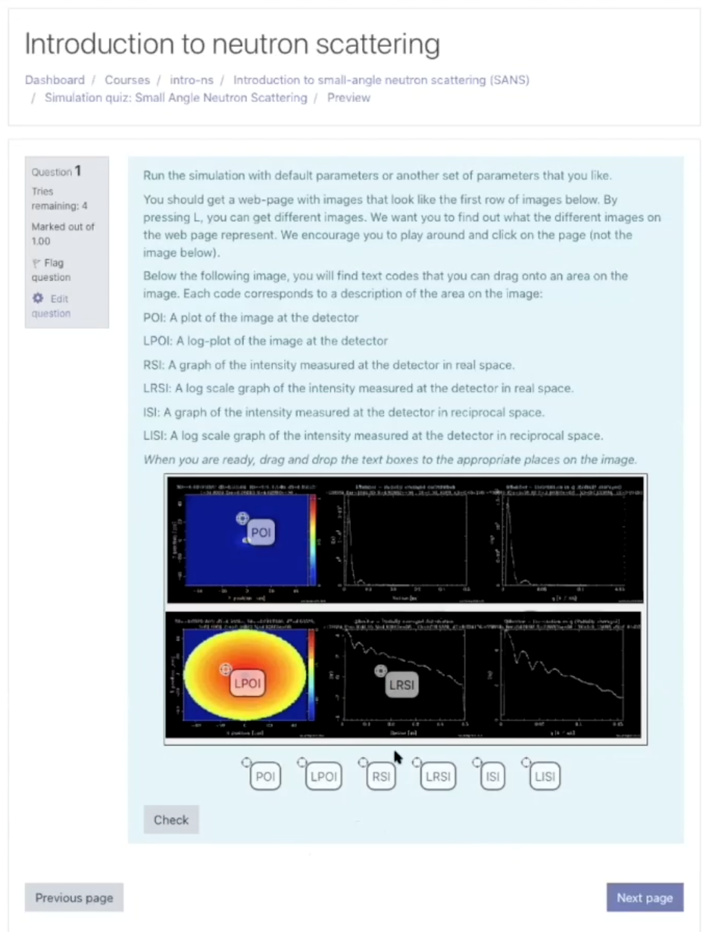
Components enable a rich e-learning environment
Types of learning materials
Text book material
Quizzes
Slides
Videos
Annotated videos
Virtual experiments
Jupyter (scripting)

Slide 11
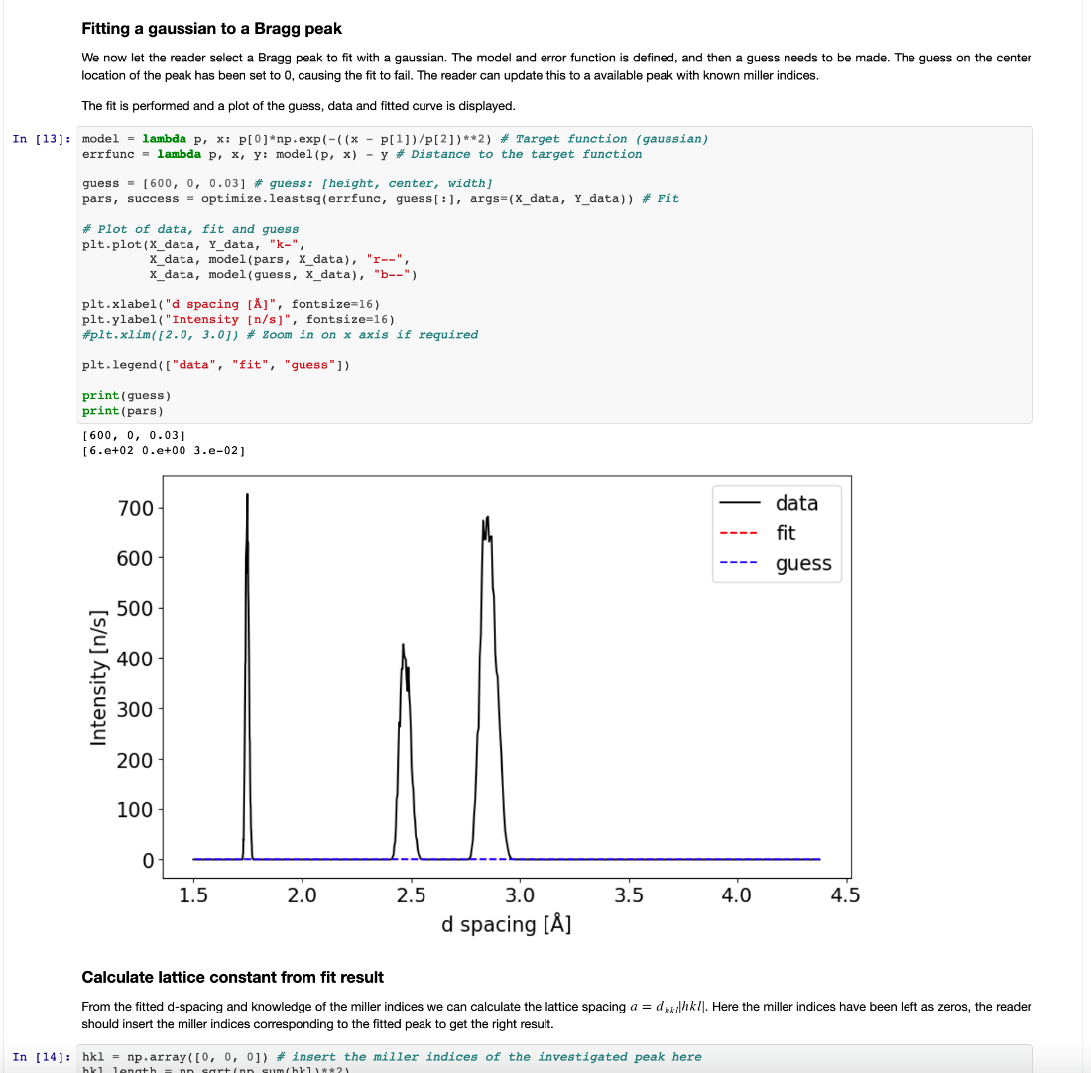
Progress
Annotated videos
e-neutrons.org migrated to ESS under the name of pan-learning.org
devops and security improved
Jupyter integrated
Umbrella AAI integrated
pan-learning.org -> EOSC service
pan-learning.org workshop
Separation of library of training material from e-learning platform
New content

Slide 12
Added-value of the future PaN training portal
single entry point to relevant training ressources and tools to create training material for the PaN community
centralised environment for sharing training material and events information
effective gateway to find relevant training events and ressources for the PaN community
opportunity to promote training events
contribute to a growing catalogue of PaN dedicated training materials

Slide 13
Thank you!

