Slide 1
Photon and Neutron (PaN) Remote Access @ EGI 2020 Conference
Andy Götz
9th of November 2020

Slide 2
Overview
Why Remote Access?
COVID-19 impact for PaNs
Remote services
Needs for EGI and EOSC

Slide 3
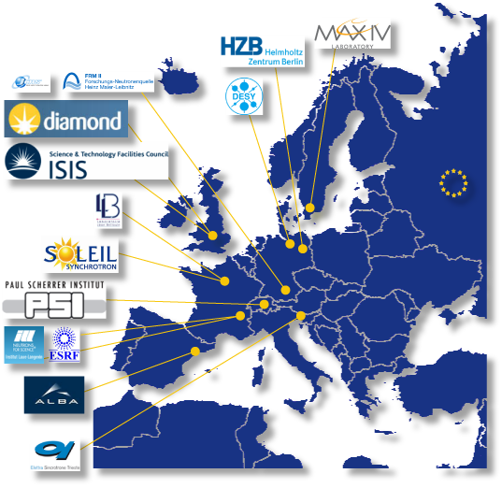
Photon and neutron sources + community
10 photon sources
7 neutron sources
Represents ~40 000 users/yr
PaN is not CERN !

Slide 4
Photon and Neutron Sources in Europe

Slide 5
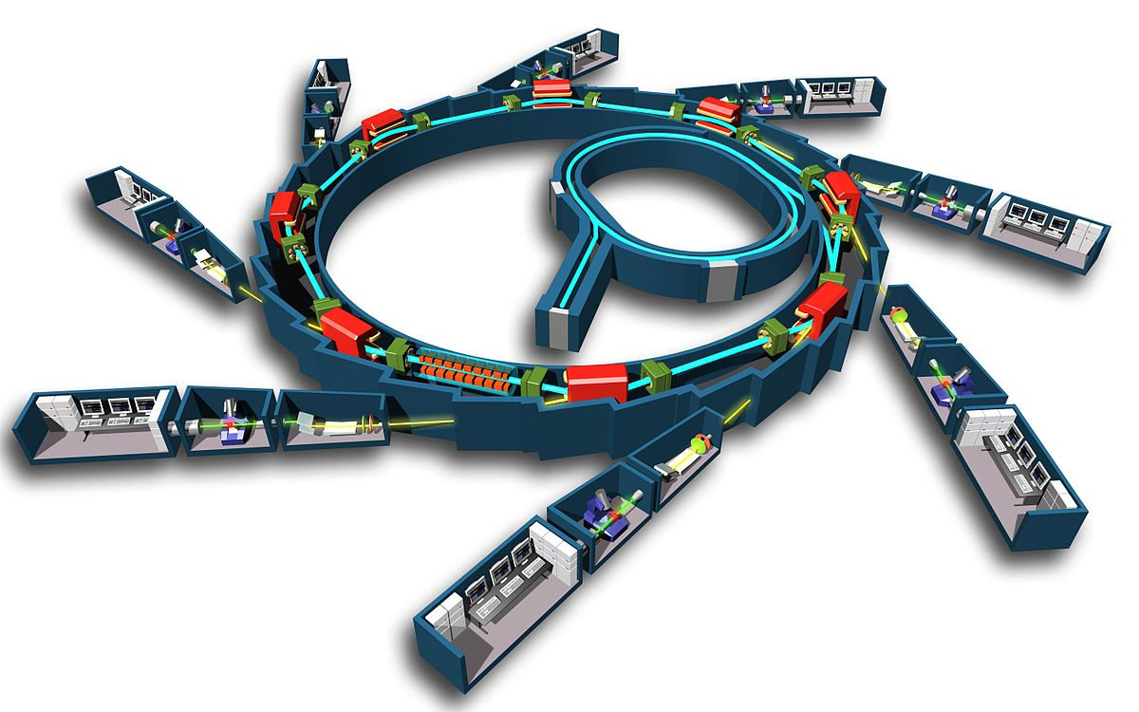
How do PaN User Facilities work?
User: has an idea / need to study a sample
Proposal: User writes a proposal for one of the PaN facilities
Review committee: Reviews proposal and rates scientific quality
Beamline scientist: Review proposal and checks feasibility
Beamtime allocated: User travels to facility / sends sample
Experiment: Sample(s) are exposed to beam + data collected
Analysis: Data is reduced, analysed + curated (DOI)
Publication: User publishes results (DOI) in peer reviewed journal

Slide 6
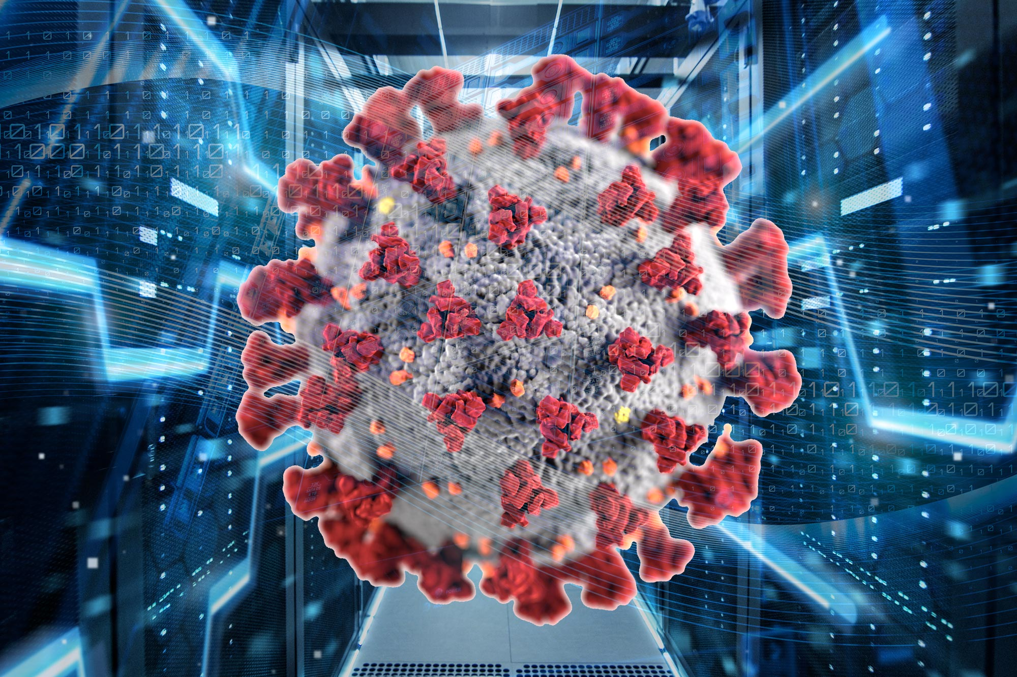
PaN Users remote access requirements post-
User: has an idea / need to study a sample
Proposal: User writes a proposal for one of the PaN facilities
Review committee: Reviews proposal and rates scientific quality
Beamline scientist: Review proposal and checks feasibility
Beamtime allocated: User travels to facility / sends sample
Experiment: Sample(s) are exposed to beam + data collected
Analysis: Data is remotely reduced, analysed, downloaded + curated (DOI)
Publication: User publishes results (DOI) in peer reviewed journal
Proposal system
Remote meeting
Sample tracking
Remote control system
+ monitoring + reduction
Remote data analysis +
Data transfer
Long term archiving

Slide 7
Post-COVID-19 impact on PaN
sources and community
ALL PaNs are generalising REMOTE EXPERIMENTS (WIP)
USERS → remote
SAFETY → security
SAMPLE TRACKING → by post
DATA ANALYSIS → remote analysis
DATA TRANSFER → via internet

Slide 8
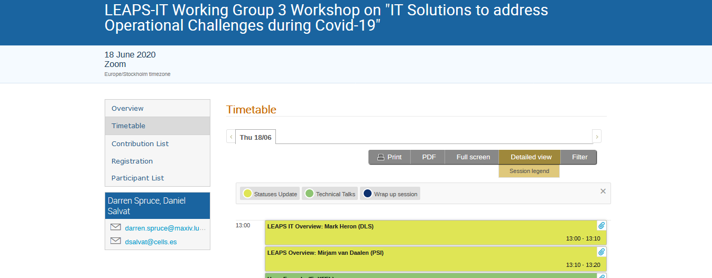
PaNs workshop on IT solutions for COVID-19
https://indico.maxiv.lu.se/event/1375/timetable/#20200618.detailed

Slide 9
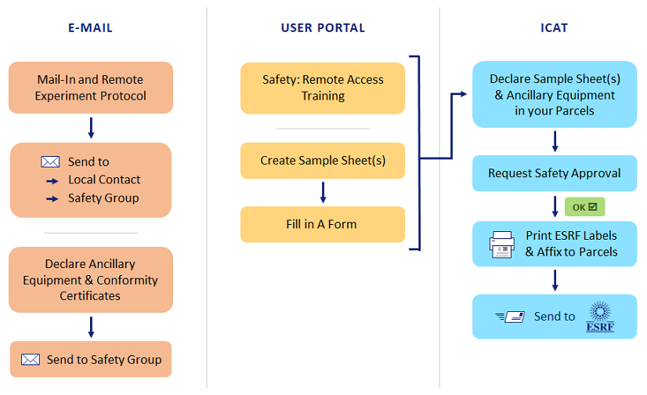
Remote Experiments @ ESRF

Slide 10
VISA - ILL remote access post-COVID-19
Provide remote data analysis services with access to
Experimental data
Analysis software
Compute infrastructure
Support (IT and Scientific)
Make access as simple as possible using a web browser
Remote desktop as if the user was sitting in front of an ILL data treatment workstation
Easy and flexible machine management
Allow scientific collaborations
Sharing desktops
Enable remote experiments
Access Nomad (SCI) to perform instrument control
This is the current priority for the next reactor cycle (August)
credits – Jamie Hall (ILL) + Stuart Caunt (ILL)

Slide 11
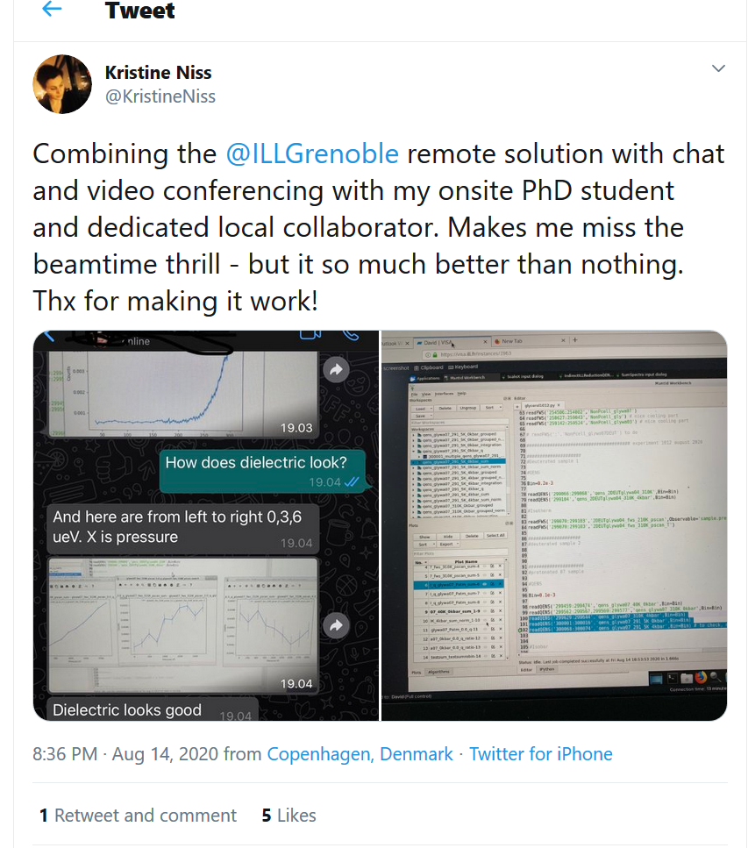
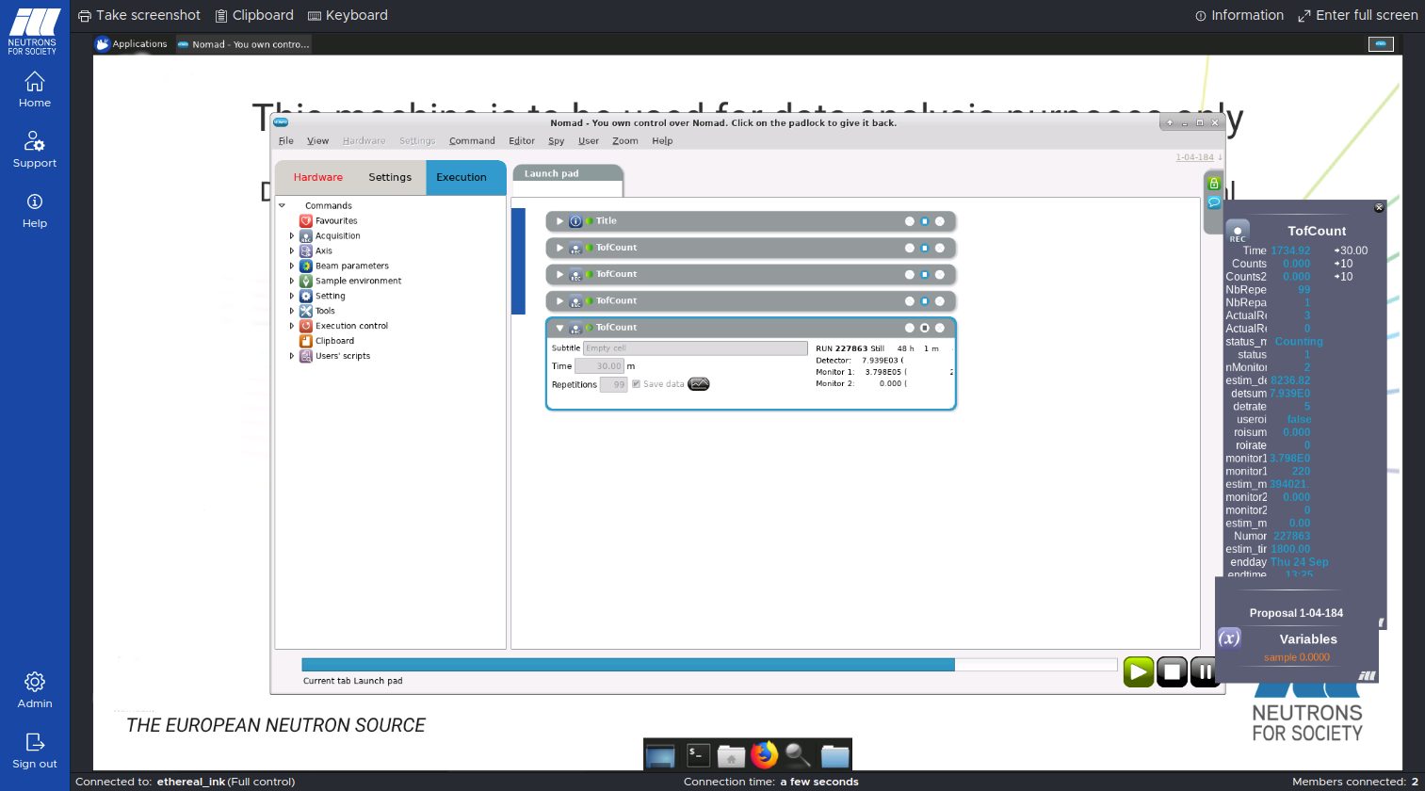
Remote Experiments @ ILL

Slide 12
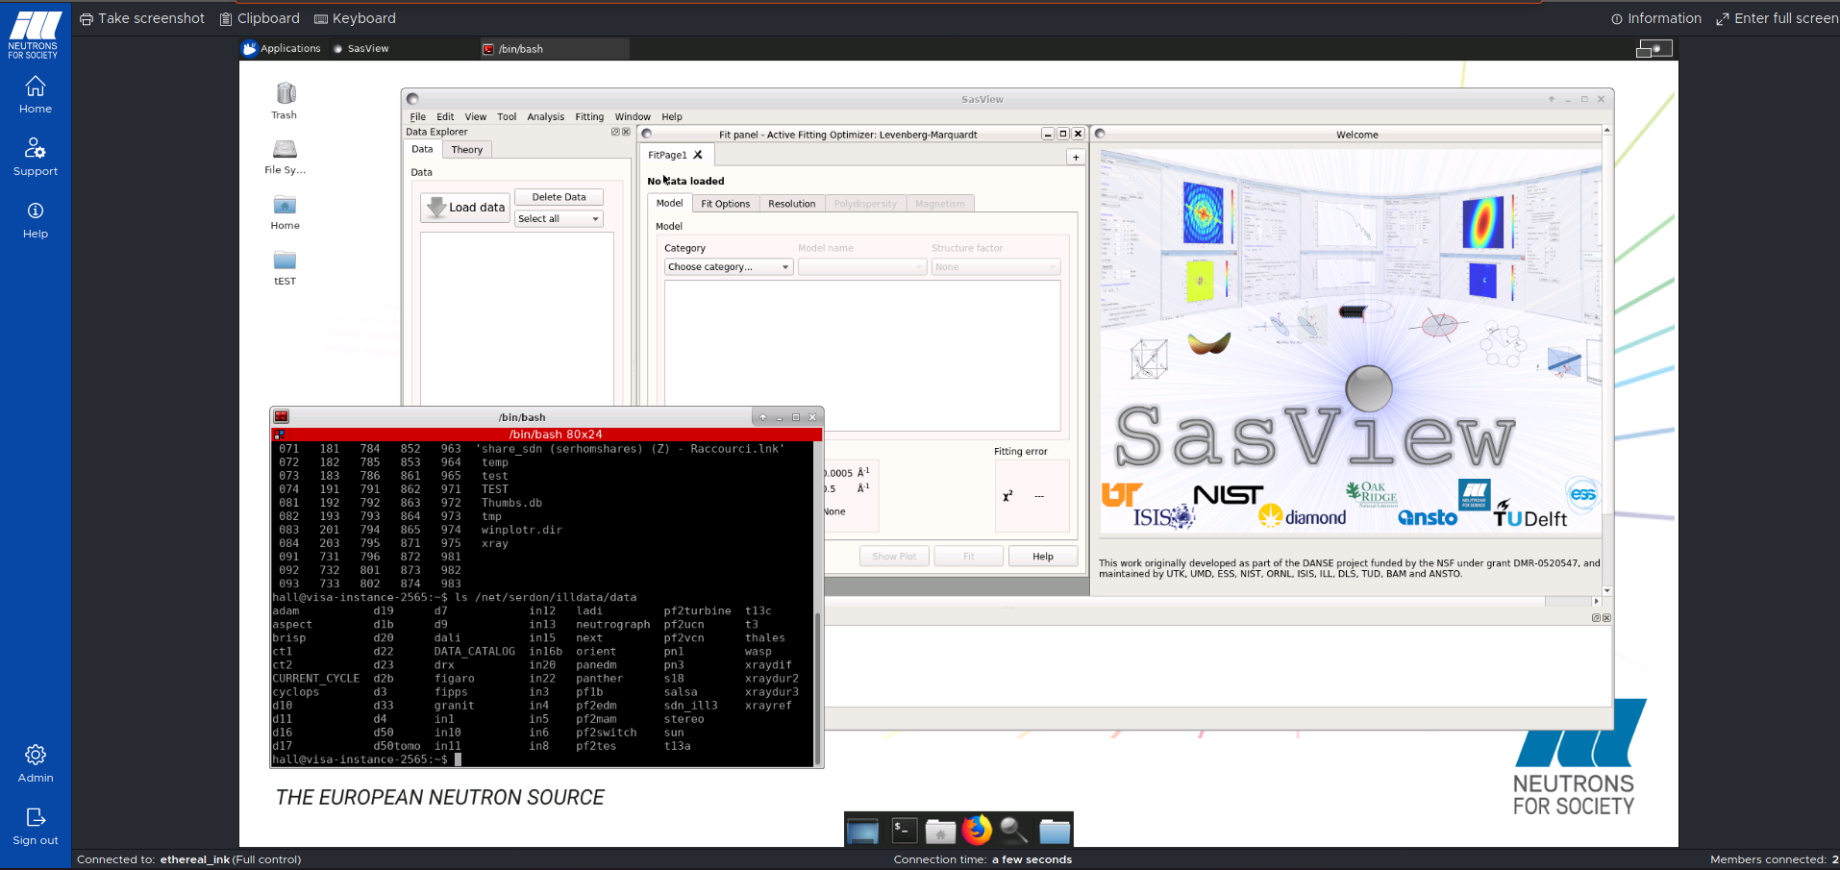
Remote Experiments @ ILL

Slide 13
ILL VISA architecture
Token creation
VISA
OpenStack
Web Application
Angular6
Linux VM
Linux VM
Keycloak
OpenID Connect
Linux VM
RDP /
guacd
Instance Management
REST API
Remote Desktop Access
Socket.io
Token validation
Instance
management
Session authorisation and
Session management
REST API
Business logic
DB
credits – Jamie Hall (ILL) + Stuart Caunt (ILL)

Slide 14
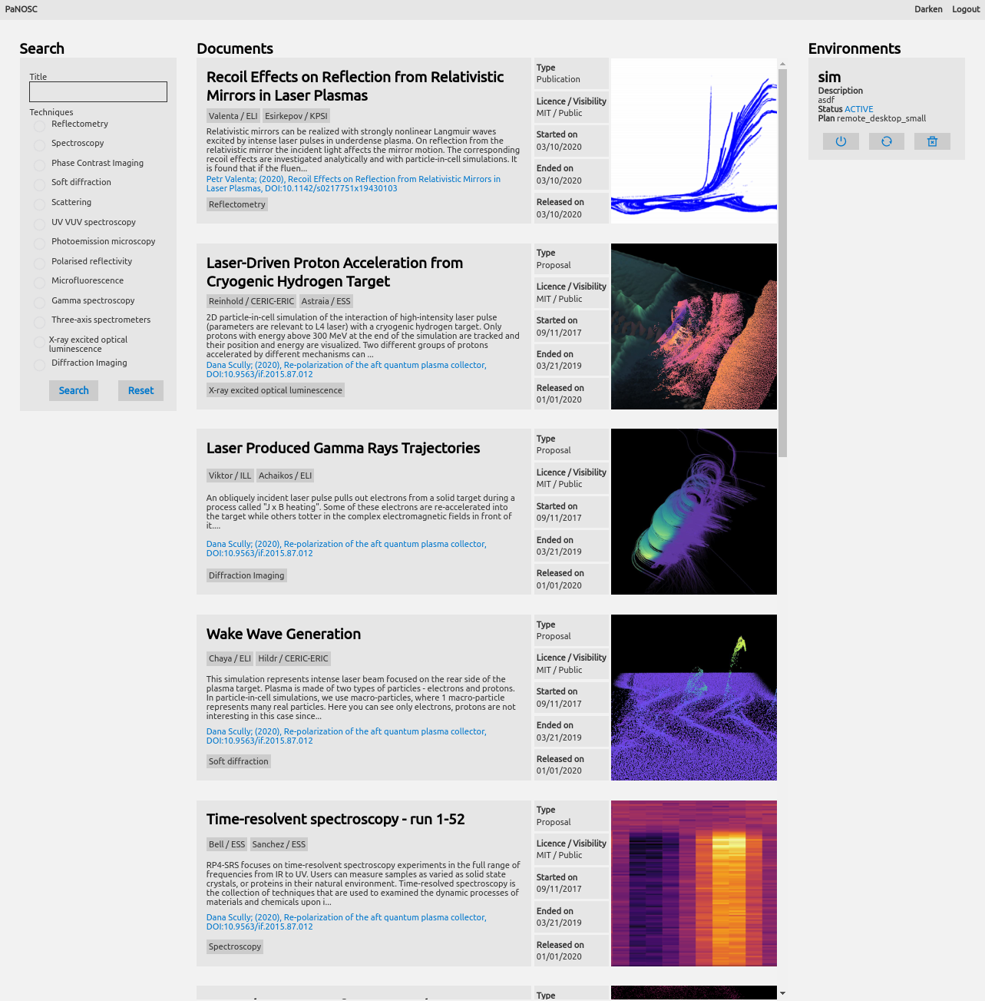
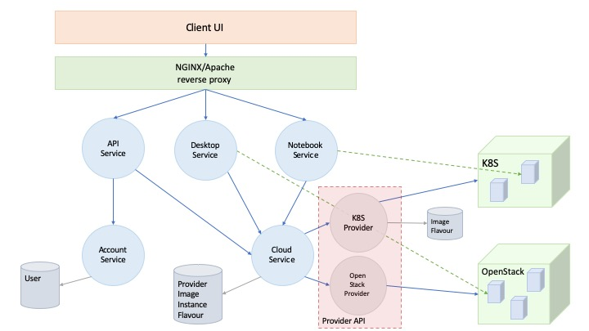
PaNOSC + ExPaNDS portal architecture
?
?
credits – Jamie Hall (ILL) + Stuart Caunt (ILL)

Slide 15
PaN Use Cases for Remote Services
User 1: How can I download 5 TBs of raw data?
User 2: How can I search, view and process data remotely?
User 3: How can I access a Jupyter notebook to process my data?
User 4: How can I make my data open and get a DOI to cite?
User 5: How can I get credentials to login and use these services?
Beamline scientist: How can I provide standard notebooks for processing data for my users?

Slide 16
Post-COVID all PaNs will / should offer
Remote experiments
Downloadable Metadata & Raw data
Software service to browse and analyse raw data
Platform as a service to do computations + simulations
Common space to share progress and workflows

Slide 17
Remote access bottlenecks
Remote experiments → internet bandwidth, remote desktop tools
Downloading (Terabytes) Data → efficient, ease of use
Software service to browse and analyse raw data → compute cluster(s), batch scheduler, VMs, containers
Platform to do computations + simulations → HPC cluster
Common space to share workflows → workflow tools

Slide 18
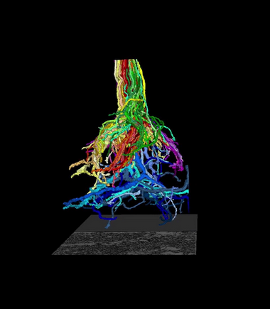
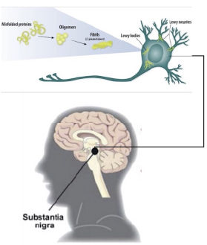
Use Case
Parkinson’s disease
Institute: CERIC-ERIC, ESRF
Scientists: L.Casalis et al. + A.Pacureanu et al.
Objective: mapping of neurons in 2d and 3d
Request: make large data volumes available as Open Data

Slide 19
Use Case
Demonstrates: open data, big data download, data portal, HDF5 data format, search API
Work packages: WP2, WP3, WP4, WP6
Linked to: any user community which needs to publish open data and make it FAIR for their community

Slide 20
Where can EGI help?
Jupyter notebook service
Binder service for reproducible notebooks
Compute resources for HTC with GPUs / FPGAs
High data volume download service
Common AAI solution

Slide 21
Conclusion
PaNs are generalizing remote access to experiments and data
Strong need to collaborate on remote access tools
EGI can help PaNs to provide remote services
EOSC could help in this area

Slide 22
Thank you to all colleagues @
PaNOSC, ExPaNDS + EGI !

Slide 23
ILL VISA remote services usage since 11 August 2020
Number of instances by type of user:
Instrument Scientists 291
External users 235
Session stats:
User type Count Average duration (m)
Instrument responsible 3614 121
External user 3578 99
credits – Jamie Hall (ILL) + Stuart Caunt (ILL)

