Slide 1
EGI Service Design Workshop
OSCAR 2.0: Serverless Scientific Computing
Sebastián Risco, Germán Moltó,
Diana María Naranjo, Miguel Caballer
Instituto de Instrumentación para Imagen Molecular
Universitat Politècnica de València, Spain

Slide 2
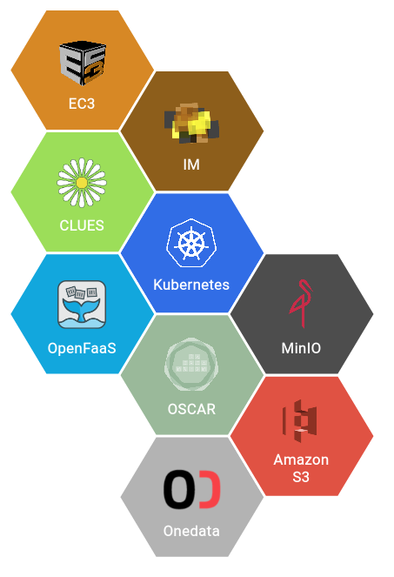
Introduce the service: OSCAR 2.0
Open Source Serverless Computing for Data-Processing Applications
Platform to support the Functions as a Service (FaaS) computing model for containerised file-processing applications
Initial prototype version was co-funded by the EGI Strategic and Innovation Fund and reached TRL6
What’s new?
Redesigned architecture to support a new Functions Definition Language (FDL) in order to easily define serverless workflows
Improved user interface
Integrated with the SCAR tool, enabling the definition of hybrid workflows, i.e. across the Cloud continuum (OSCAR clusters and Amazon Web Services)

Slide 3
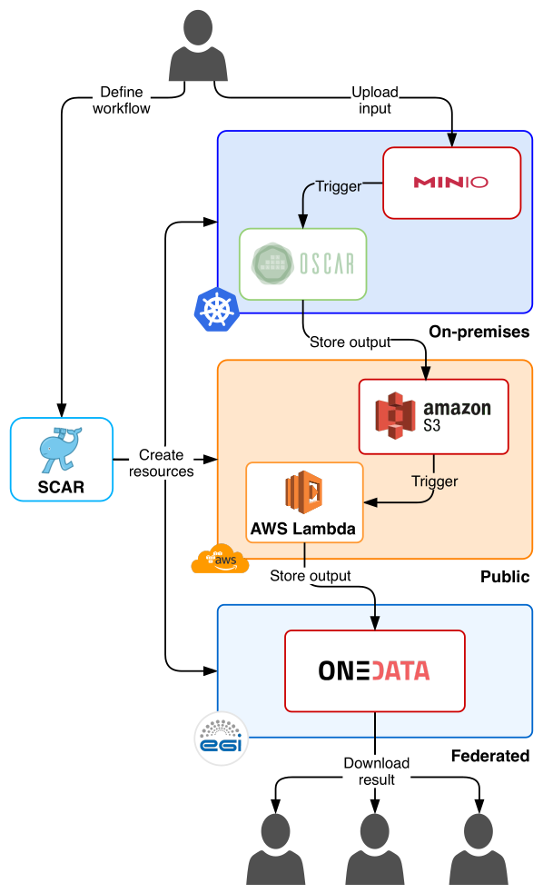
Introduce the service: OSCAR 2.0
Suitable for user communities who want to deploy data-driven containerised applications across serverless platforms (with automated elasticity)
Upload file -> Retrieve processed file
Developed by the UPV-GRYCAP (authors of the Infrastructure Manager (IM) and Elastic Cloud Computing Cluster (EC3) services already integrated with EGI
Publicly available at:
https://github.com/grycap/oscar
https://github.com/grycap/scar

Slide 4
EGI integration plans
for OSCAR 2.0
OSCAR is already integrated with:
The EGI Applications on Demand portal through the EC3 portal, and integrated with the IM Dashboard
The EGI DataHub (Onedata)
as the output storage back-end to store the results of the computations
there is a connector to periodically poll for changes in a Onedata space to trigger the functions (suboptimal)
OSCAR would like to have the following support from these EGI services:
Onedata should allow to define webhooks to be able to trigger the execution of the functions without doing an active polling

Slide 5
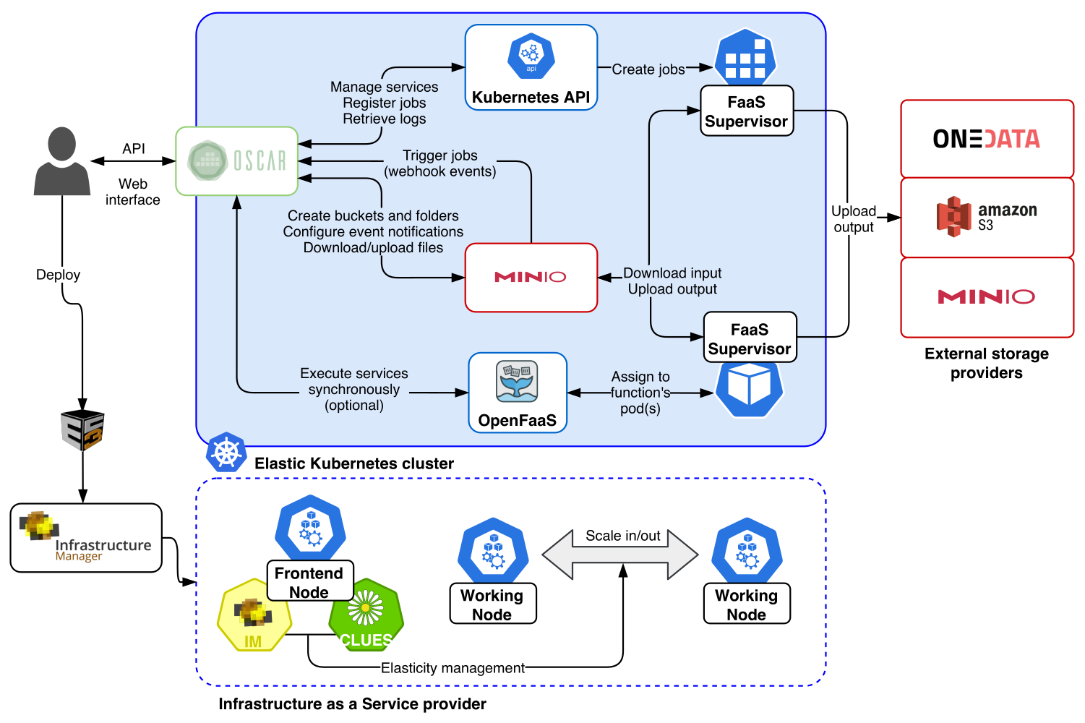
EGI integration plans
for OSCAR 2.0

Slide 6
SDTP section: Service Transition Plan
for OSCAR 2.0
Transition plan
We plan to create a specific portal for OSCAR, integrated with EGI Check-In, to deploy OSCAR clusters and to manage the lifecycle of functions (outside the EC3 portal for enhanced visibility)
Increase the Technology Readiness Level (TRL6 -> TRL8)
Supporting projects
BigCLOE (Spanish National R+D project, ending in 2020)
AI_SPRINT - Artificial Intelligence in Secure Privacy-preserving Computing Continuum (Horizon 2020, starting in 2021)

Slide 7
Open issues
for OSCAR 2.0
Some sites have the MinIO access port blocked
It would be convenient to unify the firewall management of the different endpoints that conform FedCloud (or at least know the open port ranges)
Better integration with EGI DataHub
Webhooks support
On-boarding of new use cases
Face mask detection on public crowds using AI and serverless platforms across the Cloud continuum with OSCAR
Anything you can suggest
We are open to new proposals and use cases

Slide 8
Thank you!
Sebas Risco - serisgal@i3m.upv.es
Germán Moltó - gmolto@dsic.upv.es

