Slide 1
DANS Archives
EGI – 4 November 2020
Chris Baars, supervisor Electronic Services DANS
Chris.Baars@dans.knaw.nl

Slide 2
DANS Archiving: present situation
EASY
VAULT
DataverseNL
IR
external
SWORD
Notes:
Simple Web-service Offering Repository Deposit (SWORD)

Slide 3
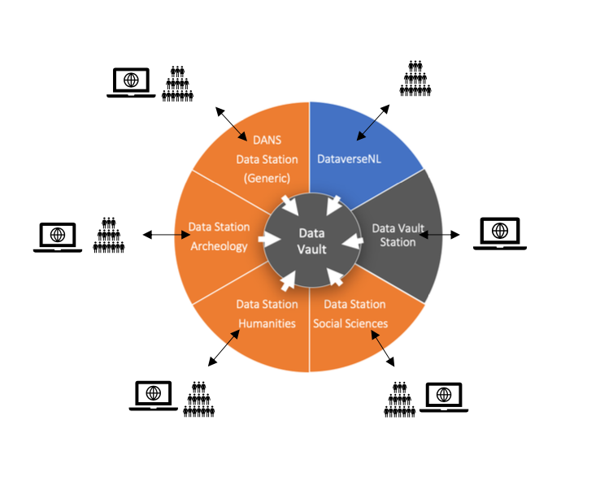
DANS Archiving: new situation

Slide 4
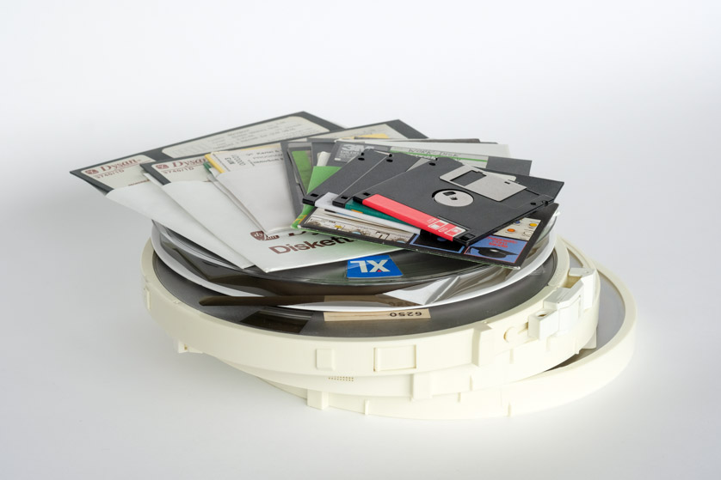
Archiving @ DANS Archives
Machine - and manual depositing
Long Term Preservation
Preferred Formats & checksums
Original files / current formats
CORE TRUST SEAL
Vault
RDA BagIt Profile format (Library of Congres)
on Tape Storage

Slide 5
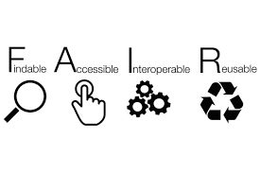
Dissemination and reuse
Dissemination: APIs, Search Interface
- SURF Conext: in 2021 GitHub, ORCID and Google
FAIR: DANS offers archiving, not storage
Metadata, incl. mandatory fields
Dissemination done @DANS or elsewhere
Assign and support PIDs
Controlled Vocabularies
Metadata in other (EOSC) services, e.g.
B2Find
OpenAIRE
DataCite MDS, Google Data Search

Slide 6
Customers of DANS services
In total >150.000 datasets
Manually: > 22.000 active accounts (depositors & reuse)
DataverseNL: 13 universities and HBO
Machine2Machine deposits: currently 10 customers
Vault: all data@DANS will be in the vault
Integration: by standard protocols (SWORD, OAI-PMH etc).

Slide 7
Questions?

