Slide 1
EGI Service Design Workshop
The D4Science Catalogue
Pasquale Pagano
D4Science Technical Director
pasquale.pagano@d4science.org

Slide 2
Introduce the service: <service name>
2 slides maximum – images/diagrams are welcome
Present your service
What are you offering?
What can you do with it?
What is the maturity level? (https://ec.europa.eu/research/participants/data/ref/h2020/wp/2014_2015/annexes/h2020-wp1415-annex-g-trl_en.pdf )
What makes the use case interesting
why was the service developed, which gaps you’re filling
Value proposition (potential customers and users)
Who developed it and for whom?
When is it available?
Where is the service used now? Who in the EGI community should be interested in it?

Slide 3
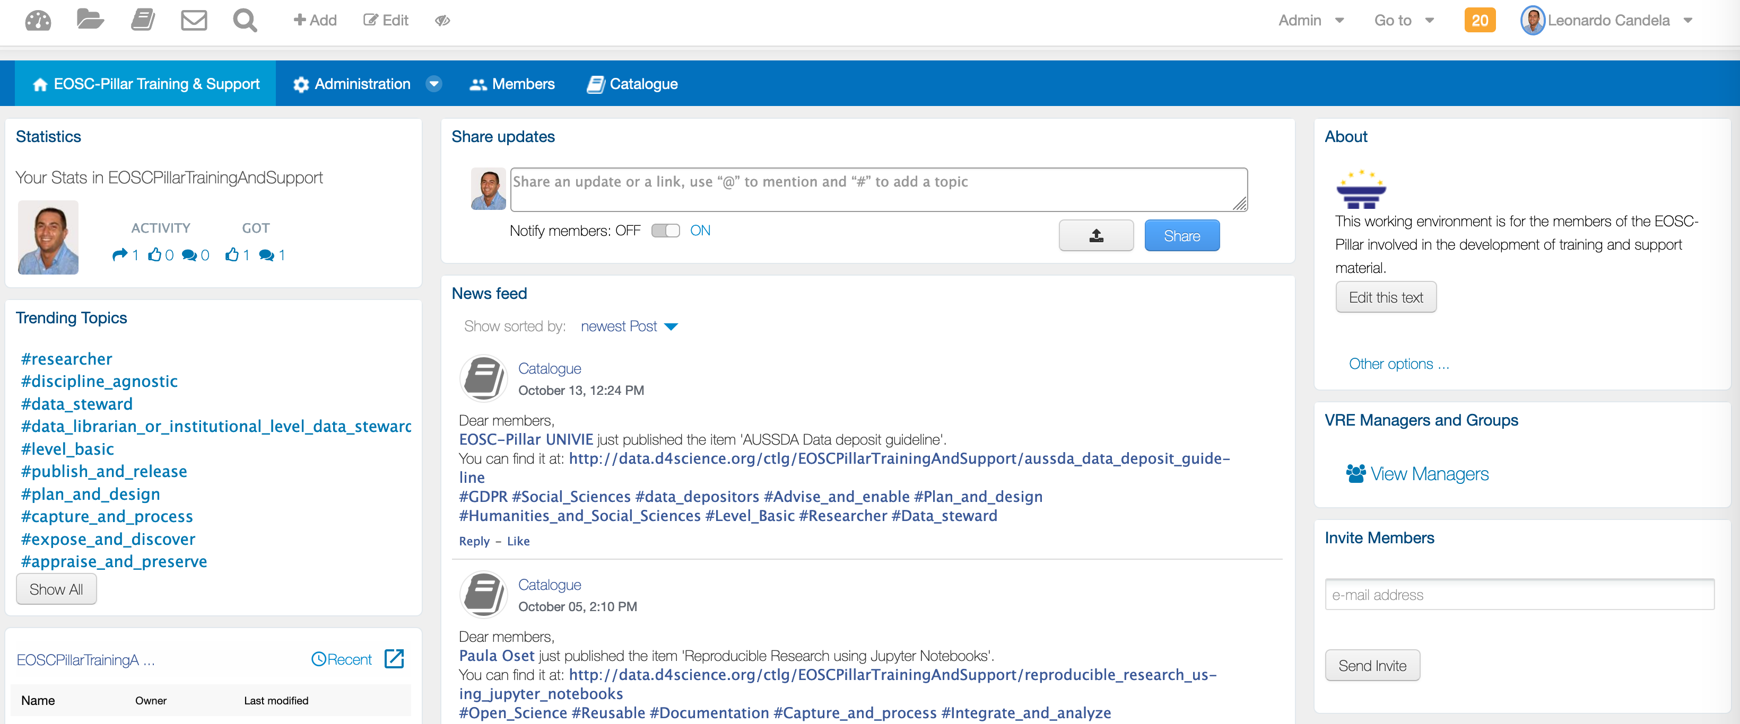
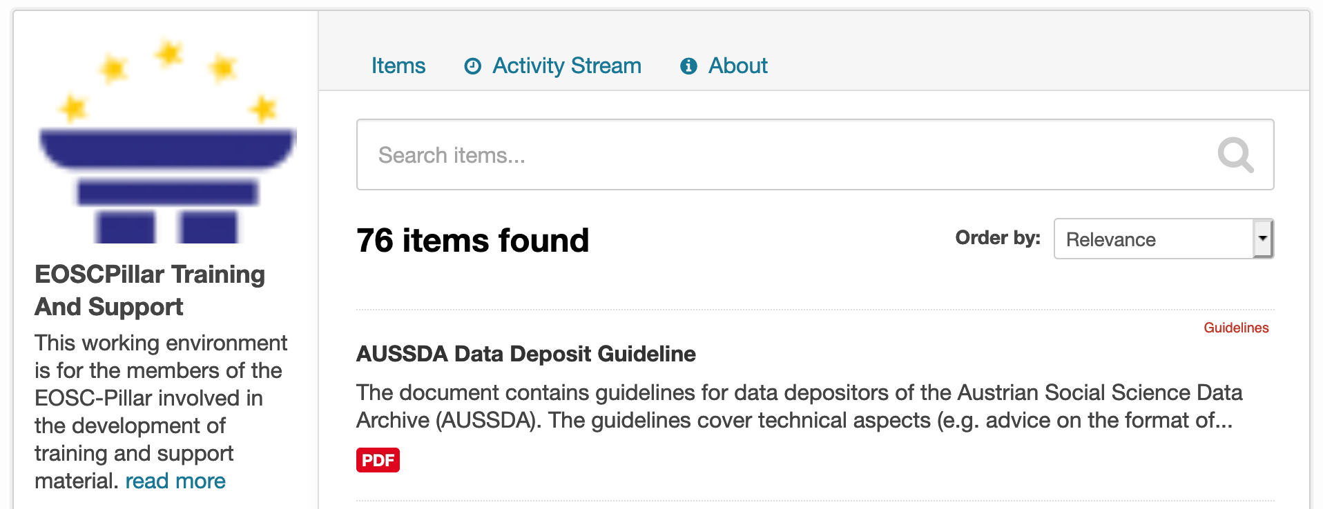
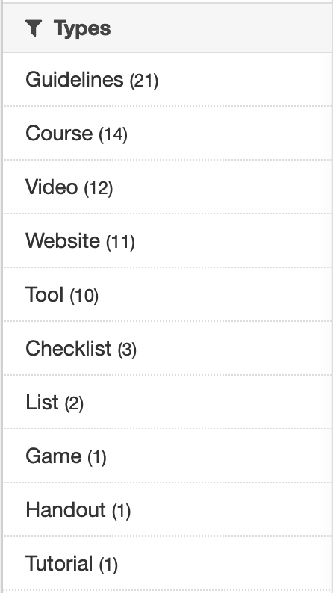
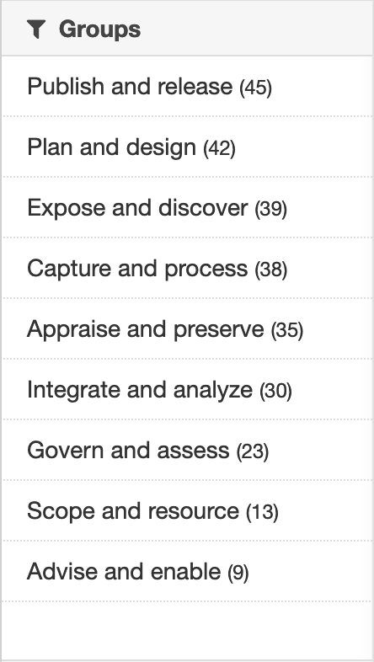
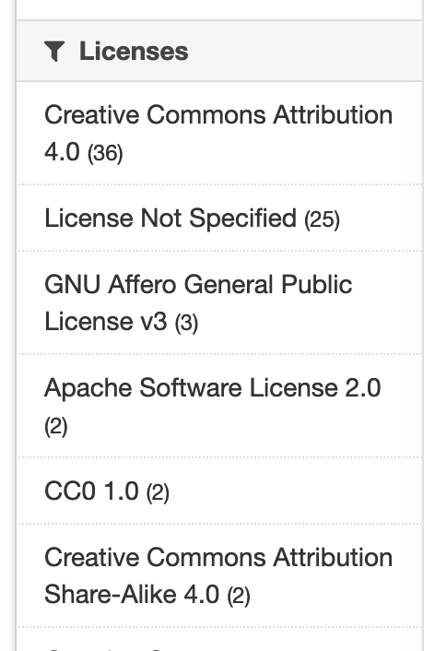
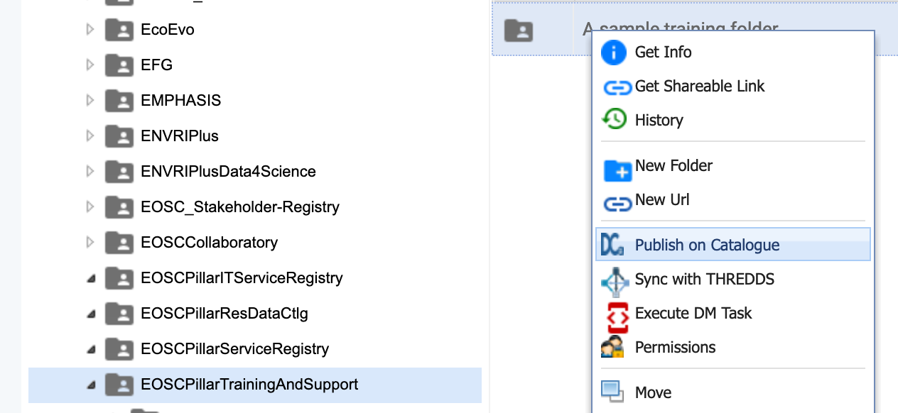
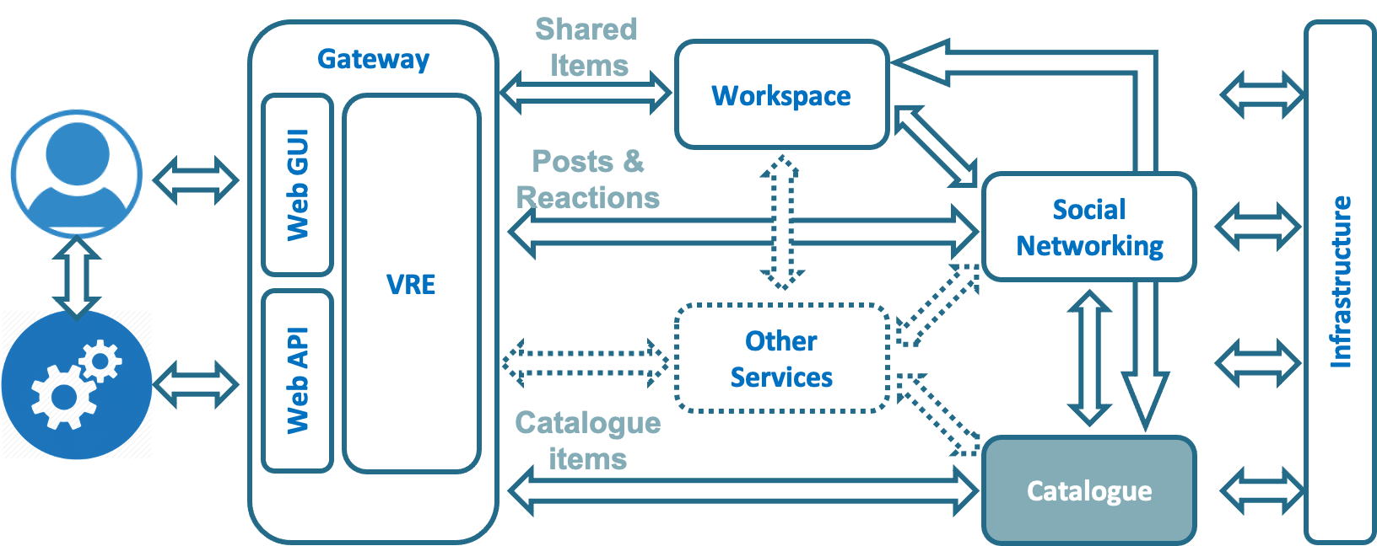
Introduce the service: D4Science VRE-Catalogue
Promoting collaboration and reuse
Notes:
A catalogue service (to search and browse items) embedded into a fully fledged and extensible working environment promoting collaboration and cooperation both during catalogue population and consumption

Slide 4
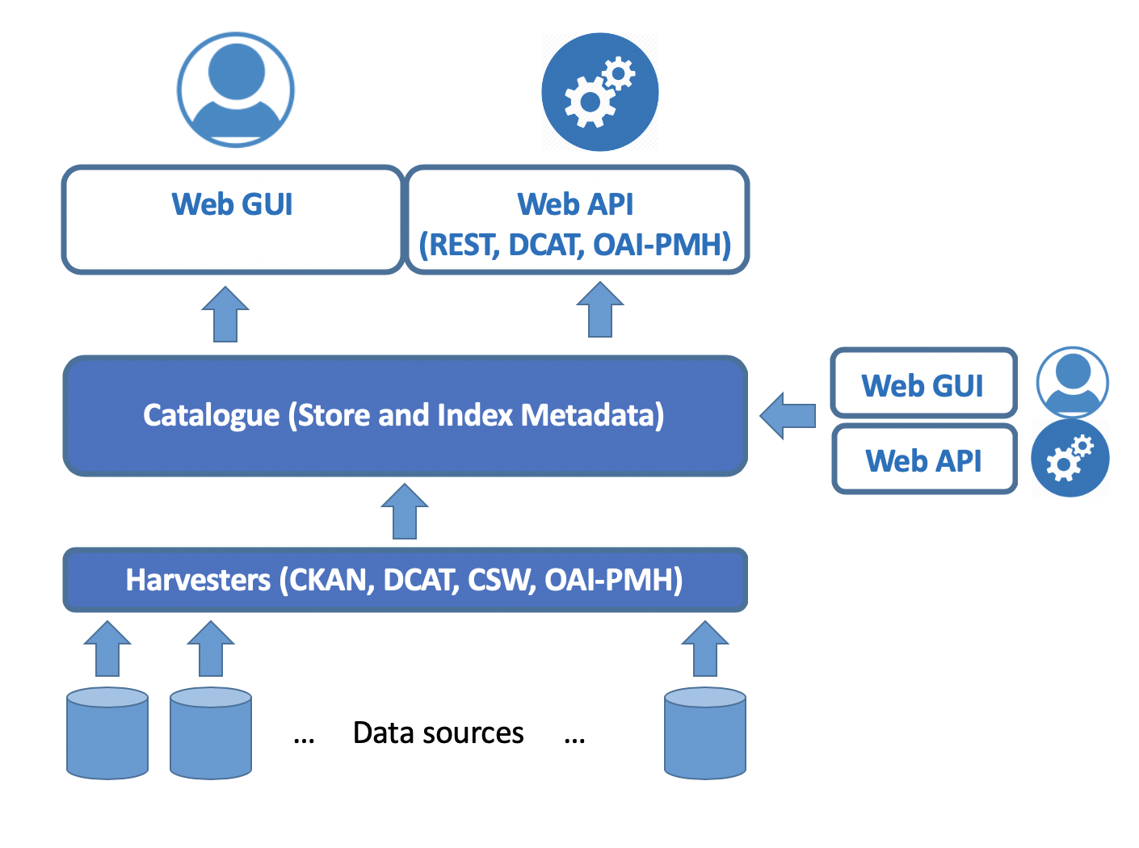
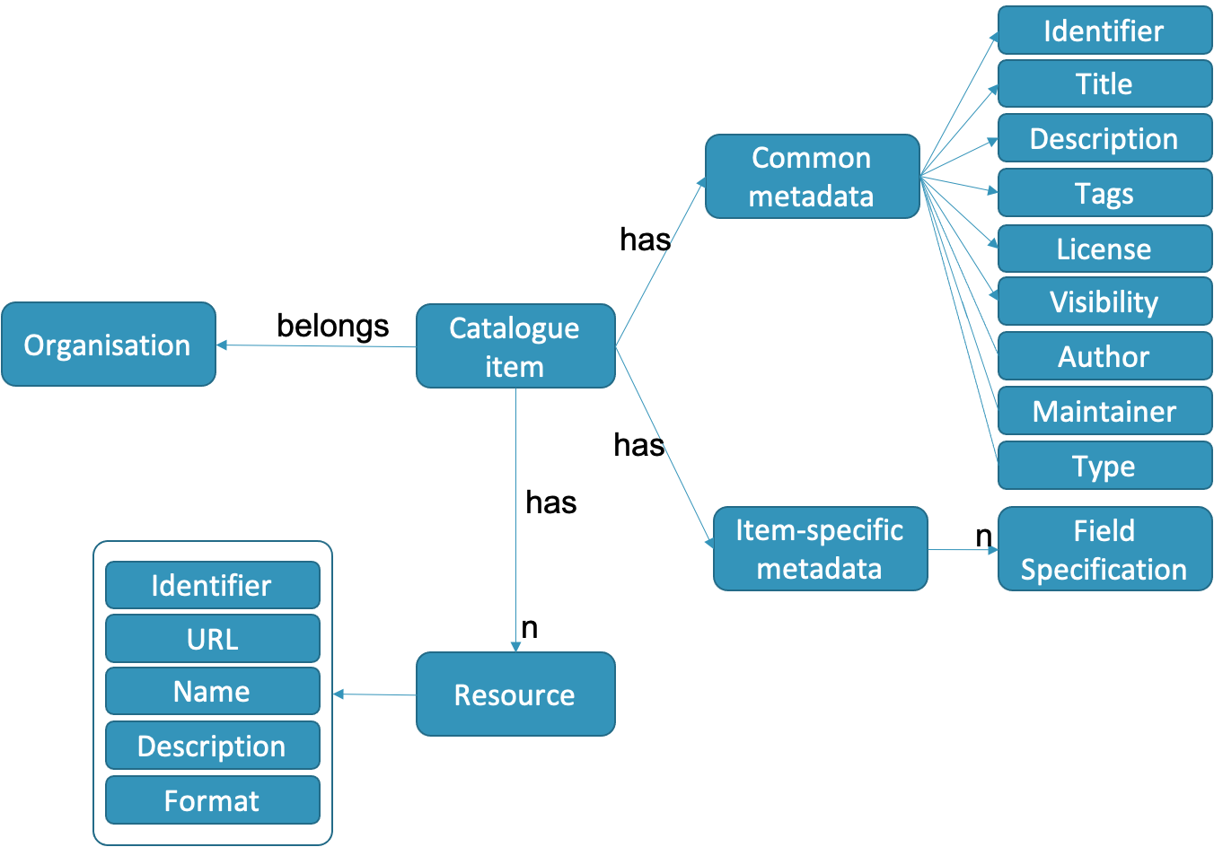
Introduce the service: D4Science VRE-Catalogue
Promoting collaboration and reuse
Catalogues are key services for many communities / scenarios
for services, datasets, training material, processes, workflows, records, …
… fully customizable data model
… enabling interoperability patterns
… providing usage indicators
… enabling several access patterns (open, restricted, moderated)

Slide 5
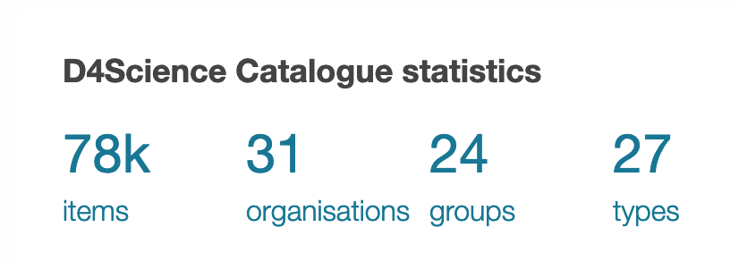
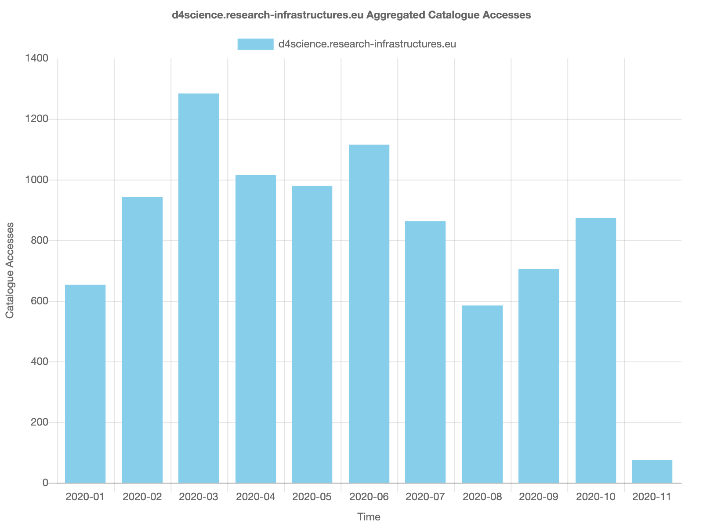
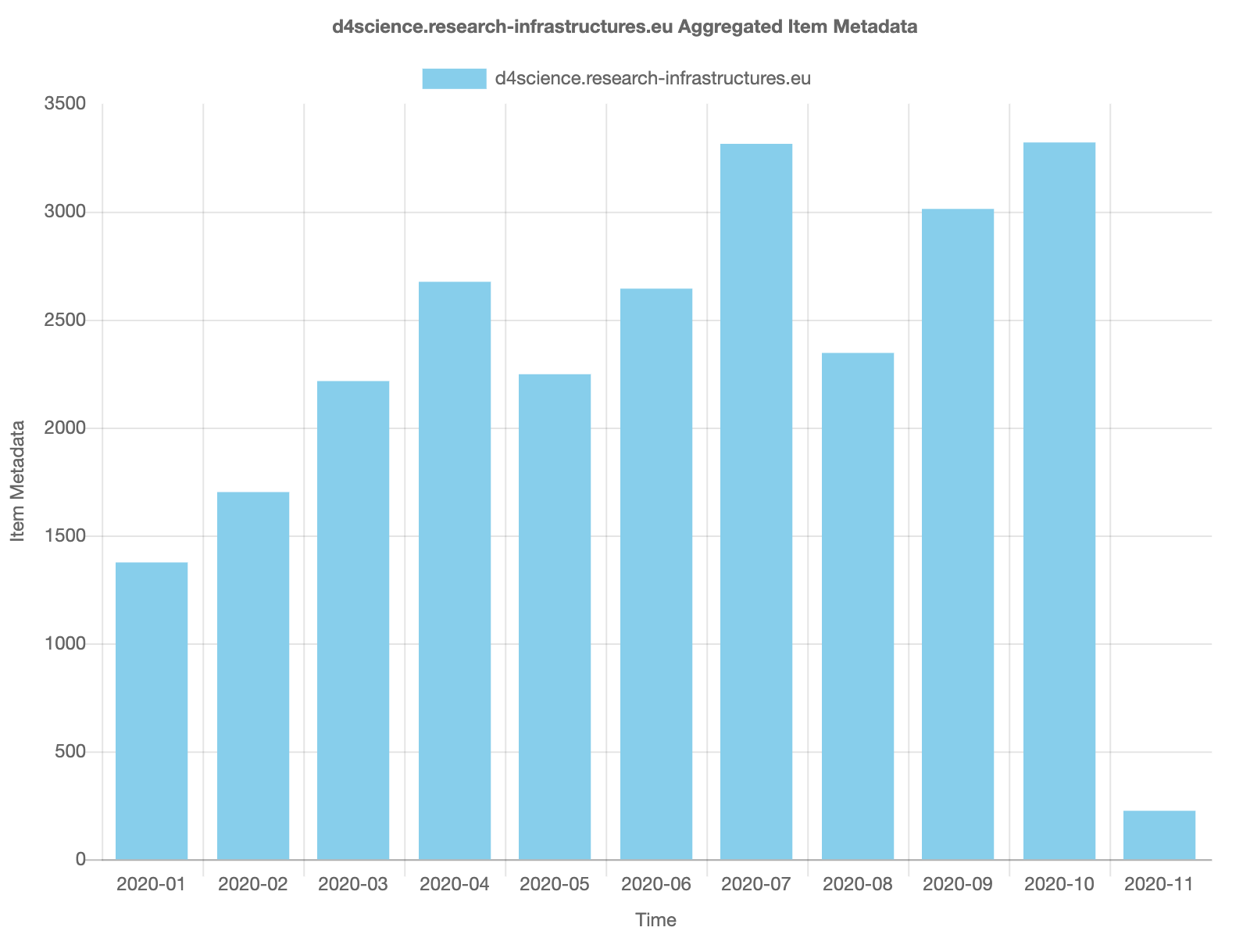
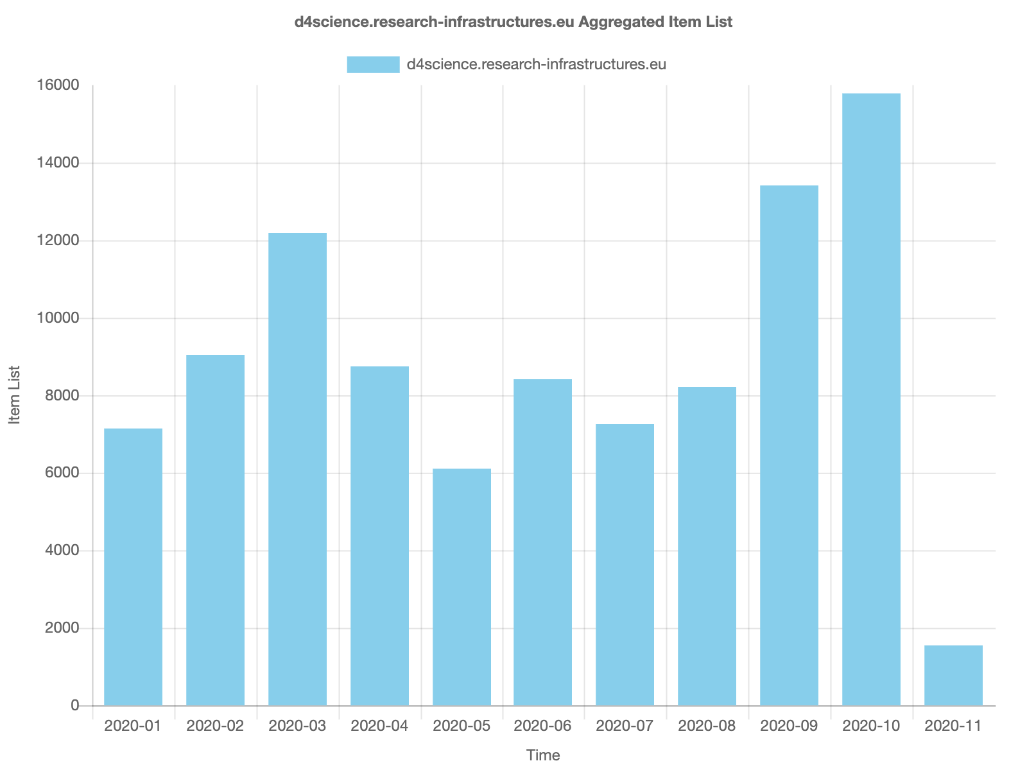
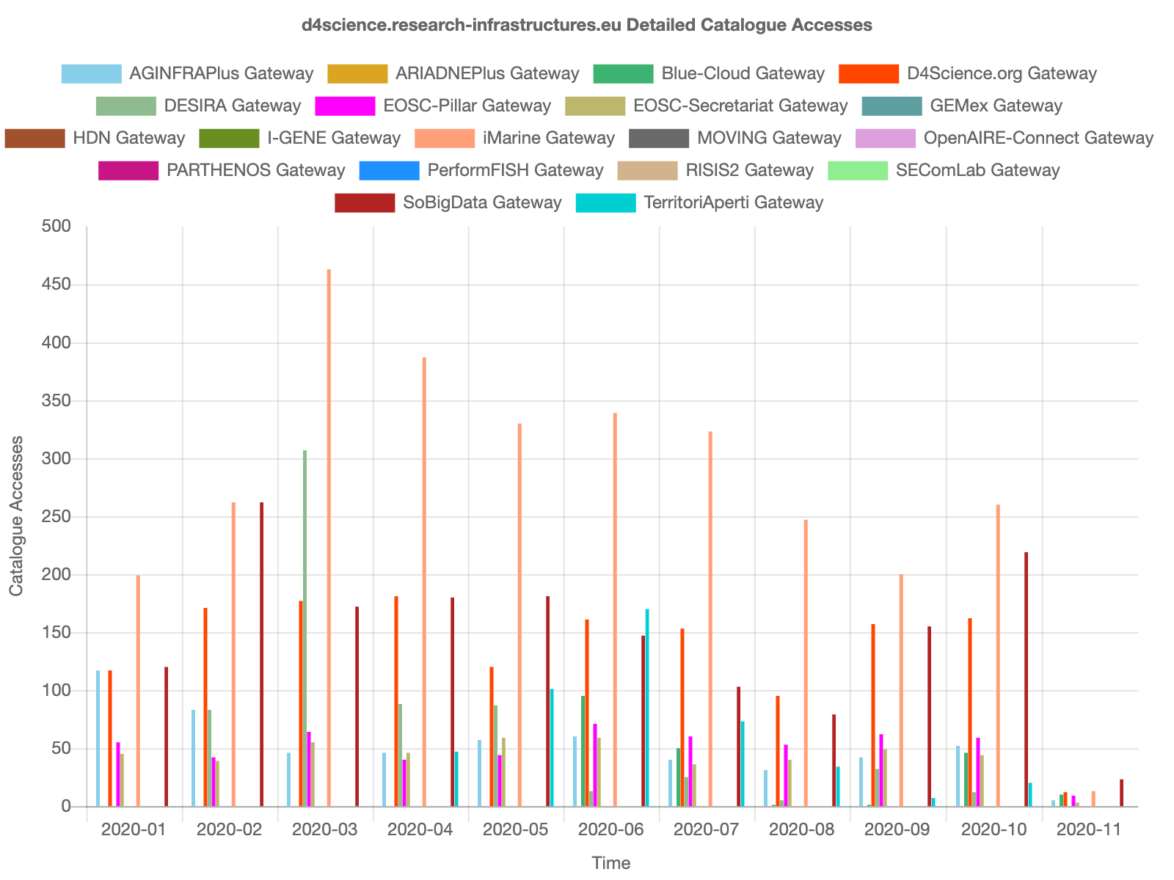
Introduce the service: D4Science VRE-Catalogue
Promoting collaboration and reuse
The service is fully operational in D4Science (TRL9)
16 instances currently operated

Slide 6
EGI integration plans
Planned integration with EGI services
AAI, Ordering, SMS, Compute resources, Data mgmt. system, etc.
Try to identify which EGI services you should/may integrate with your service (e.g. AAI).
Assign a different priority
High/Medium/Low (e.g. AAI – High priority)

Slide 7
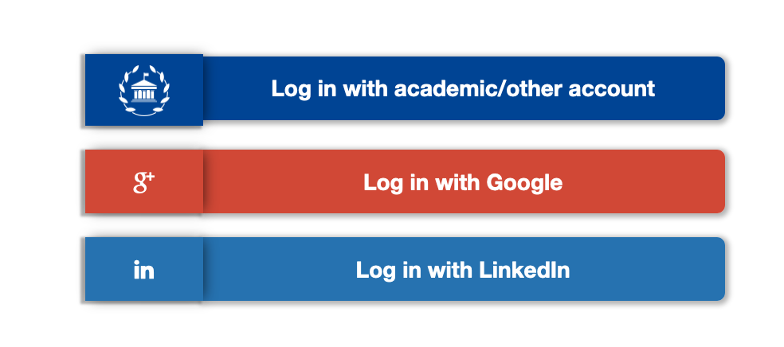
EGI integration plans
AAI: done
Ordering: possibly
SMS, Compute resources, Data mgmt. system, etc.: To be discussed

Slide 8
SDTP section: <section name>
Choose one of the following section from the EGI SDTP template (PDF attached to the e-mail)
Business case design
Service design
Service transition plan
Summarise in the slides the expected information following the structure of the SDTP section
Put any relevant question to be discussed during the workshop
We suggest to select the section where you think more support is needed

Slide 9
SDTP section: Service Transition Plan
Transition Plan
Specification, negotiation and agreement
The D4Science VRE-Catalogue is associated to one VRE at least. Each new instance of it requires at least the creation of a VRE in D4Science
Supporting projects
Many, too many to list here. See https://services.d4science.org/thematic-gateways

Slide 10
Open issues
Future plans
Issues to discuss/brainstorm about
Lessons learned (related to the initial EGI contact and the service in general)
Any other comment

Slide 11
Open issues
Open discussion
Clearly define the added value of the service once channelled via EGI (vs the D4Science delivery channel)
At least two resellers co-exist
What about EOSC and it’s marketplace ?
What about a Catalogue fed with some contents ?
What about consulting about catalogue exploitation ?

