Slide 1
EGI 101: introduction to EGI
EGI Conference
2/Nov/2020
Gergely Sipos
Head of Services, Solutions, Support
gergely.sipos@egi.eu

Slide 2
Topics to be covered
Who we are
What we do
Our services/technologies – With some examples
Where to hear more during the EGI Conference
Recommended session
Time

Slide 3
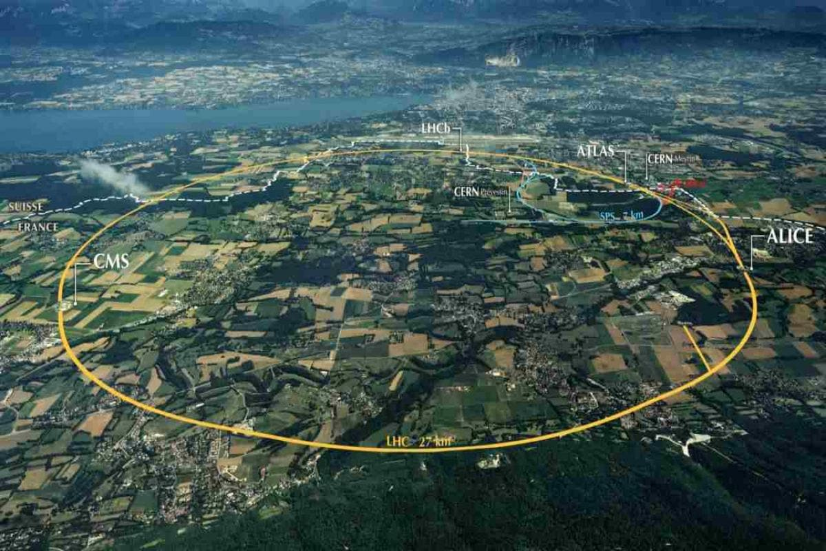
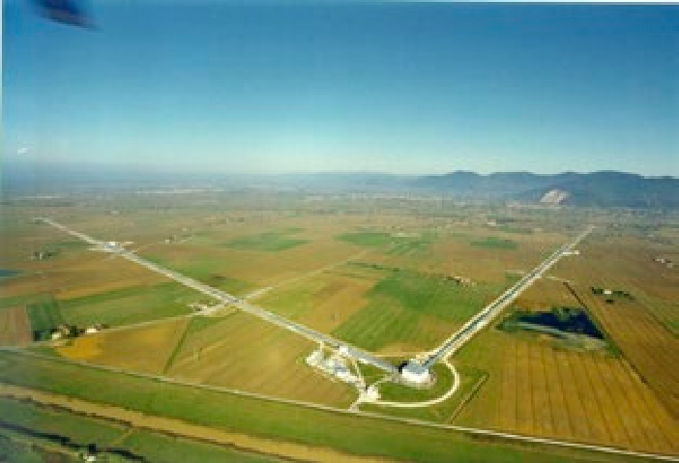
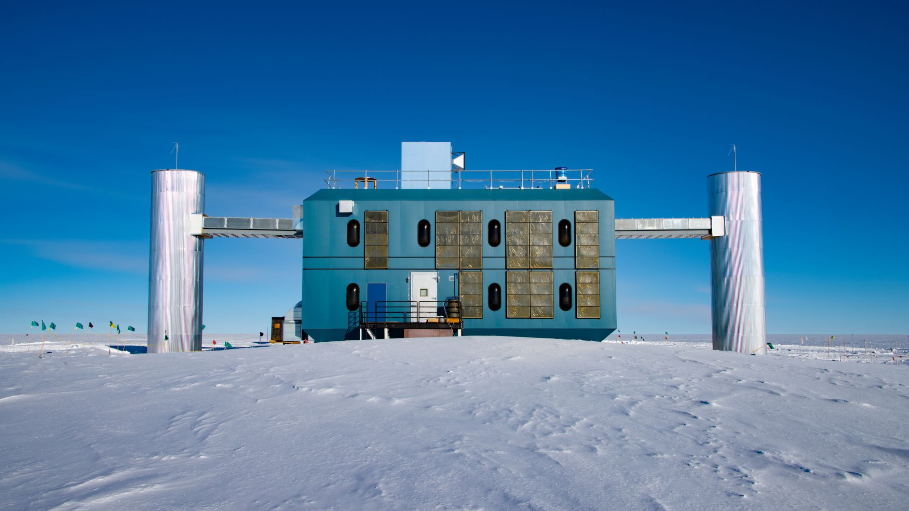
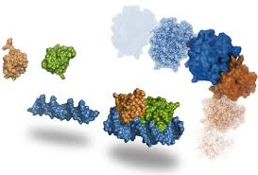
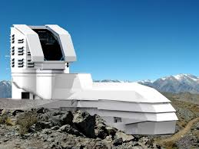
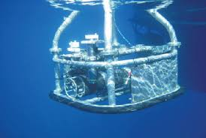
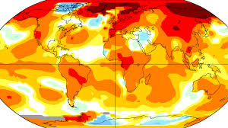
The EGI Federation is an international e-infrastructure that provides advanced computing and data analytics for research and innovation.
VIRGO
IceCube
WeNMR
2010
LSST
EMSO
ENES
…
250+
From the high-energy physics compute grid (WLCG)
To a multi-disciplinary, multi-technology infrastructure

Slide 4
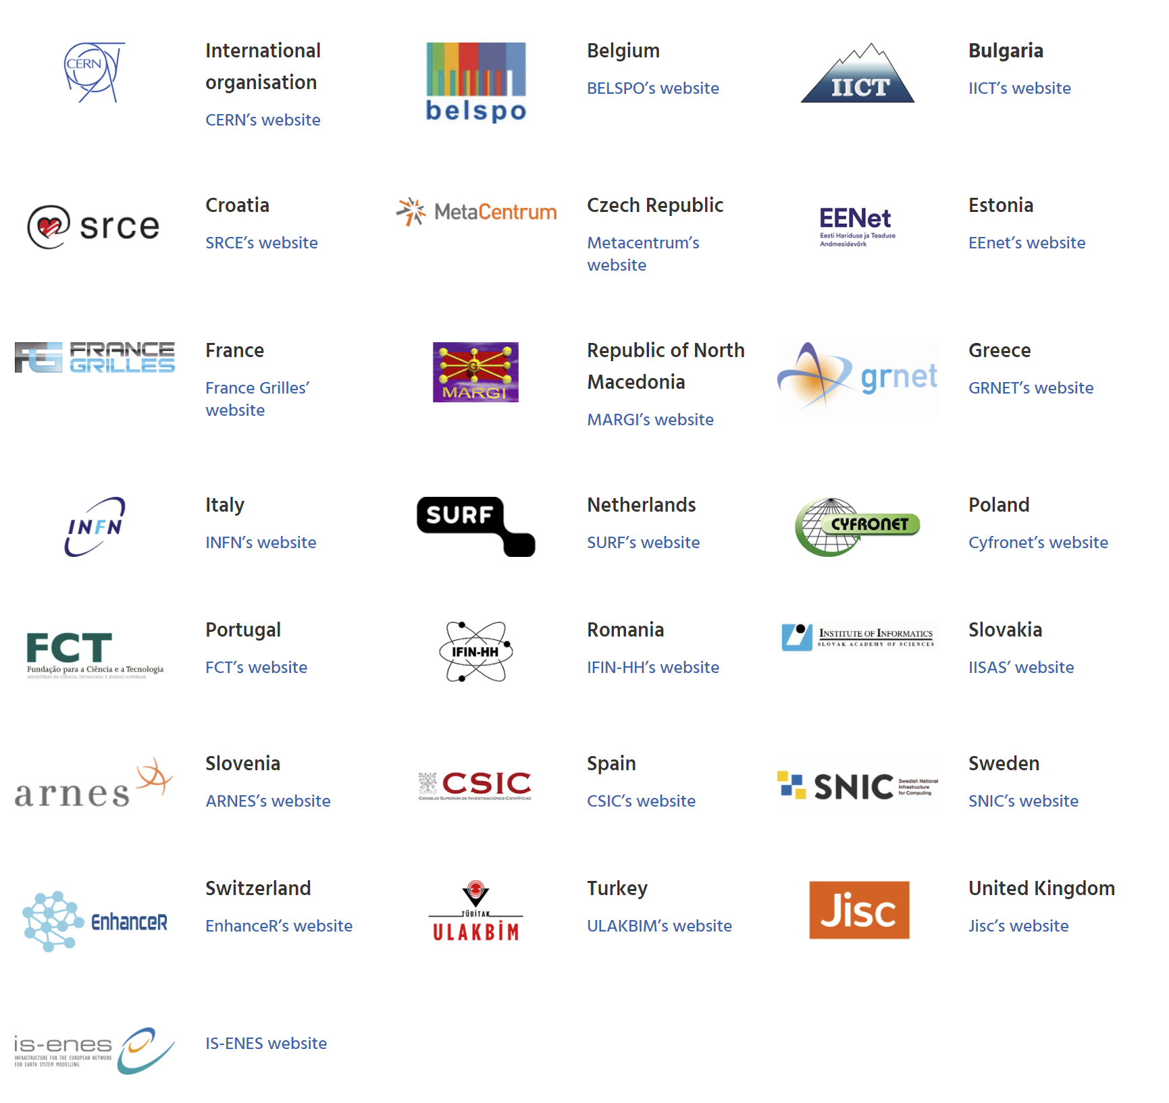
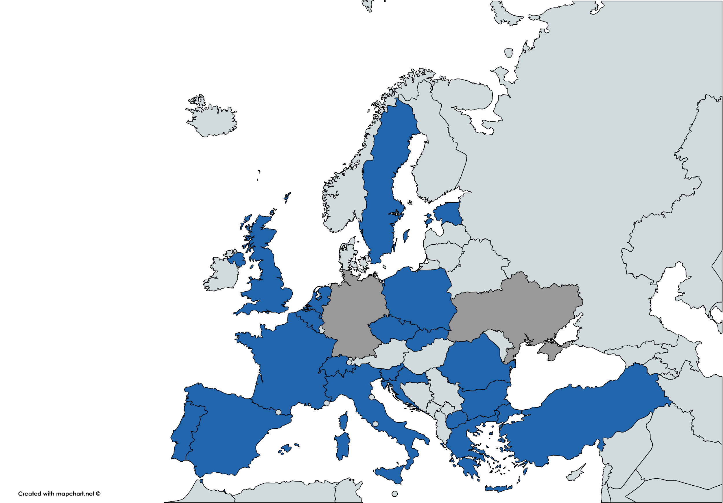
EGI Participants
https://www.egi.eu/about/egi-council/joining-the-egi-council/
22 countries + CERN + IS-ENES
Coordinated by the EGI Foundation
Collaboration agreement with Austria (Tech. University of Wien)
EGI Foundation
From 2021:
SZTAKI (Hungary)

Slide 5
EGI: Advanced computing for research
Mission
To deliver open solutions for advanced computing and data analytics in research and innovation, by coordinating and provisioning an international federated infrastructure from both the public and private sector in Europe. As an open initiative with a global outlook, the EGI Federation also connects service providers beyond Europe following the collaboration needs of the served communities.
Vision
The EGI Federation believes that all researchers should have seamless access to services, resources and expertise to collaborate and conduct world-class research and innovation.

Slide 6
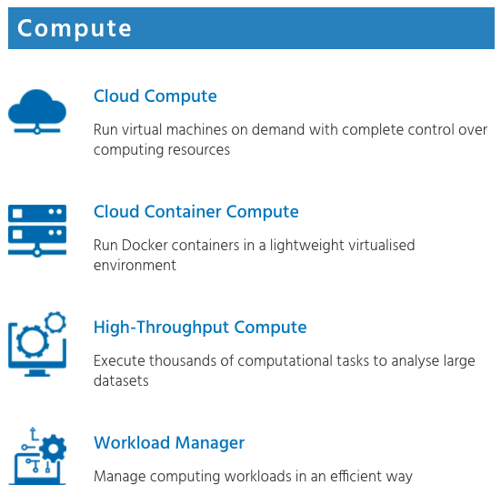
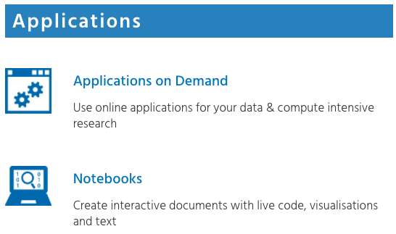
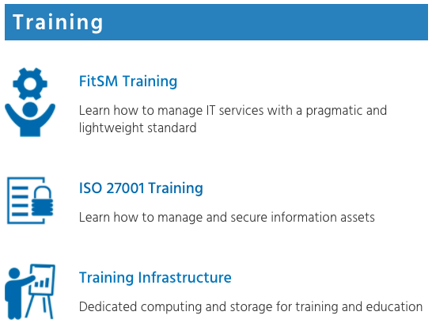
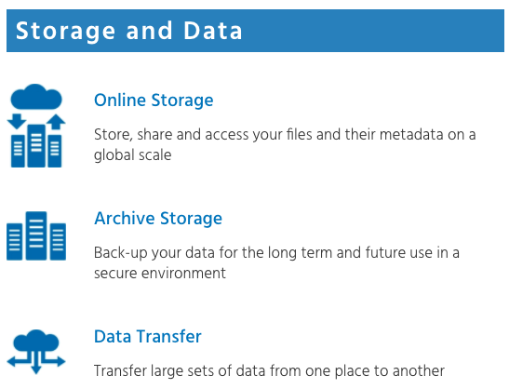
EGI Service Catalogue – Value proposition 1
https://www.egi.eu/services/
CHIPSTER, NAMD, ECAS
VMOps, EC3, FGSG
New: https://docs.egi.eu
4 x Overview and use cases
4 x Clinics
Mon Security; Tue Compute; Wed Storage&Data; Analytics

Slide 7
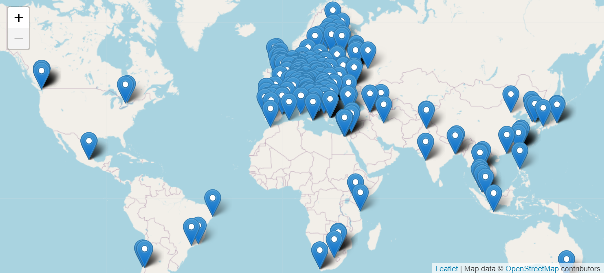
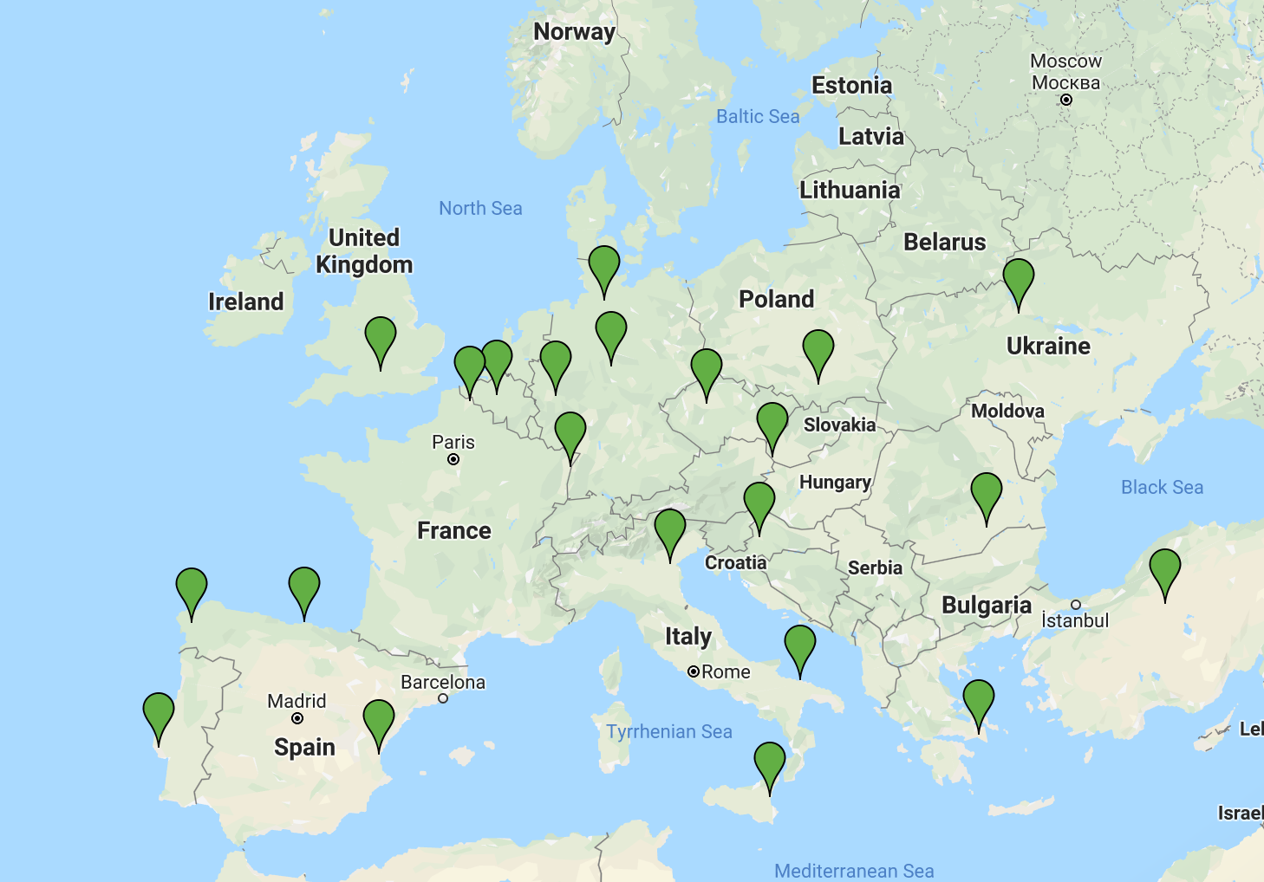
EGI HTC Federation & Cloud federation
>1 Million computing cores
> 900 PB disk & tape
HTC providers
2,915 service end-points
Cloud providers

Slide 8
International Partnerships
e-Infrastructure International Partnerships
Centre for Development of Advanced Computing (C-DAC, India)
Computer Network Information Center (CNIC, China)
Inst. of Mathematics and Computer Science (IMCS UL, Latvia)
GRENA (Georgia)
RENAM (Moldova)
Shanghai Technology Development Co. (SSTIR, China)
GEANT Association
Compute Canada
Open Science Grid (USA)
The Latin American Centre for Physics (CLAF)
Inst. of High Energy Physics (IHEP, China)
Academia Sinica Grid Computing Centre (ASGC)
CSIR Meraka Institute (South Africa)
EGI Federation partnerships with research communities, industry and infrastructure providers
Monday 11:15

Slide 9
Access policies
Wide access
Users can freely access scientific data and digital services provided by EGI resource providers
Policy-based
Users are granted access based on policies defined by the EGI resource providers or by the EGI Foundation
Market-driven
Users can negotiate a fee to access services either directly with EGI resource providers or indirectly with the EGI Foundation
For example:
EGI Cloud for application piloting
EGI Notebooks open instance
Science discipline-specific HTC pools
Chipster NGS toolkit (App. on demand)
For example:
Biomed HTC pool for life sciences
INFN-Bari (IT) provides Cloud for the National Bioinformatics Infrastructure of Sweden
EGI Foundation negotiates services for projects
For example:
FitSM training
4 EGI Cloud providers deliver to Exprivia (ESA Data and Information Access Services)

Slide 10
Who do we serve
Size of individual groups
WLCG
ELI
CTA
CLARIN
EISCAT_3D
LIGO
LOFAR
ELIXIR
INSTRUCT
DARIAH
LifeWatch
EPOS
EMSO
eLTER
…
WeNMR
LSGC
BioExcel
NextGEOSS
SoBigData
PolicyCloud
TRIPLE
AgINFRA
OpenRiskNet
OpenDreamKit
DRIHM
VERCE
PhenoMeNal
Multiscale Genomics
…
100% IT
Exprivia
CFD Support
CloudEO
CloudSME
Ecohydros
EOproc
IBM Research
mITSM
Numeca
Peachnote
RHEA
SixSq
Terradue
UberCloud
…
PeachNote
CEBA Galaxy eLab
Semiconductor design
Main-belt comets
Quantum pysics studies
Virtual imaging (LS)
Bovine tuberculosis spread
Convergent evol. in genomes
Geography evolution
Seafloor seismic waves
3D liver maps with MRI
Metabolic rate modelling
Genome alignment
Tapeworms infection on fish
…
Research infrastructures
Multinational communities (often H2020 projects)
Industry, SMEs
‘Long tail of science’

Slide 11
Allocating capacity for user communities
Negotiate access to resources
Taking into consideration user requirements (type, number, size, cost, availability, ++)
Type, number, size, cost, availability, etc.
Applic. provider
Instance requirements
Conditions
Storage provider
Cloud provider
Negotiator
HTC provider
Project/Community representative
Service Level Agreement
Operation Level Agreement
Training
Support
Regular satisfaction interviews
Regular service delivery reports
Ensure that customer is happy
Ensuring that agreed targets are met
Notes:
Motivations of providers – National mission vs. pay for use
Regular satisfaction interviews

Slide 12
Support to the Photon & Neutron Research Infrastructures – PaNOSC cluster project
EGI provides:
A Notebooks instance with EGI Cloud resources
Connected to community-specific storage with DataHub
Login
ESRF (France)
ILL (France)
ESS (Sweden)
ELI-DC (Belgium)
XFEL (Germany)
CERIC-ERIC (Italy)
Notebooks
Read datasets
DataHub
Write analysis results
Alpha
Cloud
Achieving a Photon and Neutron community federated cloud in EOSC Monday 13:15
Notes:
Giuseppe to update

Slide 13
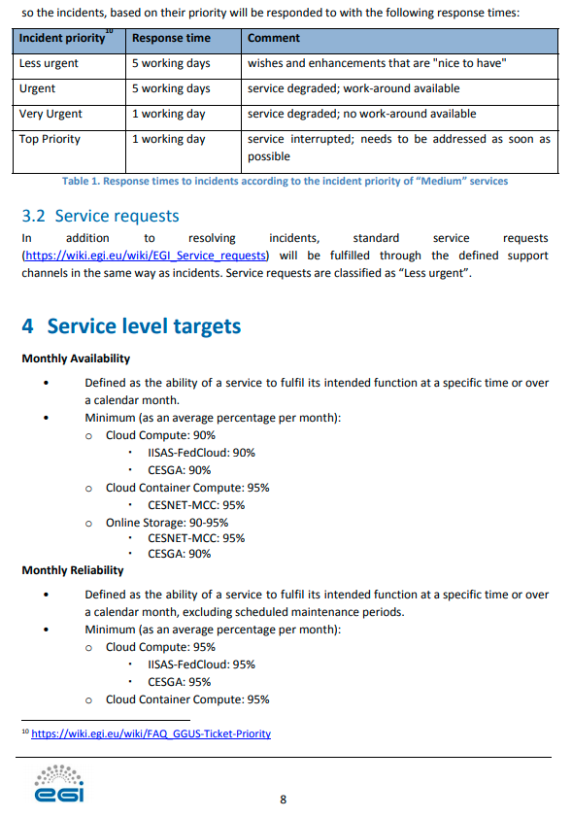
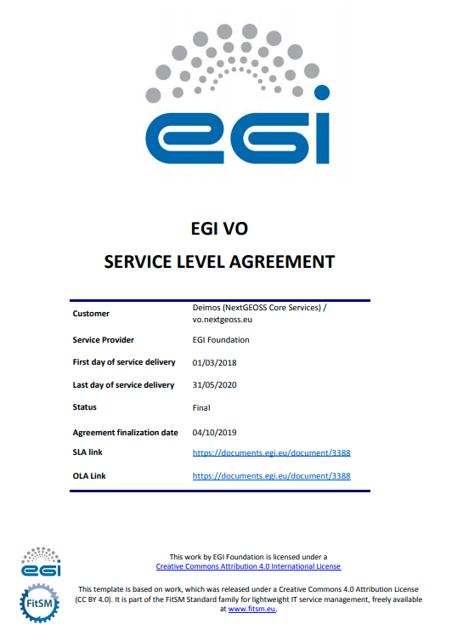
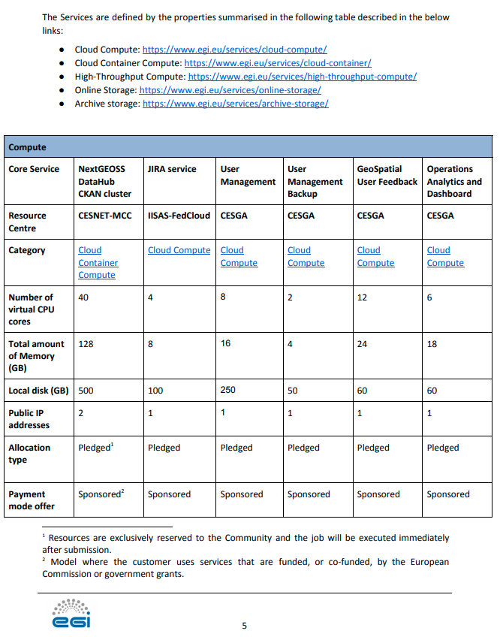
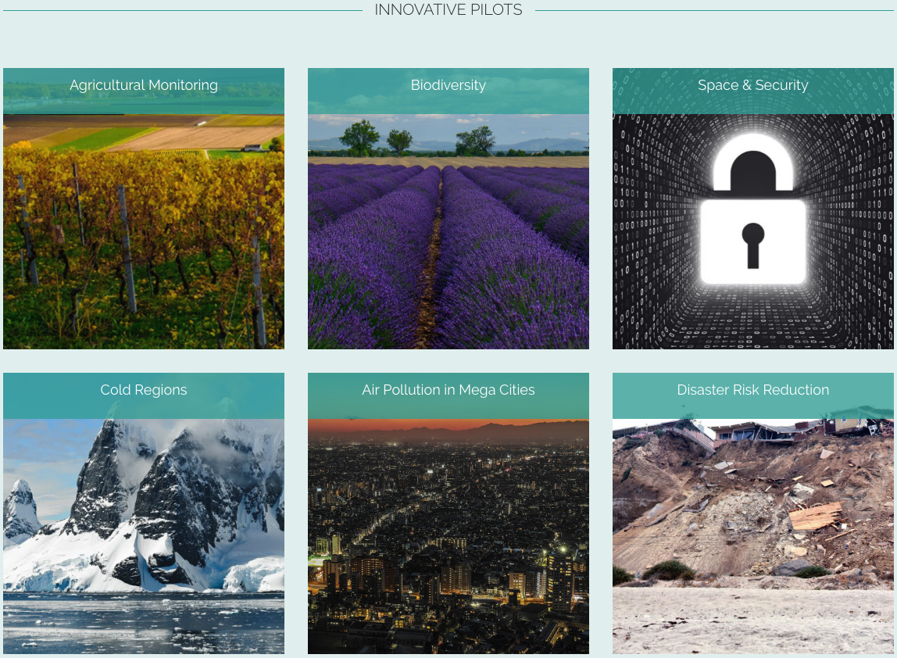
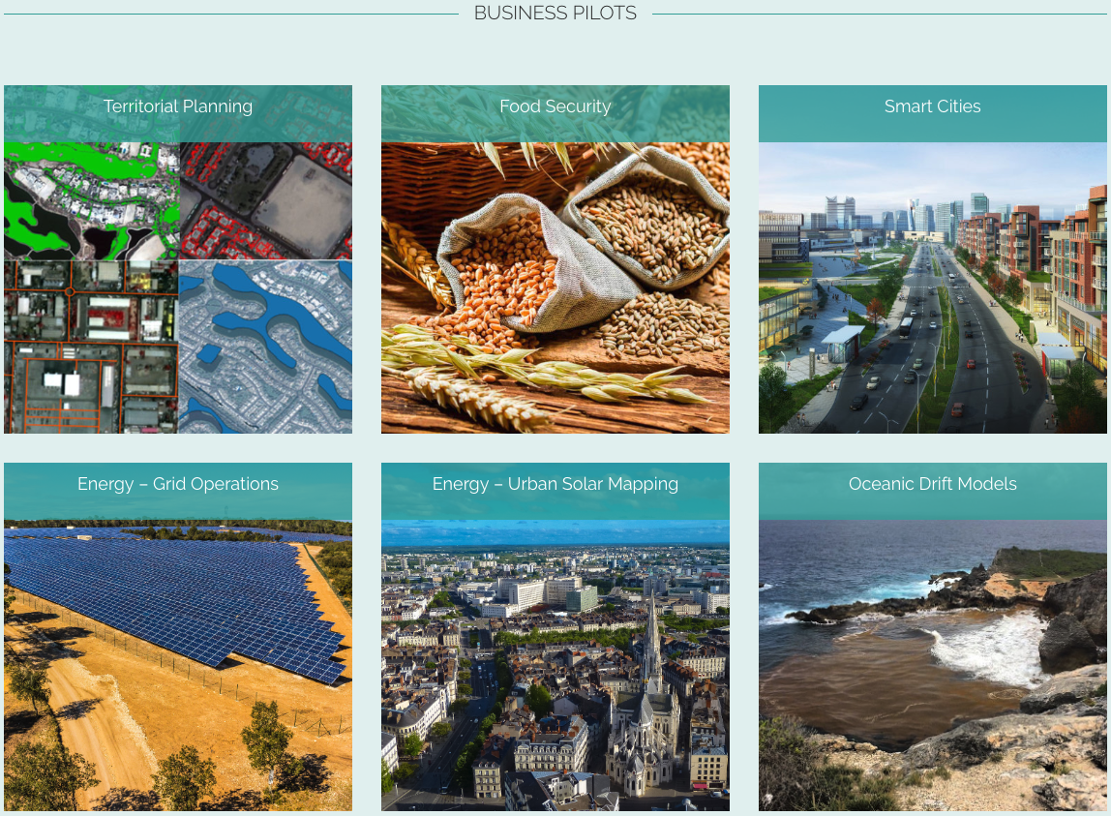
An SLA example
https://documents.egi.eu/document/3388
A centralised European Earth observation data hub and platform.
Project Core services
Innovative & Business Pilots
Earth Observation data, cloud services and analytics tools for climate and environment protection Wednesday 9:45

Slide 14
Services that are open for anyone: Example EGI Notebooks
https://notebooks.egi.eu
User guide
Open for anyone
Login with EduGAIN, Google, Facebook, LinkedIn…
1 CPU, 1GB RAM and 10GB of storage
Persistence (don’t loose work after logout)
Often used as test environment by communities
Stepping stone to dedicated setup with custom SLA
Login
Demos 6: Reproducible Open Data analysis with Binder and DataHub Tuesday 15:00

Slide 15
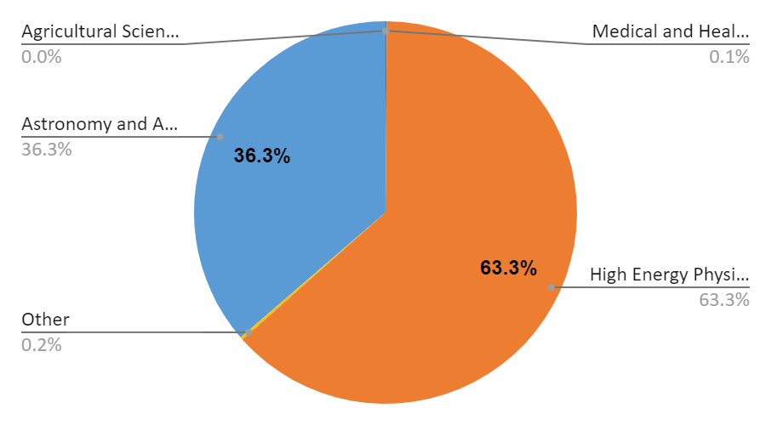
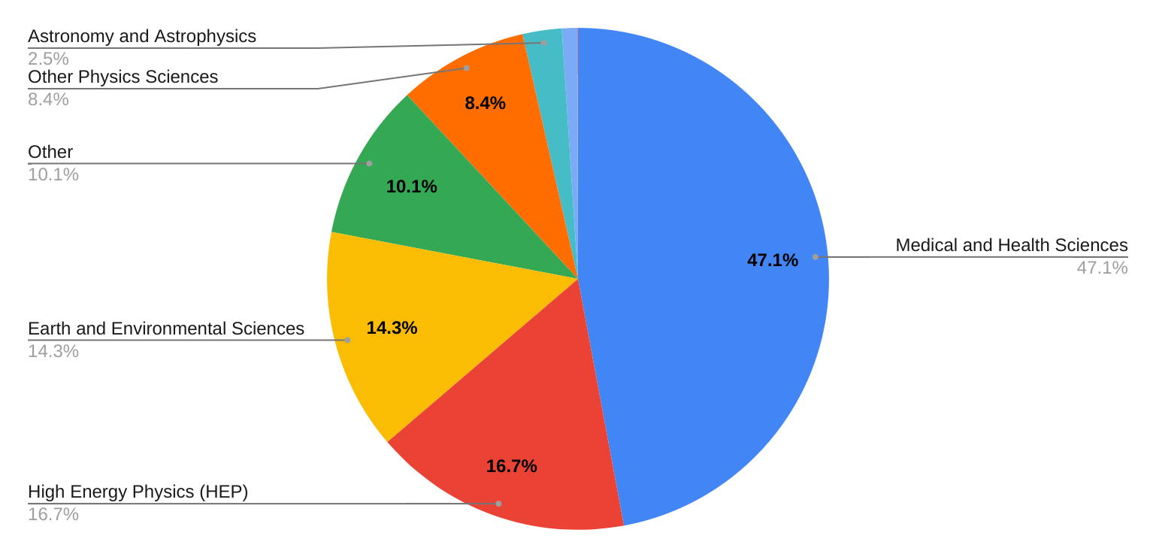
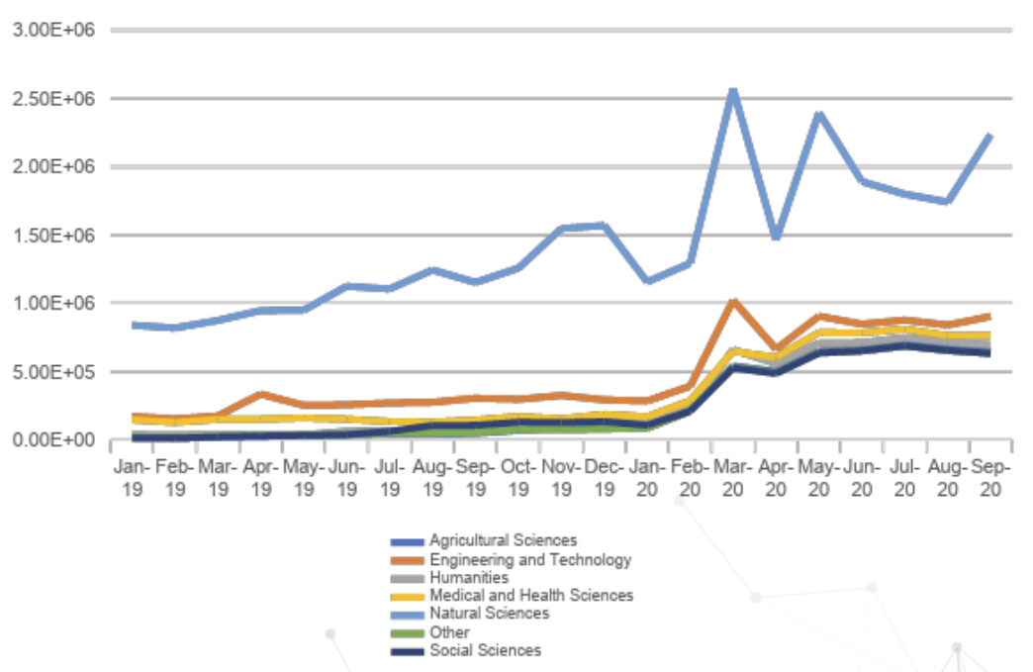
EGI users, CPU usage
HTC: 13 billon CPUh in 2020
71,000 users
Cloud: 18 million CPUh in 2020

Slide 16
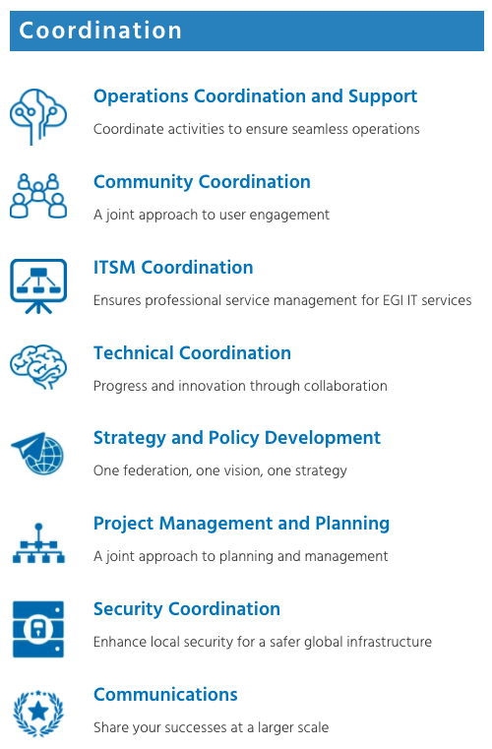
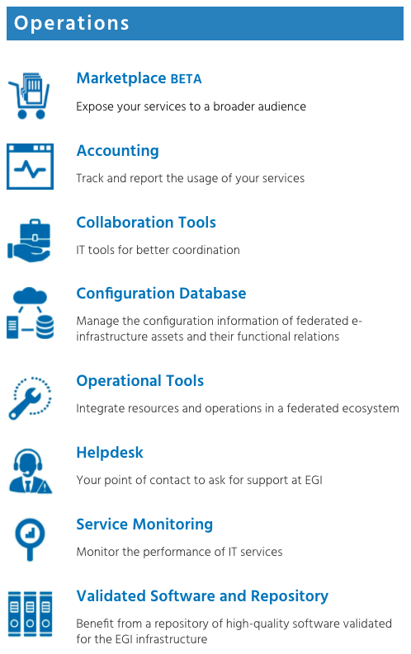
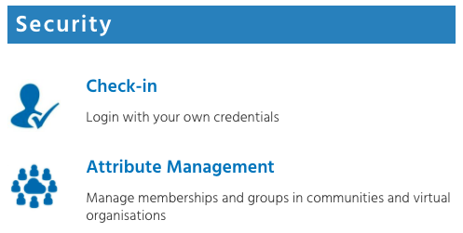
EGI Internal Service Catalogue – Value proposition 2
https://www.egi.eu/internal-services/
Offered by the EGI Foundation for the members of the federation
EGI Core Services Roadmap pt 1 & 2 Tuesday 13:15-16:45

Slide 17
Distributed scientific computing enables scientific discoveries…
1700 open access publications / year
LHC Collaboration
LIGO-VIRGO Collaboration
https://www.egi.eu/use-cases/

Slide 18
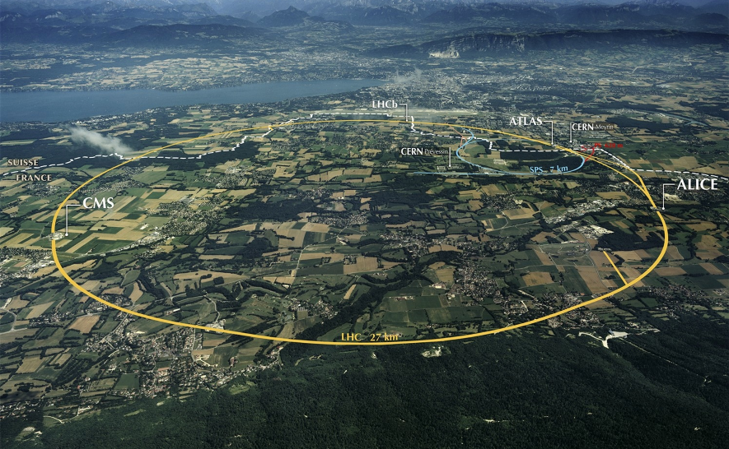
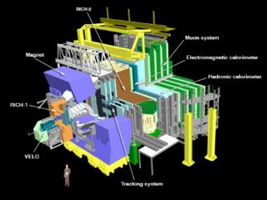
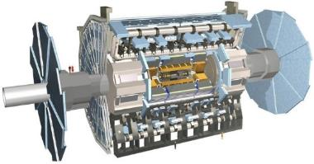
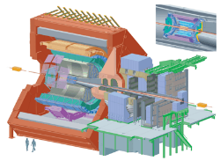
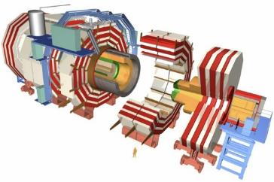
The Large Hadron Collider (LHC)
>1 GB/s
~700 MB/s
A new frontier in Energy & Data volumes:
LHC experiments generate 50 PB/year
~10 GB/s
>1 GB/s
Notes:
Largest scientific apparatus ever build
27km around
2 general purpose detectors: Huge microscopes – to explore the very small – using a long lever arm
2 specialized detectors

Slide 19
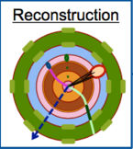
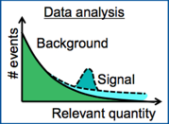
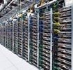
LHC data analysis and EGI support
Based on LHC slide from Ian.Bird@cern.ch
The process to transform raw data into useful physics datasets
This is a complicated series of steps
Requiring a distributed and well-managed IT infrastructure
EGI collaboration with WLCG
High Throughput Computing and paradigms, originally developed for LHC now delivered via EGI to multiple communities
Service delivery between EGI and WLCG (Helpdesk, Accounting, Information system, Security coord., Data transfer)
Interactions at multiple projects (INDICO, XDC, EOSC-hub, ESCAPE,…)
MoU between EGI and WLCG
And more! (such as Grid Deployment Board)
After HardwareTrigger (TB/s)
From Detector (1PB/s)
Analysis Selection
(100MB/s)
Data
Volume
Derived Data (2 GB/s)
Derived Data (2 GB/s)
Selected RAW (1 GB/s)
20k
cores
Processing and people
HLT
Reconstruction
Reprocessing
Organized Analysis
Final Selection
40k
cores
30k
cores
DAQ and Trigger (less than 200)
Operations
(less than100)
Analysis Users
(lMore than 1000)
Operations
(less than 100)
60k cores
Analysis Users
(More than 1000)
19

Slide 20
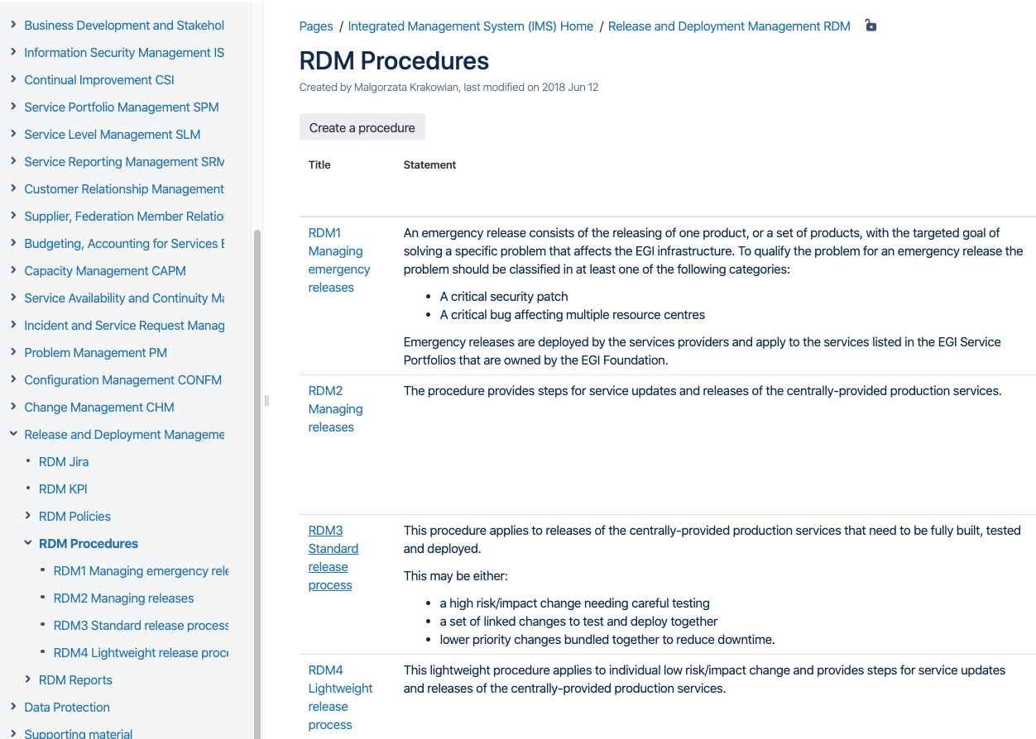
IT Service Management
Example – Release and Deployment Management:
PR13.1 A release policy shall be defined.
PR13.2 The deployment of new or changed services and service components to the live environment shall be planned with all relevant parties including affected customers.
PR13.3 Releases shall be built and tested prior to being deployed.
PR13.4 Acceptance criteria for each release shall be agreed with the customers and any other relevant parties. Before deployment the release shall be verified against the agreed acceptance criteria and approved.
PR13.5 Deployment preparation shall consider steps to be taken in case of unsuccessful deployment to reduce the impact on services and customers.
PR13.6 Releases shall be evaluated for success or failure.
Aiming at user-driven and professional service delivery
IT service management
Focuses on the provision of high quality IT services
Defines, documents and maintains service management processes
ITIL, ISO20k, COBIT, …
EGI Service Management is Based on the open FitSM standard
85 requirements that should be fulfilled by an organisation (or federation)
16 general requirements; 69 process-specific requirements
14 processes
FitSM training
Thu PM; Fri AM
Service portfolio management
Service level management
Incident management
Change management
Capacity management
Information security management
…
https://www.fitsm.eu

Slide 21
EGI and the European Open Science Cloud
“… a virtual environment with free at the point of use, open and seamless services for storage, management, analysis and re-use of research data, across borders and scientific disciplines”
2016 Communication on the “European Cloud Initiative
EOSC phase 1: Until end of 2020
EGI operates several core elements of EOSC – Portal; Helpdesk
EGI participates in the design and operation of CRM; Service onboarding; …
EGI contributes to the EOSC service portfolio.
EGI Cloud is the most demanded service in EOSC so far
…
EOSC phase 2: From 2021 – EOSC Association
EGI will provide the EOSC Compute infrastructure (EGI-ACE project)
EGI continues to operate the Portal and various operational tools and processes
Closing plenary
Wednesday 16:45

Slide 22
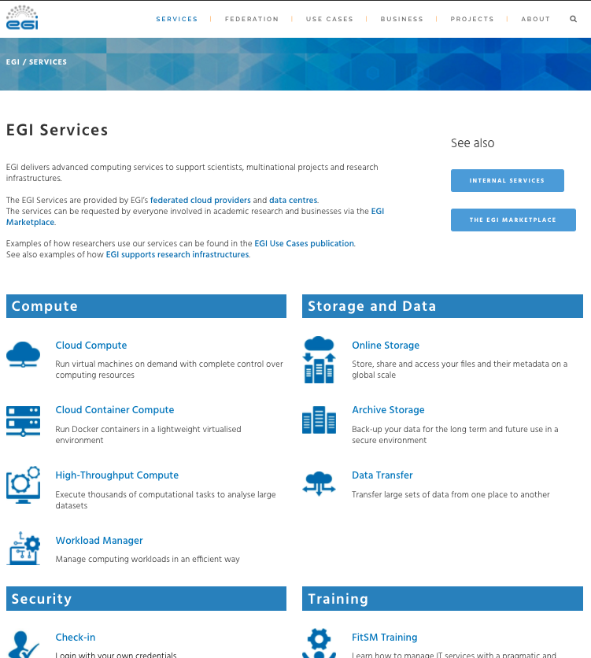
Learn more about EGI
Access/order EGI services:
https://www.egi.eu/services/
support@egi.eu
https://www.egi.eu/about/publications/

