Slide 1
SoBigData++ Data Science, Multidisciplinary & AI
SoBigData
SoBigData
www.sobigdata.eu
www.sobigdata.eu
Luca Pappalardo
ISTI-CNR

Slide 2
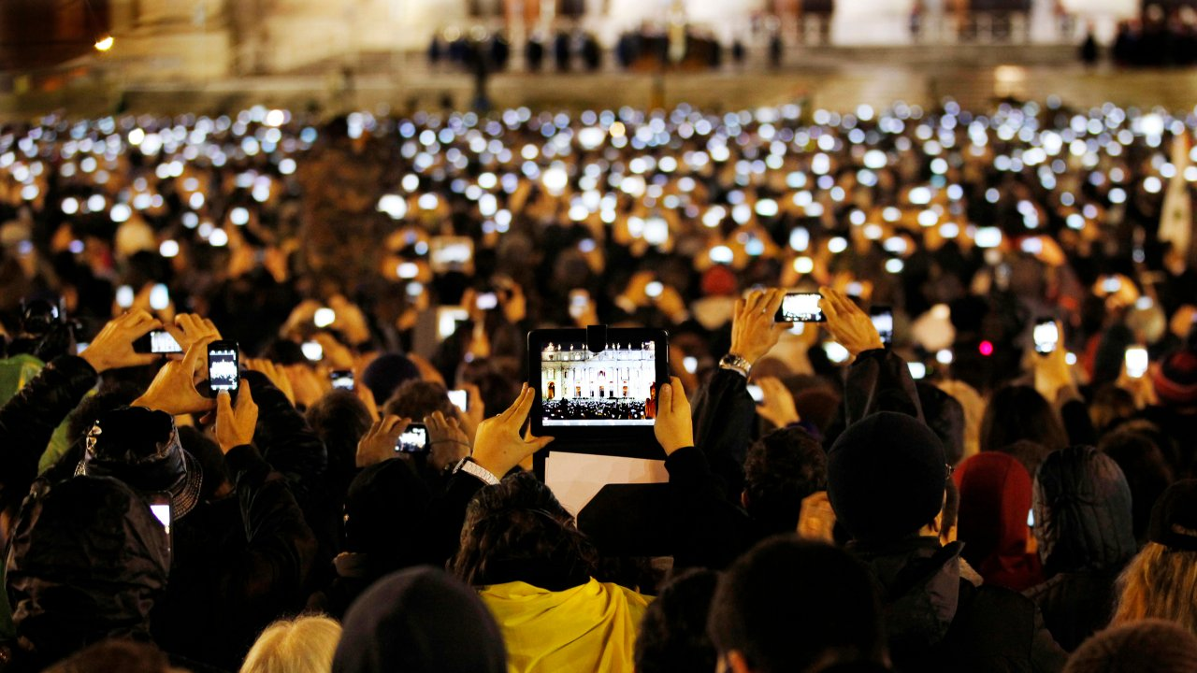
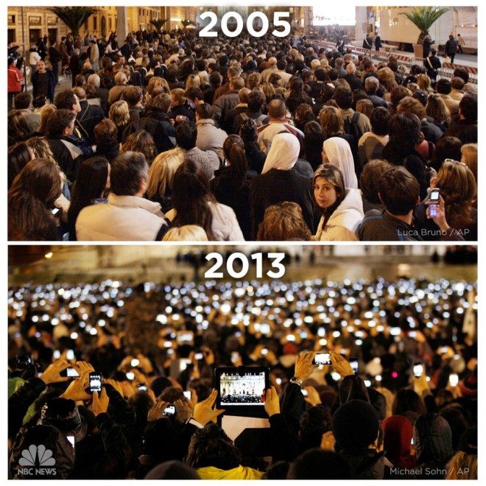

Slide 3
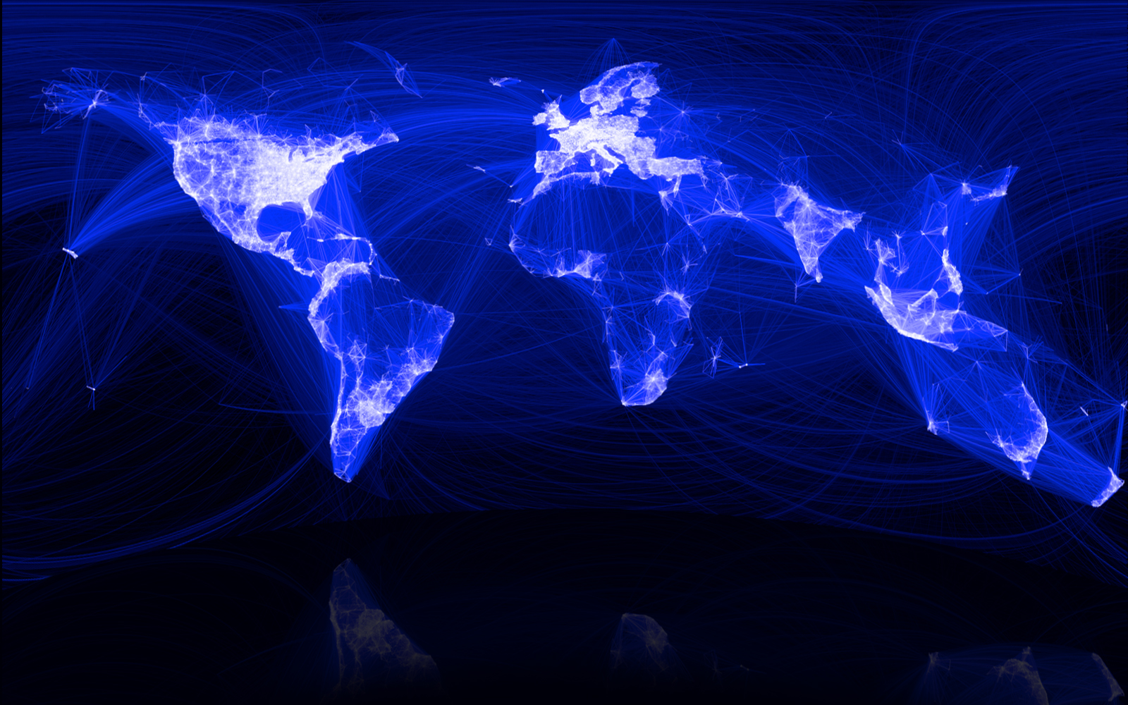
sociallinks

Slide 4
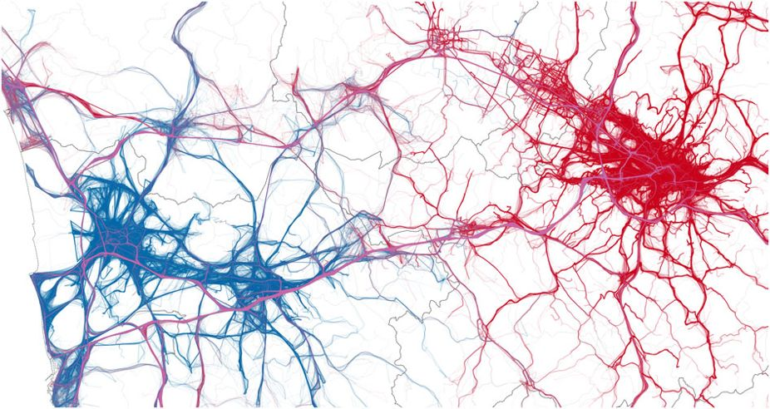
cartravels

Slide 5
opinions&emotions
shoppingpatterns

Slide 6
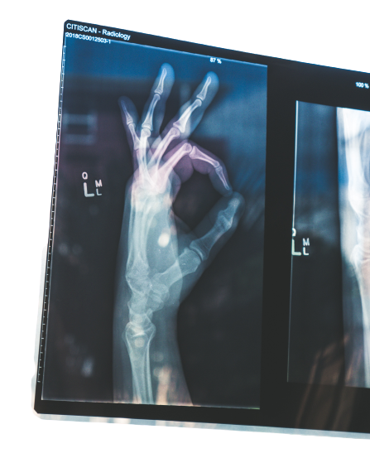
sportsactivity
medicalrecords

Slide 7
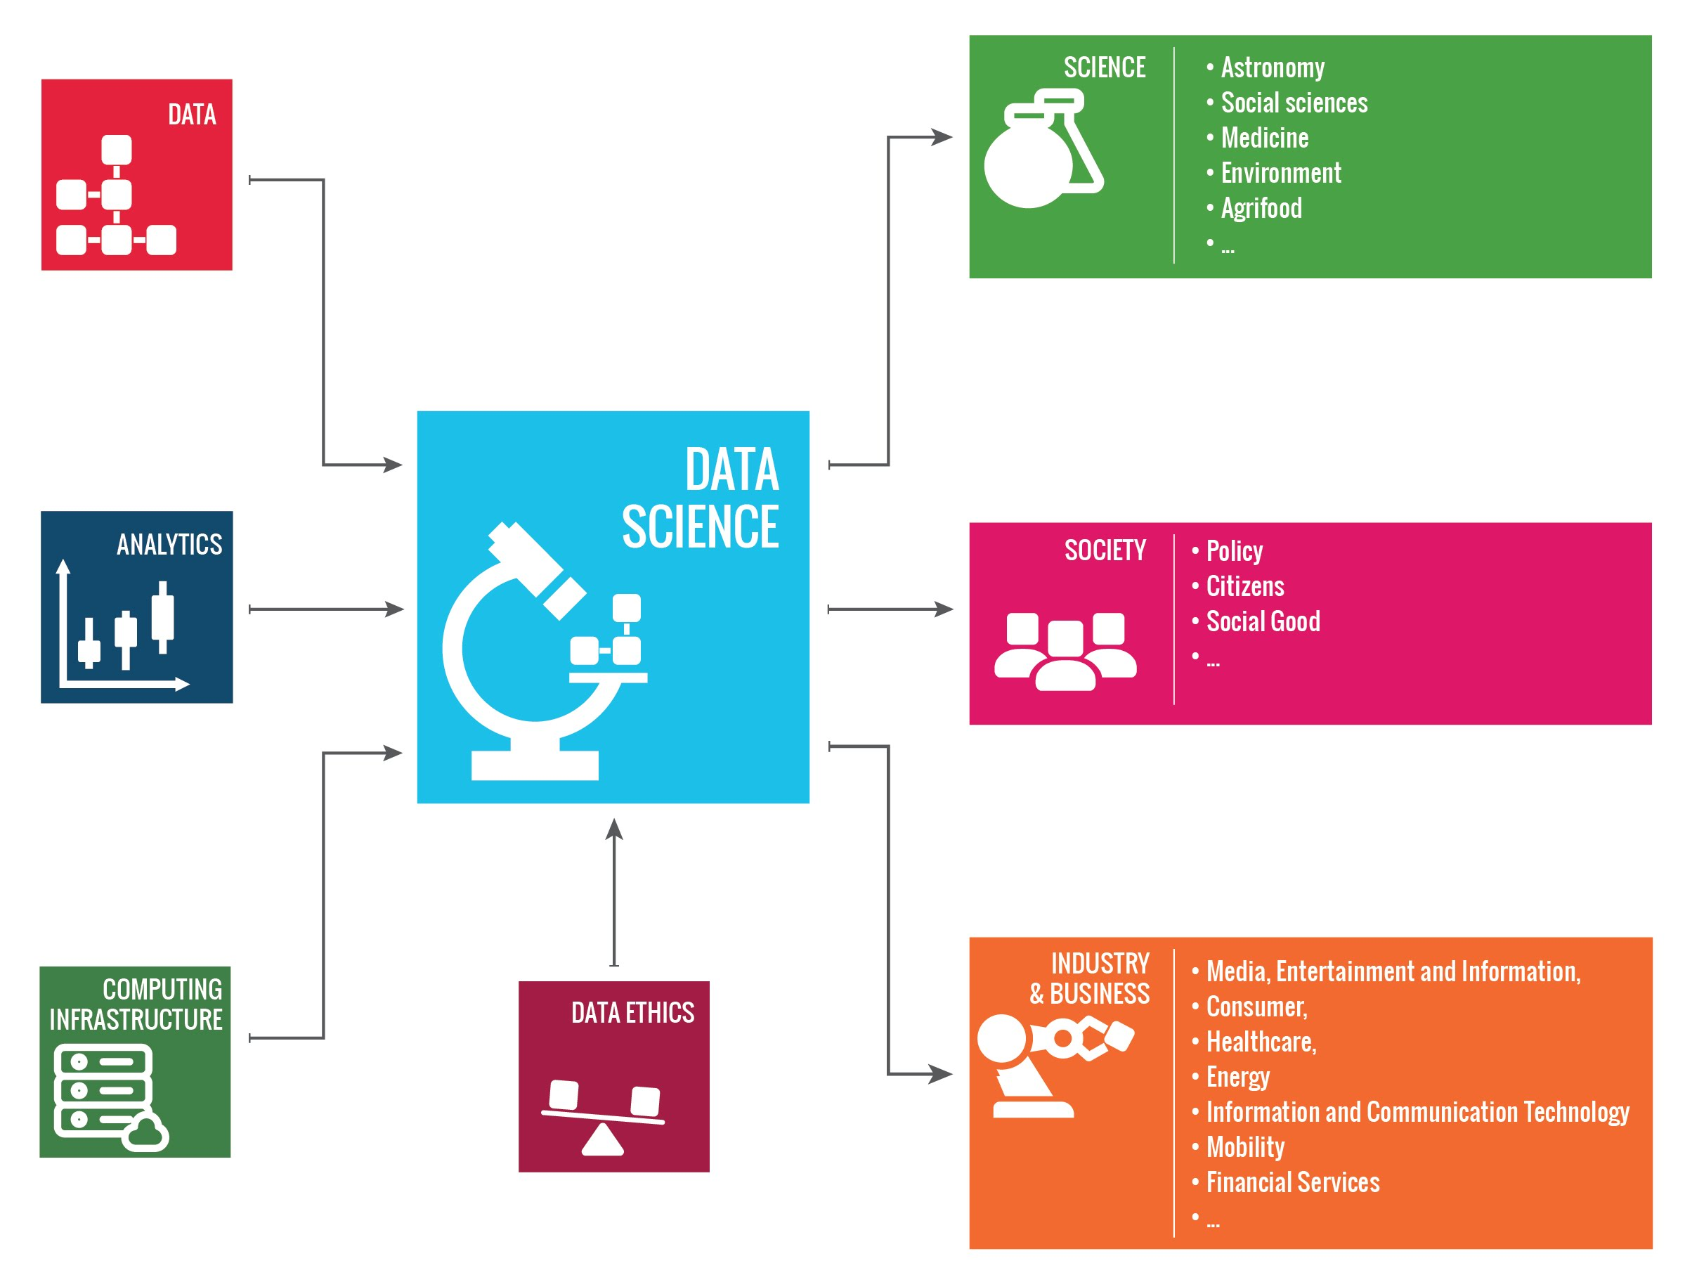
interdisciplinarity

Slide 8
exploratories
create and integrate new services within the infrastructure
activity will be monitored by:
Scientific Leader, fostering research and supervising scientific validity;
User Community Activist, sharing information among partners, collaborating with other WPs and exploratories, organizing events and disseminating results.

Slide 9
exploratories
Societal Debates and Misinformation Analysis
text, social network, and misinformation analysis
Demography, Economy & Finance 2.0
poverty indicators, spatial analysis, AI 4 Social Good
Sustainable Cities for Citizens
smart cities, human mobility behavior analysis

Slide 10
exploratories
Migration studies
macroscopic human flows, social behavior analysis
Sports Data Science
performance evaluation, injury prediction
Social Impacts of AI and Expainable ML
artificial intelligence, machine learning, explanation, ethics
SoBigData interest group
Network medicine

Slide 11
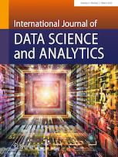
Output of exploratories in SoBigData
International Journal of Data Science and Analytics
Special issue: “A Social Mining and Big Data Ecosystem for Open, Responsible Data Science”
Measuring objective and subjective well-being: dimensions and data sources
(So) Big Data and the transformation of the city
Human migration: the Big Data perspective
Corruption risk in contracting markets: a network science perspective (host)
A workflow language for research e-infrastructures
Data Science: a game-changer for science and innovation
Ethical and Legal Framework for Research Infrastructures

Slide 12
Thank you!
SoBigData
SoBigData
www.sobigdata.eu
www.sobigdata.eu
Luca Pappalardo
ISTI-CNR

