Slide 1
Ethics & Privacy Towards a Responsible Data Science
Francesca Pratesi University of Pisa / ISTI – CNR
francesca.pratesi@isti.cnr.it

Slide 2
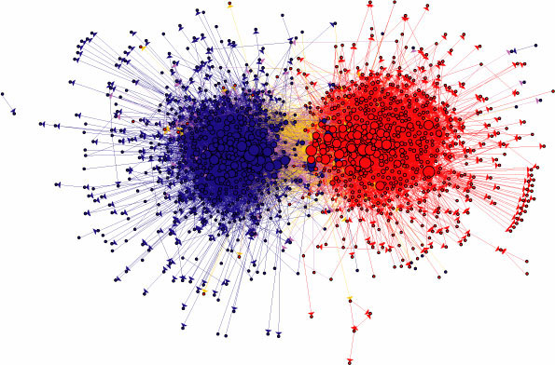
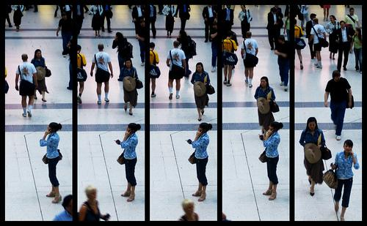
Big Data as ‘proxies’ of social life
Shopping patterns & lifestyle
Relationships & social ties
Movements
Desires, opinions, sentiments

Slide 3
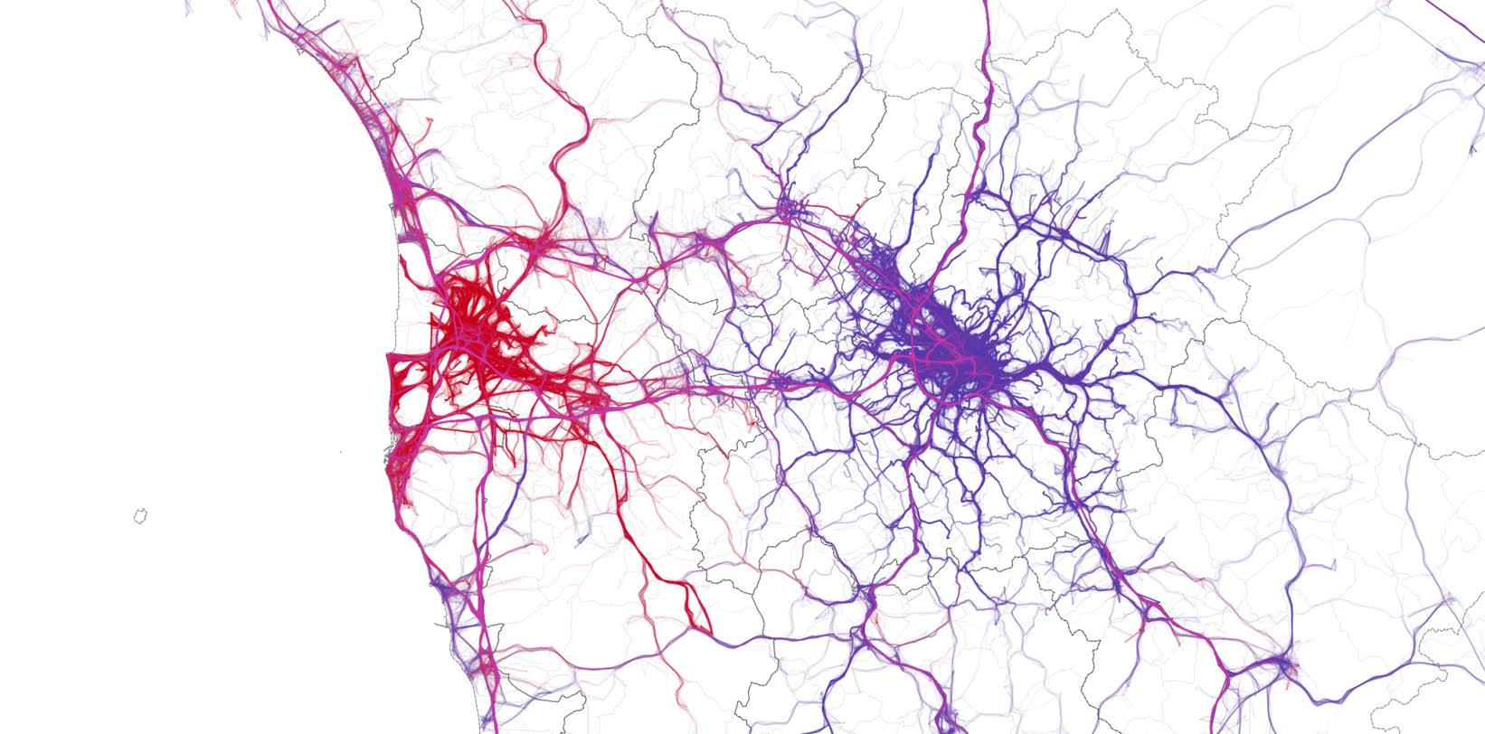
from data…
Notes:
The GPS tracks of car travels originating in Pisa (red) vs. the GPS tracks of car travels originating in Florence (green) (viz by KDD LAB)

Slide 4
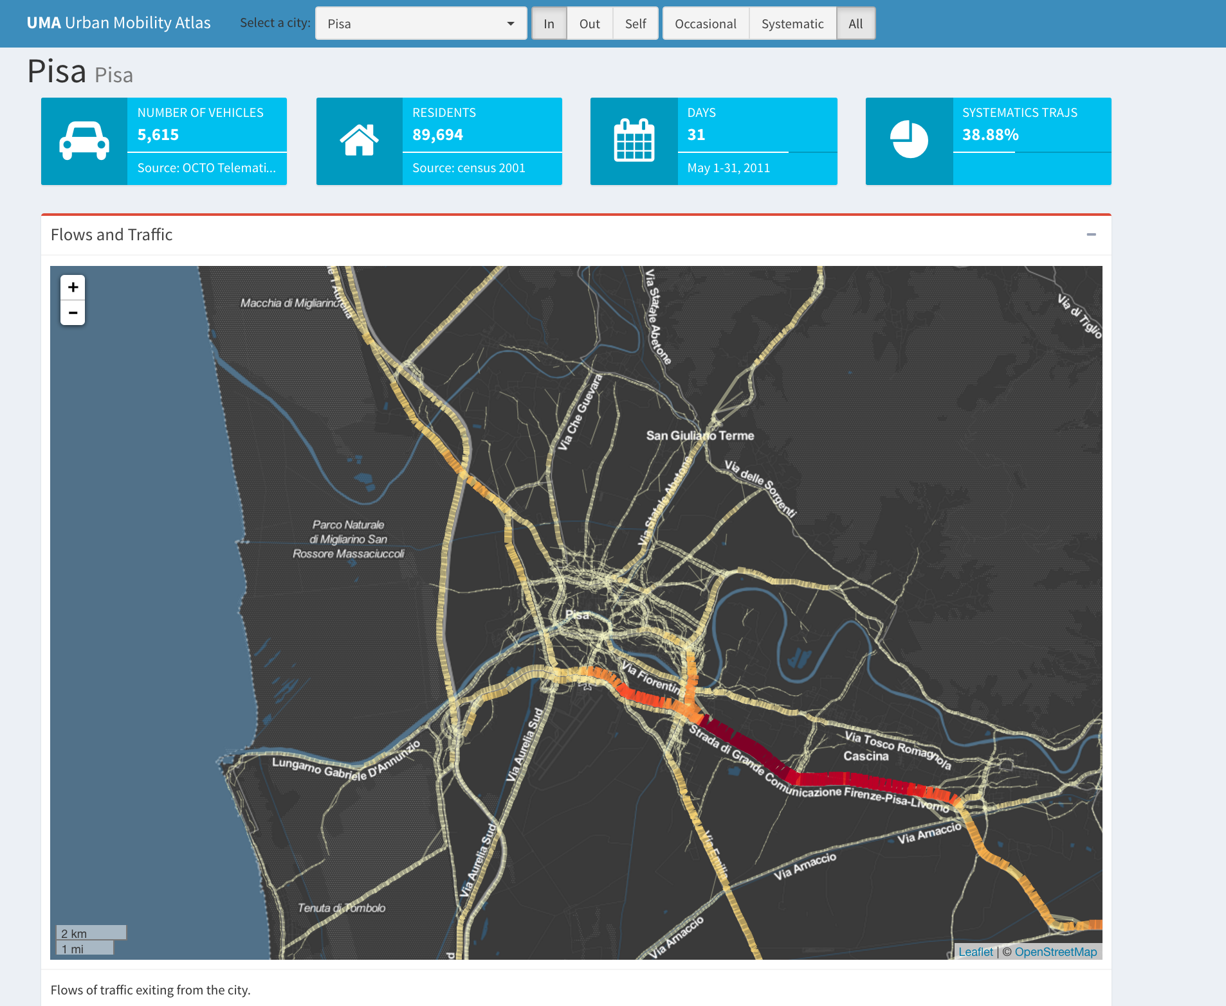
… to knowledge

Slide 5
Why consider privacy?

Slide 6
EU Legislation for protection of personal data
European directives:
Data protection directive (95/46/EC)
ePrivacy directive (2002/58/EC) and its revision (2009/136/EC)
General Data Protection Regulation (25 May 2018)
Opinions by EU Article 29 Data Protection Working Party

Slide 7
Anonymization vs Pseudonymization
Often misunderstood
From a legal prespective, anonymized data and pseudonymized data are very different
Pseudonymization substitutes identity of a individual to avoid re-identification without use of additional knowledge
Anonymization ensures data protection against direct or undirect re-identification of a data subject
Pseudoanonymized Data are still Personal Data!
Notes:
La pseudonimizzazione è un processo in cui gli identificatori relativi ad un individuo (tipicamente il nome e il codice fiscale) vengono sostituiti con identificatori fittizi, noti come pseudonimi.
5) «pseudonimizzazione»:il trattamento dei dati personali in modo tale che i dati personali non possano più essere attribuiti a un interessato specifico senza l'utilizzo di informazioni aggiuntive, a condizione che tali informazioni aggiuntive siano conservate separatamente e soggette a misure tecniche e organizzative intese a garantire che tali dati personali non siano attribuiti a una persona fisica identificata o identificabile;

Slide 8
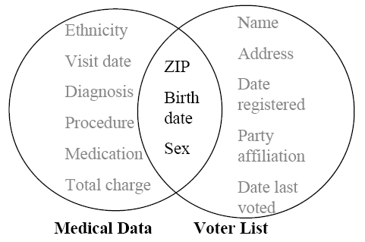
THE GOVERNOR OF MASSACHUSETTS’ CASE
An attack performed on a medical dataset (without direct identifier!) leads to re-identification of the Governor of MA
MA published some (supposed secure) medical data (left)
Data about MA voters; public dataset (right)
Linking the two datasets we have:
6 persons with the same date of birth
3 were men
Only 1 with the same ZIP code
Pierangela Samarati and Latanya Sweeney: Generalizing Data to Provide Anonymity when Disclosing Information. PODS 1998

Slide 9
THE GOVERNOR OF MASSACHUSETTS’ CASE
An attack performed on a medical dataset (without direct identifier!) leads to re-identification of the Governor of MA
MA published some (supposed secure) medical data (left)
Data about MA voters; public dataset (right)
Linking the two datasets we have:
6 persons with the same date of birth
3 were men
Only 1 with the same ZIP code
Pierangela Samarati and Latanya Sweeney: Generalizing Data to Provide Anonymity when Disclosing Information. PODS 1998

Slide 10
THE GOVERNOR OF MASSACHUSETTS’ CASE
An attack performed on a medical dataset (without direct identifier!) leads to re-identification of the Governor of MA
MA published some (supposed secure) medical data (left)
Data about MA voters; public dataset (right)
Linking the two datasets we have:
6 persons with the same date of birth
3 were men
Only 1 with the same ZIP code
Pierangela Samarati and Latanya Sweeney: Generalizing Data to Provide Anonymity when Disclosing Information. PODS 1998

Slide 11
THE GOVERNOR OF MASSACHUSETTS’ CASE
An attack performed on a medical dataset (without direct identifier!) leads to re-identification of the Governor of MA
MA published some (supposed secure) medical data (left)
Data about MA voters; public dataset (right)
Linking the two datasets we have:
6 persons with the same date of birth
3 were men
Only 1 with the same ZIP code
Pierangela Samarati and Latanya Sweeney: Generalizing Data to Provide Anonymity when Disclosing Information. PODS 1998

Slide 12
Some possible strategies
Data Minimization
Privacy-by-Design
Proactive approach
Needs some assumptions on:
data type
attack model
service to be implemented
Anonymization Techniques
Anonymity by Indistinguishability
K-anonymity
l-diversity
t-closeness
Anonymity by Randomization
Differential-privacy
Ann Cavoukian: Privacy by Design: The 7 Foundational Principles. Information & Privacy Commissioner, Ontario Canada
Cynthia Dwork: Differential Privacy, pages 1–12. Springer Berlin Heidelberg, Berlin, Heidelberg, 2006
Latanya Sweeney, k-anonymity: A model for protecting privacy. International Journal of Uncertainty, Fuzziness and Knowledge-Based Systems, 10(5):557–570 (2002)
Ashwin Machanavajjhala et al.: l-diversity: Privacy beyond k-anonymity, ICDE 2006.
Ninghui Li et al.: t-closeness: Privacy beyond k-anonymity and l-diversity, ICDE 2007.
Notes:
techniques for privacy preservation strongly depend on the nature of the data that we want to protect.
For example, many proposed methods are suitable for continuous variables but not for categorical variables, while other techniques employed to anonymize sequential
data such as tabular data are not appropriate for moving object datasets.
Second, a valid framework for privacy protection has to define the background knowledge of the adversary, that strongly depends on the context and on the kind of data. Different assumptions on the background knowledge of an attacker entail different defense strategies.
Finally, a privacy-preserving strategy should find an acceptable trade-off between data privacy on one side and data utility on the other side. In order to reach this goal it is fundamental to take into account during the design of the framework the analytical questions that might be answered with the transformed data. This means designing a transformation process capable to preserve some data properties that are necessary to preserve the results obtained by specific analytical and/or mining tasks.

Slide 13
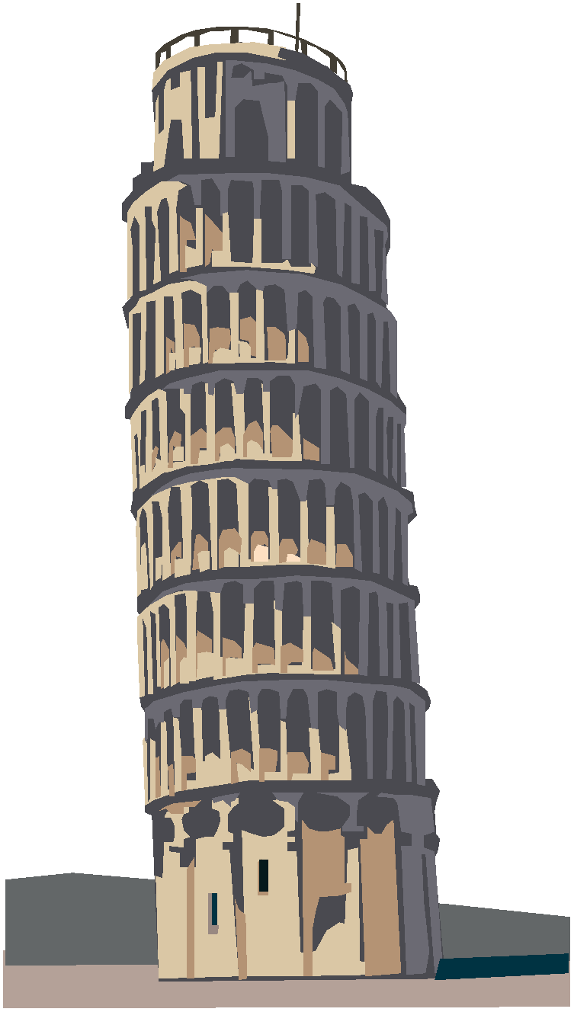
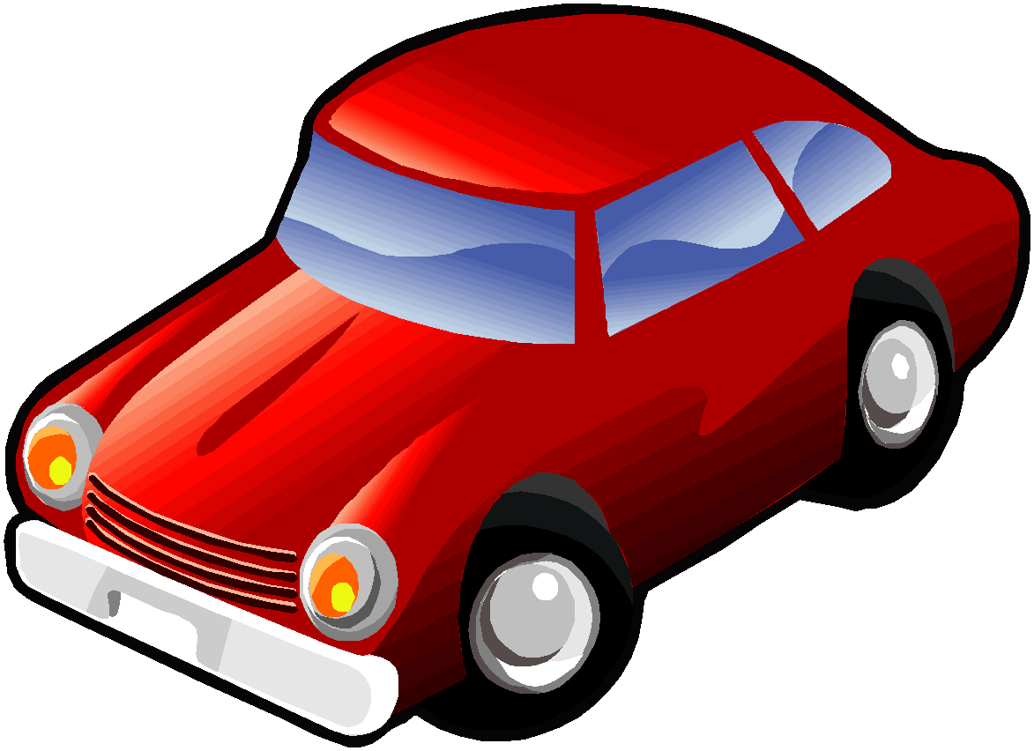
Sociometer: Estimating User Category
Resident
Visitor
B
A
A
Commuter
In transit
B
A
A
Notes:
Resident. A person is resident in an area A when his/her home is inside the A. Therefore the mobility tends to be from and towards his/her home.
Commuter. A person is a commuter between an area B and an area A, if his/her home is in B while the workplace is in A. Therefore the daily mobility of this person is mainly between B and A.
Visitor. A person is a Visitor in an area A if his/her home and work/school places are outside A, and the presence inside the area is limited to a certain period of time that can allow him/her to perform some activities in A.
In Transit. An individual is “in transit” over an area A, if his/her home and work places are outside area A, and his/her presence inside area A is limited by a temporal threshold representing the time necessary to transit through A.

Slide 14
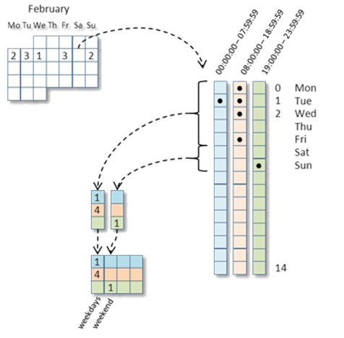
Sociometer: Data Definition
Notes:
l'altra volta avevo analizzato il rischio della privacy nei dati GSM aggregati simulando due attacchi

Slide 15
?

Slide 16
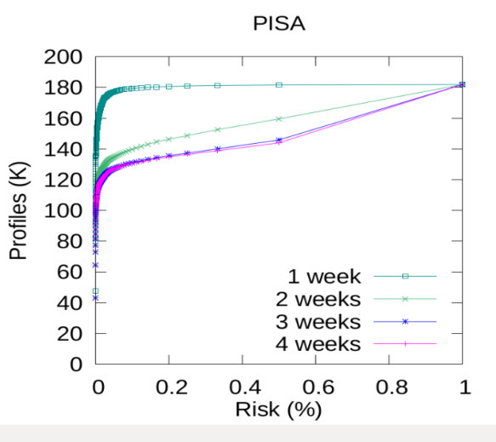
Real Experiments Results
bk: 1 week
bk: 2 weeks
bk: 3 weeks
bk: 4 weeks
Risk (r) | K | % users | # users | % users | # users | % users | # users | % users | # users
r<=0.01% | K>=10.000 | 50 | 91.613 | 40 | 73.141 | 40 | 73.001 | 40 | 73.001
0.01%<r r<=0.1% | 1000<=K K<10.000 | 22 | 40.514 | 16 | 29.595 | 14 | 26.311 | 14 | 26.328
0.1%<r r<=1% | 100<=K K<1.000 | 16 | 30.179 | 11 | 19.707 | 9,6 | 17.494 | 9,5 | 17.381
1%<r r<=2% | 50<=K K<100 | 4,8 | 8.688 | 2,7 | 4.953 | 2,3 | 4.244 | 2,3 | 4.225
2%<r r<=10% | 10<=K K<50 | 4,6 | 8.434 | 6,8 | 12.322 | 5,5 | 10.031 | 5,3 | 9.741
10%<r r<=20% | 5<=K K<10 | 0,7 | 1.213 | 3,6 | 6.574 | 2,5 | 4.586 | 2,3 | 4.170
r>20% | 1<=K K<5 | 0,7 | 1.225 | 19 | 35.574 | 25 | 46.199 | 25 | 47.000

Slide 18
MAJOR ETHICAL DILEMMAS
Accuracy vs Fairness
Quality & efficiency vs Informational autonomy
Personalisation vs Solidarity
Convenience vs Self-actualisation
Whittlestone, J. Nyrup, R. Alexandrova, A. Dihal, K. Cave, S. (2019) Ethical and societal implications of algorithms, data, and artificial intelligence: a roadmap for research. London: Nuffield Foundation

Slide 19
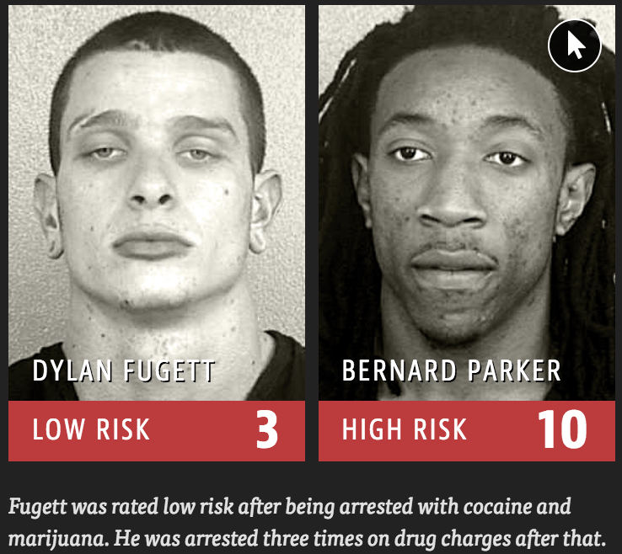
COMPAS crime recidivism score
Notes:
The journalists of propublica. org have shown that the COMPAS score, a predictive model for the “risk of crime recidivism” (proprietary secret of Northpointe), has a strong ethnic bias. Indeed, according to this score, a black who did not re-offend was classified as high risk twice as much as whites who did not re-offend,and white repeat offenders were classified as low risk twice as much as black repeat offenders.
The COMPAS score for predictig the “risk of crime recidivism”, has a strong ethnic bias as a black who did not re-offend was classified as high risk twice as much as whites who did not re-offend.

Slide 20
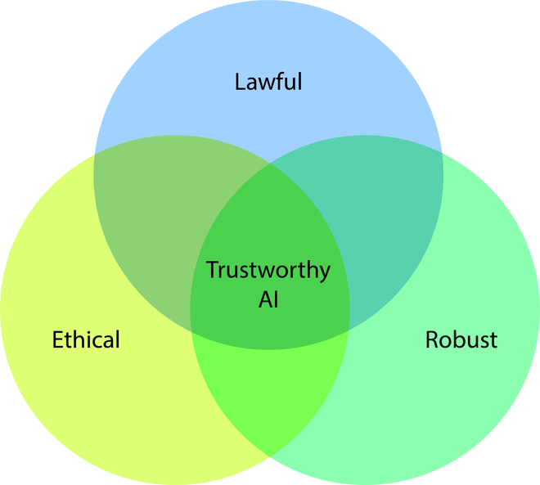
Towards Trusworthy AI

Slide 21
fair.sobigdata.eu/moodle

