Slide 1
The Destination Earth Initiative 4 November 2020 EGI Conference 2020
Christian KIRCHSTEIGER
European Commission
Communications Networks, Content and Technologies Directorate General (DG CNECT)
Unit C.1 – eInfrastructure and Open Science Cloud

Slide 2
What is Destination Earth not ?
What is it ?
What is the problem ?

Slide 3
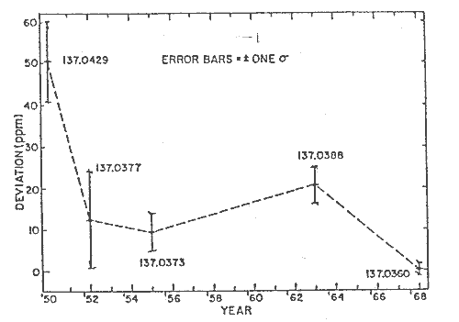
What is the type of problem?
Source: http://www.nusap.net
Successive "recommended values" of the fine-structure constant

Slide 4
What is the problem?
Modelling has become so complex and a black box for many non-experts (and some experts too) that it seriously limits the transfer of knowledge generated to decision-makers, incl. the public, resulting in loss of trust (cf. e.g. financial crisis, climate change debate, pandemics, …).
DestinE is very much needed to cover a number of important service & scientific gaps in relation to how evidence-based policy support is currently done vis-à-vis key societal challenges such as those addressed by the EU Green Deal.

Slide 5
What is the problem?
DestinE is about much more than running bigger problems on bigger computers. It particularly needs creating an open & flexible SW infrastructure that allows non-experts to intervene in a workflow at a particular point and thus at a level of complexity which matches the specific interests and background knowledge of the user. This SW adaptation to the future architecture of DestinE is a major investment effort.
DestinE needs a novel science and user oriented approach, which needs wide engagement with Earth-system, impact sector and digital infrastructure communities through sharing of codes and data ("Open Science") but also synergy with science and user oriented funding programs (e.g. Horizon Europe).

Slide 6
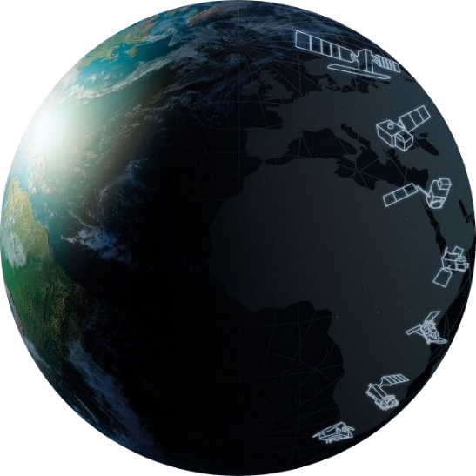
Policy context & key objectives
Key initiative, announced in:
Aim and goals
A European Green Deal (2019)
A European strategy for data (2020)
Shaping Europe's digital future (2020)
Bring together European scientific and industrial excellence
Use increased HPC capabilities and AI tools to develop a very high precision digital model of the Earth to monitor and simulate natural and human activity, supporting sustainable development
Develop a “Digital Twin” of the earth to support verifiable evidence-based EU policy-making and implementation
Notes:
Destination Earth is a key initiative, announced in the Communications from the Commission of December 2019 on “The European Green Deal”, and of February 2020 on “A European strategy for data” and on “Shaping Europe's digital future”. It will unlock the potential of digital modelling of the Earth’s physical resources and related phenomena on a global scale to speed up the green transition and help plan for major environmental degradation and disasters.
By bringing together European scientific and industrial excellence and by harnessing the power of latest Supercomputing facilities , Destination Earth will develop a very high precision digital model of the Earth, to monitor and simulate natural and human activity, and to develop and test scenarios that would enable more sustainable development, for achieving both the green (Green Deal) and digital (Digital Strategy) priorities of the EU.
The ultimate goal is to develop a full “digital twin” of the earth, enabling us not only to understand better our climate, environment and the impact of human behavior but also to act in real time to address the challenges ahead, including saving lives and avoiding large economic downturns. This requires a significant increase of the current available High Performance Computing capacities in order to o support evidence-based EU policy-making and implementation, through a break-through in monitoring and prediction capabilities of the Earth system.

Slide 7
Concept in a nutshell
The objective of the Destination Earth initiative is to develop an accurate digital model of the Earth via sets of thematic Digital Twins to monitor and simulate natural and human activity, and to develop and test scenarios that would enable more sustainable development and support European environmental policies.
It is expected to significantly support the green transition and help plan mitigation strategies for major environmental degradation and disasters.
“Science for policy” approach for public sector decision-making, gradual opening to scientific (benchmarking of models and data) and industrial users (innovation)

Slide 8
Destination Earth – core elements
Data
Vast amount of data to be accessed and processed “on the fly”
Copernicus/Earth Observation, IoT, environmental (e.g.
climate, land cover, marine/ oceans, geological,
atmosphere, air quality, winds etc.), users own data …
Deal
Dataspace
Green
Federated cloud-based modelling, simulation and predictive analytics platform
(fast) access to data and HPC infrastructures (IaaS),
high connectivity capacities, AI, data fusion…
Digital Twins (SaaS)
Simulations in real / near-real time mode
DT1: weather-induced and geophysical extremes,
DT2: climate change adaptation
Applications / services (PaaS)
Users’ own working environments
value-added services by/for private/public entities
available through the platform and digital twins

Slide 9
Implementation as much as possible via existing EU assets
Copernicus
Supercomputing
Cloud computing
High-speed connectivity networks
AI development

Slide 10
A note: Destination Earth > Copernicus
Core platform will use data to build and update DT models (own intelligence layer with own modelling, simulation and prediction capabilities); offer users “what if” scenarios and allow them to generate their own
First DTs close to EO but still going beyond
E.g. by including prognostic simulation models, impact models (VA) as well as user-interfaces and QM for non-expert users (“science for policy”))
Future DTs will depart from the Copernicus data and service logic to offer a wealth of many other “what if” scenarios in many different areas of activity
Clear delineation between DestinE & Copernicus
Mapping of interfaces

Slide 11
DestinE – how we build it
Existing assets
Collaborative preparations
European level:
- ESA, EUMETSAT, ECMWF, the European Environmental Agency, Mercator Ocean, HPC centres, GEANT…
National/regional:
- geospatial, earth observation and environmental data, meteorological information…
EU platforms and services:
- e.g. Copernicus
European Commission (DG CNECT, JRC, Other DGs)
EU Member States
(Digital Europe Programme)
ESA/ECMWF/EUMETSAT
(technical preparations)
Stakeholder workshops

Slide 12
Final remarks
Long-term initiative
Timing:
1st steps: core platform & 2 priority DTs
End 2023: offering cloud services from these DTs
Resources will be procured via a few key European implementation partners
Governance as light as possible & focus on operation rather than administration

