Slide 1
The new partnership on AI, Data and Robotics in Europe
EGI Conference 2020
November 4th, 2020
Sonja Zillner, Siemens, SRIDA Lead BDVA

Slide 2
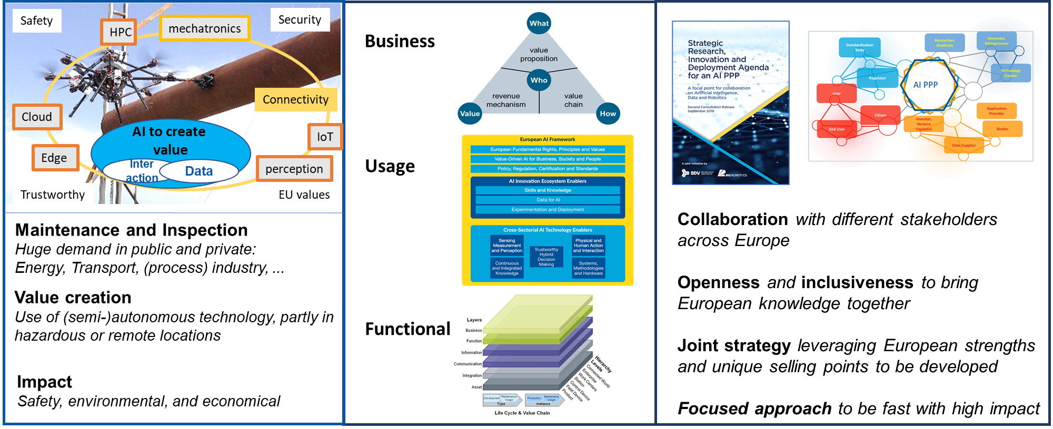
Holistic view needed!

Slide 3
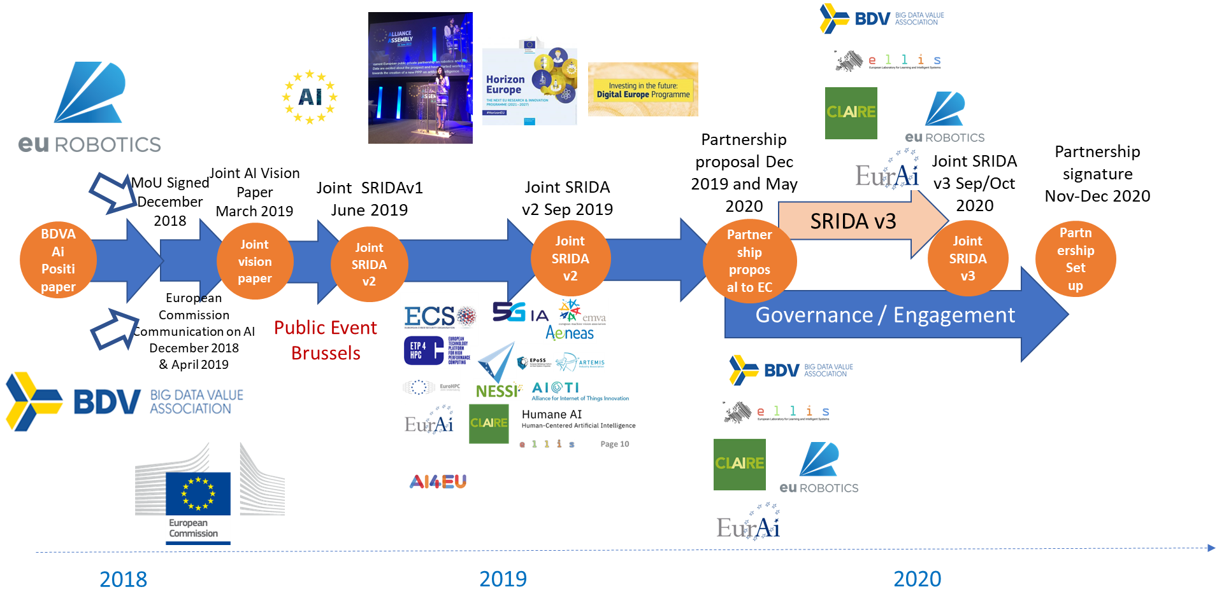
Partnership: history of preparation and next steps roadmap

Slide 4
Guiding principles for successful partnership
“The Vision of the Partnership is to boost European competitiveness, societal wellbeing and environmental aspects to lead the world in researching, developing and deploying value-driven trustworthy AI, Data and Robotics based on European fundamental rights, principles and values”
Openness and inclusiveness to bring European and cross-domain knowledge together to fulfill above mentioned vision
Openness to include new partners (new businesses, new experts, new knowledge, new entrepreneurs etc.)
Joint strategy leveraging European strengths and unique selling points to be developed
BUT also with a strong focus on new emerging businesses (e.g. verticals, service businesses etc.)
Leading principle must be to produce valuable content in/for Europe and to overcome particular interests. Trust to each others.
Well balanced amount of members covering AI, Data and Robotics and well balanced between Research and Industry. Representativeness of the new innovation forces/communities (e.g Start-ups, high-tech companies, …)
03.11.2020
4

Slide 5



Partnership General Objectives
Secure European’s sovereignty over AI, Data and Robotics technologies and knowhow
Establish European leadership in AI, Data and Robotics technologies with high socio-economic impact
Reinforce a strong and global competitive position of Europe in AI, Data and Robotics
03.11.2020
5

Slide 6
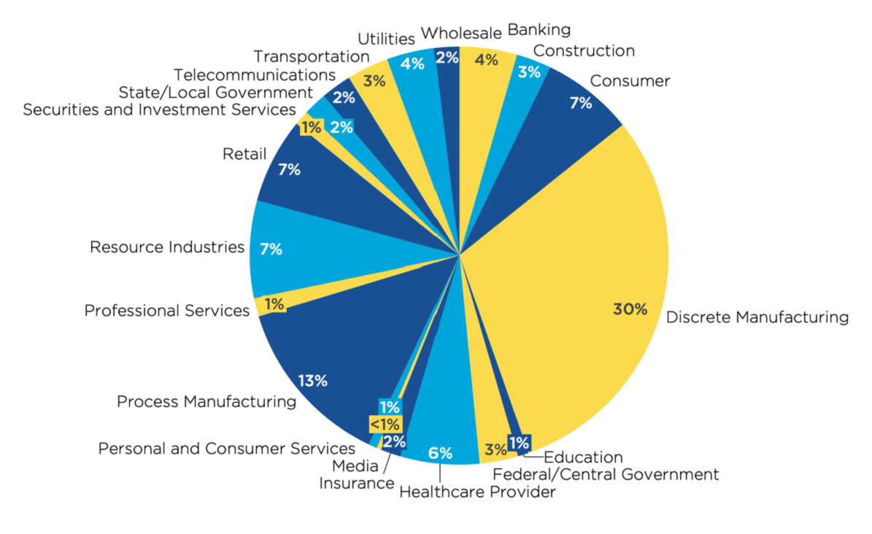
AI, Data and Robotics Opportunities exist across sectors
Expected distribution of financial investments in Artificial Intelligence systems, Robotics and Drones in Western Europe in 2019
Source: Combined data from IDC Worldwide Semi-annual Artificial Intelligence Systems & Robotics and Drones Spending Guide -2018 H2)

Slide 7
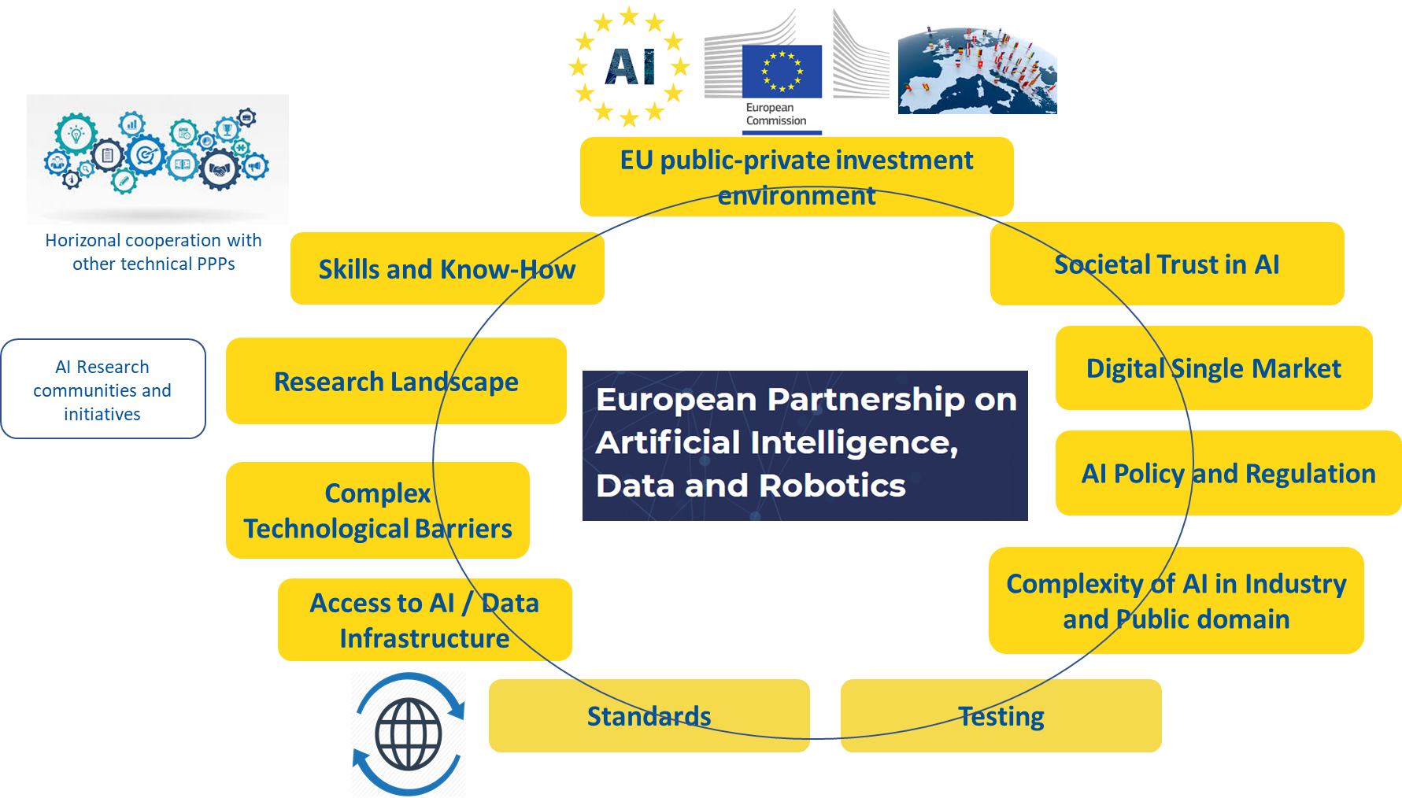
Adoption challenges: Open collaboration needed!

Slide 8
Activities
Research and Innovation Action (RIA)
Innovation Actions (IA)
Coordination and Support Actions (CSA)
Horizon Europe
Digital Europe
Novelty Exploration
Cascade Actions
Lighthouses
Uptake Actions
Infrastructure
Development
Mission Based
Challenges
Community
Building
Challenge Based Competitions
Operational objectives
Lead and support research raising the state-of-the-art around AI, Data and Robotics
Support initiatives aiming integrating and building systems around AI, Data and Robotics
Promote collaborative working with other horizontal and vertical communities
Support initiatives that engage and promote SMEs & stimulate investments
Accelerate digital transformation and uptake of industry in all sectors (e.g. through large scale pilots, DIH, CoE)
Support initiatives that foster AI Skill building & strengthening of societal awareness
Work towards aligning legal foundations, standards & regulations
Develop and implement mechanisms to create an effective & accessible ecosystem (incl. innovation infrastructure)
Specific objectives
Strengthen scientific capabilities in human-centred / trustworthy AI, Data and Robotics
Master essential technologies in human-centred / trustworthy AI, Data and Robotics
Maximise the economic benefit of AI, Data and Robotics in all sectors and regions in Europe
Accelerate and scale-up new markets and novel applications of AI, Data and Robotics
Maximise the societal and environmental benefits of AI, Data and Robotics
Make the benefits of AI, Data and Robotics accessible to everyone everywhere
Build a strong and effective European AI, Data and Robotics innovation ecosystem
General objectives
Secure European sovereignty over AI, Data and Robotics technologies and knowhow (Position & Control)
Establish European leadership in AI Data and Robotics technologies with high socio-economic impact (Technology & Innovation)
Reinforce a strong and global competitive position of Europe in AI, Data and Robotics (Market)

Slide 9
Activities
Research and Innovation Action (RIA)
Innovation Actions (IA)
Coordination and Support Actions (CSA)
Horizon Europe
Digital Europe
Novelty Exploration
Cascade Actions
Lighthouses
Uptake Actions
Infrastructure
Development
Mission Based
Challenges
Community
Building
Challenge Based Competitions
Operational objectives
Lead and support research beyond state-of-the-art around AI, Data and Robotics
Integrate and build systems around AI, Data and Robotics
Collaborate with other horizontal and vertical communities
Promote SMEs
and
stimulate investment
Accelerate digital transformation and uptake of industry in all sectors
Foster AI Skill building
&
strengthen societal awareness
Work towards aligning legal foundations standards & regulations
Develop and implement mechanisms to create an effective & accessible ecosystem
Operational objectives
Lead and support research raising the state-of-the-art around AI, Data and Robotics
Support initiatives aiming integrating and building systems around AI, Data and Robotics
Promote collaborative working with other horizontal and vertical communities
Support initiatives that engage and promote SMEs & stimulate investments
Accelerate digital transformation and uptake of industry in all sectors (e.g. through large scale pilots, DIH, CoE)
Support initiatives that foster AI Skill building & strengthening of societal awareness
Work towards aligning legal foundations, standards & regulations
Develop and implement mechanisms to create an effective & accessible ecosystem (incl. innovation infrastructure)
Specific objectives
Strengthen scientific capabilities in human-centred / trustworthy AI, Data and Robotics
Master essential technologies in human-centred / trustworthy AI, Data and Robotics
Maximise the economic benefit of AI, Data and Robotics in all sectors and regions in Europe
Accelerate and scale-up new markets and novel applications of AI, Data and Robotics
Maximise the societal and environmental benefits of AI, Data and Robotics
Make the benefits of AI, Data and Robotics accessible to everyone everywhere
Build a strong and effective European AI, Data and Robotics innovation ecosystem
General objectives
Secure European sovereignty over AI, Data and Robotics technologies and knowhow (Position & Control)
Establish European leadership in AI Data and Robotics technologies with high socio-economic impact (Technology & Innovation)
Reinforce a strong and global competitive position of Europe in AI, Data and Robotics (Market)

Slide 10
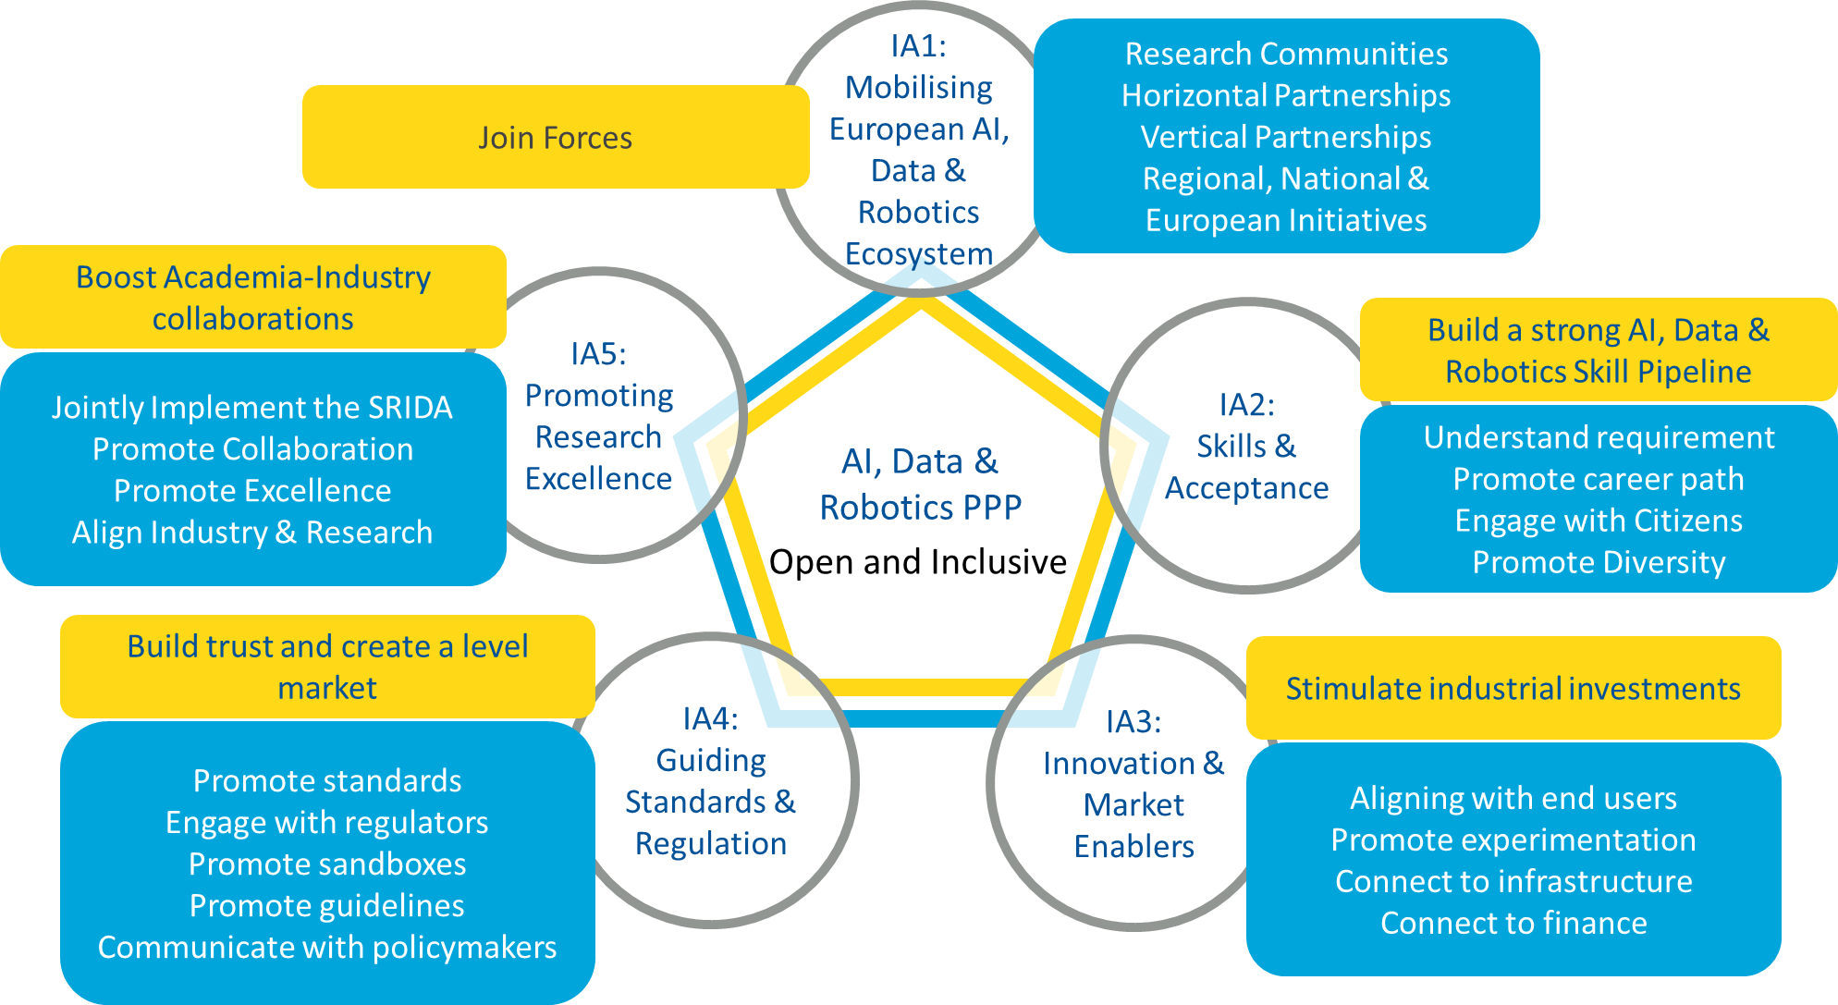
Investment areas

Slide 11
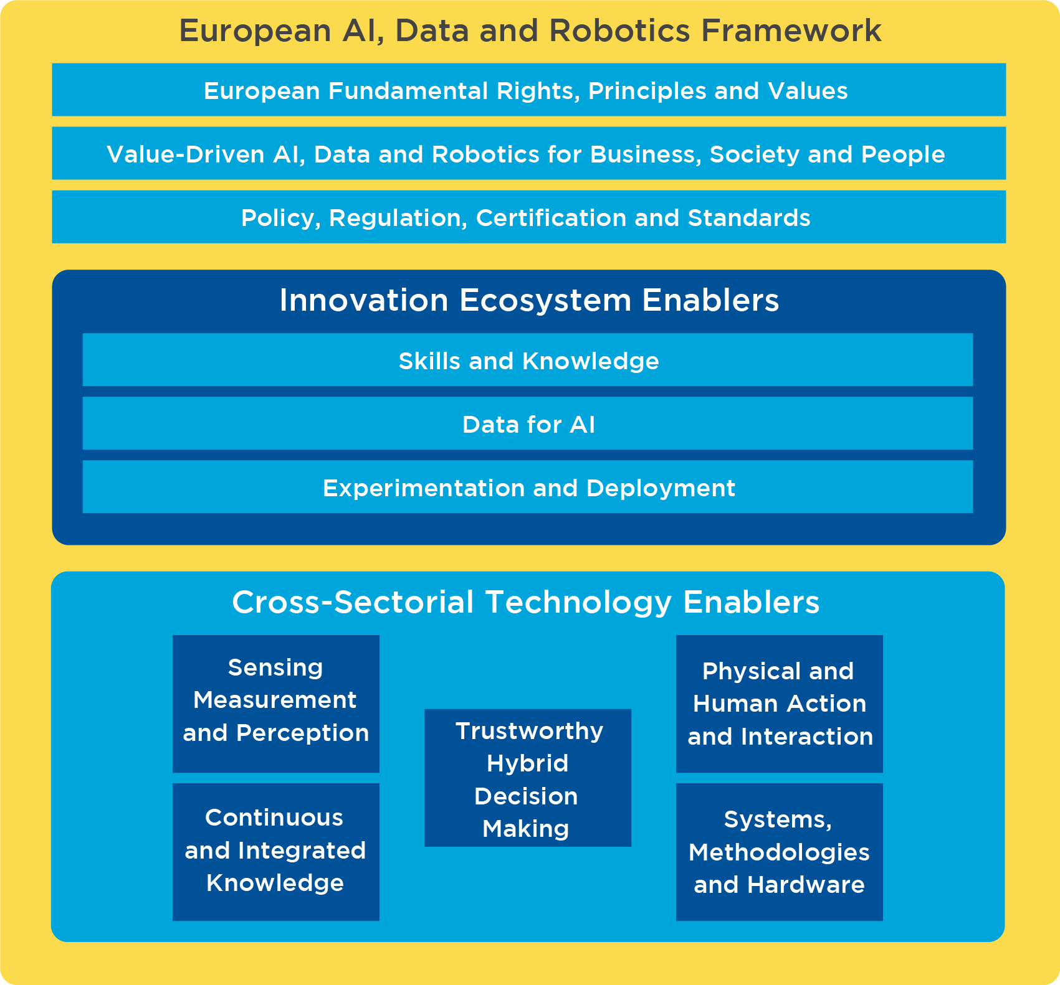
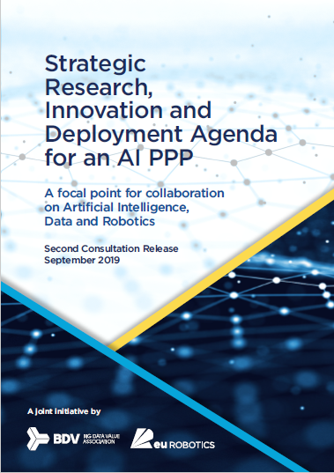
Notes:
These are areas of action to BOOST European AI Ecosystem

Slide 12
European AI, Data and Robotics Framework…
… represents the legal and societal fabric that underpins the impact of AI, Data and Robotics on stakeholder and users
European Fundamental Right, Principles and Values
Products and Services based on AI, Data and Robotics must be based on values that are compatible with European rights principles and values
Value-Driven AI, Data and Robotics for Business, Society and People
Critical to deploying AI, Data and Robotics is its acceptance by users, and citizen, acceptance comes when they see value AND they can assign trust
Policy, Regulation, Certification and Standards
The adoption of AI, Data and Robotics depends on a legal framework of approval built on regulation, partly driven by policy, and an array of certification processes and standards driven by industry

Slide 13
AI, Data and Robotics Innovation Ecosystem Enablers…
… are the essential ingredients for success in the innovation system
Skills and Knowledge
AI, Data and Robotics will affect skills needed by both industry and society
Data for AI
For AI, Data and Robotics to develop further, large volumes of cross-sectorial, unbiased, high-quality and trustworthy data need to be made available
Experimentation and Deployment
Experimentation is critical for AI, Data and Robotics based innovation because of the need to deploy in complex physical and digital environments

Slide 14
Cross-Sectorial AI, Data and Robotics Technology Enablers...
… represent the fundamental building blocks needed to create AI, Data and Robotics systems of all types.
Sensing , Measuring and Perception
encompass methods to access, assess, convert and aggregate signals that represent real-world parameters into communicable data assets
Continuous and Integrated Knowledge
involves transforming, cleaning, storing, sharing, modelling, simulation, synthesizing and extracting insights
Trustworthy Hybrid Decision Making
includes human decision making, machine decision making, mixed decision making and decision support and sliding or variable decision making
Physical and Human Interactions
covers the challenge of human interaction, machine to machine interoperation and machine interaction with human environment
Systems, Methodologies and Hardware
provides methods that enable the construction and configurating of systems by integrating technologies into systems and ensuring that core systems properties, such as safety, robustness, dependability and trustworthiness are met.

Slide 15

Link to documents and press releases
AI position Statement (12/11/2108) “Data-driven artificial intelligence for European economic competitiveness and societal progress” (Recommendation 1: “Set-up a European Public-Private-Partnership on AI (Partnership)”)
BDVA and euRobotics sign a MoU to boost AI progress in Europe (5/12/2018)
AI coordinated action plan Full document (Main communication 2.2 section) and related Press release (7/12/2018)
Vision paper and related Press release (March 2019)
First version of the SRIDA and related Press release (6/6/2019)
Intervention by Commissioner Gabriel on June 26th at the AI Alliance Assembly)
Second version of the SRIDA and related Press release (September 2019)
EBDVF 2019 sessions and policy discussions (October 2019)

Slide 16
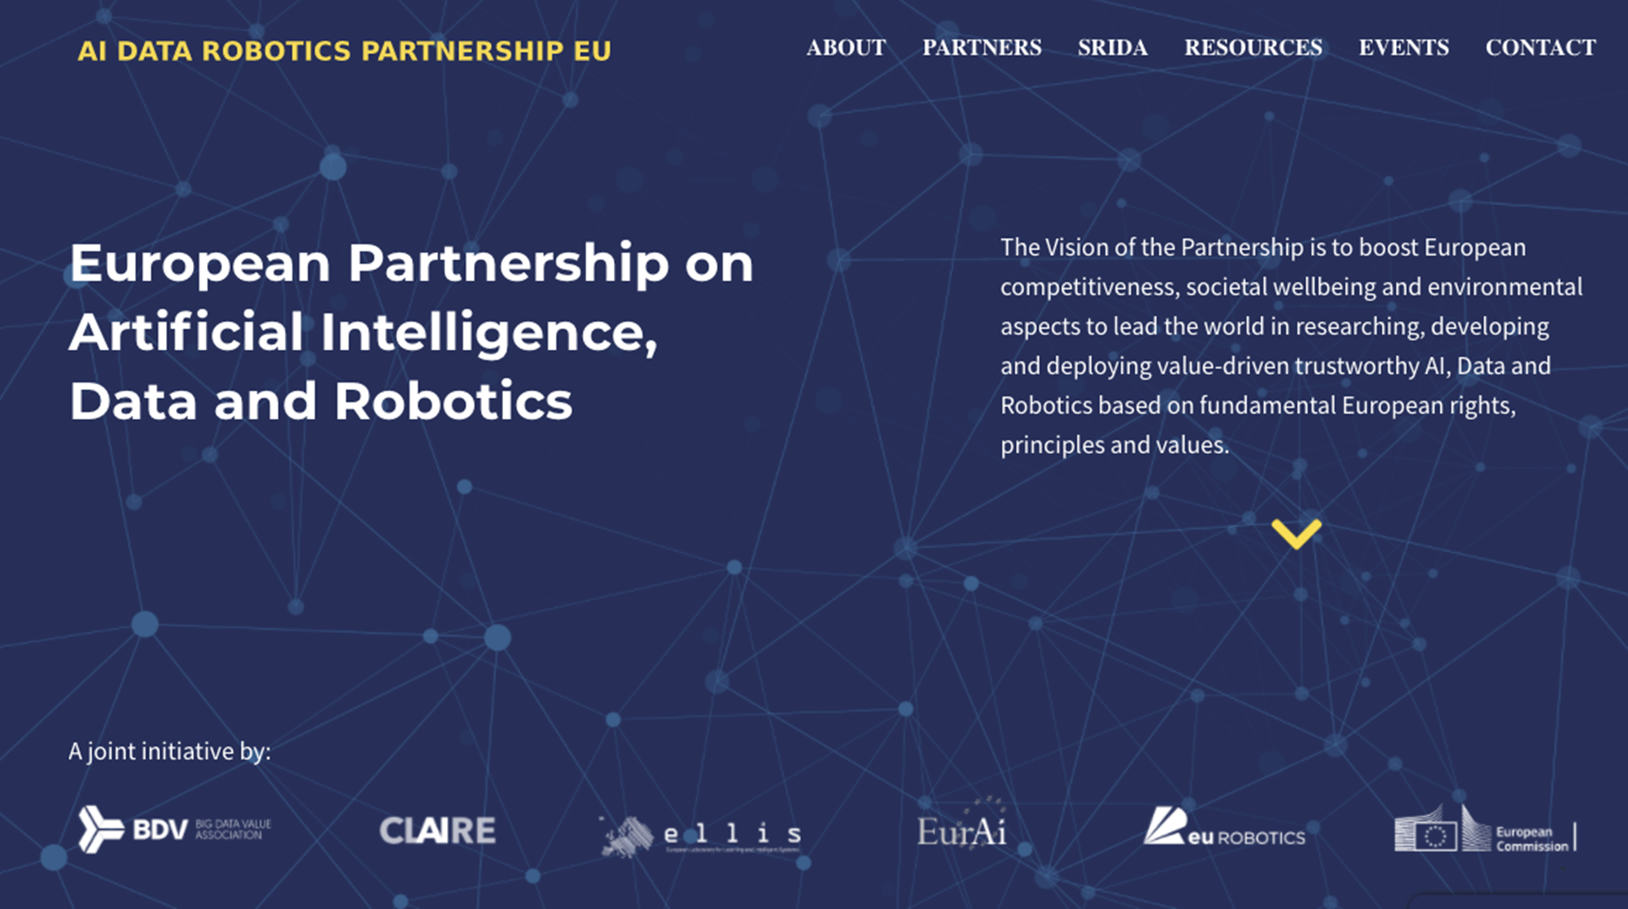




Thank you!
https://ai-data-robotics-partnership.eu/

