Slide 1





DIGITbrain @ EGI conference 2020 aka
AI and ML in Manufacturing
André Stork
Fraunhofer
EGI conference 2020
2th-4th November 2020
www.digitbrain.eu
www.linkedin.com/groups/12439191
www.twitter.com/digitbrain_eu
www.facebook.com/DIGITbrainProject

Slide 2





























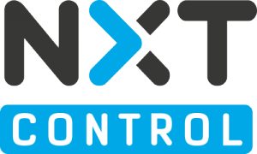



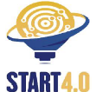


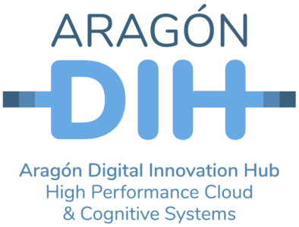




The DIGITbrain consortium
Core technical and administrative partners
Experiment partners
Network of DIHs

Slide 3
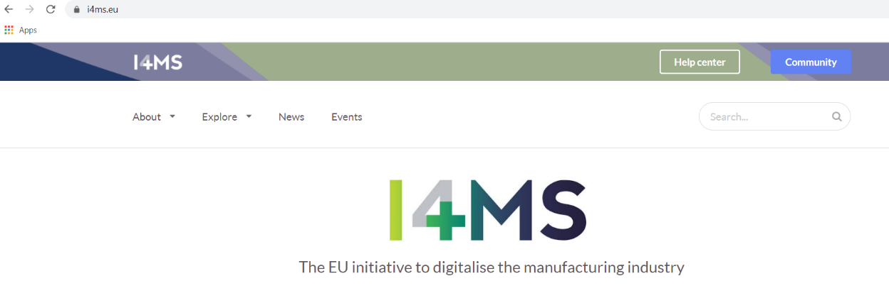
DIGITbrain - details
EC programme/initiative: I4MS
Start date: 1st July 2020 - Duration: 42 months - Number of partners: 36
2 Open Calls, €1,4 Mio. for funding Third Parties

Slide 4
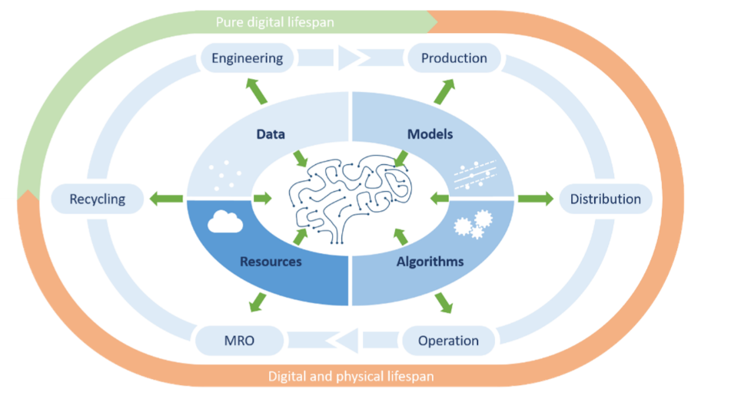
Challenge
The DIGITbrain project aims to enable
customised industrial products and to facilitate
cost-effective distributed and localised production for manufacturing SMEs, by means of
leveraging edge-, cloud- and HPC-based
modelling, simulation, optimisation, analytics, and
machine learning tools and by means of
augmenting the concept of digital twin with a
memorising capacity towards recording the provenance and boosting the cognition of the industrial product over its full lifecycle, and em­powering the network of DIHs to implement the smart business model “Manufacturing as a Service”.

Slide 5
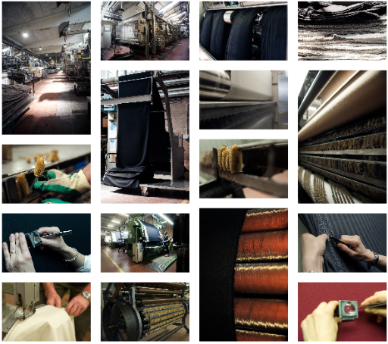
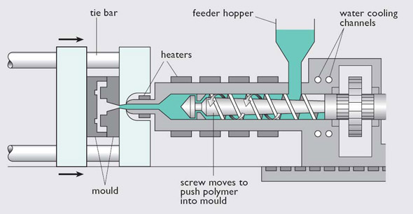
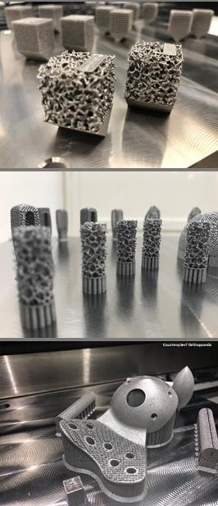
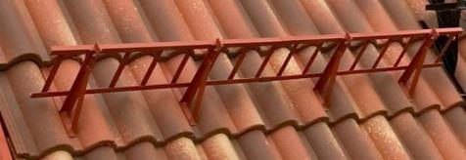
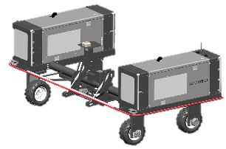
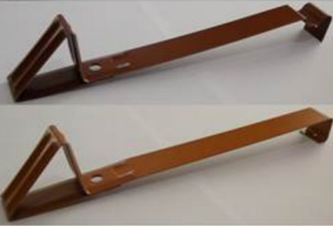
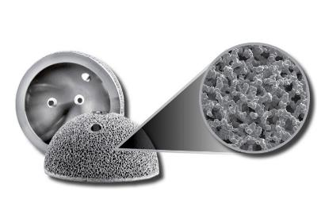
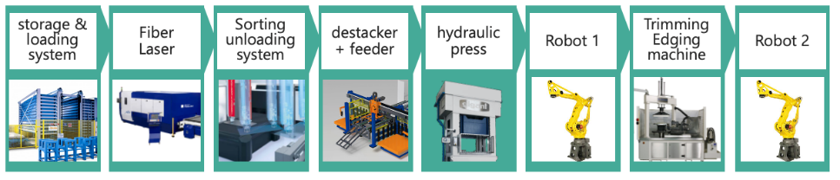
Use cases
7 application experiments
  Manufacturing of fine woolen fabrics
  Digital Brain for Injection Moulding
  AI-based discrete manufacturing optimization of
  roof systems
  Digital Twin for AM ensuring compliance
  across multiple machines
  Laser-Cutting and Forming of Aluminium
  Agricultural Robots
  Digital Brain in
  additive manufacturing industry

Slide 6
Use cases
All use cases are concerned with
  products that are used to produce other products/goods, so-called Industrial Products equipped with sensors
  data about and from these Industrial Products
  models that represent certain behaviour of these Industrial Products
  algorithms used to evaluate these models running on a diversity of compute resources
  => All use cases want to capture the history/provenance of this information, learn from it for the future and optimize products /processes

Slide 7
Use cases
7 application experiments
  Manufacturing of fine woolen fabrics
  Digital Brain for Injection Moulding
  AI-based discrete manufacturing optimization of
  roof systems
  Digital Twin for AM ensuring compliance
  across multiple machines
  Laser-Cutting and Forming of Aluminium
  Agricultural Robots
  Digital Brain in
  additive manufacturing industry

Slide 8





Use case example 1: Digital Brain for Injection Moulding
Input data
Process
Current solution
Part
few weeks
Process design
Production

Slide 9

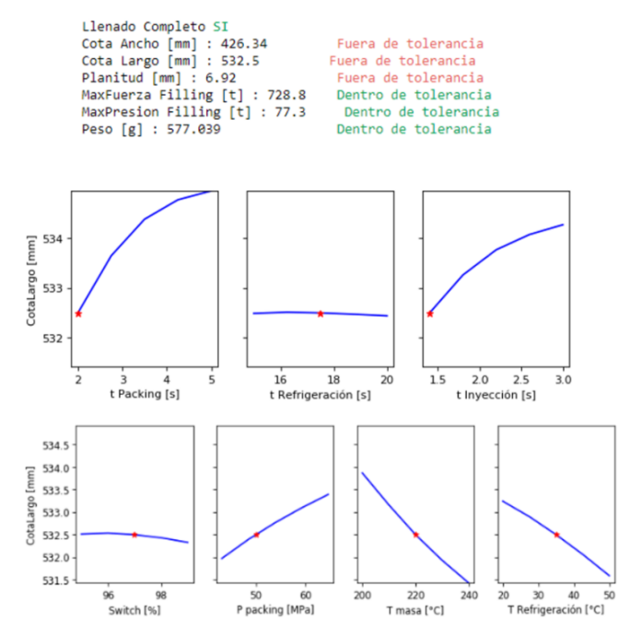
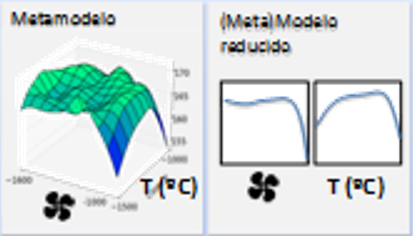
Use case example 1: Digital Brain for Injection Moulding
What needs to be done?
Model Order Reduction
For every KPI
P2
P1
P2
P1

Slide 10

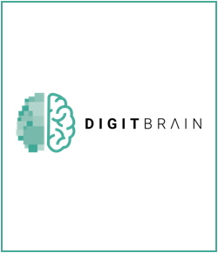

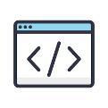
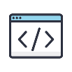
Use case example 1: Digital Brain for Injection Moulding
Input data
Process
Current solution
Part
few weeks
Process design
Production
Input data
Process
DigitBRAIN solution
FMU/FMI
Part
few days
Every day updating

Slide 11
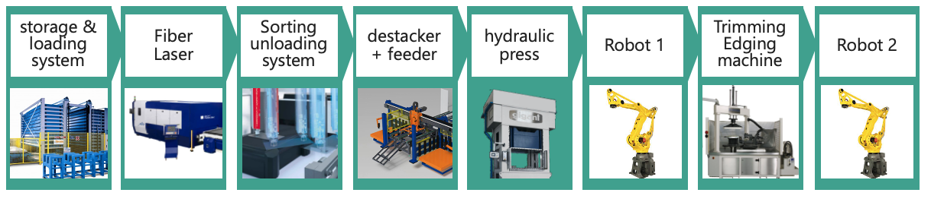
UC example 2: Laser-Cutting and Forming of Aluminium
GIGANT is a manufacturing SME working in the metal processing field
Laser-cutting and forming of aluminium products: a complex, automated manufacturing system where different technologies, different vendors and different control systems co-exist and cooperate.

Slide 12
UC example 2: Laser-Cutting and Forming of Aluminium
  The “as is” situation:
Inability to perform real-time “what-if” analysis based on the actual plant data
Inability to use the digital twin in the bidding/negotiation phase
Inability to provide simulation services and analytics empowered by the knowledge developed all along the plant’s life-cycle
Dichotomy existing between the real plant and its digital representation

Slide 13
UC example 2: Laser-Cutting and Forming of Aluminium
  The “to be” situation:
Implement a Digital Brain solution for one of GIGANT’s manufacturing systems
TTS s.r.l. Digital Twin tools in the DIGITbrain framework
NXT CPS-izer technology, a gateway to real plant data
create a fully working Digital Brain of a GIGANT plant
integrated with the FIWARE architecture
=> Digital Brain interfacing with the real plant counterpart

Slide 14

DIGITbrain High-level System Architecture Design
Digital Brain
Authoring tools
Digital Agora
signal/
trigger
event
User
DIGITbrain
Platform
Db P S
Expert
user
Db P S
Expert
user
Orchestrator
deployment
execution
metadata
update
resource broker
data and message broker
results
Production site
Remote compute resources
Local comp. res.
Edge dev.
Sensors
data
Industrial Product
Cloud
…
HPC
data
model(s)
algorithm(s)

Slide 15
Executing applications in DIGITbrain
Modelling, simulation, optimisation, analytics, and machine learning applications implementing the various algorithms are executed on
cloud, HPC and local (edge/fog) resources to evaluate the various models
EGI is the cloud/HPC provider of DIGITbrain
Application execution is based on the CloudiFacturing Solution that will be gradually extended with DIGITbrain services and components

Slide 16
Challenges of application execution
Cloud/HPC native solutions are required to avoid vendor lock-in
  seamless migration between cloud/HPC providers
Support for a varity of execution mechanisms/workflow systems is needed
  generic/uniform execution of applications/workflows
Need to integrate data from sensors and distribute execution to edge/fog layers
  deployment and execution to support the cloud to edge continuum
Solution is intended to be run on a commercial basis after the end of the project
  appropriate billing and security mechanisms need to be provided

Slide 17
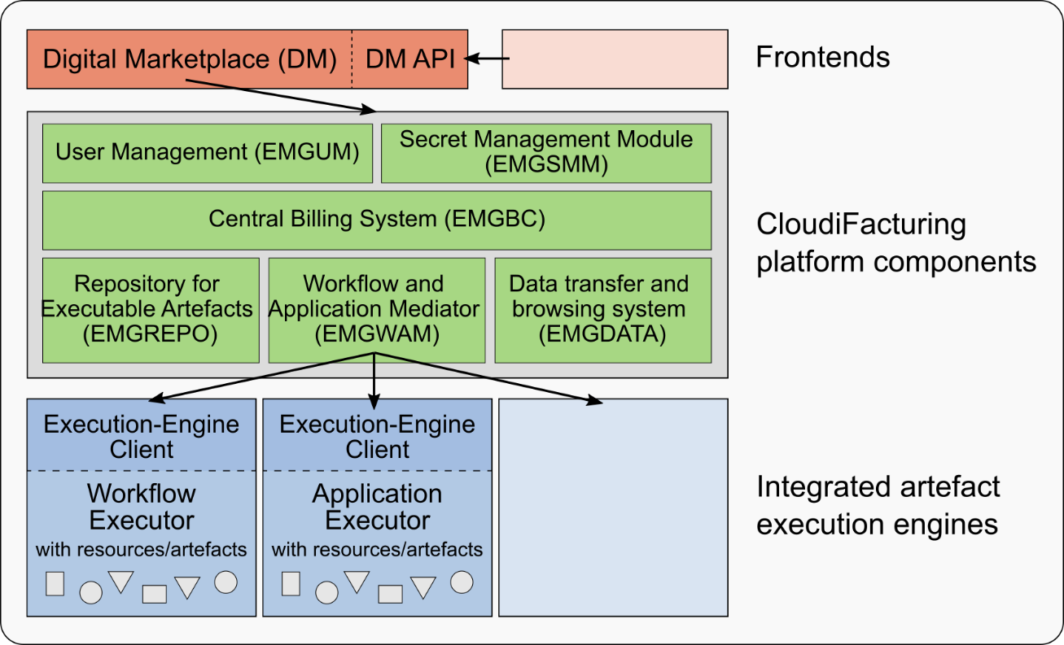
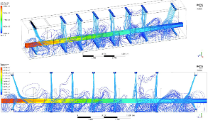
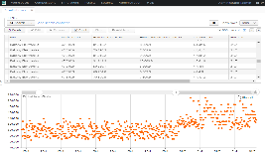
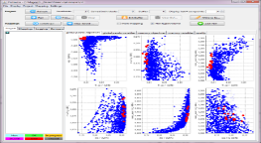
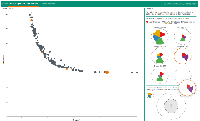

Towards a solution - The CloudiFacturing Solution
Entry point for customers
CloudiFacturing Platform
Execution engine agnostic
Flowbster
CloudBroker
MiCADO
Execution engines
New in DIGITbrain
Executable artefacts
Running on EGI and locally

Slide 18
The CloudBroker Platform
Multicloud platform for the deployment and execution of compute-intensive scientific and technical software in the cloud.
PaaS to register, deploy, charge for and use cloud resources and application software on a commercial basis.
More information:
http://cloudbroker.com/

Slide 19
Flowbster
Data intensive workflows in multicloud environments
Enables quick deployment of the workflow as a pipeline infrastructure
Workflow nodes can be deployed using the CloudBroker Platform
Data set
to be processed
Processed
data set
More information:
https://www.sztaki.hu/en/innovation/products/flowbster

Slide 20
MiCADO
Automated deployment and run-time management of containerised applications in multi-cloud environments – virtual machine creation also via the CloudBroker Platform
Currently being extended to uitlise edge/fog resources
More information:
https://micado-scale.eu/

Slide 21
DIGITbrain Open Calls
2 Open Calls
Who can participate?
  End users (manufacturing companies – SMEs and mid-caps)
  Independent Software Vendors (ISV) – SMEs and mid-caps
  Engineering consultants – SMEs and mid-caps
  Research organisations
  High-Performance Computing (HPCs)
  Digital Innovation Hubs
Number of experiments: 14 (7 per Open Call)
Budget: 1 400 000 € (≈100K€ per experiment)
Open Call (OC) | Launch | Execution
OC1 | March 2021 | September 2021 – August 2022
OC2 | March 2022 | September 2022 – August 2023

Slide 22
Thank you for your interest!
André Stork
Fraunhofer
EGI conference 2020
2th-4th November 2020
www.digitbrain.eu
www.linkedin.com/groups/12439191
www.twitter.com/digitbrain_eu
www.facebook.com/DIGITbrainProject

Slide 23

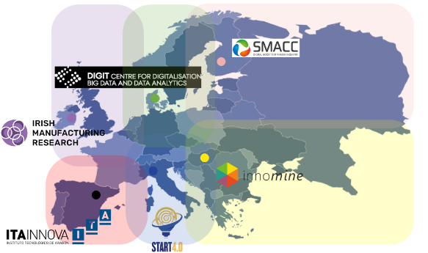
Objectives
To implement the Digital Brain concept
  To configure and orchestrate data, models, algorithms, and resources
To extend the CloudiFacturing Platform
  Integrating new execution engine for co-simulation
To develop MaaS business model
  To be implemented by the DIHs
To augment the capabilities of the Marketplace
  Integrating Digital Brain concept and MaaS business model
To conduct three waves of experiments
  To validate the project results: 1 internal, and 2 Open Calls
To evangelise the manufacturing community
  On the benefits and impact of MaaS – DIHs involvement

Slide 24
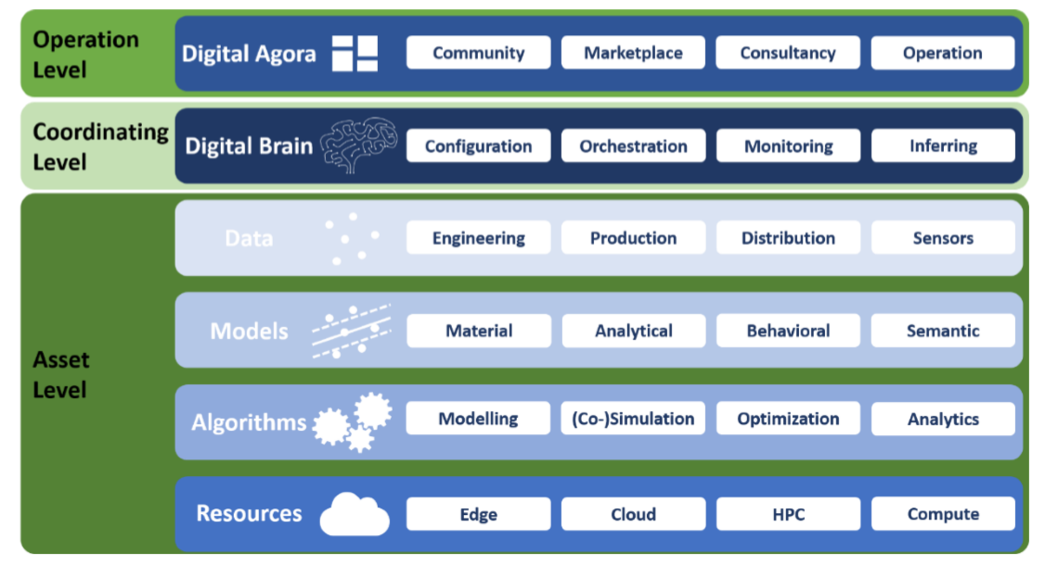
DIGITbrain - Concept
vertical
integration
horizontal
integration

Slide 25
DIGITbrain timeline
Open Call
Open Call
Wave 1 Experiments
Wave 2 Experiments
Wave 3 Experiments
Advanced Technical and Business Support
Continuous implementation, integration, and validation
M01
M03
M06
M09
M12
M15
M18
M21
M24
M27
M30
M33
M36
M39
M42
July 2020
March 2021
March 2022
December 2023

