Slide 1
EGI-ACE Project Overview
EGI Advanced Computing for EOSC
Gergely Sipos
Head of Services, Solutions, Support
EGI Foundation

Slide 2
EGI-ACE Overall objective
H2020 Call INFRAEOSC-07-2020 - Increasing the service offer of the EOSC Portal
Topic (a1) - Distributed and cloud computing resources
Implement the Compute Platform of the European Open Science Cloud and contribute to the EOSC Data Commons by delivering integrated computing, platforms, data spaces and tools as an integrated solution that is aligned with major European cloud federation projects and HPC initiatives.
8 Million Euro (EC Grant) + 2.4 Million Euro (EGI.eu contribution)
30 months, expected start in Jan 2021

Slide 3
EGI-ACE specific objectives
Objective 1. Deliver the European Open Science Cloud Compute Platform and expand the supply-side
Objective 2: Contribute to the implementation of the EU Data Strategy and the EOSC Data Commons to support the Green Deal, Health and Fundamental Research
Objective 3: Integrate the EOSC Compute Platform with the EOSC Portal and the EOSC Core
Objective 4: Contribute to the realization of a global Open Science Cloud
Objective 5: Expand the demand-side of EOSC across sectors and disciplines
EOSC-Exchange
O4
O1
O5
Federated Data
O2
EGI-ACE
O3
EOSC Core

Slide 4
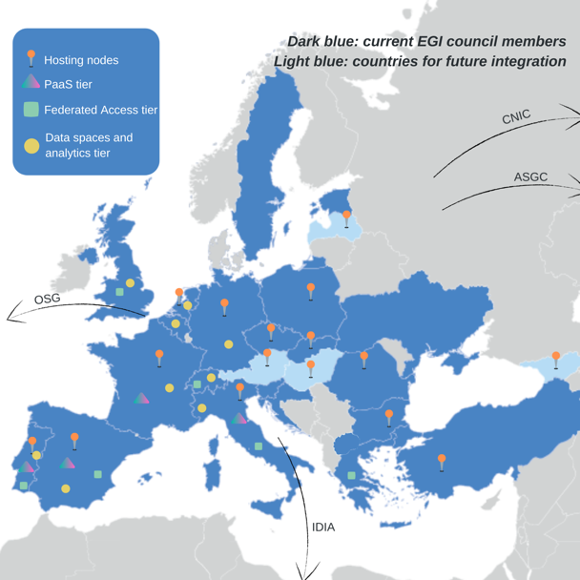
Consortium Overview and Service Providers
EGI Foundation as coordinator
33 participating partners, 23 third-parties
Consortium at a glance
16 partners to deliver HTC, HPC and cloud resources
12 user access and platform solution providers
21 providers from 13 communities to deliver data spaces
12 federation service providers
57% of the budget for service provisioning

Slide 5
Tier service architecture
Data Spaces
and Analytics
Data and thematic data analytics and processing tools
EOSC portal
Green Deal Data Space
Health Data Space
Fundamental Science Data Space
Platforms
generic added-value platform level services
Interactive Computing
Automated Cluster deployment
Distributed AI training
Workload Management
EOSC
users
Service Management, Tools, Processes, Policies
Federated
Access
Federation-wide management of data and computing
Federated Compute
Federated Identity
Federated Data
Federated
Resources
Compute and storage facilities
Research Clouds
Public Clouds
HTC
HPC

Slide 6
Hosting nodes – Cloud & HTC
Allocation for communities within the project AND for new EOSC users
Increasing capacity (Cloud and HTC):
Phase 1 (month 1-10) ⇒ 13.8 Million CPU hours/41,300 GPU hours/7.5 PB/month
Phase 2 (month 11-20) ⇒ 27.6 Million CPU hours/83,000 GPU hours/15 PB/month
Phase 3 (month 21-30) ⇒ 41.4 Million CPU hours/124,000 GPU hours/23 PB/month
Mix of funding mechanisms
Virtual Access:
Grants enabling policy-based access (EGI Cloud Federation + new partners):
Pay-for-use:
Diverse locations AND compute flavors
Moldova
Latvia
Georgia
Hungary
Austria
USA
China
South Africa

Slide 7
HPC infrastructure
Objective: Interoperability guidelines for HPC systems with the EOSC Cloud Compute platform
Best ways to present HPC systems via the EOSC portal
Best ways for user interaction (AAI, containers, accounting, helpdesk, …)
Hybrid workflow support
Organising HPC user support in EOSC
Activities:
Pilot sites:
Scientific validation:
Extreme Light Infrastructure (Nuclear Physics)
High Energy Physics
Earth System Modelling (Climate research)
PROMINENCE Fusion physics
Coordination with broader HPC landscape:
Benefitting from the EGI federation capabilities

Slide 8
Access and platforms
From the consortium
From the EOSC Portal
From the EGI channels
Resource brokering and allocation process
(Service Level Management)
e.g. ENES data space
e.g. A project from EOSC Portal
e.g. A community allocation from EGI
Access interfaces/environments (e.g. AppDB, EC3, OpenStack dashboard, SPIDER, Notebooks-Binder, APIs, etc.)
Application/workload management (CVMFS, AppDB, DIRAC, DEEP, DODAS, INDIGO-PaaS)
Data management (FTS, DataHub, RUCIO, OpenRDM)
Authentication-authorization infrastructure (Check-in)
Additional EGI federated sites
Additional peer infrastructure partners

Slide 9
Humanities
Integration support
OPERAS metrics and certification service
Disaster mitigation and agriculture
WeNMR (structural biology)
Health and medicine
EISCAT_3D Data Portal
(atmospheric physics)
GEOSS Portal and GEO DAB
Earthquake response and landslide analysis
Environmental sciences
GBIF Cloud data space
Virtual Imaging Platform (medical imaging)
EGI-ACE Data spaces
EMSO ERIC data services
OpenRiskNet NanoCommons
VIRGO (gravitational waves)
MeerKAT workflows (astronomy)
E-RHIS (heritage object analytics)
The project to perform FAIR maturity assessment & improvement recommendations
SeaDataNet WebOcean Data Analysis
UseGalaxy.eu (bioinformatics)
PHIRI (population health)
JupyterLab
Enes libraries
EC3
Synda & DataHub
ESGF data archive
Cloud and HPC
LOFAR science products (astronomy)
OPENCoastS (circulation forecast)
PROMINENCE (fusion physics)
ENES (climate analytics)
Climate research
Energy and physical sciences

Slide 10
Expanding the user and supplier base
EOSC Future | EGI-ACE
1 call for use cases per year Training on AI/ML in the cloud (LIP), FitSM (EGI.eu), Data transfer (STFC), Security forensics (CESNET, NIKHEF), Federation tools (KIT, GRNET, CESGA, STFC) Run EOSC event programme (TBD) | Support the EOSC Future calls 2 additional call for compute use cases / year User support for each service Training effort for infra, platform, access services Contribute to EOSC event programme Two Project Flagship Events, one public event per year Webinar programme Integration handbooks Integration bootcamps (for data spaces; for compute providers)

Slide 11
Key exploitable results and target groups
Research, public sector, industry/SMEs
KER1 Free at point of use services, IT resources, data and analytics via EOSC portal
KER2 Training, handbooks and consultancy
EOSC Portal Operator
KER3 Improved Service Management System and Tools
Service and content providers
KER4 Interoperability Toolkit
Projects INFRAEOSC-7-A*
KER5 Strategy and Recommendations
EOSC governance

Slide 12
Questions?
Stay informed via www.egi.eu

