Slide 1
Short overview of the EOSC Synergy countries report
EOSC Synergy Dutch Data Landscape Workshop - 5 November 2020
Valentino Cavalli – EGI Foundation
Valentino.Cavalli@egi.eu

Slide 2
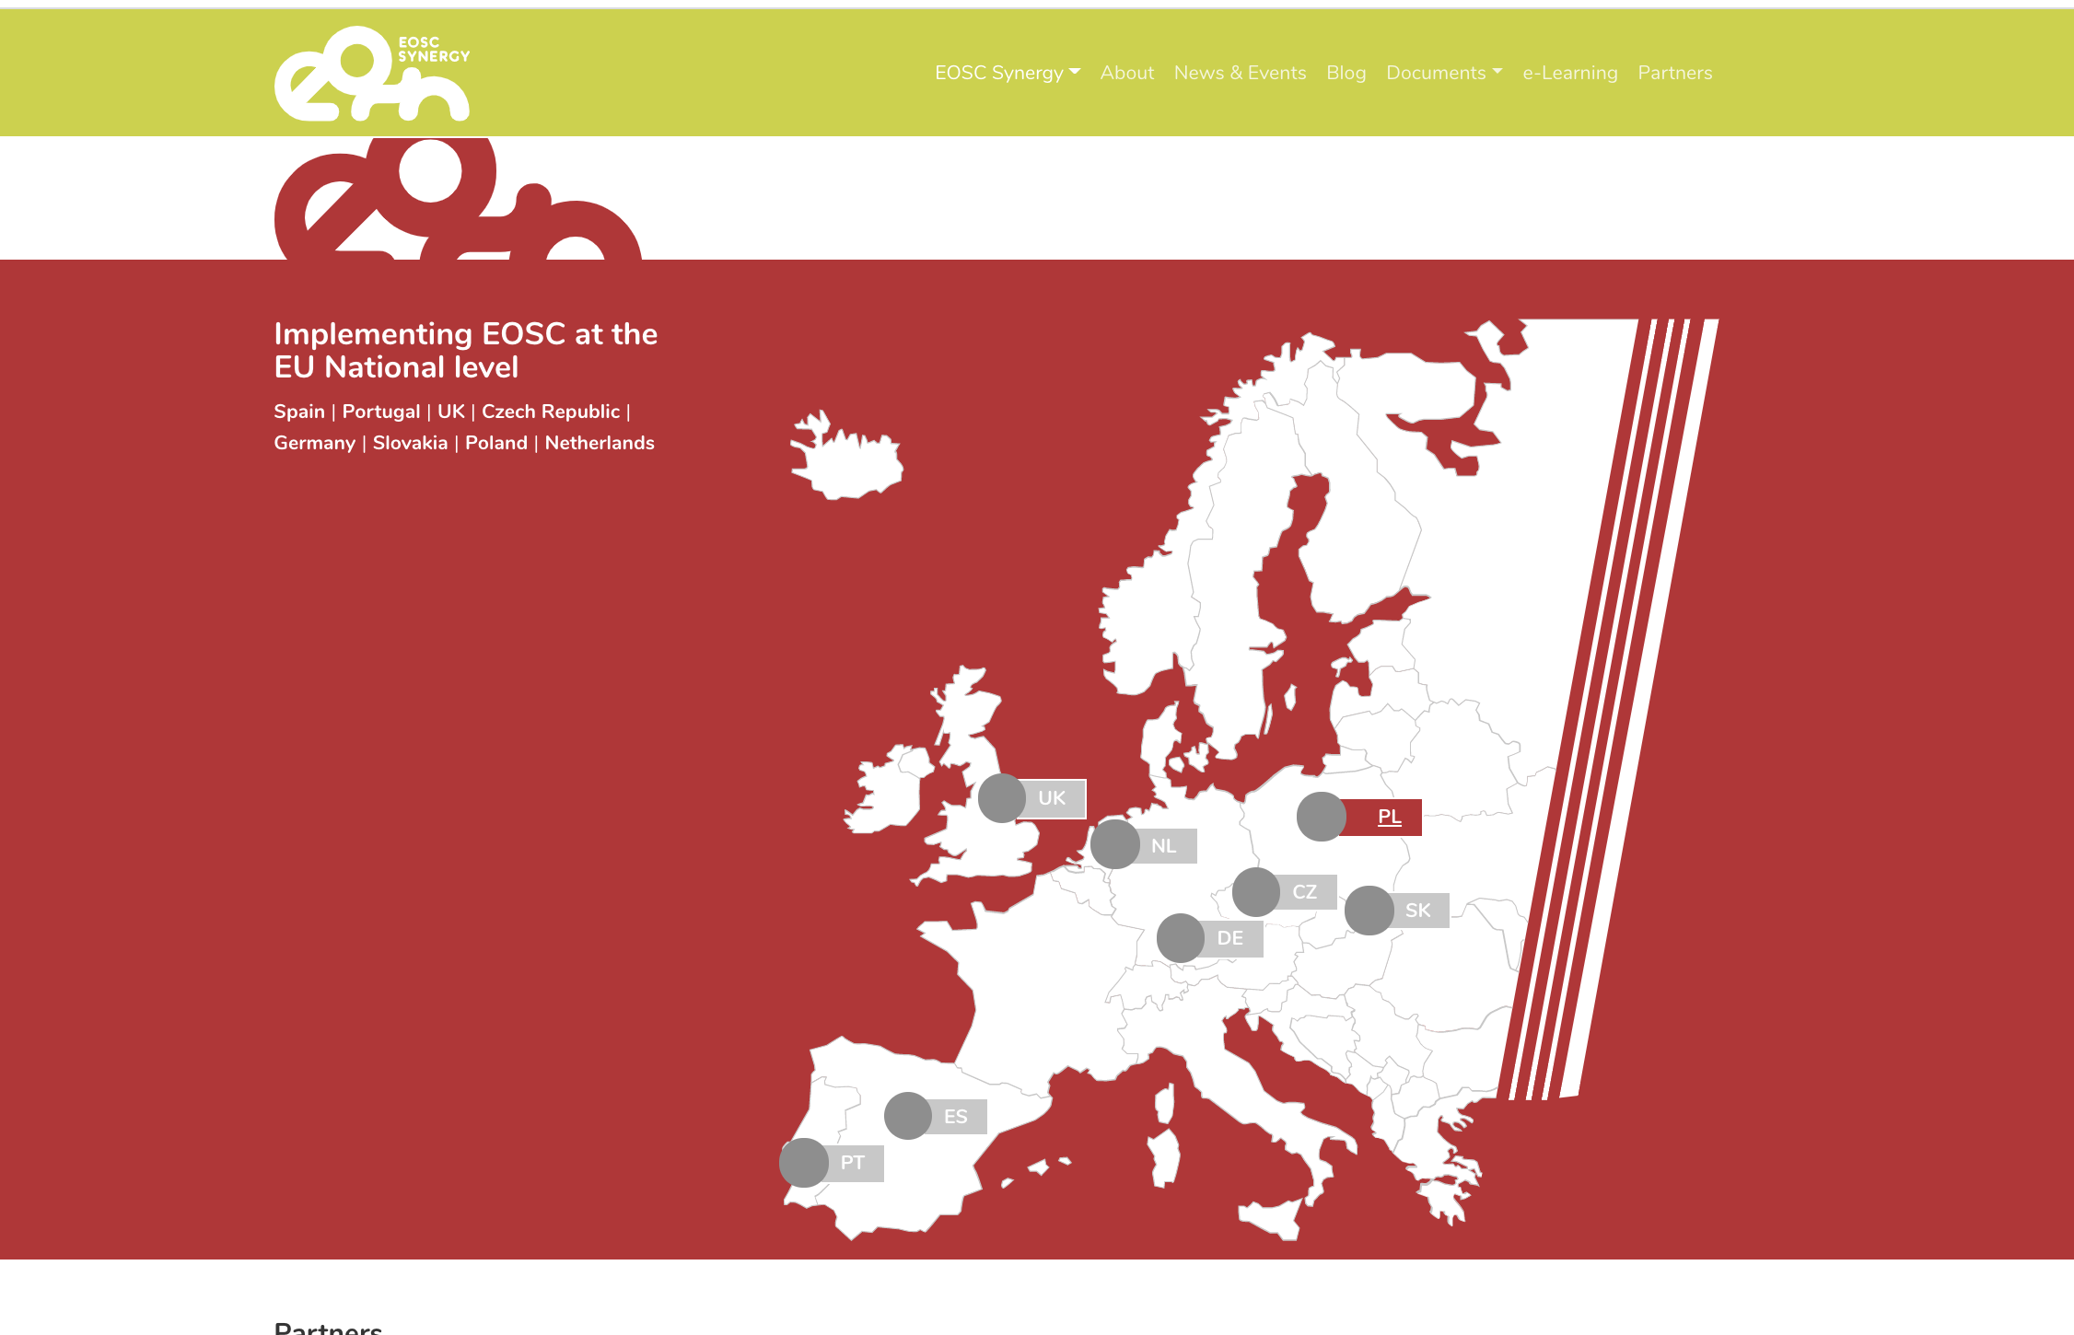
EOSC Landscaping activities in Europe
EOSC-Synergy: Analysis of EOSC
landscape in 7 countries:
CZ, ES, NL, PL, PT, SK, UK.
Other EC INFRAEOSC 5b projects cover different regions:
EOSC-Nordic, NI4OS (SE Europe), EOSC-Pillar (FR, IT, AT, DE, BE).
Europe-wide summary report by EOSC Secretariat.
EOSC Landscaping Working Group report.

Slide 3
Rationale/aims for Landscape analysis
“Collect information about the national policies, practices, roadmaps and strategies around funding, procuring, providing, accessing and sharing of services and resources in the EOSC scope.
Special emphasis will be given to policies and practices that address the needs of different EOSC user groups, with a focus on the user communities that are already part of national research roadmaps.
The work will cover a wide range of policies, including those dealing with generic services for data production, processing and preservation, as well as those for thematic resources and services that target the needs of specific research communities.
Existing policies and practices, where applicable, will be related to national and international regulatory frameworks (e.g. handling of privacy-sensitive data in compliance with GDPR)”

Slide 4
A ”regional” project which covers various regions with quite diverse macro-indicators

Slide 5
Fixed list of topics/questions
Structure of Analysis / Table of Contents derived from EOSC PILLAR project
Around 70-80 topics/questions
Most countries organized a survey with a questionnaire
ES, UK, NL (partly also CZ and PT) based themselves on existing sources
https://www.eosc-pillar.eu
Austria, Belgium, France, Germany and Italy

Slide 6
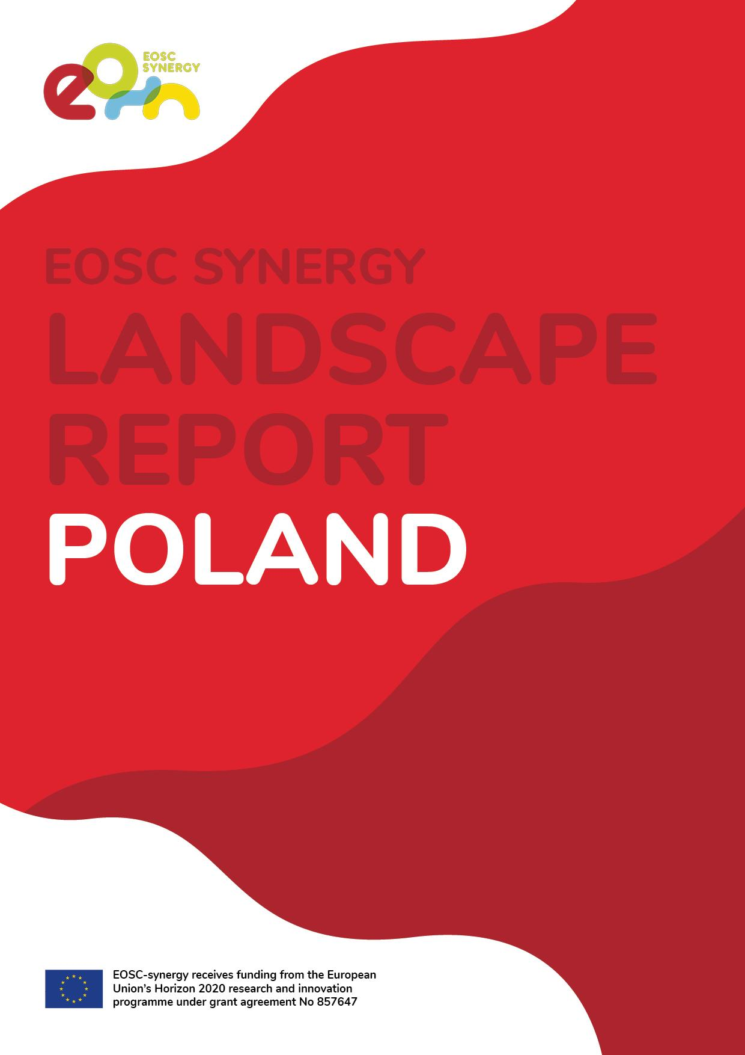
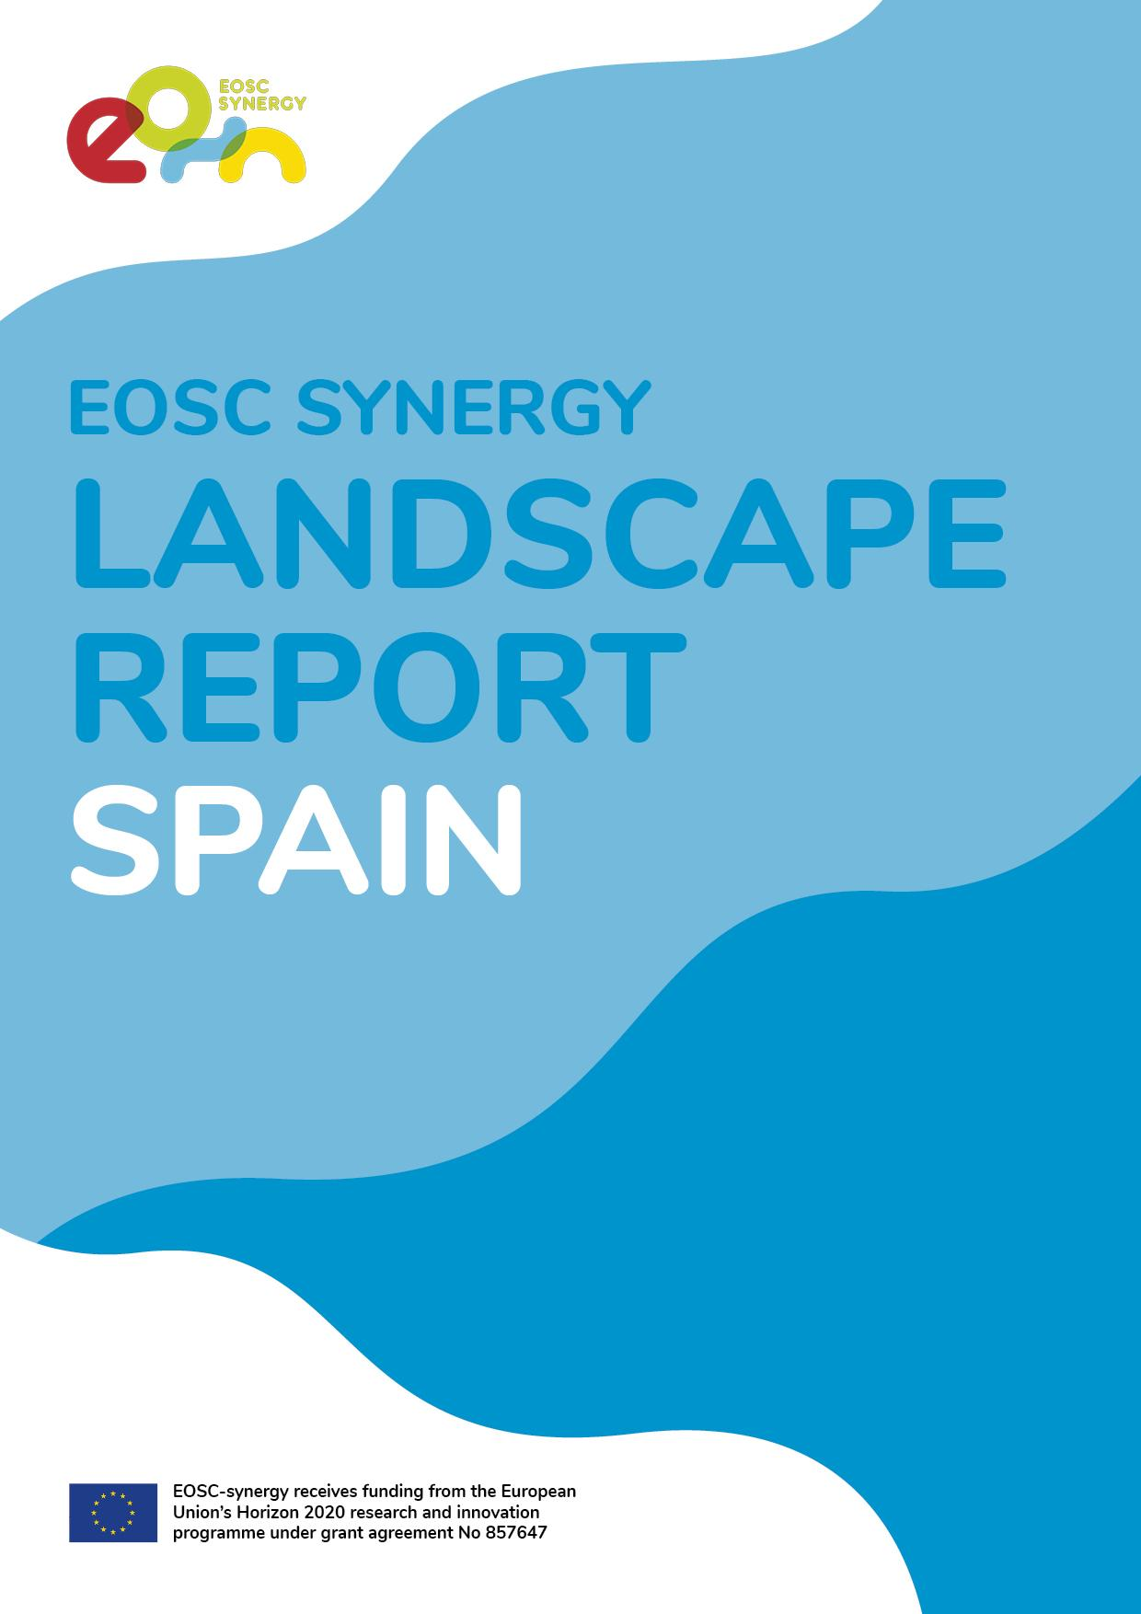
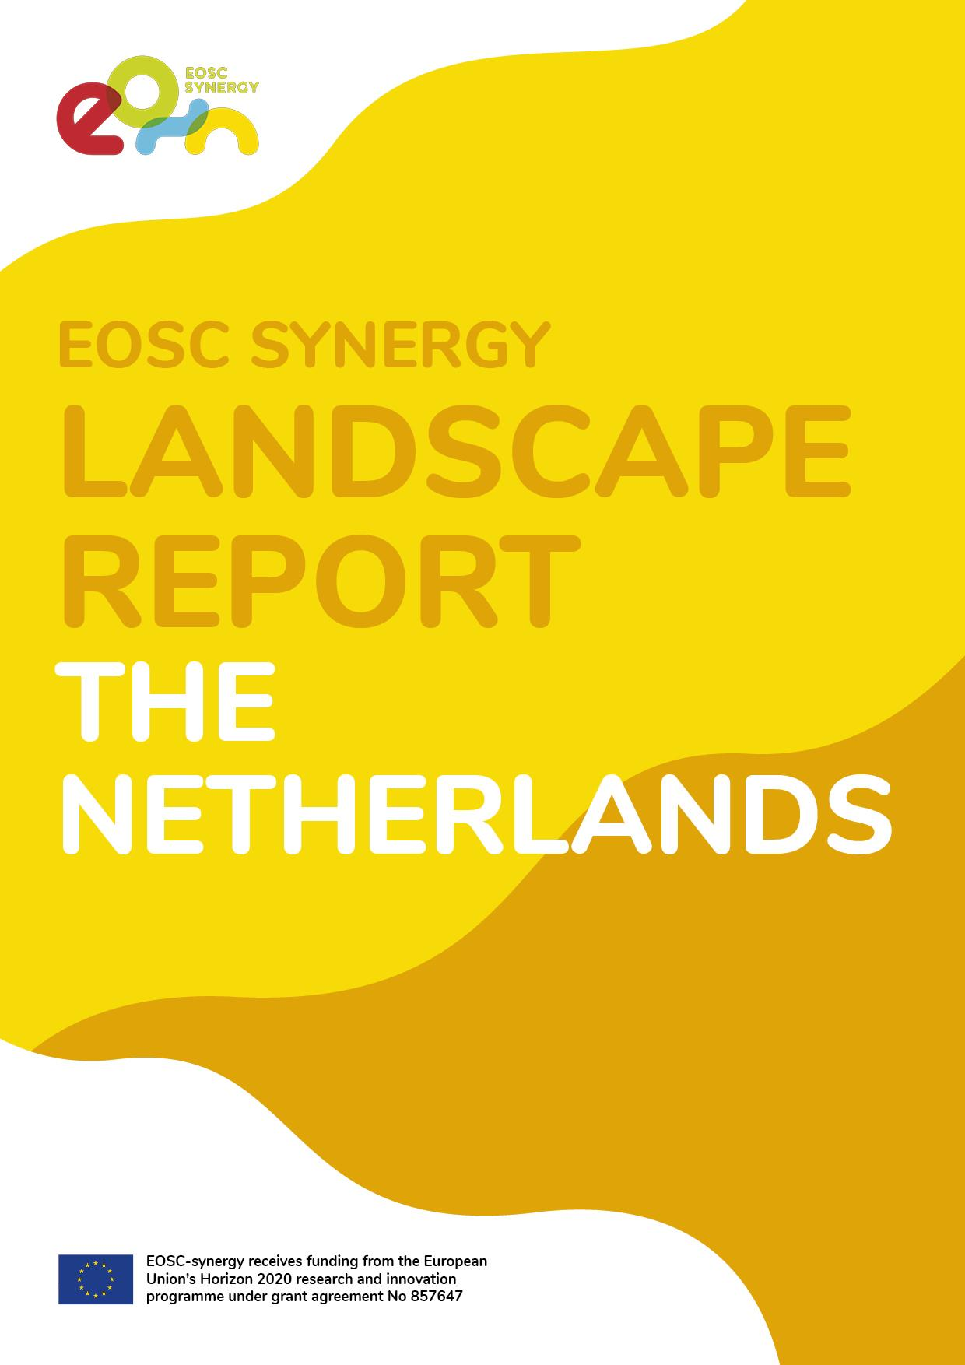
Not a single landscape - 7 country reports
Current snapshot - Reports finalized in May 2020
CZ | Michal Růžička, Ivana Křenková, Luděk Matyska (CESNET) | http://dx.doi.org/10.5281/zenodo.3891370
SK | Ladislav Hluchy and Miroslav Dobrucky (IISAS) | http://dx.doi.org/10.20350/digitalCSIC/12626
ES | Ignacio Blanquer (UPV), Isabel Campos (CSIC), Maria Cuesta, Inmaculada Figueroa (MICIN-ES) | http://dx.doi.org/10.20350/digitalCSIC/12624
PL | Miroslaw Kupczyk (PSNC) | http://dx.doi.org/10.20350/digitalCSIC/12625
PT | Filipa Pereira (FCCN) | https://doi.org/10.34642/fccn_bep7-qk29
NL | Peter Doorn (DANS) | https://doi.org/10.17026/dans-2by-ereu
UK | Dale Robertson (Jisc) | http://dx.doi.org/10.20350/digitalCSIC/12631

Slide 7
Research topics
Policies/strategies about:
Funding, procuring, provisioning, accessing and sharing services/resources
Generic services for:
data production, processing, curation, preservation and sharing
Specific thematic services/resources for:
EOS community
Biomedicine community
Astrophysics community
Environmental Sciences community
National organisational/regulatory frameworks about:
integrated procurement
open science support and collaboration

Slide 8
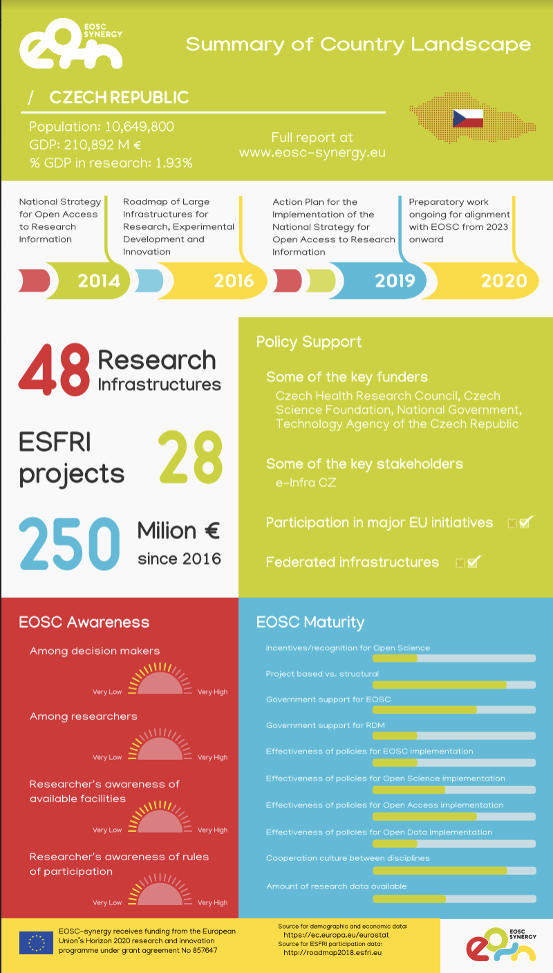
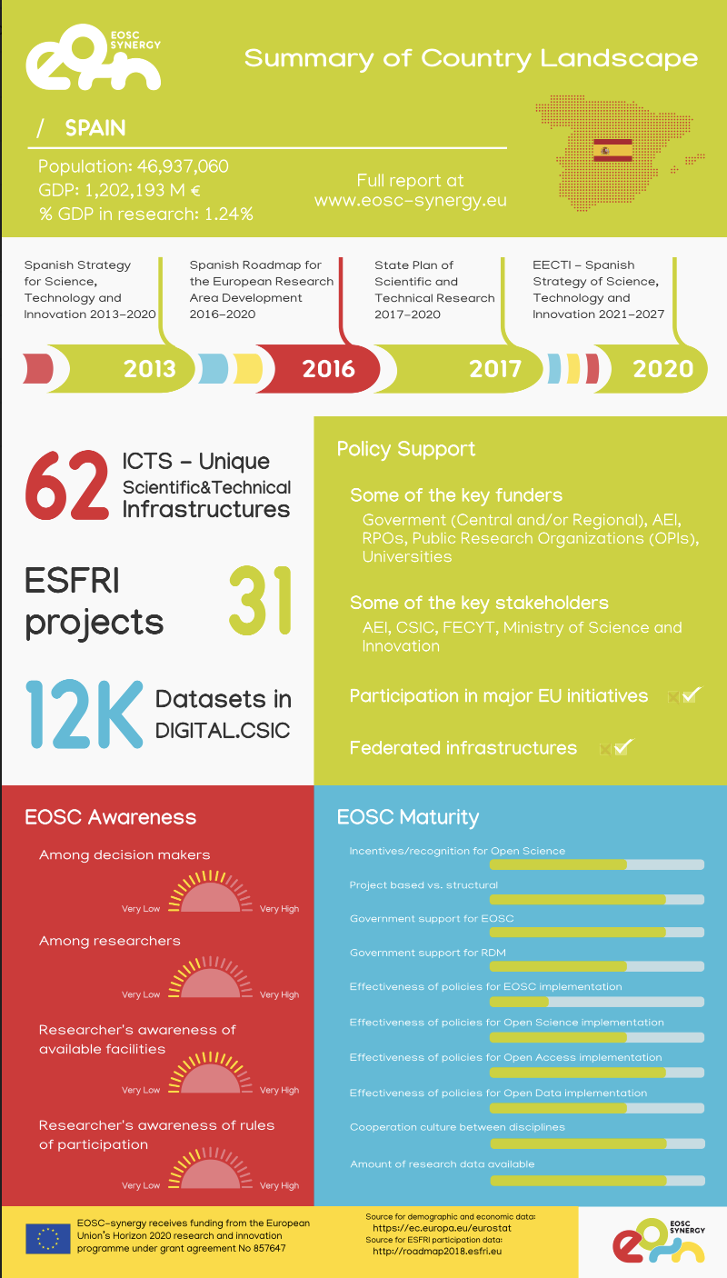
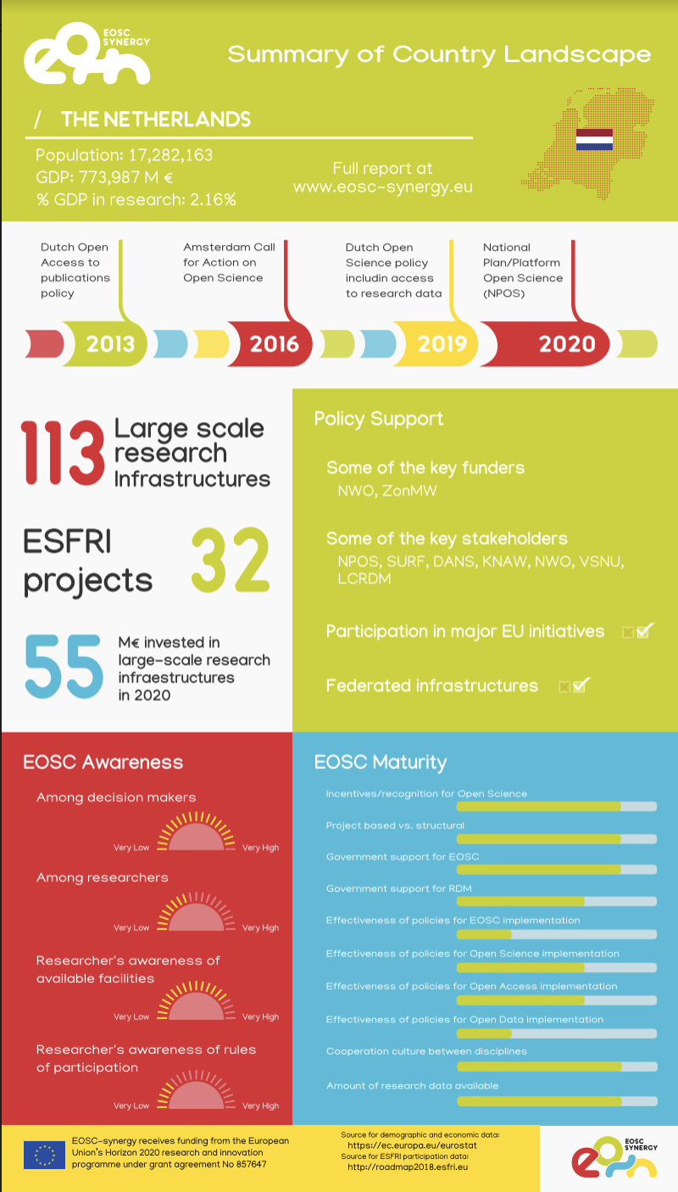
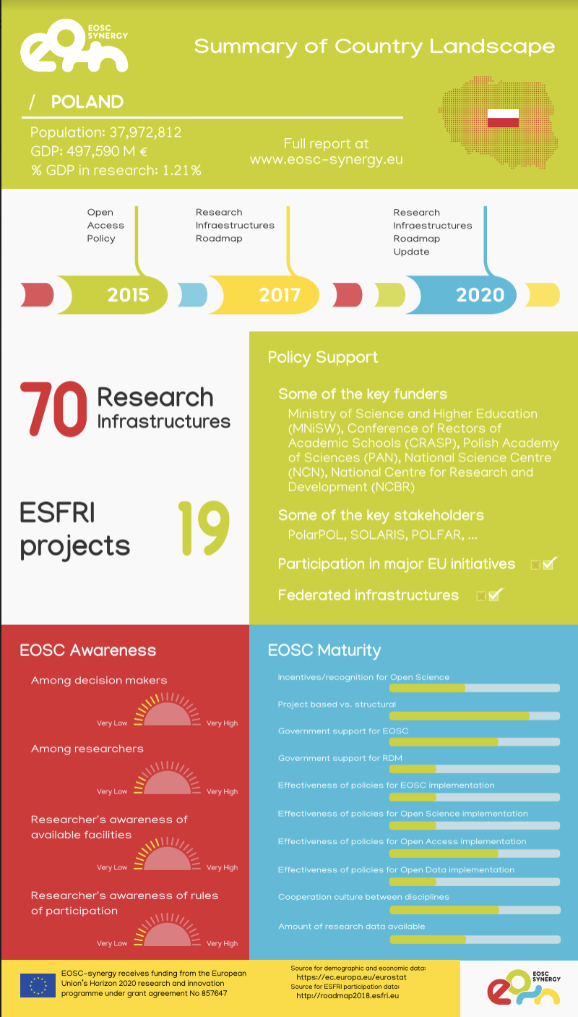
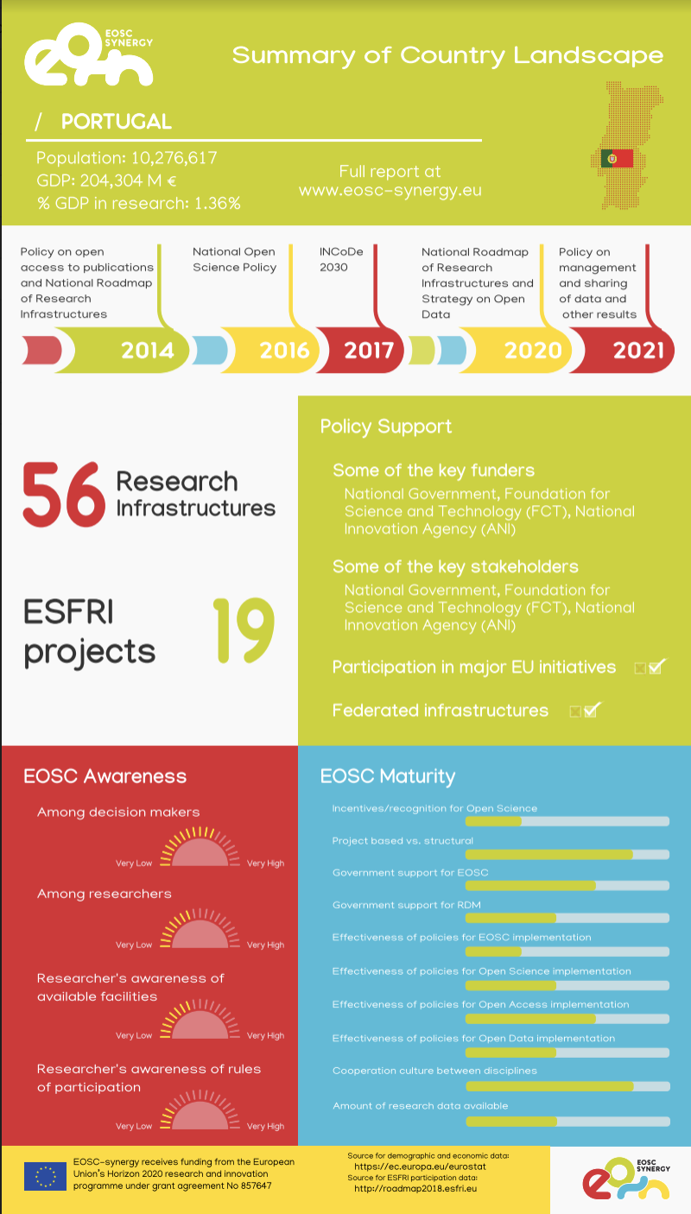
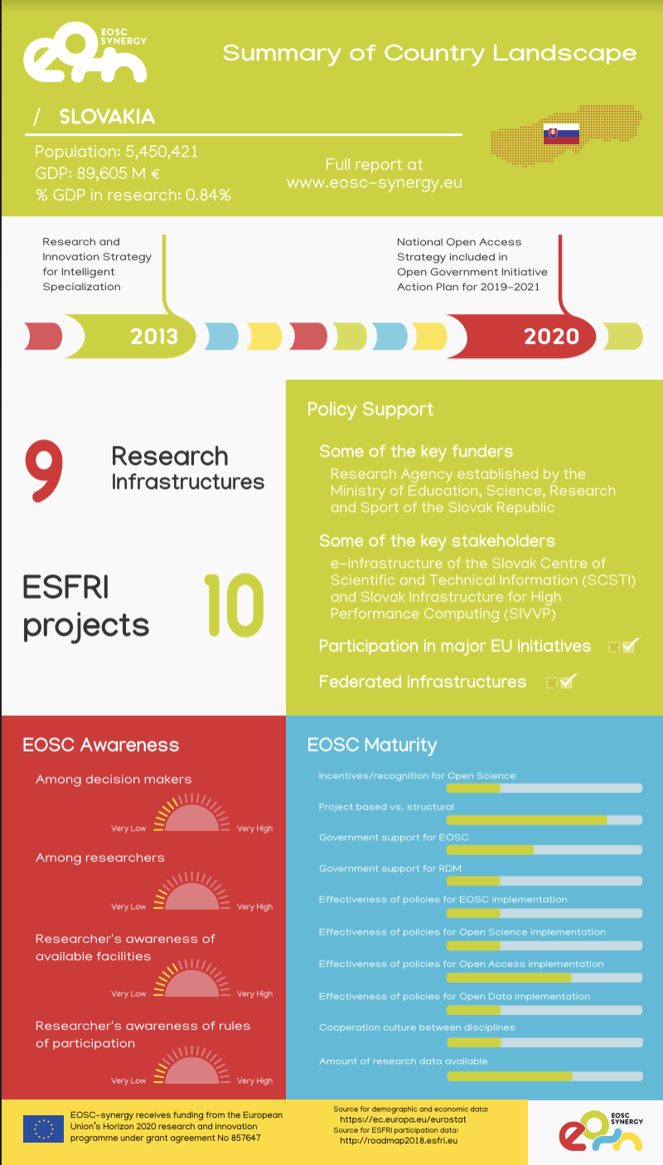
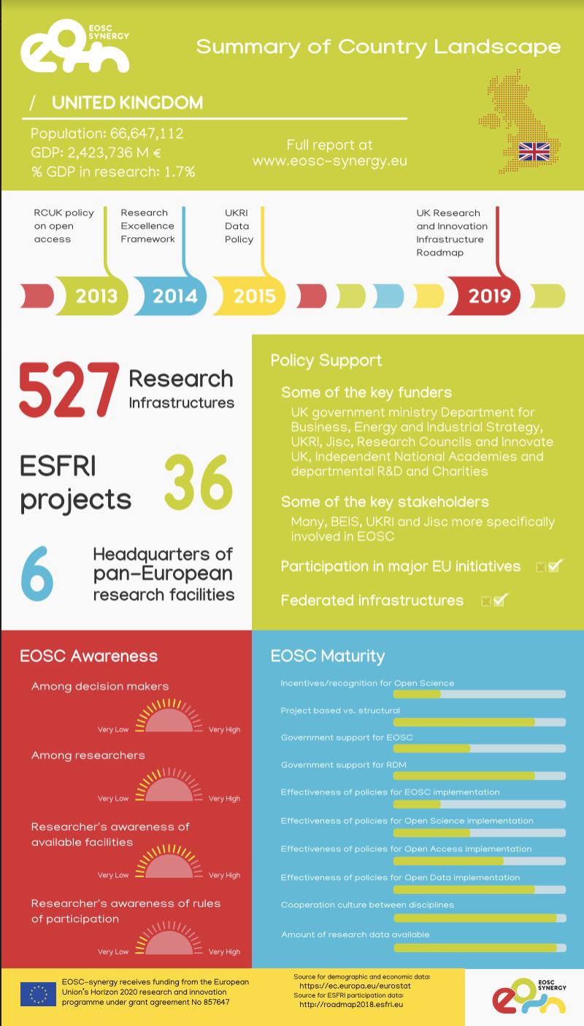
Highlights - 7 information sheets
Available at
www.eosc-synergy.eu

Slide 9
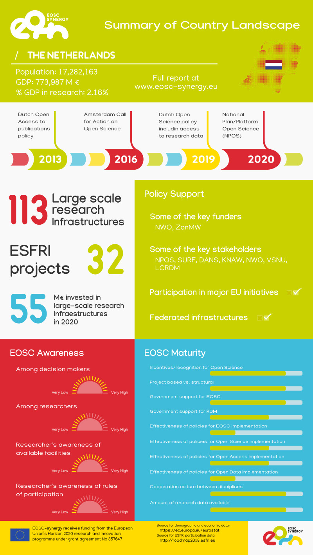
Macro- economic context
Timeline with the main policy roadmaps
Highlights from each country
Policy support, funding and stakeholders
EOSC awareness
EOSC Maturity

Slide 10
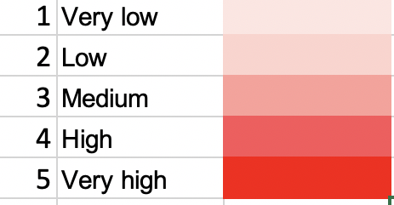
Awareness

Slide 11
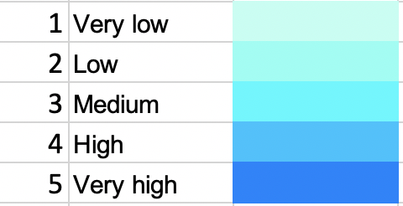
Maturity

Slide 12
Next steps
EOSC landscape is changing constantly so each landscape exercise is just a snapshot at a particular point in time. Other groups are thinking about establishing regular monitoring mechanisms.
Our “snapshot” feeds a gap analysis of relevant policies in our “region” with a view to identify barriers and scope for better harmonisation (some areas):
Integrated procurement,
Resource/service access provisioning,
Other barriers to cross border (international) collaboration in the EOSC context.
Report and recommendations in summer 2021.

Slide 13
Thank you
Any questions?

