Slide 1
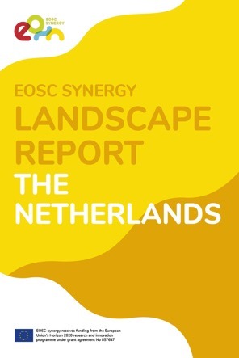
Main results of the Netherlands landscape analysis
EOSC Synergy Dutch Data Landscape Workshop - 5 November 2020
Peter Doorn – Data Archiving and Networked Sevices (DANS)
peter.doorn@dans.knaw.nl
@pkdoorn @dansknaw
https://doi.org/10.17026/dans-2by-ereu

Slide 2
Table of Contents: focus on
1. Introduction
1.2. Definition/delimitation of “EOSC compliant resources”
1.3. Information sources on services, repositories, facilities and infrastructures
2. National policies and frameworks for open science
3. EOSC compliant resources
3.1. Characteristics of services/resources
3.2. Data services
4. Procurement of and transnational access to EOSC-compatible services
5. Conclusions
5.1. SWOT analysis
5.2. Gaps, overlaps and optimization of the landscape

Slide 3
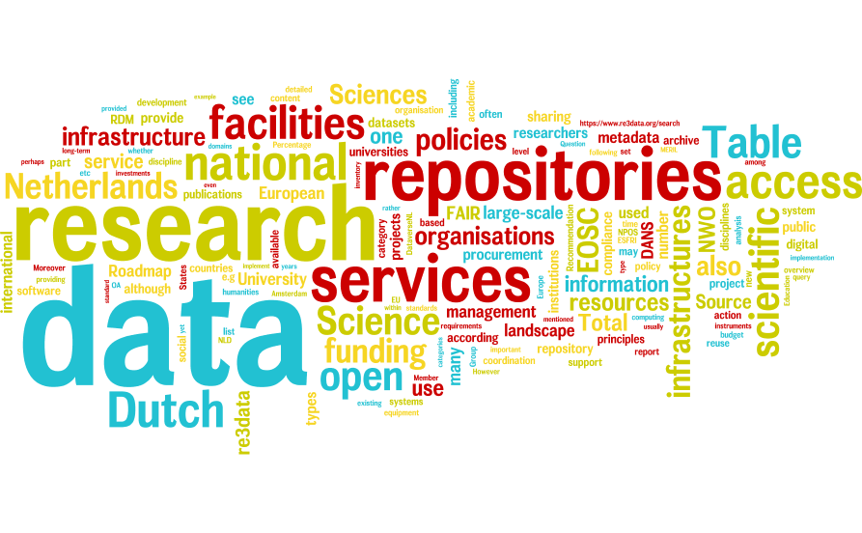
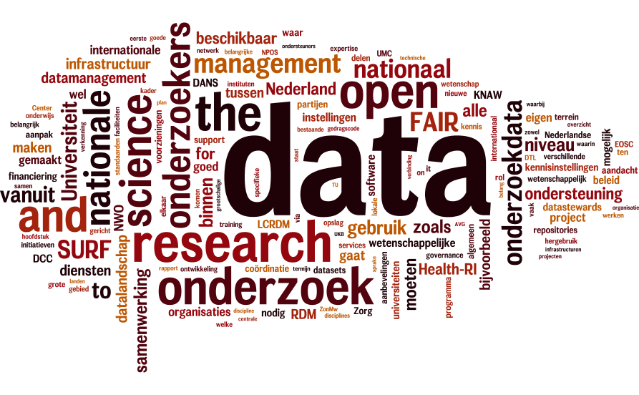
EOSC Synergy landscape report compared to NPOS “Verkenning nationaal datalandschap”
EOSC Synergy Landscape Report – based on available data sources
NPOS Verkenning nationaal datalandschap – based on interviews
Notes:
The EOSC Synergy report aims to provide an overview of what is there, with quantitative information where available.

Slide 4
Definition/delimitation of “EOSC compliant resources”: many terms, not always clear
Big Research Facilities
Data Repositories
FAIR Data Services
e-Infrastructure
ICT Infrastructure
ICT Services
Trusted Digital Repositories
EOSC Compliant Services
Digital Infrastructure

Slide 5
What are we talking about? Some terms and definitions (a selection)
Data repositories are places where collections of data(sets/files) are stored and logically organized (i.e., usually described according to some metadata schema), so that they can be found and accessed for reuse.
E-Infrastructure is “a combination of digital technologies (hardware and software), resources (data, services, digital libraries), communications (protocols, access rights and networks), and the people and organisational structures needed to manage them.” (European Commission) [....] E-Infrastructures provide digital-based services and tools for data- and computing-intensive research in virtual and collaborative environments.”
“Research Infrastructures are facilities that provide resources and services for research communities to conduct research and foster innovation [...]. They may be single-sited, distributed, or virtual.” (ESFRI)
Notes:
In practice it depends on who is defining and deciding. Some infrastructures are really temporary projects.

Slide 6
2. Policies and frameworks for open science
2.1. Formal regulations or publicly available policies
2.1.1. Open Access to publications
2.1.2. Research Data Management (RDM)
2.1.3. Open research data
2.1.4. Long-term availability of research data
2.1.5. Compliance of data to the FAIR principles
2.1.6. Publication of data in a repository
2.2. Strategies and policies for funding infrastructure services and resources
2.2.1. Subsidies for the use of large facilities
2.2.2. Example of research calls contributing to infrastructure
2.3. Present status with regard to Commission Recommendation (EU) 2018/790 on access to and preservation of scientific information
Like the Open Data Directive
of 25/4/2018, Recommendation 2018/790 received remarkably little attention. Everybody seemed preoccupied with the GDPR!
Notes:
I will largely skip this chapter. It is remarkable how little attention the Commission Recommendation (EU) 2018/790 on access to and preservation of scientific information received, and the same is true for the Open Data Directive (25 April 2018), formerly known as the PSI Directive.

Slide 7
3. Characteristics of “EOSC compliant resources”
25 repositories harvested by NARCIS
Is being updated right now
Notes:
Digital Research Infrastructure components according to NWO, Re3Data, MERIL, ESFRI and LCRDM
Different registers and overviews define digital research infrastructure differently. NWO presents a list of “large-scale scientific infrastructures”, also called “facilities”; Re3Data is a registry of “repositories”, which also appears to include some individual information systems and databanks; MERIL and ESFRI provide an overview of research infrastructures, but ESFRI maintains a more restrictive Roadmap, distinguishing R.I. “projects” and “landmarks”; the overview of LCRDM consists of “RDM facilities”, including such things as repositories, training courses, etc. Moreover, sometimes the focus is on the institution, sometimes on the services of these institutions; therefore, what is measured depends on how it is measured. Keep in mind that the registrations are seldom complete, and get quickly outdated. Still, we can safely assume the Dutch data infrastructure consist of > 100 components of some substance and recognition.

Slide 8
Research facilities / data repositories / infrastructures by discipline according to NWO, Re3Data, MERIL
Notes:
Research facilities/data repositories/infrastructures by discipline according to NWO, Re3Data, MERIL
The division of research infrastructures over disciplines varies, depending on the way it is defined. In terms of the NWO facilities, the humanities and social sciences are much more underrepresented (12%) than in terms of Re3Data repositories (31%), whereas in terms of MERIL general RI’s, the percentage is in between (22%).

Slide 9
Characteristics of data/content services “Dutch Open Science Monitor”

Slide 10
Certified data repositories for Long Term Preservation
Source: Dutch data repositories in Re3Data
Notes:
Certified data repositories for Long Term Preservation
16 out of 56 data repositories in The Netherlands comply with some certificate for trustworthy long-term preservation. Data Seal of Approval, which now is part of Core Trust Seal, is the most common. 15 repositories comply with one (or both) of these two. These Seals make sure data is preserved and shared in a FAIR way.

Slide 11
Use of Persistent Identifiers (PID) in data repositories
Source: Dutch data repositories in Re3Data
Notes:
Use of Persistent Identifiers (PID) in data repositories
The use of persistent identifiers is an important criterion of FAIR data. Slightly over half of the Dutch data repositories supply a PID, mostly Handle or DOI, sometimes a URN.

Slide 12
Numbers of data sets/collections (logarithmic) in 25 data repositories (June 5th, 2020)
Source: Repositories harvested by NARCIS
Notes:
Numbers of datasets in data repositories
There is no complete overview of research data in repositories, let alone of data that are not in a repository. Moreover, the definitions of the data unit (set, collection) vary. One data set may consist of just one file, or of thousands of files. One file may be a small table or consist of millions of records. Such differences are again partially dependent upon the discipline or community. E.g., TLA-MPI registers individual language files (in NARCIS, instead of sets of data or collections, like the other repositories. More research into what data are stored under controlled conditions in repositories, and what data are not, is urgently required.

Slide 13
Another visualisation (September 2020)
Files on SURF hierarchical storage system (111M total) - CDIMS top file count per user on 2020/20/30
What you count is what you get… The character, contents, curation and sizes of datasets vary across disciplines and repositories. This complicates direct comparison.
Figure provided by Maurice Bouwhuis, SURF-DANS meeting, 30/10/2020
Notes:
Het DANS-archief omvat veruit de meeste datasets van alle research data repositories in Nederland: bijna 150.000 in september 2020. Die 150.000 datasets omvatten meer dan 5 miljoen bestanden. De aard, inhoud en omvang van datasets verschilt over vakgebieden en repositories, wat directe vergelijking bemoeilijkt. The Language Archive van het MPI bevat bijvoorbeeld ca. 130.000 spraakbestanden, verdeeld over een kleine 300 collecties. In datasets gerekend is het repository van 4TU.ResearchData met ruim 6000 datasets veel kleiner dan DANS, maar individuele files met meetgegevens zijn in de technische wetenschappen vaak groter dan files met geestes- of sociaalwetenschappelijke gegevens. Het SURF repository bevat niet meer dan 700 datasets afkomstig uit de astrofysica, maar in terabytes uitgedrukt gaat het om aanzienlijke hoeveelheden. Er is niet één lokaal universitair repository met meer dan 1500 datasets, de meeste tellen er enkele honderden of zelfs slechts enkele tientallen.
My personal drive “Documents” contains 90,000 files, of which 10,000 in my DANS folder and 4,000 in my personal research project folder; my “private” folder also contains about 4000 files.

Slide 14
Access licenses and access restrictions applicable in data repositories
Source: Dutch data repositories in Re3Data
Notes:
Access licenses and access restrictions applicable in data repositories
Note that this graph does not show the percentage of open or restricted data sets, but the licenses present in the repositories. Not all data can be open, and the fact that there are 58 restrictions in 56 repositories shows that different kinds of restrictions can apply in one repository.

Slide 15
Metadata standards used by data repositories
Source: Dutch data repositories in Re3Data
Notes:
Metadata standards used by data repositories
Another important element of FAIRness is the description of data using a metadata standard. There is quite a variety of such standards, partly dependent on the conventions of different disciplines. 9 out of 56 repositories seem not to provide such a standard data description schema.

Slide 16
Open Access in 49 publication repositories, 2016-2020
Source: NARCIS (total number of publications in brackets)
Notes:
Open Access in 49 Academic and Higher Education publication repositories, 2016-2020 (total number of publications in brackets)
The final graph monitors the progress in Open Access to scientific publications (not research data!) in 49 publication repositories. The percentage of OA publications is clearly on the rise, from a bit over 40% in 2016 to slightly over 60% now (June 2020). This is close to the original target set by the vice-minister for science in 2014, but quite below the later and more ambitious target of 100% OA in 2020.

Slide 17
University Data Repositories
Content in August 2020
University | Repository | Datasets
Vrije Universiteit Amsterdam (VU) | DataverseNL | 38
University of Twente (UT)* | DataverseNL | 10
Delft University of Technology (TUD)* | DataverseNL | 43
Eindhoven University of Technology (TU/e)* | DataverseNL | 4
Wageningen University & Research* | DataverseNL | 17?
Universiteit Utrecht (UU) | DataverseNL | 559
Universiteit Utrecht (UU)** | UU YODA Portal | 102
Maastricht University (UM) | DataverseNL | 145
Tilburg University | DataverseNL | 110
Rijksuniversiteit Groningen (RUG) | DataverseNL | 115
University | Repository | Datasets
Universiteit Leiden | DataverseNL | 53
Radboud Universiteit Nijmegen (RUN) | Radboud Repository | 483
Radboud Universiteit Nijmegen (RUN) | Radboud Donders Repository | 1518
Radboud Universiteit Nijmegen (RUN) | Radboud UMC Digital Research Environment | ?
Universiteit van Amsterdam (UvA) | UvA/AUAS figshare | 105
Erasmus University Rotterdam (EUR) |  | ?
4TU.Researchdata | 4TU Data Archive | 9240
DataverseNL | DataverseNL | 1363
* The three Technical Universities and the Agricultural University also use a common Data Archive: 4TU.Researchdata ** Figure added on November 3rd on basis of Datacite search
? The repositories of these universities are not accessible for the outside world
Dutch university researchers also use other data repositories and archives, such as DANS, figshare, Zenodo, Mendeley Data, Dryad, OSF, etc.

Slide 18
University Data Repositories
?
?
Content in August 2020

Slide 19
EOSC Awareness, Readiness, Willingness
Qualitative assessment!
Awareness: high among service providers, funders, less among researchers
Readiness: EOSC Rules of Participation are under development → uncertain; general acceptance of FAIR principles, but implementation varies
Willingness: depends on:
what will EOSC offer except bureaucracy?
Will the needs of researchers be heard?
For thematic/domain/disciplinary services: What is the added value of coordination above the level of the domain/discipline?

Slide 20
4. Procurement of and transnational access to EOSC-compatible services
4.1. Transnational access to national resources/services
4.2. Potential for harmonization of national procurement policies
4.2.1. Harmonization of joint procurement
4.2.2. Coordinated service provisioning
4.2.3. Coordinated organisation models
4.3. Procuring services/resources
I will skip this chapter

Slide 21
5. Conclusions - 5.1. SWOT analysis
Based on SWOT analysis from “Verkenning Nationaal Datalandschap” by National Platform Open Science (with permission)
SWOT and consequences to be discussed in more detail at later workshop(s) by NPOS and others

Slide 22
Focus here on Weaknesses (a selection)
● There is overlap and fragmentation of data-oriented services. Despite the many consultative and coordinating bodies, there is a lack of true cooperation, harmonization measures, and division of tasks.
● In spite of existing policies, agreements, protocols and standards, these are not generally accepted and / or implemented.
● Most of the research data from recently completed research is located on personal disks or closed network drives of the knowledge institutions and is not FAIR.
● The degree of organization within disciplines and domains is very diverse, also depending on available international partnerships (with national focal points) and temporary or structural financing.
● Research funding is often on a project basis, while careful data management and infrastructural facilities require longer-term investments.
● There is still insufficient recognition and appreciation in the research sector for careful data management, the sharing of data and the associated roles.

Slide 23
5. Conclusions - 5.2. Gaps, overlaps and optimization of the landscape
The Dutch landscape is rich but fragmented – in how far is that a problem? Many infra-components are tied to disciplines or research communities. Science and scholarship are intrinsically rather fragmented.
Where are the inefficiencies exactly, and can more harmonization / integration / collaboration cure them, or will that just lead to more coordinating bodies and red tape? Is a “national data competence network” or European/international “open science cloud” a panacea?
If the landscape needs more coordination, at what level? Nationally, internationally, within or across disciplines?
Open science and FAIR have only partially permeated the research culture – but is not that to be expected?

Slide 24
Thank you
Any questions?

