Slide 1
The ARDC’s Nectar Research Cloud: Challenges and Opportunities for the GOSC
4 November 2020
Rosie Hicks, CEO, ARDC Ltd
Rosie.Hicks@ardc.edu.au

Slide 2
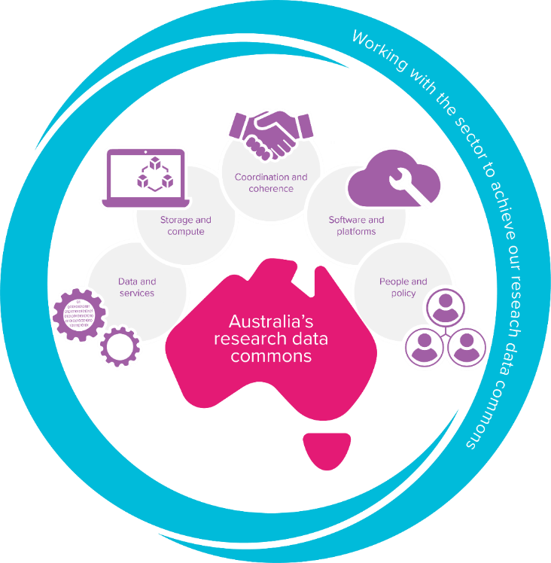
ARDC – The Australian Research Data Commons
Purpose: to provide Australian researchers with competitive advantage through data.
Mission: to accelerate research and innovation by driving excellence in the creation, analysis and retention of high-quality data assets.

Slide 3
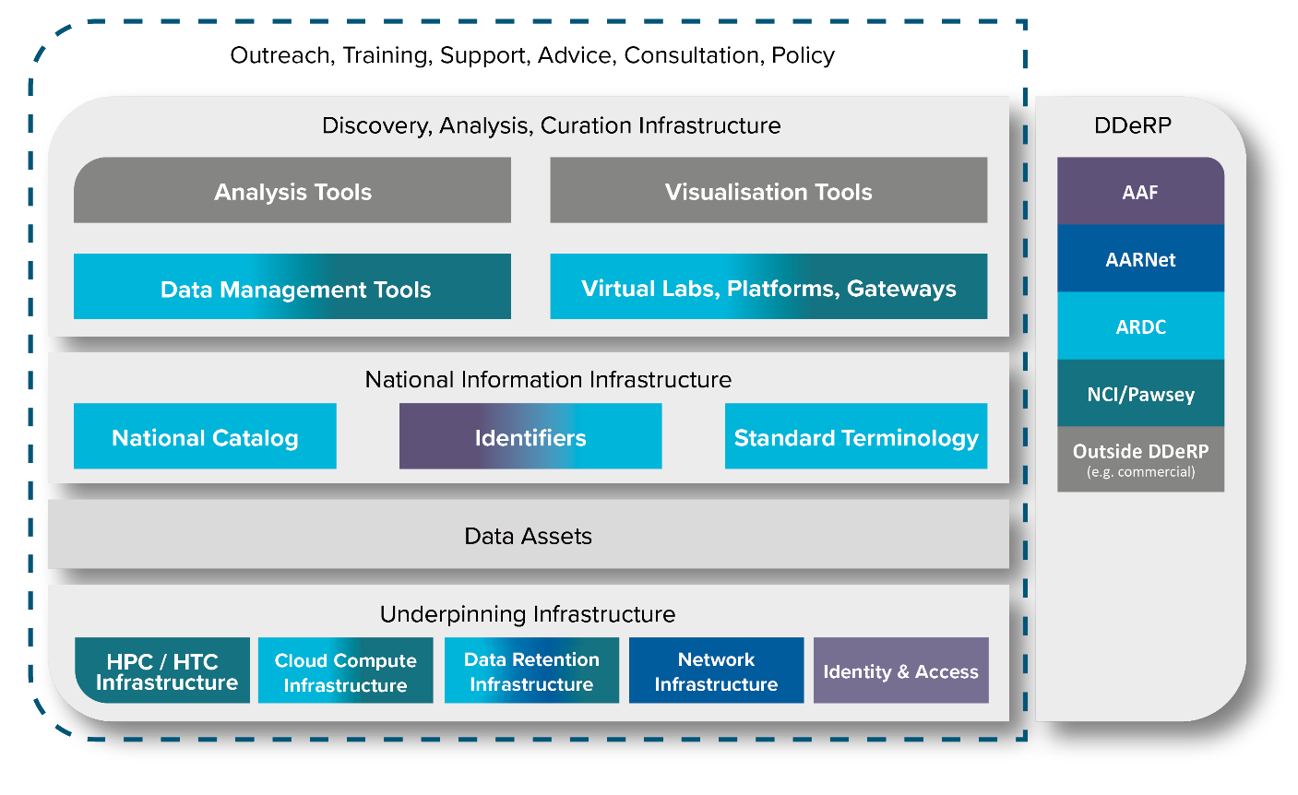
ARDC’s Areas of Activity

Slide 4
ARDC – Four Themes

Slide 5
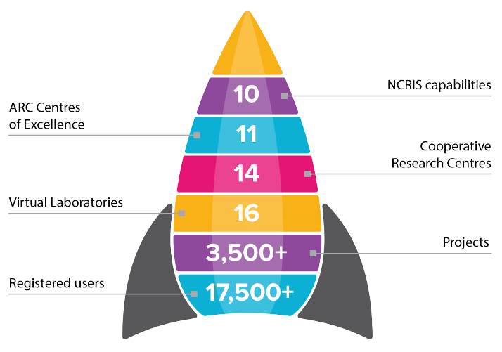
ARDC Nectar Research Cloud – Capabilities
National eResearch Infrastructure Leader
Federated Model
National Impact
Supporting Australian researchers
since 2012

Slide 6
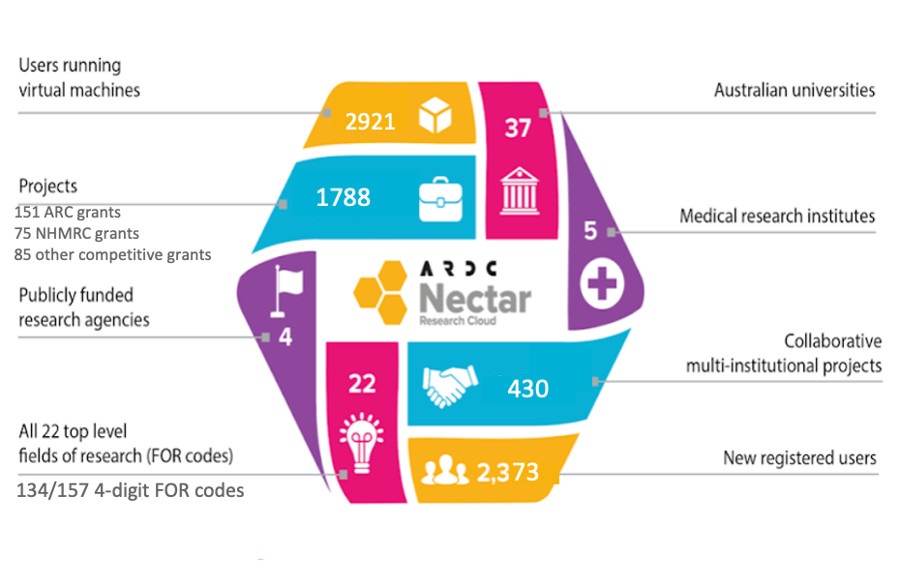
ARDC Nectar: Lessons Learned
Self-service model for researchers
Benefits & pitfalls of a federated model
National bias & approach
Usage 2019-20

Slide 7
ARDC Nectar: Challenges
Access to compute on a national scale (democratisation of access to eInfrastructure)
Capacity to support all types of research disciplines and domains
Access to and sharing of sensitive data
Easy navigation for researchers between resources between different types of compute (cloud, HTC, HPC)
Addressing the growing need for multi-skilled resources across the research ecosystem

Slide 8
Global Open Science Cloud: Opportunities
All research is global and increasingly multi-disciplinary
Move the compute and analysis to the data (Australian researchers need access to large international data sets)
Make research collaboration easier - using digital infrastructure in a coherent way across disciplines and institutions
Skills for research infrastructure - transition of specialist skills to shared commodity skills
Share best practice approaches
Standardised authentication and authorisation mechanisms across different resources

Slide 9
Global Open Science Cloud: Next Steps
Alignment: Developing standards, open-source tools, best practices etc. Allowing the different infrastructure to be used by researchers and VL developers/providers in a similar way.
Federation at a global level: While this would be quite difficult, could start with a discipline-specific pilot - e.g. Biocommons.
Opportunities to collaborate: Common eResearch infrastructure challenges globally, such as making research data sets readily available. For example, COVID-19 & Melbourne’s lockdown success - converting data insights into digital tools to tackle contact-tracing?

Slide 10
Transforming digital infrastructure to support leading edge research and innovation

