Slide 1
International Cooperation and GOSC

Slide 2
Established on November 1, 1949, in Beijing

Slide 3
Position in China’s National Innovation System

Slide 4
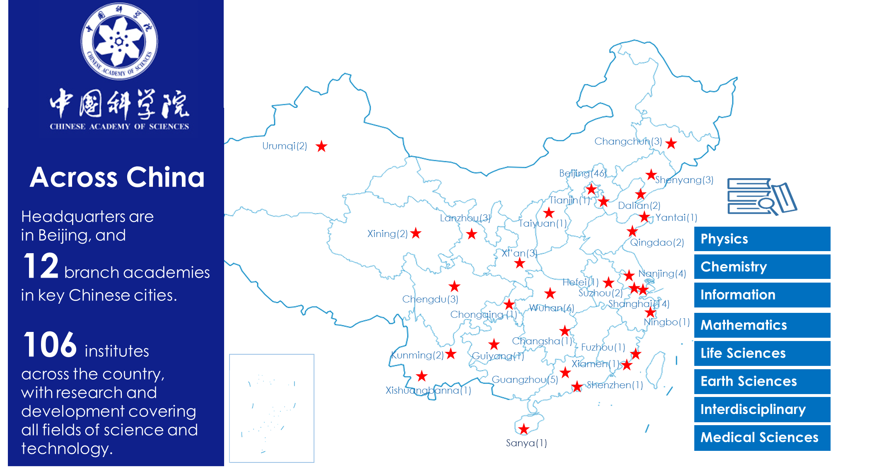
Basic science and technologies
Strategic advance technologies
Areas related to the public welfare and the development of emerging industries

Slide 5
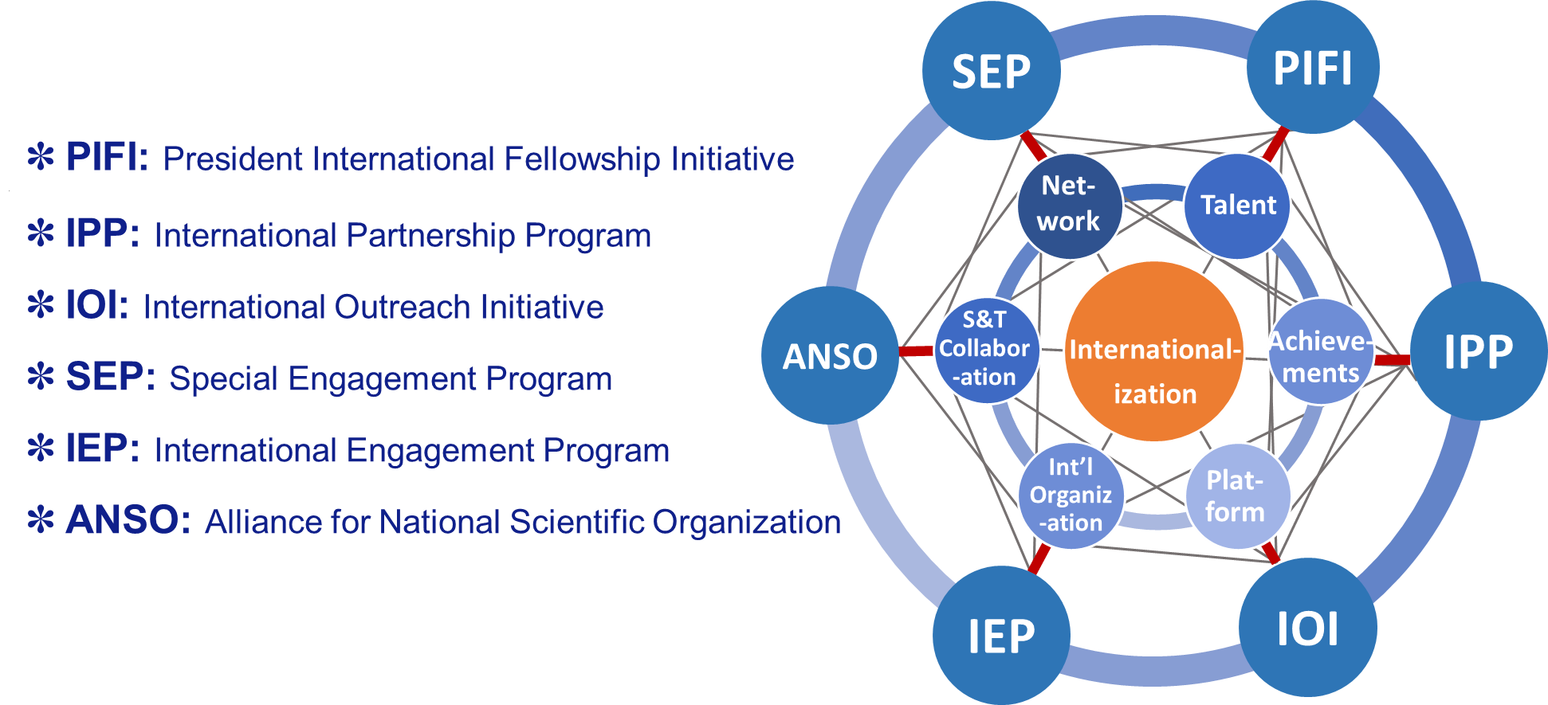
CAS Internationalization Strategy
Extensive and diversified forms of funding opportunities to support international cooperation
For details, email cas_en@cas.cn

Slide 6
International Cooperation and GOSC:
Connect CAS with the rest of the World!
CAS attaches great importance to international cooperation and considers it as a recipe of its success. Through Global Open Science Cloud and its support to international research activities, we will work with our partners to harness the full potential of cooperation network and e-infrastructure to advance science and address global challenges.

Slide 7
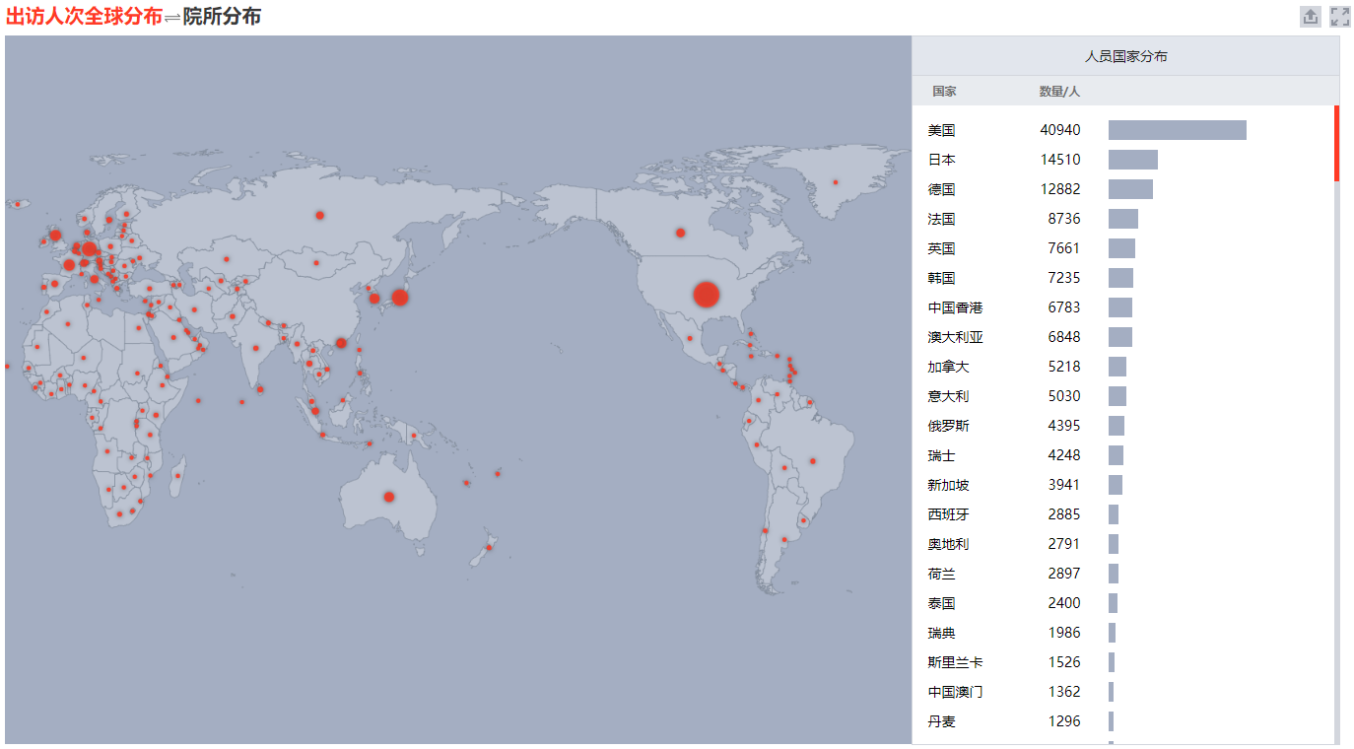
CAS connection with the World
Extensive and diversified cooperation and partnership with scientists all over the world
CAS scientists travelled broad 2011-2019
Top 3: EU, US, Japan
Top 3 in EU: Germany, France, Italy
CAS papers published based on international cooperation 2015-2019
Top 3: EU, US, UK
Top 3 in EU: Germany, France, Italy
Scientists visited CAS from abroad 2011-2019
Top 3: EU, US, UK
Top 3 in EU: Germany, France, Italy

Slide 8
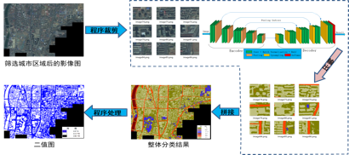
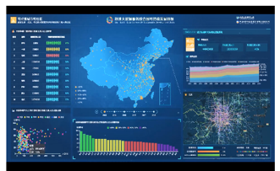
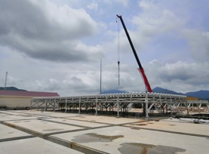
Challenges towards better connection
CASEarth for Sustainable Development Goals (CASEarth4SDG), is a platform system of data sharing and online computing for monitoring, measuring, and evaluating SDGs indicators under designing and developing by Big Earth Data Science Engineering Program (CASEarth). Data per year will increase by nearly 3.5 folds in five years. One challenge is how to real-time and rapidly handle high-resolution multi-source Big Earth Data at global, regional, and national scale that will be massively generated at great speeds and volumes.
www.sdgs.casearth.cn
Sharing of data and algorithm
SDGs deployment
EISCA-3D&SYRSI radar data fusion and computing
Use the incoherent scatter technique to study the atmosphere in the Fenno-Scandinavian Arctic and investigate how the Earth's atmosphere is coupled to space. Data per year will increase 8 folds in five years.
Challenges: cross-continental data migration and federation computing, high-speed and high-capacity experimental data processing, data sharing policies and mechanisms.

Slide 9
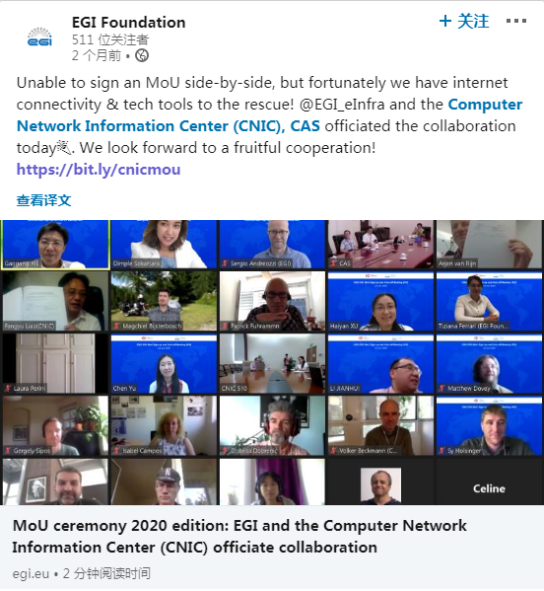
e-Connection driven by COVID-19
We share “desktops” when it is not possible to sit around “desks”.
272,465
10226
CAS scientists flocked to virtual meeting services by CSTCloud after COVID-19

Slide 10
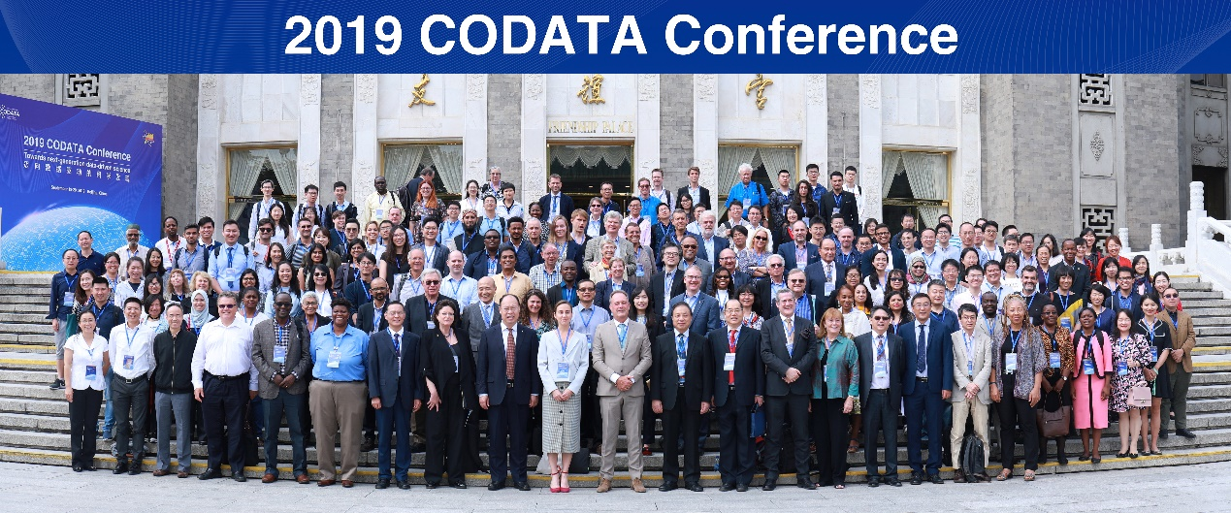
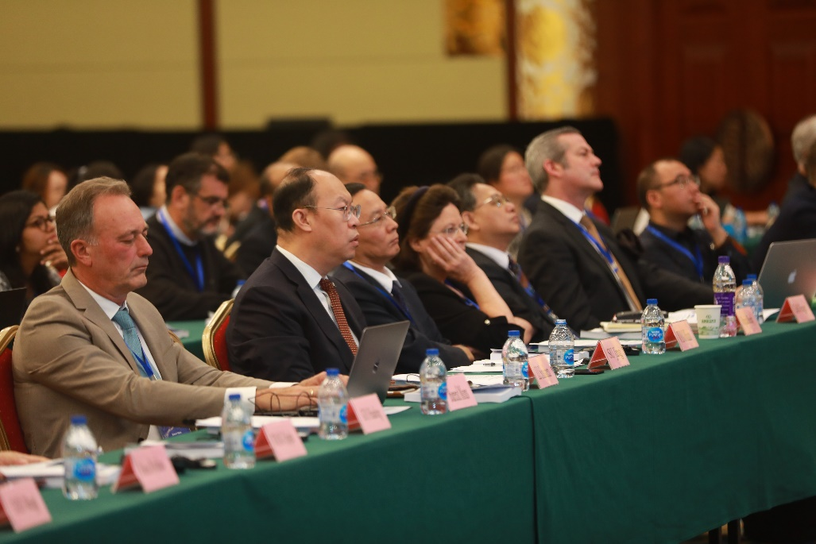
CAS seed money for brainstorms
The idea of Global Open Science Cloud was discussed during 2019 CODATA Conference, which was supported by CAS International Conference Program. Apart from broad-ranging conferences like CODATA 2019, This program and travel funding for international organization activities also support brainstorms in specific areas.

Slide 11
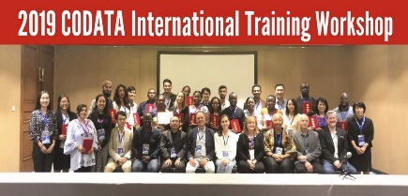
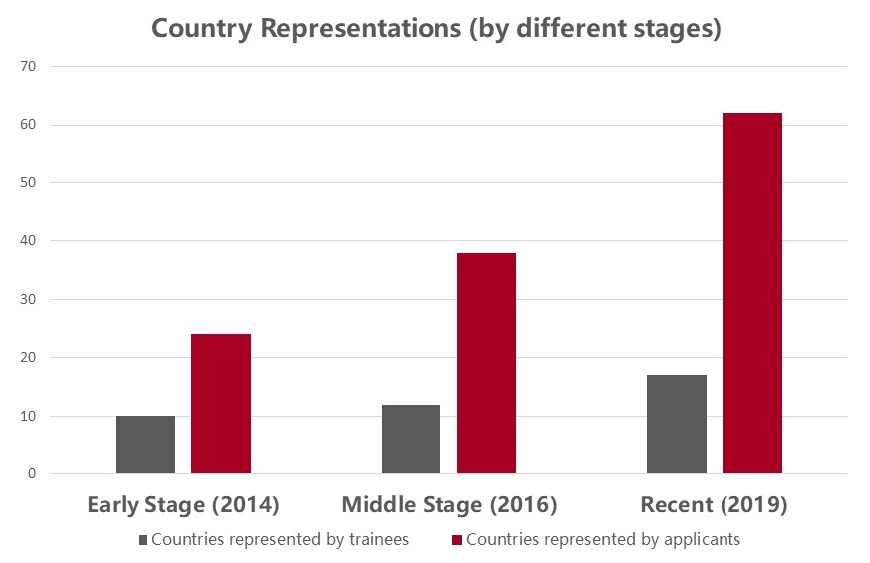
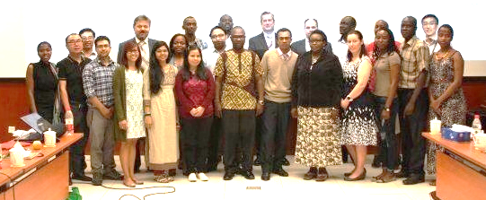
CAS funding for capacity building
CNIC has been organizing training workshops with CODATA since 2012 supported by CAS Training Program for Developing Countries. Some participants of previous workshops have contributed to the discussion about GOSC.

Slide 12
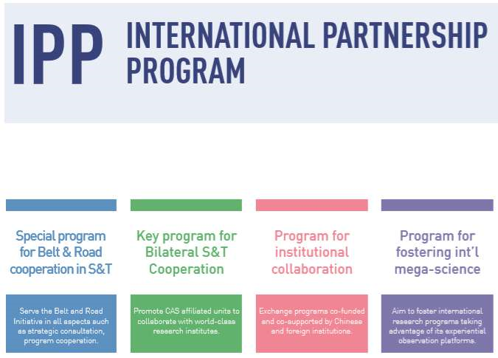
CAS funding for collaborative research
CAS has approved a collaborative research project on Global Open Science Cloud under the framework of its International Partnership Program.

Slide 13
Other possible funding opportunities
Within CAS
President’s International Fellowship Initiative
Out of CAS
Ministry of Science and Technology
China Association for Science and Technology
National Natural Science Foundation of China
Beijing Municipal S&T Commission

Slide 14
Discussion about Future Vision
Exploratory
Appropriateness
Practicality
Sustainability
Framework
Roadmap
Testbed
Demonstration
What kind of funding opportunities are open to initiatives like GOSC?
No collaboration: seed money / Low collaboration: collaborative research /
Moderate collaboration: Pilot International Program / High collaboration: International Mega-Science?

Slide 15
Thanks for listening

