Slide 1

INTERNATIONAL SCIENCE COUNCIL
OPEN SCIENCE IN THE COUNCIL’s 2019 - 2021 ACTION PLAN
Geoffrey Boulton
Global Open Science Cloud Workshop
November 2020

Slide 2

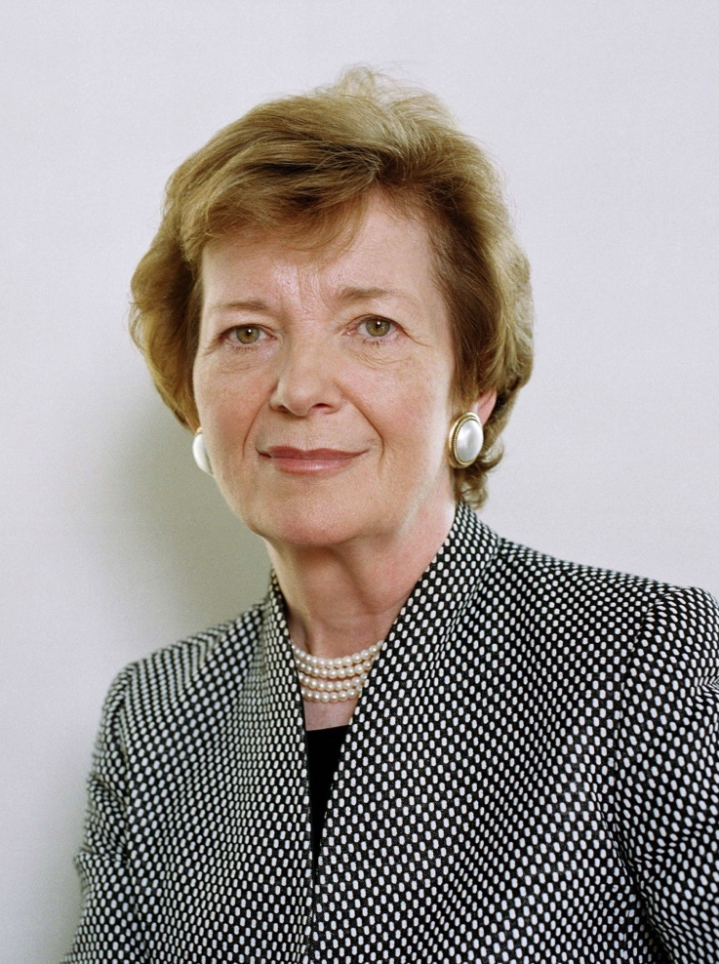

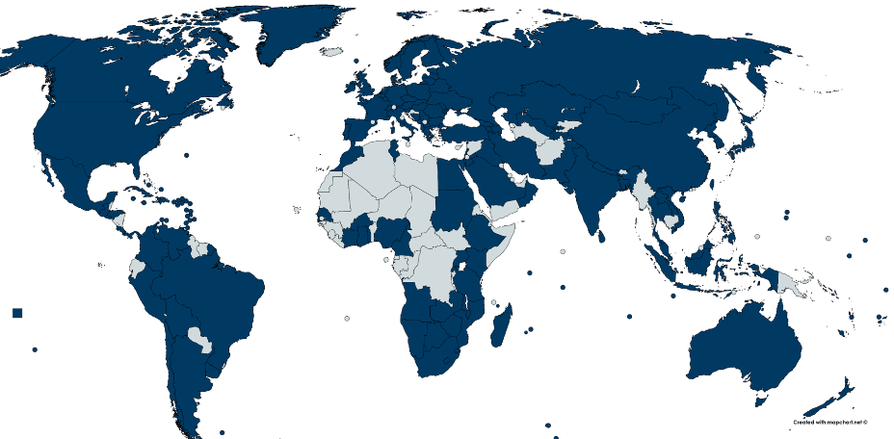

The International Science Council (ISC)
The global voice for science
Patrons
Members
140 + National Academies and Regional Scientific Bodies
40 International Scientific Unions and Associations
Mary Robinson
Ismail Serageldin
Regional Structures
Vint Cerf
Regional Offices in Africa, Asia and the Pacific, Latin America and the Caribbean
Regional Social Science Councils in Africa, Latin America, Asia and the Arab World

Slide 3
Global scientific networks
ISC Science Support Bodies
Committee on Data for Science and Technology (CODATA)
World Data System (WDS)
International Network for Government Science Advice (INGSA)
International Scientific Committees
Antarctic Research (SCAR)
Frequencies for Radio Astronomy and Space Science (IUCAF)
Oceanic Research (SCOR)
Space Research (COSPAR)
Solar Terrestrial Physics (SCOSTEP)
International Research Programmes
Comparative Research on Poverty Programme (CROP)
Future Earth
Integrated Research on Disaster Risk Programme (IRDR)
Urban Health and Wellbeing Programme (UHWB)
Climate Research Programme (WCRP)
Global Observing Systems
Global Climate Observing
System (GCOS)
Global Ocean Observing
System (GOOS)
Funding Programmes
Transformations to Sustainability (Sida, Belmont Forum, Norface)
Leading Integrated Research for Agenda 2030 in Africa (Sida, Bosch Foundation)

Slide 4
ISC Science Action Plan, 2019 -2021
The 2030 Agenda for Sustainable Development
The Digital Revolution
Science in Policy and Public Action
The Evolution of Science and Science Systems
Digital planet for sustainability (+UNEP, FE)
SDG Interactions as a policy driver (+IIASA)
Re-thinking human development (+UNDP)
Data-driven interdisciplinarity (CODATA)
Global data resources and governance (+UBA)
Strengthened science-policy interfaces
The public value of science
Science in the private sector
Refugee scientists
Open Science Systems & Open Science in the Global South
The future of scientific publishing

Slide 5
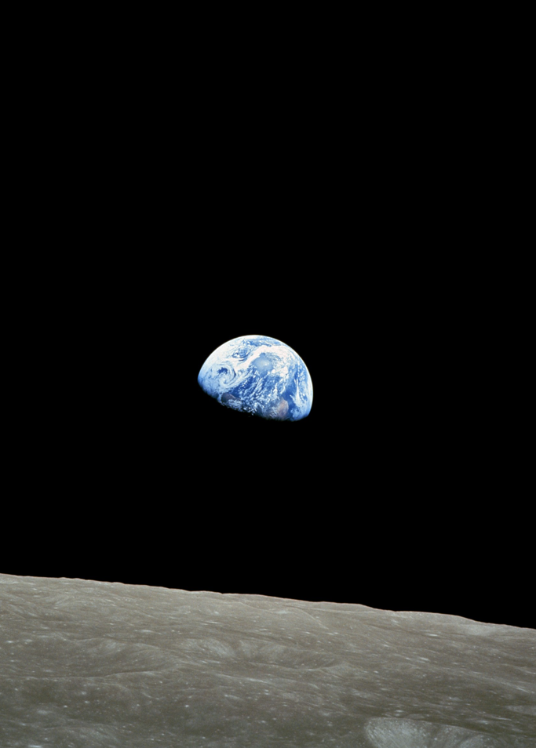
ISC Action Plan, 2019-2021
“The biggest and most urgent challenge for contemporary science is to identify pathways to global sustainability, and to assist in the creation and promotion of policies and public action that can advance societies along those pathways”.

Slide 6

Challenges to science as an open, collaborative enterprise
Operationally connected
Globally inclusive
Societally engaged
Discovery and action-oriented
Open access to the record of science
Access to infrastructure
Changing funding policies and practices
Re-designing assessment and reward systems
Overcoming persistent global knowledge divides
Evolving into an enabling global commons?
With a robust foundation that values disciplinary-based, fundamental enquiry and unfettered curiosity.

Slide 7

THE AFRICAN OPEN SCIENCE PLATFORM
Outreach & engagement:
- Transdisciplinary action
- Education
- Capacity building
Science programmes:
Cutting-edge support:
Multi-national Challenge Projects
Essential Infrastructure:
Data Science
Cloud Computing
Data Management Policies, processes, Tools
AI Institute
Outcomes
Infrastructure
Convene and coordinate the interests, ideas, people, institutions and resources for Open Science in and for Africa

Slide 8
African Open Science Platform Hub and Nodes Structure
Hub and Nodes Structure
Principle: Africa-led
Structural problems:
Low Investment potential
Poor connectivity
Low intra-African collaboration
Few critical masses
Infrastructure (hard & soft)
Federated Network
Common Data Policies
Distributed AI Institute
Delivery Programmes
Science Programmes (SDGs)
Capacities & Skills
Community Engagement

Slide 9

South – South Discussions: Emerging Potential
?
Sharing good practice (e.g. FAIR, AI Governance principles
A network for peers and communities
Collaborating on major programmes of common interest
Supporting environmental justice
Equitable open access publishing systems
A voice for the global south

