Slide 1
APEL and ActiveMQ
Cristina del Cano Novales
STFC - RAL

Slide 2
Current System
APEL client installed on sites
  APEL parser (CE)
  APEL publisher (MON)
APEL central server
  Flexible Archiver (receiving data from sites)
  Central Repository (storing all records)
  Front End (containing summaries)
Other Grid/Subgrids collecting own data and sending it to APEL server
EGEE Accounting Portal

Slide 3








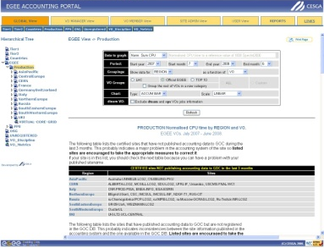
Current Architecture
APEL
APEL
R-GMA
R-GMA
R-GMA REGISTRY
APEL
R-GMA
FLEXIBLE ARCHIVER
CENTRAL DATABASE
GRID/SUBGRID
GRID/SUBGRID
MySQL
MySQL
OTHER TOOL
OTHER TOOL
CENTRAL ACCOUNTING PORTAL

Slide 4
New Architecture
R-GMA transport mechanism to be replaced with Apache ActiveMQ
  Registry -> Broker (with differences)
Architecture allowing regionalisation
  Two level architecture
Regions to decide whether to regionalise
Standard publishing method
Central Accounting Server as a cache (cross-region queries)

Slide 5
New Architecture
APEL
ACTIVEMQ BROKER
APEL
APEL
FLEXIBLE ARCHIVER
CENTRAL DATABASE
GRID/SUBGRID
MySQL
MySQL
OTHER TOOL
OTHER TOOL
CENTRAL ACCOUNTING PORTAL

Slide 6
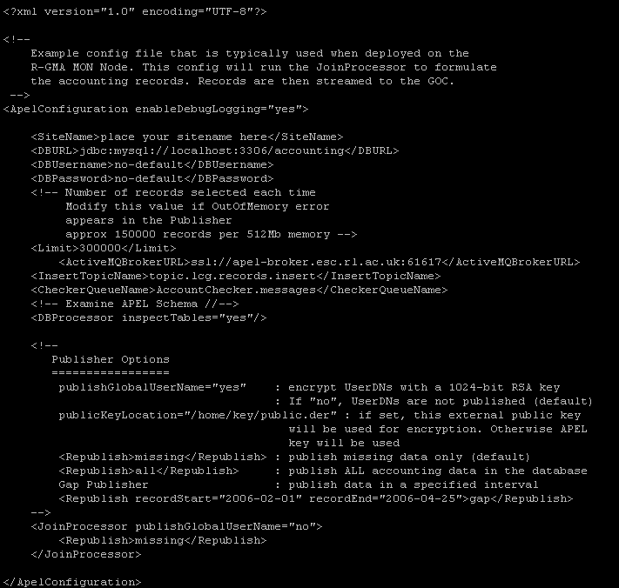
New Configuration
Three new variables in config file for AMQ based publisher
  Broker URL
  Topic name
  Queue name
Working on AMQ with SSL, using host certificates and a list of DNs for authorisation
http://wiki.ndgf.org/display/ndgfwiki/Standalone+Apache+ActiveMQ+with+SSL+support

Slide 7
Region A
ACTIVEMQ BROKER
REGION A
APEL
Region A
  APEL (Parser + Publisher) installed at all sites
  No Regional Accounting Server
  Sites publish directly to Central Accounting Server
FLEXIBLE ARCHIVER
APEL
PROS:
  No changes required
  No regional accounting infrastructure to install and maintain
CONS:
  Accounting data for region only available through Central Accounting Portal (have to filter)
CENTRAL DATABASE
CENTRAL ACCOUNTING PORTAL

Slide 8





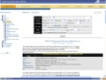
Region B
REGION B
ACTIVEMQ BROKER
Region B
  APEL (Parser + Publisher) installed at all sites
  Regional Accounting Server
  Sites publish to Regional Archiver
  Regional Accounting Server publishes summaries to Central Accounting Server
APEL
APEL
FLEXIBLE ARCHIVER
REGIONAL ARCHIVER
PROS:
  No significant changes on client
  Regional Portal
  Data available at region
  Easier to accounting data at sites
  Filtering of data for Central Accounting Portal
CONS:
  Install and maintain an Accounting Server
REGIONAL PORTAL
REGIONAL DATABASE
CENTRAL DATABASE
CENTRAL ACCOUNTING PORTAL

Slide 9
New Architecture
ACTIVEMQ BROKER
REGION D
REGION C
REGIONAL DB
REGIONAL DB
OTHER TOOL
FLEXIBLE ARCHIVER
OTHER TOOL
Region C
  Own accounting tool
  Own accounting system
  Region to publish summaries to the Central Accounting System
Region D
  Own accounting tool
  Own accounting system
  Region to publish individual records to the Central Accounting System
CENTRAL DATABASE
CENTRAL ACCOUNTING PORTAL

Slide 10
Regional Accounting Server
Regional broker
Regional accounting consumer (~Flexible Archiver)
  Receiving records from sites in region
Storing all records for region
  Central Repository
Front End
  Summarising data for Regional Accounting Portal
  Publishing summaries into Central Accounting Server

Slide 11
Roadmap
Replace R-GMA with ActiveMQ (December 09)
  Client and new archiver implemented for Region A case
  Testing at the moment
  Next step, external testing by volunteers
    Australia
    Greece
    France
  Distribution in gLite
Status
  development complete
  Tested by guineapigs in Greece, Australia
  In EGEE Certification

Slide 12
Roadmap
Distribution of APEL Accounting (April 2010)
  Still implementing client for Regions B,C,D
  Redesign and implementation of system
  Working with Accounting Portal for distribution of the two tools together
Status – Late
  Will not be complete by end of EGEE.
  Development will continue under EMI
  Region D (publishing job records) could start now based on Region A client
  Region C (publishing summaries from own tool) will take priority.
  Central support for all NGIs will continue into EGI.

Slide 13
Summary
By the end of EGEE there will be a new version of the APEL client based on ActiveMQ
The infrastructure for NGIs running their own repository will not be ready.
The ability for regions/NGIs with their own repositories to publish via ActiveMQ will be the next development.
The existing APEL infrastructure will continue to run as is into EGI.

Slide 14
New Architecture
ACTIVEMQ BROKER
REGION D
REGION C
REGIONAL DB
REGIONAL DB
OTHER TOOL
FLEXIBLE ARCHIVER
OTHER TOOL
Region C
  Own accounting tool
  Own accounting system
  Region to publish summaries to the Central Accounting System
Region D
  Own accounting tool
  Own accounting system
  Region to publish individual records to the Central Accounting System
CENTRAL DATABASE
CENTRAL ACCOUNTING PORTAL

Slide 15
Accounting with New Middleware
A new batch system
  Need to parse logs and cut accounting records
A new CE
  If it uses blah then it will work
A new security infrastructure
  Don’t know.
Your own site accounting system
  Publish job records or summaries
Your own Grid accounting system
  Publish summaries

Slide 16
Links
APEL Home
  http://goc.grid.sinica.edu.tw/gocwiki/ApelHome
APEL FAQ
  http://goc.grid.sinica.edu.tw/gocwiki/ApelFAQ
Accounting deliverable document
  https://edms.cern.ch/document/726137
Accounting Portal
  http://www3.egee.cesga.es/gridsite/accounting/CESGA/egee_view.html
Accounting Service News
  http://goc.grid.sinica.edu.tw/gocwiki/ApelStatus

Slide 17

Questions
APEL-SUPPORT@JISCMAIL.AC.UK

